Slide 1
TCP/IP Networking

Slide 2
Basic Term
IP
  32-bit, Unique Internet Address of a host
Port
  16-bit, Uniquely identify application
MAC Address
  Media Access Control Address
  48-bit, Network Interface Card (NIC) Hardware address
tytsai@qkmj:~> ifconfig
em0: flags=8843<UP,BROADCAST,RUNNING,SIMPLEX,MULTICAST> mtu 1500
options=43<RXCSUM,TXCSUM,POLLING>
inet 140.113.209.32 netmask 0xffffff00 broadcast 140.113.209.255
inet 140.113.209.65 netmask 0xffffffff broadcast 140.113.209.65
ether 00:07:e9:39:66:77
media: Ethernet autoselect (100baseTX <full-duplex>)
status: active
lo0: flags=8049<UP,LOOPBACK,RUNNING,MULTICAST> mtu 16384
inet 127.0.0.1 netmask 0xff000000

Slide 3
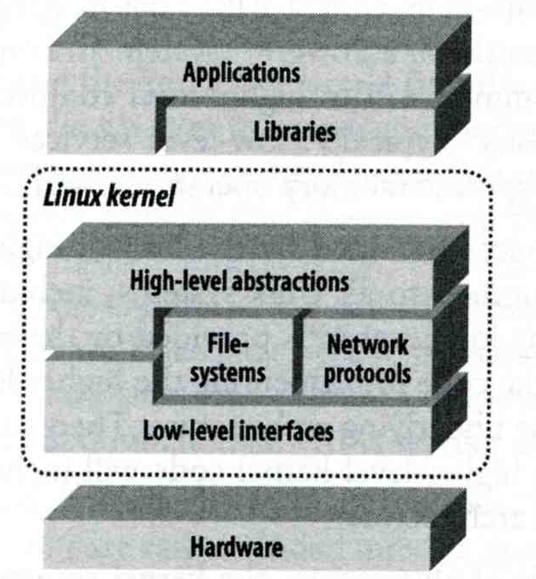
Why TCP/IP ?
The gap between applications and Network
  Network
    802.3 Ethernet
    802.4 Token bus
    802.5 Token Ring
    802.11 Wireless
  Application
    Reliable
    Performance
We need something to do the translating work!
TCP/IP it is!!

Slide 4
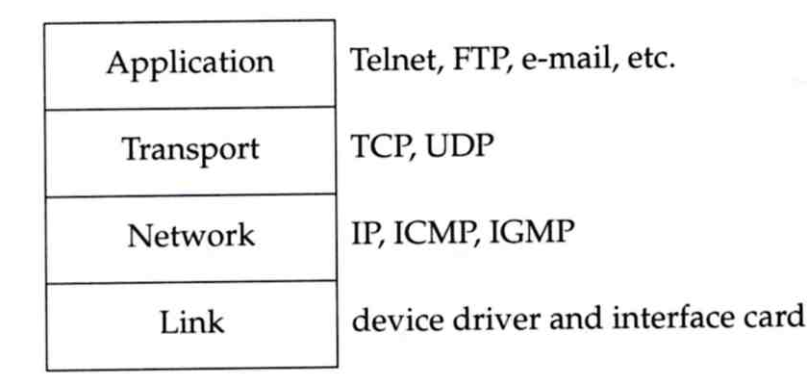
TCP/IP protocol stack (1)
TCP/IP is a suite of networking protocols
  4 layers Layering architecture
    Link layer (data-link layer)
      Include device drivers to handle hardware details
    Network layer (IP)
      Handle the movement of packets around the network
    Transport layer (Port)
      Handle flow of data between hosts
    Application

Slide 5
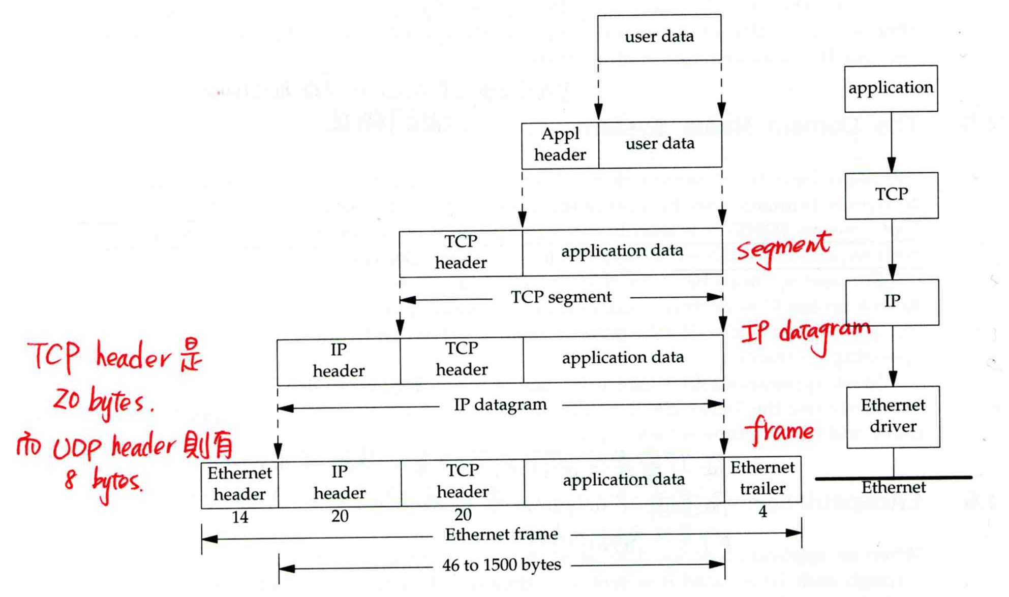
TCP/IP protocol stack (2)
When we want to transfer data across the network
  Encapsulation

Slide 6
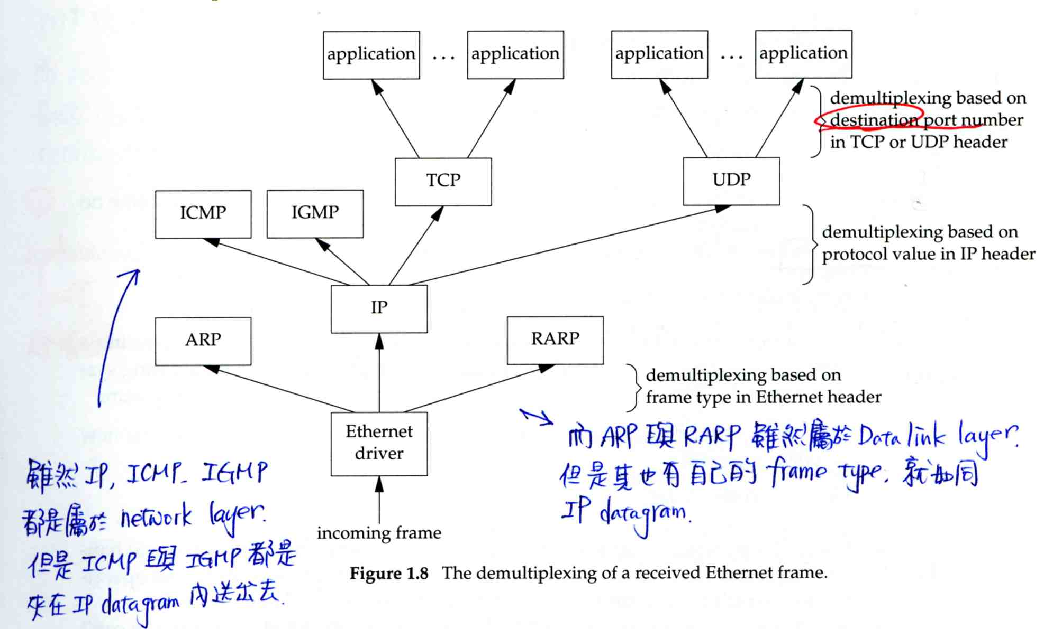
TCP/IP protocol stack (3)
Receiving data (Demultiplexing)

Slide 7
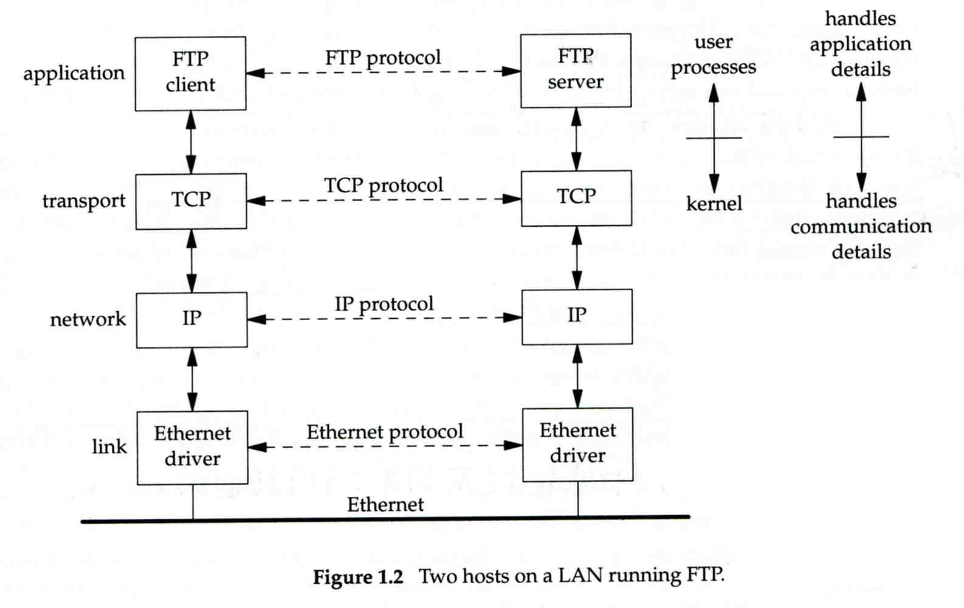
TCP/IP protocol stack (4)
Transmission on the same network …

Slide 8
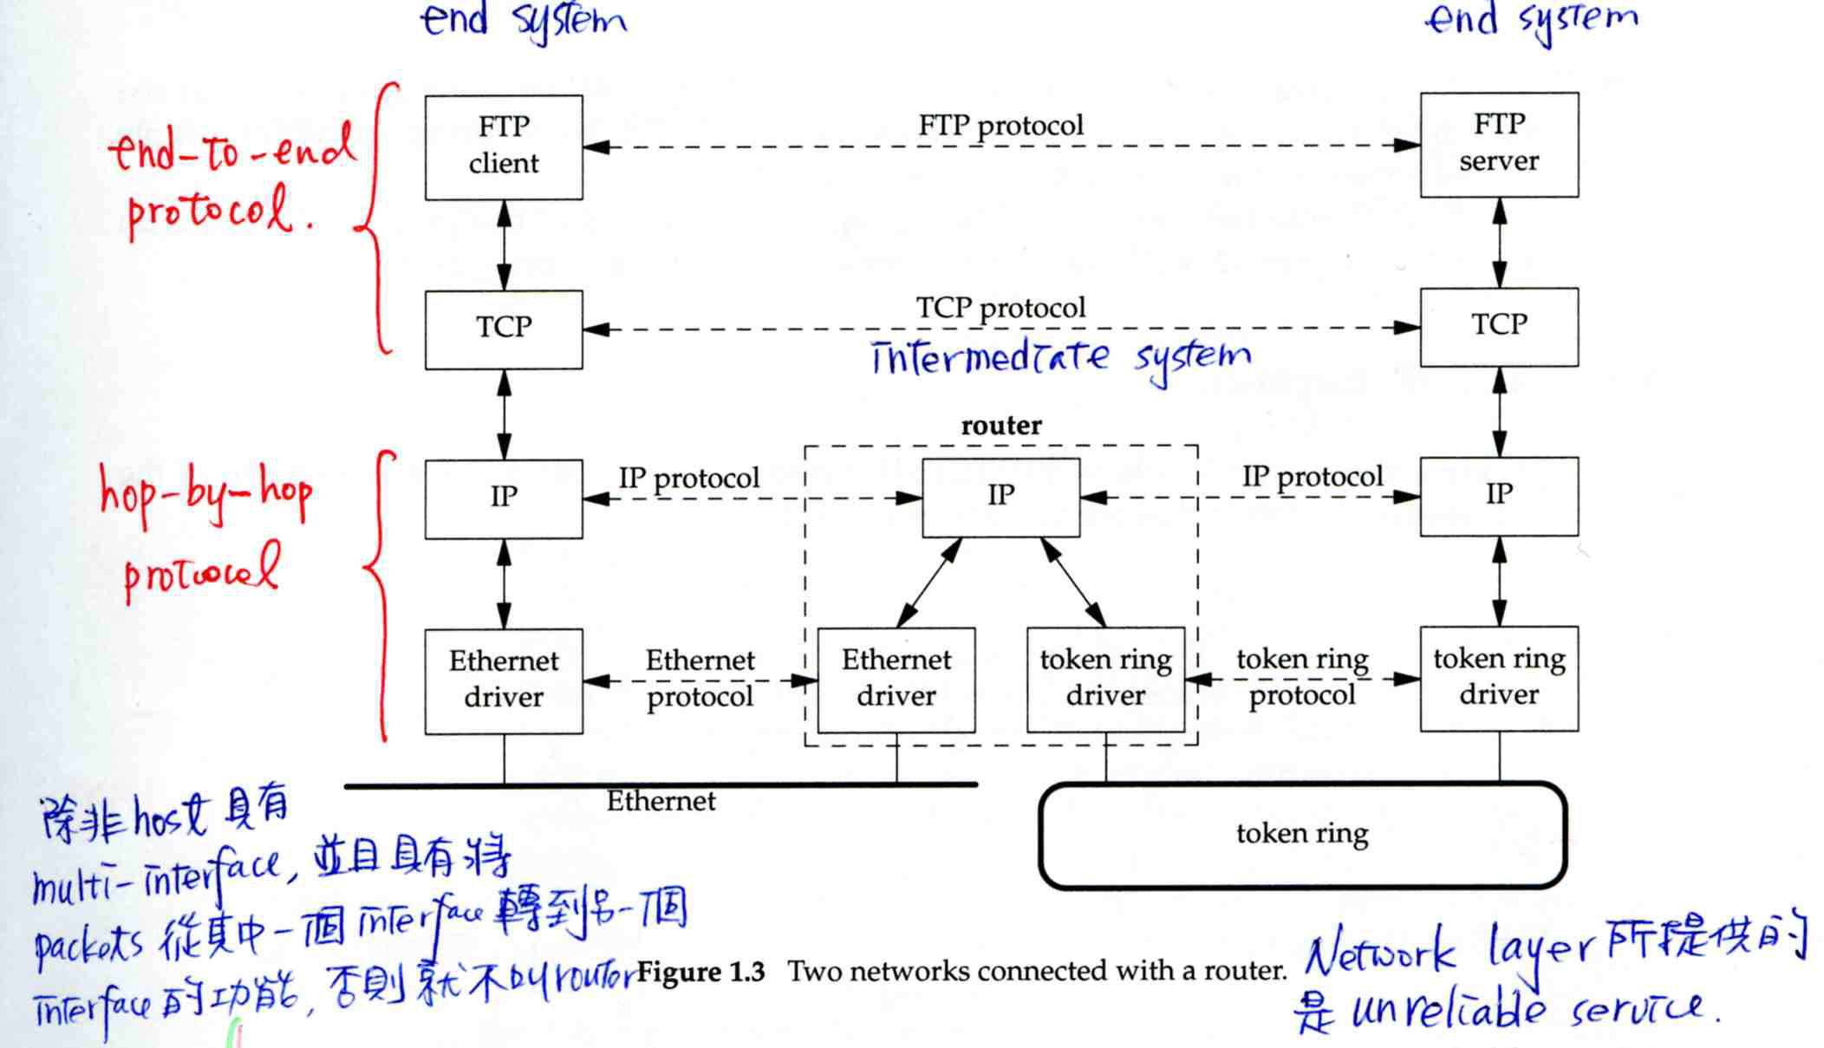
TCP/IP protocol stack (5)
Transmission across different network
  Require “Routing”

Slide 9
loopback interface (1)
Allow a client and a server to be on the same host
Special device name
  lo0
Special hostname and IP
  127.0.0.1
  localhost
Anything that is sent to loopback interface will not go to network

Slide 10
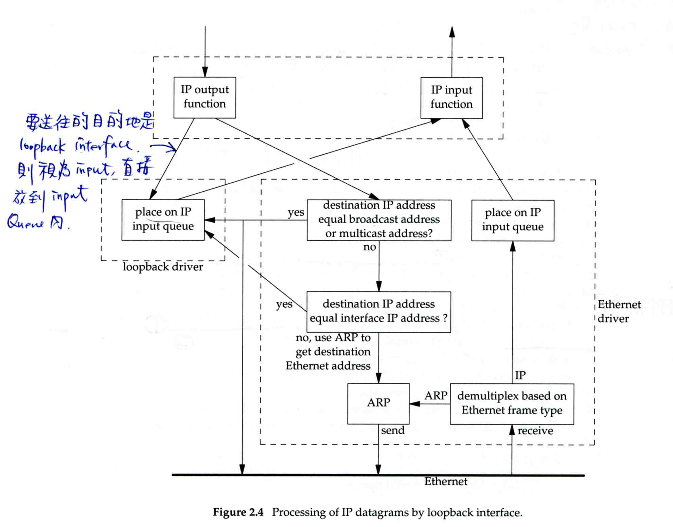
loopback interface (2)

Slide 11
Chapter 13
TCP/IP Networking

Slide 12
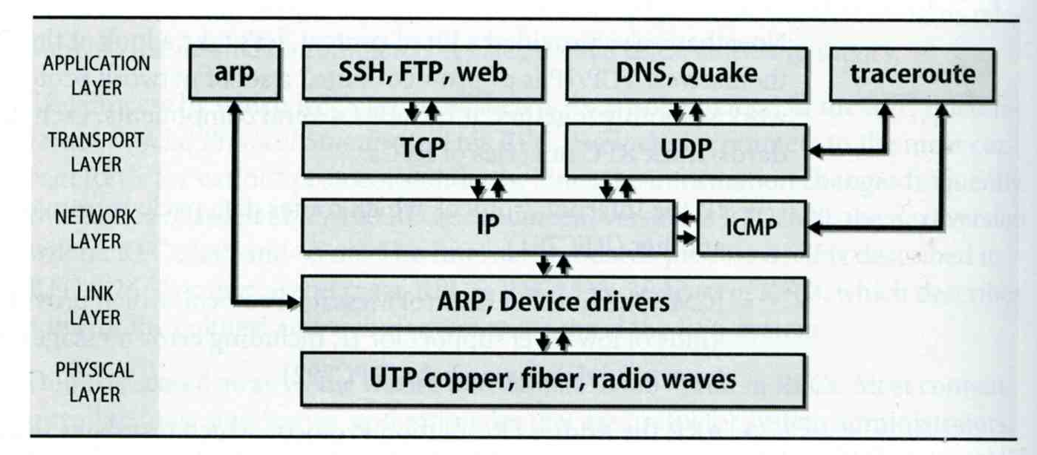
One Big happy TCP/IP family
Layering architecture

Slide 13
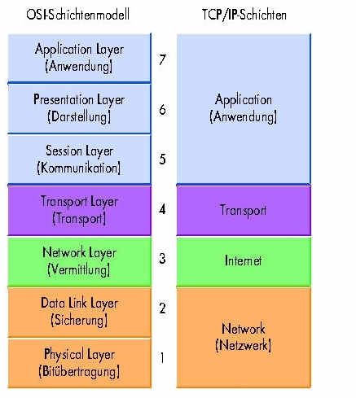
OSI 7-layer vs. TCP/IP
Layer2 device
  MAC
Layer3 device
  IP

Slide 14
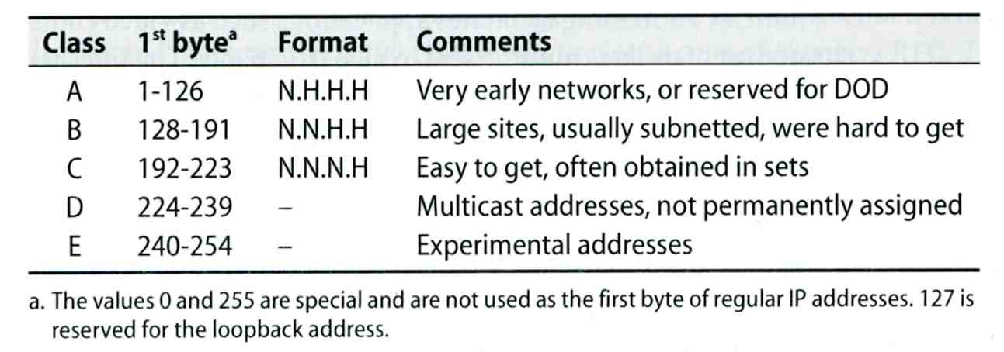
IP Address (1)
32-bit long
  Network part
    Identify a logical network
  Host part
    Identify a machine on certain network
IP address category

Slide 15
IP Address (2)
Ex:
  NCTU
    Class B address: 140.113.0.0
    Network ID: 140.113
    Number of hosts: 255*255 = 65535

Slide 16
subnetting and netmask (1)
Subnetting
  Borrow some bits from network ID to extends hosts ID
  Ex:
    ClassB address : 140.113.0.0
    = 256 ClassC-like IP addresses
    in N.N.N.H subnetting method
    140.113.209.0 subnet
netmask
  Specify how many bits of network-ID are used for network-ID
  Continuous 1 bits form the network part
  Ex:
    255.255.255.0 in NCTU-CSIE example
      256 hosts available
    255.255.255.248 in ADSL example
      Only 8 hosts available

Slide 17
subnetting and netmask (2)
How to determine your network ID?
  Bit-wise-and IP and netmask
  Ex:
    140.113.214.37 & 255.255.255.0 ➔ 140.113.214.0
    140.113.209.37 & 255.255.255.0 ➔ 140.113.209.0
    140.113.214.37 & 255.255.0.0 ➔ 140.113.0.0
    140.113.209.37 & 255.255.0.0 ➔ 140.113.0.0
    211.23.188.78 & 255.255.255.248 ➔ 211.23.188.76
      78 = 01001110
      78 & 248= 01001110 & 11111000 =72

Slide 18
subnetting and netmask (3)
In a subnet, not all IP are usable
  The first one IP ➔ network ID
  The last one IP ➔ broadcast address
  Ex:
    Netmask 255.255.255.0
    140.113.209.32/24
    140.113.209.0 ➔ network ID
    140.113.209.255 ➔ broadcast address
    1 ~ 254, total 254 IPs are usable
  Ex:
    Netmask 255.255.255.252
    211.23.188.78/29
    211.23.188.72 ➔ network ID
    211.23.188.79 ➔ broadcast address
    73 ~ 78, total 6 IPs are usable

Slide 19
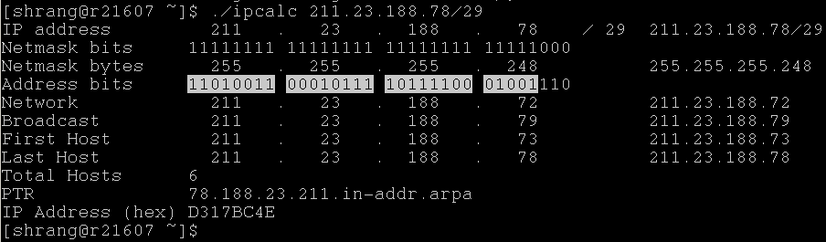
subnetting and netmask (4)
The smallest subnetting
  Network portion : 30 bits
  Host portion : 2 bits
  ➔ 4 hosts, but only 2 IPs are available
ipcalc.pl

Slide 20
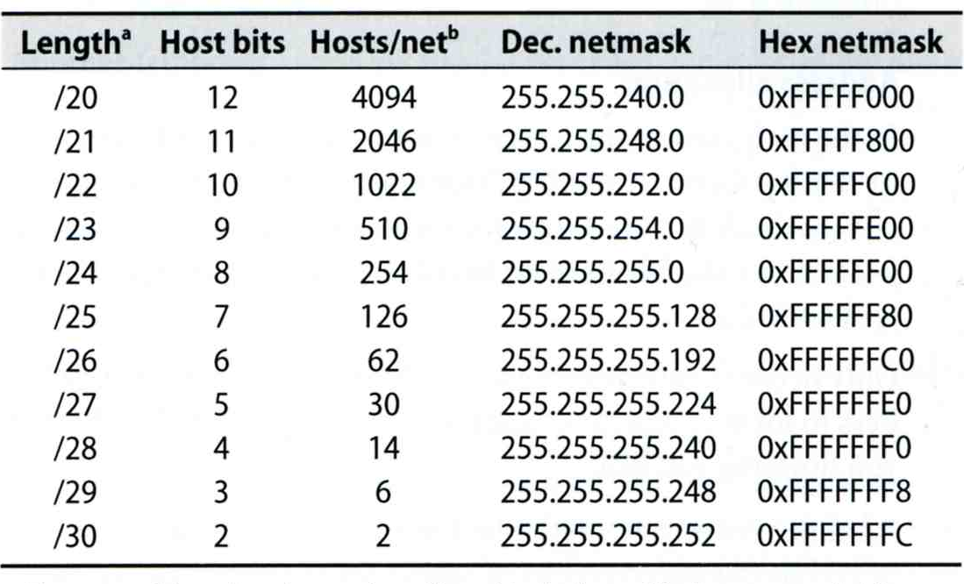
subnetting and netmask (5)
Network configuration for various lengths of netmask

Slide 21
port
16-bits number
Preserve ports
  1 ~ 1024 (root access only)
Well-known port
    /etc/services
…
chargen 19/tcp ttytst source #Character Generator
chargen 19/udp ttytst source #Character Generator
ftp-data 20/tcp #File Transfer [Default Data]
ftp-data 20/udp #File Transfer [Default Data]
ftp 21/tcp #File Transfer [Control]
ftp 21/udp #File Transfer [Control]
ssh 22/tcp #Secure Shell Login
ssh 22/udp #Secure Shell Login
telnet 23/tcp
telnet 23/udp
…

Slide 22
Address Type
Unicast
  Address refer to a single hosts, only the host with that IP will receive the data
  Ex:
    ssh 140.113.209.65
Broadcast
  Addresses that include all hosts on the local network
  All hosts on the same network will receive the data
  Ex:
    arp packet
Multicast
  Addresses that identify a group of hosts
  Only hosts on the same group will receive the data
  Ex:
    Video conference

Slide 23
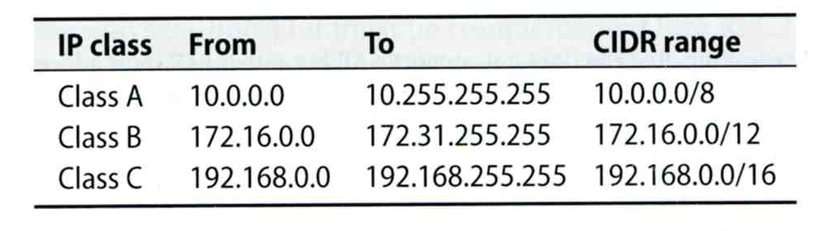
Private address (1)
Packets that bearing private address will not go out to the Internet
3 private addresses range
  Depend on the size of your organization

Slide 24
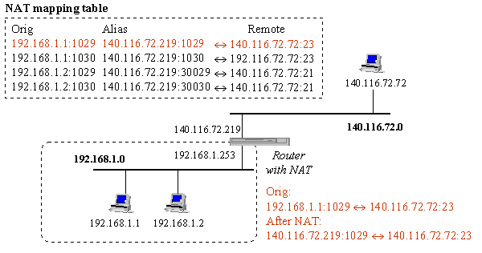
Private address (2)
NAT
  Network Address Translation
  Allow hosts using private address to talk with outside

Slide 25
Routing (1)
Direct a packet closer to the destination
Routing table
  Routing information (which kind of packets to which way)
  Rule-based information
  Kernel will pick the most suitable way to route the packets
tytsai@tybsd:~> netstat -rn
Routing tables
Internet:
Destination Gateway Flags Refs Use Netif Expire
default 140.113.235.254 UGS 0 1120943 fxp0
127.0.0.1 127.0.0.1 UH 0 225 lo0
140.113.235/24 link#1 UC 0 0 fxp0
140.113.235.1 00:0f:ea:48:92:85 UHLW 0 89748 fxp0 882
140.113.235.248 00:05:1a:d2:24:00 UHLW 0 0 fxp0 1196
140.113.235.254 00:0e:38:48:be:ce UHLW 1 0 fxp0 1200
192.168.1 link#4 UC 0 0 fxp1
192.168.1.30 00:d0:59:83:d9:16 UHLW 0 101125 fxp1 664

Slide 26
Routing (2)
Static route
  Statically configured by “route” command
  Ex:
    % route add default 140.113.235.254
    % route add 192.168.1.0/24 192.168.1.254
Dynamic route
  gated

Slide 27
ARP (1)
Address Resolution Protocol
  Ask MAC address of certain IP
  Broadcast
  Any one receiving ARP packet and having this IP will reply to the sender
  When the host owing this IP is not on the same network, sender will use the MAC address of next-hop router to send the packet

Slide 28
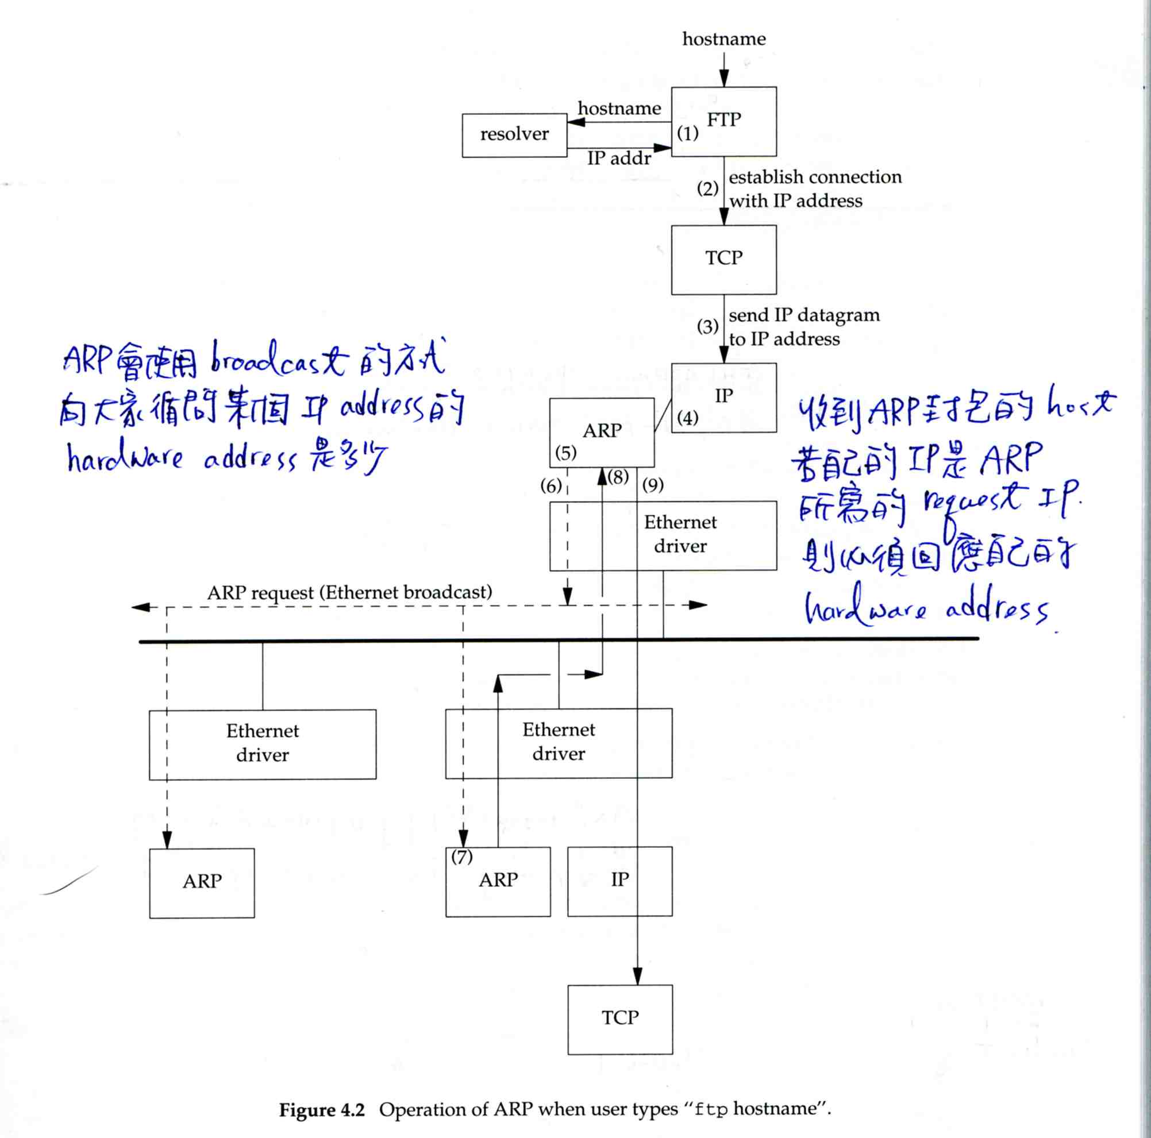
ARP (2)

Slide 29
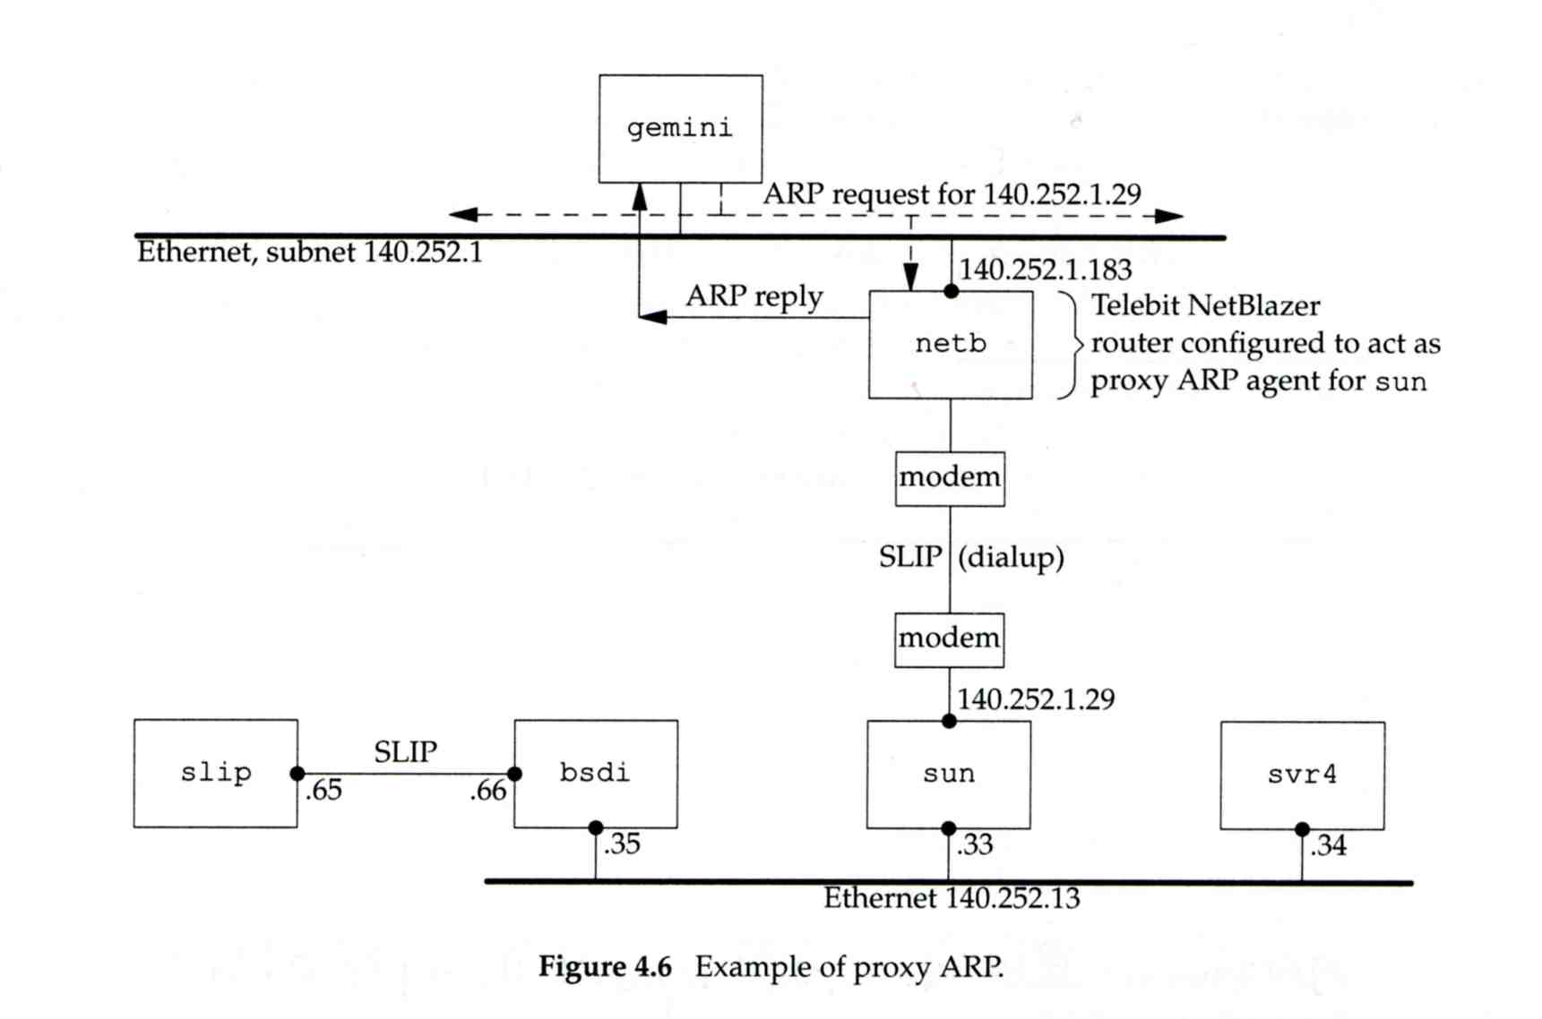
ARP (3)

Slide 30
ARP (4)
ARP cache
  A table that contains the result of recent ARP queries
  % arp –a
ccamd.csie.nctu.edu.tw (140.113.235.1) at 00:0f:ea:48:92:85 on fxp0 [ethernet]
3com-4900-235-EC318.csie.nctu.edu.tw (140.113.235.248) at 00:05:1a:d2:24:00 on fxp0 [ethernet]
e3rtn-235.csie.nctu.edu.tw (140.113.235.254) at 00:0e:38:48:be:ce on fxp0 [ethernet]
? (192.168.1.30) at 00:d0:59:83:d9:16 on fxp1 [ethernet]

Slide 31
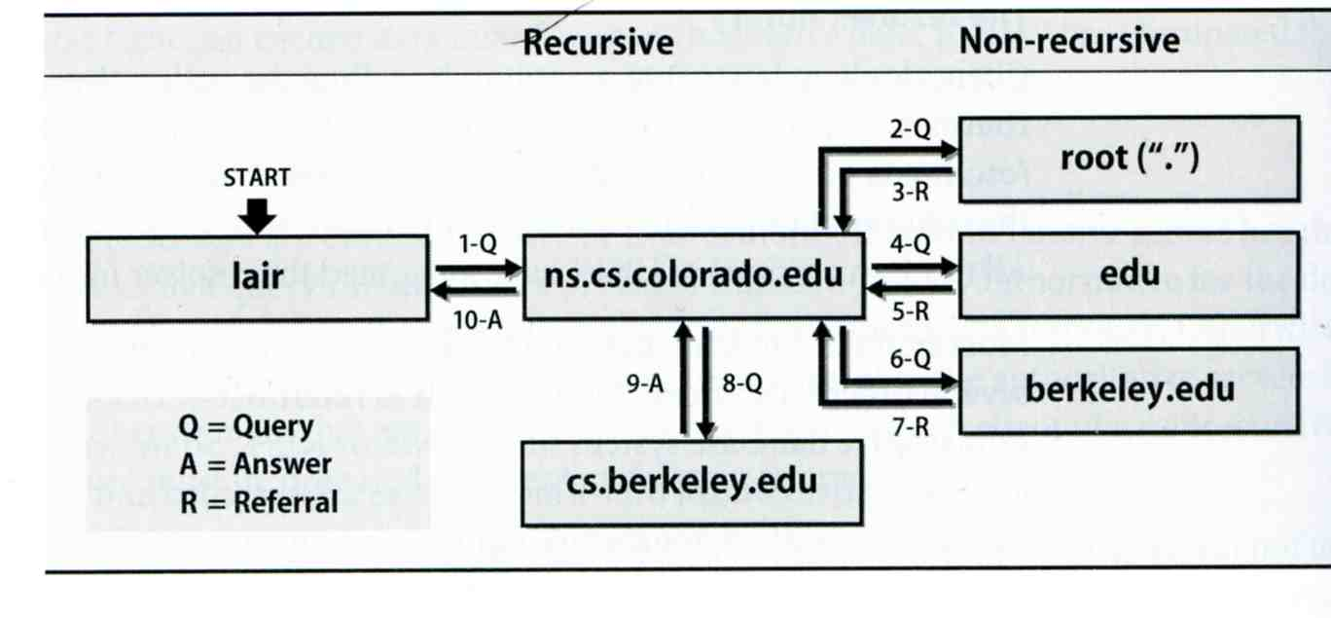
DNS
Domain Name System
  Record IP-hostname mapping
  DNS query
    “what is the IP of vangogh.cs.berkeley.edu” from lair.cs.colorado.edu
  Hierarchical architecture

Slide 32
Setup network connection
Steps
  Assign an IP address and hostname
  Default route
  DNS
  Utility to test whether you connect to the Internet

Slide 33
Setup network connection - assign IP, hostname and default route (1)
FreeBSD
  In /etc/rc.conf
Linux
  /etc/sysconfig/network
  /etc/sysconfig/network-scripts/ifcfg-eth0
defaultrouter="140.113.235.254"
hostname="tybsd.csie.nctu.edu.tw"
ifconfig_fxp0="inet 140.113.235.4 netmask 255.255.255.0 media autoselect"
ifconfig_fxp1="inet 192.168.1.254 netmask 255.255.255.0 media autoselect"
NETWORKING=yes
HOSTNAME=linux3
GATEWAY=140.113.209.254
DEVICE=eth0
BOOTPROTO=static
BROADCAST=140.113.209.255
IPADDR=140.113.209.143
NETMASK=255.255.255.0
NETWORK=140.113.209.0
ONBOOT=yes

Slide 34
Setup network connection - assign IP, hostname and default route (2)
/etc/hosts
  Host name database
  Each line is a host
    Internet address
    Official host name
    aliases
tytsai@qkmj:~> less /etc/hosts
127.0.0.1 localhost
140.113.209.74 ccbsd14 ccbsd14.csie.nctu.edu.tw
140.113.209.2 ccserv
140.113.209.6 ccduty
140.113.209.7 mailgate
140.113.209.32 qkmj

Slide 35
Setup network connection - assign IP, hostname and default route (3)
Solaris
  /etc/inet/netmasks (network and netmask)
  /etc/inet/hosts (hosts)
  /etc/defaultrouter (default router)
  /etc/nodename (host name)
  /etc/resolv.conf (domain, nameserver, search)
  /etc/hostname.interface (IP, either hostname in hosts or IP)
tytsai@ccsun3:/etc> cat hostname.hme0 nodename defaultrouter resolv.conf
140.113.209.3
ccsun3
140.113.209.254
domain csie.nctu.edu.tw
nameserver 140.113.209.1
nameserver 140.113.1.1
search csie.nctu.edu.tw nctu.edu.tw edu.tw tw
tytsai@ccsun3:/etc> cat /etc/inet/netmasks /etc/inet/hosts
140.113.209.0 255.255.255.0
140.113.209.103 ccsun3
140.113.209.110 ccsun10

Slide 36
Setup network connection - assign IP, hostname and default route (3)
Change IP manually
  Ex:
    % ifconfig fxp0 inet 140.113.235.4 netmask 255.255.255.0
    % ifconfig fxp0 up
    % ifconfig fxp0 down
Specify default route manually
  Ex:
    % route add default 140.113.235.254

Slide 37
Setup network connection - configuring DNS
FreeBSD, Linux
  /etc/resolv.conf
Host lookup order
  FreeBSD
    /etc/host.conf
  Linux
    /etc/nsswitch.conf
tytsai@tybsd:/etc> less resolv.conf
domain csie.nctu.edu.tw
nameserver 140.113.17.5
nameserver 140.113.1.1
tytsai@tybsd:/etc> less host.conf
# Auto-generated from nsswitch.conf, do not edit
hosts
bind
hosts: files nisplus nis dns

Slide 38
Utilities for network connection
ping
  Send ICMP ECHO_REQUEST o a host
traceroute
  Print the route packets take to network host
tytsai@tybsd:/etc> ping -c 1 -R www.nctu.edu.tw
PING www.nctu.edu.tw (140.113.250.5): 56 data bytes
64 bytes from 140.113.250.5: icmp_seq=0 ttl=60 time=3.022 ms
--- www.nctu.edu.tw ping statistics ---
1 packets transmitted, 1 packets received, 0% packet loss
round-trip min/avg/max/stddev = 3.022/3.022/3.022/0.000 ms
tytsai@tybsd:/etc> traceroute www.nctu.edu.tw
traceroute to www.nctu.edu.tw (140.113.250.5), 64 hops max, 40 byte packets
1 e3rtn-235 (140.113.235.254) 0.640 ms 0.449 ms 0.474 ms
2 140.113.0.210 (140.113.0.210) 0.465 ms 0.310 ms 0.361 ms
3 140.113.0.166 (140.113.0.166) 0.415 ms 0.379 ms 0.403 ms
4 140.113.0.149 (140.113.0.149) 0.678 ms 0.536 ms 0.574 ms
5 www.NCTU.edu.tw (140.113.250.5) 0.533 ms 0.415 ms 0.438 ms

Slide 39
Other issues
The following issues will be given in NA (Network Administration)
  DHCP
  PPP
  NAT
  DNS
  Mail
  …

