Slide 1
Chapter 19
Electronic Mail

Slide 2
Mail System (1)
Major components
  Mail User Agent (MUA)
    Help user read and compose mails
  Mail Transport Agent (MTA)
    Route mails among machines
  Delivery Agent (DA)
    Place mails in users’ mail boxes
  Access Agent (AA)
    Connects the user agent to the mail box using POP or IMAP protocols
  Submission Agent (SA)
    Route mails to local MTA

Slide 3
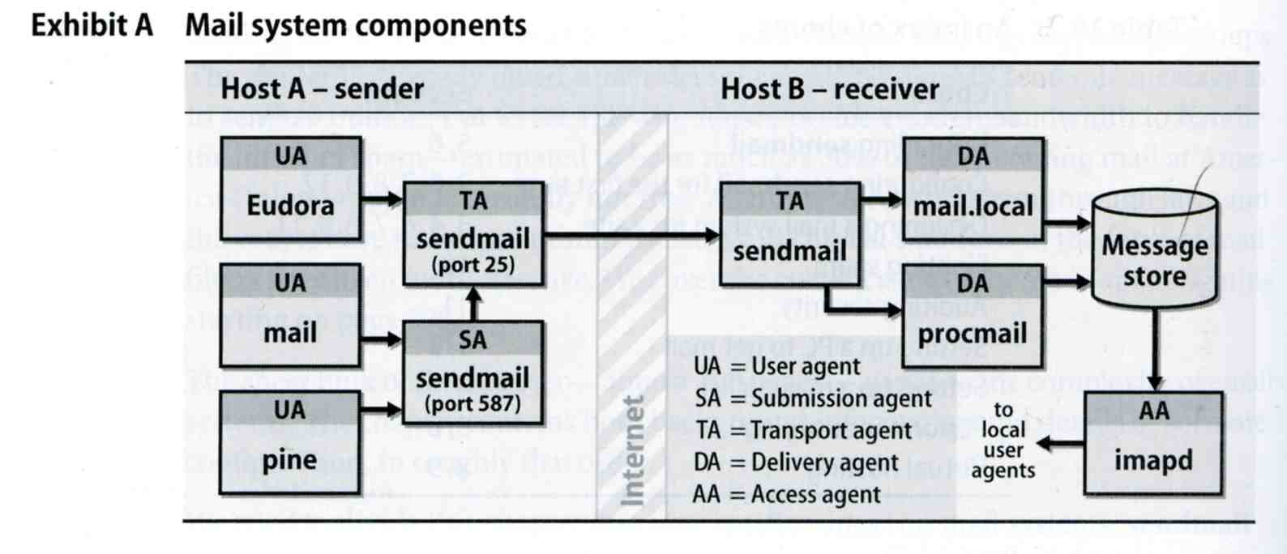
Mail System (2)

Slide 4
Mail System –
The Message Stores
The place on the local machine where email is stored
  Usually the directory: /var/mail or /var/spool/mail
    Users’ mails are stored in files named with each user’s login name
      Such as /var/mail/tytsai
    Permission “775” and root:mail as the owner and group owner
      drwxrwxr-x 2 root mail 512 Dec 16 15:51 mail/
  Using database
    When the organization is large or for ISP with millions of customers

Slide 5
Mail System –
The User Agent (1)
Help user read and compose mails
  UA must know mail format
    Originally: Text only
    Now: MIME
  MIME (Multipurpose Internet Mail Extensions)
    Include several types of content that can be encoded in the mail, such as image, video, …

Slide 6
Mail System –
The User Agent (2)
  Popular Mail User Agents
User Agent | System Config. | User Config. | MIME | POP | IMAP | SMTP
bin/mail | mail.rc | .mailrc
pine | pine.conf | .pinerc
elm | lib/elm.rc | .elm/elmrc
mutt | /etc/Muttrc | .muttrc
Netscape | - | -
Eudora | - | -
Outlook Ep. | - | -

Slide 7
Mail System –
The Transport Agent (1)
Route mails among machines
  Accept mail from UA, examine the recipients’ addresses, and delivery the mail to the correct host
  Protocols
    SMTP (Simple Mail Transport Protocol)
      RFC 821
    ESMTP (Extended SMTP)
      RFC 1869, 1870, 1891, 1985
  Popular transport agents
    sendmail
    Portfix

Slide 8
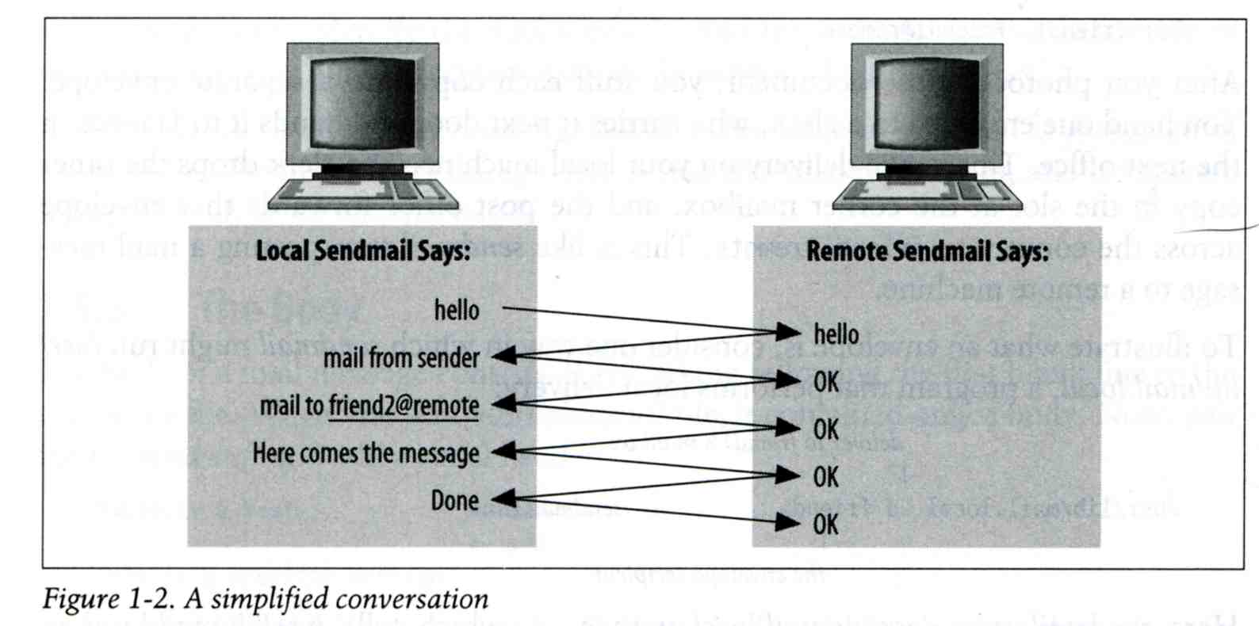
Mail System –
The Transport Agent (2)
Conversation between TAs

Slide 9
Mail System –
The Transport Agent (3)
Taking in SMTP
tytsai@tybsd:/etc> telnet localhost 25
Trying 127.0.0.1...
Connected to localhost.csie.nctu.edu.tw.
Escape character is '^]'.
220 tybsd.csie.nctu.edu.tw ESMTP Sendmail 8.13.1/8.13.1; Mon, 20 Dec 2004 15:49:00 GMT
HELP
214-2.0.0 This is sendmail version 8.13.1
214-2.0.0 Topics:
214-2.0.0 HELO EHLO MAIL RCPT DATA
214-2.0.0 RSET NOOP QUIT HELP VRFY
214-2.0.0 EXPN VERB ETRN DSN AUTH
214-2.0.0 STARTTLS
214-2.0.0 For more info use "HELP <topic>".
214-2.0.0 To report bugs in the implementation send email to
214-2.0.0 sendmail-bugs@sendmail.org.
214-2.0.0 For local information send email to Postmaster at your site.
214 2.0.0 End of HELP info
EHLO tybsd
250-tybsd.csie.nctu.edu.tw Hello localhost [127.0.0.1], pleased to meet you
…
quit
221 2.0.0 tybsd.csie.nctu.edu.tw closing connection
Connection closed by foreign host.

Slide 10
Mail System –
The Delivery Agent
Place mails in users’ mail boxes
  Accept mail from MTA and deliver the mail to the local recipients
  Type of recipients
    User
    Program, such as
      mail.local
      procmail
  mail.local
    Read the stdin up to an EOF and appends it to each user’s mail file
  procmail
    Do something between mail coming in and stored in mail box
    CSIE: Help → 5 → 2 → 8

Slide 11
Mail System –
The Access Agent
Help user download mail from server
  Protocols
    IMAP (Internet Message Access Protocol)
    POP (Post Office Protocol)

Slide 12
Mail System –
The Submission Agent
Route mails to local MTA
  Typical works that a MTA must do:
    Ensuring that all hostname are fully qualified
    Modifying headers
    Logging errors
    …
  RFC2476 introduces the idea of splitting MTA
    Let SA to share the load

Slide 13
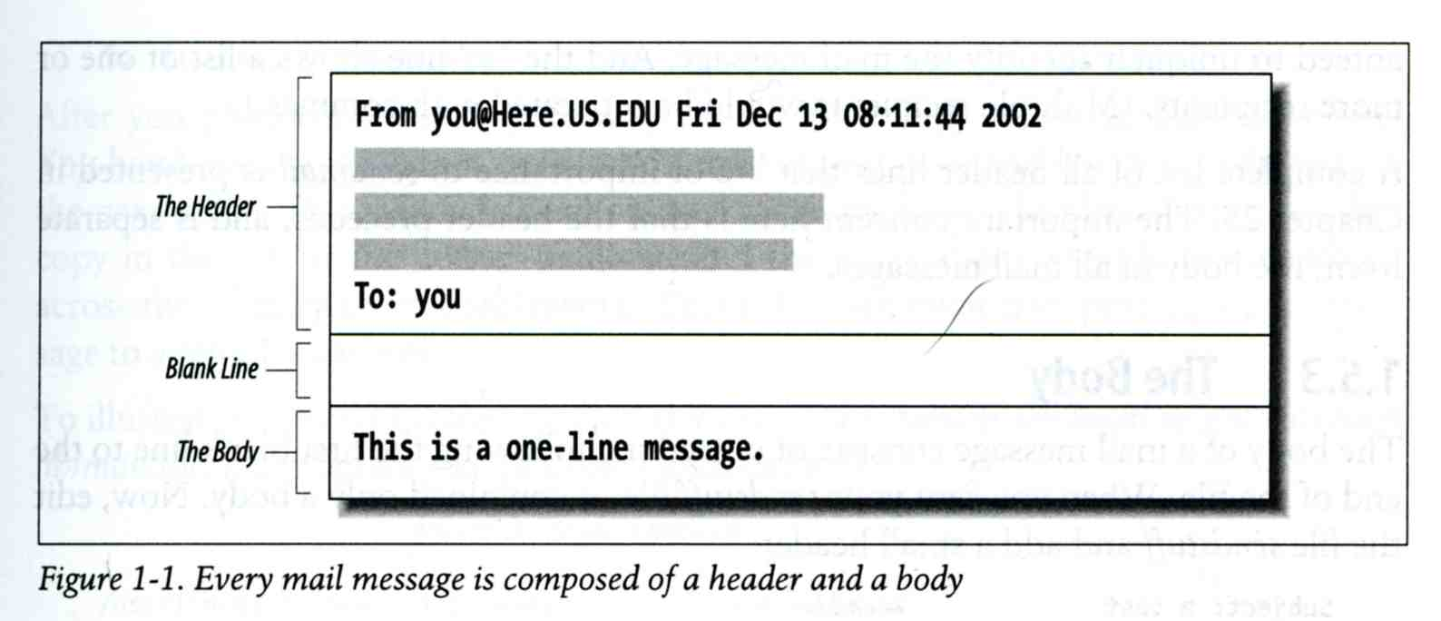
Components of a mail (1)

Slide 14
Components of a mail (2)
Three major components
  The envelope
    Invisible to users
    Determine where the message should be delivered, or to whom it should be returned
  The headers
    Information about the messages, defined in RFC822
      From, To, Date, Time, MTA, …
  The message body
    Plain text only
    Various MIME contents are encoded as printable characters using radix-64 algorithm

Slide 15
Mail Addressing (1)
Two kinds of email addresses:
  Route based address
    Message will travel through several intermediate hosts to the destination
    Format: host!path!user
      Ex: castle!sun!sierra!hplabs!ucbvax!winsor
      This mail is sent from “castle” host to the user “winsor” at “ucbvax” host
  Location independent address
    Simply identify the final destination
    Format: user@host.domain
      Ex: tytsai@tybsd.csie.nctu.edu.tw

Slide 16
Mail Addressing (2)
Alias
  Map a username to something else, such as
    To a group of users
      Ex: cp86 → tytsai, chiaming, wujc, …
    To the same user at different machine
      Ex: tytsai@csie.nctu.edu.tw → tytsai@ee.nctu.edu.tw
    To another user
      Ex: admin@csie.nctu.edu.tw → tytsai@csie.nctu.edu.tw

Slide 17
Mail Addressing (3)
Where to send the mail?
  When you want to send the mail to tytsai@csie.nctu.edu.tw, the MTA will:
    First, lookup up the mail exchanger of “csie.nctu.edu.tw”
      % dig mx csie.nctu.edu.tw
      If there is any servers, choose the higher preference one
      If this preferred one can not be connected, choose another
      If all the mx servers can not be connected, mail it directly to the host
      Ex:
tytsai@ccduty:~/Mail/2004-12-18> dig mx csie.nctu.edu.tw
;; ANSWER SECTION:
csie.nctu.edu.tw. 8640 IN MX 1 mx3.csie.nctu.edu.tw.
csie.nctu.edu.tw. 8640 IN MX 5 mx1.csie.nctu.edu.tw.
csie.nctu.edu.tw. 8640 IN MX 5 mx2.csie.nctu.edu.tw.

Slide 18
Mail Addressing (4)
Why using “Mail eXchanger”?
  We can centralize all the mail tasks to group of servers
  Multiple mail exchangers make it more robust

Slide 19
Mail Headers (1)
Defined by RFC822 which is obsoleted by RFC2822
  Mail reader will hide some uninteresting header information
Date: Sat, 18 Dec 2004 11:50:13 +0000
From: Tsung-Yi Tsai <tytsai@tybsd.csie.nctu.edu.tw>
To: Tsung-Yi Tsai <tytsai@tybsd.csie.nctu.edu.tw>
Subject: 哈哈
User-Agent: Mutt/1.4.2.1i

Slide 20
Mail Headers (2)
From tytsai@tybsd.csie.nctu.edu.tw Sat Dec 18 11:50:13 2004
Return-Path: <tytsai@tybsd.csie.nctu.edu.tw>
Received: from tybsd.csie.nctu.edu.tw (localhost [127.0.0.1])
by tybsd.csie.nctu.edu.tw (8.13.1/8.13.1) with ESMTP id iBIBoDmY029830
for <tytsai@tybsd.csie.nctu.edu.tw>; Sat, 18 Dec 2004 11:50:13 GMT
(envelope-from tytsai@tybsd.csie.nctu.edu.tw)
Received: (from tytsai@localhost)
by tybsd.csie.nctu.edu.tw (8.13.1/8.13.1/Submit) id iBIBoDjv029829
for tytsai@tybsd.csie.nctu.edu.tw; Sat, 18 Dec 2004 11:50:13 GMT
(envelope-from tytsai)
Date: Sat, 18 Dec 2004 11:50:13 +0000
From: Tsung-Yi Tsai <tytsai@tybsd.csie.nctu.edu.tw>
To: Tsung-Yi Tsai <tytsai@tybsd.csie.nctu.edu.tw>
Subject: 哈哈
Message-ID: <20041218115013.GA29818@tybsd.csie.nctu.edu.tw>
Mime-Version: 1.0
Content-Type: text/plain; charset=utf-8
Content-Disposition: inline
Content-Transfer-Encoding: 8bit
User-Agent: Mutt/1.4.2.1i
Status: RO
Content-Length: 10
Lines: 1
現在呢

Slide 21
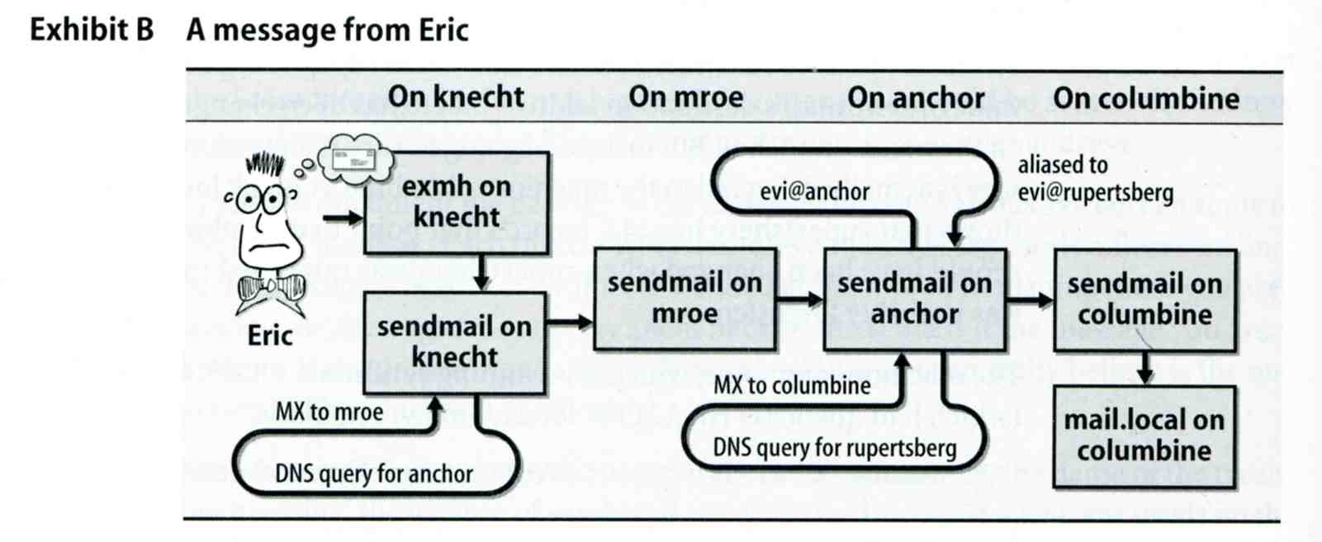
Mail Headers (3)
Example
  User “eric” on “knecht.sendmail.org” sends a email to user “evi” on “anchor.cs.colorado.edu”
    % dig mx anchor.cs.colorado.edu
      mroe.cs.colorado.edu

Slide 22
Mail Headers (4)
Headers in this example
  From eric@knecht.sendmail.org
    Added by mail.local when the mail is put in user’s mailbox
    Used to separate message boundary
  Return-Path: eric@knecht.sendmail.org
    Used to send the error message to this address
    May be different to the “From” address
  Received: from knecht.sendmail.org (localhost [127.0.0.1]) by knecht.sendmail.org (8.9.3/8.9.2) with ESMTP id GAA18984; Fri 1 Oct 1999 06:04:02 -800 (PST)
    Every machine that is ever processed this mail will add a “Received” record in top of headers
      Sending machine
      Receiving machine
      Version of sendmail in receiving machine
      Message unique identifier in receiving machine
      Date and time

Slide 23
Mail Headers (5)
  Received: from anchor.cs.Colorado.EDU (root@anchor.cs.colorado.edu [128.138.242.1]) by columbine.cs.colorado.edu (8.9.3/8.9.2) with ESMTP id HAA21741 for <evi@rupertsberg.cs.colorado.edu>; Fri, 1 Oct 1999 07:04:25 -0700 (MST)
  Received: from more.cs.colorado.edu (more.cs.colorado.edu [128.138.243.1]) by anchor.cs.colorado.edu (8.9.3/8.9.2) with ESMTP id HAA26176 for <evi@anchor.cs.colorado.edu>; Fri, 1 Oct 1999 07:04:24 -0700 (MST)
  Received: from knecht.sendmail.org (knecht.sendmail.org [209.31.233.160]) by more.cs.colorado.edu (8.9.3/8.9.2) with ESMTP id HAA09899 fro <evi@anchor.cs.colorado.edu>; Fri, 1 Oct 1999 07:04:23 -700 (MST)
  Received: from knecht.sendmail.org (localhost [127.0.0.1]) by knecht.sendmail.org (8.9.3/8.9.2) with ESMTP id GAA18984; Fri 1 Oct 1999 06:04:02 -800 (PST)

Slide 24
Mail Headers (6)
  Message-Id: <199910011404.GAA18984@knecht.sendmail.org)
    Add by sender’s MTA
  X-Mailer: exmh version 2.0.2 2/24/98
    MUA
    Non-standard header information
  To: Evi Nemeth <evi@anchor.cs.colorado.edu>
  Subject: Re: hi
  Date: Fri, 1 Oct 1999 06:04:02 -800

Slide 25
Mail System Architecture
Components in a mail system architecture
  Mail servers for incoming and outgoing mails
  Mail home
  IMAP or POP to integrate PC and remote clients
Simplest architecture
  Only one machine
    This machine has sendmail to let you send and receive mail
    This machine is also the mailbox home
    This machine also provides IMAP or POP to let you download mail from PC

Slide 26
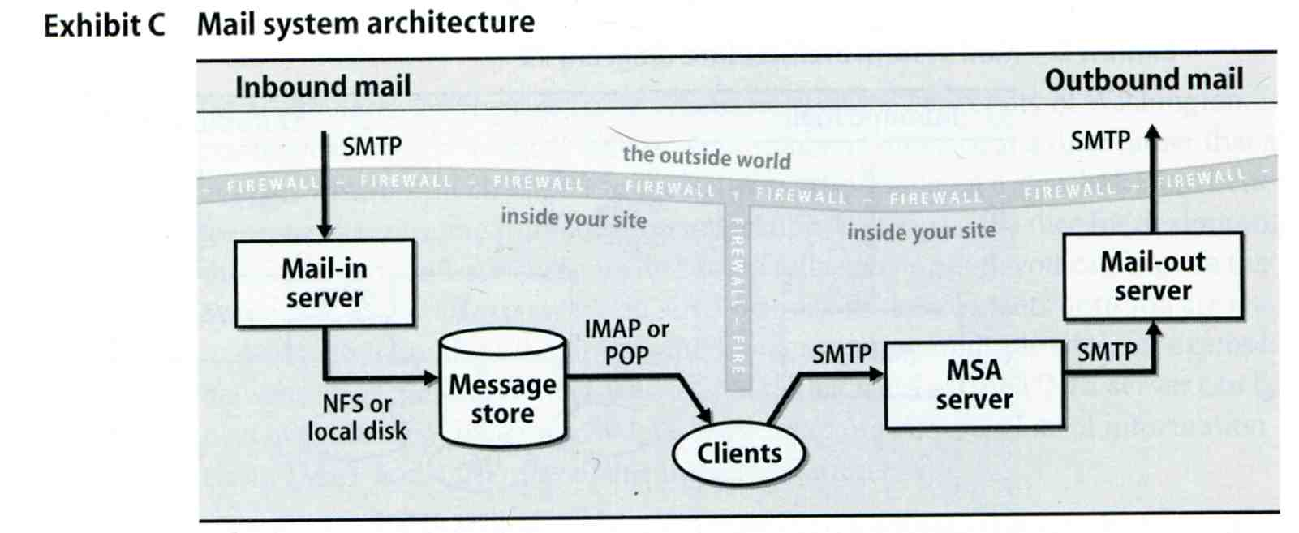
Mail System Architecture –
Scalable architecture for medium sites
Centralize
  At least one machine for incoming message and
    Mail home can be the same host or another one
  At least one machine for outgoing message
    Each host run MSA and forward mail to the same mail-out server or send the mail directly

Slide 27
Mail Alias
Several mechanisms to define aliases:
  Traditional method: in files
  Traditional method with NIS
  LDAP (Light-weight Directory Access Protocol)
When the sendmail wants to resolve name
  File-based method
    sendmail looks up files to resolve it by itself
  LDAP-based method
    sendmail call LDAP server to resolve the name and return the results

Slide 28
Mail Alias –
Traditional aliasing mechanism (1)
Aliases can be defined in three places
  In MUA’s configuraiton file
    Read by MUA and expand the alias before injecting the message into the mail system
  In the system-wide /etc/mail/aliases file
    Read by MTA
    The path to the system-wide alias file can be specified in sendmail’s configuration file
  In user’s forwarding file, ~/.forward
    Read by MTA after system-wide alias file

Slide 29
Mail Alias –
Traditional aliasing mechanism (2)
The format of an entry in aliases file
  Local-name: recipient1,recipient2,…
  Ex:
    admin: tytsai,jwwang
    tytsai: tytsai@tybsd.csie.nctu.edu.tw
  Local-name: :include:another-file
  Ex:
    bsdTA: :include:/usr/local/mail/bsdTA
Contents of bsdTA
tytsai
kctao
chiahung
lwhsu
chlo
hwchu
liling

Slide 30
Mail Alias –
Traditional aliasing mechanism (3)
  Local-name: absolute-path-file
  Mails will be appended to this file
  Ex:
    complaints: /dev/null
    troubles: trouble_admin,trouble_log
    trouble_admin: :include:/usr/local/mail/troadm
    trouble_log: /usr/local/mail/logs/troublemail
  Local-name: "|program-path"
  Route mail to stdin of program
  Ex:
    autoftp: “|/usr/local/bin/ftpserver”

Slide 31
Mail Alias –
Traditional aliasing mechanism (4)
The hashed aliases DB
  /etc/mail/aliases is the plaintext aliases information
  /etc/mail/aliases.db is the hashed version for efficiency
  Use “newaliases” command to rebuild the hashed version when you change the aliases file

Slide 32
Mail Alias –
Traditional aliasing mechanism (5)
User maintainable forwarding file
  In ~/.forward
  Format: comma-separated
  Ex:
    tytsai@gmail.com
    \tytsai, tytsai@gmail.com, tytsai@yahoo.com.tw
  Must be owned by user and with permission of 600
    The path to .forward file should be writable only to user

Slide 33
Mail Alias –
Traditional aliasing mechanism (6)
Alias must
  postmaster and MAILER-DAEMON
    Mail system maintainer
  bin, sys, daemon, nobody, …
    System accounts (root)
  root
    forward root mail to the administrator (.forward)
MAILER-DAEMON: postmaster
postmaster: root
bin: root
bind: root
daemon: root
games: root
kmem: root
mailnull: postmaster
nobody: root
operator: root
…

Slide 34
sendmail

Slide 35
Introduction
sendmail is a MTA program
  The most complete and complex mail transport program with about 70% popularity
  Interface between MUA and MDA
  Speak SMTP and deliver mail to remote via the Internet

Slide 36
History of sendmail
sendmail version5
  Eric Allman, student of UC Berkeley, in 1983
IDA sendmail enhanced from v5
  Lennart Lovstrand, student of University of Linkoping in Sweden, 1987
    Institutionen for Datavetenskap (cs department)
KJS sendmail enhanced from IDA
  Paul Vixie at DECWRL during 1989-1993
    King James Sendmail
sendmail version8
  Eric included enhanced features in IDA and KJS in 1993

Slide 37
sendmail installation
Major components of sendmail
  /usr/sbin/sendmail
    The sendmail binary with access mode 4755 setuid to root
  /etc/mail/sendmail.cf
    Configuration file
  /var/spool/mqueue
    Mail queue directory, with mode 700 owned by root
  newaliases, mailq, hoststat, …
    Various link to sendmail
  mail.local and smrsh
    sendmail’s safer local delivery agent

Slide 38
Modes of operation
sendmail can be run in several modes
Flag | Meaning | link
-bd | In daemon mode, on port 25
-bD | In daemon mode, on port 25, foreground
-bh | View recent connection information | hoststat
-bH | Purge disk copy of outdated connection info | purgestat
-bi | Initialize hashed aliases | newaliases
-bp | Print mail queue | mailq
-bt | Enter address test mode
-bv | Verify mail address only; don’t send mail
-bs | Enter SMTP server mode (on stdin, not port 25)

Slide 39
Modes of operation – daemon mode
Daemon mode
  sendmail listens on port 25 and waits for work
  Usually specify the –q flag to set the interval to process mails in queue
    -q30m to check the queue every 30 minutes
    -q1h to check the queue every 1 hour
  /var/run/sendmail.pid
    Contain the sendmail pid and command that starts it
  Reset sendmail when you change the configuration
    % kill -1 `head -1 /var/run/sendmail.pid`
tytsai@tybsd:/var/run> sudo less sendmail.pid
567
/usr/sbin/sendmail -L sm-mta -bd -q30m -ODaemonPortOptions=Addr=localhost

Slide 40
Mail queue (1)
When to store message in queue
  Messages that host is too busy to deliver immediately or
  Messages that destination host is unavailable
Components of each queued message
  Each message is saved in pieces in several different files
    Filename: Two-bit-prefix + random-ID
tytsai@tybsd [2:43pm] /var/spool/mqueue> ls -l
total 4
-rw------- 1 root daemon 16 Dec 20 14:32 dfiBKEWSmU037293
-rw------- 1 root daemon 1215 Dec 20 14:41 qfiBKEWSmU037293
tytsai@tybsd [2:44pm] /var/spool/mqueue> mailq
/var/spool/mqueue (1 request)
-----Q-ID----- --Size-- -----Q-Time----- ------------Sender/Recipient-----------
iBKEWSmU037293 16 Mon Dec 20 14:32 <tytsai@tybsd.csie.nctu.edu.tw>
(Deferred: Connection refused by r21607.csie.nctu.edu.tw.)
<shrang@r21607.csie.nctu.edu.tw>
Total requests: 1

Slide 41
Mail queue (2)
Queued message prefix
  Required pieces
    qf
      Message header (H)
      envelope address
        Sender Address (S)
        Recipient Address (R)
      The date to return as undeliverable
      Message priority in queue (P)
      The reason of why being queued (M)
      Time last processed (K)
      Time created (T)
    df
      Message body

Slide 42
Mail queue (3)
Example of qf
V8
T1103553148
K1103553704
N2
P120520
I4/12/1343513
MDeferred: Connection refused by r21607.csie.nctu.edu.tw.
Fbs
$_localhost [127.0.0.1]
$rESMTP
$stybsd.csie.nctu.edu.tw
${daemon_flags}
${if_addr}127.0.0.1
S<tytsai@tybsd.csie.nctu.edu.tw>
MDeferred: Connection refused by r21607.csie.nctu.edu.tw.
rRFC822; shrang@r21607.csie.nctu.edu.tw
RPFD:<shrang@r21607.csie.nctu.edu.tw>

Slide 43
Mail queue (4)
H?P?Return-Path: <<81>g>
H??Received: from tybsd.csie.nctu.edu.tw (localhost [127.0.0.1])
by tybsd.csie.nctu.edu.tw (8.13.1/8.13.1) with ESMTP id iBKEWSmU037293
for <shrang@r21607.csie.nctu.edu.tw>; Mon, 20 Dec 2004 14:32:28 GMT
(envelope-from tytsai@tybsd.csie.nctu.edu.tw)
H?x?Full-Name: Tsung-Yi Tsai
H??Received: (from root@localhost)
by tybsd.csie.nctu.edu.tw (8.13.1/8.13.1/Submit) id iBKEWSvL037292
for shrang@r21607.csie.nctu.edu.tw; Mon, 20 Dec 2004 14:32:28 GMT
(envelope-from tytsai)
H??Date: Mon, 20 Dec 2004 14:32:28 +0000
H??From: Charlie Root <root@tybsd.csie.nctu.edu.tw>
H??To: shrang@r21607.csie.nctu.edu.tw
H??Subject: test1
H??Message-ID: <20041220143228.GA37284@tybsd.csie.nctu.edu.tw>
H??Mime-Version: 1.0
H??Content-Type: text/plain; charset=us-ascii
H??Content-Disposition: inline
H??User-Agent: Mutt/1.4.2.1i
.

Slide 44
Mail queue (5)
When /var/spool/mqueue is full
  we can move mqueue to another place and digest it later using this command
    % /usr/sbin/sendmail –oQ/var/spool/cloggedqueue
  Example script to help to digest large amount of queued mails manually
#!/bin/sh
for suffix in 0 1 2 3 4 5 6 7 8 9
do
mkdir clog${suffix}
mv ?f*${suffix} clog${suffix}
/usr/sbin/sendmail –oQclog${suffix}
done

Slide 45
In NA …
We leave following issues in NA, including
  Configuration of sendmail
  Postfix
  Spam

