Slide 1
Chapter 2
Booting and Shutting Down

Slide 2
Bootstrapping
Starting up a computer
  Load kernel into memory and execute it.
    BIOS load and run the MBR (Master Boot Record)
    MBR searches for the bootable slice on the disk and then run the code on the slice to load OS.
    kernel is loaded into memory, and then probing, initialization, init process.

Slide 3
MBR、Boot Stages one、two、three
MBR
  First 512 bytes of disk, outside the FreeBSD area
  Corresponding copy in FreeBSD is /boot/boot0
  Responsible to find the boot code on the boot sector of bootable slice.
MBR
Slice 1 (/dev/ad0s1)
Slice 2 (/dev/ad0s2)
Slice 3 (/dev/ad0s3)
Slice 4 (/dev/ad0s4)
Slice 5 /dev/ad0s5 | Slice 6 /dev/ad0s6
F1 FreeBSD
Default: F1

Slide 4
Boot Stages one and two
boot1 and boot2
  Conceptually both are part of the same program, but split into two due to space constrain.
  Used to run the loader.
  As MBR, boot1 and boot2 are outside the FreeBSD, and the copy of these two are
    /boot/boot1
    /boot/boot2
MBR
Slice 1 (/dev/ad0s1) /boot/boot1, boot2 /boot/loader
Slice 2 (/dev/ad0s2)
Slice 3 (/dev/ad0s3)

Slide 5
Boot Stage Three
The loader
  Provide a user-friendly interface to configure booting choice.
  /boot/loader
    /etc/loader.rc use processing commands in /etc/loader.4th to manipulate loader.conf
    Wait for 10 seconds then autoboot
/boot/default/loader.conf
Default loader behavior
/boot/loader.conf
autoboot_delay="10"
password="ooxx"
User-defined loader behavior

Slide 6
MBR recover
If MBR is overwritten by MS, and you want to replace it with FreeBSD MBR:
  Boot with CD or Floppy
  % fdisk –B –b /boot/boot0 ad0
  or
  % boot0cfg –B /dev/ad0
If you want to replace it with MS MBR
  Boot with DOS floppy
  C:\fdisk /mbr
-B means reinitialize the boot code contained
in sector 0 of the disk
-b is used to specify the boot code

Slide 7
Boot in single user mode
OS | command
FreeBSD | Interrupt the boot loader and type “boot –s”
Linux | LILO: linux single
Solaris | Press “STOP” and “a” to enter the boot PROM and Press “boot –s”

Slide 8
Insecure single user mode
When the physical security to the console is considerable,
  Set console to be insecure in /etc/ttys
# name getty type status comments
#
# If console is marked "insecure", then init will ask for the root password
# when going to single-user mode.
# console none unknown off secure
console none unknown off insecure

Slide 9
Multibooting (1)
FreeBSD
  FreeBSD’s boot loader will try to detect bootable partitions
  You can also declare the bootable partitions explicitly with boot0cfg
    % boot0cfg –B –m 0x7 ad0
-m means mask
0x7 means 0111 and boot menu will include
at least three options

Slide 10
Multibooting (2)
Linux
  Using lilo or GRUB
boot=/dev/hda
map=/boot/map
install=/boot/boot.b
prompt
timeout=50
message=/boot/message
linear
default=Linux2_4_18
image=/boot/vmlinuz-2.2.17-14
label=Linux2_2_17
root=/dev/hda7
image=/boot/bzImage
label=Linux2_4_18
root=/dev/hda7

Slide 11
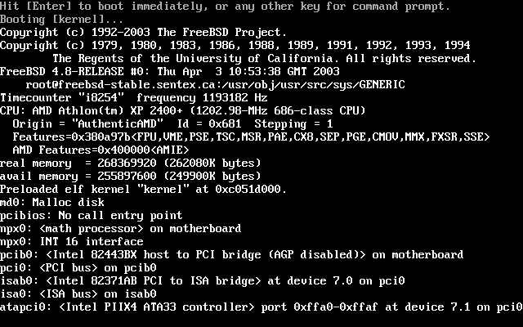
Steps in the boot process
Loading and initialization of the kernel
Device detection and configuration
Creation of spontaneous system processes
Operator intervention
Execution of system startup scripts
Multiuser operation

Slide 12
Steps in the boot process –
Kernel initialization
Get kernel image into memory to be executed
Perform memory test
  Allocate kernel’s internal data structures
OS | Kernel image path
FreeBSD | /kernel
Linux | /boot/vmlinuz
Solaris | /kernel/genunix
SunOS | /vmunix

Slide 13
Steps in the boot process –
Hardware configuration
Devices specified in kernel configuration file
  Kernel will try to locate and initialize it
Devices not specified
  Kernel tries to determine the other information by probing the bus
    If the driver is missing or not responsible to the probe, device is disabled

Slide 14
Steps in the boot process –
System Processes
Spontaneous process
  Not created by the normal UNIX fork mechanism
OS | Pid 0 | Pid 1 | Pid 2 and more
FreeBSD | swapper | init | pagedaemon
Linux | - | init | kflushed,kupdate Kpiod,kswapd
Solaris | sched | init | various handlers
SunOS | swapper | init | Pagedaemon

Slide 15
Steps in the boot process –
Operator intervention
Manual boot only
  Only the root partition is mounted and mounted as read only
    mount –u /
    mount –a –t ufs
    swapon -a
mount –u indicates that the status of an already
mounted file system should be changed
mount –a –t means mount all ufs file systems

Slide 16
Steps in the boot process – execution of startup scripts
The startup scripts are selected and run by init
Typical works are:
  Setting the name of the computer
  Setting the time zone
  Checking the disk with fsck
  Mounting the system’s disks
  Removing files from /tmp directory
  Configuring network interface
  Starting up daemons and network services

Slide 17
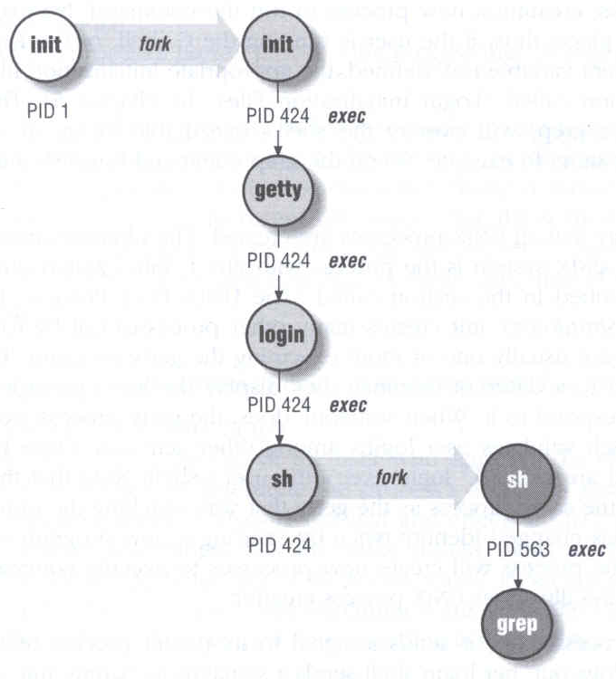
Steps in the boot process – multiuser operator
From now on, the system is fully operational, but no one can login
  init will spawn getty processes to listen for login

Slide 18
Startup Scripts
SystemV-style startup scripts
  ccsun1~ccsun7, linux1~linux20
  /etc/init.d/
  /etc/rc.d/rcn.d/
  Each script is responsible for one
  daemon or one aspect of system.
Example: sshd in ccsun2
Symbolic link
case "$1" in
'start')
if [ -x /usr/local/sbin/sshd ]; then
echo "Starting the secure shell daemon"
/usr/local/sbin/sshd &
fi
;;
'stop')
echo "Stopping the secure shell daemon "
pkill -TERM sshd
;;
*)
echo "Usage: /etc/init.d/sshd { start | stop }"
;;
esac
exit 0

Slide 19
Startup Scripts –
SystemV-style startup scripts (1)
Run-level
  /etc/inittab
  init follow the inittab from level 0 to level k
Example: inittab in linux5
Run Level | Startup scripts | Meaning
0 | /etc/rc.d/rc0.d/ | Halt
1 | /etc/rc.d/rc1.d/ | Single User Mode
2 | /etc/rc.d/rc2.d/ | Multiuser without NFS
3 | /etc/rc.d/rc3.d/ | Full multiuser mode
4 | /etc/rc.d/rc4.d/ | Unused
5 | /etc/rc.d/rc5.d/ | X11
6 | /etc/rc.d/rc6.d/ | reboot

Slide 20
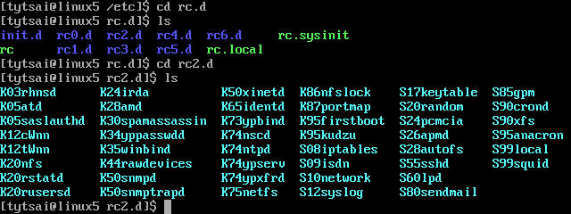
Startup Scripts –
SystemV-style startup scripts (2)
/etc/rc.d/rcn.d/
  When init transitions from lower run level to higher one,
    it runs all the scripts that start with “S” in ascending order with “start” argument
  When init transitions from high run level to lower one,
    it runs all the scripts that start with “K” in descending order with “stop” argument

Slide 21
Startup Scripts –
SystemV-style startup scripts (3)
If you write a daemon and want init to start/stop it,
  write a script and put in /etc/init.d
  make suitable symbolic link in rcn.d
    ln –s /etc/init.d/initiald /etc/rc2.d/S61initiald
    ln –s /etc/init.d/initiald /etc/rc0.d/K33initiald

Slide 22
Startup Scripts –
SystemV-style startup scripts (4)
In linux
  /etc/sysconfig/ contain config data used by startup scripts
  Ex:
    network
      Set global network option (hostname, gateway, ..)
        HOSTNAME=linux5
        GATEWAY=140.113.209.254
    network-scripts/
      Contain accessory scripts and network config file
      EX: ifcfg-eth0
        DEVICE=eth0
        BROADCAST=140.113.209.255
        IPADDR=140.113.209.145
        NETMASK=255.255.255.0
        ONBOOT=yes

Slide 23
FreeBSD startup scripts
No concept of run level
  init will run /etc/rc
  /etc/rc will reads the following configuration
    /etc/defaults/rc.conf
    /etc/rc.conf
    /etc/rc.conf.local
  /etc/rc then executes the following scripts in predefined order
    /etc/rc.diskless1
    /etc/rc.early
    /etc/rc.sysctl
    /etc/rc.serial
    /etc/rc.pccard
    /etc/rc.network
    /etc/rc.network6
    /etc/rc.{arch}
    /etc/rc.syscons
    /etc/rc.local

Slide 24
Ways to shut down or reboot
Turning off the power
Using the shutdown command
Using the halt and reboot command
  halt = shutdown –h
  reboot = shutdown -r
Sending init a TERM signal
  kill –TERM 1
Using telinit to change init’s level
Killing init

Slide 25
Ways to shut down or reboot – shutdown command
OS | Pathname | Time | R | H | S | F
FreeBSD | /sbin/shutdown | time | -r | -h
Linux | /sbin/shutdown | time | -r | -h
Solaris | /usr/sbin/shutdown | -gsecs | -i6 | -i0 | -is
SunOS | /usr/sbin/shutdown | +mins | -r | -h |  | -f
R=Reboot, H=Halt, S=Enter Single user mode, F=Skip fsck
time format can be
+m
hh:mm ➔linux
yymmddhhmm ➔ FreeBSD

Slide 26
Ways to shut down or reboot – telinit
Only for SystemV systems
  Linux, Solaris
    % telinit 1

Slide 27
Poweroff ?
In linux,
  You can use “poweroff” to shutdown the system and turn the power off.
In FreeBSD,
  (1) Compile this into kernel
  device apm0 at nexus?flag 0x20
  (2) Rebuild the kernel
  (3) Edit /etc/rc.conf
  apm_enable=“YES”
  apmd_enable=“YES”
  (4) Reboot
  (5) Try “shtudown –p now”

