Slide 1
Chapter 21
Security

Slide 2
Firewall (1)
Using ipfw
  Add these options in kernel configuration file and recompile the kernel
  Edit /etc/rc.conf to start firewall
    % man rc.conf and search firewall keyword
options IPFIREWALL
options IPFIREWALL_VERBOSE
options IPFIREWALL_FORWARD
options IPFIREWALL_DEFAULT_TO_ACCEPT
# firewall
firewall_enable="YES"
firewall_script="etc/firewalls/rules"
firewall_quiet="YES"

Slide 3
Firewall (2)
  Edit ipfw command script that you specify in rc.conf
    Ex: /etc/firewall/rules
  ipfw command
    % sudo ipfw list (show current firewall rules)
    % sudo ipfw flush (delete all firewall rules)
    % ipfw add {pass|deny} {udp|tcp|all} from
    where to where

Slide 4
Firewall (3)
Example (Head part)
#!/bin/sh
fwcmd="/sbin/ipfw -q“
myip=“140.113.235.4”
${fwcmd} -f flush
${fwcmd} add pass all from ${myip} to any
# Allow TCP through if setup succeeded
${fwcmd} add pass tcp from any to any established
${fwcmd} add deny log all from any to any frag
echo -n "Established “
# Allow icmp (ping only)
${fwcmd} add pass icmp from any to any icmptypes 0,3,8,11

Slide 5
Firewall (4)
Example (service part)
# Allow SMB
${fwcmd} add pass tcp from 140.113.235.0/24 to ${myip} 137-139 setup
# Allow HTTP/HTTPS
${fwcmd} add pass tcp from any to ${myip} 80 setup
${fwcmd} add pass tcp from any to ${myip} 443 setup
echo -n "HTTP/HTTPS "
# SSH access control
${fwcmd} add pass tcp from any to any 22 setup
echo -n "SSH "
# open any system port that your system provide

Slide 6
Firewall (5)
Example (Tail part)
# Default to deny
${fwcmd} add 65500 reset log tcp from any to any
${fwcmd} add 65501 reject udp from any to any
${fwcmd} add 65502 reject log icmp from any to any
${fwcmd} add 65534 deny log all from any to any

Slide 7
Firewall (6)
Manual reset firewall rules
  Edit the script and
  % sudo sh /etc/firewall/rules
When you install new service and wondering why it can not use…
  % sudo ipfw flush
  Delete all firewall rules to remove problems caused by firewall

Slide 8
Firewall (7)
Debug your system via log file
  /var/log/security
Dec 25 11:25:36 tybsd last message repeated 2 times
Dec 25 11:45:06 tybsd kernel: ipfw: 65500 Reset TCP 211.48.52.58:1997 140.113.235.4:5554 in via fxp0
Dec 25 11:45:07 tybsd kernel: ipfw: 65500 Reset TCP 211.48.52.58:1997 140.113.235.4:5554 in via fxp0
Dec 25 11:45:07 tybsd kernel: ipfw: 65500 Reset TCP 211.48.52.58:4062 140.113.235.4:1023 in via fxp0
Dec 25 11:45:08 tybsd kernel: ipfw: 65500 Reset TCP 211.48.52.58:4062 140.113.235.4:1023 in via fxp0
Dec 25 11:45:09 tybsd kernel: ipfw: 65500 Reset TCP 211.48.52.58:4246 140.113.235.4:9898 in via fxp0
Dec 25 12:05:44 tybsd kernel: ipfw: 65500 Reset TCP 204.100.126.30:2188 140.113.235.4:445 in via fxp0
Dec 25 12:05:45 tybsd last message repeated 2 times

Slide 9
/etc/hosts.equiv and ~/.rhosts
Trusted remote host and user name DB
  Allow user to login (via rlogin) and copy files (rcp) between machines without passwords
  Format:
    Simple: hostname [username]
    Complex: [+-][hostname|@netgroup]
    [[+-][username|@netgorup]]
  Example
    bar.com foo (trust user “foo” from host “bar.com”)
    +@adm_csie_cc (trust all hosts from amd_csie_cc group)
    +@adm_csie_cc -@tytsai
Not to use this

Slide 10
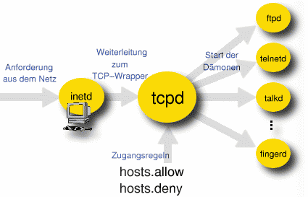
/etc/hosts.allow (1)
TCP Wrapper
  Provide support for every server daemon under its control

Slide 11
/etc/hosts.allow (2)
  To see what daemons are controlled by inetd, see /etc/inetd.conf
  TCP wrapper should not be considered a replacement of a good firewall. Instead, it should be used in conjunction with a firewall or other security tools
#ftp stream tcp nowait root /usr/libexec/ftpd ftpd -l
#ftp stream tcp6 nowait root /usr/libexec/ftpd ftpd -l
#telnet stream tcp nowait root /usr/libexec/telnetd telnetd
#telnet stream tcp6 nowait root /usr/libexec/telnetd telnetd
shell stream tcp nowait root /usr/libexec/rshd rshd
#shell stream tcp6 nowait root /usr/libexec/rshd rshd
login stream tcp nowait root /usr/libexec/rlogind rlogind
#login stream tcp6 nowait root /usr/libexec/rlogind rlogind

Slide 12
/etc/hosts.allow (3)
To use TCP wrapper
  inetd daemon must start up with “-Ww” option (default)
  Or edit /etc/rc.conf
  Edit /etc/hosts.allow
    Format:
    daemon:address:action
      daemon is the daemon name which inetd started
      address can be hostname, IPv4 addr, IPv6 addr
      action can be “allow” or “deny”
      Keyword “ALL” can be used in daemon and address fields to means everything
inetd_enable="YES"
inetd_flags="-wW"

Slide 13
/etc/hosts.allow (4)
  First rule match semantic
    Meaning that the configuration file is scanned in ascending order for a matching rule
    When a match is found, the rule is applied and the search process will stop
example
ALL : localhost, loghost @adm_cc_csie : allow
ptelnetd pftpd sshd: @sun_cc_csie, @bsd_cc_csie, @linux_cc_csie : allow
ptelnetd pftpd sshd: cflee, ycchang, zeiss, liao, tybsd : allow
identd : ALL : allow
portmap : 140.113.17. ALL : allow
sendmail : ALL : allow
rpc.rstatd : @all_cc_csie 140.113.17.203: allow
rpc.rusersd : @all_cc_csie 140.113.17.203: allow
ALL : ALL : deny

Slide 14
/etc/hosts.allow (5)
Advance configuration
  External commands (twist option)
    twist will be called to execute a shell command or script
  External commands (spawn option)
    spawn is like twist, but it will not send a reply back to the client
# The rest of the daemons are protected.
telnet : ALL \
: severity auth.info \
: twist /bin/echo "You are not welcome to use %d from %h."
# We do not allow connections from example.com:
ALL : .example.com \
: spawn (/bin/echo %a from %h attempted to access %d >> \
/var/log/connections.log) \
: deny

Slide 15
/etc/hosts.allow (6)
  Wildcard (PARANOID option)
    Match any connection that is made from an IP address that differs from its hostname
See man 5 hosts_access
# Block possibly spoofed requests to sendmail:
sendmail : PARANOID : deny

Slide 16
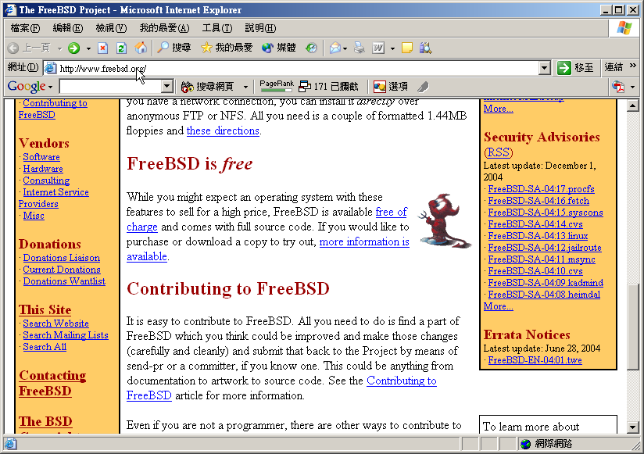
FreeBSD Security Advisories (1)
Advisory
  Security information
Where to find it
  freebsd-security-notifications Mailing list
    http://lists.freebsd.org/mailman/listinfo/freebsd-security-notifications
  Web page (Security Advisories Channel)
    http://www.freebsd.org

Slide 17
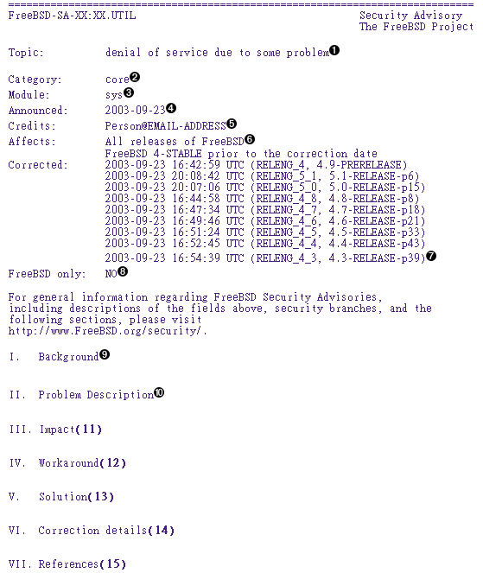
FreeBSD Security
Advisories (2)
Advisory content
  core
    core OS
  contrib
    Software for FreeBSD project
  Ports
    Add on software
  Solution
    Workaround
    Solution

Slide 18
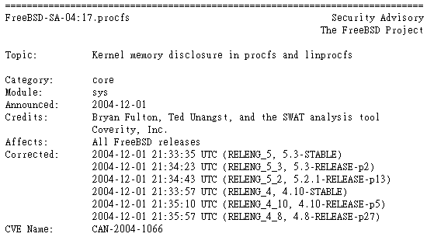
FreeBSD Security
Advisories (3)
Example
  proc filesystem advisory

Slide 19
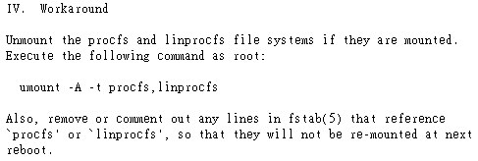
FreeBSD Security
Advisories (4)
Example
  workaround

Slide 20
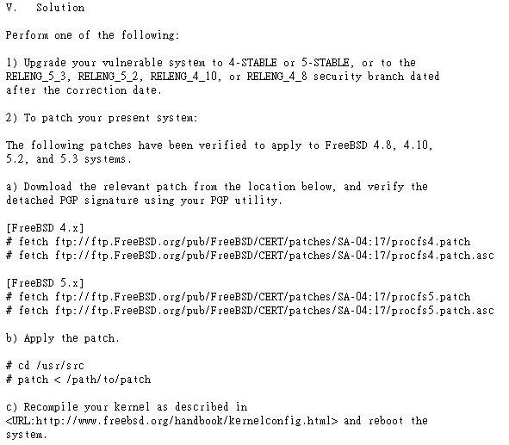
FreeBSD Security
Advisories (5)
Example
  solution

