Slide 1
Chapter 4
Controlling Processes

Slide 2
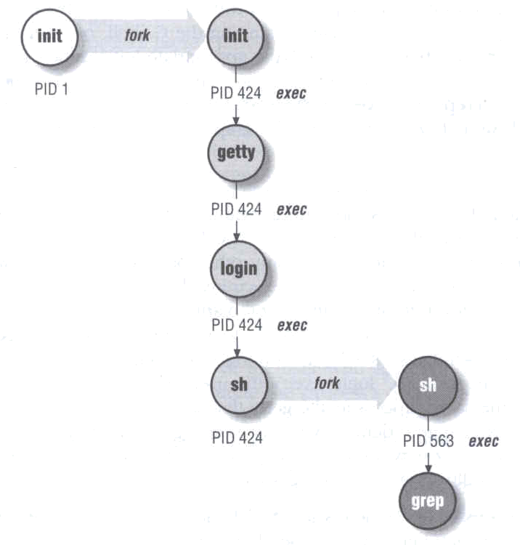
Program to Process
Program is dead
  Just lie on disk
  grep is a program
    /usr/bin/grep
    % file /usr/bin/grep
      ELF 32-bit LSB executable
When you execute it
  It becomes a process
Process is alive
  It resides in memory
Notes:
Executable and linkable file format

Slide 3
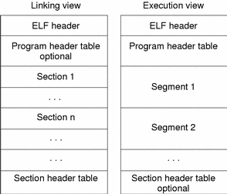
ELF
Executable and Linkable Format
.text
CPU instructions
.bss
un-initialized data
.data
initialized data
Into Memory

Slide 4
Components of a Process
An address space in memory
  Code and data of this process
A set of data structures within the kernel
  Used to monitor, schedule, trace, …., this process
    owner
    Current status
    Execution priority
    Information of used resource
    Signal mask

Slide 5
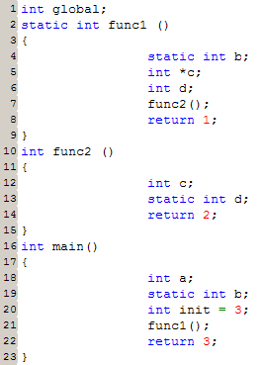
Components of a Process – address space in memory (1)
gcc

Slide 6
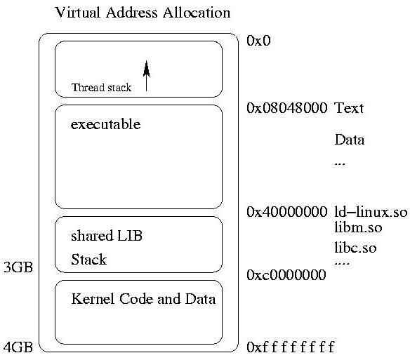
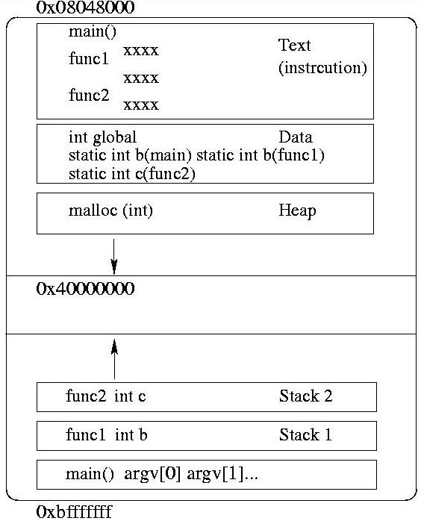
Components of a Process – address space in memory (2)

Slide 7
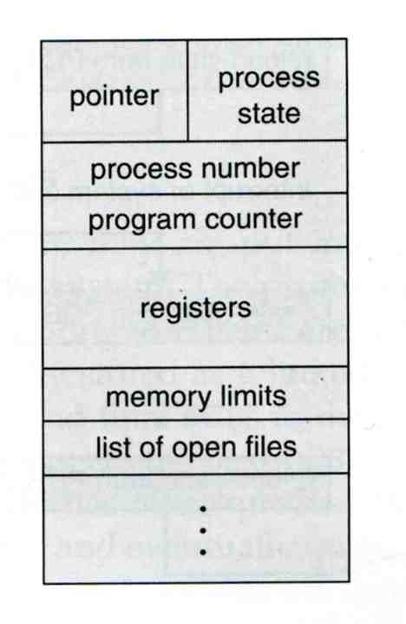
Components of a Process – data structure in kernel (1)
In OS, we call these as PCB
  Process Control Block

Slide 8
Components of a Process – data structure in kernel (2)
FreeBSD
  /usr/include/sys/proc.h
  struct proc
Linux
  /usr/include/linux/sched.h
  struct task_struct
struct proc
{
…
pid_t p_pid;
struct pcred *p_cred;
…
}
struct task_struct
{
…
pid_t pid;
pid_t pgrp;
uid_t uid,euid,suid,fsuid;
gid_t gid,egid,sgid,fsgid;
char comm[16];
…
}
struct pcred
{
…
uid_t p_ruid, p_svuid;
gid_t p_rgid,p_svgid;
…
}

Slide 9
Attributes of the Process
PID, PPID
  Process ID and parent process ID
UID, EUID
  User ID and Effective user ID
GID, EGID
  Group ID and Effective group ID
Niceness
  The suggested priority of this process

Slide 10
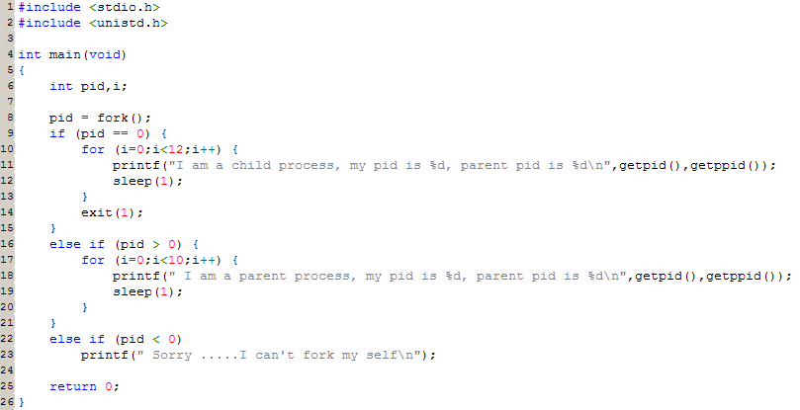
Attributes of the process –
PID and PPID
PID – process id
  Unique number assigned for each process in increasing order when they are created
PPID – parent PID
  The PID of the parent from which it was cloned
  UNIX uses fork-and-exec model to create new process

Slide 11
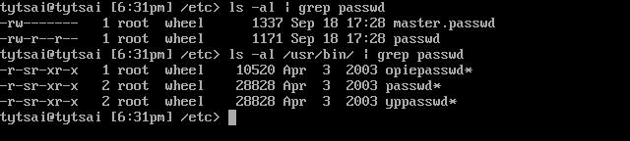
Attributes of the process –
UID、GID、EUID and EGID
UID, GID, EUID, EGID
  The effective uid and gid can be used to enable or restrict the additional permissions
  Effective uid will be set to
    Real uid if setuid bit is off
    The file owner’s uid if setuid bit is on
Ex:
/etc/master.passwd is “root read-write only” and
/usr/bin/passwd is a “setuid” program

Slide 12
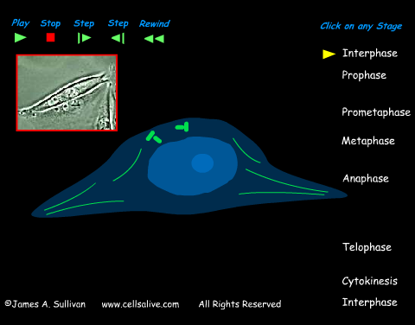
Process Lifecycle
fork
  child has the same program context
exec
  child use exec to change the program context
exit
  child use _exit to tell kernel that it is ready to die and this death should be acknowledged by the child’s parent
wait
  parent use wait to wait for child’s death
  If parent died before child, this orphan process will have init as it’s new parent

Slide 13
Signal
A way of telling a process something has happened
Signals can be sent
  among processes as a means of communication
  by the terminal driver to kill, interrupt, or suspend process
    <Ctrl-C>、<Ctrl-Z>
  by the administrator to achieve various results
  by the kernel when a process violate the rules, such as divide by zero

Slide 14
Actions when receiving signal
Depend on whether there is a designated handler routine for that signal
  If yes, the handler is called
  If no, the kernel takes some default action
“Catching” the signal
  Specify a handler routine for a signal within a program
Two ways to prevent signals from arriving
  Ignored
    Just discard it and there is no effect to process
  Blocked
    Queue for delivery until unblocked
    The handler for a newly unblocked signal is called only once

Slide 15

UNIX signals
man signal or see /usr/include/sys/signal.h
FreeBSD
# | Name | Description | Default | Catch | Block | Dump core
1 | SIGHUP | Hangup | Terminate
2 | SIGINT | Interrupt (^C) | Terminate
3 | SIGQUIT | Quit | Terminate
9 | SIGKILL | Kill | Terminate
10 | SIGBUS | Bus error | Terminate
11 | SIGSEGV | Segmentation fault | Terminate
15 | SIGTERM | Soft. termination | Terminate
17 | SIGSTOP | Stop | Stop
18 | SIGTSTP | Stop from tty (^Z) | Stop
19 | SIGCONT | Continue after stop | Ignore
Notes:
Quit, kill, segv 是同一組

Slide 16
Kill – send signals
% kill [-signal] pid
  Ex:
    First, find out the pid you want to kill
    % kill –l (list all available signals)
    % kill 49222
    % kill –TERM 49222
    % kill –15 49222

Slide 17
Process States
man ps and see “state” keyword
State | Meaning
I | Idle
R | Runnable
S | Sleeping
T | Stopped
Z | Zombie
D | in Disk

Slide 18
Niceness
How kindly of you when contending CPU time
  High nice value ➔ low priority
Inherent Property
  A newly created process inherits the nice value of its parent
    Prevent processes with low priority from bearing high-priority children
Root has complete freedom in setting nice value
  Use nice to start a high-priority shell to beat berserk process
Notes:
@ be nice
@ low priority parent has high priority children

Slide 19
nice and renice commands
nice format
  OS nice : % /usr/bin/nice [range] utility [argument]
  csh nice : % nice [range] utility [argument]
    % nice +10 ps -l
renice format
  % renice [prio | -n incr] [–p pid] [–g gid] [-u user]
    % renice 15 –u tytsai
System | Prio. Range | OS nice | csh nice | renice
FreeBSD | -20 ~ 20 | -incr | -n incr | +prio | -prio | prio | -n incr
Red Hat | -20 ~ 20 | -incr | -n incr | +prio | -prio | prio
Solaris | 0 ~ 39 | -incr | -n incr | +incr | -incr | prio | -n incr
SunOS | -20 ~ 19 | -incr | +prio | -prio | prio

Slide 20
ps command (BSD、Linux)
ps
ps aux
ps auxww
tytsai@tybsd:~> ps
PID TT STAT TIME COMMAND
125 p0 Ss 0:00.03 -tcsh (tcsh)
139 p0 R+ 0:00.00 ps
tytsai@tybsd:~> ps aux
USER PID %CPU %MEM VSZ RSS TT STAT STARTED TIME COMMAND
root 0 0.0 0.0 0 0 ?? DLs 4:50PM 0:00.00 (swapper)
tytsai 125 0.0 0.2 1456 1128 p0 Ss 8:52AM 0:00.04 -tcsh (tcsh)
tytsai 124 0.0 0.4 5296 2304 ?? S 8:52AM 0:00.01 sshd: tytsai@ttyp
root 89 0.0 0.4 3144 2324 ?? Ss 8:50AM 0:00.02 sendmail: accepti
tytsai@tybsd:~> ps auxww
USER PID %CPU %MEM VSZ RSS TT STAT STARTED TIME COMMAND
root 89 0.0 0.4 3144 2324 ?? Ss 8:50AM 0:00.02 sendmail: accepti
g connections (sendmail)

Slide 21
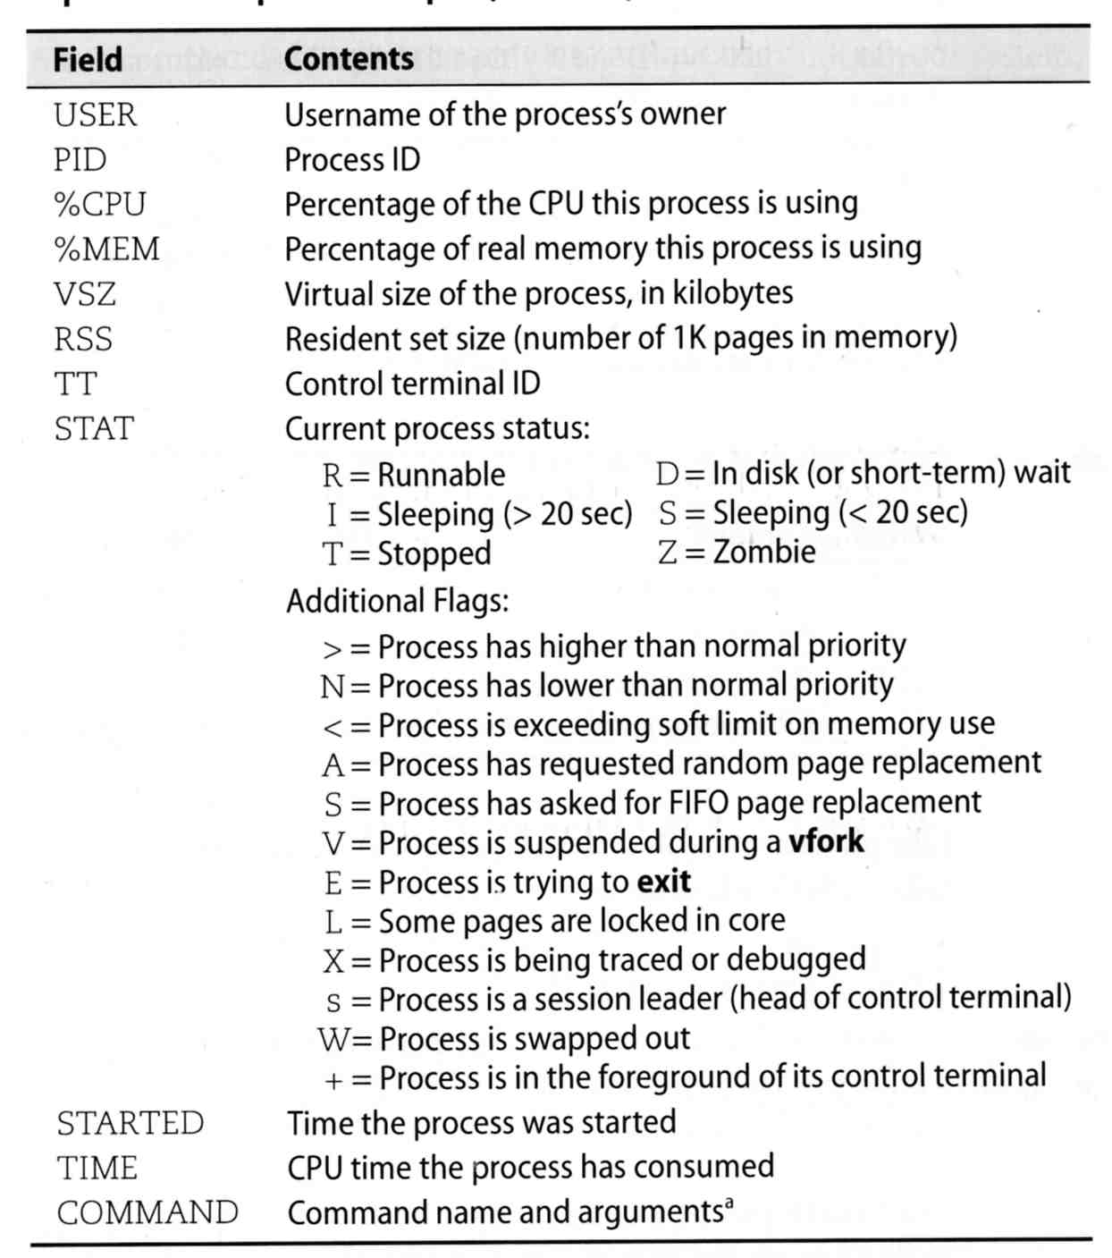
ps command –
Explanation of ps –aux (BSD、Linux)

Slide 22
ps command (BSD、Linux)
ps –j
ps –o
ps -L
tytsai@tybsd:~> ps -j
USER PID PPID PGID SESS JOBC STAT TT TIME COMMAND
tytsai 125 124 125 c2053500 0 Ss p0 0:00.06 -tcsh (tcsh)
tytsai 205 125 205 c2053500 1 R+ p0 0:00.00 ps -j
tytsai@tybsd:~> ps -o uid,pid,ppid,%cpu,%mem,command
UID PID PPID %CPU %MEM COMMAND
1001 125 124 0.0 0.2 -tcsh (tcsh)
1001 237 125 0.0 0.1 ps -o uid,pid,ppid,%cpu,%mem,command
tytsai@tybsd:~> ps -L
%cpu %mem acflag acflg blocked caught command cpu cputime f flags ignored inblk
inblock jobc ktrace ktracep lim login logname lstart majflt minflt msgrcv msgsnd
ni nice nivcsw nsignals nsigs nswap nvcsw nwchan oublk oublock p_ru paddr pagein
pcpu pending pgid pid pmem ppid pri re rgid rlink rss rssize rsz rtprio ruid
ruser sess sig sigcatch sigignore sigmask sl start stat state svgid svuid tdev
time tpgid tsess tsiz tt tty ucomm uid upr user usrpri vsize vsz wchan xstat

Slide 23
top command
last pid: 49993; load averages: 0.00, 0.01, 0.00 up 20+06:54:04 21:25:22
59 processes: 1 running, 58 sleeping
CPU states: 0.0% user, 0.0% nice, 0.0% system, 0.0% interrupt, 100% idle
Mem: 30M Active, 265M Inact, 153M Wired, 48K Cache, 199M Buf, 1562M Free
Swap: 1024M Total, 1024M Free
PID USERNAME PRI NICE SIZE RES STATE C TIME WCPU CPU COMMAND
201 mysql 2 0 36640K 16660K poll 0 4:45 0.00% 0.00% mysqld
129 root 2 0 596K 360K select 0 2:22 0.00% 0.00% natd
205 root 2 0 3164K 2492K select 0 0:38 0.00% 0.00% httpd
Various usage
  top –q run top and renice it to -20
  top –u don’t map uid to username
  top –Uusername show process owned by user
Interactive command
  o change display order
  u show only processes owned by user

Slide 24
Runaway process
Processes that use up excessive system resource or just go berserk
  kill –STOP for unknown process
  renice it to a higher nice value for reasonable process

