Slide 1
Chapter 5
The Filesystem

Slide 2
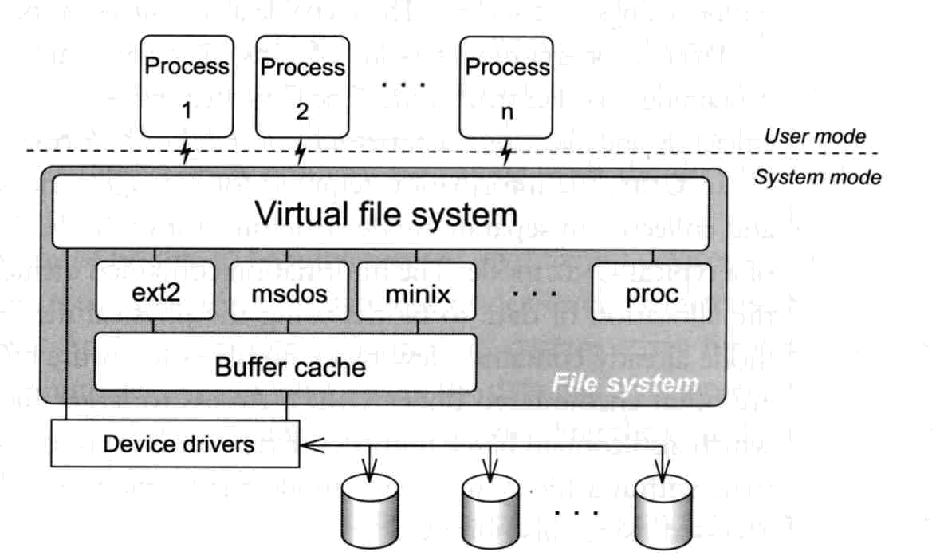
Application Kernel hardware
  Applications call system-calls to request service
  Kernel invokes corresponding drivers to fulfill this service

Slide 3
The basic purpose of filesystem
Represent and organize the system’s storage
  Four main components:
    Namespace
      A way of naming things and arranging them in a hierarchy
    API
      A set of system calls for navigating and manipulating nodes
    Security model
      A scheme for protecting, hiding and sharing things
    Implementation
      Code that ties the logical model to an actual disk

Slide 4

Take a ride of filesystem
What you can find in a filesystem:
  Files and directories
  Hardware device files
  Processes information
  Interprocess communication channel
  Shared memory segments
We can use common filesystem interface to access such “object”
  open、read、write、close、seek、ioctl…

Slide 5
pathname
Two kinds
  Absolute path ➔ start from /
    Such as /u/gcp/92/9217810/test/hehe.c
  Relative path ➔ start from your current directory
    Such as test/hehe.c
Pathname constrains
  Single component: ≦ 255 characters
  Single absolute path: ≦ 1023 characters

Slide 6
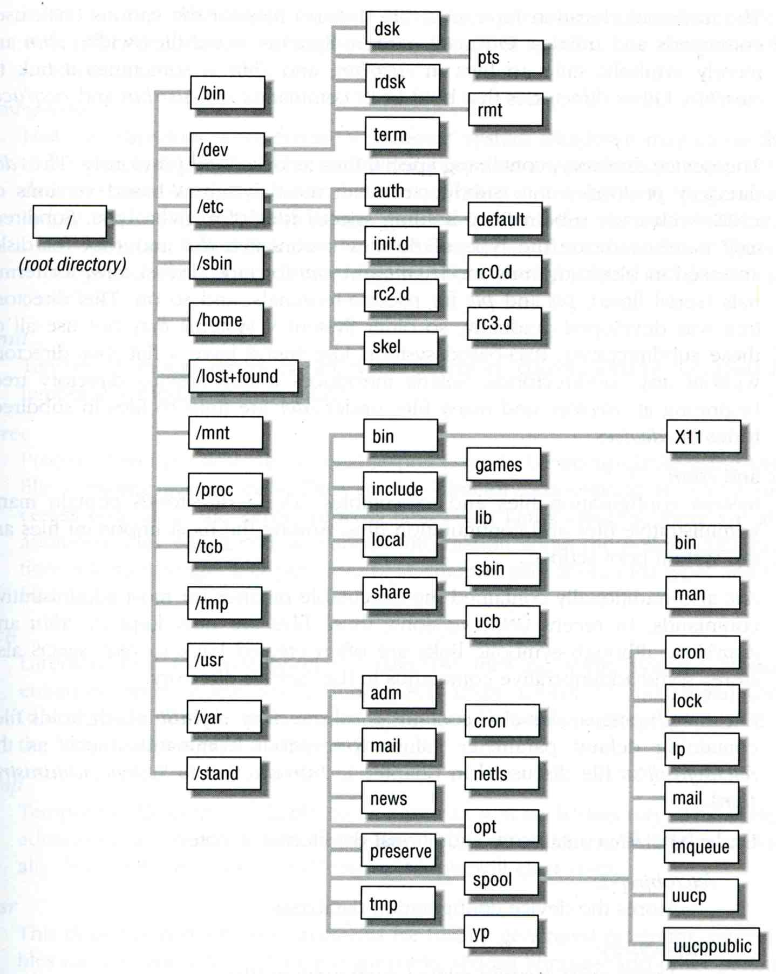
The organization of the file tree

Slide 7
The organization of the file tree – standard directories and their contents
pathname | Contents
/ | The root directory
/bin or /sbin | Commands needed for minimal system operability
/usr/bin | Executable files
/usr/local/bin | Local executable
/usr/local/sbin | Local system maintenance commands
/etc | Critical startup and configuration files
/usr/local/etc | Local system configuration files
/dev | Device entries for disks, terminals, modems, etc
/proc | Images of all running process
/usr/lib | Support libraries for standard UNIX programs
/usr/include | Libraries Header files
/var/log | Various system log files
/var/spool | Spooling directories for printers, mails, etc

Slide 8
Mounting file system
The filesystem in composed of chunks
  Most are disk partitions
  Network file servers
  Memory disk emulators
  Kernel components
  Etc,…
mount command
  Map the mount point of the existing file tree to the root of the newly attached filesystem
  % mount /dev/ad2s1e /home2
  The previous contents of the mount point become inaccessible

Slide 9
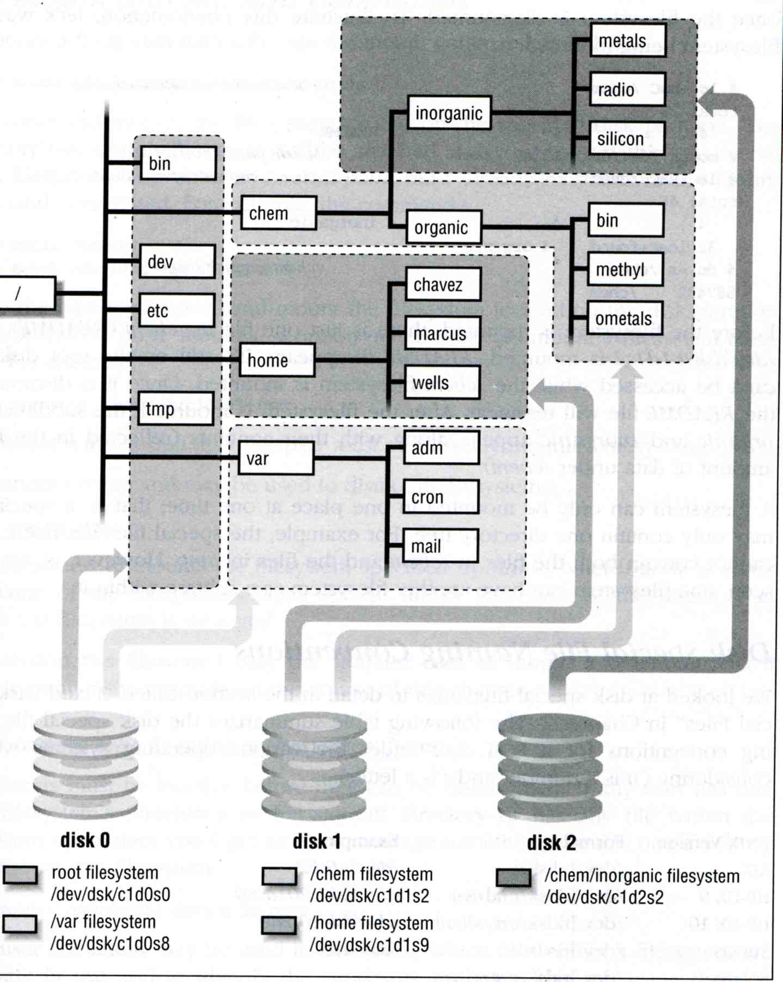
Example

Slide 10
fstab – filesystem table
Automatically mounted at boot time
  /etc/fstab
    Filesystem in this file will be checked and mounted automatically at boot time
ccbsd2’s /etc/fstab
# Device Mountpoint FStype Options Dump Pass#
/dev/ad0s1b none swap sw 0 0
/dev/ad0s1a / ufs rw 1 1
/dev/acd0c /cdrom cd9660 ro,noauto 0 0
proc /proc procfs rw 0 0
ccduty:/bsdhome /bsdhome nfs rw,noauto 0 0

Slide 11
Unmounting file system
umount command
  % umount node
    Ex: umount /home2
Busy filesystem
  Someone’s current directory is there or there is opened file
  Use “umount –f”
  We can use “lsof” or “fstat” like utilities to figure out who makes it busy

Slide 12
lsof, fuser and fstat commands
lsof (/usr/ports/sysutils/lsof)
fstat (FreeBSD)
tytsai@tybsd:~> lsof /home
COMMAND PID USER FD TYPE DEVICE SIZE/OFF NODE NAME
tcsh 125 tytsai cwd VDIR 116,196612 512 425600 /home/tytsai
ssh 292 tytsai cwd VDIR 116,196612 512 425600 /home/tytsai
tcsh 319 tytsai cwd VDIR 116,196612 512 425600 /home/tytsai
lsof 1259 tytsai cwd VDIR 116,196612 512 425600 /home/tytsai
lsof 1260 tytsai cwd VDIR 116,196612 512 425600 /home/tytsai
tytsai@tybsd:~> fstat -f /home
USER CMD PID FD MOUNT INUM MODE SZ|DV R/W
tytsai fstat 1249 wd /home 425600 drwxr-xr-x 512 r
tytsai tcsh 319 wd /home 425600 drwxr-xr-x 512 r
tytsai ssh 292 wd /home 425600 drwxr-xr-x 512 r
tytsai tcsh 125 wd /home 425600 drwxr-xr-x 512 r

Slide 13
Type of files
Regular files
Directories
  Include “.” and “..”
Character and Block device files
UNIX domain sockets
Named pipes
Symbolic links

Slide 14
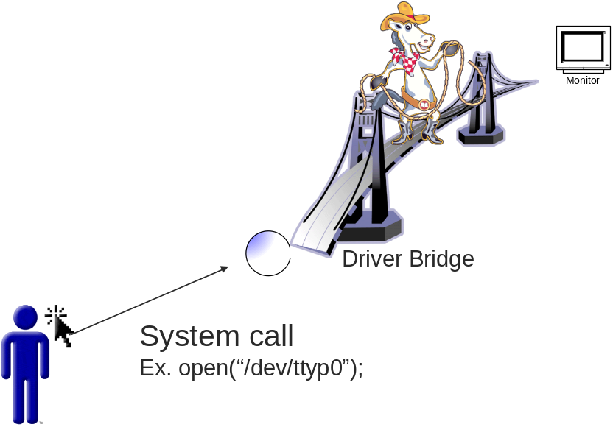
Type of files – character and block device files
Use “mknod” to build special file
  % mknod name [c|b] major minor
    The same major number will use the same driver
drivers
major | capabilities
1
2
…
5 | open,read,write,…
…
Major =5
Minor = 0

Slide 15
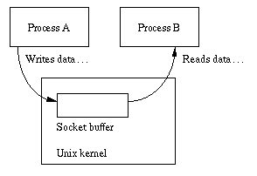
Type of files –
UNIX domain sockets
UNIX domain socket
  Created by socket()
  Local to a particular host
  Be referenced through a filesystem object rather than a network port

Slide 16
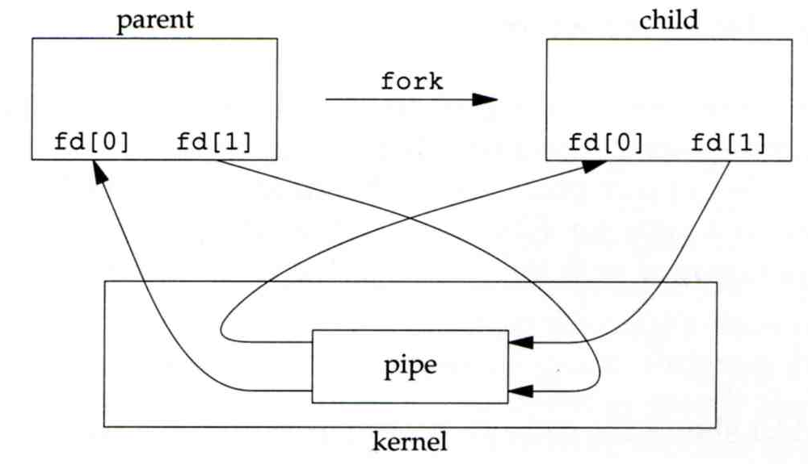
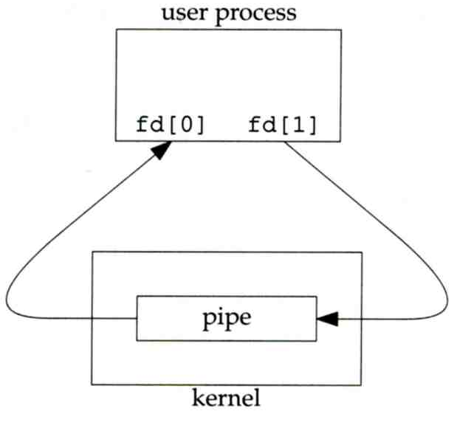
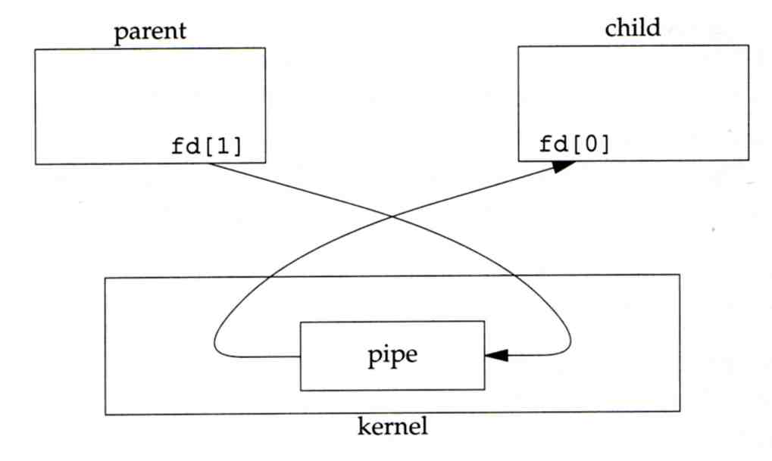
Type of files –
Named pipes
Let two processes do “FIFO” communication

Slide 17
Type of files – symbolic link (1)
Link
  Hard link
    associate two or more filenames with the same inode
    % ln ori-file hard-file
  Soft (symbolic) link
    A file which points to another pathname
    % ln –s ori-file soft-file

Slide 18
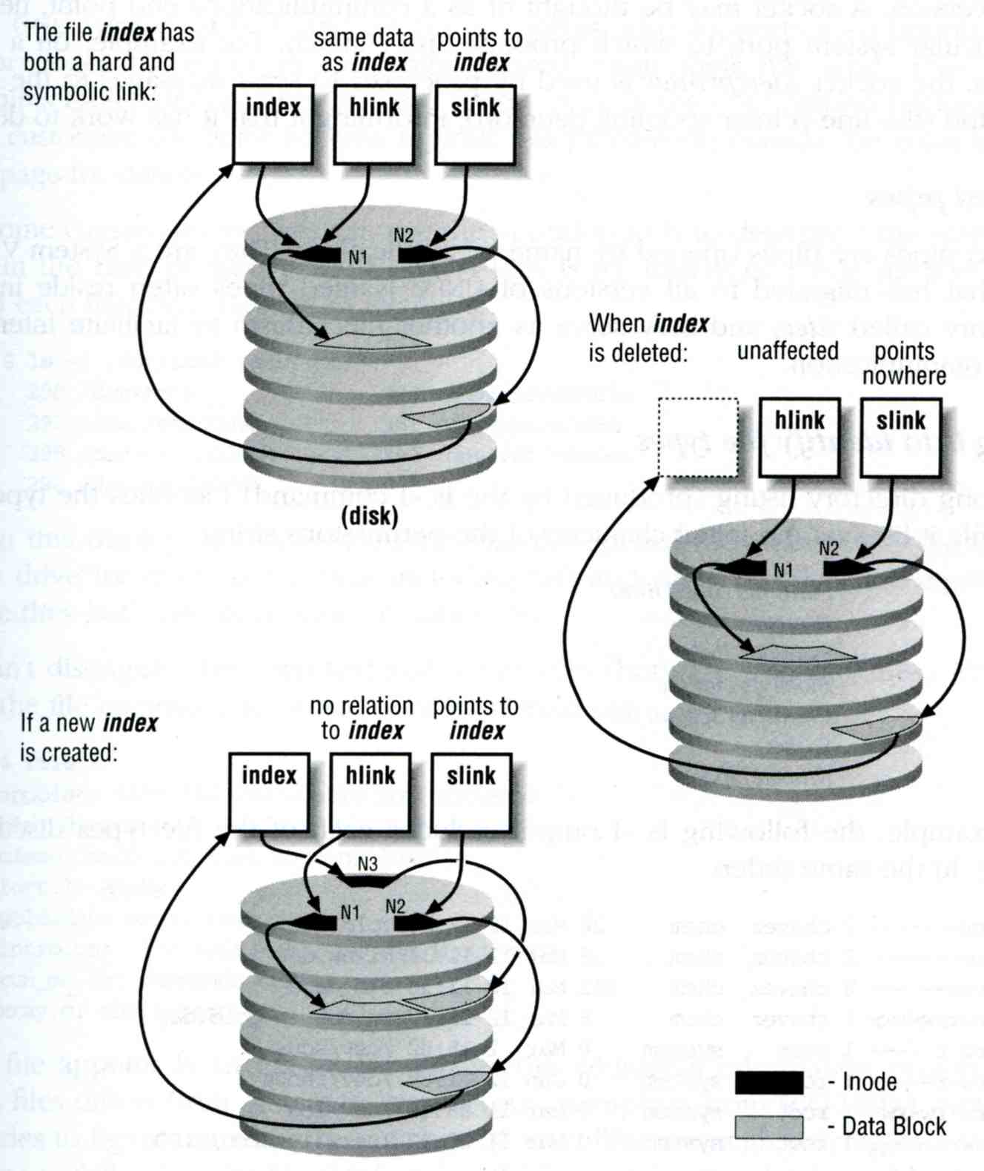
Type of files – symbolic link (2)
Ex:
  % touch index
  % ln index hlink
  % ln –s index slink

Slide 19
File type encoding used by ls
File type | Symbol | Created by | Removed by
Regular file | - | editors, cp, etc | rm
Directory | d | mkdir | rmdir
Character device file | c | mknod | rm
Block device file | b | mknod | rm
UNIX domain socket | s | socket(2) | rm
Named pipe | p | mknod | rm
Symbolic link | l | ln -s | rm
tytsai@tybsd:/var/run> ls -al
total 98
drwxr-xr-x 4 root wheel 512 Oct 4 08:50 ./
drwxr-xr-x 20 root wheel 512 Sep 18 22:37 ../
srw-rw-rw- 1 root wheel 0 Oct 4 08:50 log=

Slide 20
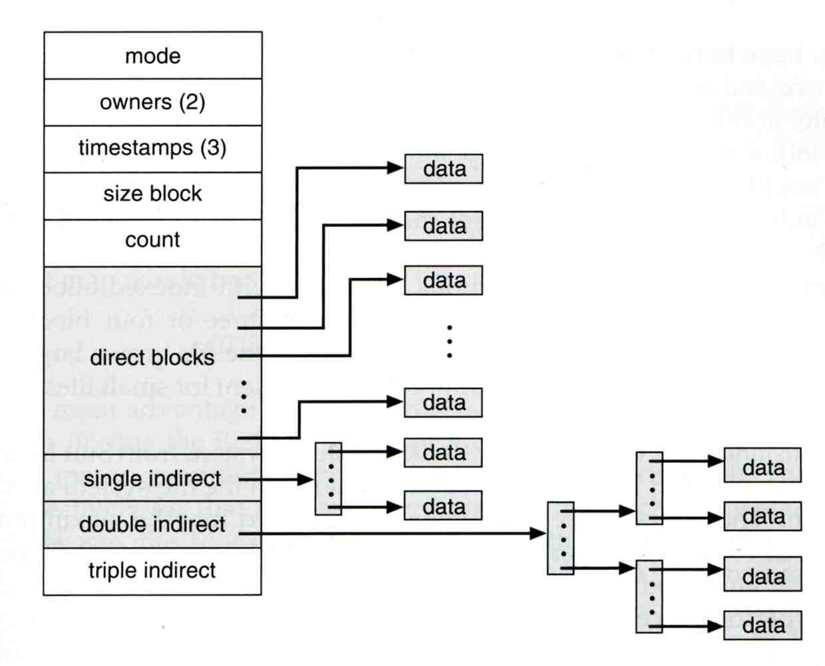
inode
A structure that records information of a file
  You can use “ls –il” to see each file’s inode number

Slide 21
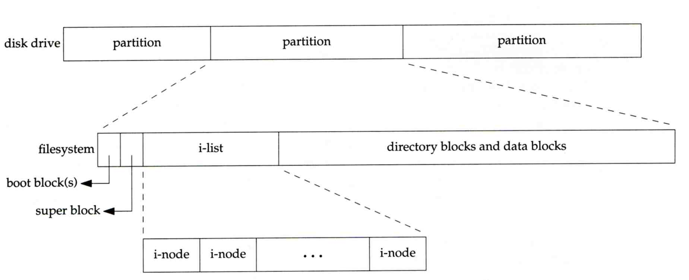
Disk, inode and file (1)
Filesystem
  Inode list
  Data block

Slide 22
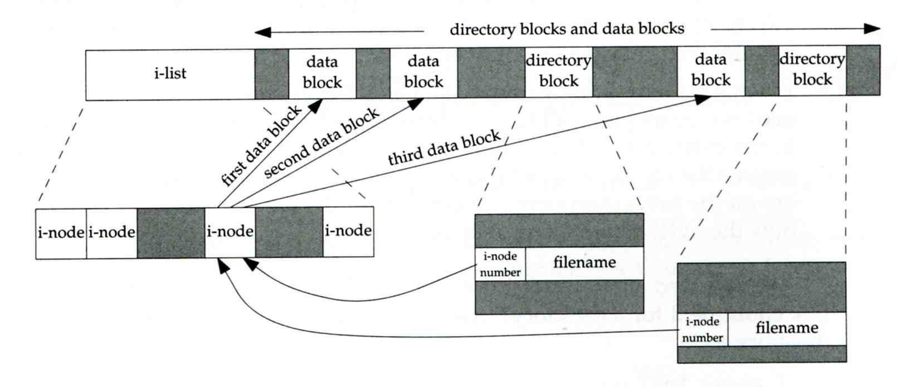
Disk, inode and file (2)
More detail of inode and data block

Slide 23
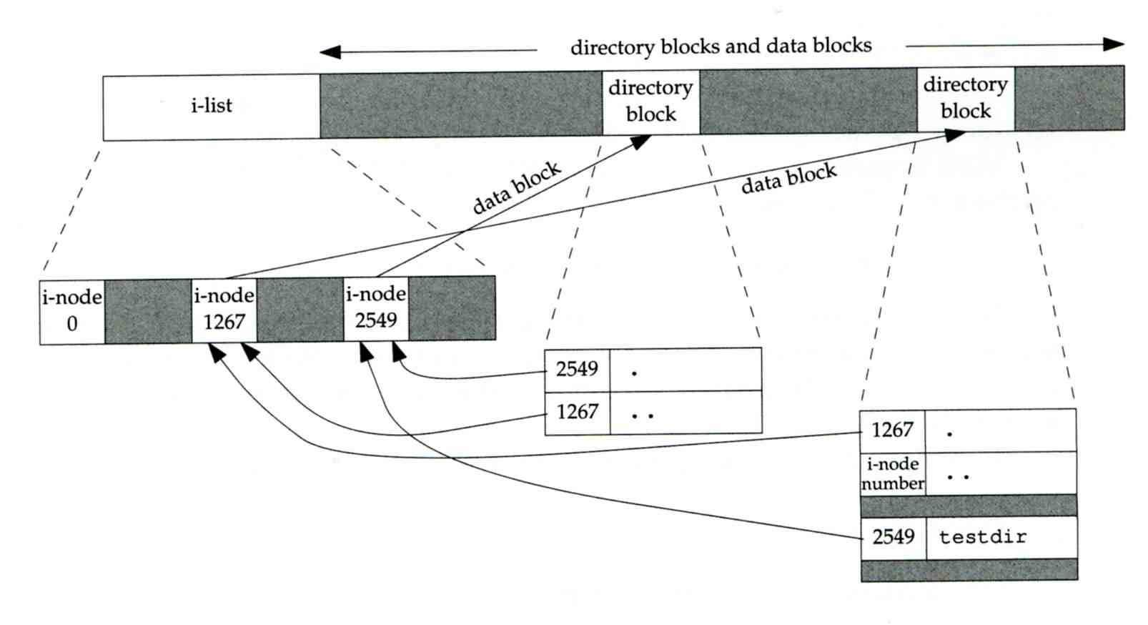
Disk, inode and file (3)
Example
  .
  ..
  testdir
/home/tytsai/testdir

Slide 24
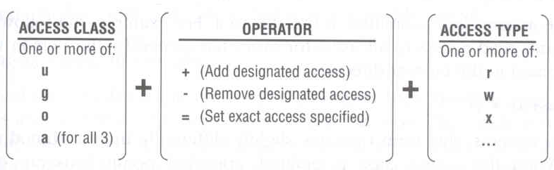
File Access Mode (1)
rwx r-x r-x
  User, group, other privileges
chmod command
  % chmod access-string file
    % chmod u+x test.sh
    % chmod go-w .tcshrc
    % chmod u+w,r-w hehe haha
    % chmod –R 755 public_html/

Slide 25
File Access Mode (2)
setuid, setgid, sticky bit
  setuid, setgid on file
    The effective uid/gid of resulting process will be set to the UID/GID of the file
    setuid
      passwd, chsh, crontab
    setgid
      top, fstat, write
  setgid on directory
    Cause newly created files within the directory to be the same group as directory
  sticky on directory
    Do not allow to delete or rename a file unless you are
      The owner of the file
      The owner of the directory
      root

Slide 26
File Access Mode (3)
Decimal argument of chmod
  setuid: 4000
  setgid: 2000
  stiky : 1000
Mode | Attribute | Mode | Attribute
755 | - rwx r-x r-x | 644 | - rw- r-- r--
4755 | - rws r-x r-x | 600 | - rw- --- ---
2755 | - rwx r-s r-x | 400 | - r-- r-- r--
2775 | d rwx rws r-x | 1777 | d rwx rwx rwt
755 | d rwx r-x r-x | 4555 | - r-s r-x r-x
750 | d rwx r-x --- | 711 | - rwx --x --x
700 | d rwx --- --- | 711 | d rwx --x --x

Slide 27
chown and chgrp
Change the file ownership and group ownership
  % chown –R tytsai /home/tytsai
  % chgrp –R csie /home/tytsai
  % chown –R tytsai:csie /home/tytsai

Slide 28
FreeBSD bonus flags
chflags command
  schg system immutable flag (root only)
  sunlnk system undeletable flag (root only)
  sappnd system append-only flag (root only)
  uappend user append-only flag (root, user)
  uunlnk user undeletable flag (root, user)
  …
/kernel
  ls –o
  chflags noschg /kernel ⬅ unlock
tytsai@tybsd:/> ls -lo /
-r-xr-xr-x 1 root wheel schg 2839142 Sep 20 14:04 kernel

