Slide 1
Chapter7
Serial Devices

Slide 2
Common serial device
Printer
Terminal
Modem

Slide 3
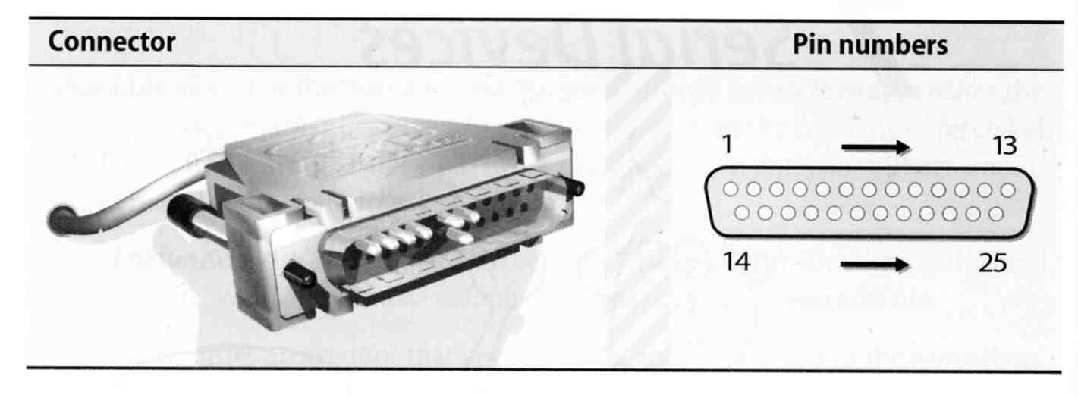
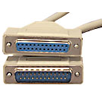
Serial standard (1)
RS-232 standard on DB25 connector
  Electrical characteristics
  Meaning of each signal wire
  Ping assignment
  DB25P (male)
  DB25S (female)

Slide 4
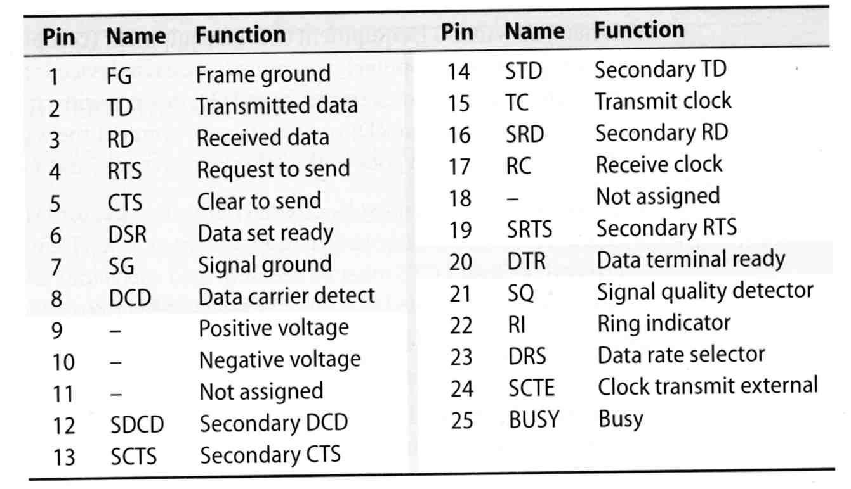
Serial standard (2)
RS-232 signals and ping assignment

Slide 5
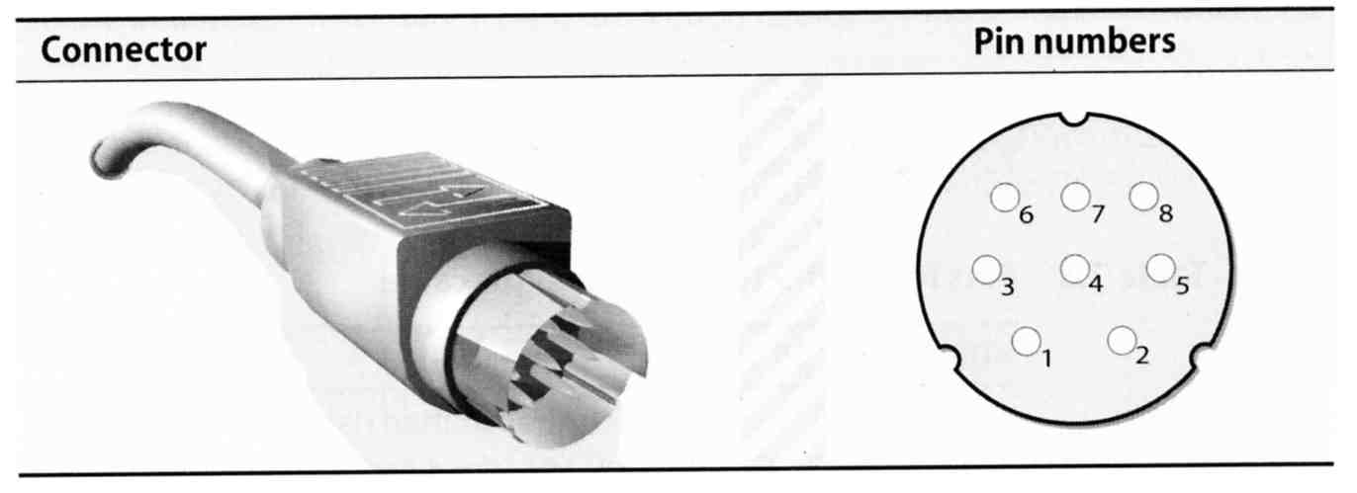
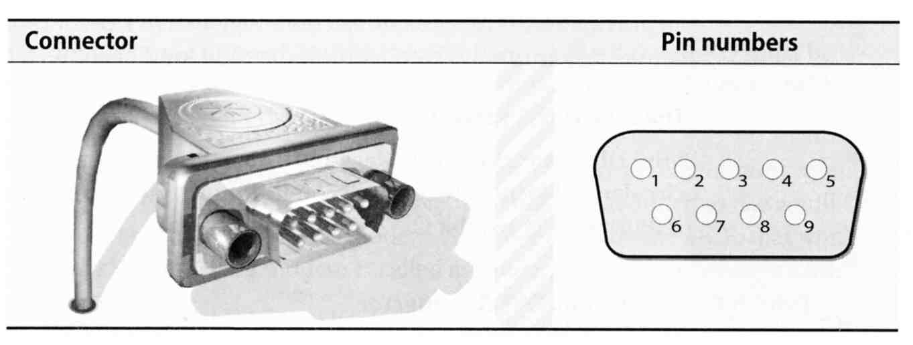
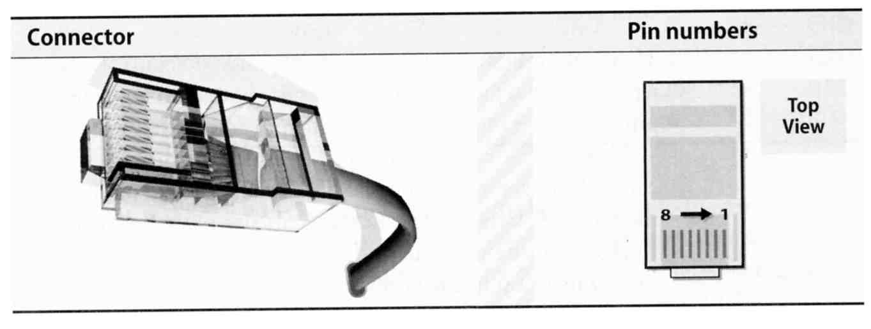
Serial standard (3)
Alternative connectors
  Since RS-232 is overkill for all real-world situation
    Mini DIN-8
    DB-9
    RJ-45

Slide 6
Serial standard (4)
Cable Length
  RS-232 specifies a maximum length of 75 feet at 9600 bps
    75 * 30.5 ≒ 22 m
  In reality, they hit the limit between 800 ~ 1000 feet

Slide 7
Serial Device File
Serial ports are represented by device files under /dev
The name of the device file is no big deal
  behavior is determined by the major and minor device number
System | Device files for the first two serial ports
FreeBSD | /dev/ttyd[0,1] (com1, com2)
Red Hat | /dev/ttyS[0,1]
Solaris | /dev/term[a,b]
SunOS | /dev/tty[a,b]
tytsai@tybsd:/dev> ls -al | grep ttyd
crw------- 1 root wheel 28, 0 Sep 19 20:14 ttyd0
crw------- 1 root wheel 28, 1 Sep 19 20:14 ttyd1
crw------- 1 root wheel 28, 2 Sep 19 20:14 ttyd2
crw------- 1 root wheel 28, 3 Sep 19 20:14 ttyd3

Slide 8
Kernel Configuration
dmesg
  /sbin/dmesg | grep sio
Kernel configuration file
  device sio0 at isa? port IO_COM1 irq 4
  device sio1 at isa? port IO_COM2 irq 3
sio0 at port 0x3f8-0x3ff irq 4 flags 0x10 on isa0
sio0: type 16550A
sio1 at port 0x2f8-0x2ff irq 3 on isa0
sio1: type 16550A

Slide 9
Software Configuration
Depend on the type of serial device
  Hardwired terminal
  Modem
  Printer
    Left to chapter23

Slide 10
Configuration of
Hardwired Terminals (1)
Two main tasks
  Make sure each process is attached to a terminal to accept logins
  Make sure that information about the terminal is available once a user login

Slide 11
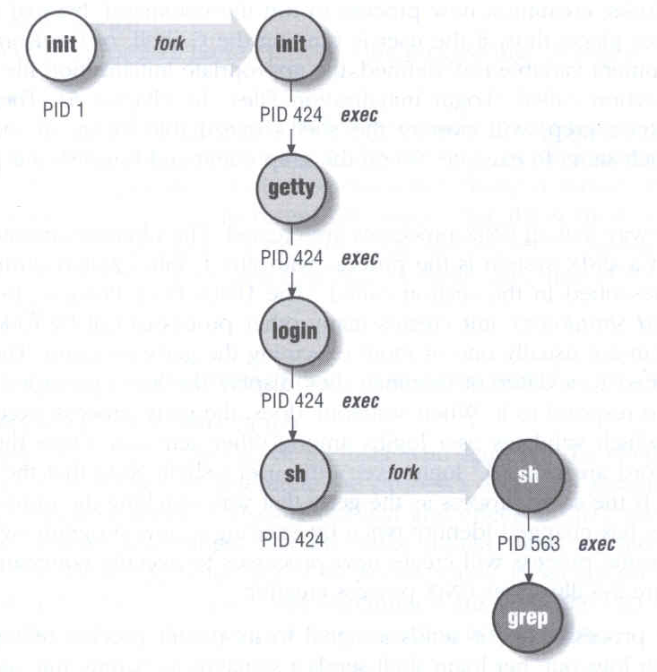
Configuration of
Hardwired Terminals (2)
The login process
  init spawn getty according to /etc/ttys
  getty sets the port’s initial characteristics and print the prompt
  User enter login name
  getty executes login program
  login request password
  login prints /etc/motd
  login sets up environment variables
  login runs a shell for user

Slide 12
Configuration of
Hardwired Terminals (3)
Terminal Configuration Files
  On/Off
    whether the terminal should be run a getty
  term type
    Virtual, network, dial-in
  Parameter
    Terminal parameters, such as speed
System | On/Off | Term Type | Parameters | Monitor
FreeBSD | /etc/ttys | /etc/ttys | /etc/gettytab | getty
Red Hat | /etc/inittab | /etc/ttytype | /etc/gettydefs | getty
SunOS | /etc/ttytab | /etc/ttytab | /etc/gettytab | getty
Solaris | _sactab | _sactab | zsmon/_pmtab | ttymon

Slide 13
Configuration of
Hardwired Terminals (4)
FreeBSD: /etc/ttys
  Format
  device program termtype {on|off} [secure]
  Restart init process
    kill -1 1
    kill –HUP 1
ttyv1 "/usr/libexec/getty Pc" cons25 on secure
ttyv2 "/usr/libexec/getty Pc" cons25 on secure
ttyd0 "/usr/libexec/getty std.9600" dialup off secure
ttyd1 "/usr/libexec/getty std.9600" dialup off secure
ttyp0 none network
ttyp1 none network

Slide 14
Configuration of
Hardwired Terminals (5)
FreeBSD: /etc/gettytab
  Associate symbolic names with port configuration information, such as speed, parity, prompt
  man gettytab
default:\
:cb:ce:ck:lc:fd#1000:im=\r\n%s/%m (%h) (%t)\r\n\r\n:sp#1200:\
:if=/etc/issue:
2|std.9600|9600-baud:\
:np:sp#9600:
P|Pc|Pc console:\
:ht:np:sp#115200:
Notes:
sp: line speed
np: no parity
ht: terminal has real tabs
cb: use crt backspace mode
ce: use crt erase algorithm
ck: use crt kill algorithm
lc: terminal has lower case
fd: form feed delay
im: login prompt
if: display named file before prompt

Slide 15
Special Characters and
The terminal driver
The terminal driver supports several special function when typing special keys
Name | Default | Function
Erase | ^H | Erases one character of input
WErase | ^W | Erases one word of input
Kill | ^U | Erases the entire line of input
EOF | ^D | Sends an “end of file” indication
INTR | ^C | Interrupts the currently running process
Quit | ^\ | Kills the current process with a core dump
Stop | ^S | Stops output to the screen
Start | ^Q | Restarts output to the screen
Discard | ^O | Throws away pending output
Suspend | ^Z | Suspends the current process
LNext | ^V | Interprets the next character literally

Slide 16
stty –
Set Terminal Options
Change and query various settings of the terminal drivers
  There are about a zillion options
  man tty(4) and stty(1)
Example
  stty intr "^C" kill "^U" erase "^H"
  stty –a
  reset tty
    reset
    stty sane
speed 38400 baud; 24 rows; 80 columns;
lflags: icanon isig iexten echo echoe -echok echoke -echonl echoctl
-echoprt -altwerase -noflsh -tostop -flusho pendin -nokerninfo
-extproc
iflags: -istrip icrnl -inlcr -igncr ixon -ixoff ixany imaxbel -ignbrk
brkint -inpck -ignpar -parmrk
oflags: opost onlcr -ocrnl -oxtabs -onocr -onlret
cflags: cread cs8 -parenb -parodd hupcl -clocal -cstopb -crtscts -dsrflow
-dtrflow -mdmbuf
cchars: discard = ^O; dsusp = ^Y; eof = ^D; eol = <undef>;
eol2 = <undef>; erase = ^?; erase2 = ^H; intr = ^C; kill = ^U;
lnext = ^V; min = 1; quit = ^\; reprint = ^R; start = ^Q;
status = ^T; stop = ^S; susp = ^Z; time = 0; werase = ^W;

Slide 17


Other Common I/O ports (1)
Parallel ports
  Similar to serial ports in concept, but parallel ports transfer 8 bits of data at once
  IEEE-1284 standard
  Male DB25 ←→ male Centronics connector
  Parallel device is rarely supported under UNIX
Female Centronics connector
Male Centronics connector

Slide 18
Other Common I/O ports (2)
USB – Universal Serial Bus
  Up to 127 devices can be connected
  Standardized connectors
  Devices can be connected and disconnected without powering down
  Up to 12Mb/s
USB 2.0
  Up to 480Mb/s

