Slide 1
Chapter 9
Periodic Processes

Slide 2
CRON – Schedule Commands (1)
What we want?
  Do things at right time automatically
cron daemon
  The daemon that handles periodic execution
  cron daemon reads configuration file and executes commands on time

Slide 3
CRON – Schedule Commands (2)
cron configuration file
  crontab – cron table
  Every user can have at most one crontab file and this file will be named the user’s login ID
  All crontab files will be in the same directory
  /etc/crontab
    System crontab
System | Cron Dir
FreeBSD | /var/cron/tabs
Red Hat | /var/spool/cron
Solaris | /var/spool/cron/crontabs
SunOS | /var/spool/cron/crontabs

Slide 4
CRON – Schedule Commands (3)
crontab file format
  minute hour day month weekday command
  * matches everything
  Single character matches exactly
  Dash matches range
  Comma matches any listed value
Field | Description | Range
minute | Minute of the hour | 0 ~ 59
hour | Hour of the day | 0 ~ 23
day | Day of the month | 1 ~ 31
month | Month of the year | 1 ~ 12
weekday | Day of the week | 0 ~ 6 (0 = Sunday)

Slide 5
CRON – Schedule Commands (4)
crontab time format example
  45 10 * * 1-5 ➔ AM 10:45, from Mon. to Fri.
  10 * * * * ➔ On 10 minutes of each hour
  */3 * * * * ➔ Every three minutes
  30 15 5 * * ➔ PM 3:30 of each 5-th day
  0 0 14 2 * ➔ On the Midnight of Valentine’s day
  5 0-6 * * *
  0,30 * 13 * 5 ➔ every half-hour on Fri. and every
  half-hour on the 13-th day
crontab example
  20 1 * * * find /tmp –atime +3 –exec rm –f {} ‘;’
  55 23 * * 0-3,6 /home/tytsai/virus-check.sh

Slide 6
crontab command
% crontab –e [-u user]
  Edit the [user’s] crontab using editor
% crontab –l
  List the content of the crontab
% crontab –r
  Remove the current crontab
% crontab filename
  Install filename as your crontab

Slide 7
crontab management
Allow or deny
  By default, all users can have their own crontab
  allow file
    A list of users that may use crontab, any other not in the list can not use it
  deny file
    Reverse meaning
log
System | Allow or deny file | Log file
FreeBSD | /var/cron/{allow,deny} | By syslogd
Red Hat | /etc/{cron.allow,cron.deny} | /var/log/cron
Solaris | /etc/cron.d/{cron.allow,cron.deny} | /var/cron/log
SunOS | /var/spool/cron/{cron.allow,cron.deny} | By syslogd

Slide 8
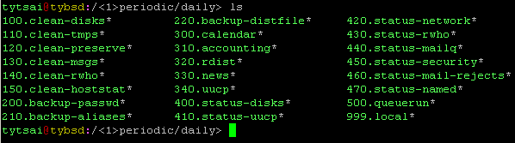
/etc/crontab
1 3 * * * root periodic daily
15 4 * * 6 root periodic weekly
30 5 1 * * root periodic monthly
periodic command
  [Synopsis] periodic directory …
  Run periodic system function under /etc/periodic

