Slide 1
Shell and Shell Programming

Slide 2
The UNIX Shells
Shell | Originator | System Name | Prompt
Bourne | S. R. Bourne | /bin/sh | $
Korn | David Korn | /usr/local/ksh93 | $
C | Bill Joy | /bin/csh | %

Slide 3
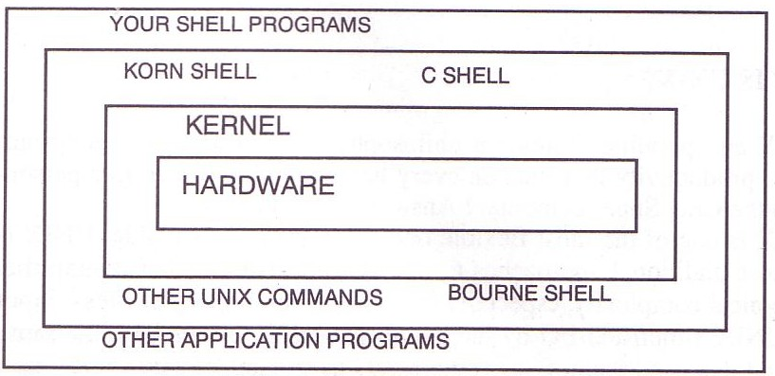
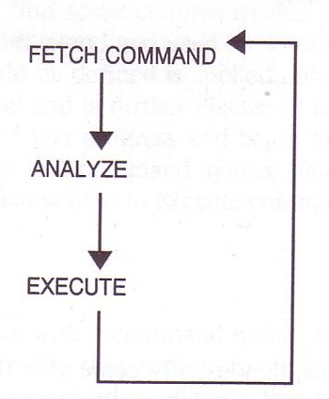
UNIX Kernel and shell
interpret

Slide 4
Shell Program (1)
A collection of commands
Ex:
#!/bin/sh
ls -al
touch aa
cp aa bb

Slide 5
Shell Program (2)
What you have to learn?
  Some magic in UNIX environment
  UNIX commands
  Shell program structure

Slide 6
Startup files
sh
  /etc/profile login shell, system wide
csh
  /etc/csh.cshrc always, system wide
  /etc/csh.login login shell, system wide
  /etc/csh.logout logout shell, system wide
  ~/.cshrc always
  ~/.login login shell
  ~/.logout logout shell
tcsh
  ~/.tcshrc login shell
bash
  /etc/profile →
~/.bash_profile
~/.bash_login
~/.profile

Slide 7
Shell Special Characters (1)
Reduce typing as much as possible
Characters | Description
* | Match any string of characters
? | Match any single alphanumeric character
[…] | Match any single character within []
[!...] | Match any single character not in []
~ | Home directory
Example
  test1 test2 test3 test4 test-5 testmess
Command | Result
% ls test* | test1 test2 test3 test4 test-5 testmess
% ls test? | test1 test2 test3 test4
% ls test[123] | test1 test2 test3
% ls ~ | List files under your home

Slide 8
Shell Special Characters (2)
Char. | Purpose | Example
# | Start a shell comment | # this is a comment
; | Command separator | % ls test*; ls test?
\ | Escape character Command continuation indicator | % touch test\*; ls test\* % ls \ > test*
& | Background execution | % make buildworld &

Slide 9

Shell Special Characters (3)
Char. | Purpose
${var} | Shell variable
`cmd` | Substitution stdout
‘string’ | Quote character without substitution
“string” | Quote character with substitution
  % varname=`/bin/date`
  % echo $varname
  % echo ‘Now is $varname’
  % echo “Now is $varname”
      Mon Oct 11 13:24:29 CST 2004
      Now is $varname
      Now is Mon Oct 11 13:24:29 CST 2004
  % setenv varname2 `/bin/date`
  % echo $varname2
  % echo ‘Now is $varname2’
  % echo “Now is $varname2”

Slide 10
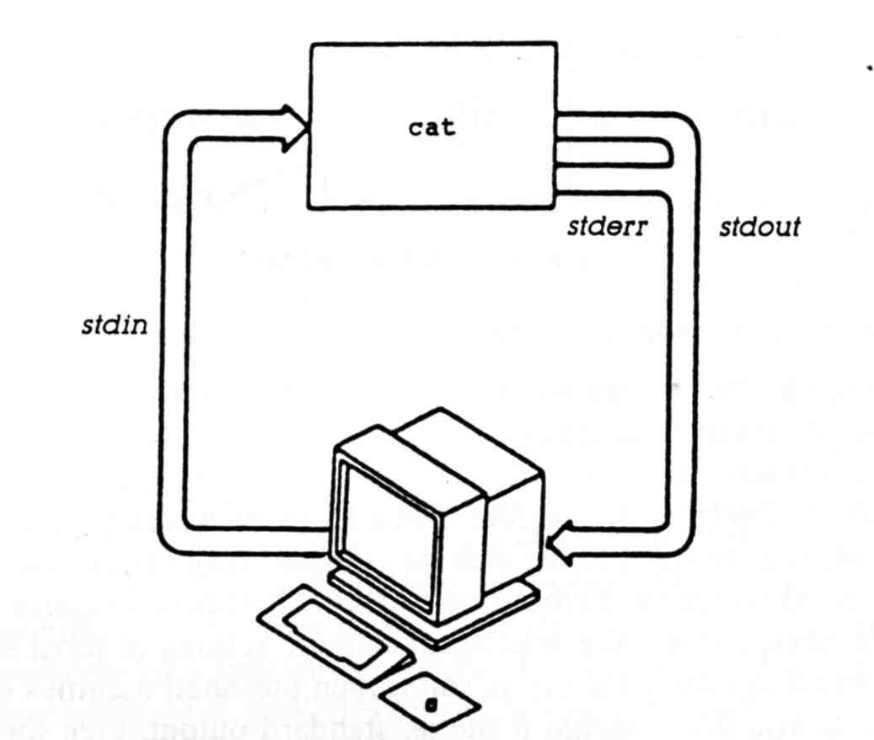
Input/Output Redirection (1)
Every process has 3 default file descriptors
Name | I/O | Descriptor #
stdin | input | 0
stdout | output | 1
stderr | error output | 2
User-defined | Input/output | 3 ~ 19
In normal situation
  The terminal will be stdout and stderr
  The keyboard will be stdin

Slide 11
Input/Output Redirection (2)
Redirection
  Change the direction of stdin, stdout, stderr or any other user-defined file descriptor
    Create files
    Append to files
    Use existing files as input
    Merge two output streams
    Use part of the Shell command as input

Slide 12
Input/Output Redirection (3)
Operator | Description
< | Open the following file as stdin
> | Open the following file as stdout
>> | Append to the following file
<<del | Take stdin from here, up to the delimiter del
>& | Merge stdout with stderr
>>& | Append stdout to stderr
| | Pipe stdout into stdin
n>&- | Close file descriptor

Slide 13
Input/Output Redirection (4)
Example
  % echo "we have several shell > chapter1
  % sed –e "s/shell/SHELL/g" < chapter1
    we have several SHELL
  % sed –e "s/SHELL/shell/g" < chapter1 > newchapter1
    stdout goes to newchapter1 file
    stderr still goes to terminal
  % sed –e "s/SHELL/shell/g" < chapter1 > newchapter1 2> errchapter
    stdout goes to newchapter1 and stderr goes to errchapter
  % sed –e "s/SHELL/shell/g" < chapter1 2>&1
    Both stdout and stderr go to terminal
  % sed –e "s/SHELL/shell/g" < chapter1 > newchapter1 2>&1
    Both stdout and stderr go to newchapter1
  % sed –e "s/SHELL/shell/g" < chapter1 >& newchapter1

Slide 14
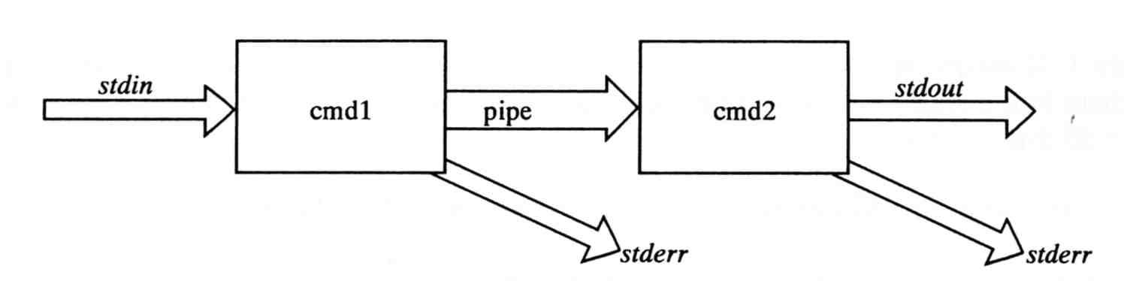
Input/Output Redirection (5)
pipe
  Connect the stdout of one command to the stdin of another
  Two commands will operate asynchronously
Example
  % dmesg | grep CPU | less
  % command arguments 2>&1 | nextcommand
  % command arguments |& nextcommand
    Merge stderr with stdout and pipe to next command

Slide 15
Input/Output Redirection (6)
  % exec 4>&- # close file descriptor 4
  % exec 1>&- # close stdin

Slide 16
Regular Expression (1)
Informal definition
  Basis:
    A single character “a” is a R.E.
  Hypothesis
    If r and s are R.E.
  Inductive
    Union: r + s is R.E
      Ex: a + b
    Concatenation: rs is R.E.
      Ex: ab
    Kleene closure: r* is R.E.
      Ex: a*
Example:
  (1+2+3+4+5+6+7+8+9) (1+2+3+4+5+6+7+8+9)*
  Letter: (A + B + C + … + Z + a + b + c + … + z)
  Digit: (0 + 1 + 2 + 3 + 4 + 5 + 6 + 7 + 8 + 9 + 0)

Slide 17
Regular Expression (2)
Pattern-matching
  Contain letters, number and special operators
operator | Description
. | Match any single character
[] | Match any character found in []
[^] | Match any character not found in []
^ | Match following R.E. only if occurs at start of a line
$ | Match following R.E. only if occurs at end of a line
* | Match zero or more occurrence of preceding R.E.
\{m,n\} \{m,\} \{m\} | Number of times of preceding R.E. At least m times and at most n times
\ | Escape character

Slide 18
Regular Expression (3)
Example:
  r.n
    Any 3-character string that start with r and end with n
      r1n, rxn, r&n will match
      r1xn, axn will not match
  ..Z..
    Any 5-character strings that have Z as 3rd character
      aeZoo, 12Zos will match
      aeooZ, aeZooa will not match
  r[a-z]n
    Any 3-character strings that start with r and end with n and the 2nd character is a alphabet
      rxn will match
      r1n, r&n will not match
  [A-Za-z][0-9]
    Any 2-character strings that 1st character is a alphabet and 2nd is a number
      A2 will match
      2c, 22, A2A will not match

Slide 19
Regular Expression (4)
  ^Windy
    Any string starts with Windy
      Windy is great ➔ match
      My Windy is great ➔ not match
  ^..Z..
    Any string ..Z.. and ..Z.. starts in a line
  [E,e][N,n][D,d]$
    Any string ends with any combination of “end”
  ^$
    Match blank line
  ZA*P
    “A” can be appeared 0 or more times
      ZP, ZAP, ZAAP, …
  ZAA*P
      ZAP, ZAAP, …
  [A-Za-z] [A-Za-z]*
    String of characters
  [+\-][0-9] [0-9]*
    Integer with a preceding + or -

Slide 20
Regular Expression (5)
  [+\-]\{0,1\}[0-9][0-9]*
    Match any legal integer expression
  [+\-]\{0,1\}[0-9][0-9]*\.\{0,1\} [0-9][0-9]*
    Match any real or integer decimal
  [A-Z]\{2\}Z[0-9]\{2\}
    Two capital characters followed by Z followed by two numbers

Slide 21
Commands –
File and Directory Related
Command | Purpose
cd | Change directory
ls | List a directory’s content
pwd | Print working directory
mkdir | Make a new directory
rmdir | Remove existing directory
cat | Concatenate file
cp | Copy file
ln | Link two names to one file
mv | Move file
rm | Remove file
split | Split a file into n line chunks

Slide 22
Commands –
Select and file processing Related (1)
Command | Purpose
awk | Pattern scanning and processing language
cut | Select columns
diff | Compare and select difference in two files
grep | Select lines
head | Display first lines of a file
sed | Edit streams of data
tail | Select trailing lines
uniq | Select uniq lines
wc | Count characters, words or lines of a file
join | Join two files, matching row by row
sort | Sort and merge multiple files together
tr | Transform character

Slide 23
Commands –
Select and file processing Related (2)
Example usage:
  Look first few lines or last few lines
    % head /var/log/message
    % tail /var/log/message
  Find the occurrence of certain pattern in file
    % grep –l tytsai *
      Print the filename that has “tytsai” as content
  Print the line number when using grep
    % grep –n tytsai /etc/passwd
  Ignore case-sensitive
    % grep -i tytsai /etc/passwd
      List any line contains any combination of “tytsai”
    % ps auxww | grep ^tytsai | wc –l
      Count number of processes owned by tytsai

Slide 24
Commands –
Select and file processing Related (3)
  List tytsai’s id, uid, home, shell in /etc/passwd
    % grep tytsai /etc/passwd | cut –f1,3,6,7 –d:
      tytsai:1001:/home/tytsai:/bin/tcsh
  Cut out file permission and file name from ls output
    % ls -l | grep –v ^total | cut -c1-12 -c45-
      drwxr-xr-x GNUstep/
      drwx------ Mail/
      drwx------ News/

Slide 25
Commands –
Select and file processing Related (4)
  Use awk to generate the same behavior of cut
    % awk –F: ‘{print $1 “ “ $6}’ /etc/passwd
      nobody /nonexistent
      tytsai /home/tytsai

Slide 26
Commands –
Select and file processing Related (5)
  Sort
    % ls –al | sort +4 -5 –r
      List directory contents and sort by file size decreasingly
    % sort –t: +0 -1 /etc/passwd | grep –v ^#
      List records in /etc/passwd increasingly by id
  Translate characters
    % tr “[A-Z]” “[a-z]” < file1 > file2
    % grep tytsai /etc/passwd | tr "[:]" "[\n]“
    % tr –d “[\t]” < file1
      Delete tab in file1
    % tr –s “[ ]” “[ ]” < file1
      Delete multiple space in file1

Slide 27
Built-in Shell Commands (1)
sh | csh | description
 | alias/unalias | command alias
ulimit | limit/unlimit | limit job’s resource usage
cd | cd | change directory
echo | echo | write arguments on stdout
eval |  | evaluate and execute arguments
exec | exec | execute arguments
exit | exit | exit shell

Slide 28
Built-in Shell Commands (2)
sh | csh | description
 | goto | Goto label within shell program
 | history | Display history list
jobs | jobs | List active jobs
%[job no.] | %[job no.] | Bring a process to foreground
kill | kill | Send a signal to a job
fg, bg | fg, bg | Bring a process to foreground/background
 | stop | Stop a background process
 | suspend | Suspend the shell
login | login, logout | Login/logout

Slide 29
Built-in Shell Commands (3)
sh | csh | description
set/unset |  | Set/Unset shell’s parameters
 | set/unset | Set/Unset a local variable
export | setenv/unsetenv | Set/Unset a global variable
 | nice | Change nice value
 | nohup | Ignore hangups
 | notify | Notify user when jobs status changes
trap | onintr | Manage execution signals
 | dirs | print directory stack
 | popd, pushd | Pop/push directory stack

Slide 30
Built-in Shell Commands (4)
sh | csh | description
hash | rehash | Evaluate the internal hash table of the contents of directories
read |  | Read a line from stdin
shift | shift | Shift shell parameters
. | source | Read and execute a file
times | time | Display execution time
umask | umask | Set default file permission
test |  | Evaluation conditional expressions
expr | @ | Display or set shell variables
wait | wait | Wait for background jobs to finish

Slide 31
Built-in Shell Commands (5)
  http://www.unet.univie.ac.at/aix/aixuser/usrosdev/list_bourne_builtin_cmds.htm
  http://www.europa.idv.tw/UNIX-Shell/csh/V2-01-09.html
  http://www.unix.org.ua/orelly/unix/unixnut/ch04_06.htm
  http://publib.boulder.ibm.com/infocenter/pseries/index.jsp?topic=/com.ibm.aix.doc/aixuser/usrosdev/list_c_builtin_cmds.htm

Slide 32
Shell Programming

Slide 33
Shell variables (1)
Assignment
  Example:
    $ export PAGER=/usr/bin/less
    % setenv PAGER /usr/bin/less
    $ current_month=`date +%m`
    % set current_month =`date +%m`
 | Bourne Shell | C Shell
Local variable | my=test | set my=test
Global variable | export my | setenv my test
Notes:
Assignment 左右不能有空白

Slide 34
Shell variables (2)
Access
    % echo “$PAGER”
    % echo “${PAGER}”
  Use {} to avoid ambiguous
    % temp_name=“haha”
    % temp=“hehe”
    % echo $temp
      hehe
    % echo $temp_name
      haha
    % echo ${temp}_name
      hehe_name
    % echo ${temp_name}
      haha

Slide 35
Shell variable operator (1)
BadCond : var is not set or the value is null
GoodCond : var is set and is not null
operator | description
${var:=value} | If BadCond, assign value to var
${var:+value} | If GoodCond, use value instead else null value is used but not assign to var
${var:-value} | If !GoodCond, use the value but not assign to var
${var:?value} | If !GoodCond, print value and shell exists

Slide 36
Shell variable operator (2)
Ex:
#!/bin/sh
var1="haha"
echo ${var1:+"hehe"}
echo ${var1}
echo ${var2:-"wow"}
echo ${var2="what"}
echo ${var2}
Results:
hehe
haha
wow
what
what

Slide 37
Shell variable operator (3)
operator | description
${#var} | String length
${var#pattern} | Remove the smallest prefix
${var##pattern} | Remove the largest prefix
${var%pattern} | Remove the smallest suffix
${var%%pattern} | Remove the largest suffix
#!/bin/sh
var="Nothing happened end closing end"
echo ${#var}
echo ${var#*ing}
echo ${var##*ing}
echo ${var%end*}
echo ${var%%end*}
Results:
32
happened end closing end
end
Nothing happened end closing
Nothing happened

Slide 38
Predefined shell variables (1)
sh | csh | description
HOME | home | User’s home
MAIL | MAIL | User’s mail file
PATH | PATH | Search path
PS1 | prompt | Primary prompt string
PS2 |  | Secondary prompt string
IFS |  | Internal field separators
 | history | Number of history commands

Slide 39
Predefined shell variables (2)
sh | csh | description
$# | $# | Number of positional arguments
$0 | $0 | Command name
$1, $2, .. | $1, $2, .. $argv[n] | Positional arguments
$* | $*, $argv[*] | List of positional arguments (useful in for loop)
$? | $? | Return code from last command
$$ | $$ | Process number of current command
$! | $! | Process number of last background command

Slide 40
test command (1)
test command can test
  File
  String
  Number
Test and return 0 (true) or 1 (false) in $?
  % test –e News ; echo $?
    If there exist the file named “News”
  % test "haha" = "hehe" ; echo $?
    Whether “haha” equal “hehe”
  % test 10 -eq 11 ; echo $?
    Whether 10 equal 11

Slide 41
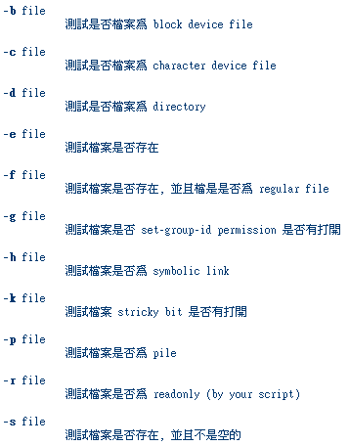
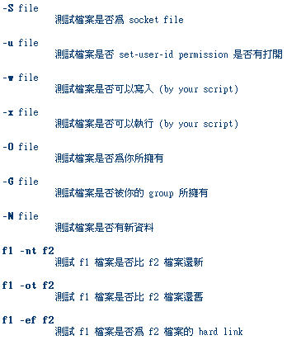
Test command –
File test

Slide 42
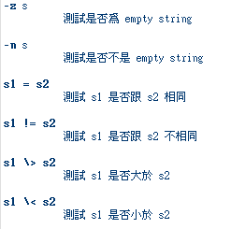
Test command –
String test
Example
  % test "haha" \> "hehe"; echo $?
    1

Slide 43
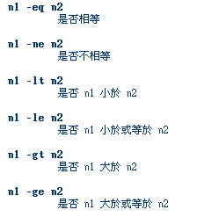
Test command –
Number test
Example
  % test 10 –gt 10 ; echo $?
    1
  % test 10 –ge 10 ; echo $?
    0

Slide 44
test command (2)
test command short format using [] or ()
  % test "haha" = "hehe" ; echo $?
if test “haha” = “hehe” ; then
echo “haha equals hehe”
else
echo “haha do not equal hehe”
fi
if [ “haha” = “hehe” ] ; then
echo “haha equals hehe”
else
echo “haha doesn’t equal hehe”
fi
if ( “haha” == “hehe” ) then
echo “haha equals hehe”
else
echo “haha doesn’t equal hehe”
endif

Slide 45
expr command (1)
Evaluate arguments and return 0 (true) or 1 (false) in $?
  % a=10
  % a=`expr $a + 10` ; echo $a
  % set a=10
  % set a=`expr $a + 10`; echo $a
  % @ a = $a + 10 ; echo $a

Slide 46
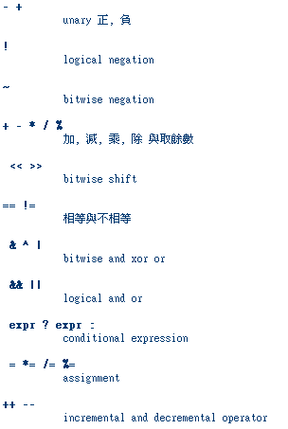
expr command (2)
Example
  % a=10
  % a=`expr $a \*2`; echo $a
  % a=5
  % b=5
  % cc=`expr $a = = $b`

Slide 47
if-then-else structure
if [test conditions] ; then
command-list
else
command-list
fi
if ( test conditions ) then
command-list
else
command-list
endif
#!/bin/sh
a=10
b=12
if [ $a != $b ] ; then
echo "$a not equal $b"
fi
#!/bin/tcsh
set a=10
set b=12
if ( $a != $b ) then
echo "$a not equal $b"
endif

Slide 48
switch-case structure (1)
switch ( $var )
case value1:
action1
breaksw
case value2:
action2
breaksw
case value3:
case value4:
action3
breaksw
default:
default-action
breaksw
endsw
case $var in
value1)
action1
;;
value2)
action2
;;
value3|value4)
action3
;;
*)
default-action
;;
esac

Slide 49
switch-case structure (2)
example
case $# in
0)
echo “Enter file name:”
read argument1
;;
1)
argument1=$1
;;
*)
echo “[Usage] comm file”
esac
switch ($#)
case 0:
echo “Enter file name:”
read argument1
breaksw
case 1:
argument=$1
breaksw
default:
echo “[Usage] comm file”
endsw

Slide 50
For loop
for var in var1 var2 …
do
action
done
foreach var (var1 var2 …)
action
end
for dir in bin doc src
do
cd $dir
for file in *
do
echo $file
done
cd ..
done
foreach dir ( bin doc src )
cd $dir
foreach file ( * )
echo $file
end
cd ..
end

Slide 51
While loop
while […]
do
action
done
while (…)
action
end
month=1
while [ ${month} –le 12 ]
do
echo $month
month=`expr $month + 1`
done
set month=1
while ( ${month} < 12 )
echo $month
@ month += 1
end

Slide 52
Read from input
#!/bin/sh
echo "hello! How are you ?“
read line
if [ "$line" = "fine, thank you" ] ; then
echo "right answer"
else
echo "wrong answer, pig head"
fi
#!/bin/tcsh
echo "hello! How are you ?"
set line=$<
if ( "$line" == "fine, thank you" ) then
echo "right answer"
else
echo "wrong answer, pig head"
endif

Slide 53
Read from file
#!/bin/sh
exec 3< "file"
while read line <&3 ; do
echo "$line"
done
#!/bin/tcsh
set lc=1
while ( 1 )
set line=`sed -n $lc,${lc}p "file"`
if ( "$line" == "" ) then
break
endif
echo $line
@ lc ++
end

Slide 54
Shell functions (1)
Define function
  function_name ( ) {
  command_list
  }
Removing function definition
  unset function_name
Function execution
  function_name
Function definition is local to the current shell
dir ( ) {
ls –l | less
}

Slide 55
Shell functions (2)
example
#!/bin/sh
function1 () {
result=`expr ${a:=0} + ${b:=0}`
}
a=5
b=10
function1
echo $result

Slide 56
Handling Error Conditions
Internal error
  Caused by some command’s failing to perform
    User-error
      Invalid input
      Unmatched shell-script usage
    Command failure
External error
  By the system telling you that some system-level event has occurred by sending signal

Slide 57
Handling Error Conditions –
Internal Error
Ex:
UsageString="Usage: ./command -man=val1 -woman=val2"
if [ $# != 2 ] ; then
echo "$UsageString"
else
echo "ok!"
man=`echo $1 | cut -c6-`
woman=`echo $2 | cut -c8-`
echo "Man is ${man}"
echo "Woman is ${woman}"
fi

Slide 58
Handling Error Conditions –
External Error (1)
Using trap in Bourne shell
  trap [command-list] [signal-list]
    Perform command-list when receiving any signal in signal-list
trap ( rm tmp*; exit0) 1 2 3 14 15
trap "" 1 2 3
Ignore signal 1 2 3

Slide 59
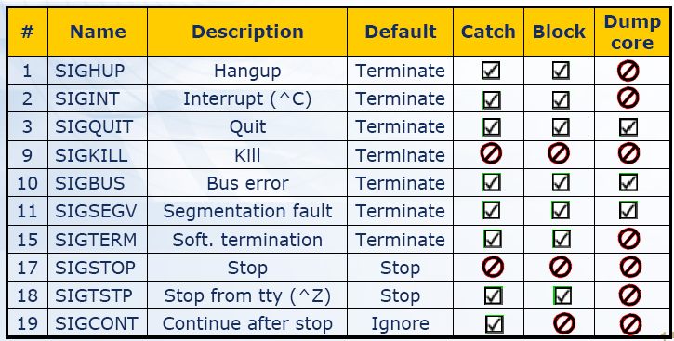
Handling Error Conditions –
External Error (2)

Slide 60
Handling Error Conditions –
External Error (3)
Using onintr in C shell
  onintr label
    Transfer control to label when an interrupt occurs
  onintr –
    Disable interrupt
  onintr
    Restore the default action
onitr catch
…
Do something in here
…
exit 0
catch:
set nonomatch
rm temp*
exit 1

Slide 61
sed and awk

Slide 62
sed – Stream EDitor (1)
Syntax
  sed –e “command” –e “command”… file
  sed –f script-file file
    Sed will read the file line by line and do the commands, then output to stdout
    Ex:
      sed -e '1,10d' -e 's/yellow/black/g' yel.dat
Command format
  [address1[,address2]]function[argument]
    From address 1 to address 2
    Do what action
Address format
  n ➔ line number
  /R.E./ ➔ the line that matches R.E

Slide 63
sed – Stream EDitor (2)
  Example of address format
    sed –e 10d
    sed –e /man/d
    sed –e 10,100d
    sed –e 10,/man/d
      Delete line from line 10 to the line contain “man”

Slide 64
sed – Stream EDitor
Function: substitution (1)
substitution
  Syntax
    [address] s/pattern/replace/flags
  Flags
    n: do the substitution for the n-th match
    g: replace all matches
    p: print the matched and replaced line
    w: write the matched and replaced line to
    file

Slide 65
sed – Stream EDitor
Function: substitution (2)
Ex:
  sed –e ‘s/tytsai/TYTSAI/2’ file
  sed –e ‘s/tytsai/TYTSAI/g’ file
  sed –e ‘s/tytsai/TYTSAI/p’ file
  sed –n –e ‘s/tytsai/TYTSAI/p’ file
  sed –e ‘s/tytsai/TYTSAI/w wfile’ file
File Content:
I am jon
I am john
I am tytsai
I am tytsai
I am nothing

Slide 66
sed – Stream EDitor
Function: delete
delete
  Syntax:
    [address]d
Ex:
  sed –e 10d
  sed –e /man/d
  sed –e 10,100d
  sed –e 10,/man/d

Slide 67
sed – Stream EDitor
Function: append, insert, change
append, insert, change
  Syntax:
    [address]a\
    [address]i \
    [address]c \
Ex:
  sed –f sed.src file
File Content:
I am jon
I am john
I am tytsai
I am tytsai
I am nothing
Results:
I am jon
I am john
How are your?
I am tytsai
How are your?
I am tytsai
I am nothing
Content of sed.src
/tytsai/i \
Meet tytsa, Hello

Slide 68
sed – Stream EDitor
Function: transform
transform
  Syntax:
    [add1,addr2]y/xyz…/abc…/
Ex:
  sed –e ‘y/abcdefghijklmnopqrstuvwxyz/ABCDEFGHIJKLMNOPQRSTUVWXYZ/’ file
    Lowercase to uppercase

Slide 69
sed – Stream EDitor
Function: print
print
  Syntax:
    [addr1, addr2]p
Ex:
  sed –e ‘/^tytsai/p’

Slide 70
sed – Stream EDitor other commands
l | r | w | y | ! | n | q | = | N | D | P | h | H | g | G | x | b | t |

Slide 71
awk
Syntax
  awk Pattern {Action} file
  awk –f script-file file
    awk will read the file line by line and evaluate the pattern, then do the action if the test is true
    Ex:
      awk ‘{print Hello World}’ file
      awk ‘/MA/ {print $1}’ list
Amy 32 0800995995 nctu.csie
$1
$2
$3
$4

Slide 72
awk –
Pattern format
pattern formats
  Relational expression
    ==, <, <=, >, >=, !=, ~, !~
    A ~ B means whether A contains substring B
  Regular Expression
      awk ‘/[0-9]+/ {print “This is an integer” }
      awk ‘/[A-Za-z]+/ {print “This is a string” }
      awk ‘/^$/ {print “this is a blank line.”}
  BEGIN
    It will be true when the awk start to work before reading any data
      awk ‘BEGIN {print “Nice to meet you”}’
  End
    It will be true when the awk finished processing all data and is ready to exit
      awk ‘END {print “Bye Bye”}

Slide 73
awk – action format
File Content:
I am jon
I am john
I am tytsai
I am tytsai
I am nothing
Actions
  Print
  if( expression ) statement [else statement2]
    awk '/tytsai/ { if( $2 ~ /am/ ) print $1}' file
  while( expression ) statement
    awk 'BEGIN {count=0} /tytsai/ {while (count < 3) {print count;count++}}' file
    awk 'BEGIN {count=0} /tytsai/ {while (count < 3) {print count;count++};count=0}' file
  for ( init ; test ; incr ) action
    awk '/tytsai/ {for (i=0;i<3;i++) print i}' file

Slide 74
awk – built-in variables (1)
$0, $1, $2, ...
  Column variables
NF
  Number of fields in current line
NR
  Number of line processed
FILENAME
  the name of the file being processed
FS
  Field separator
OFS
  Output field separator

Slide 75
awk – built-in variables (2)
Ex:
  awk ‘BEGIN {FS=“:”} /tytsai/ {print $3}’ /etc/passwd
    1001
  awk 'BEGIN {FS=":"} /^tytsai/{print $3 $6}' /etc/passwd
    1001/home/tytsai
  awk 'BEGIN {FS=":"} /^tytsai/{print $3 " " $6}' /etc/passwd
  awk 'BEGIN {FS=":" ;OFS="=="} /^tytsai/{print $3 ,$6}' /etc/passwd
    1001==/home/tytsai

Slide 76
example

Slide 77
檢查某一台機器是否當掉 (1)
Useful details
  /sbin/ping –c 3 ccbsd1
  PING ccbsd1 (140.113.209.61): 56 data bytes
  64 bytes from 140.113.209.61: icmp_seq=0 ttl=64 time=0.101 ms
  64 bytes from 140.113.209.61: icmp_seq=1 ttl=64 time=0.092 ms
  64 bytes from 140.113.209.61: icmp_seq=2 ttl=64 time=0.104 ms
  --- ccbsd1 ping statistics ---
  3 packets transmitted, 3 packets received, 0% packet loss
  round-trip min/avg/max/stddev = 0.092/0.099/0.104/0.005 ms

Slide 78
檢查某一台機器是否當掉 (2)
# [Usage] isAlive.sh ccbsd1
Usage="[Usage] isAlive.sh host”
temp="$1.ping"
Admin="tytsai"
/sbin/ping –c 10 $1 | /usr/bin/grep 'transmitted' > $temp
Lost=`awk –F" " '{print $7}' $temp ` | awk –F"%" '{print $1}' `
if [ $Lost –ge 50 ] ; then
mail –s "$1 failed" $Admin < $temp
fi

