Slide 1
Exercise 1 –
FreeBSD Installation
Announced Date: 2004/9/20
Due Date: 2004/10/3
Bonus Due Date: 2004/9/27

Slide 2
Outline
FreeBSD version
Installing FreeBSD
Update source and make world
Rebuild kernel

Slide 3
FreeBSD branches
Two parallel development branches:
  -CURRENT
    Latest working sources for FreeBSD
    Latest release version: 5.2.1 in Feb. 2004.
  -STABLE
    Receive only well-tested bug fixes and other small incremental enhancement
    Latest release version: 4.10 May. 2004.

Slide 4
FreeBSD version
A.B.C – Type
  A: major version Number
  B: minor version Number
  C: slight patch version number
  Type: version type
    SNAP
    ALPHA、BETA、GAMMA
    RELEASE
    RELENG
    STABLE
    CURRENT
Alpha
Beta
Gamma
Snapshot →
→ Release → Releng → Stable

Slide 5
FreeBSD view of Disk (1)
What is the meaning of ad0s1e
  Disk name
    IDE: ad
    SCSI: da
  Slice is equal to the partition of common use
    Primary partition: s1 ~ s4
    Extended partition: s5 ~ s8
  Label in each slice
    a: root partition
    b: swap
    c: entire disk
    d: entire partition
    efgh: /usr, /home, …
MBR
Slice 1 (/dev/ad0s1)
Slice 2 (/dev/ad0s2)
Slice 3 (/dev/ad0s3)
Slice 4 (/dev/ad0s4)
Slice 5 /dev/ad0s5 | Slice 6 /dev/ad0s6

Slide 6
FreeBSD view of Disk (2)
An Example
MBR
Slice 1 (ad0s1)
Slice 2 (ad0s2)
Slice 3 (ad0s3)
Slice 4 (ad0s4)
Windows XP (NTFS)
Linux (EXT3FS)
disklabel
ad0s3a
ad0s3b
ad0s3c
ad0s3d
ad0s3e
/ (root)
swap
Extended Partiton
/home
D-Disk NTFS | Linux Swap

Slide 7
Installing FreeBSD
Steps
  Knowing your hardware
  Obtaining installation file
  Booting from CD
  Kernel Configuration Menu
  sysinstall main menu
  Custom Installation Options
    Partition
    Label
    Distribution
    Media
    Commit
  Post Installation

Slide 8
Installing FreeBSD –
1. knowing your hardware
CPU
  32bit or 64bit, Xeon, Intel、AMD or other brand
RAM
  Size
HD
  Size, amount, SCSI or IDE
VGA
  Brand, ram size
Sound
  Brand
Network Interface Card
  Brand
  IP、Netmask、default gateway、Hostname、DNS
Other Special device

Slide 9
Installing FreeBSD –
2. Obtaining installation file
FreeBSD installation CD
  ftp://freebsd.csie.nctu.edu.tw/pub/ISO-IMAGES-i386/4.10/4.10-RELEASE-i386-disc1.iso
  Burn!
Boot Floppy Image
  ftp://ftp.freebsd.org/pub/FreeBSD/releases/i386/4.10-RELEASE/floppies/
  ftp://ftp.freebsd.org/pub/FreeBSD/tools/fdimage.exe
  C:\fdimage.exe kern.flp a:\

Slide 10
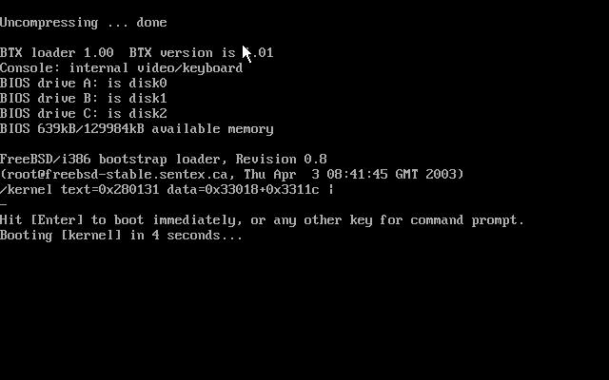
Installing FreeBSD –
3. Booting from CD

Slide 11
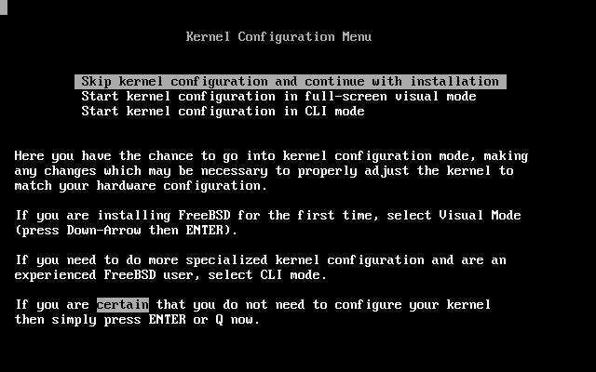
Installing FreeBSD –
4. Kernel Configuration Menu
Install first and configure kernel later
  Choose “Skip kernel configuration and continue with installation”
  Then it will probe the devices in your system

Slide 12
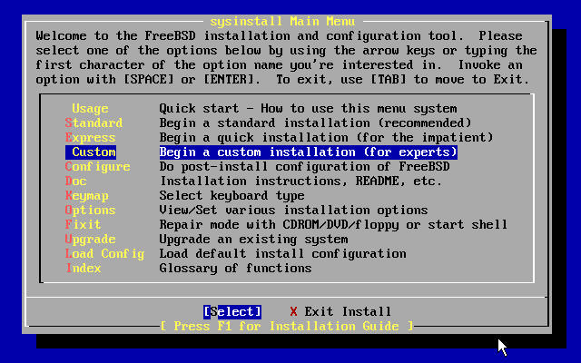
Installing FreeBSD –
5. sysinstall Main Menu
  You can press “Scroll Lock” key to see probe results.
sysinstall Main Menu
  Choose “Custom”

Slide 13
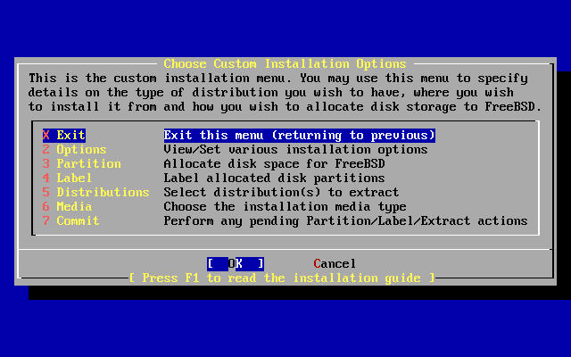
Installing FreeBSD –
6. Custom Installation Options
4 major steps
  Partition and label your disk
  Choose what to install and how to install
  Commit

Slide 14
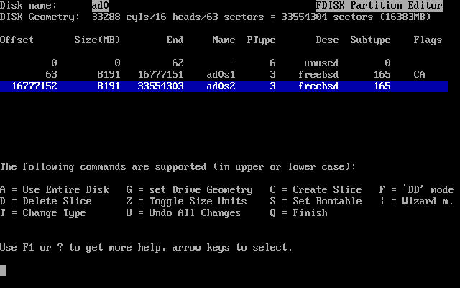
Installing FreeBSD –
6. Custom Installation – partition (1)
Create slice and choose boot manager
  Press “C” to create a new slice or press “A” to use entire disk
  Press “S” to toggle ad0s1 as bootable (we will put / on this slice)
  Press “Q” to next step (Select Boot Manager)

Slide 15
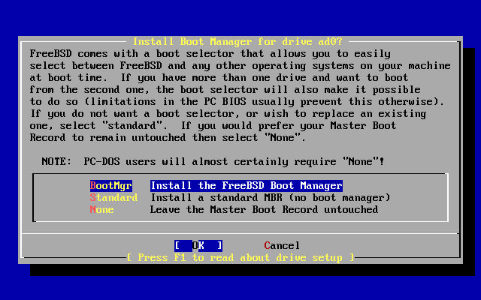
Installing FreeBSD –
6. Custom Installation – partition (2)
  Select “BootMgr” for ad0
  After press OK, it will back to Custom Installation Options menu
BootMgr
  multiple OS
Standard
  single OS
None
  Other BM

Slide 16
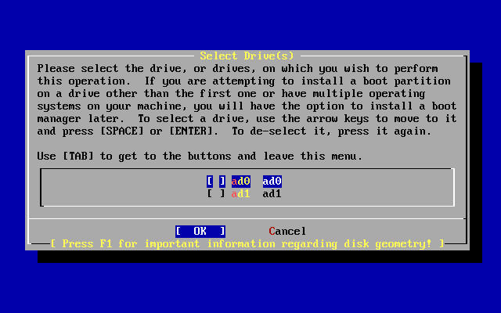
Installing FreeBSD –
6. Custom Installation – partition (3)
If you have more than one disk…
  You can choose whether to partition it.
  Install “BootMgr” for first disk and “none” for rest ones

Slide 17
Installing FreeBSD –
6. Custom Installation – Label (1)
Disklabel Editor
  Move blue bar to select slice
  Press “C” to create disk label
    / , swap, /home
      Specify size
      Choose type (either swap or FS)
      Specify mount point
  Press “S” to toggle SoftUpdates (async written to disk)
  Press “Q” to next step (back to custom installation options menu)

Slide 18
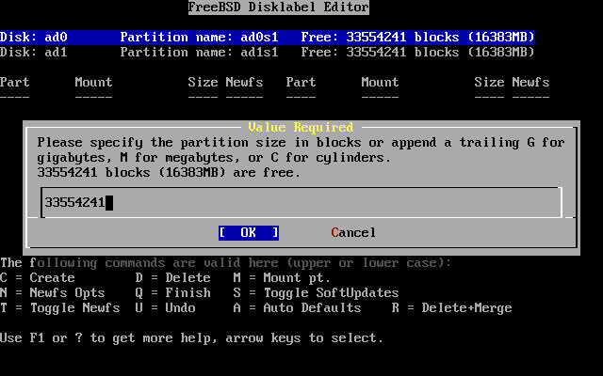
Installing FreeBSD –
6. Custom Installation – Label (2)
  Create label in ad0 and specify size

Slide 19
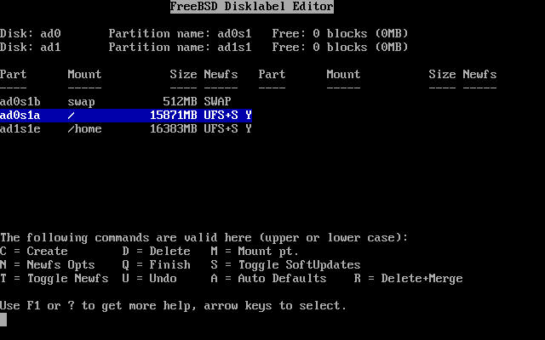
Installing FreeBSD –
6. Custom Installation – Label (3)
  Complete disklabel

Slide 20
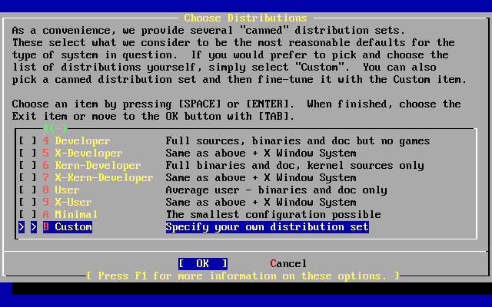
Installing FreeBSD –
6. Custom Installation – distri. (1)
Choose Distributions Menu
  Choose “Custom”

Slide 21
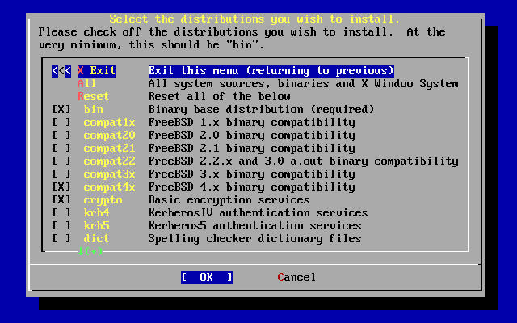
Installing FreeBSD –
6. Custom Installation – distri. (2)
  Select
    bin : binary
    compat4x : 4.x binary compatibility
    crypto : encryption service
    man : man page
    src (all) : FreeBSD source code
    ports : FreeBSD software collection

Slide 22
Installing FreeBSD –
6. Custom Installation – distri. (3)
  Press “OK” and it will return to “Choose Distributions menu”
  Press “OK” again to back to “Custom Installation Options menu”
  Select “Media”

Slide 23
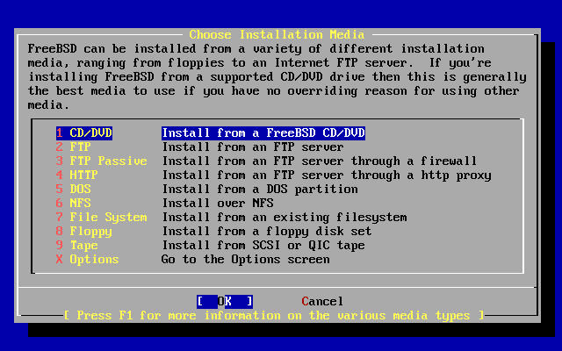
Installing FreeBSD –
6. Custom Installation – Media (1)
  Choose CD/DVD if you have 4.10 Stable CD
  Choose FTP if your NIC is detected
    Choose FTP Passive if you in private network

Slide 24
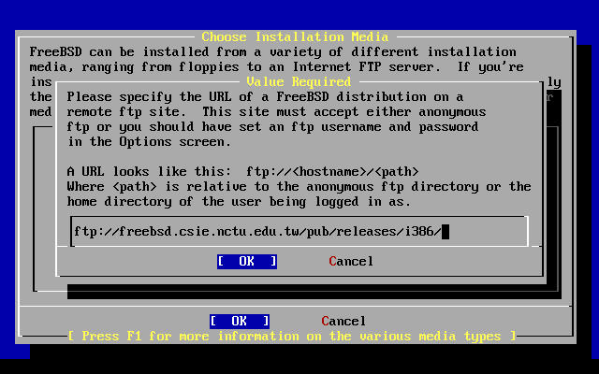
Installing FreeBSD –
6. Custom Installation – Media (2)
Install through FTP
  Specify ftp server and path

Slide 25
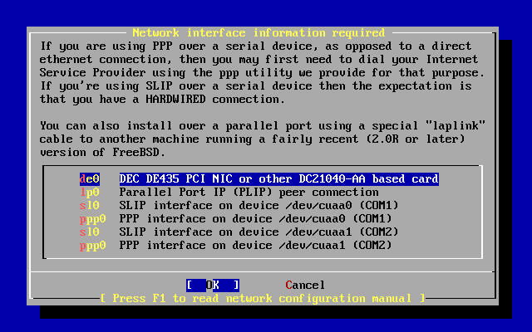
Installing FreeBSD –
6. Custom Installation – Media (3)
  Select NIC
  IPv6 and DHCP

Slide 26
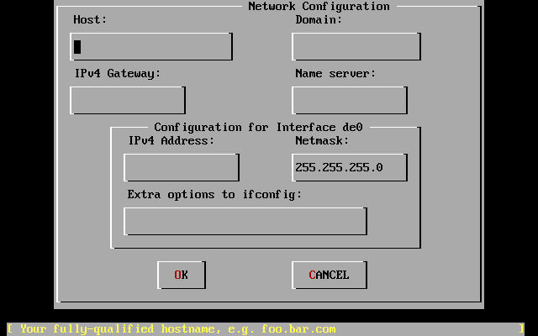
Installing FreeBSD –
6. Custom Installation – Media (4)
  Specify your IP information
  Press “OK” to next step

Slide 27
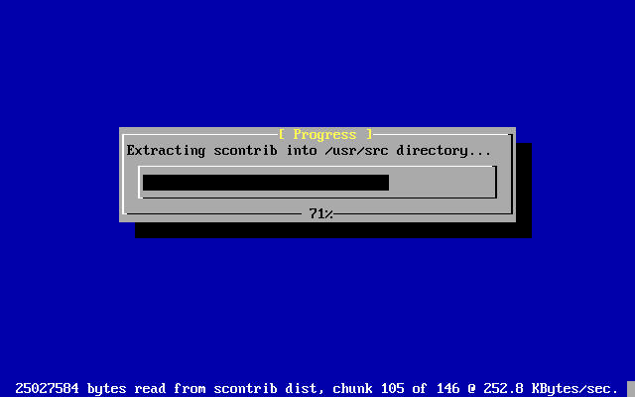
Installing FreeBSD –
6. Custom Installation – Commit
Start to format disk、make file system and install software
You can press “Alt + F2” to see the install detail

Slide 28
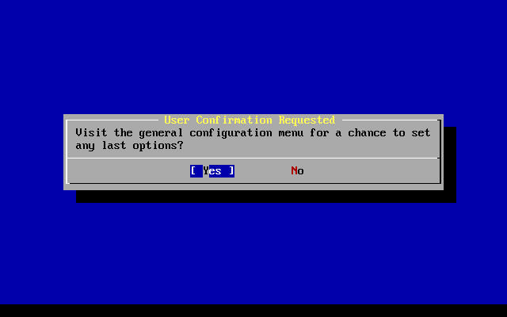
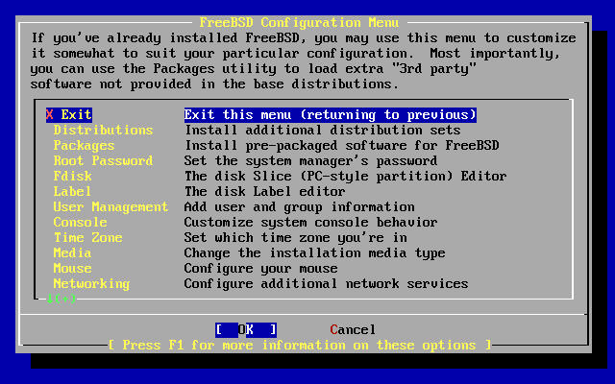
Installing FreeBSD –
7. Post Installation (1)

Slide 29
Installing FreeBSD –
7. Post Installation (2)
Root Password
Time Zone → Asia → Taiwan
Mouse → enable

Slide 30
Exercise 1 –
FreeBSD build world and kernel

Slide 31
FreeBSD source
Maintained in a CVS repository in California
We can use CVSup keep our system up-to-date with any FreeBSD mirror sites
  Install CVSup
  Edit CVSup supfile
  Update source using CVSup
  Make world to build the updated source

Slide 32
CVSup –
CVSup Installation
Install via pkg_add
  Package is pre-compiled application
  % pkg_add ftp://freebsd.csie.nctu.edu.tw/pub/CVSup/cvsup-16.1e.tgz
  pkg_add package-name
  pkg_delete package-name
  pkg_info package-name
  All installed package is stored in /var/db/pkg
The cvsup binary is in /usr/local/bin/cvsup
  You can use “whereis” command to find something

Slide 33
CVSup –
CVSup Configuration file (1)
Example cvsup supfile
  /usr/share/examples/cvsup/stable-supfile
  /usr/share/examples/cvsup/ports-supfile
Create your own supfile
  Edit /usr/local/etc/cvsup-src
  Edit /usr/local/etc/cvsup-ports

Slide 34
CVSup –
CVSup Configuration file (2)
/usr/local/etc/cvsup-src
*default host=freebsd.csie.nctu.edu.tw
*default base=/usr
*default prefix=/usr
*default delete use-rel-suffix
*default release=cvs tag=RELENG_4
src-all
Where to get source
Where to put status file
Where to put source
Allow cvs to delete

Slide 35
CVSup –
CVSup Configuration file (3)
/usr/local/etc/cvsup-ports
*default host=freebsd.csie.nctu.edu.tw
*default base=/usr
*default prefix=/usr
*default delete use-rel-suffix
*default release=cvs tag=.
ports-all

Slide 36
CVSup –
CVSup Configuration file (4)
Or you can put them all together
/usr/local/etc/cvsup-all
*default host=freebsd.csie.nctu.edu.tw
*default base=/usr
*default prefix=/usr
*default delete use-rel-suffix
*default release=cvs tag=RELENG_4
src-all
ports-all tag=.

Slide 37
CVSup – update source using CVSup
Update both src and ports
  % /usr/local/bin/cvsup -g -L 1 /usr/local/etc/cvsup-all > /var/log/cvsup.log
The “–g” tells cvsup not to use its GUI
The “–L 1” tells cvsup to print out the details of
all the file updates it is doing.
from 0 (silent) to 2
It will run about 10 minutes
P4 1.8G 1GB Ram 100MB NIC

Slide 38
Rebuilding world
The canonical way to update system
  make buildworld
  make buildkernel
  make installkernel
  reboot and boot in single user mode
  make installworld
  mergemaster
  reboot

Slide 39
Rebuilding world –
Prepare make.conf
Example make.conf
  /etc/defaults/make.conf 4.x
  /usr/share/examples/etc/make.conf 5.x
Everything add in make.conf is used every time you run make
  KERNCONF=TYBSD

Slide 40
Rebuilding world – make buildworld
Build FreeBSD entire system
  % cd /usr/src
  % make –j3 buildworld >& /var/log/world.log &
Spawn multiple (n) processes to do make.
The compiling processes of make world is I/O bound.
It will run about 30 minutes
P4 1.8G 1GB Ram 100MB NIC

Slide 41
Rebuilding world – make buildkernel (1)
Why rebuild kernel?
  Fast boot time.
    Probe necessary device
  Lower memory usage
    Smaller kernel image
  Additional hardware support.

Slide 42
Rebuilding world – make buildkernel (2)
Edit kernel config file
  cd /usr/src/sys/i386/conf
    GENERIC may not have all for your system
    LINT has every options
  cp GENERIC “YOUR-NAME”
    We often use hostname to be “YOUR-NAME”
  edit config file
    Depend on your system
    Be attention to related options
    Following the explanation of http://www.freebsd.org/doc/en_US.ISO8859-1/books/handbook/kernelconfig-config.html

Slide 43
Rebuilding world – make buildkernel (3)
Build kernel
  % cd /usr/src
  % make KERNCONF=TYBSD buildkernel
It will run about 5 minutes depend on your configuration
P4 1.8G 1GB Ram 100MB NIC

Slide 44
Rebuilding world – make installkernel
Install kernel
  % cd /usr/src
  % make KERNCONF=TYBSD installkernel

Slide 45
Rebuilding world – reboot in single user mode
Boot in single user mode
  Hit any key other than “enter” when counting down
  Type “boot –s”
  Or
  % shutdown now
    For a running system, this will drop it to single user mode

Slide 46
Rebuilding world – make installworld
Install the built world
  % make installworld

Slide 47
Rebuilding world – mergemaster
mergemaster
  Synchronize /usr/src/etc with /etc
  Choose “i” for most case, such as
    /etc/defaults/rc.conf, …
  Press “enter” for certain file, such as
    master.passwd, hosts, csh.*

Slide 48
Reboot
Reboot and enjoy it
  % reboot

Slide 49
If Something Goes Wrong … (1)
Boot with old kernel
  Hit any key other than “enter” when counting down
  Type “unload”
  Type “load /kernel.old”
  Type “boot”

Slide 50
If Something Goes Wrong … (2)
Unlock kernel
  Make sure the securelevel in /etc/rc.conf below 0, if not, change it and reboot.
  % chflags noschg /kernel
  % cp kernel.old kernel
  sync;sync; reboot
Lock kernel
  % chflags schg /kernel
Use ls –lo to check similar file
schg → set the immutable (永遠不變的) flag
ls –o → include file flags in long output

Slide 51
Install software
Ports
  cd /usr/ports, make search, make install clean
Package
  Pre-built ports
  pkg_add, pkg_delete, pkg_info
Source
  Tar ball
  tar xzvf certain-source.tar.gz
  ./configure
  make; make install

Slide 52
How to use ports
Steps of install software using ports
  (1) Figure out the path to the software
    % cd /usr/ports
    % make search key=mutt
    % cd /usr/ports/chinese/mutt
  (2) Fetch and compile the source
    % make install
Uninstall
    % make deinstall

