Slide 1
Exercise 2 –
Build X window
Announced Date: 2004/10/11
Due Date: 2004/10/24
Bonus Due Date: 2004/17

Slide 2
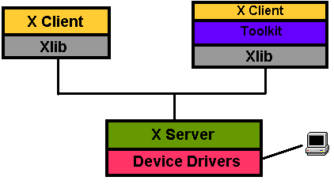
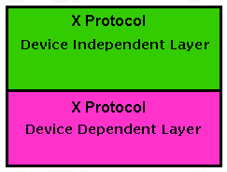
X Window System (1)
The X Protocol
  Aim to provide a network transparent graphical user interface for the UNIX-like OS.
  Client-Server architecture
    The X client request display service.
    The X server provide display service

Slide 3
X Window System (2)
Naming
  X Window System
  X Version 11
  X Window System, Version 11
  X11
Version
  X11R6
    X Window System Version 11 Release 6
Latest version
  From X.Org
    X11R6.8 Sep.9 2004

Slide 4
X Window System (3)
Advantages of X protocol
  The X server is highly portable (various OS, Language)
  The X Clients also have high portability
  X support most oriented network protocol
  Local and network based computing look and feel the same

Slide 5
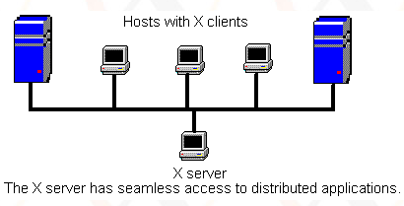
X Window System –
Client-Server Design
Client
  Request service (like create window)
  Receive events from X server (like mouse input)
Server
  Manage the keyboard, mouse and display device
  Create, draw and destroy graphic objects on screen

Slide 6


X11 implementation
An open-source implementation of X Window System
  XFree86 project
    FreeBSD 4.10-Release, 5.2.1-Release
  Xorg foundation
    FreeBSD 5.3-Release
    X11 official flavor

Slide 7
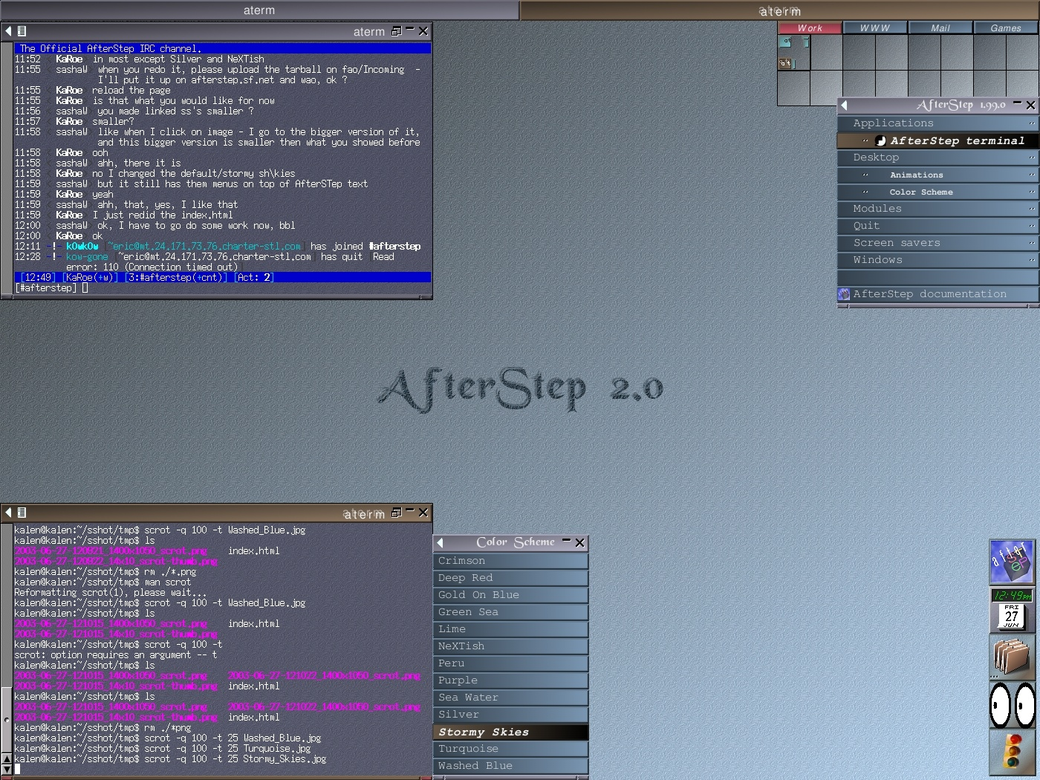
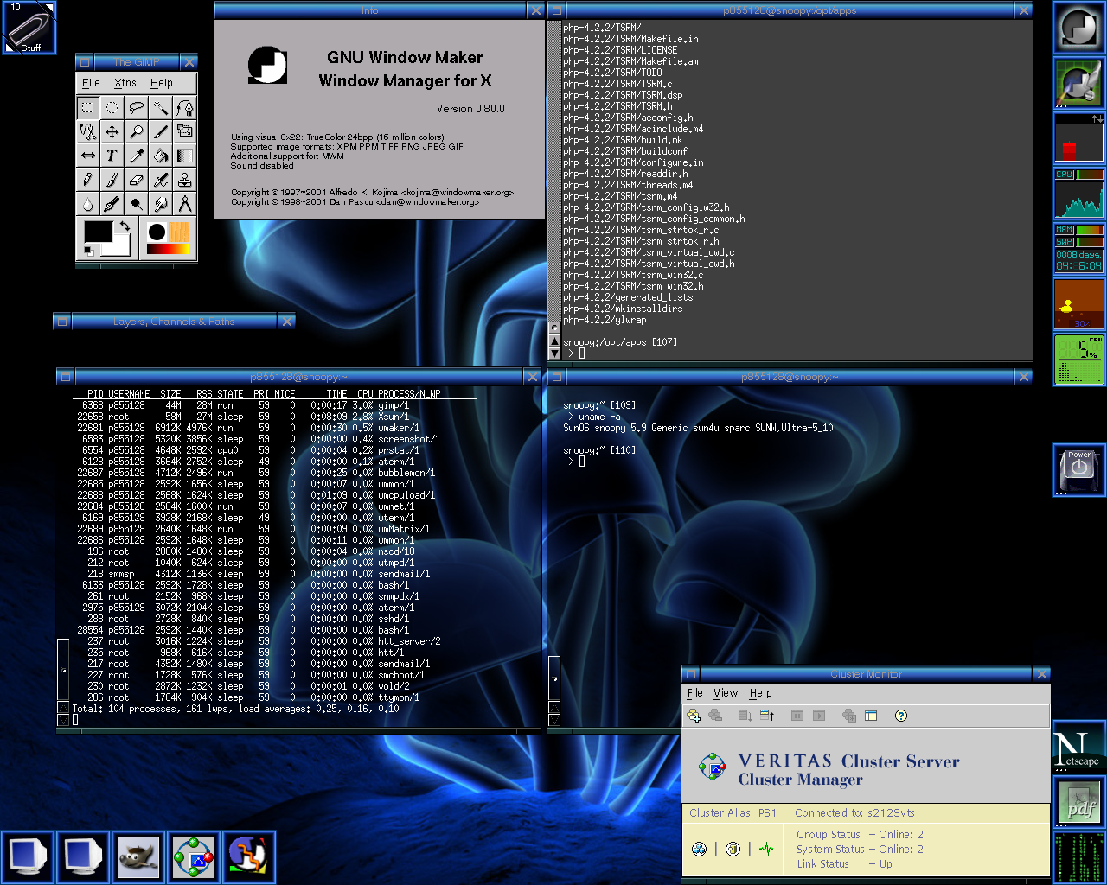
The Window Manager
Window Manager
  Provide certain look-and-feel window in front of you
    AfterStep
    Enlightenment
    Window Maker

Slide 8
Steps of this exercise
Install X11
Configuring X11
Install Window Manager

Slide 9
Installing X11 (1)
Use cvsup to update your ports
  /usr/local/bin/cvsup –g –L 1 /usr/local/etc/cvsup-ports
Pre-steps:
  We use Xorg as our X Server
  Add the following line in /etc/make.conf
      X_WINDOW_SYSTEM=xorg
  Do this line
      pkg_delete -f /var/db/pkg/imake-4* /var/db/pkg/XFree86-*
  Your “PATH” environment variable
      Edit /etc/csh.cshrc
      set path = (/bin /sbin /usr/bin /usr/sbin /usr/local/bin /usr/X11R6/bin )

Slide 10
Installing X11 (2)
We use Xorg as our X Server
  To build and install Xorg from the ports
    % login as root
    % cd /usr/ports/x11/xorg
    % make install clean
If you want to install XFree86
    % login as root
    % cd /usr/ports/x11/XFree86-4
    % make install clean
It will run about 50 minutes
P4 1.8G 1GB Ram 100MB NIC
Install Xorg needs 4G free space

Slide 11
Configuring X11 (1)
Pre-step – know your hardware
  Monitor specifications
    Horizon Synchronization frequency
      Ex: 31 ~ 81 KHz
    Vertical Synchronization frequency
      Ex: 56 ~ 76 KHz
  Video adaptor chipset
      Ex: ATi Radeon 9200SE
      Ex: nVIDIA GeFource FX5200
      Ex: ATI Mobility RADEON 7500 (16M) (IBMT30)
  Video Adapter Memory
      Ex:128MB

Slide 12
Configuring X11 (2)
Configuration of X11 is a multi-step process
  Generate an X11 configuration skeleton file
    % Xorg –configure (Xorg)
      The file will be put in /root/xorg.conf.new
    % XFree86 –configure (XFree86)
      The file will be put in /root/XF86Config.new
  Test the existing configuration to
    % Xorg –config /root/xorg.conf.new (Xorg)
    % XFree86 –xf86config /root/XF86Config.new (XFree86)
      If a black and grey grid and an X mouse cursor
      appear, the configuration was successful
      Press “Ctrl+Alt+Backspace” to leave the test

Slide 13
Configuring X11 (3)
  Tune Configuration file
    Edit /root/xorg.conf.new (Xorg)
    Edit /root/XF86Config.new (XFree86)
      Section Monitor
      Section Screen
Section "Screen"
Identifier "Screen0"
Device "Card0"
Monitor "Monitor0“
DefaultDepth 24
SubSection "Display"
Viewport 0 0
Depth 24
Modes "1280x1024" "1024x768"
EndSubSection
EndSection
Section "Monitor"
Identifier "Monitor0"
VendorName "Monitor Vendor"
ModelName "Monitor Model"
EndSection

Slide 14
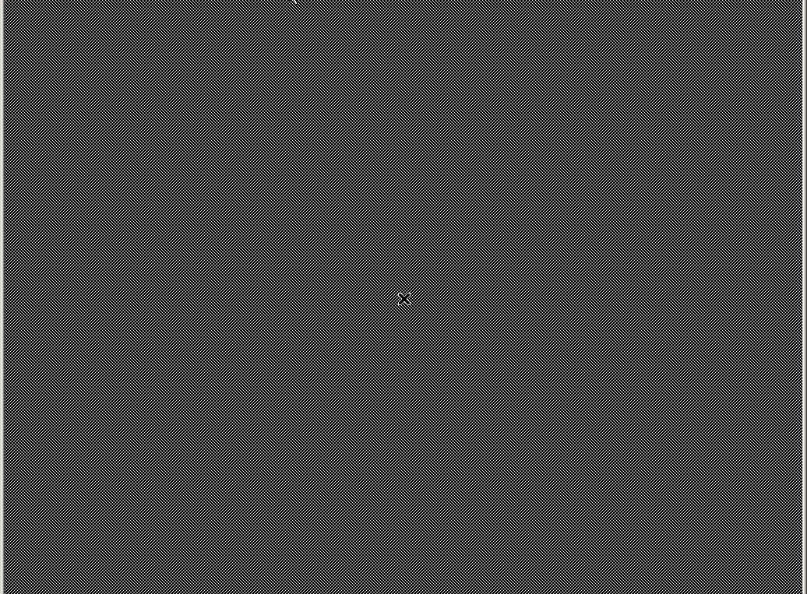
Configuring X11 (4)
  Copy configuration file to real place
    % cp /root/xorg.conf.new /etc/X11/xorg.conf (Xorg)
    % cp /root/XF86Config.new /etc/X11/XF86Config (XFree86)
  Use X window
    % startx

Slide 15
Install Window Manager
We use afterstep as our WM
  http://www.afterstep.org/
    % cd /usr/ports/x11-wm/afterstep-stable
    % make –DWITH_DIFFERENT_LOOKNFEELS
    –DWITH_SAVEWINDOWS install clean

Slide 16
Configuring X11 to use afterstep
Edit xinitrc
    % cd /usr/X11R6/lib/X11/xinit
    % chmod u+w xinitrc
    Edit xinitrc
Original
# start some nice programs
twm &
xclock -geometry 50x50-1+1 &
xterm -geometry 80x50+494+51 &
xterm -geometry 80x20+494-0 &
exec xterm -geometry 80x66+0+0 -name login
# start some nice programs
exec afterstep

Slide 17
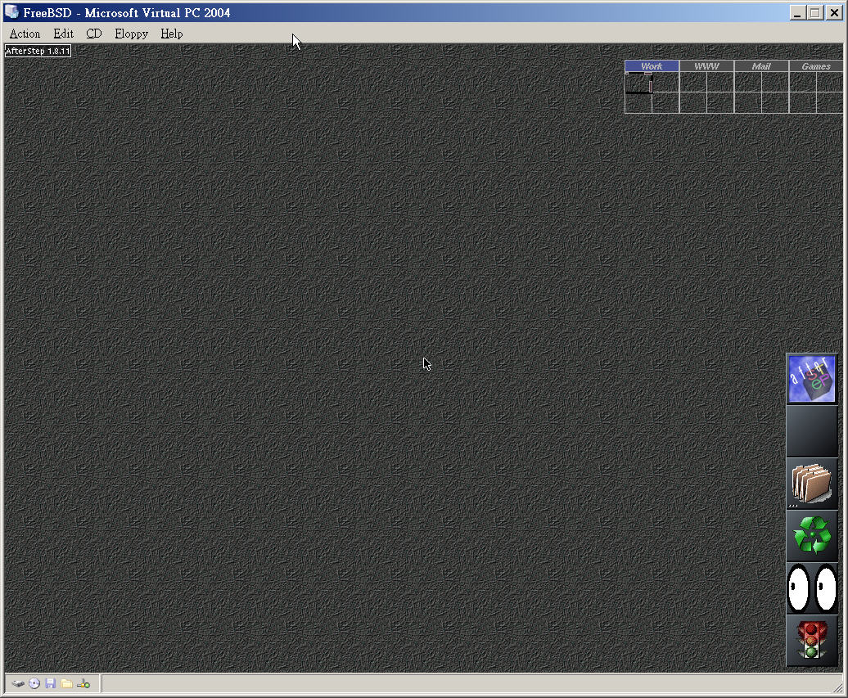
Run Your X-window
% startx
Ctrl + Alt + Backspace – force to quit X
Left button: copy
Right button: paste

Slide 18
AfterStep Configuration (1)
Location of configuration file
  Global configuration file directory
    /usr/X11R6/share/afterstep/
  Personal configuration file directory
    ~/GNUstep/Library/AfterStep/
When AfterStep starts
  It first tries to read personal configuration files, and then read global configuration files for those not found.
  Copy what you want to change from global to personal and edit it

Slide 19
AfterStep Configuration (2)
Under /usr/X11R6/share/afterstep/
Name | Purpose
autoexec | Define what is run when AfterStep starts and restarts
base.24bpp | Define module, pixmap, scripts, cursor, pager
start/ | Start menu when you click left button
looks/ | Define how AfterStep looks
wharf | wharf module configuration file
pager | pager module configuration file

Slide 20
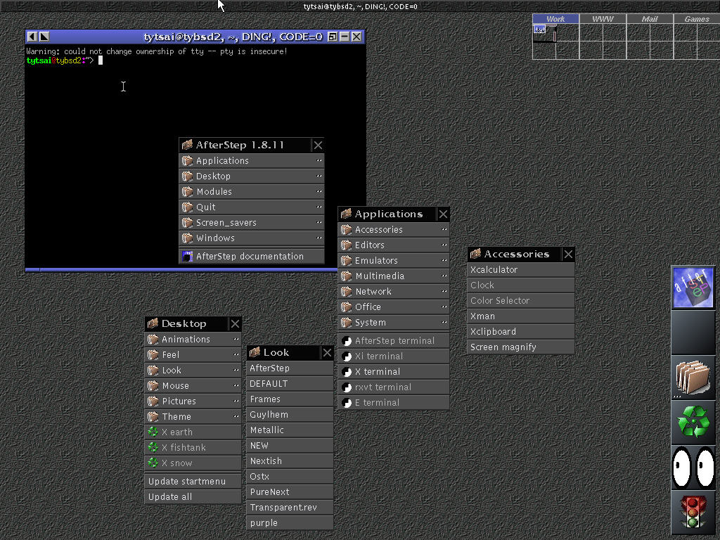
AfterStep Configuration (3)
Pager module
Start menu
look
Wharf module

Slide 21
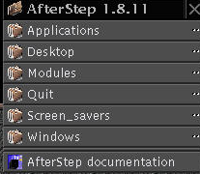
AfterStep Configuration –
Add something to start menu
Steps
  install your favorite applications first
  Add entry under directory
  Edit the entry file
  Update menu
Exec "WWW-firefox" exec firefox &
MiniPixmap "mini-app.xpm"
tytsai@tybsd:/<3>afterstep/start> ls
Applications/ Modules/ Screen_savers/ a_nop
Desktop/ Quit/ Windows/ b_afterstepdoc
tytsai@tybsd:/<3>afterstep/start> ls
Applications/ Modules/ Screen_savers/ a_nop c_firefox
Desktop/ Quit/ Windows/ b_afterstepdoc d_xterm

Slide 22

AfterStep Configuration –
Add something to wharf module
Edit wharf configuration file
# AfterStep documentation
*Wharf afterstepdoc AfterStep3.xpm Exec "-" afterstepdoc &
# Time
*Wharf clock - Swallow "asclock" asclock -shape -12 -position +1+1 &
# Pagers
#*Wharf Pagers Monitor.xpm,3_dots.xpm Folders
# *Wharf Pager - MaxSwallowModule "Pager" Pager 0 3
#*Wharf ~Folders
# File system
#
#*Wharf asfsm - Swallow "asfsm_lite" asfsm_lite -bg Grey30 -fg Grey70 -bp None -
pbg Grey40 -pfg Grey70 -pbp None -i 30 &
# System load
#*Wharf asload - Swallow "asload" asload -shape &
# Mail
#*Wharf asmail - Swallow "asmail" asmail -geometry +0+0 &
…

