Slide 1
Exercise 5
NFS and NIS
Announced Date: 2004/11/29
Due Date: 2004/12/17
Bonus Due Date: 2004/12/12

Slide 2
Lab 1 –
Play with NFS (1)
Find two partners to finish this lab
Goal
  Know how to export NFS
  Know how to import NFS

Slide 3
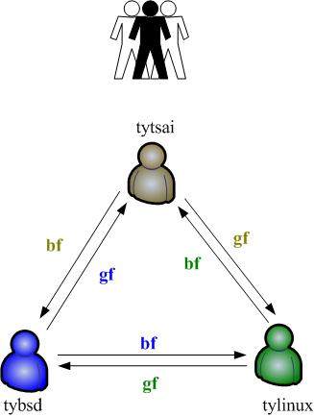
Lab 1 –
Play with NFS (2)
Triangle relationship

Slide 4
Lab 1 –
Play with NFS (3)
Steps
  Make these directories
    % mkdir /home/SA_myhostname
    % mkdir /home/bf
    % mkdir /home/gf
  Edit /etc/export to export /home/SA_myhostname
    One for bf, read-only
    One for gf, read-write
  Edit /etc/fstab to mount
    Mount gf’s NFS to /home/gf
    Mount bf’s NFS to /home/bf
  Try to do these
    % cd /home/bf ; touch got-you
    % cd /home/gf ; touch why

Slide 5
Lab 2 –
Play with NIS (1)
Let one of three be the NIS master, the other two are NIS clients
Let another of three be the home server
Steps
  NIS master server build the NIS
    /var/yp/master.passwd should have two accounts,
      “sapartner1” /home/nfs/sapartner1
      “sapartner2” /home/nfs/sapartner2
    /var/yp/netgroup, add “adm_user” and let “sapartner1” as member of adm_user
    Edit /etc/passwd
      +@adm_user can login to NIS server
      + can not login

Slide 6
Lab 2 –
Play with NIS (2)
  Home server
    % mkdir /home/nfs
    % mkdir /home/nfs/sapartner1; chown …
    % mkdir /home/nfs/sapartner2; chown …
    Edit /etc/exports to export /home/nfs to the other two hosts, read-write
  The other two hosts
    mkdir /home/nfs
    Edit /etc/fstab to mount /home/nfs
  NIS clients bind NIS
  Try to login to these three machine using “sapartner1” and “sapartner2” accounts

Slide 7
Lab 3 –
Play with amd and NIS
Modify NIS server
  Use amd auto.home to tell others where to find NFS
  Add two entries in /var/yp/master.passwd
    “sapartner3” /net/sa/sapartner3
    “sapartner4” /net/sa/sapartner4
Modify Home server
  Make the following directories
    /home/amd
    /home/amd/sapartner3
    /home/amd/sapartner4
  Edit /etc/exports to export /home/amd
sa host==home-server;type:=link;fs=/home/amd
host!=home-server;type:=nfs;rhost=home-server; opts:=nfsv3,rw,grpid,quota,
intr,soft,nodev,nosuid,resvport,timeo=10,retrans=5,nqnfs

