Slide 1
Introduction

Slide 2
Outline
What SA Should do.
What You can expect to learn from this course.
What attitude you should take.
Syllabus
  Course Info.
  Content
  Grade Policy
Am I OK to take this course?
UNIX Introduction

Slide 3

What System Administrator Should do? (1)
Ordinary list
  Install new system, programs and OS updates
  Monitoring system and trying to tune performance
  Adding and removing users
  Adding and removing hardware
  Backup and Restore
  Security
Notes:
SA 要做的事情並沒有因為 PC 進步而減少

Slide 4
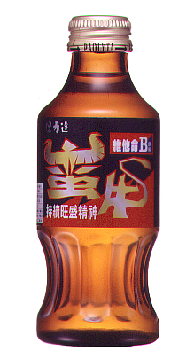

What System Administrator Should do? (2)
Non-technique list
  Helping users
  Maintaining documentation
  Moving furniture
  Burning your lung
  Good communication and memorization

Slide 5
What System Administrator Should do? (3)
The best words to describe the job
  Thankless job.
  System administration is like keeping the trains on time; no one notices except when they’re late.

Slide 6
Philosophy of system administration
Know how things really work.
Plan it before you do it.
Make it reversible
Make changes incrementally.
Test before you unleash it .

Slide 7
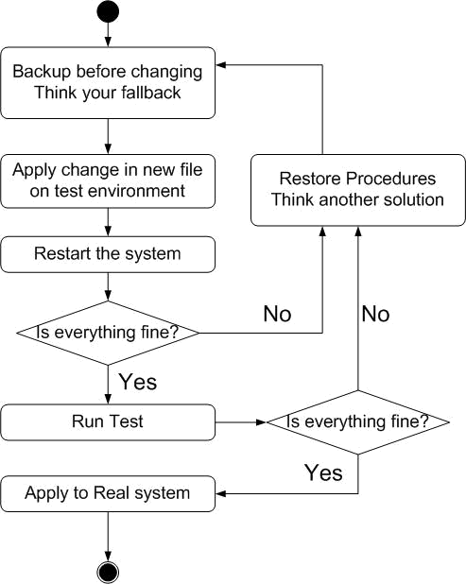
Flow of Change

Slide 8
What you can learn in this course?
Mostly, the skill to be a candidate of system administrator
Secondary, information about csie computer center

Slide 9
Attitude
Attend every class
Do every exercise
  As early as possible
  On your own
Read book at least 6 hours every week
Collect information on the internet

Slide 10
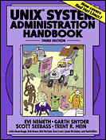
Syllabus
http://www.csie.nctu.edu.tw/~tytsai/course/sysadm/
Instructor:
  蔡宗易 tytsai@csie.nctu.edu.tw
Time:
  Mon IJK (PM 6:30 ~ 9:20)
Textbook:
  UNIX System Administration Handbook," 3rd ed.

Slide 11
Syllabus - Content
We will cover the following chapters in this semester:
  Chapter 1 ~ 12
  Chapter 13, 17, 18, 22, 23, 26
  Shell Programming
The following chapters is covered in the next semester:
  Chapter 14, 15, 16, 19, 20
  News Server
  SNMP
  Perl Programming

Slide 12
Syllabus – Grade Policy
Mid
  30 ~ 35%
    2004/11/15
Final
  30 ~ 35%
    2005/01/03
Exercise
  35 ~ 45%
    No Delay Work
    We will have probably 9 exercises
    We may have some bonus exercises
Grade will not be normalize.
Why?
Do exercise gets points.
Study book gets points.
This might be discussed again in class when the list is ascertained.

Slide 13
Finally,
Am I OK to take this course?
Are you willing to devote yourself to exercise?
  Yes! Please come
Are you newbie in this area?
  Yes!? It’s ok, Please come
Do you take more than 3 major courses?
  Yes!??? It is quite dangerous, but I can not stop u

Slide 14


UNIX History (1)
Before Multics there was chaos, and afterwards, too
  Multics:
    Multiplexed information and Computing Service
    1965 ~ 1969
    Bell labs, GE, MIT
    Ken Thompson, Dennis Ritchie

Slide 15
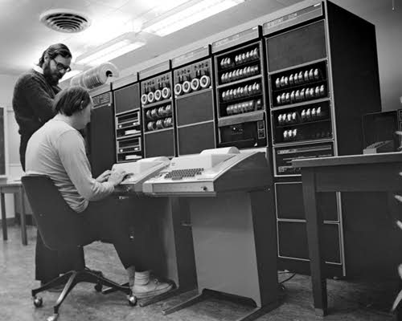
UNIX History (2)
From Multics to something else
  Ken Thompson first written a game called “Space Travel” on Multics on GE machine in 1969.
  Implement “Space Travel” on PDP-7 again.
  Thompson began to design the shell, the editor and the assembler on PDP-7.
  In 1970, Brian Kernighan suggested the name “UNIX”.

Slide 16
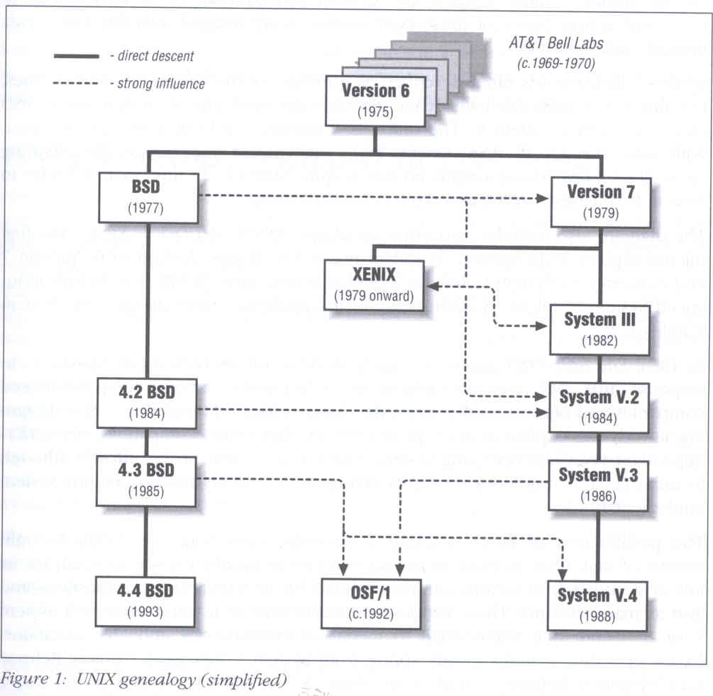
UNIX genealogy
AT&T
  Version 7~10
  System III ~ V
UCB
  BSD
IBM、DEC、HP
  OSF/1

Slide 17
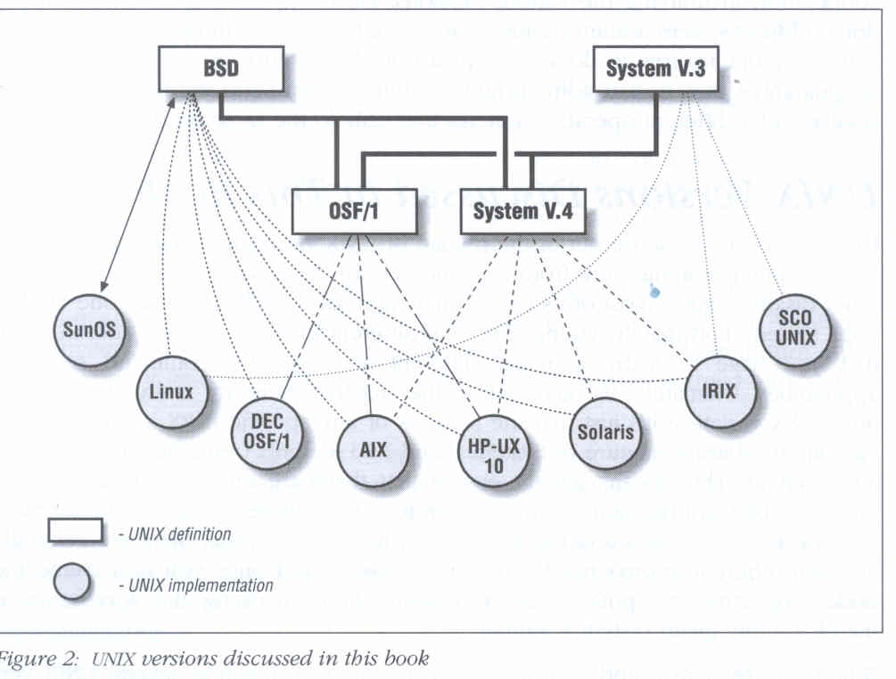
UNIX versions

Slide 18
man pages (manual)
Contain descriptions of
  Individual command.
    % man cp
  File format.
    % man rc.local
  Library routines.
    % man strcpy

Slide 19
man command
Command
  % man [-s section] title (AT&T)
  % man [section] title (BSD)
    % man printf (bash printf command)
    % man 3 printf (C Standard printf func.)
    % man –k exit (keyword search)
Man pages organization
AT&T | BSD | Contents
1 | 1 | User-Level commands and applications
2 | 2 | System calls and kernel error code
3 | 3 | Library calls
4 | 5 | Standard file format
5 | 7 | Miscellaneous files and documents
6 | 6 | Games and demonstrations
7 | 4 | Device Drivers and network protocols
1m | 8 | System administration commands
9 | 9 | Obscure kernel specs and interfaces

Slide 20
UNIX Concepts - ID
User ID, Group ID
  % id tytsai
    uid=11896(tytsai) gid=200(dcp) groups=200(dcp)
Super user
  root
    uid=0(root) gid=0(wheel) groups=0(wheel), …
Other Important Users
  daemon: owner of unprivileged software
  bin: owner of system commands
  sys: owner of the kernel and memory images
  nobody: owner of nothing

Slide 21
Unix Concept - Files
% ls –l
  d rwxr-xr-x 22 tytsai dcp 512 Sep 1 18:17 public_html/
File type
File access mode
# of inodes
File user owner
File group owner
File size
File last modify time
File name

Slide 22
File types
File types
file command
  determine file type
    % file .tcshrc ➔ .tcshrc: ASCII text
  /usr/share/misc/magic
symbol | File types
b | Block device file
c | Character device file
d | Directory
l | symbolic Link
s | Socket
p | named Pipe
- | Regular file

Slide 23
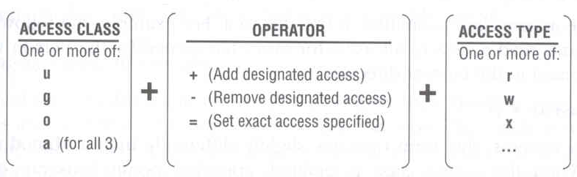
File Access Mode
rwx r-x r-x
  User, group, other privileges
chmod command
  % chmod access-string file
    % chmod u+x test.sh
    % chmod go-w .tcshrc
    % chmod u+w,r-w hehe haha
    % chmod –R 755 public_html/

Slide 24
File Protection
Command | Minimum Access Needed
 | On file itself | On directory file is in
cd /home/test |  | x
ls /home/test/*.c |  | r
ls –s /home/test/*.c |  | rx
cat runme | r | x
cat >> runme | w | x
run-binary | x | x
run-script | rx | x
rm rumme |  | wx

Slide 25
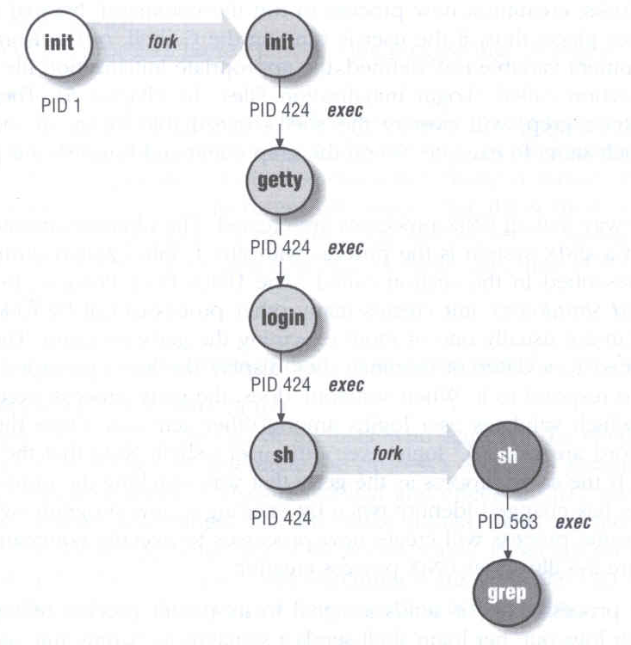
UNIX Concept - Process
A working program
  foreground
    remain attached to the terminal
  background
    can not communicate with terminal
Process Life Cycle
  fork, exec

Slide 26
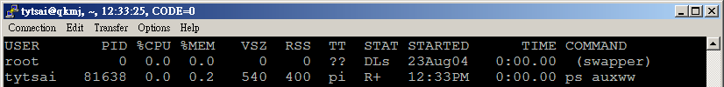
Watching Process
ps command
  ps –aux, ps –auxww
    USER, PID, %CPU, %MEM, VSZ RSS, TTY, STAT, START, TIME, COMMAND
      D: in Disk
      I: Idle
      R: Running
      S: Sleeping
      T: sTopped
      Z: Zombie
      man ps…

Slide 27
Kill Process
kill command
  % kill –[signal_name] pid
  % kill –[signal_number] pid
    % kill –HUP 88192 (hang up, reset)
    % kill -1 88192
    % kill –TERM 12345 (software termination)
    % kill –15 12345
    % kill –KILL 3456 (kill program at OS level)
    % kill -9 3456

Slide 28
CSIE workstation group
FreeBSD
  ccbsd1 ~ ccbsd12, ccbsd18
Linux
  linux1 ~ linux20
Solaris
  ccsun1 ~ ccsun7
SunOS
  ccsun30, ccsun31, ccsun32

Slide 29
Thank you!
Q & A

