Slide 1
Chapter 10
Backups

Slide 2
Outline
Backup devices and media
Backup philosophy
Unix backup and archiving commands

Slide 3
Backup Media –
By Storage (1)
By Storage category
  Hard disk
    IDE / SCSI
      30 ~ 40 MB /s
    160 GB IDE : NT 3500.
    36GB SCSI: NT 5000.
  CD/DVD R RW
    CD
      4 ~ 6 MB/s
    DVD
      8 ~ 15 MB/s
    CD-R 0.7G : NT 8.
    DVD-R 4.7G : NT 20.
    DVD DL 8.5GB : NT 400.

Slide 4
Backup Media –
By Storage (2)
  Tape
    DAT (Digital Audio Tape) 4mm tapes
      DDS (Digital Data Storage)
      DDS-4
        20 GB NT 330.
        2.5 MB /s
    Travan tapes
      QIC (Quarter-Inch Cartridge) technology
        20GB NT 1000.
        1 MB /s
    DLT (Digital Linear Tape)
      DLT IV
        40GB NT 1000.
        6 MB /s
    Mammoth
      Mammoth-2
        20GB NT 1800.
        12 MB /2

Slide 5
Backup Media –
By Storage (3)
    Ultrium LTO (Linear Tape Open)
      Ultrium LTO G2
        200 GB NT 2300.
        15 MB /s
  MO (Magneto-Optical)
    MO 540, 640, 1.3G, 2.3G
  Removable Media
    Floppy, LS-120, ZIP
  Jukebox
    Automatically change removable media
      DAT, DLT, CD, …
  Tape Library
    Hardware backup solution for large data set

Slide 6
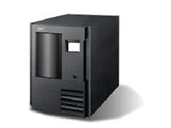
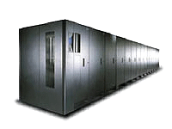
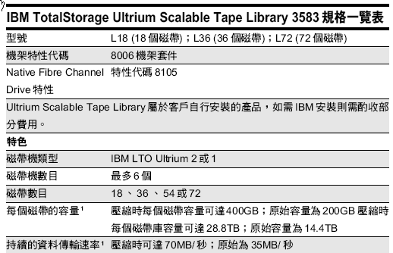
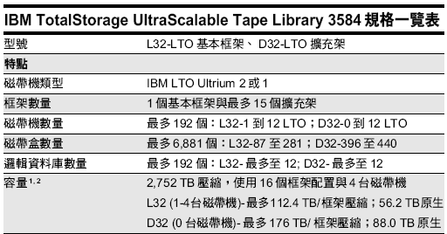
Backup Media –
By Storage (4)
Ex: Tape Library

Slide 7
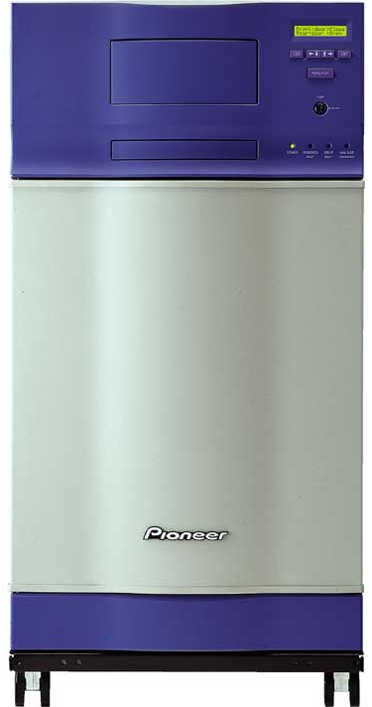
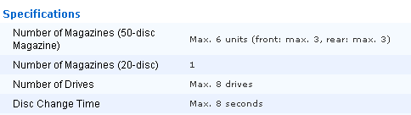
Backup Media –
By Storage (5)
Ex: JukeBox (Pioneer)

Slide 8
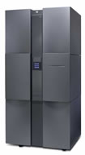
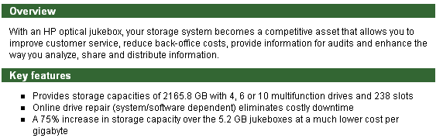
Backup Media –
By Storage (6)
Ex: JukeBox (HP)

Slide 9
Backup Media –
By Availability
Off-line Storage
  CD、DVD、MO
    Adv:
      low cost, high reliability
    Disadv:
      Not-convenient, low speed
Near-line Storage
  JukeBox、Tape Library
    Adv:
      High capacity, high reliability
    Disadv:
      High malfunction rate, Not-convenient
On-line Storage
  Disk Array (RAID)
    Adv:
      Fast and high availability
    Disadv:
      High cost

Slide 10
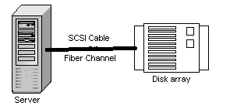

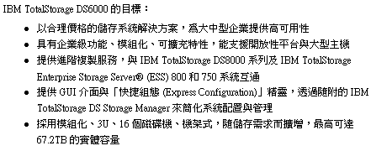
Backup Media –
By Enterprise Product (1)
RAID architecture

Slide 11
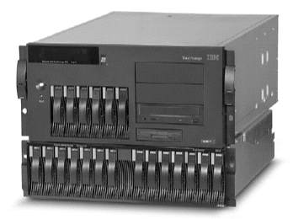
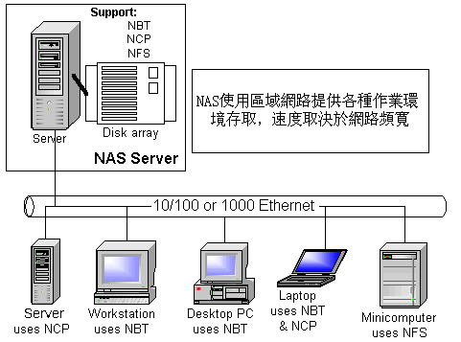
Backup Media –
By Enterprise Product (2)
NAS (Network Attached Storage)
  Storage + Server + Cross-platform access OS + network access protocol
IBM NAS 300G
Supported Protocol:
NFS, HTTP, FTP, CIFS
Netware

Slide 12
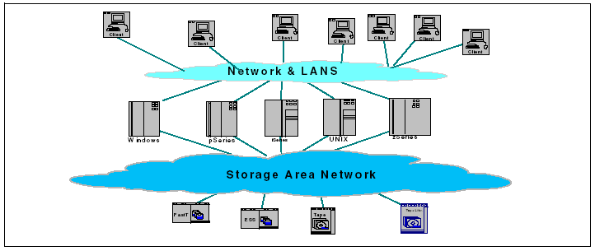
Backup Media –
By Enterprise Product (3)
SAN (Storage Area Network)
  A high-speed network that allows the direct connections between storage devices and servers

Slide 13
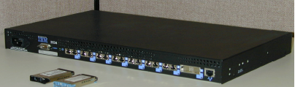
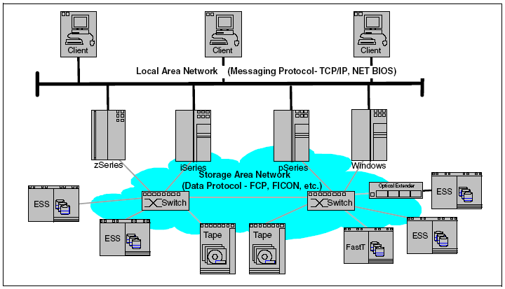
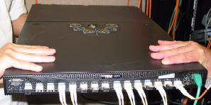
Backup Media –
By Enterprise Product (4)
  In SAN, data transfer can be in the following ways:
    Server to Storage
    Server to Server
    Storage to Storage

Slide 14
Backup Philosophy
Perform all dumps from one machine
Label your taps
Pick a reasonable backup interval
Choose filesystems carefully
Make daily dumps fit on one tape
Make filesystems smaller than your dump device
Keep Tapes off-site
Protect your backups
Limit activity during dumps
Check your tapes
Develop a tape life cycle
Design your data for backups
Prepare for the worst

Slide 15
Dumping filesystems – dump command (1)
Used to backup filesystem into a large file to a external device
Advantages:
  Backups can span multiple output media
  Files of any type can be backed up and restored
  Permissions, ownerships, and modification times are preserved
  Files with holes are handled correctly
  Backups can be performed incrementally
Limitations:
  Each filesystems must be dumped individually
  Only filesystems on the local machine can be dumped

Slide 16
Dumping filesystems – dump command (2)
Backup level
  0 ~ 9
    Level 0 ➔ full backup
    Level N ➔ incremental backup of Level≦ N-1
    for N = 1 ~ 9
dump command format
  % dump [arguments] file-system
dump command arguments
  u: update the /etc/dumpdates file after dump
  f: the output backup file
    Special device file, like /dev/nrsa0
    Ordinary file
    ‘-’ to standard out
    “user@host:file”
  d: tape density in bytes per inch
  s: tape length in feet

Slide 17
Dumping filesystems – dump command (3)
Ex:
  Full backup
tytsai@tybsd:/home> dump 0uf - / | gzip > /home/root.0.gz
DUMP: Date of this level 0 dump: Sun Nov 7 14:15:32 2004
DUMP: Date of last level 0 dump: the epoch
DUMP: Dumping /dev/ad0s1a (/) to standard output
DUMP: mapping (Pass I) [regular files]
DUMP: mapping (Pass II) [directories]
DUMP: estimated 2574705 tape blocks.
DUMP: dumping (Pass III) [directories]
DUMP: dumping (Pass IV) [regular files]
DUMP: 28.55% done, finished in 0:12
DUMP: 60.41% done, finished in 0:06
DUMP: 93.38% done, finished in 0:01
DUMP: DUMP: 2771926 tape blocks
DUMP: finished in 1033 seconds, throughput 2683 KBytes/sec
DUMP: level 0 dump on Sun Nov 7 14:15:32 2004
DUMP: DUMP IS DONE
339.739u 49.836s 17:25.91 37.2% 148+716k 14+6366io 1pf+0w
tytsai@tybsd:/home> cat /etc/dumpdates
/dev/ad0s1a 0 Sun Nov 7 14:15:32 2004
tytsai@tybsd:/home> ls -lh /home/root.0.gz
-rw-r--r-- 1 root wheel 795M Nov 7 14:32 /home/root.0.gz

Slide 18
Dumping filesystems – dump command (4)
Ex:
  Incremental backup
tytsai@tybsd:/home> dump 3uf - / | gzip > /home/root.3.gz
DUMP: Date of this level 3 dump: Sun Nov 7 14:37:58 2004
DUMP: Date of last level 0 dump: Sun Nov 7 14:15:32 2004
DUMP: Dumping /dev/ad0s1a (/) to standard output
DUMP: mapping (Pass I) [regular files]
DUMP: mapping (Pass II) [directories]
DUMP: estimated 706 tape blocks.
DUMP: dumping (Pass III) [directories]
DUMP: dumping (Pass IV) [regular files]
DUMP: DUMP: 496 tape blocks
DUMP: finished in less than a second
DUMP: level 3 dump on Sun Nov 7 14:37:58 2004
DUMP: DUMP IS DONE
tytsai@tybsd:/home> cat /etc/dumpdates
/dev/ad0s1a 0 Sun Nov 7 14:15:32 2004
/dev/ad0s1a 3 Sun Nov 7 14:37:58 2004
tytsai@tybsd:/home> ls -al /home/root.3.gz
-rw-r--r-- 1 root wheel 12643 Nov 7 14:41 /home/root.3.gz
tytsai@tybsd:/home> ls -alh /home/root.3.gz
-rw-r--r-- 1 root wheel 12K Nov 7 14:41 /home/root.3.gz

Slide 19
Dumping filesystems – dump command (5)
Default SCSI tape drive device file
System | Rewinding | Nonrewinding
FreeBSD | /dev/rsa0 | /dev/nrsa0
Red Hat | /dev/st0 | /dev/nst0
Solaris | /dev/rmt/0 | /dev/rmt/0n
SunOS | /dev/rst0 | /dev/nrst0

Slide 20
Restoring from dumps – restore command (1)
Restore can do
  Restoring individual files
  Restoring entire filesystem
Options of restore command
  i: interactive restore
  r: restore an entire filesystem
  f: the backup file that restore is going to use

Slide 21
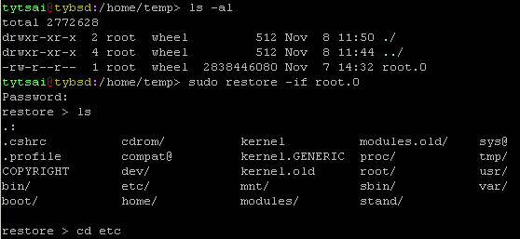
Restoring from dumps – restore command (2)
Restore individual file interactively

Slide 22
Restoring from dumps – restore command (3)
Restore individual file interactively (cont.)
restore > ?
Available commands are:
ls [arg] - list directory
cd arg - change directory
pwd - print current directory
add [arg] - add `arg' to list of files to be extracted
delete [arg] - delete `arg' from list of files to be extracted
extract - extract requested files
setmodes - set modes of requested directories
quit - immediately exit program
what - list dump header information
verbose - toggle verbose flag (useful with ``ls'')
help or `?' - print this list
If no `arg' is supplied, the current directory is used
restore >

Slide 23
Restoring from dumps – restore command (4)
Restore individual file interactively (cont.)
restore > add /etc/passwd
restore > extract
You have not read any tapes yet.
If you are extracting just a few files, start with the last volume
and work towards the first; restore can quickly skip tapes that
have no further files to extract. Otherwise, begin with volume 1.
Specify next volume #: 1
set owner/mode for '.'? [yn] n
restore > quit
tytsai@tybsd:/home/temp> ls -al etc
total 6
drwxr-xr-x 2 root wheel 512 Nov 4 17:09 ./
drwxr-xr-x 3 root wheel 512 Nov 8 11:57 ../
-rw-r--r-- 1 root wheel 1253 Oct 19 22:48 passwd
tytsai@tybsd:/home/temp>

Slide 24
Restoring from dumps – restore command (5)
Restore entire filesystem
  % restore -rf /home/temp/root.0
  Steps
    Restore level 0 first
    Restore incremental dumps
      0 0 0 0 0
      0 5 5 5 5
      0 3 2 5 4 5
      0 9 9 5 9 9 3 9 9 5 9 9
      0 3 5 9 3 5 9

Slide 25
Other archiving programs
tar command
  Read multiple files and packages them into one file
  % tar czvf name.tar.gz /etc/
  % tar xzvf name.tar.gz
  % tar cf – fromdir | ( cd todir ; tar xfp –)
dd command
  Copy filesystems between partitions of exactly the same size
  % dd if=/dev/rst0 of=/dev/rst1
  % dd if=/tmp/kern.flp of=/dev/fd0
  % dd if=/dev/da1 of=/dev/da2 bs=1048576

Slide 26
csie home backup
Using rsync
  % rsync –a --delete
    -a: archive mode
      Recursive and preserve everything
    --delete:
      Delete any file that are not in the sending side
0 4 * * 1 (/bin/date;cd /raid;/usr/local/bin/rsync -al --delete cp /backup/user/;/bin/date)
0 4 * * 2 (/bin/date;cd /raid;/usr/local/bin/rsync -al --delete gcp /backup/user/;/bin/date)
0 4 * * 3 (/bin/date;cd /raid;/usr/local/bin/rsync -al --delete staff /backup/user/;/bin/date)
0 4 * * 4 (/bin/date;cd /raid;/usr/local/bin/rsync -al --delete dcp /backup/user/;/bin/date)
0 4 * * 5 (/bin/date;cd /raid;/usr/local/bin/rsync -al --delete faculty /backup/user/;/bin/date)
0 4 * * 6 (/bin/date;cd /raid;/usr/local/bin/rsync -al --delete relative /backup/user/;/bin/date)
0 3 * * 2 (/bin/date;cd /raid;/usr/local/bin/rsync -al --delete alumni /backup/user/;/bin/date)

