Slide 1
Chapter 11
Syslog and Log Files

Slide 2
Log files
Execution information of each services
  sshd log files
  httpd log files
  ftpd log files
Purpose
  For post tracking
  Like insurance

Slide 3
Logging Policies
Common schemes
  Throw away all log files
  Rotate log files at periodic intervals
  Archiving log files
#!/bin/sh
/usr/bin/cd /var/log
/bin/mv logfile.2.gz logfile.3.gz
/bin/mv logfile.1.gz logfile.2.gz
/bin/mv logfile logfile.1
/bin/cat /dev/null > logfile
/bin/kill –signal pid
/usr/bin/gzip logfile.1
0 3 * * * /usr/bin/tar czvf /backup/logfile.`/bin/date +\%Y\%m\%d`.tar.gz /etc

Slide 4
Finding Log Files
Ways and locations
  Common directory
    /var/log, /var/adm
  Read software configuration files
    Ex: httpd.conf
    TransferLog /home/www/logs/access.log
  See /etc/syslog.conf

Slide 5
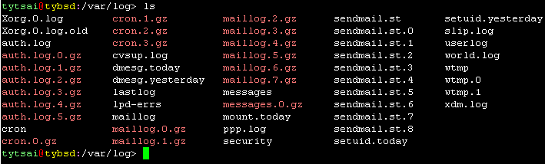
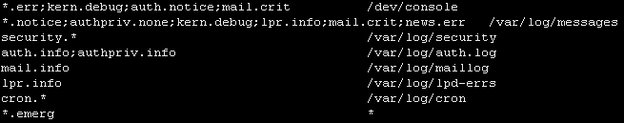
Under /var/log in FreeBSD (1)
You can see that under /var/log …
That is because syslogd …

Slide 6
Under /var/log in FreeBSD (2)
Why it rotates? That is because the newsyslog facility …
tytsai@tybsd:/etc> grep newsyslog crontab
0 * * * * root newsyslog
tytsai@tybsd:/etc>
newsyslog.conf
# logfilename [owner:group] mode count size when flags
/var/log/cron 600 3 100 * Z
/var/log/amd.log 644 7 100 * Z
/var/log/auth.log 600 7 100 * Z
/var/log/lpd-errs 644 7 100 * Z
/var/log/maillog 640 7 * @T00 Z
/var/log/sendmail.st 640 10 * 168 B
/var/log/messages 644 5 100 * Z
/var/log/all.log 600 7 * @T00 Z

Slide 7
Vendor Specifics
FreeBSD
  newsyslog utility
  /etc/periodic
Red Hat
  logrotate utility
  /etc/logrotate.conf, /etc/logrotate.d directory
tytsai@linux3:/etc/logrotate.d> less amd
/var/log/amd.log {
create 0640 root security
daily
rotate 10
notifempty
missingok
compress
}

Slide 8
Files Not to Manage
You can manage most log files yourself, except…
  /var/log/lastlog (/var/adm/lastlog)
    Record of each user’s last login
  /var/run/utmp (/etc/utmp)
    Record of each user that is currently logged in

Slide 9
Syslog –
The system event logger (1)
Two main functions
  To release programmers from the tedious of writing log files
  To put administrators in control of logging
Three parts:
  syslogd, /etc/syslog.conf
    The logging daemon and configure file
  openlog, syslog(), closelog()
    Library routines to use syslogd
  logger
    A user command that use syslogd from shell

Slide 10
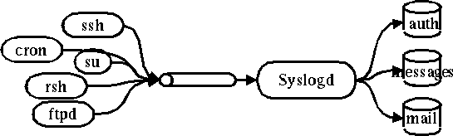
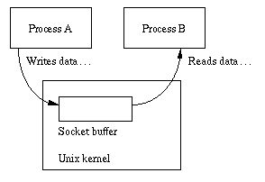
Syslog –
The system event logger (2)
/var/run/log
tytsai@tybsd:/var/run> ls -al | grep log
srw-rw-rw- 1 root wheel 0 Nov 7 15:12 log=

Slide 11
Configuring syslogd (1)
Basic format
  selector <Tab> action
    Selector: program.level
      Program: the program that sends the log message
      Level: the message severity level
    Action: tells what to do with the message
  Ex:
    mail.info /var/log/maillog

Slide 12
Configuring syslogd (2)
selector
  Syntax: facility.level
    Facility and level are predefined
    (see next page)
  Combined selector
    facility.level
    facility1,facility2.level
    facility1.level;facility2.level
    *.level
  Level indicate the minimum importance that a message must be logged
  A message matching any selector will be subject to the line’s action

Slide 13
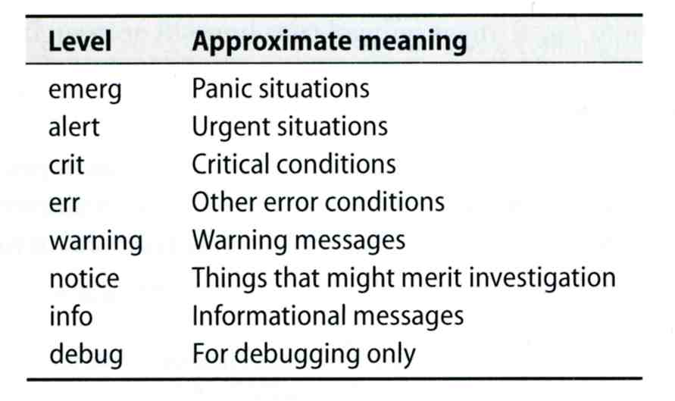
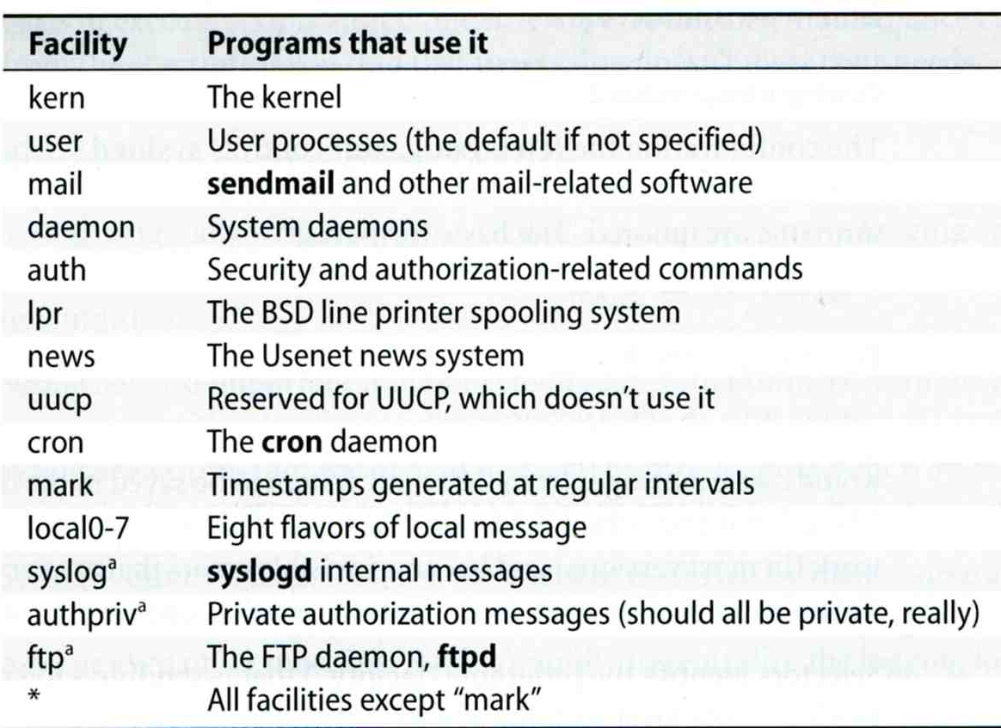
Configuring syslogd (3)

Slide 14
Configuring syslogd (4)
Action
  filename
    Write the message to a local file
  @hostname
    Forward the message to the syslogd on hostname
  @ipaddress
    Forwards the message to the host at that IP address
  user1, user2
    Write the message to the user’s screen if they are logged in
  *
    Write the message to all user logged in

Slide 15
Configuring syslogd (5)
Ex:
*.emerg /dev/console
*.err;kern,mark.debug;auth.notice;user.none /var/adm/console.log
*.info;kern,user,mark,auth.none @loghost
*alert;kern.crit;local0,local1,local2.info root
lpr.err ➔ /var/adm/console.log
@loghost

Slide 16
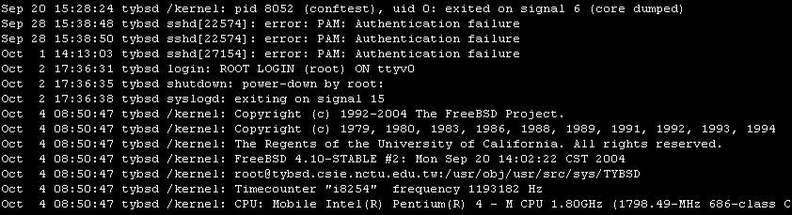
Configuring syslogd (6)
Output of syslogd

Slide 17
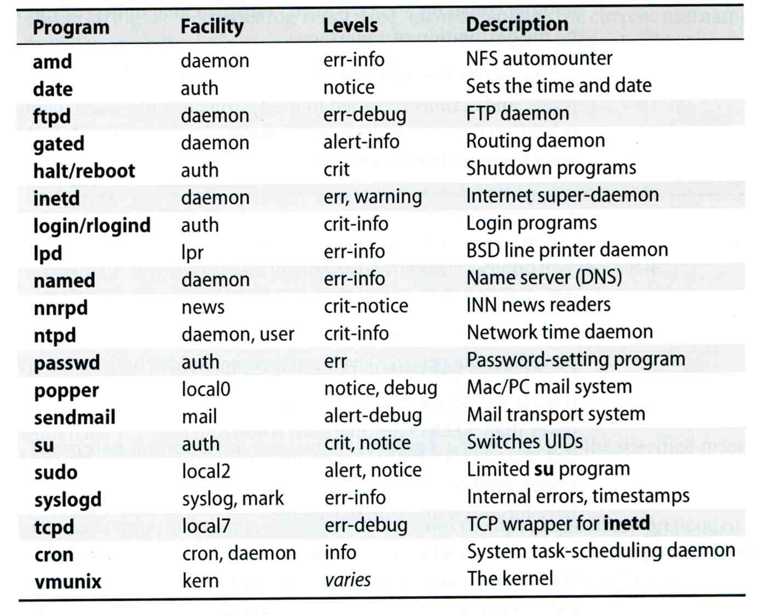
Software that use syslog

Slide 18
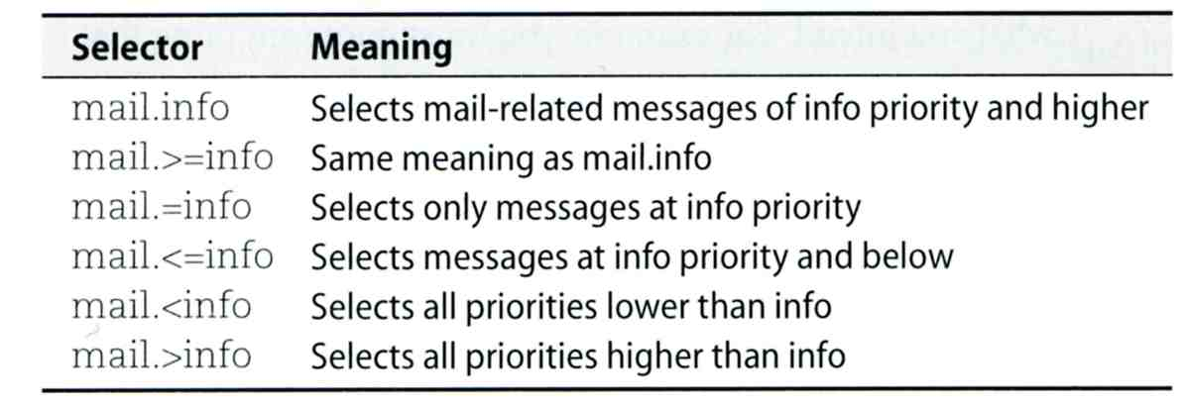
FreeBSD Enhancement (1)
Facility name
  FreeBSD allows you to select messages based on the name of the program
Severity level
!named
*.* /var/log/named.log

Slide 19
FreeBSD Enhancement (2)
Restriction log messages from remote hosts
  syslogd –a *.csie.nctu.edu.tw –a 140.113.209.0/24
  rc.conf
syslogd_flags="-a 140.113.209.0/24:* -a 140.113.17.0/24:*"

