Slide 1
Chapter 22
Web Hosting and Internet Servers

Slide 2
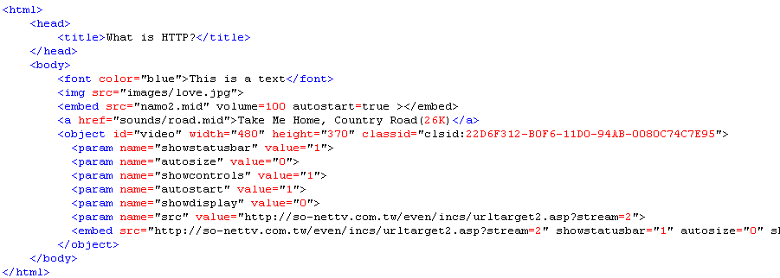
Web Hosting Basics (1)
HTTP
  Hyper-Text Transfer Protocol
    TCP-based protocol
    Used to format, transmit, and link documents of variety media types
      Text, picture, sound, animation, video, …

Slide 3
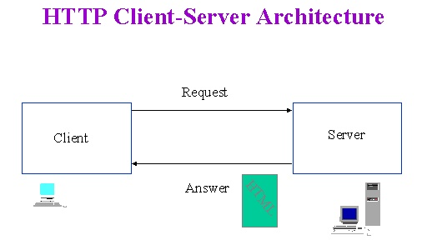
Web Hosting Basics (2)
Client-server architecture
  Web Server: Answer HTTP request
  Web Client: Request certain page using URL

Slide 4
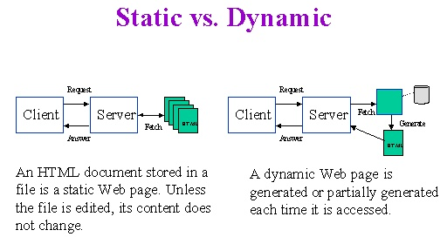
Web Hosting Basics (3)
Static vs. Dynamic Pages

Slide 5
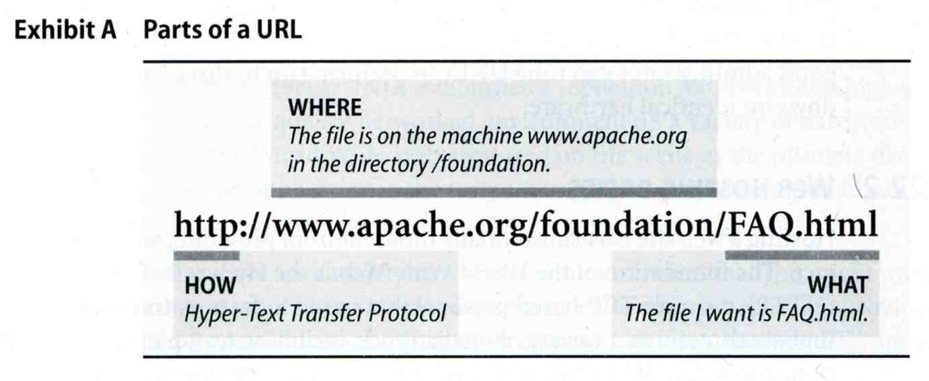
URL (1)
Uniform Resource Locator
  Describe how to access an object shared on the Internet
    Protocol
    Hostname
    TCP/IP port
    Directory
    Filename
Notes:
透過 網路, 藉由不同的通訊協定來存取 Internet 上所分享的東西

Slide 6
URL (2)
URL Protocols
Proto | What it does | Example
http | Accesses a remote file via HTTP | http://www.csie.nctu.edu.tw
https | Accesses a remote file via HTTP/SSL | https://www.csie.nctu.edu.tw
ftp | Accesses a remote file via FTP | ftp://ftp.csie.nctu.edu.tw/
mailto | Sends mail | mailto:tytsai@csie.nctu.edu.tw
news | Accesses Usenet newsgroups | news:tw.bbs.comp.hardware
telnet | Logs in to a remote computer | telnet://bbs.csie.nctu.edu.tw
file | Access a local file | file:///home/tytsai/.tcshrc

Slide 7
URL (3)
Using “telnet” to web server
tytsai@ccduty:~> telnet www.csie.nctu.edu.tw 80
Trying 140.113.209.63...
Connected to www.csie.nctu.edu.tw.
Escape character is '^]'.
GET /note.html HTTP/1.0
HTTP/1.1 200 OK
Date: Sat, 04 Dec 2004 04:39:22 GMT
Server: Apache/1.3.31 (Unix) mod_ssl/2.8.18 OpenSSL/0.9.7d PHP/4.3.7 PHP/3.0.18
Last-Modified: Tue, 27 Jul 2004 04:58:25 GMT
ETag: "10e2a57-3a5-4105e0f1"
Accept-Ranges: bytes
Content-Length: 933
Connection: close
Content-Type: text/html
<html>
<title>最新消息!</title>
…
</html>
Connection closed by foreign host.

Slide 8
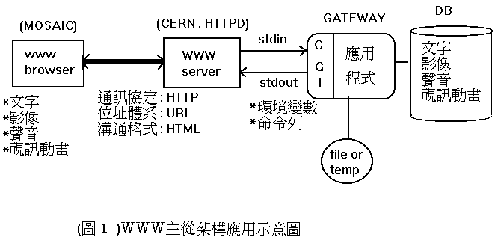
CGI
Common Gateway Interface
  A specification that allows an HTTP server to exchange information with other programs

Slide 9
Virtual Interface
Idea
  Let single machine responds to more IP addresses than it has physical network interfaces
  Each of the virtual network interface can be associated with different domain name
Ex:
  smtp.csie.nctu.edu.tw one NIC with two IP
{tytsai@smtp}/etc> ifconfig
fxp0: flags=8843<UP,BROADCAST,RUNNING,SIMPLEX,MULTICAST> mtu 1500
inet 140.113.235.235 netmask 0xffffff00 broadcast 140.113.235.255
inet 140.113.235.211 netmask 0xffffffff broadcast 140.113.235.211
ether 00:03:47:24:6c:e2
media: Ethernet autoselect (100baseTX <full-duplex>)
status: active
lo0: flags=8049<UP,LOOPBACK,RUNNING,MULTICAST> mtu 16384
inet 127.0.0.1 netmask 0xff000000

Slide 10
Virtual Interface Configuration –
FreeBSD
Using “ifconfig” command and “alias” option
  % ifconfig fxp0 inet 140.113.235.211 netmask 255.255.255.255 alias
  % ifconfig fxp0 inet 140.113.235.211 delete
  (when you want to delete it)
Specify in /etc/rc.conf
ifconfig_fxp0="inet 140.113.235.235 netmask 255.255.255.0"
ifconfig_fxp0_alias0="inet 140.113.235.211 netmask 255.255.255.255"
defaultrouter="140.113.235.254"
hostname="smtp"
…

Slide 11
Virtual Interface Configuration –
Linux
Using ifconfig command
  % ifconfig eth0:0 140.113.235.6 netmask 255.255.255.0 up
Add file under /etc/sysconfig/network-scripts/
  Original IP: /etc/sysconfig/network-scripts/ifcfg-eth0
  Add /etc/sysconfig/network-scripts/ifcfg-eth0:0
DEVICE=eth0:0
BOOTPROTO=static
BROADCAST=140.113.235.255
IPADDR=140.113.235.6
NETMASK=255.255.255.0
NETWORK=140.113.235.0
ONBOOT=yes

Slide 12
Virtual Interface Configuration –
Solaris
Edit /etc/hostname.interface:1 and /etc/inet/hosts
Ex:
  /etc/hostname.hme0
  Edit /etc/hostname.hme0:1 and /etc/inet/hosts
tytsai@ccsun3:/etc/inet> cat /etc/hostname.hme0
ccsun3
tytsai@ccsun3:/etc/inet> cat /etc/hostname.hme0:1
ccsun10
tytsai@ccsun3:/etc/inet> cat /etc/inet/hosts
127.0.0.1 localhost
140.113.209.103 ccsun3
140.113.209.110 ccsun10
tytsai@ccsun3:/etc/inet> ifconfig -a
lo0: flags=1000849<UP,LOOPBACK,RUNNING,MULTICAST,IPv4> mtu 8232 index 1
inet 127.0.0.1 netmask ff000000
hme0: flags=1000843<UP,BROADCAST,RUNNING,MULTICAST,IPv4> mtu 1500 index 2
inet 140.113.209.103 netmask ffffff00 broadcast 140.113.209.255
hme0:1: flags=1000843<UP,BROADCAST,RUNNING,MULTICAST,IPv4> mtu 1500 index 2
inet 140.113.209.110 netmask ffffff00 broadcast 140.113.209.255

