Slide 1
Exercise 3 –
Build X window
Announced Date: 2005/10/27

Slide 2
Outline
X Window System
  Introduction
  Architecture
  X11 implementation
  The Window Manager
Steps of Exercise
  Install X11
  Configuring X11
  Install Afterstep
  Configuring Afterstep
Appendix
  Classic S Apps
  X Startup
  Remote X client
  X11 Forwarding

Slide 3
X Window System (1)
Introduction
  What is X Window System?
    The X Windows System, also referred to as ‘X’ or “X11”, is the standard graphical engine for Unix and Linux.
    It is largely OS and hardware independent, it is network-transparent, and it supports many different desktops.
  History
    1984: The X Window system was developed as part of Project Athena at MIT.
    1987: X Version 11 is released. X is now controlled and maintained by the Open Group.
    1993: X11R6

Slide 4
X Window System (2)
  Naming
    X Window System
    X Version 11
    X Window System, Version 11
    X11
  Version
    X11R6
      X Window System Version 11 Release 6
  Latest version
    From X.Org
      X11R6.8.2 Feb.9 2005

Slide 5
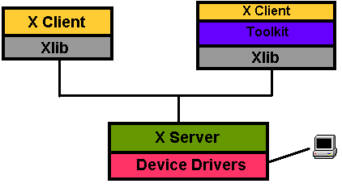
X Window System (3)
Architecture:
  A client-server architecture
    The X client request display service
    The X server provide display service
    Communicate with X Protocol

Slide 6
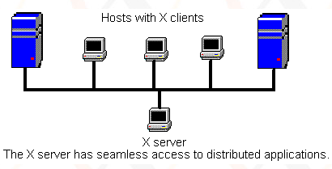
X Window System (4)
  Client-Server Design
    Client
      An application written using X libraries (e.g. Xlib)
      Request service (like create window)
      Receive events from X server (like mouse input)
    Server
      Runs locally and accepts multiple X clients
      Manage the keyboard, mouse and display device
      Create, draw and destroy graphic objects on screen

Slide 7
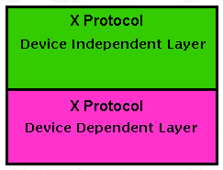
X Window System (5)
  X Protocol
    The X Protocol is also divided into device dependent and device independent layers.
    Advantages of X protocol
      The X server is highly portable
      (various OS, Language)
      The X Clients also have high portability
      X support most oriented network protocol
      Local and network based computing look and feel the same

Slide 8


X11 implementation
Open-source implementations of X Window System
  XFree86 project
    FreeBSD 4.10-Release, 5.2.1-Release
    Latest Version: 4.5.0 Mar. 16, 2005
  Xorg foundation
    FreeBSD 5.3-Release
    X11 official flavor
    Latest Version: 6.8.2 Feb. 9, 2005
From 1992
From 2004

Slide 9
The Window Manager (1)
Window Manager
  A special kind of “X Client” provides certain look-and-feel window in front of you.
    Background, desktop, theme
    Virtual desktop
    Window attributes and operations
      Size: resize, minimize, maximize
      Position: Overlap, move

Slide 10
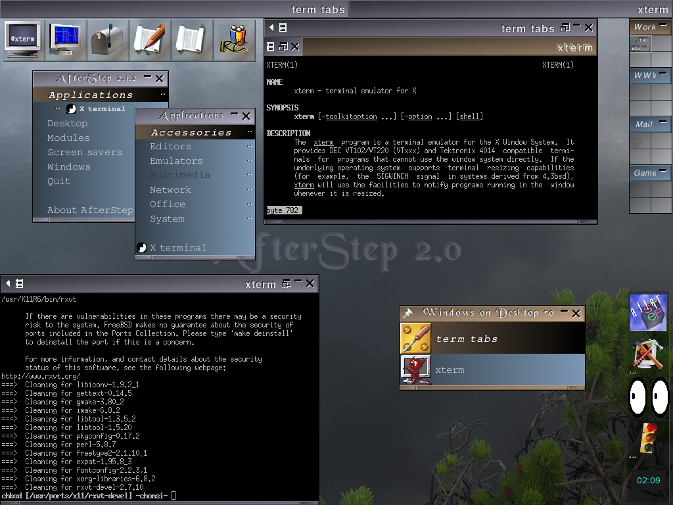
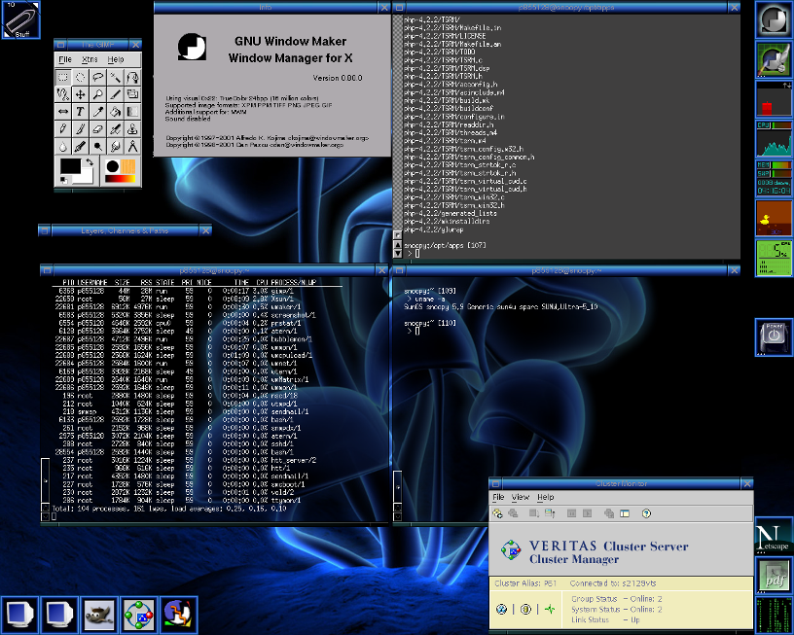
The Window Manager (2)
Examples:
    AfterStep
    Enlightenment
    Window Maker
    Gnome
    KDE
    …

Slide 11
Steps of this exercise
Install X11
Configuring X11
Install Afterstep
Configuring Afterstep

Slide 12
Installing X11 (1)
Use cvsup to update your ports
  /usr/local/bin/cvsup –g –L 1 /usr/local/etc/cvsup-ports
Pre-steps:
  We use Xorg as our X Server
  Add the following line in /etc/make.conf
      X_WINDOW_SYSTEM=xorg
  Do this line
      pkg_delete -f /var/db/pkg/imake-4* /var/db/pkg/XFree86-*
  Your “PATH” environment variable
      Edit /etc/csh.cshrc
      set path = (/bin /sbin /usr/bin /usr/sbin /usr/local/bin /usr/X11R6/bin )

Slide 13
Installing X11 (2)
We use Xorg as our X Server
  To build and install Xorg from the ports
    % login as root
    % cd /usr/ports/x11/xorg
    % make install clean
If you want to install XFree86
    % login as root
    % cd /usr/ports/x11/XFree86-4
    % make install clean
It will run about 50 minutes
P4 1.8G 1GB Ram 100MB NIC
Install Xorg needs 4G free space

Slide 14
Configuring X11 (1)
Pre-step – know your hardware
  Monitor specifications
    Horizon Synchronization frequency
      Ex: 31 ~ 81 KHz
    Vertical Synchronization frequency
      Ex: 56 ~ 76 KHz
  Video adaptor chipset
      Ex: ATi Radeon 9200SE
      Ex: nVIDIA GeFource FX5200
      Ex: ATI Mobility RADEON 7500 (16M) (IBMT30)
  Video Adapter Memory
      Ex:128MB

Slide 15
Configuring X11 (2)
Steps of X11 configuration
  Generate an X11 configuration skeleton file
    % Xorg –configure (Xorg)
      The file will be put in /root/xorg.conf.new
    % XFree86 –configure (XFree86)
      The file will be put in /root/XF86Config.new

Slide 16
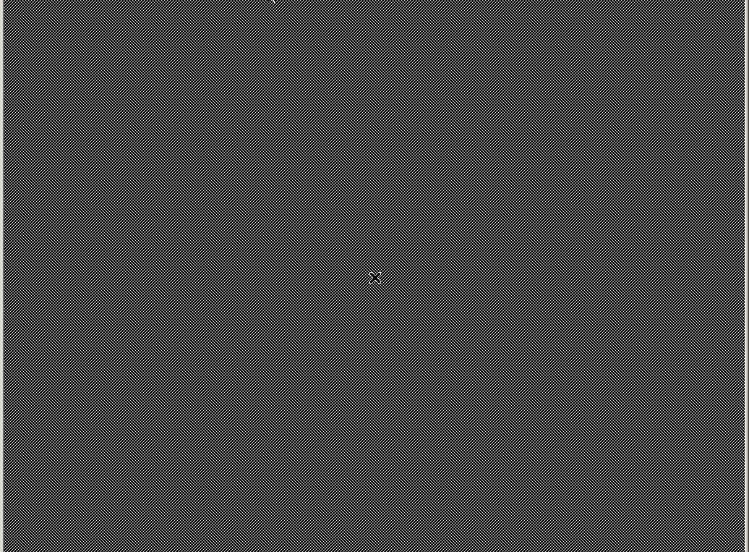
Configuring X11 (3)
Test the existing configuration
  % Xorg –config /root/xorg.conf.new (Xorg)
  % XFree86 –xf86config /root/XF86Config.new (XFree86)
    If a black and grey grid and an X mouse cursor
    appear, the configuration was successful
    Press “Ctrl+Alt+Backspace” to leave the test

Slide 17
Configuring X11 (4)
  Tune Configuration file
    Edit /root/xorg.conf.new (Xorg)
    Edit /root/XF86Config.new (XFree86)
      Section Monitor
      Section Screen
      Section InputDevice
Section "InputDevice"
Identifier "Mouse0"
Driver "mouse"
Option "Protocol" "auto"
Option "Device" "/dev/sysmouse"
Option "ZAxisMapping" "4 5"
EndSection
Section "Screen"
Identifier "Screen0"
Device "Card0"
Monitor "Monitor0“
DefaultDepth 24
SubSection "Display"
Viewport 0 0
Depth 24
Modes "1280x1024" "1024x768"
EndSubSection
EndSection
Section "Monitor"
Identifier "Monitor0"
VendorName "Monitor Vendor"
ModelName "Monitor Model“
HorizSync 31.0 - 81.0
VertRefresh 56.0 - 76.0
EndSection

Slide 18
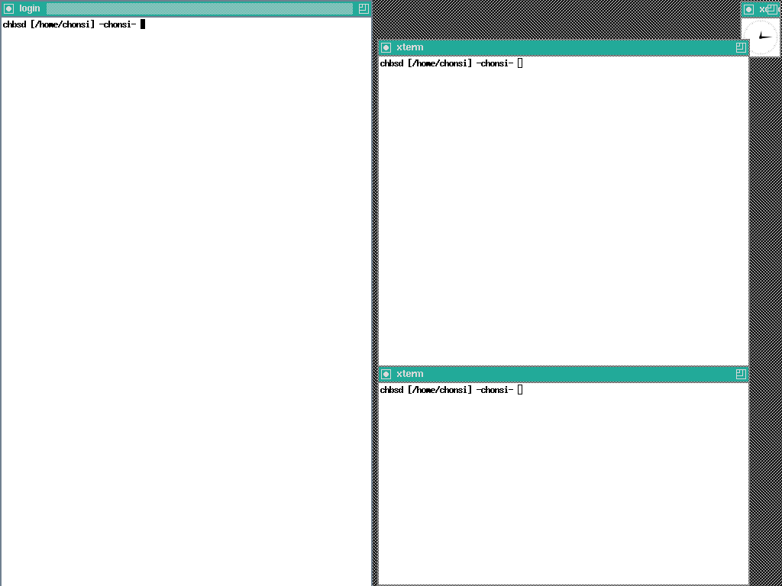
Configuring X11 (5)
  Copy configuration file to real place
    % cp /root/xorg.conf.new /etc/X11/xorg.conf (Xorg)
    % cp /root/XF86Config.new /etc/X11/XF86Config (XFree86)
  Startup X window
    % startx
  [Comment]
    Switch to Virtual Console
      Press “Ctrl+Alt+F1~F8”
    View xinitrc
      /usr/X11R6/lib/X11/xinit/xinitrc
# start some nice programs
twm &
xclock -geometry 50x50-1+1 &
xterm -geometry 80x50+494+51 &
xterm -geometry 80x20+494-0 &
exec xterm -geometry 80x66+0+0 -name login

Slide 19
Install Afterstep (1)
Here we use afterstep as our WM
  http://www.afterstep.org/
Installation
  % cd /usr/ports/x11-wm/afterstep-stable
  % make –DWITH_DIFFERENT_LOOKNFEELS
  –DWITH_SAVEWINDOWS install clean

Slide 20
Install Afterstep (2)
Configuring X11 to use afterstep
  Edit “xinitrc”
    File Location:
      System Default: /usr/X11R6/lib/X11/xinit/xinitrc
      Personal: ~/.xinitrc
    Format: just like a shell script!
System Default
To execute afterstep
# start some nice programs
twm &
xclock -geometry 50x50-1+1 &
xterm -geometry 80x50+494+51 &
xterm -geometry 80x20+494-0 &
exec xterm -geometry 80x66+0+0 -name login
# start some nice programs
exec afterstep

Slide 21
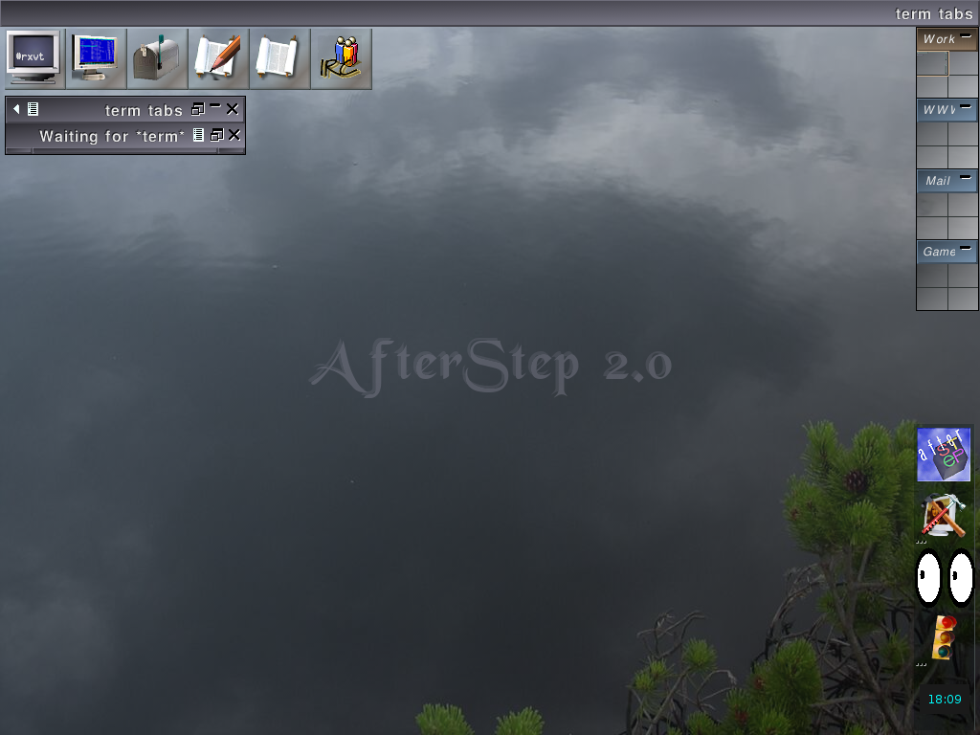
Install Afterstep (3)
Run Your X-Window
  % startx
Usage
  Ctrl + Alt + Backspace
  ➔ force to quit X
  Left button: copy
  Right button: paste

Slide 22
AfterStep Configuration (1)
Location of configuration file
  Global configuration file directory
    /usr/X11R6/share/afterstep/
  Personal configuration file directory
    ~/.afterstep/
When AfterStep starts
  Personal configuration first
    It first tries to read personal configuration files, and then read global configuration files for those not found.
    Follow “.include” configuration
  Global configuration if missing personal configuration
To make personal configuration
  Copy what you want to change from global to personal and modify it. And
  Add “.include” to include other global you need.

Slide 23
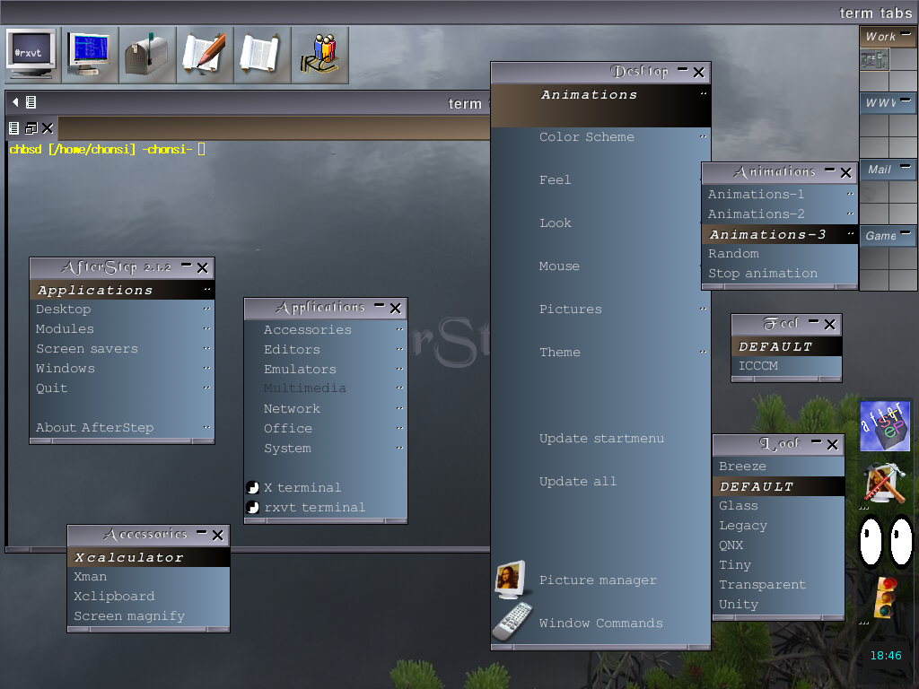
AfterStep Configuration (2)
Pager module
WinList
Wharf module
Start menu
WinTab
Animation
feel
look
MinitorWharf

Slide 24
AfterStep Configuration (3)
Under /usr/X11R6/share/afterstep/
Name | Purpose
base | Afterstep configuration file
autoexec | Define what is run when AfterStep starts and restarts
animate | Animate Module configuration file
pager | Pager module configuration file
wharf | Wharf/MonitorWharf module configuration file
winlist | WinList module configuration file
start/ | Start menu when you click left button
feels/ | Define how AfterStep feels
looks/ | Define how AfterStep looks

Slide 25
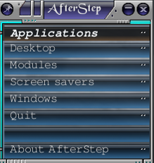
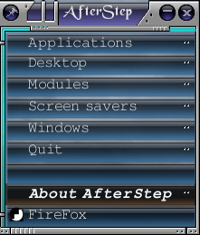
AfterStep Configuration (4)
Steps to add something to start menu
  install your favorite applications first
  Add entry under directory
  Edit the entry file
  Update menu
% ls
0_Applications 3_Screen_savers 6_nop
1_Desktop 4_Windows 7_About_AfterStep
2_Modules 5_Quit
Exec “Firefox" exec firefox &
MiniPixmap "mini-app.xpm"
% ls
0_Applications 3_Screen_savers 6_nop
1_Desktop 4_Windows 7_About_AfterStep
2_Modules 5_Quit f_firefox

Slide 26
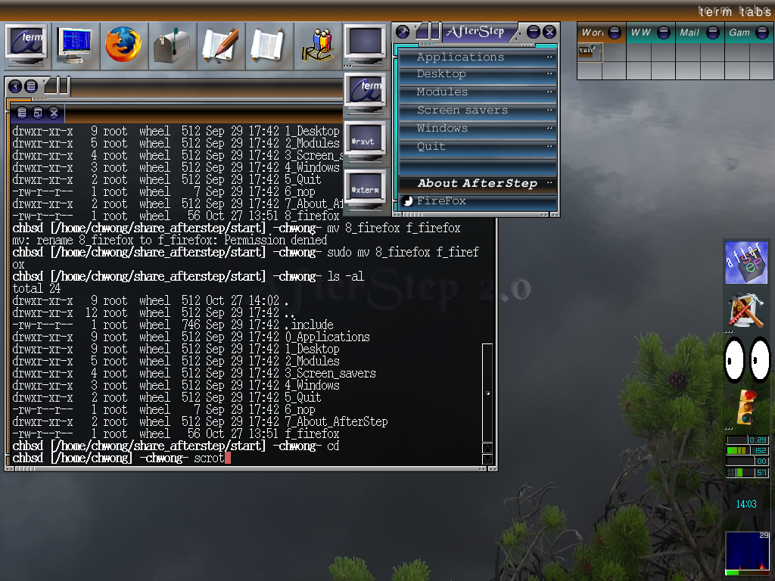
AfterStep Configuration (5)
Add something to wharf module
  Edit wharf configuration file (ex. add Term Folder)
…
*Wharf Terms large/Monitor1,dots/3_dots Folder
*Wharf aterm aterm Exec "-" aterm -tr -tint blue -fg yellow -bg black &
*Wharf rxvt rxvt Exec "-" rxvt -tr -fg yellow -bg black &
*Wharf eterm eterm Exec "-" Eterm -O --tint blue -fg yellow -bg black &
*Wharf xterm xterm Exec "-" xterm -fg yellow -bg blue &
*Wharf ~Folder
…

Slide 27
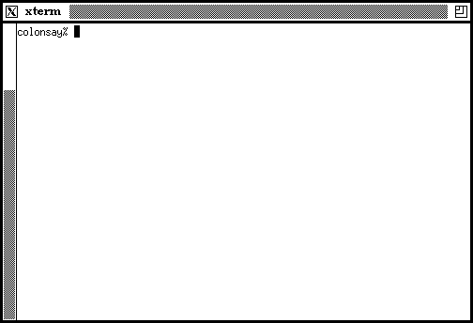

Appendix A: classic x apps (1)
xterm
xclock

Slide 28





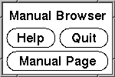
Appendix A: classic x apps (2)
xeyes
xbiff
xman
Not this

Slide 29
Appendix B: X Startup (1)
xinit - X Window System initializer
  xinit [ [ client ] options ] [ -- [ server ] [ display ] options ]
  Files
    Default client script:
      ~/.xinitrc
      /usr/X11R6/lib/X11/xinit/xinitrc
    (run xterm if .xinitrc does not exist)
    Default server script:
      ~/ .xserverrc
      / usr/X11R6/lib/X11/xinit/xserverrc
    (run X if .xserverrc does not exist)
    startx:
      script to initiate an X session

Slide 30
Appendix B: X Startup (2)
xdm - X Display Manager
  Xdm provides services similar to those provided byinit, getty and login on character terminals
  Files:
    /etc/ttys
    Default script
      ~/.xsession
ttyv8 "/usr/X11R6/bin/xdm -nodaemon" xterm on secure

Slide 31
Appendix C: remote x-client
To launch an X client from a remote host for display on the local X server, you need to do following steps:
  Start X Server with tcp connection support
    %startx -listen_tcp
  Permit for the remote host to display X clients on the local machine.
    %xhost +remotehost
  set DISPLAY for remote X clients
    %setenv DISPLAY=server:display
[hostname]:displaynumber[.screennumber]
not needed if localhost
“0” in most cases
defaults to “0”

Slide 32
Appendix D: X11 forwarding
To forward X11 connection
  Connection to X11 DISPLAY can be forward by ssh, any X11 programs started will go through the encrypted channel.
  Server:
    Enables X11 forwarding: ssh -X
    Enables trusted X11 forwarding: ssh –Y
  Client:
    Execute any X clients you want
  ※Note:
    X11 forwarding can represent a security hazard.
X11 forwarding should be enabled with caution. Users with the ability to bypass file permissions on the remote host (for the user's X authorization database) can access the local X11 display through the forwarded connection. An attacker may then be able to perform activities such as keystroke monitoring.

