Slide 1
Exercise 6
Apache and MySQL

Slide 2
Outline
Apache introduction
SQL Introduction
Install Apache + MySQL + PHP
Administration of Apache
Administration of MySQL
Exercise

Slide 3
DSO (1)
Dynamic Shared Object
  A way to build a piece of program code in a special format for loading it at run-time into the address space of an executable program
Two ways to use DSO
  Shared Library
    Reside in /usr/lib
    Link to the executable program is established at build time
  Shared Object files
    Reside in program-specific directory
    No link to the executable program
    Executable program loads the DSO at run time via dlopen()

Slide 4
DSO (2)
Apache support DSO
  Apache DSO module
    mod_so
  Build module with apache source tree
    Put module source into apache source tree
    Build apache and module
    Put module to libexec directory for future loading
  Build module outside the apache source tree

Slide 5
Apache
Web httpd server that
  HTTP/1.1 compliant web server
  Modular design
  Can be customised by writing modules using Apache module API
  Freely available cross many platforms
Two main parts
  core
    Implement basic functions
  Modules
    Extend or override the functionality of the server
    Example:
      Access control, logging, CGI, proxy, cache control, PHP…

Slide 6
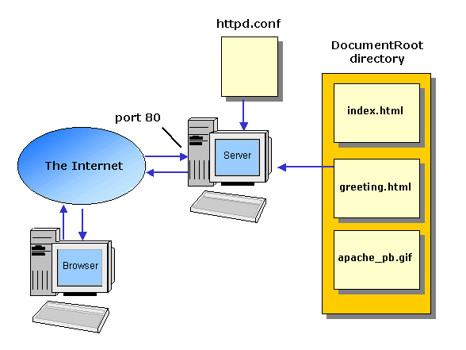
How Apache Works – request and response

Slide 7
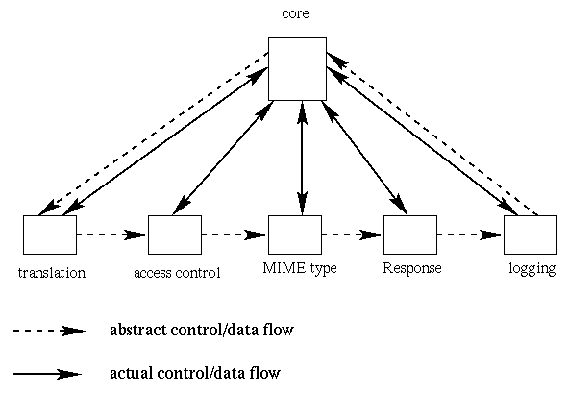
How Apache Works –
Each request-response
Apache breaks client request into several steps which are implemented as modules
Notes:
Translation:
filename translation:
Determine what information is wanted and where in storage it is
Access control
authentication and authorization
Is the user who they say they are, and Is the user authorized here?
MIME
text or image or sound or video or, …
Response
return to the client
Logging
logging the request

Slide 8
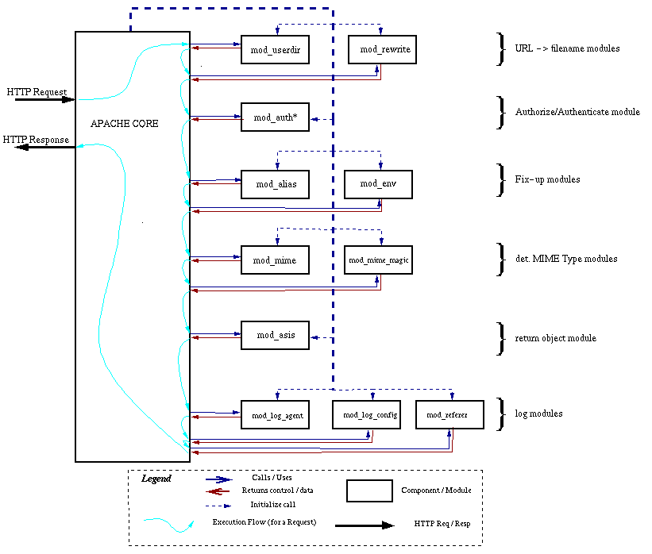
A p a c h e
D e t a i l

Slide 9
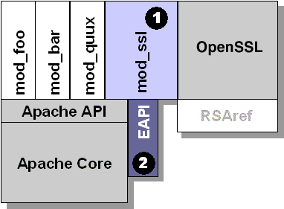
Apache with mod_ssl

Slide 10
Installation

Slide 11
In this exercise …
We want to install apache + PHP + MySQL + mod_ssl
Files that we need …
  apache_1.3.33.tar.gz
  php-4.3.9.tar.gz
  mysql-4.1.7.tar.gz
  mod_ssl-2.8.22-1.3.33.tar.gz
  openssl-0.9.7e.tar.gz
  Move this file into /usr/local/src
Install sequence
  Untar all tarballs
  Install MySQL
  Install openssl
  Configure mod_ssl and apache first
  Install PHP
  Install apache
  Test PHP in apache

Slide 12
Install Sequence – untar all tarballs
Using tar command
  % cd /usr/local/src
  % sudo tar xzvf apache_1.3.33.tar.gz
  % sudo tar xzvf mod_ssl-2.8.22-1.3.33.tar.gz
  % sudo tar xzvf openssl-0.9.7e.tar.gz
  % sudo tar xzvf mysql-4.1.7.tar.gzs
  % sudo tar xzvf php-4.3.9.tar.gz
  After you untar all these three tarballs, you will get following dirs
    apache_1.3.33/
    mod_ssl-2.8.22-1.3.33/
    openssl-0.9.7e/
    mysql-4.1.7/
    php-4.3.9/

Slide 13
Install Sequence –
MySQL (1)
Resource
  http://mysql.nctu.edu.tw
Install Steps
  Configure to generate Makefile
  Make and make install
  Create “mysql” user and group to own mysql
  Copy config file and initial basic DBs
  Start mysqld and test
  Securing initial MySQL accounts

Slide 14
Install Sequence –
MySQL (2)
Configure to generate Makefile
  With the following options
    --with-charset=big5
    --prefix=/home/mysql
    --with-mysqld-user=mysql
  % cd /usr/local/src/mysql-4.1.7
  % sudo ./configure --with-charset=big5 --with-mysqld-user=mysql \
  --prefix=/home/mysql
Make and make install
  % sudo make
  % sudo make install

Slide 15
Install Sequence –
MySQL (3)
Create mysql user and group
  Edit /etc/group
  Using vipw to add “mysql” user
  % sudo chown –R root:mysql /home/mysql
  % sudo chown –R mysql /home/mysql/var
Copy config file and initial basic DBs
  % cd /usr/local/src/mysql-4.1.7
  % sudo cp support-files/my-huge.cnf /etc/my.cnf
  % cd /home/mysql
  % sudo bin/mysql_install_db --user=mysql

Slide 16
Install Sequence –
MySQL (4)
Start mysqld
  Command line
    % /home/mysql/bin/mysqld_safe --user=mysql &
  Copy management script to /usr/local/etc/rc.d/init.d
    % cd /usr/local/src/mysql-4.1.7/support-files
    % sudo cp mysql.server /usr/local/etc/rc.d/mysql.server.sh
    % sudo chmod u+x /usr/local/etc/rc.d/mysql.server.sh
  Edit /etc/my.cnf
[client]
#password = your_password
port = 3306
socket = /tmp/mysql.sock
# Here follows entries for some specific programs
[mysql.server]
basedir=/home/mysql
# The MySQL server
[mysqld]
port = 3306
user = mysql

Slide 17
Install Sequence –
MySQL (5)
  Test
    % mysql –u root –p
      The initial password for root is empty
tytsai@tybsd:/var/log> mysql -u root -p
Enter password:
Welcome to the MySQL monitor. Commands end with ; or \g.
Your MySQL connection id is 2 to server version: 4.1.7-log
Type 'help;' or '\h' for help. Type '\c' to clear the buffer.
mysql> show databases;
+----------+
| Database|
+----------+
| mysql |
| test |
+----------+
2 rows in set (0.27 sec)
mysql> exit
Bye

Slide 18
Install Sequence –
MySQL (6)
mysql> SELECT Host, User From mysql.user;
+-------------------------+------+
| Host | User |
+-------------------------+------+
| localhost | |
| localhost | root |
| tybsd.csie.nctu.edu.tw | |
| tybsd.csie.nctu.edu.tw | root |
+-------------------------+------+
Securing initial accounts
  Two initial accounts
    root
    anonymous
tytsai@tybsd:~> mysql -u root -p
Enter password:
Welcome to the MySQL monitor. Commands end with ; or \g.
Your MySQL connection id is 4 to server version: 4.1.7-log
Type 'help;' or '\h' for help. Type '\c' to clear the buffer.
mysql> UPDATE mysql.user SET Password = PASSWORD(‘user123') WHERE User = '';
Query OK, 2 rows affected (0.26 sec)
Rows matched: 2 Changed: 2 Warnings: 0
mysql> UPDATE mysql.user SET Password = PASSWORD(‘root123') WHERE User = 'root';
Query OK, 2 rows affected (0.00 sec)
Rows matched: 2 Changed: 2 Warnings: 0
mysql> FLUSH PRIVILEGES;
Query OK, 0 rows affected (0.00 sec)

Slide 19
Install Sequence – openssl
Resource
  http://www.openssl.org
Install sequence
  % cd /usr/local/src/openssl-0.9.7e
  % ./config
  % make
  % make test
  % make install

Slide 20
Install Sequence – configure mod_ssl and apache
mod_ssl
  % cd /usr/local/src/mod_ssl-2.8.22-1.3.33
  % ./configure --with-apache=/usr/local/src/apache_1.3.33
apache
  % cd /usr/local/src/apache_1.3.33
  % ./configure --prefix=/usr/local/apache

Slide 21
Install Sequence –
PHP (1)
Resource
  http://www.php.net
Install Steps
  configure PHP to use mysql with apache
  Make and make install
  Setup php.ini file

Slide 22
Install Sequence –
PHP (2)
Configure PHP to use MySQL with apache
  With the following options
    --with-mysql=/home/mysql
    --with-apache=/usr/local/src/apache_1.3.33
    --enable-track-vars
  % cd /usr/local/src/php-4.3.9
  % ./configure --with-mysql=/home/mysql \
  --with-apache=/usr/local/src/apache_1.3.33 –enable-track-vars
Make and make install
  % make
  % make install

Slide 23
Install Sequence –
PHP (3)
Setup php.ini file
  % cd /usr/local/src/php-4.3.9
  % cp php.ini-dist /usr/local/lib/php.ini

Slide 24
Install Sequence –
Apache (1)
Resource
  http://httpd.apache.org/
Install Sequence
  Configure to support ssl and php
  Make
  Make certificate
  Make install

Slide 25
Install Sequence –
Apache (2)
Configure
  With the following options
    --prefix=/usr/local/apache
    --enable-shared=max
    --enable-module=ssl
    --activate-module=src/modules/php4/libphp4.a
  % cd /usr/local/src/apache_1.3.33
  % setenv SSL_BASE "../openssl-0.9.7e"
  % ./configure --prefix=/usr/local/apache --enable-shared=max \
  --enable-module=ssl --activate-module=src/modules/php4/libphp4.a
Make
  % make

Slide 26
Install Sequence –
Apache (3)
Make certificate
  % make certificate TYPE=dummy
Make install
  % make install

Slide 27
Install Sequence – test PHP in apache (1)
Edit httpd.conf to support php
  % cd /usr/loca/apache/conf
  % mkdir /www ; mkdir /www/data
  % Edit httpd.conf
…
AddType application/x-httpd-php .php .phtml .php3
AddType application/x-httpd-php-source .phps
…
ServerName tybsd.csie.nctu.edu.tw
# DocumentRoot "/usr/local/apache/htdocs"
DocumentRoot "/www/data“
…
# <Directory "/usr/local/apache/htdocs">
<Directory "/www/data">
<IfModule mod_dir.c>
DirectoryIndex index.php index.html index.htm
</IfModule>

Slide 28
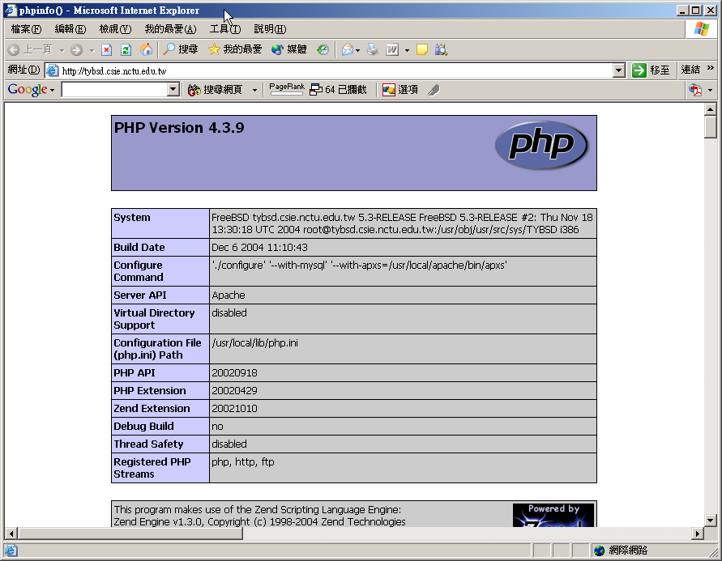
Install Sequence – test PHP in apache (2)
Restart httpd
  % /usr/local/apache/bin/apachectl startssl
Test PHP
  % Edit /www/data/index.php
<?
phpinfo();
?>

Slide 29
Administration of Apache

Slide 30
Apache Directory Architecture
Under /usr/local/apache
  bin/
    Core executable files
  cgi-bin/
    CGI storage
  conf/
    Configuration file storage
  htdocs/
    Default document root
  libexec/
    DSO modules
  logs/
    Apache log storage

Slide 31
Apache configuration
Two types
  Global configurations
    Server specific setting
    Global setting
    Virtual host setting
  Directory Configuration
    Local setting for certain directory

Slide 32
Apache configuration –
Global Configuration (1)
Global setting
  ServerType standalone
  Timeout 300
  KeepAlive On
  KeepAliveRequests 100
  StartServers 5
Server configuration
  Port 80
  ServerAdmin tytsai@tybsd.csie.nctu.edu.tw
  ServerName tybsd.csie.nctu.edu.tw
  DocumentRoot "/www/data"

Slide 33
Apache configuration –
Directory Configuration (2)
Configuration parameters
  Options
    All (turn on all options except multiview)
    ExecCGI (To allow executions of AddHandler)
    FollowSymLinks (access files outside this directory)
    Indexs (generate file-list for browsing)
    (when there is no DirectoryIndex files)
    MultiViews (multi-language support)
  AllowOverride
    All (Read .htaccess)
    None (ignoring .htaccess)
  Deny/Allow
    IP/DN (control access to this directory)
  Order
    Solve collision of deny and allow rules
<Directory "/www/data">
Options Indexes FollowSymLinks MultiViews
AllowOverride None
Order allow,deny
Allow from all
</Directory>

Slide 34
Apache configuration –
Directory Configuration (3)
<IfModule mod_userdir.c>
UserDir public_html
</IfModule>
#
# Control access to UserDir directories. The following is an example
# for a site where these directories are restricted to read-only.
#
#<Directory /home/*/public_html>
# AllowOverride FileInfo AuthConfig Limit
# Options MultiViews Indexes SymLinksIfOwnerMatch IncludesNoExec
# <Limit GET POST OPTIONS PROPFIND>
# Order allow,deny
# Allow from all
# </Limit>
# <LimitExcept GET POST OPTIONS PROPFIND>
# Order deny,allow
# Deny from all
# </LimitExcept>
#</Directory>
<IfModule mod_dir.c>
DirectoryIndex index.php index.html index.htm
</IfModule>

Slide 35
Apache configuration –
Directory Configuration (4)
<IfModule mod_alias.c>
Alias /icons/ "/usr/local/apache/icons/"
<Directory "/usr/local/apache/icons">
Options Indexes MultiViews
AllowOverride None
Order allow,deny
Allow from all
</Directory>
Alias /manual/ "/usr/local/apache/htdocs/manual/"
<Directory "/usr/local/apache/htdocs/manual">
Options Indexes FollowSymlinks MultiViews
AllowOverride None
Order allow,deny
Allow from all
</Directory>
</IfModule>

Slide 36
Apache configuration –
Virtual Host
Name-Base
  Singe IP, several hostnames
IP-Base
  several IPs
NameVirtualHost 140.113.51.24
<VirtualHost 140.113.51.24>
ServerName www.snmg.com.tw
DocumentRoot "/www"
</VirtualHost>
<VirtualHost 140.113.51.24>
ServerName mail.snmg.com.tw
DocumentRoot "/home/sywang"
</VirtualHost>
<VirtualHost 140.113.51.24>
ServerName csie.snmg.com.tw
Redirect / http://www.csie.nctu.edu.tw/
</VirtualHost>
<VirtualHost 140.113.50.33:80>
Port 80
ServerAdmin webmaster@sun3.csie.nctu.edu.tw
DocumentRoot /www/csie
ServerName sun3.csie.nctu.edu.tw
ErrorLog logs/csie-error_log
TransferLog logs/csie-access_log
</VirtualHost>
<VirtualHost 140.113.70.25:80>
Port 80
ServerAdmin webmaster@sun3.ee.nctu.edu.tw
DocumentRoot /www/ee
ServerName sun3.ee.nctu.edu.tw
ErrorLog logs/ee-error_log
TransferLog logs/ee-access_log
</VirtualHost>

Slide 37
Apache configuration –
.htaccess (1)
.htaccess
  Allow admin to use one file to control access to certain directory
Usage
  Modify httpd.conf
  Create .htaccess file
  Generate password database
  Test

Slide 38
Apache configuration –
.htaccess (2)
Example
  Modify httpd.conf
  Create .htaccess file
  Generate password file
<Directory "/www/data/test1">
Options Indexes FollowSymLinks MultiViews ExecCGI
AllowOverride All
Order allow,deny
Allow from all
</Directory>
tytsai@tybsd [3:02pm] /www/data/test1> cat .htaccess
AuthName "SA-test1"
AuthType "Basic"
AuthUserFile "/www/wwwpasswddb
require valid-user
tytsai@tybsd [2:58pm] /> /usr/local/apache/bin/htpasswd -c /www/wwwpasswddb SA-user1
New password:
Re-type new password:
Adding password for user SA-user1

Slide 39
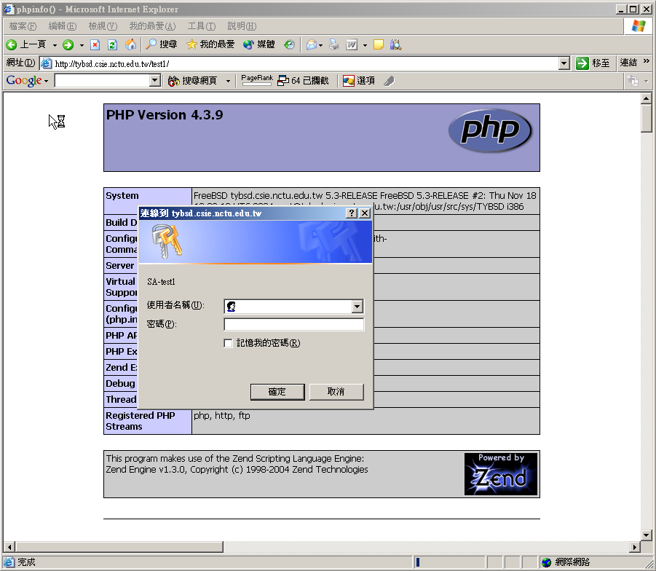
Apache configuration –
.htaccess (3)

Slide 40
Apache configuration – log
Rotate your log using newsyslog

Slide 41
Administration of MySQL

Slide 42
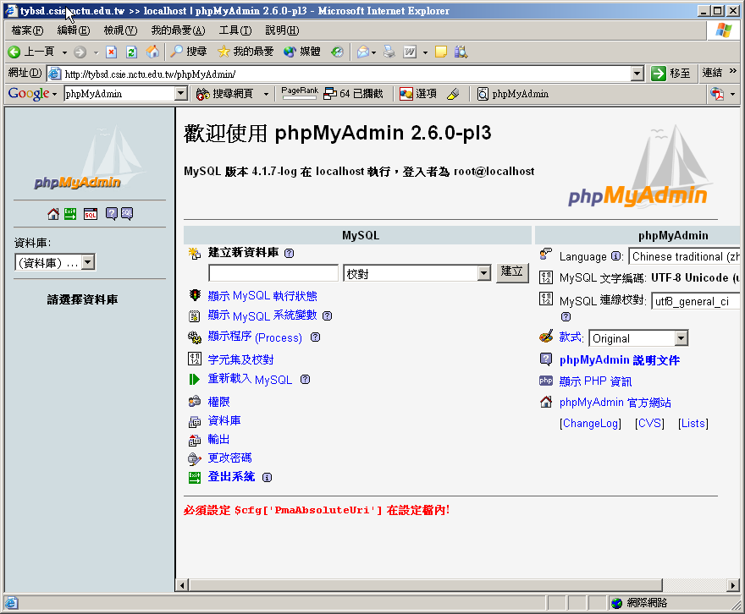
Using phpMyAdmin (1)

Slide 43
Using phpMyAdmin (2)
Steps
  Put phpMyAdmin-2.6.0-pl3.tar.gz in your document root
    % cp phpMyAdmin-2.6.0-pl3.tar.gz /www/data
  Untar it
    % cd /www/data
    % tar xzvf phpMyAdmin-2.6.0-pl3.tar.gz
  Create soft-link
    % ln –s phpMyAdmin-2.6.0-pl3 phpMyAdmin
  Modify configuration file “config.ini.php” of phpMyAdmin
//$cfg['Servers'][$i]['auth_type'] = config';
$cfg['Servers'][$i]['auth_type'] = 'http';

Slide 44
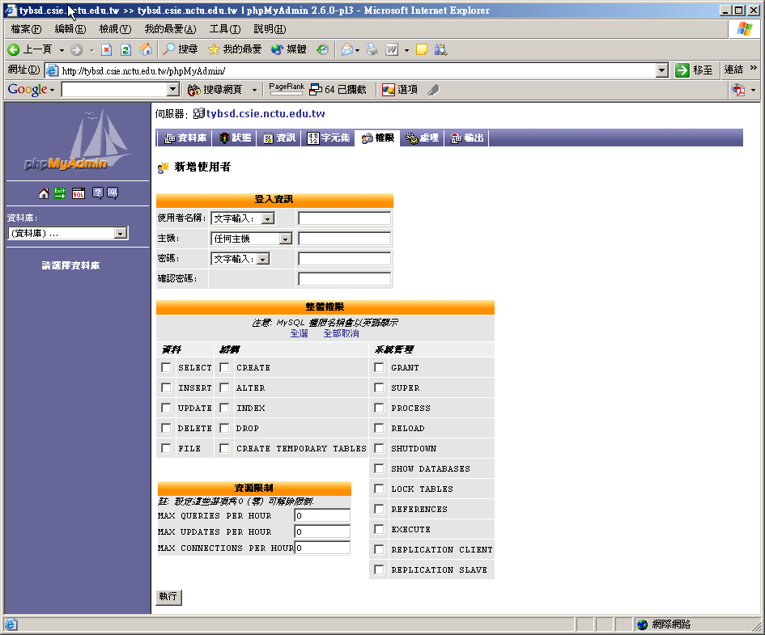
Using phpMyAdmin (3)
Create another user with limited privilege

Slide 45
Exercise

Slide 46
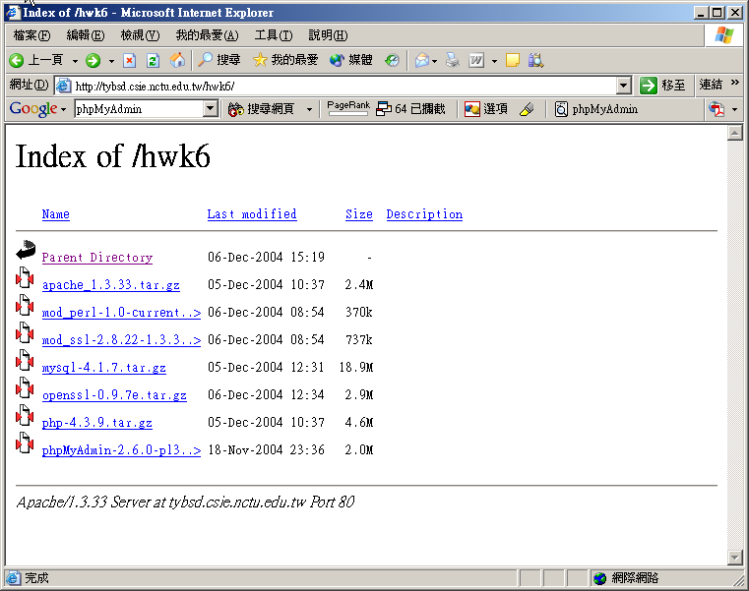
You can get all source here…

Slide 47
Lab1
Install apache + MySQL + PHP + mod_ssl
  Requirements of port80
    Set your apache document root to “/www/data”
    http://yourhostname/ will appear content of phpinfo
    http://yourhostname/test1/ must appear a authentication window using .htaccess,
      Under test1, there is a file named test1
      After login using “SA/SA123”, there will be a directory listing automatically
    http://yourhostname/test2/
      Under test2, there is a file named test2, however, there can not have directory listing automatically

Slide 48
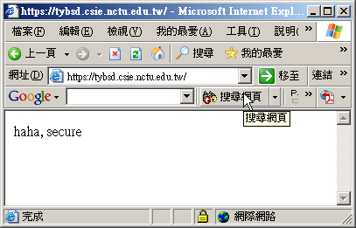
Lab1
  Requirements of mod_ssl, port 443
    Set SSL virtual host document root to “/www/data_ssl”
    Under /www/data_ssl, put a file named index.htm, with the content of “haha, secure”
    https://yourhostname/ will appear a page showing “haha, secure”

Slide 49
Lab2
Requirements
  Install phpMyAdmin
    It must provide “http” authentication
  Using phpMyAdmin to create a DB named “SA_hwk6”
    In “SA_hwk6” DB, create a table named “account”
    account table have three fields
      account_id (auto-increment)
      account_name
      account_passwd
    Add one record for account table
      account_name = SA-test1, account_passwd = “SA-test1123”
      Password must be encrypted using “password” function
  Create a user “SA” that has only “select, insert, update” privileges on SA_hwk6 DB

Slide 50
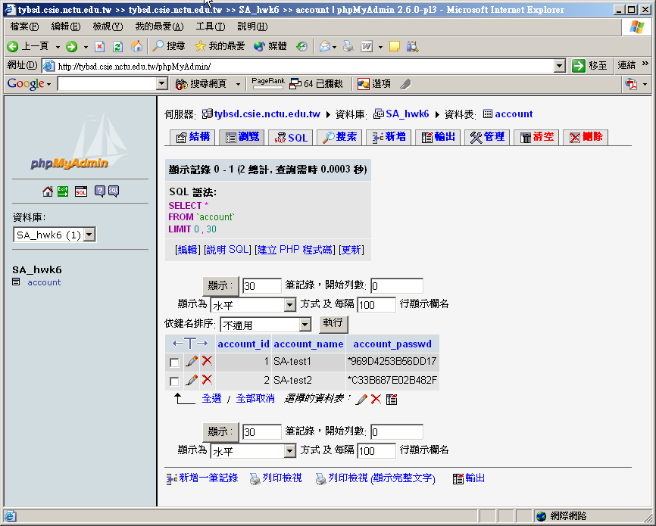
Lab2

