Slide 1
Introduction to Course Content

Slide 2
Outline
What SA Should do.
What You can expect to learn from this course.
What attitude you should take.
Syllabus
  Course Info.
  Content
  Grade Policy
What You should prepare.
Am I OK to take this course?

Slide 3

What System Administrator Should do? (1)
Ordinary list
  Install new system, programs and OS updates
  Monitoring system and trying to tune performance
  Adding and removing users
  Adding and removing hardware
  Backup and Restore
  Security
Notes:
SA 要做的事情並沒有因為 PC 進步而減少

Slide 4



What System Administrator Should do? (2)
Non-technique list
  Helping users
  Maintaining documentation
  Moving furniture
  Burning your lung
  Good communication and memorization

Slide 5
What System Administrator Should do? (3)
The best words to describe the job
  Thankless job.
  System administration is like keeping the trains on time;
  no one notices except when they’re late.
Philosophy of system administration
  Know how things really work.
  Plan it before you do it.
  Make it reversible
  Make changes incrementally.
  Test before you unleash it .

Slide 6
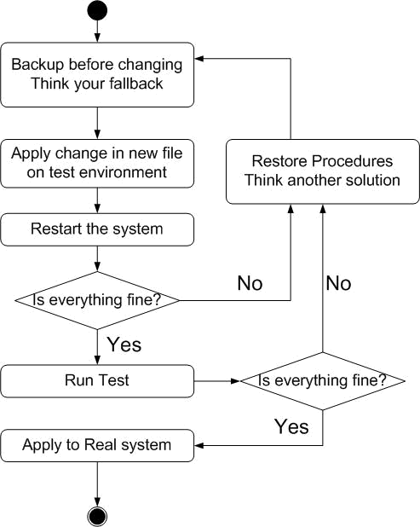
What System Administrator Should do? (4)
Flow of Change

Slide 7
What you can learn in this course?
Mostly, the skill to be a candidate of system administrator
Secondary, information about CS computer center

Slide 8
Attitude
Attend every class
Do every exercise
  As early as possible
  On your own
Read book and practice at least 6 hours every week
  Recommend: more than 1.5 hours/day averagely.
Collect information on the internet

Slide 9

Syllabus
Website:
  http://www.cs.nctu.edu.tw/~chwong/course/sysadm/
Instructor:
  翁綜禧 chwong@cs.nctu.edu.tw
Time:
  Wed. IJK (PM 6:30 ~ 9:20)
Textbook:
  UNIX System Administration Handbook," 3rd ed.

Slide 10
Syllabus - Content
We will cover the following chapters in this semester (SysAdm):
  Chapter 1 ~ 12
  Chapter 13, 17, 18, 23, 26
  Shell Programming, Perl Programming
The following chapters is covered in the next semester (NetAdm):
  Chapter 14, 15, 16, 19, 20 , 22
  News Server
  SNMP
  Perl Programming

Slide 11
Syllabus – Text book outline
Chap 1 – Where to start.
Chap 2 – Booting and shutting down
Chap 3 – Rootly powers
Chap 4 – Controlling processes
Chap 5 – The Filesystem
Chap 6 – Adding new users
Chap 7 – Serial device
Chap 8 – Adding a disk
Chap 9 – Periodic process
Chap 10 – Backups
Chap 11 – Syslog and log files
Chap 12 – Drivers and the kernel
Chap 13 – TCP/IP Networking
Chap 14 – Routing
Chap 15 – Network hardware
Chap 16 – The domain name system
Chap 17 – The network file system
Chap 18 – Sharing system files
Chap 19 – Electronic mail
Chap 20 – Network management and debugging
Chap 21 – security
Chap 22 – Web hosting and internet servers
Chap 23 – Printing
Chap 24 – Maintenance and environment
Chap 25 – Performance analysis
Chap 26 – Cooperating with Windows.

Slide 12
Syllabus – Grade Policy
Mid
  25 ~ 30%
    2006/11/08
Final
  35 ~ 40%
    2007/01/10
Exercise (Homeworks)
  40 ~ 45%
    No Delay Work
    We will have probably 5 exercises
      4 normal
      1 final project
    We may have some bonus quiz
Grade will not be normalize.
Why?
Do exercise gets points.
Study book gets points.
This might be discussed again in class when the list is ascertained.

Slide 13
What you should prepare?
Background knowledge
  Basics of TCP/IP Networking (not required)
Environment
  One dedicated PC
    Or use virtual PC.
  One extra IP
Yourself
  Your hard study

Slide 14
Finally, Am I OK to take this course?
Are you willing to devote yourself to exercise?
  Yes! Please come
Are you newbie in this area?
  Yes!? It’s ok, Please come
Do you take more than 3 major courses?
  Yes!??? It is quite dangerous, but I can not stop u

Slide 15
Basic knowledge in this course

Slide 16
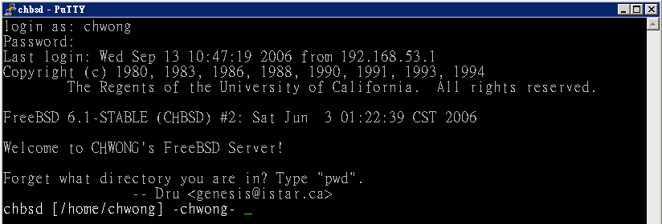
Login
SSH (Secure Shell)
  PuTTY:
  http://www.chiark.greenend.org.uk/~sgtatham/putty/download.html
  Chinese Environment:
  http://www.cs.nctu.edu.tw/help/putty.html

Slide 17
Commands
Useful commands
  passwd
  ls
  ps
  mkdir/rmdir
  cp/mv/rm
  Email reader: mutt, pine, …etc.
  News reader: tin
  Connecting: ssh/telnet
  Manual: man, info. …etc.
  exit/logout

Slide 18
Q&A
Break time.

