Slide 1
Chapter 10
Backups

Slide 2
Outline
Backup devices and media
Backup philosophy
Unix backup and archiving commands

Slide 3
Backup Media –
By Storage (1)
By Storage category
  Hard disk
    IDE/ SATA / SCSI
      40 ~ 60 MB /s
    320 GB IDE : NT 3800.
    73GB SCSI: NT 10000.
  CD/DVD R RW
    CD
      4 ~ 6 MB/s
    DVD
      8 ~ 15 MB/s
    CD-R 0.7G : NT 6.
    DVD-R 4.7G : NT 10.
    DVD DL 8.5GB : NT 150~300.

Slide 4
Backup Media –
By Storage (2)
  Tape
    DAT (Digital Audio Tape) 4mm tapes
      DDS (Digital Data Storage), Minimal Error Rate, Higher Efficiency
      DDS-4 (often used)
        20/40GB(compressed), about NT 400.
        1.0~3.0MB/s
    Travan tapes
      High Transfer Rate
      Travan 40 (often used)
        20/40GB(compressed), about NT 2000.
        Up to 8.0MB/s
    DLT (Digital Linear Tape)
      High Capacity, Solid Reliability
      Media
        Max 1600 GB (compressed), about NT 4000.
        Speed: worst at all
    LTO Ultrium
      Fast Transfer Rate, High Performance, and High Storage Capacity
      LTO Ultrium 3 (often used)
        Max 800 GB (compressed), about NT 5000.
        Speed: up to 80 MB/s
        Tape Drive is much more expensive……

Slide 5
Backup Media –
By Storage (3)
  MO (Magneto-Optical)
    MO 540, 640, 1.3G, 2.3G
  Removable Media
    Floppy, LS-120, ZIP
  Jukebox
    Automatically change removable media
      DAT, DLT, CD, …
  Tape Library
    Hardware backup solution for large data set

Slide 6
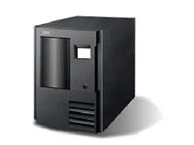
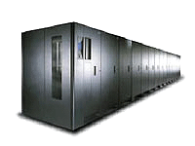
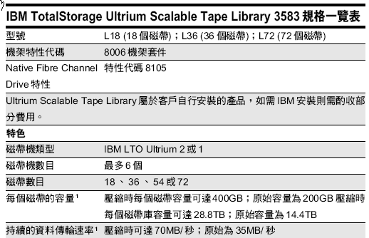
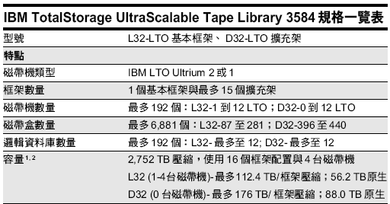
Backup Media –
By Storage (4)
Tape Library

Slide 7
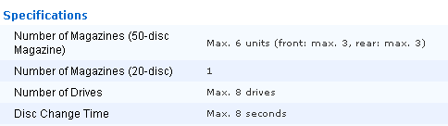
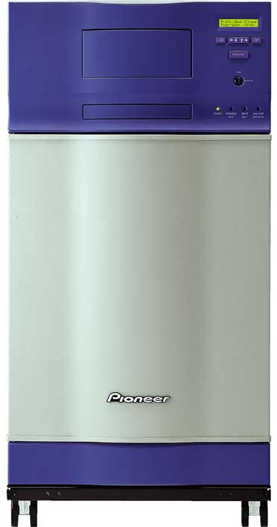
Backup Media –
By Storage (5)
JukeBox (Pioneer)

Slide 8
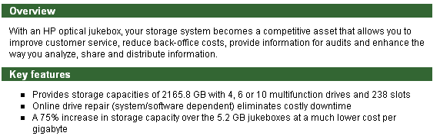
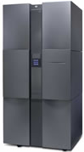
Backup Media –
By Storage (6)
JukeBox (HP)

Slide 9
Backup Media –
By Availability
Off-line Storage
  CD、DVD、MO
    Adv:
      low cost, high reliability
    Disadv:
      Not-convenient, low speed
Near-line Storage
  JukeBox、Tape Library
    Adv:
      High capacity, high reliability
    Disadv:
      High malfunction rate, Not-convenient
On-line Storage
  Disk Array (RAID)
    Adv:
      Fast and high availability
    Disadv:
      High cost

Slide 10
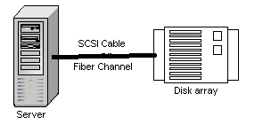

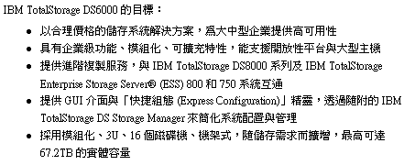
Backup Media –
By Enterprise Product (1)
RAID architecture

Slide 11
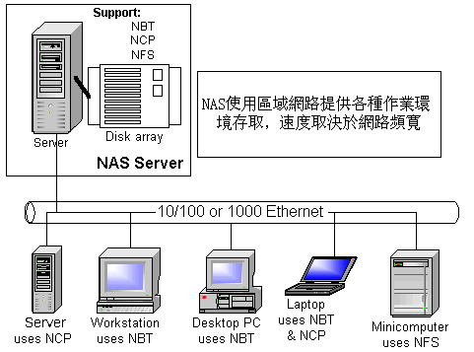
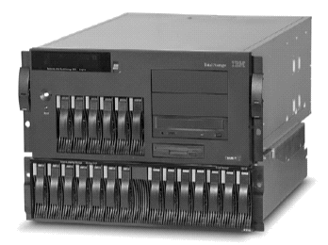
Backup Media –
By Enterprise Product (2)
NAS (Network Attached Storage)
  Storage + Server + Cross-platform access OS + network access protocol
IBM NAS 300G
Supported Protocol:
NFS, HTTP, FTP, CIFS
Netware

Slide 12
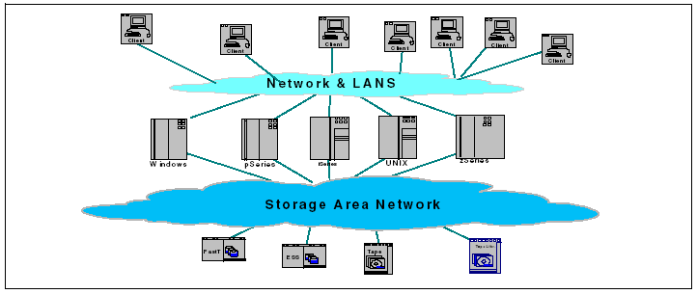
Backup Media –
By Enterprise Product (3)
SAN (Storage Area Network)
  A high-speed network that allows the direct connections between storage devices and servers

Slide 13
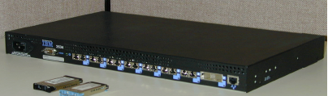
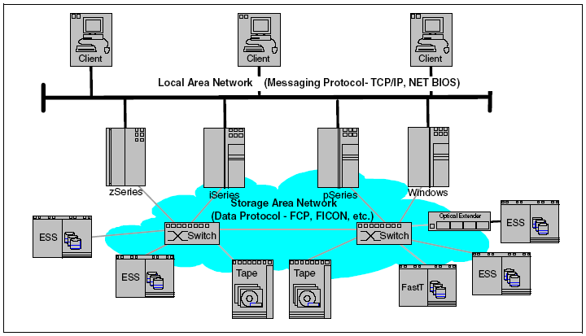
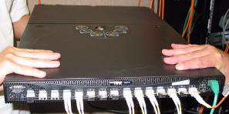
Backup Media –
By Enterprise Product (4)
  In SAN, data transfer can be in the following ways:
    Server to Storage
    Server to Server
    Storage to Storage

Slide 14
Backup Philosophy
Perform all dumps from one machine
Label your taps
Pick a reasonable backup interval
Choose filesystems carefully
Make daily dumps fit on one tape
Make filesystems smaller than your dump device
Keep Tapes off-site
Protect your backups
Limit activity during dumps
Check your tapes
Develop a tape life cycle
Design your data for backups
Prepare for the worst

Slide 15
Dumping filesystems – dump command (1)
Used to backup filesystem into a large file to a external device
Advantages:
  Backups can span multiple output media
  Files of any type can be backed up and restored
  Permissions, ownerships, and modification times are preserved
  Files with holes are handled correctly
  Backups can be performed incrementally
Limitations:
  Each filesystems must be dumped individually
  Only filesystems on the local machine can be dumped

Slide 16
Dumping filesystems – dump command (2)
Backup level
  0 ~ 9
    Level 0 ➔ full backup
    Level N ➔ incremental backup of Level≦ N-1
    for N = 1 ~ 9
dump command format
  % dump [arguments] file-system
dump command arguments
  u: update the /etc/dumpdates file after dump
  f: the output backup file
    Special device file, like /dev/nrsa0
    Ordinary file
    ‘-’ to standard out
    “user@host:file”
  d: tape density in bytes per inch
  s: tape length in feet

Slide 17
Dumping filesystems – dump command (3)
Example: Full backup
chbsd [/home/chwong] -chwong- sudo dump 0uLf - / | gzip > ~/root.0.gz
DUMP: Date of this level 0 dump: Wed Nov 29 13:46:43 2006
DUMP: Date of last level 0 dump: the epoch
DUMP: Dumping snapshot of /dev/ad0s1a (/) to standard output
DUMP: mapping (Pass I) [regular files]
DUMP: mapping (Pass II) [directories]
DUMP: estimated 367965 tape blocks.
DUMP: dumping (Pass III) [directories]
DUMP: dumping (Pass IV) [regular files]
DUMP: DUMP: 378531 tape blocks
DUMP: finished in 126 seconds, throughput 3004 KBytes/sec
DUMP: level 0 dump on Wed Nov 29 13:46:43 2006
DUMP: DUMP IS DONE
chbsd [/home/chwong] -chwong- cat /etc/dumpdates
/dev/ad0s1a 0 Wed Nov 29 13:46:43 2006
chbsd [/home/chwong] -chwong- ls -lh root.0.gz
-rw-r--r-- 1 chwong wheel 61M Nov 29 13:48 root.0.gz

Slide 18
Dumping filesystems – dump command (4)
Example: Incremental backup
chbsd [/home/chwong] -chwong- sudo dump 2uLf - / | gzip > ~/root.2.gz
DUMP: Date of this level 2 dump: Wed Nov 29 14:00:26 2006
DUMP: Date of last level 0 dump: Wed Nov 29 13:46:43 2006
DUMP: Dumping snapshot of /dev/ad0s1a (/) to standard output
DUMP: mapping (Pass I) [regular files]
DUMP: mapping (Pass II) [directories]
DUMP: estimated 2859 tape blocks.
DUMP: dumping (Pass III) [directories]
DUMP: dumping (Pass IV) [regular files]
DUMP: DUMP: 3067 tape blocks
DUMP: finished in 1 seconds, throughput 3067 KBytes/sec
DUMP: level 2 dump on Wed Nov 29 14:00:26 2006
DUMP: DUMP IS DONE
chbsd [/home/chwong] -chwong- cat /etc/dumpdates
/dev/ad0s1a 0 Wed Nov 29 13:46:43 2006
/dev/ad0s1a 2 Wed Nov 29 14:00:26 2006
chbsd [/home/chwong] -chwong- ls -lh root.*
-rw-r--r-- 1 chwong wheel 61M Nov 29 13:48 root.0.gz
-rw-r--r-- 1 chwong wheel 648K Nov 29 14:00 root.2.gz

Slide 19
Dumping filesystems – dump command (5)
Default SCSI tape drive device file
System | Rewinding | Nonrewinding
FreeBSD | /dev/rsa0 | /dev/nrsa0
Red Hat | /dev/st0 | /dev/nst0
Solaris | /dev/rmt/0 | /dev/rmt/0n
SunOS | /dev/rst0 | /dev/nrst0

Slide 20
Restoring from dumps – restore command (1)
Restore can do
  Restoring individual files
  Restoring entire filesystem
Options of restore command
  i: interactive restore
  r: restore an entire filesystem
  f: the backup file that restore is going to use

Slide 21
Restoring from dumps – restore command (2)
Restore individual file interactively
chbsd [/home/chwong] -chwong- gunzip -c root.0.gz | restore -if -
restore > ls
.:
.cshrc boot/ etc/ mnt/ sbin/
.profile cdrom/ home@ old_backup/ sys@
.snap/ compat@ lib/ proc/ tmp/
COPYRIGHT dev/ libexec/ rescue/ usr/
bin/ entropy media/ root/ var/
restore > cd etc

Slide 22
Restoring from dumps – restore command (3)
Restore individual file interactively (cont.)
restore > ?
Available commands are:
ls [arg] - list directory
cd arg - change directory
pwd - print current directory
add [arg] - add `arg' to list of files to be extracted
delete [arg] - delete `arg' from list of files to be extracted
extract - extract requested files
setmodes - set modes of requested directories
quit - immediately exit program
what - list dump header information
verbose - toggle verbose flag (useful with ``ls'')
help or `?' - print this list
If no `arg' is supplied, the current directory is used

Slide 23
Restoring from dumps – restore command (4)
Restore individual file interactively (cont.)
restore > add /etc/motd
restore > extract
set owner/mode for '.'? [yn] n
restore > quit
chbsd [/home/chwong] -chwong- ls -al etc
total 6
drwxr-xr-x 2 chwong wheel 512 Nov 29 13:46 .
drwxr-xr-x 36 chwong wheel 2048 Nov 29 14:08 ..
-rw-r--r-- 1 chwong wheel 102 Sep 22 20:16 motd

Slide 24
Restoring from dumps – restore command (5)
Restore entire filesystem
  % restore -rf /home/temp/root.0
  Steps
    Restore level 0 first
    Restore incremental dumps
      0 0 0 0 0
      0 5 5 5 5
      0 3 2 5 4 5
      0 9 9 5 9 9 3 9 9 5 9 9
      0 3 5 9 3 5 9

Slide 25
Other archiving programs
tar command
  Read multiple files and packages them into one file
  Example
    % tar czvf etc.tar.gz /etc/
    % tar xzvf etc.tar.gz
    % tar cf – fromdir | tar xfp – –C todir
dd command
  Copy filesystems between partitions of exactly the same size
  Example
    % dd if=/dev/rst0 of=/dev/rst1
    % dd if=/tmp/kern.flp of=/dev/fd0
    % dd if=/dev/da1 of=/dev/da2 bs=1048576

Slide 26
csie home backup
Using rsync
  % rsync –a --delete
    -a: archive mode
      Recursive and preserve everything
    --delete:
      Delete any file that are not in the sending side
0 4 * * 1 (/bin/date;cd /raid;/usr/local/bin/rsync -al --delete cs /backup/user/;/bin/date)
0 4 * * 2 (/bin/date;cd /raid;/usr/local/bin/rsync -al --delete gcs /backup/user/;/bin/date)
0 4 * * 3 (/bin/date;cd /raid;/usr/local/bin/rsync -al --delete staff /backup/user/;/bin/date)
0 4 * * 4 (/bin/date;cd /raid;/usr/local/bin/rsync -al --delete dcs /backup/user/;/bin/date)
0 4 * * 5 (/bin/date;cd /raid;/usr/local/bin/rsync -al --delete faculty /backup/user/;/bin/date)
0 4 * * 6 (/bin/date;cd /raid;/usr/local/bin/rsync -al --delete relative /backup/user/;/bin/date)
0 3 * * 2 (/bin/date;cd /raid;/usr/local/bin/rsync -al --delete alumni /backup/user/;/bin/date)

