Slide 1
Chapter 17
The Network File System

Slide 2
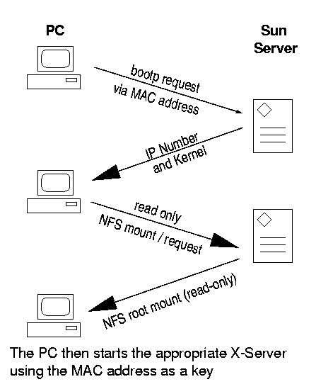
NFS
Share filesystem to other hosts via network
NFS History
  Introduced by Sun Microsystems in 1985
  Originally designed for diskless client-server architecture

Slide 3
Components of NFS
Including
  Mounting Protocol
  Mount Server
  Daemons that coordinate basic file service
  Diagnostic utilities

Slide 4
Components of NFS – mounting protocol (1)
NFSv2
  Synchronous write
  V2 NFS server must commit each modified block to disk before replying to NFS client
  Cause long delay when there is a NFS write operation
NFSv3 in 1990s
  Asynchronous write
  Provide increase performance and better support for large files

Slide 5
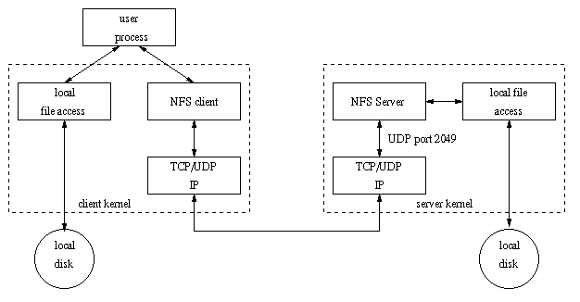
Components of NFS – mounting protocol (2)
Sun’s ONC distributed computing standards
  NFS client → RPC → Transport Layer → …
  Transport Layer
    UDP: Lack congestion control
    TCP: become more suitable

Slide 6
Components of NFS – mounting protocol (3)
Advanced NFS feature support by OS
System | NFSv3 | TCP | Default
FreeBSD | Yes | Yes | UDP
Linux (debian) | Yes | Yes | UDP
Solaris | Yes | Yes | TCP
SunOS | No | No | UDP

Slide 7
Components of NFS –
Server-side NFS (1)
NFS Server
  Export sharing filesystem
    System dependent
  Waiting for “mount request”
    mountd (rpc.mountd) daemon
  Waiting for “file access request”
    nfsd (rpc.nfsd) daemon

Slide 8
Components of NFS –
Server-side NFS (2)
Exporting filesystem
  Edit export configuration file
    Each line is “what to export and how”
  Reload related daemons
System | Exports info file | How to reload
FreeBSD | /etc/exports | kill -1 <mountd’s pid>
Linux | /etc/exports | /usr/sbin/exportfs -a
Solaris | /etc/dfs/dfstab | /usr/sbin/shareall
SunOS | /etc/exports | /usr/sbin/exportfs -a

Slide 9
Components of NFS –
Server-side NFS (FreeBSD.1)
Exporting filesystem
  /etc/exports
    White-space separated
    Format: directory-list options-list client-list
Option | Description
-ro | Exports read-only, default is (read-write)
-alldirs | Allow any subdirectory to be mounted
-maproot=user | Maps root to the specified user.
-mapall=user | Maps all UIDs to the specified user.
Client | Description
hostname | Host name (ex: mailgate ccserv)
netgroup | NIS netgroups
-network -mask | -network 140.113.235.0 -mask 255.255.255.0

Slide 10
Components of NFS –
Server-side NFS (FreeBSD.2)
Example of /etc/exports
Reload daemons
  % kill -1 `cat /var/run/mountd.pid`
/raid -alldirs –maproot=root mailgate ccserv backup
/raid -alldirs –maproot=65534 –network 140.113.209 –mask 255.255.255.0
/home -ro –mapall=nobody –network 140.113.235.0 –mask 255.255.255.0
/usr/src /usr/obj –maproot=0 bsd_cc_csie

Slide 11
Components of NFS –
Server-side NFS (Linux.1)
Exporting filesystem
  /etc/exports
    Format: directory client-list-with-option
    Ex: /home1 ccbsd5(ro)
Client | Description
hostname | Host name (ex: mailgate ccserv)
@netgroup | NIS netgroups
ipaddr/mask | CIDR-style specification (ex: 140.113.235.2/24)
Wild cards * ? | FQND with wild cards (ex: ccbsd*.csie.nctu.edu.tw)

Slide 12
Components of NFS –
Server-side NFS (Linux.2)
Option | Description
ro,rw | Read-only, Read-write (default)
rw=list | Hosts in the list can do rw, others ro only
root_squash | Maps UID 0 and GID 0 to the value of anonuid and anongid (default)
no_root_squash | Allow root access
all_squash | Maps all UID and GID to anonymous one
subtree_check | Check that the accessed file is in the appropriate filesystem and in the exported tree.
no_subtree_check | Disables subtree checking
anonuid=xxx | Related to root_squash
anongid=xxx | Related to root_squash
secure | Require remote access from privileged port
insecure | Allow remote access from any port
noaccess | Prevent access to this dir and it’s subdir

Slide 13
Components of NFS –
Server-side NFS (Linux.3)
Example of /etc/exports
Run /usr/sbin/exportfs
  % /usr/sbin/exportfs –a
    Maintain /var/lib/nfs/xtab table which is read by mountd
/home1 ccsun*.csie.nctu.eud.tw(rw)
/home2 @sun_cc_csie(ro) dragon(rw,no_root_squash)
/home ccpc1(rw,all_squash,anonuid=150,anongid=100)
/ftp/pub (ro,insecure,all_squash)
/users *.xor.com(rw)
/users/evi (noaccess)

Slide 14
Components of NFS –
Server-side NFS (Solaris.1)
Exporting filesystem
  /etc/dfs/dfstab
  Each line will execute “share” command to export one NFS
    [format] share –F nfs –o option-list directory
    Ex: share –F nfs –o rw=ccbsd5.csie.nctu.edu.tw /home2
Run shareall command
  % /usr/sbin/shareall
Client | Description
hostname | Host name (ex: mailgate ccserv)
netgroup | NIS netgroups
IP networks | @CIDR-style specification (ex: @140.113.235.2/24)
DNS domains | .xxx.yyy any host within the domain (ex: .nctu.edu.tw)

Slide 15
Components of NFS –
Server-side NFS (Solaris.2)
Option | Description
ro,rw | Read-only to all, Read-write to all
ro=list, rw=list | Hosts in the list can do ro/rw
root=list | Lists hosts permitted to access this filesystem as root. Otherwise, root access from a client is equivalent to by “nobody”
anon=xxx | Specify the UID to which root is remapped. Default is “nobody”
anongid=xxx | Related to root_squash
nosub | Forbids clients to mount subdirectories
nosuid | Prevents setuid and setgid from being created

Slide 16
Components of NFS –
Server-side NFS (3)
nfsd daemon
  Handle NFS file access request from NFS clients
  Number of nfsd is important
    Too small, some NFS request may be not served
    Too large, load will be high
In FreeBSD
  Specify nfsd options in /etc/rc.conf
    nfs_server_enable=“YES”
    nfs_server_flags=“-u –t –n 4”

Slide 17
Components of NFS – client-side NFS (1)
NFS Client
  Mount NFS filesystem first
  Access file under NFS filesystem
mount command
  [format]
    mount [-o options] host:directory mount-point
  Ex:
    % mount –t nfs ccbsd4:/home/www /home/nfs/www
/etc/fstab (/etc/vfstab in Solaris)
    % mount –a –t nfs (FreeBSD, Linux)
    % mount –a –F nfs (Solaris)
# Device Mountpoint FStype Options Dump Pass#
dragon:/usr/man /usr/man nfs ro,bg,soft 0 0
ccserv:/spool/mail /var/mail nfs rw,bg,intr 0 0

Slide 18
Components of NFS – client-side NFS (2)
NFS mount flags
Flag | Systems | Description
ro or rw | S,L,F | Mount the NFS as ro or rw
bg | S,L,F | If failed, keep trying in background
hard | S,L | If server down, access will keep trying until server comes back
soft | S,L,F | If server down, let access fail and return error
intr, nointr | S,L,F | Allow/Disallow user to interrupt blocked access
retrans=n | S,L,F | # of times to repeat a request before error return
timeo=n | S,L,F | Timeout period of requests (tens of seconds)
rsize=n | S,L,F | Set read buffer size to n bytes
wsize=n | S,L,F | Set write buffer size to n bytes
vers=n | S | Selects NFS v2 or v3
nfsv3,nfsv2 | F | Selects NFS v2 or v3
proto=prot | S | tcp or udp
tcp | L,F | Select TCP. UDP is default

Slide 19
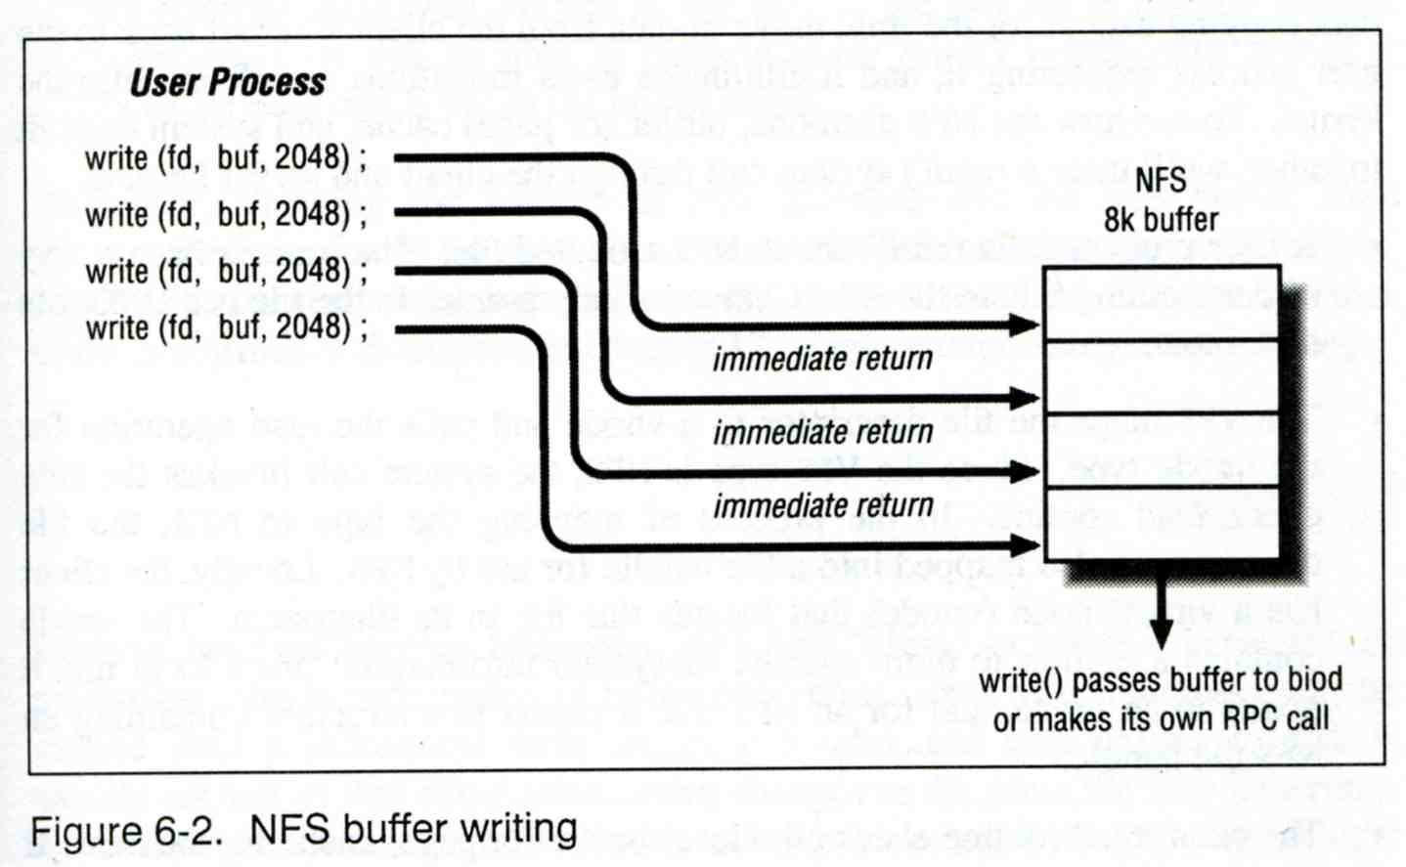
Components of NFS – client-side NFS (3)
Client side daemons that enhance performance
  biod (block I/O daemon, or called nfsiod)
  Perform read-ahead and write-behind caching

Slide 20
Components of NFS –
NFS Utilities (1)
nfsstat
  Display NFS statistics
    % nfsstat –s (display statistics of NFS server)
    % nfsstat –c (display statistics of NFS client)
csduty [/u/dcs/94/9455832] -chwong- nfsstat -c
Client Info:
Rpc Counts:
Getattr Setattr Lookup Readlink Read Write Create Remove
1065253 34196 379742 5187 111699 182603 18049 29803
Rename Link Symlink Mkdir Rmdir Readdir RdirPlus Access
20838 4746 1 10 1003 4705 0 316560
Mknod Fsstat Fsinfo PathConf Commit
0 13742 3889 0 75747
Rpc Info:
TimedOut Invalid X Replies Retries Requests
0 0 69 3994 2267773
Cache Info:
Attr Hits Misses Lkup Hits Misses BioR Hits Misses BioW Hits Misses
1920497 1259363 1256973 379714 352854 102015 521158 182603
BioRLHits Misses BioD Hits Misses DirE Hits Misses
347749 5187 14996 4685 6137 0

Slide 21
Components of NFS –
NFS Utilities (2)
showmount
  % showmount –e cchome
    show the hosts’s export list
  % showmount –a
    List all mount points
magpie [/u/dcs/94/9455832] -chwong- showmount -e magpie
Exports list on magpie:
/home ccduty mailgate 140.113.209.0
/drongo operator ccduty mailgate 140.113.209.0
cshome [/u/dcs/94/9455832] -chwong- showmount -a
All mount points on localhost:
bsd1:/home2
bsd1:/raid/home
csduty:/home2
csduty:/raid/home
linux1:/raid/home
linux2:/raid/home
nat235.dynamic:/raid/home
sun1:/raid/home
sun2:/raid

Slide 22
NFS in FreeBSD
NFS server
  Edit /etc/rc.conf
NFS client
…
nfs_server_enable="YES"
nfs_server_flags="-u –t –n 4"
…
…
nfs_client_enable="YES"
…

Slide 23
Automatic mounting
Problems of /etc/fstab
  Maintenance of /etc/fstab in large network
  Crashed NFS server will make operation blocked
  Crashed NFS server will make other local partitions unavailable
automount daemon
  Mount filesystems when they are referenced and unmount them when they are no longer needed
  Supply a list of replicated filesystems to replace important but crashed NFS servers
  Transparent to users
Products
  automount (from SUN Micro), simple and concise
  amd (from Jan-Simon Pendry), complicated but more powerful

Slide 24
automount (1)
Three kinds of configuration files (map)
  Direct map
  Indirect map
  Master map
    List which direct and indirect maps that automount should pay attention to
  Difference between direct and indirect
    All mount points in indirect map has common directory defined in master map
Provide information about filesystems
that are to be automounted

Slide 25
automount (2)
Example of automount maps
master
/net auto.net -rw, intr
/- auto.direct -ro, intr
WWW -rw,soft,nosuid,vers=2 vega:/home/www
mail -rw,soft,nosuid,quota ccserv:/spool/mail
ftp -ro,soft,nosuid ftp:/home/ftp
indirect
direct
/vlsi/vlsi1 -rw,soft,nosuid scorpio:/vlsi1
/vlsi/vlsi2 -rw,soft,nosuid scorpio:/vlsi2

Slide 26
automount (3)
Master map
  /etc/auto.master (Linux)
  /etc/auto_master (Solaris)
Restart automounter when you change the maps
  /etc/init.d/autofs {start|stop} (Solairs)
  /etc/init.d/autofs {start|stop|reload|status} (Linux)

Slide 27
automount (4)
Replicated filesystem
  There are several identical NFS and I would like to mount anyone of them
  Constrain
    Read-only
    These replicated filesystem should be truly identical
  Automounter will choose a server based on its own idea of which one is the best
/usr/man -ro chimchim:/usr/man band:/usr/man
/www/data -ro ccbsd4,altair:/www/data

Slide 28
amd (1)
Advantages over automount
  Sends “keep alive” queries to remote servers at regular intervals and maintains a list of servers that are accessible
  Return an “operation would block” rather than hanging
  Not proprietary source code
  Offer another mount types that are not supported by automount
  Map syntax is more generic
  Provide a query-and-manipulation tool, amq
  …

Slide 29
amd (2)
Flexible map syntax
  One map used by many machines
  Contain conditions that control which parts of map entry are activate
    Selector variable
/defaults type:=nfs;fs:=${autodir}/${key};opts:=nfsv3,rw, \
grpid,quota,intr,soft,nodev,nosuid,resvport, \
timeo=10,retrans=5,nqnfs
mail rhost:=ccserv;rfs:=/spool/mail
ftp rhost:=ftp;rfs:=/home/ftp
raid1 host==cchome;type:=ufs;dev:=/dev/da0s1e\
host!=cchome;type:=nfs;rhost:=cchome;rfs:=/${key};\
opts:=nfsv3,rw,grpid,soft,nodev,nosuid,resvport
drongo host==magpie;type:=link;fs:=/${key} \
host!=magpie;type:=nfs;rhost:=magpie;rfs:=/${key}

Slide 30
amd (3)
Selector | Description
arch | Architecture of the current machine
autodir | Default directory under which to mount filesystems
domain | Local NIS domain name
host | Local hostname
key | Volume name being resolved
map | Name of mount map being used
os | Operating System
Option | Description
rhost | Remote host on which the volume lives
rfs | Remote filesystem name
type | Type of mount, nfs or ufs (local disk)
fs | Local mount point
opts | Mount options
remopts | Options to use if server is nonlocal

Slide 31
amd (4)
Starting amd
  % amd –a /tmp_mnt –l syslog –x fatal, error, user /net auto.home
Stopping amd
  % kill -15 <amd_pid>
options | Description
-x | Sets run-time logging options, such as fatal, error, user, warn, info, …
-r | Restart existing mounts
-l | Log file name or “syslog”
-a | Specify alternative location for mount points
/net | Sets the automount directory
auto.home | The map files

Slide 32
amd (5)
Remount without kill amd
  Unmount such mounted partition
    % umount /amd/magpie
  Delete such virtual /net/DIR
    % rm /net/magpie
  cd /net/DIR
    % cd /net/magpie
amd in FreeBSD
  Edit rc.conf
…
amd_enable=“YES”
amd_flags=“-a /amd –d csie.nctu.edu.tw –l /var/log/amd.log –x all /net auto.home”
…

