Slide 1
Chapter 18
Sharing System Files

Slide 2
Why share?
One functioning host depends on hundreds of configuration files
  But groups of hosts in your network needs more !!
  Think about you have linux1 ~ linux20, and each year, there are about 250 new students in csie.

Slide 3
What to share?
Good candidates to share
Filename | Function
/etc/passwd | User account information
/etc/group | UNIX group definitions
/etc/hosts | Maps between IP and hostname
/etc/services | Well-known network service port
/etc/protocols | Maps text names to protocol numbers
/etc/mail/aliases | E-mail alias
/etc/rpc | Lists ID numbers for RPC services
/etc/printcap | Printer information
/etc/termcap | Terminal type information

Slide 4
How to share?
Keep a master copy of each configuration file in one place and distribute it
  Push vs. Pull model
  Copy files around
    rdist
    rsync
    expect
Let each machine obtain its configuration file from a center server
  NIS

Slide 5
rdist – push files (1)
Advantage
  Simple
  Preserve owner, group, mode, and modification time of files
Control file
  makefile like
  distfile
  How to distribute the files
    [Usage] % rdist [-f distfile] [label]
    [Format] label: pathnames -> destinations commands
Command | Description
notify namelist | Sends email to namelist
except pathlist | Do not distribute files in pathlist
except_pat patternlist | Do not distribute files that matches patternlist
Special [pathlist] “string” | Execute an sh “string” command

Slide 6
rdist – push files (2)
Example
  % rdist
  % rdist –f distfile
  % rdist –f distfile all
SYS_FILES = (/etc/passwd /etc/group /etc/mail/aliases)
GET_ALL = (bsd1 bsd2 linux1)
GET_SOME = (csduty alumni)
all: ${SYS_FILES} -> ${GET_ALL}
notify chwong@cs.nctu.edu.tw;
special /etc/mail/aliases “/usr/bin/newaliases”;
some: ${SYS_FILES} -> ${GET_SOME}
except /etc/mail/aliases;
except_pat /etc/passwd*;
notify root@cs.nctu.edu.tw;

Slide 7
rdist – push files (3)
Disadvantage
  Based on rsh
    /.rhosts or /etc/hosts.equiv permit root access
rdist in FreeBSD
  /usr/ports/net/rdist6
  Use more secure “ssh” to replace rsh
    Use public-key cryptography to do identification
    Encrypt entire rdist conversation
    % rdist –P /usr/local/bin/ssh –f myDistfile

Slide 8
expect – pull files (1)
Write control scripts for interactive programs
Fundamental expect commands
  spawn
    Start up a subprocess to control
  send
    Feed input to subprocess
  expect
    Take action depending on a subprocess’s output
    expect “pattern” {action}
      timeout and eof are special patterns
Our tactic
  Connect to server using ftp and pull down what we want

Slide 9
expect – pull files (2)
example
spawn /usr/bin/ftp netserver
while 1 { expect {
“Name*:” {send “netclient\r”}
“Password:” {send “netclientpassword\r”}
“ftp> ” {break}
“failed” {send_user “Can’t login.\r”; exit 1}
timeout {send_user “Timeout problem.\r”; exit 2}
}}
send “lcd /etc\r”
expect “ftp> ” {send “cd pub/sysfiles\r”}
expect “ftp> ” {send “get passwd\r”}
expect “ftp> ” {send “quit\r”; send_user “\r”}
exit 0

Slide 10
NIS –
The Network Information Service (1)
NIS (YP – Yellow Page)
  Release by SUN in 1980s
  For master server
    System files are kept in original locations and edited as before
    There will be a server process takes care of availability of these files over the network
  Data files are hashed and formed a database for lookup efficiency
    ypmake
    gdbm hashing library
    Make + Makefile
  NIS domain
    The NIS server and it’s clients
  Multiple NIS server
    One master NIS server and multiple NIS slave servers

Slide 11
NIS –
The Network Information Service (2)
/etc/netgroup
  Group users, machines, nets for easy reference in other system files
  Can be used in such as /etc/{passwd,group,exports}, /etc/exports
  [format]
    groupname list-of-members
  [member-format]
    (hostname, username, nisdomainname)
  Example of /etc/netgroup
adm_user (,chwong,) (,chiahung,)
adm_cc_cs (cshome,,) (csduty,,) (csmailgate,,)
sun_cc_cs (sun1,,) (sun2,,) (sun3,,)
bsd_cc_cs (bsd1,,) (bsd2,,) (bsd3,,)
linux_cc_cs (linux1,,) (linux2,,) (linux3,,)
all_cc_cs adm_cc_cs sun_cc_cs bsd_cc_cs linux_cc_cs

Slide 12
NIS –
The Network Information Service (3)
Prioritizing sources
  System information can come from many resource
    Local, NIS, …
  Specify the sources that we are going to use and the order of them
/etc/{passwd, group}
  +
    Entire NIS map is included
  +@
    Include only certain netgroup
  +name
    Include only a single
/etc/nsswitch.conf
  FreeBSD has no /etc/nsswitch.conf (/etc/host.conf for hostname lookup)
…
passwd: files nisplus nis
shadow: files nisplus nis
group: files nisplus nis
hosts: files nisplus nis dns
…

Slide 13
NIS –
The Network Information Service (4)
Use netgroup in other system files
  Example for used in /etc/passwd
  Example for used in /etc/exports
…
pop:*:68:6:Post Office Owner:/nonexistent:/sbin/nologin
www:*:80:80:World Wide Web Owner:/nonexistent:/sbin/nologin
nobody:*:65534:65534:Unprivileged user:/nonexistent:/sbin/nologin
+@admin-user:*:::::
+:*:::::/usr/local/bin/cs.nologin
/raid -alldirs –maproot=root mailgate ccserv backup
/raid -alldirs –maproot=65534 –network 140.113.209 –mask 255.255.255.0
/home -ro –mapall=nobody –network 140.113.235.0 –mask 255.255.255.0
/usr/src /usr/obj –maproot=0 bsd_cc_csie

Slide 14
NIS –
The Network Information Service (5)
Advantages of NIS
  Not necessary for administrator to be aware of NIS internal data format
  Cross-platform
Disadvantages of NIS
  If a slave NIS server is down, the slave’s copy may not be updated
    Periodically poll data
  Not secure
    Any host on a network can claim to be NIS Server
    Any one can read your NIS maps
  Consume network bandwidth

Slide 15
How NIS works (1)
NIS directory
  /var/yp
NIS Server Map directory
  In a subdirectory of the NIS directory named for the NIS domain
    /var/yp/+csie.nis
  Example:
csduty [/var/yp] -chwong- sudo ls +cs.nis/
auto.home group.byname netgroup.byuser publickey.byname
auto.master hosts.byaddr netid.byname rpc.byname
auto.net hosts.byname networks.byaddr rpc.bynumber
auto.user mail.aliases networks.byname services.byname
bootparams master.passwd.byname passwd.byname shadow.byname
ethers.byaddr master.passwd.byuid passwd.byuid sudoers.pwd.byname
ethers.byname netgroup protocols.byname ypservers
group.bygid netgroup.byhost protocols.bynumber

Slide 16
How NIS works (2)
NIS master server → NIS slave servers
  “ypxfr” pull command
    Every NIS slave server runs ypxfr periodically
  “yppush” push command
    NIS master server use yppush to instruct each slave to execute ypxfr
  ypservers special map
    A list of all NIS slave servers in that NIS domain

Slide 17
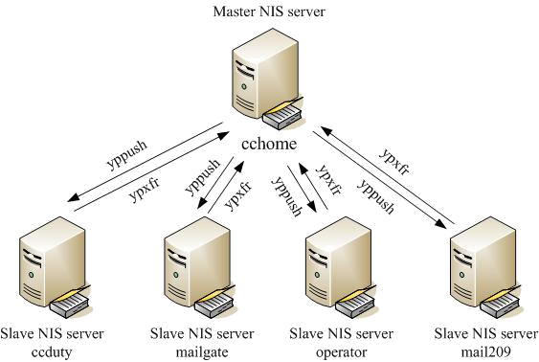
How NIS works (3)
Example of cs
cshome [/var/yp] -chwong- sudo cat ypservers
csduty.cs.nctu.edu.tw
csmailgate.cs.nctu.edu.tw

Slide 18
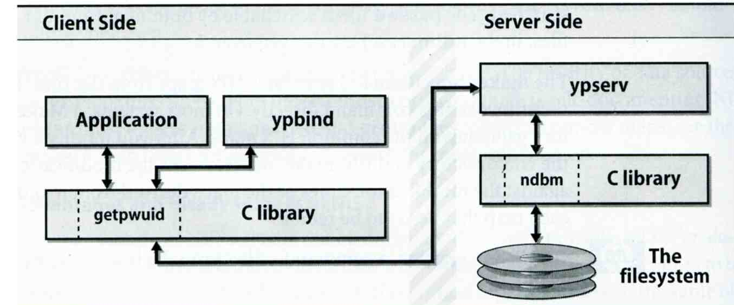
How NIS works (4)
After all maps are ready
  Request and response
  ypserv daemons
    Run on NIS servers
    Waiting for NIS requests and answering them by looking up information in maps
  ypbind daemons
    Run on every machine in NIS domain
    Locate a ypserv and return the identity to the C library, which then contact the server directly

Slide 19
How NIS works (5)
NIS commands and daemons
Program | Description
domainname | Set or print name of current NIS domain
makedbm yp_mkdb (FreeBSD) | Build hashed map
ypinit | Configure a host as master or slave
ypset | Let ypbind to bind a particular NIS server
ypwhich | Find out which yp server is using
ypcat | Print the value contained in an NIS map
yppasswd | Change password on the NIS server
ypchfn | Change GECOS information on NIS server
ypchsh | Change login shell on NIS server
yppasswdd | Server daemon for yppasswd,ypchsh,ypchfn

Slide 20
Configuring NIS Servers
Steps
  Sequence: Master Server → Slave Servers → each client
Master Server
  Set nis domain name
  Use ypinit to construct a list of slave servers
  Run ypserv and rpc.yppasswdd daemons
Slave Servers
  Set nis domain name
  Use ypinit to set master NIS server
  Get NIS maps
NIS client
  Set nis domain name
  Modify /etc/passwd, /etc/group
  Run ypbind daemons

Slide 21
Configuring NIS Servers –
FreeBSD (1)
Edit /etc/rc.conf
  If your host does not want to be a NIS client, remove nis_client related entries
  It is a good idea to force NIS master server to ypbind itself
    % man ypbind
…
# NIS
nisdomainname=“sabsd.nis"
nis_server_enable="YES"
nis_server_flags="“
nis_client_enable=“YES”
nis_client_flags=“-s –m –S sabsd.nis,sabsd”
nis_yppasswdd_enable="YES"
nis_yppasswdd_flags=“”
…

Slide 22
Configuring NIS Servers –
FreeBSD (2)
Initializing the NIS Maps
  NIS maps are generated from configuration files in /etc with exceptions : /etc/master.passwd, /etc/netgroup, /etc/passwd
  % cp /etc/master.passwd /var/yp/master.passwd
  % cp /etc/netgroup /var/yp/netgroup
  Edit /var/yp/master.passwd , removing all system accounts
  % cd /var/yp
  % ypinit –m sabsd.nis
  % reboot
Rebuild yp maps whenever the configuration files are changed
Example
  When you change /var/yp/master.passwd
  % cd /var/yp
  % make

Slide 23
Configuring NIS Servers –
FreeBSD (3)
Makefile of NIS
…
YPSRCDIR = /etc
YPDIR = /var/yp
YPMAPDIR = $(YPDIR)/$(DOMAIN)
ETHERS = $(YPSRCDIR)/ethers # ethernet addresses (for rarpd)
BOOTPARAMS= $(YPSRCDIR)/bootparams # for booting Sun boxes (bootparamd)
HOSTS = $(YPSRCDIR)/hosts
NETWORKS = $(YPSRCDIR)/networks
PROTOCOLS = $(YPSRCDIR)/protocols
RPC = $(YPSRCDIR)/rpc
SERVICES = $(YPSRCDIR)/services
SHELLS = $(YPSRCDIR)/shells
GROUP = $(YPSRCDIR)/group
ALIASES = $(YPSRCDIR)/mail/aliases
NETGROUP = $(YPDIR)/netgroup
PASSWD = $(YPDIR)/passwd
MASTER = $(YPDIR)/master.passwd
YPSERVERS = $(YPDIR)/ypservers # List of all NIS servers for a domain
PUBLICKEY = $(YPSRCDIR)/publickey
NETID = $(YPSRCDIR)/netid
AMDHOST = $(YPSRCDIR)/amd.map
…

Slide 24
Configuring NIS Servers –
FreeBSD (4)
sabsd [/home/chwong] -chwong- ps auxww | grep yp
root 367 0.0 0.2 1384 1096 ?? Is 2:57PM 0:00.01 /usr/sbin/ypserv
root 381 0.0 0.2 1400 1152 ?? Is 2:57PM 0:00.00 /usr/sbin/ypbind -s -m -S sabsd.nis,sabsd
root 396 0.0 0.2 1616 1236 ?? Ss 2:57PM 0:00.00 /usr/sbin/rpc.yppasswdd
sabsd [/home/chwong] -chwong- ypwhich
sabsd.cs.nctu.edu.tw
sabsd [/home/chwong] -chwong- ypcat -x
Use "passwd" for "passwd.byname"
Use "master.passwd" for "master.passwd.byname"
Use "group" for "group.byname"
Use "networks" for "networks.byaddr"
Use "hosts" for "hosts.byaddr"
Use "protocols" for "protocols.bynumber"
Use "services" for "services.byname"
Use "aliases" for "mail.aliases"
Use "ethers" for "ethers.byname"
sabsd [/home/chwong] -chwong- ypcat passwd
chiahung:*:1000:1000:chiahung:/home/chiahung:/bin/tcsh
chwong:*:1001:1000:chwong:/home/chwong:/bin/tcsh
sabsd [/home/chwong] -chwong- ypcat hosts
140.113.17.215 sabsd.cs.nctu.edu.tw sabsd
140.113.17.221 tphp.csie.nctu.edu.tw tphp

Slide 25
Configuring NIS Servers –
FreeBSD (5)
NIS client configuration
  Edit /etc/rc.conf
  Edit /etc/master.passwd (using vipw) and /etc/group
  reboot
…
# NIS
nisdomainname="sabsd.nis"
nis_client_enable=“YES”
nis_client_flags=“-s”
…
…
nobody:*:65534:65534::0:0:Unprivileged user:/nonexistent:/usr/sbin/nologin
+:*::::::::
nobody:*:65534:
+:*::

