Slide 1
Exercise 4 –
NFS and NIS
Announced Date: 2006/12/20
Due Date: 2007/1/3

Slide 2
Outline
Team Work - Find at most two partner to finish this job
Labs
  Lab1 – NFS exports and mount
  Lab2 – NIS servers and clients
  Lab3 – NIS, NFS, and amd
Bonus
  Bonus1 – NIS slave server
  Bonus2 – Backup
Appendix
  Appendix A – mount_nullfs

Slide 3
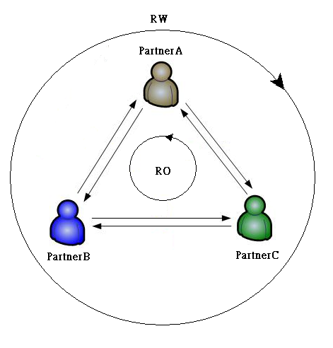
Labs
Lab1 – NFS exports and mount(1)
Goal:
  Export NFS
  Import NFS
Requirement:
  Mount NFS with correct exports permission
Triangle relationship
Arrow is the direction of exports

Slide 4
Labs
Lab1 – NFS exports and mount(2)
For PartnerA
  Make directories as following names
    % mkdir /home/partnerA
    % mkdir /home/partnerB
    % mkdir /home/partnerC
  Export /home/partnerA (Relation as previous picture)
    Modify /etc/exports
    Read-Only for partnerB, Read-Write for partnerC
  Edit /etc/fstab to mount partnerB and partnerC via NFS
  Try to Create Files in these two NFS
    PartnerA can write /home/partberB, cannot write /home/partnerC
Similarly for PartnerB and PartnerC

Slide 5
Labs
Lab2 – NIS servers and clients(1)
Goal:
  NIS master servers, and clients
Requirement:
  Share master.passwd, passwd, and group
  Three NIS accounts, you can choose names you like
  The group of these accounts is written in NIS group
  All NIS accounts can login all NIS clients, but only admin user (the user in NIS master server) can login the NIS master server
  No need to take care the home directories, and other filesystems

Slide 6
Labs
Lab2 – NIS servers and clients(2)
Settings for NIS master server(1)
  Copy /var/yp/Makefile.dist to /var/yp/Makefile (original is a symbolic link)
  Comment out this line in the Makefile
    NOPUSH = "True“ ➔ #NOPUSH = “True”
  To ensure NIS master server reads the shared files from NIS, please modify the GROUP variables to be read from /var/yp/
    GROUP = $(YPDIR)/group
  Copy master.passwd, group from /etc/ to /var/yp/

Slide 7
Labs
Lab2 – NIS servers and clients(3)
Settings for NIS master server(2)
  Modify master.passwd
    Delete system accounts, and add three NIS accounts
      You can use the names you like, but not be the same as system’s accounts
    Their home directories in /nis/home/ (Will be done in Lab3)
  Modify group
    Add a NIS group
  Build NIS master server
    Set domainname
    Modify /etc/rc.conf
    % ypinit –m <domainname>
    Start NIS Master Server

Slide 8
Labs
Lab2 – NIS servers and clients(4)
Settings for NIS clients
  Set domainname
  Modify /etc/rc.conf
  Modify /etc/hosts
    Add the entry of the NIS server
  Modify /etc/group
  Modify /etc/master.passwd
  Start NIS Client
  Note: The NIS master server also needs to be an NIS client, but only admin can login

Slide 9
Labs
Lab3 – NIS, NFS, and amd(1)
Goal:
  Continue after Lab2, using NFS as NIS home
Requirement:
  Pick a machine different from the NIS master server to export NFS
  Export Read-Write for all
  maproot=nobody for all clients, but root for NIS master server
  Because /etc/exports cannot export one device, please use mount_nullfs to mount this filesystem to /nis/home
  NFS clients should let NIS users see their home directories at /nis/home/
    Directly mount on /nis/home
    Symbolic link /nis/home to the amd mount point

Slide 10
Labs
Lab3 – NIS, NFS, and amd(2)
Add some files on the NIS master server
  Modify the AMDHOST variables to be read from /var/yp/
    AMDHOST = $(YPDIR)/amd.map
  Copy amd.map, netgroup from /etc/ to /var/yp/
  Modify amd.map
    NFS machine doesn’t need to mount it, because it should mount by mount_nullfs
  Modify netgroup
    Use netgroup to export the NFS, and so add one new client is easy
    Also, you can add admins in one netgroup for NIS master to set in the master.passwd (Optional)
  Rebuild NIS database

Slide 11
Labs
Lab3 – NIS, NFS, and amd(3)
Export NIS Home
  Use mount_nullfs to mount this filesystem to /nis/home
  Modify /etc/exports
    Export /nis/home to all, specify the maproot option.
  Modify /etc/rc.conf
  Run NFS server
Run amd on all machines
  Modify /etc/rc.conf
  Start amd
  Note: In amd_flags, set the mapname as amd.map, it will automatically search the NIS, you can man amd.conf and see the map_type for more information.

Slide 12
Bonus
Bonus1 – NIS slave server
Goal:
  Pick the machine, which is neither the NFS server nor the NIS master server, and build the NIS slave server.
Requirement:
  The NIS slave server can bind itself
Settings for the NIS slave server
  Set domainname
  Modify /etc/rc.conf
  ypinit -s <master> <domainname>
  Start NIS Slave Server
  You can read this for more details
    http://www.tw.freebsd.org/doc/zh_TW.Big5/books/handbook/network-nis.html

Slide 13
Bonus
Bonus2 – Backup
Goal:
  Backup all data on the NIS system, including NIS database, and Homes of NIS accounts
Requirement
  NIS master server exports Backup via NFS, and all read-only, maproot=nobody
Settings for the Backup
  Use mount_nullfs to mount this filesystem to /nis/backup
  Export /nis/backup
    Modify configuration files and run NFS server
  Mount /nis/backup by amd
    Write amd map in the NIS amd.map
    Update NIS database

Slide 14
Appendix
Appendix A – mount_nullfs
The command
  mount_nullfs <origin> <new_path>
  For example
    % mkdir /home/for_nis make a directory for NIS Home
    % mkdir –p /nis/home make a mount point for NIS Home
    % mount_nullfs /home/for_nis /nis/home mount it
Use it in /etc/fstab
  Change the fstype to nullfs
  For example
    /home/for_nis /nis/home nullfs rw 2 2

