Slide 1
Homework 5b:
Samba

Slide 2
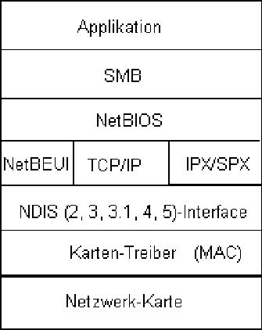
Network-based File Sharing (1)
NFS (UNIX-based)
  mountd is responsible for mount request
  nfsd and nfsiod
CIFS (Microsoft)
  Common Internet File System
  網路芳鄰

Slide 3
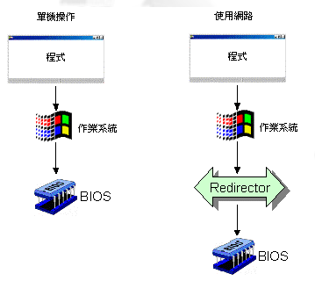
Network-based File Sharing (2)
Difference between local filesystem and network filesystem when accessing
  NetBIOS (API)
    Used to share or access network-based filesystem just as BIOS does in local filesystem
NetBIOS

Slide 4
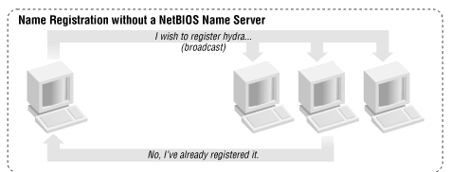
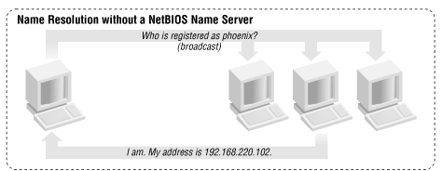
Network-based File Sharing (3)
  NetBEUI (transport protocol)
    Transfer NetBIOS commands across network
    Each host can claim a name not used in network
      NetBIOS Name Server or not

Slide 5
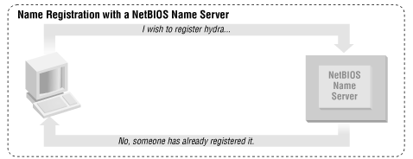
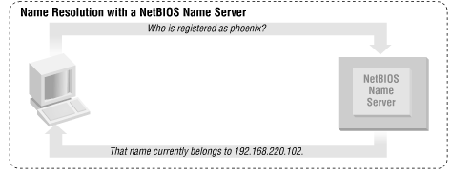
Network-based File Sharing (4)

Slide 6
UNIX-Windows communication
SAMBA
  A UNIX application that speak SMB protocol
  Designed by Andrew Tridgwell, in 1991
  Original Name: Server Message Block (SMB)

Slide 7
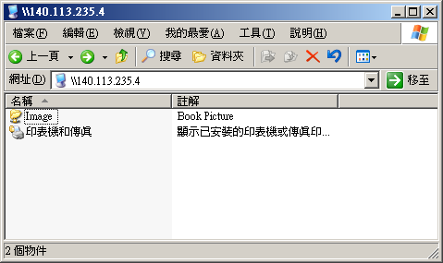
What SAMBA can do?
Sharing
  Sharing files or printers just like Microsoft does
  Authenticate user identity just like Microsoft does
  Resolve NetBIOS name just like Microsoft does

Slide 8
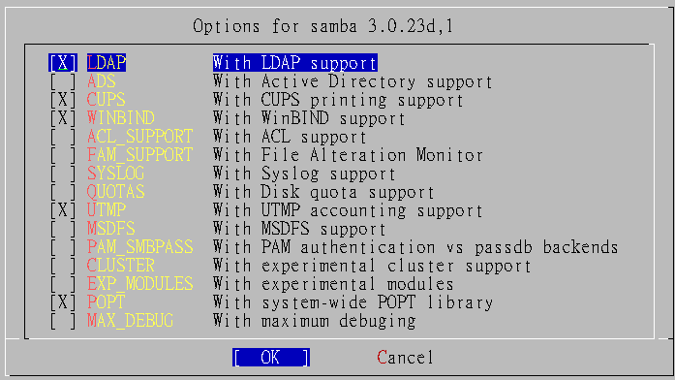
Install SAMBA
Using ports
  % cd /usr/ports/net/samba
  % make; make install; make clean

Slide 9
SAMBA components
Configuration files
  /usr/local/etc/smb.conf.default → /usr/local/etc/smb.conf
  /usr/local/etc/lmhosts
Major execution files
  smbd (/usr/local/sbin/smbd)
    Management of sharing directories, files and printers
  nmbd (/usr/local/sbin/nmbd)
    Resolve NetBIOS name and manage workgroup
  smbpasswd (/usr/local/bin/smbpasswd)
    Change a user’s SMB password

Slide 10
SAMBA configuration file
smb.conf
  Three sections
    Global Setting
    Printer Sharing Setting
    Home Sharing Setting
# comments
[global]
para1 = value1
…
[printers]
para2 = value2
…
[homes]
para3 = value3
…
[share-dir]
para4 = value4
…

Slide 11
SAMBA configuration file –
Global Setting (1)
Global Configuration
  workgroup
    Group name to join
    Ex: workgroup = chwong
  server string
    Description of this host
    Ex: server string = Samba Server of SA Course
  netbios name
    NetBIOS name of this host
    Ex: netbios name = sabsd
  Charset Settings
    “display charset”, “unix charset”, “dos charset”
    Ex:
      display charset = CP950
      unix charset = CP950
      dos charset = CP950
  hosts allow
    Apply to all services, regardless or individual service setting;
    Ex: hosts allow = 140.113.235. , 140.113.

Slide 12
SAMBA configuration file –
Global Setting (2)
  guest ok (or public = yes)
    If this is yes, no password is required
    Ex: guest ok = no
  guest account
    If guest can use this samba service, any guest request will map to this guest account
    Ex: guest account = ftp
  log file
    Full path of log file
    Ex: log file = /var/log/samba/log.%m
  max log size (KB)
    Ex: max log size = 500

Slide 13
SAMBA configuration file –
Global Setting (3)
  security = [share/user/server/domain]
    share: no need of id and password to login
    user: default option, login with id and password
    server: check id and password by another server
    domain: check id and password by domain controller
    Ex:
      security = user
      passdb backend = tdbsam

Slide 14
SAMBA configuration file –
Global Setting (4)
Example of global setting
[global]
workgroup = chwong
server string = sabsd samba server
netbios name = sabsd
display charset = CP950
unix charset = CP950
dos charset = CP950
printcap name = /etc/printcap
load printers = yes
printing = cups
log file = /var/log/samba/log.%m
max log size = 500
security = user
passdb backend = tdbsam

Slide 15
Samba parameters
Default parameters in samba
  %m
    Client NetBIOS name
  %M
    Client Hostname
  %I
    Client IP
  %L
    Samba server NetBIOS name
  %h
    Samba server Hostname
  %H
    User home directory
  %U
    Login name
  %T
    Current Date time

Slide 16
SAMBA configuration file –
Home Sharing Setting (1)
Home sharing setting
  comment
    Description of this directory
  path
    Sharing directory path
  browseable
    Display sharing name or not
  read only , writeable
  write list
    Only users on this can write content if read only
  create mode / create mask
    Default permission when file is created
  directory mode / directory mask
    Default permission when directory is created
  guest ok (or public = yes)

Slide 17
SAMBA configuration file –
Home Sharing Setting (2)
Example of home sharing
[Image]
comment = Book Picture
path = /home/image
read only = no
public = yes
writable = yes
create mode = 0664
directory mode = 0775

Slide 18
Starting SAMBA
Script
  /usr/local/etc/rc.d/samba.sh {start|stop}

Slide 19
SAMBA password
smb password file
  Now samba stores accounts and passwords in tdb
    Default database path: /var/db/samba
smbpasswd command
  -a
    Add new user
  -d
    Let some account in smbpasswd file can not login (to disable)
  -e
    Let some disable account resume (to enable)

Slide 20
Tool: smbclient (1)
A client program that can talk to an SMB server
Usage:
  -L [hostname]
    List sharable resource
  -U [username]
    Login with username

Slide 21
Tool: smbclient (2)
sabsd [/home/chwong] -chwong- smbclient -L sabsd -U chwong
Password:
Domain=[SABSD] OS=[Unix] Server=[Samba 3.0.23c]
Sharename Type Comment
--------- ---- -------
Image Disk Book Picture
IPC$ IPC IPC Service (sabsd)
ADMIN$ IPC IPC Service (sabsd)
Domain=[SABSD] OS=[Unix] Server=[Samba 3.0.23c]
Server Comment
--------- -------
Workgroup Master
--------- -------

Slide 22
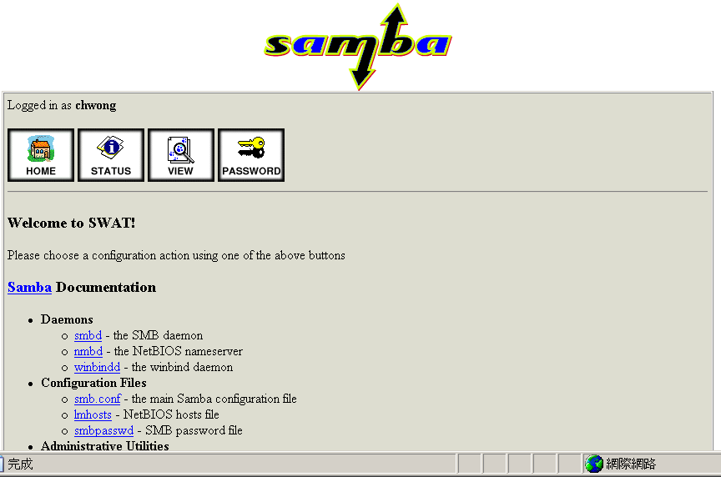
SWAT (1)
Edit /etc/inetd.conf
  Unmark
Restart inetd
Browse http://sabsd.cs.nctu.edu.tw:901/
swat stream tcp nowait/400 root /usr/local/sbin/swat swat

Slide 23
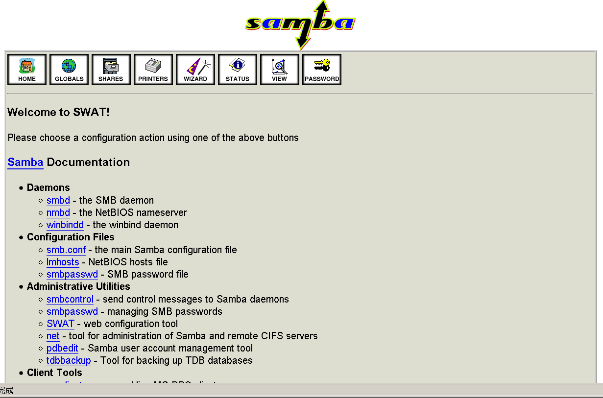
SWAT (2)
Root access

