Slide 1
FTP –
File Transfer Protocol

Slide 2
FTP
FTP
  File Transfer Protocol
  Used to transfer data from one computer to another over the internet.
  Client-Server Architecture.
  Separated control/data connections.
  Modes:
    Active Mode, Passive Mode
  RFCs:
    RFC 959 – File Transfer Protocol
    RFC 2228 – FTP Security Extensions
    RFC 2640 – UTF-8 support for file name

Slide 3
FTP
– FLOW (1)
Client
  Connect to server port 21 using port A.
  USER ####
  PASS ********
  PORT h1,h2,h3,h4,p1,p2
  Send some requests
  get return data from p1*256+p2
  Quit
Server
  Binding on port 21
  Accepts connection from client, output welcome messages.
  331 User name okay, need password.
  230 User logged in, proceed.
  200 PORT Command successful.
  Binding source port 20, connect to client port p1*256+p2, send data.
  …

Slide 4
FTP
– Flow (2)
lwbsd:~ -lwhsu- telnet ftp.tw.freebsd.org 21
Trying 140.113.17.209...
Connected to freebsd.cs.nctu.edu.tw.
Escape character is '^]'.
220-FTP server ready.
220 Only anonymous FTP is allowed here
USER anonymous
331 Any password will work
PASS lwhsu@cs.nctu.edu.tw
230 Any password will work
PORT 140,113,17,197,39,19
200 PORT command successful
CWD pub
250-If you're looking for one of the FreeBSD releases, please look in the
250-releases/${ARCH}/${RELNAME} directory, where ARCH = "i386" or "alpha"
250-for Intel and DEC Alpha architecture machines and RELNAME = the release
250-you're interested in, e.g. "3.5.1-RELEASE" or "4.2-RELEASE".
250-
250 OK. Current directory is /pub
LIST
150 Connecting to port 10003
226-Options: -l
226 30 matches total
QUIT
221-Goodbye. You uploaded 0 and downloaded 0 kbytes.
221 Logout.
Connection closed by foreign host.
Example
  Control
  Connection

Slide 5
FTP
– Flow (3)
$ cat server.pl
#!/usr/bin/perl -w
package MyPackage;
use strict;
use base qw(Net::Server::PreFork);
MyPackage->run(port => $ARGV[0]);
sub process_request {
while (<STDIN>) {
s/\r?\n$//;
print STDERR "$_\n";
}
}
Example (contd.)
  Retrieving Data
    Client must bind the random port
lwbsd:~ -lwhsu- perl server.pl 10003
2009/04/08-16:40:38 MyPackage (type Net::Server::PreFork) starting! pid(70673)
Binding to TCP port 10003 on host *
Group Not Defined. Defaulting to EGID '20 20 0 80'
User Not Defined. Defaulting to EUID '1001'
drwxrwxr-x 6 888 2010 11 Oct 25 2007 CERT
lrwxr-xr-x 1 888 2010 15 Jun 1 2005 CTM -> development/CTM
lrwxr-xr-x 1 888 2010 17 Jun 1 2005 CVSup -> development/CVSup
drwxrwxr-x 4 888 2010 4 Jun 10 2005 ERRATA
lrwxr-xr-x 1 888 2010 1 Jun 10 2005 FreeBSD -> .
lrwxr-xr-x 1 888 2010 17 Jun 1 2005 FreeBSD-current -> branches/-current
lrwxr-xr-x 1 888 2010 19 Jun 1 2005 FreeBSD-stable -> branches/4.0-stable
lrwxr-xr-x 1 888 2010 25 Jun 1 2005 ISO-IMAGES-alpha -> releases/alpha/ISO-IMAGES
lrwxr-xr-x 1 888 2010 25 Jun 1 2005 ISO-IMAGES-amd64 -> releases/amd64/ISO-IMAGES
lrwxr-xr-x 1 888 2010 24 Jun 1 2005 ISO-IMAGES-i386 -> releases/i386/ISO-IMAGES
lrwxr-xr-x 1 888 2010 24 Jun 1 2005 ISO-IMAGES-ia64 -> releases/ia64/ISO-IMAGES
lrwxr-xr-x 1 888 2010 24 Jun 1 2005 ISO-IMAGES-pc98 -> releases/pc98/ISO-IMAGES
lrwxr-xr-x 1 888 2010 27 Feb 19 2008 ISO-IMAGES-powerpc -> releases/powerpc/ISO-IMAGES
lrwxr-xr-x 1 888 2010 27 Jan 15 2007 ISO-IMAGES-ppc -> releases/powerpc/ISO-IMAGES
lrwxr-xr-x 1 888 2010 27 Jun 1 2005 ISO-IMAGES-sparc64 -> releases/sparc64/ISO-IMAGES
-rw-rw-r-- 1 888 2010 6430 Jun 19 2004 README.TXT
-rw------- 1 888 2010 11 May 10 2008 TIMESTAMP
drwxrwxr-x 2 888 2010 3 Jun 10 2005 TrustedBSD
drwxrwxr-x 9 888 2010 9 Mar 11 2008 branches
drwxrwxr-x 8 888 2010 8 Jun 10 2005 development
lrwxr-xr-x 1 888 2010 15 Jun 1 2005 distfiles -> ports/distfiles
(...)

Slide 6
FTP
– COMMANDS, RESPONSES
Commands
  USER username
  PASS password
  LIST
    Return list of file in current dir.
  RETR filename
    Retrieves (gets) file.
  STOR filename
    Stores (puts) file onto server.
  PORT h1,h2,h3,h4,p1,p2
    Set to active mode
  PASV
    Set to passive mode
  DELE
    Remove file on the server.
  QUIT
Return Codes
  First code
  1: Positive Preliminary reply
  2: Positive Completion reply
  3: Positive Intermediate reply
  4: Transient Negative Completion reply
  5: Permanent Negative Completion reply
  Second code
  0: The failure was due to a syntax error
  1: A reply to a request for information.
  2: A reply relating to connection information
  3: A reply relating to accounting and authorization.
  5: The status of the Server file system

Slide 7
FTP
– Active Mode vs. Passive Mode (1)
Active Mode
  FTP client bind a random port (>1023) and sends the random port to FTP server using “PORT” command.
  When the FTP server initiates the data connection to the FTP client, it binds the source port 20 and connect to the FTP client the random port sent by client.
  PORT h1,h2,h3,h4,p1,p2
Passive Mode
  FTP client sends “PASV” command to the server, make the server bind a random port (>1023) and reply the random port back.
  When initializing the data connection, the FTP client connect to the FTP Server the random port, get data from that port.
  PASV ➔ Server reply: 227 Entering Passive Mode (h1,h2,h3,h4,p1,p2)
※ IP:port (6bytes) → h1,h2,h3,h4,p1,p2
Ex. 140.113.17.215:45678 → 140,113,17,215,178,110

Slide 8
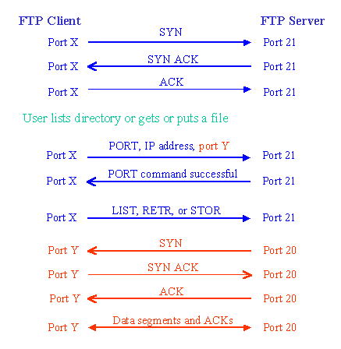
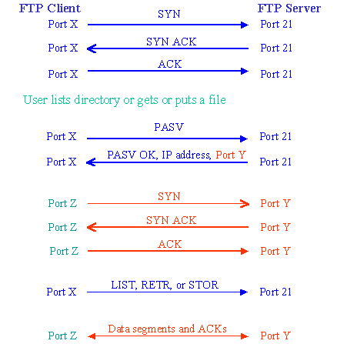
FTP
– ACTIVE MODE VS. PASSIVE MODE (2)
Active mode
Passive mode

Slide 9
FTP
– When FTP meets NAT/Firewall (1)
Firewall behavior
  Generally, the NAT/Firewall permits all outgoing connection from internal network, and denies all incoming connection from external network.
Problem when FTP meets NAT/Firewall
  Due to the separated command/data connection, the data connections are easily blocked by the NAT/Firewall.
Problem Cases:
  Active mode, NAT/Firewall on client side.
    Passive mode can solve this problem.
  Passive mode, NAT/Firewall on server side.
    Active mode can solve this problem.
  Both client side and server side have NAT/Firewall
    The real problem.

Slide 10


FTP
– When FTP meets NAT/Firewall (2)
Active mode, NAT/Firewall on client side.
  Passive mode can solve this problem.
NAT/Firewall
NAT/Firewall
Client
Server
Client
Server
PORT IP, port Y
PASV
reply IP, port Z
Connect to port Y
BLOCKED
Connect to port Z
PASS
Active Mode
Passive Mode

Slide 11
FTP
– When FTP meets NAT/Firewall (3)
Passive mode, NAT/Firewall on Server side.
  Active mode can solve this problem.
NAT/Firewall
NAT/Firewall
Client
Server
Client
Server
PASV
PORT IP, port Y
reply IP, port Z
Connect to port Z
BLOCKED
Connect to port Y
PASS
Passive Mode
Active Mode

Slide 12
FTP
– When FTP meets NAT/Firewall (4)
Real Problem: Firewall on both sides.
  Solution: ftp-proxy running on NAT/Firewall
NAT/Firewall
NAT/Firewall
NAT/Firewall
NAT/Firewall
Client
Server
Client
Server
PORT IP, port Y
PASV
reply IP, port Z
Connect to port Y
BLOCKED
Connect to port Z
BLOCKED
Active Mode
Passive Mode

Slide 13
FTP
– Security
Security concern
  As we seen, FTP connections (both command and data) are transmitted in clear text.
  What if somebody sniffing the network?
    We need encryption.
Solutions
  FTP over SSH
    So called secure-FTP.
    Both commands and data are encrypted while transmitting.
    Poor performance.
  FTP over TLS
    Only commands are encrypted while transmitting.
    Better performance.

Slide 14
FTP
– Pure-FTPd (1)
Introduction
  A small, easy to set up, fast and secure FTP server
  Support chroot
  Restrictions on clients, and system-wide.
  Verbose logging with syslog
  Anonymous FTP with more restrictions
  Virtual Users, and Unix authentication
  FXP (File eXchange Protocol)
  FTP over TLS
  UTF-8 support for file names

Slide 15
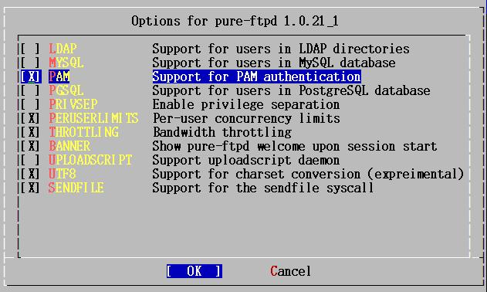
FTP
– PURE-FTPD (2)
Installation
  Ports: /usr/ports/ftp/pure-ftpd
  Options

Slide 16
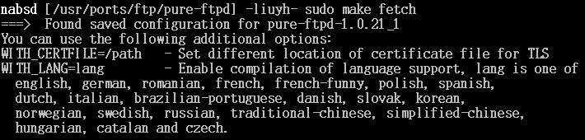
FTP
– PURE-FTPD (3)
  Other options
  WITH_CERTFILE for TLS
    Default: /etc/ssl/private/pure-ftpd.pem
  WITH_LANG
    Change the language of output messages
Startup:
  Add pureftpd_enable="YES" into /etc/rc.conf

Slide 17
FTP
– PURE-FTPD CONFIGURATIONS(1)
Configurations:
  File: /usr/local/etc/pure-ftpd.conf
  Documents
    Configuration sample: /usr/local/etc/pure-ftpd.conf.sample
      All options are explained clearly in this file.
    Other documents
      See /usr/local/share/doc/pure-ftpd
mirror:/usr/local/share/doc/pure-ftpd -lwhsu- ls
AUTHORS README.Authentication-Modules README.PGSQL
CONTACT README.Configuration-File README.TLS
COPYING README.Contrib README.Virtual-Users
HISTORY README.LDAP THANKS
NEWS README.MySQL pure-ftpd.png
README README.Netfilter pureftpd.schema

Slide 18
FTP
– PURE-FTPD CONFIGURATIONS(2)
# Cage in every user in his home directory
ChrootEveryone yes
# If the previous option is set to "no", members of the following group
# won't be caged. Others will be. If you don't want chroot()ing anyone,
# just comment out ChrootEveryone and TrustedGID.
TrustedGID 0
# PureDB user database (see README.Virtual-Users)
PureDB /etc/pureftpd.pdb
# If you want simple Unix (/etc/passwd) authentication, uncomment this
UnixAuthentication yes
# Port range for passive connections replies. - for firewalling.
PassivePortRange 30000 50000
# This option can accept three values :
# 0 : disable SSL/TLS encryption layer (default).
# 1 : accept both traditional and encrypted sessions.
# 2 : refuse connections that don't use SSL/TLS security mechanisms,
# including anonymous sessions.
# Do _not_ uncomment this blindly. Be sure that :
# 1) Your server has been compiled with SSL/TLS support (--with-tls),
# 2) A valid certificate is in place,
# 3) Only compatible clients will log in.
TLS 2
# UTF-8 support for file names (RFC 2640)
# Define charset of the server filesystem and optionnally the default charset
# for remote clients if they don't use UTF-8.
# Works only if pure-ftpd has been compiled with --with-rfc2640
ClientCharset big5
FileSystemCharset utf-8

Slide 19
FTP
– PURE-FTPD PROBLEM SHOOTING
Logs Location
  In default, syslogd keeps ftp logs in /var/log/xferlog
  Most frequent problem
    pure-ftpd: (?@?) [ERROR] Unable to find the 'ftp' account
      It’s ok, but you may need it for Virtual FTP Account.
    pure-ftpd: (?@?) [ERROR] Sorry, but that file doesn't exist: [/etc/ssl/private/pure-ftpd.pem]
      If you set TLS = 2, then this file is needed.
    How to generate a pure-ftpd.pem?
      See README.TLS

Slide 20
FTP
– PURE-FTPD TOOLS
pure-*
pure-ftpwho
  List information of users who use the FTP server now.
pure-pw
  To create Virtual Users using PureDB
  man pure-pw
  See README.Virtual-Users

Slide 21
FTP
– PF: ISSUES WITH FTP (1)
Reference: http://www.openbsd.org/faq/pf/ftp.html
FTP Client Behind the Firewall
  Problem
    Clients cannot use active mode
  Use ftp-proxy
    Use inetd to start ftp-proxy
    man ftp-proxy
  In pf.conf
    nat-anchor “ftp-proxy/*”
    rdr-anchor “ftp-proxy/*”
    rdr on $int_if proto tcp from any to any port 21 -> 127.0.0.1 \ port 8021
    anchor “ftp-proxy/*”

Slide 22
FTP
– PF: ISSUES WITH FTP (2)
PF "Self-Protecting" an FTP Server
  Problem
    Clients cannot use passive mode
  Open holes so that clients can connect into the data channel
  In pf.conf
    pass in on $ext_if proto tcp from any to any port 21 keep state
    pass in on $ext_if proto tcp from any to any port > 49151 keep state

Slide 23
FTP
– PF: ISSUES WITH FTP (3)
FTP Server Protected by an External PF Firewall Running NAT
  Problem
    Clients cannot use passive mode
  Use ftp-proxy
    Need some flags of ftp-proxy
    man ftp-proxy
  In pf.conf
    nat-anchor “ftp-proxy/*”
    nat on $ext_if inet from $int_if -> ($ext_if)
    rdr-anchor “ftp-proxy/*”
    pass in on $ext_if inet proto tcp to $ext_ip port 21 flags S/SA keep state
    pass out on $int_if inet proto tcp to $ftp_ip port 21 user proxy flags S/SA keep state
    anchor “ftp-proxy/*”

Slide 24
FTP
– MORE TOOLS
/usr/ports/ftp/pftpx
  Another ftp proxy daemon
/usr/ports/ftp/lftp
  A powerful functional client
  Support TLS
/usr/ports/ftp/wget
  Retrieve files from the Net via HTTP(S) and FTP
/usr/ports/ftp/mget
  Multithreaded commandline web-download manager
FileZilla
  An FTP Client for Windows
  Support TLS

