Slide 1
Mail System

Slide 2
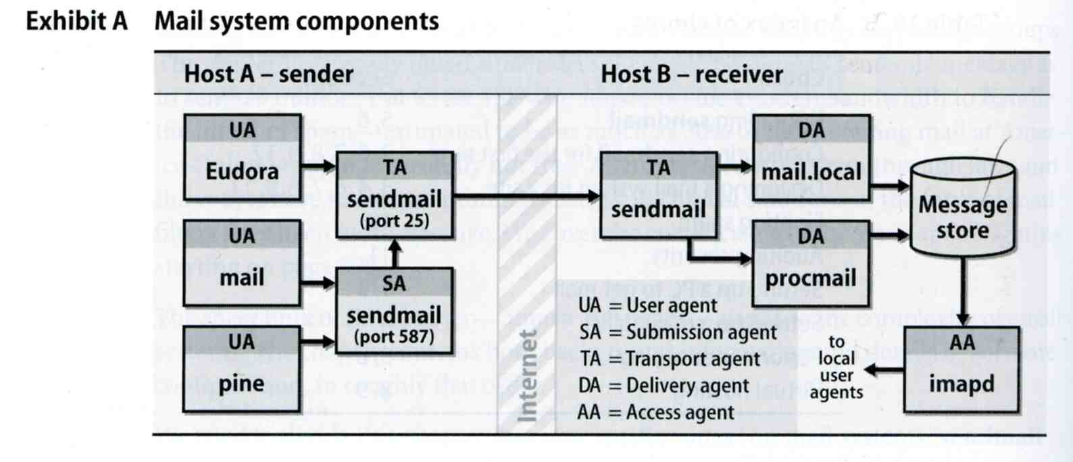
MAIL SYSTEM
  Access Agent (AA)
    Connects the user agent to the mail box using POP or IMAP protocols
  Submission Agent (SA)
    Route mails to local MTA
Major components
  Mail User Agent (MUA)
    Help user read and compose mails
  Mail Transport Agent (MTA)
    Route mails among machines
  Delivery Agent (DA)
    Place mails in users’ mail boxes

Slide 3
Mail System
– The Message Stores
The place on the local machine where email is stored
  Usually the directory: /var/mail or /var/spool/mail
    Users’ mails are stored in files named with each user’s login name
      Such as /lwhsu
    Permission “775” and root:mail as the owner and group owner
      drwxrwxr-x 2 root mail 512 Dec 16 15:51 mail/
  Using database
    When the organization is large or for ISP with millions of customers

Slide 4
Mail System
– The User Agent (1)
Help user read and compose mails
  UA must know mail format
    Originally: Text only
    Now: MIME
  ※ MIME (Multipurpose Internet Mail Extensions)
    Include several types of content that can be encoded in the mail, such as image, video, …

Slide 5
Mail System
– The User Agent (2)
  Popular Mail User Agents
User Agent | System Config. | User Config. | MIME | POP | IMAP | SMTP
bin/mail | mail.rc | .mailrc
pine | pine.conf | .pinerc
elm | lib/elm.rc | .elm/elmrc
mutt | /etc/Muttrc | .muttrc
Netscape | - | -
Eudora | - | -
Outlook Ep. | - | -

Slide 6
Mail System
– The Transport Agent (1)
Route mails among machines
  Accept mail from UA, examine the recipients’ addresses, and delivery the mail to the correct host
  Protocols
    SMTP (Simple Mail Transport Protocol)
      RFC 821
    ESMTP (Extended SMTP)
      RFC 1869, 1870, 1891, 1985
  Popular transport agents
    sendmail http://www.sendmail.org/
    Portfix http://www.postfix.org/

Slide 7
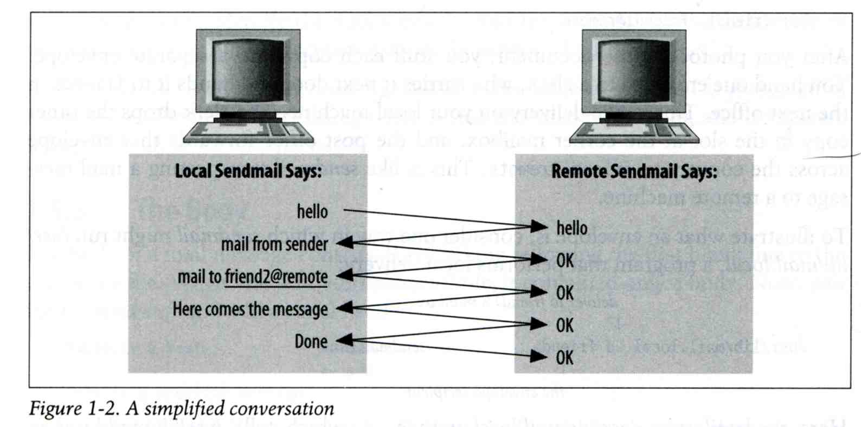
Mail System
– The Transport Agent (2)
Conversation between TAs

Slide 8
Mail System
– The Transport Agent (3)
Protocol: SMTP
lwbsd [/home/lwhsu] -lwhsu- telnet lwbsd.cs.nctu.edu.tw 25
Trying 140.113.17.212...
Connected to lwbsd.cs.nctu.edu.tw.
Escape character is '^]'.
220 lwbsd.cs.nctu.edu.tw ESMTP Sendmail 8.13.8/8.13.8; Sun, 15 Apr 2007 13:50:16 +0800 (CST)
HELP
214-2.0.0 This is sendmail version 8.13.8
214-2.0.0 Topics:
214-2.0.0 HELO EHLO MAIL RCPT DATA
214-2.0.0 RSET NOOP QUIT HELP VRFY
214-2.0.0 EXPN VERB ETRN DSN AUTH
214-2.0.0 STARTTLS
214-2.0.0 For more info use "HELP <topic>".
214-2.0.0 To report bugs in the implementation see
214-2.0.0 http://www.sendmail.org/email-addresses.html
214-2.0.0 For local information send email to Postmaster at your site.
214 2.0.0 End of HELP info
HELO lwbsd
250 lwbsd.cs.nctu.edu.tw Hello lwbsd.csie.nctu.edu.tw [140.113.17.212], pleased to meet you
QUIT
221 2.0.0 lwbsd.cs.nctu.edu.tw closing connection
Connection closed by foreign host.

Slide 9
Mail System
– The Delivery Agent
Place mails in users’ mail boxes
  Accept mail from MTA and deliver the mail to the local recipients
  Type of recipients
    User
    Program, such as
      mail.local
      procmail
  mail.local
    Read the stdin up to an EOF and appends it to each user’s mail file
  procmail
    Do something between mail coming in and stored in mail box
    CS: Help → 5 → 2 → 8
    http://www.cs.nctu.edu.tw/help/procmail.htm

Slide 10
Mail System
– The Access Agent
Help user download mail from server
  Protocols
    IMAP (Internet Message Access Protocol)
    POP (Post Office Protocol)

Slide 11
Mail System
– The Submission Agent
Route mails to local MTA
  Typical works that a MTA must do:
    Ensuring that all hostname are fully qualified
    Modifying headers
    Logging errors
    …
  RFC2476 introduces the idea of splitting MTA
    Let SA to share the load

Slide 12
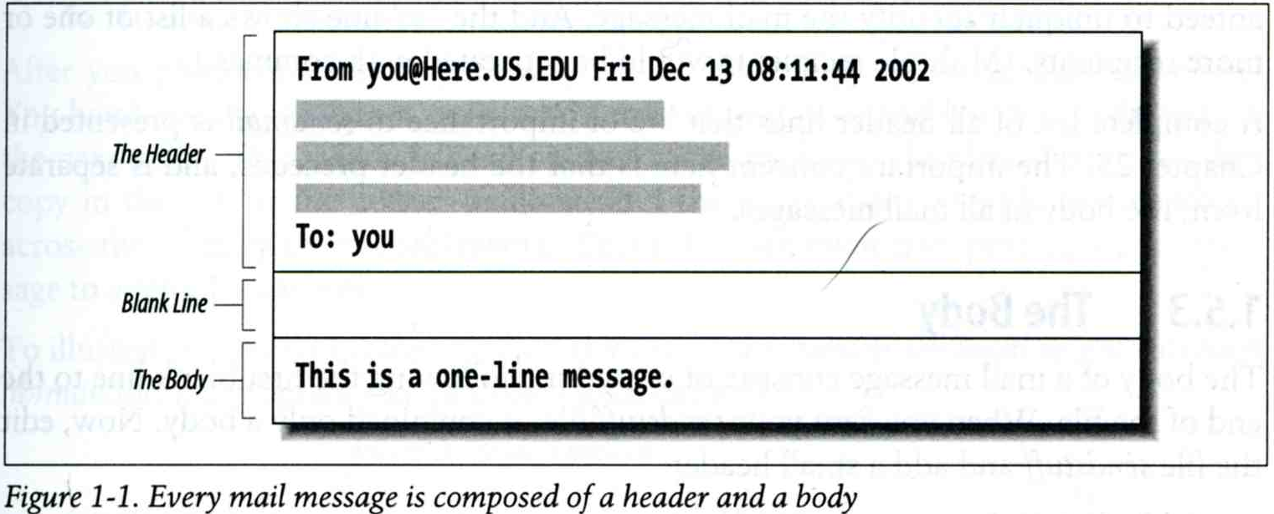
COMPONENTS OF A MAIL (1)

Slide 13
Components of A Mail (2)
Three major components
  The envelope
    Invisible to users
    Determine where the message should be delivered, or to whom it should be returned
  The headers
    Information about the messages, defined in RFC822
      From, To, Date, Time, MTA, …
  The message body
    Plain text only
    Various MIME contents are encoded as printable characters using radix-64 algorithm

Slide 14
Mail Addressing (1)
Two kinds of email addresses:
  Route based address
    Message will travel through several intermediate hosts to the destination
    Format: host!path!user
      Ex: castle!sun!sierra!hplabs!ucbvax!winsor
      This mail is sent from “castle” host to the user “winsor” at “ucbvax” host
  Location independent address
    Simply identify the final destination
    Format: user@host.domain
      Ex: lwhsu@nabsd.cs.nctu.edu.tw
Alias
  Map a username to something else, such as
    To a group of users
      Ex: ta → chunchung, ych, xclin, …
    To the same user at different machine
      Ex: lwhsu@nabsd.cs.nctu.edu.tw → lwhsu@cs.nctu.edu.tw
    To another user
      Ex: admin@cs.nctu.edu.tw → lwhsu@cs.nctu.edu.tw

Slide 15
Mail Addressing (2)
Where to send the mail?
  When you want to send the mail to lwhsu@cs.nctu.edu.tw, the MTA will:
    First, lookup up the mail exchanger of “cs.nctu.edu.tw”
      % dig mx cs.nctu.edu.tw
      If there is any servers, choose the higher preference one
      If this preferred one can not be connected, choose another
      If all the mx servers can not be connected (or not available), mail it directly to the host
knight:~ -lwhsu- dig cs.nctu.edu.tw mx
...
;; ANSWER SECTION:
cs.nctu.edu.tw. 7200 IN MX 5 csmx2.cs.nctu.edu.tw.
cs.nctu.edu.tw. 7200 IN MX 10 csmx3.cs.nctu.edu.tw.
cs.nctu.edu.tw. 7200 IN MX 5 csmx1.cs.nctu.edu.tw.
...

Slide 16
Mail Addressing (3)
Why using “Mail eXchanger”?
  We can centralize all the mail tasks to group of servers
  Multiple mail exchangers make it more robust

Slide 17
Mail Headers (1)
Defined by RFC822 which is obsoleted by RFC2822
  Mail reader will hide some uninteresting header information
Date: Wed, 18 Apr 2007 14:05:04 +0800
From: 蓉蓉 <dragon@mail.hell.net>
Subject: 想吃炸蝦飯
To: Li-Wen Hsu <lwhsu@nabsd.cs.nctu.edu.tw>
User-Agent: Mutt/1.5.15 (2007-04-06)
你買給我好不好？

Slide 18
Mail Headers (2)
From lwhsu@lwbsd.cs.nctu.edu.tw Wed Apr 18 14:07:21 2007
Return-Path: <lwhsu@lwbsd.cs.nctu.edu.tw>
X-Original-To: lwhsu@nabsd.cs.nctu.edu.tw
Delivered-To: lwhsu@nabsd.cs.nctu.edu.tw
Received: from lwbsd.cs.nctu.edu.tw (lwbsd.csie.nctu.edu.tw [140.113.17.212])
by nabsd.cs.nctu.edu.tw (Postfix) with ESMTP id 22EC73B4D51
for <lwhsu@nabsd.cs.nctu.edu.tw>; Wed, 18 Apr 2007 14:07:21 +0800 (CST)
Received: from lwbsd.cs.nctu.edu.tw (localhost [127.0.0.1])
by lwbsd.cs.nctu.edu.tw (8.13.8/8.13.8) with ESMTP id l3I654P3060925
for <lwhsu@nabsd.cs.nctu.edu.tw>; Wed, 18 Apr 2007 14:05:04 +0800 (CST)
(envelope-from lwhsu@lwbsd.cs.nctu.edu.tw)
Received: (from lwhsu@localhost)
by lwbsd.cs.nctu.edu.tw (8.13.8/8.13.8/Submit) id l3I654AY060924
for lwhsu@nabsd.cs.nctu.edu.tw; Wed, 18 Apr 2007 14:05:04 +0800 (CST)
(envelope-from lwhsu)
Date: Wed, 18 Apr 2007 14:05:04 +0800
From: =?big5?Q?=BBT=BBT?= <dragon@mail.hell.net>
To: Li-Wen Hsu <lwhsu@nabsd.cs.nctu.edu.tw>
Subject: =?big5?B?t1GmWay1vby2ug==?=
Message-ID: <20070418060503.GA60903@lwbsd.csie.nctu.edu.tw>
MIME-Version: 1.0
Content-Type: text/plain; charset=big5
Content-Disposition: inline
Content-Transfer-Encoding: 8bit
User-Agent: Mutt/1.5.15 (2007-04-06)
Status: RO
Content-Length: 17
Lines: 1
你買給我好不好？

Slide 19
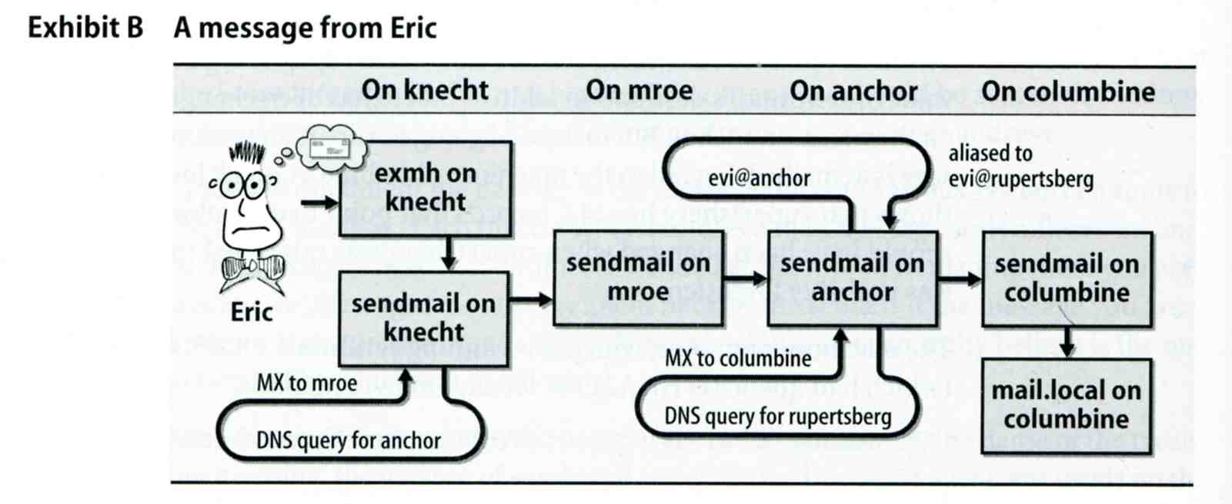
Mail Headers (3)
Example
  User “eric” on “knecht.sendmail.org” sends a email to user “evi” on “anchor.cs.colorado.edu”
    % dig mx anchor.cs.colorado.edu
      mroe.cs.colorado.edu

Slide 20
Mail Headers (4)
Headers in this example
  From eric@knecht.sendmail.org
    Added by mail.local when the mail is put in user’s mailbox
    Used to separate message boundary
  Return-Path: eric@knecht.sendmail.org
    Used to send the error message to this address
    May be different to the “From” address
  Received: from knecht.sendmail.org (localhost [127.0.0.1]) by knecht.sendmail.org (8.9.3/8.9.2) with ESMTP id GAA18984; Fri 1 Oct 1999 06:04:02 -800 (PST)
    Every machine that is ever processed this mail will add a “Received” record in top of headers
      Sending machine
      Receiving machine
      Version of sendmail in receiving machine
      Message unique identifier in receiving machine
      Date and time

Slide 21
Mail Headers (5)
  Received: from anchor.cs.Colorado.EDU (root@anchor.cs.colorado.edu [128.138.242.1]) by columbine.cs.colorado.edu (8.9.3/8.9.2) with ESMTP id HAA21741 for <evi@rupertsberg.cs.colorado.edu>; Fri, 1 Oct 1999 07:04:25 -0700 (MST)
  Received: from more.cs.colorado.edu (more.cs.colorado.edu [128.138.243.1]) by anchor.cs.colorado.edu (8.9.3/8.9.2) with ESMTP id HAA26176 for <evi@anchor.cs.colorado.edu>; Fri, 1 Oct 1999 07:04:24 -0700 (MST)
  Received: from knecht.sendmail.org (knecht.sendmail.org [209.31.233.160]) by more.cs.colorado.edu (8.9.3/8.9.2) with ESMTP id HAA09899 fro <evi@anchor.cs.colorado.edu>; Fri, 1 Oct 1999 07:04:23 -700 (MST)
  Received: from knecht.sendmail.org (localhost [127.0.0.1]) by knecht.sendmail.org (8.9.3/8.9.2) with ESMTP id GAA18984; Fri 1 Oct 1999 06:04:02 -800 (PST)

Slide 22
Mail Headers (6)
  Message-Id: <199910011404.GAA18984@knecht.sendmail.org)
    Add by sender’s MTA
  X-Mailer: exmh version 2.0.2 2/24/98
    MUA
    Non-standard header information
  To: Evi Nemeth <evi@anchor.cs.colorado.edu>
  Subject: Re: hi
  Date: Fri, 1 Oct 1999 06:04:02 -800

Slide 23
Mail System Architecture
Components in a mail system architecture
  Mail servers for incoming and outgoing mails
  Mail home
  IMAP or POP to integrate PC and remote clients
Simplest architecture
  Only one machine
    This machine has sendmail to let you send and receive mail
    This machine is also the mailbox home
    This machine also provides IMAP or POP to let you download mail from PC

Slide 24
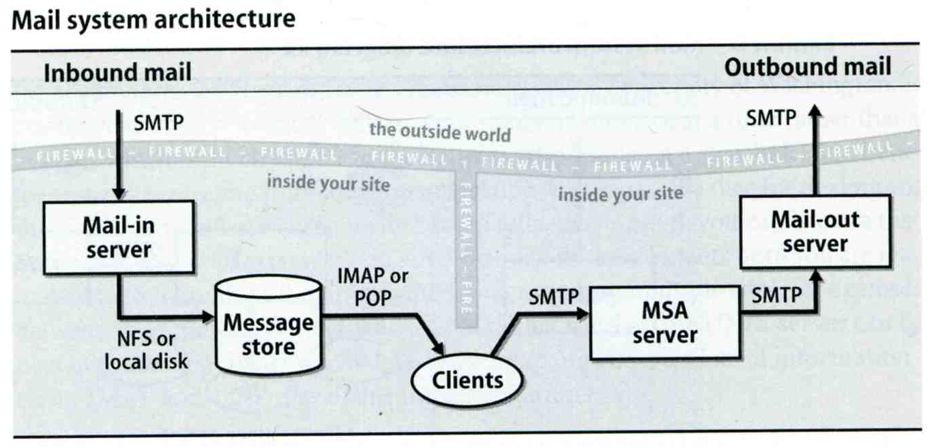
Mail System Architecture –
Scalable architecture for medium sites
Centralize
  At least one machine for incoming message and
    Mail home can be the same host or another one
  At least one machine for outgoing message
    Each host run MSA and forward mail to the same mail-out server or send the mail directly

Slide 25
Mail Alias
Several mechanisms to define aliases:
  Traditional method: in files
  Traditional method with NIS
  LDAP (Light-weight Directory Access Protocol)
When the sendmail wants to resolve name
  File-based method
    sendmail looks up files to resolve it by itself
  LDAP-based method
    sendmail call LDAP server to resolve the name and return the results

Slide 26
Mail Alias
– Traditional aliasing mechanism (1)
Aliases can be defined in three places
  In MUA’s configuraiton file
    Read by MUA and expand the alias before injecting the message into the mail system
  In the system-wide /etc/mail/aliases file
    Read by MTA
    The path to the system-wide alias file can be specified in sendmail’s configuration file
  In user’s forwarding file, ~/.forward
    Read by MTA after system-wide alias file
    forward(5)

Slide 27
Mail Alias
– Traditional aliasing mechanism (2)
The format of an entry in aliases file
  Local-name: recipient1,recipient2,…
  Ex:
    admin: lwhsu,chwong
    lwhsu: lwhsu@lwbsd.cs.nctu.edu.tw
  Local-name: :include:another-file
  Ex:
    mailTA: :include:/usr/local/mail/mailTA
Contents of mailTA
tytsai
chwong
hhyou
lwhsu
wchunhao
chiahung
liuyh
chenbc

Slide 28
Mail Alias
– Traditional aliasing mechanism (3)
  Local-name: absolute-path-file
  Mails will be appended to this file
  Ex:
    complaints: /dev/null
    troubles: trouble_admin,trouble_log
    trouble_admin: :include:/usr/local/mail/troadm
    trouble_log: /usr/local/mail/logs/troublemail
  Local-name: "|program-path"
  Route mail to stdin of program
  Ex:
    autoftp: “|/usr/local/bin/ftpserver”

Slide 29
Mail Alias
– Traditional aliasing mechanism (4)
The hashed aliases DB
  /etc/mail/aliases is the plaintext aliases information
  /etc/mail/aliases.db is the hashed version for efficiency
  Use “newaliases” command to rebuild the hashed version when you change the aliases file

Slide 30
Mail Alias
– Traditional aliasing mechanism (5)
User maintainable forwarding file
  In ~/.forward
  Format: comma-separated
  Ex:
    lwhsu.tw@gmail.com
    \lwhsu, lwhsu.tw@gmail.com, lwhsu@FreeBSD.org
  Must be owned by user and with permission of 600
    The path to .forward file should be writable only to user

Slide 31
Mail Alias
– Traditional aliasing mechanism (6)
Alias must
  postmaster and MAILER-DAEMON
    Mail system maintainer
  bin, sys, daemon, nobody, …
    System accounts (root)
  root
    forward root mail to the administrator (.forward)
MAILER-DAEMON: postmaster
postmaster: root
bin: root
bind: root
daemon: root
games: root
kmem: root
mailnull: postmaster
nobody: root
operator: root
…

Slide 32
vacation(1)
E-mail auto-responder
  returns a message, ~/.vacation.msg by default
  ~/.vacation.db
    default database file for db(3)
  ~/.vacation.{dir,pag}
    default database file for dbm(3)
  ~/.vacation.msg
    default message to send
Use with forward(5)
  |/usr/bin/vacation

