Slide 1
Network Basics

Slide 2
Contents
TCP/IP Protocol
Routing
Network Hardware
Notes:
http://linux.tnc.edu.tw/techdoc/perl_intro/c119.html

Slide 3
TCP/IP Protocol

Slide 4
TCP/IP and the Internet
In 1969
  ARPA funded and created the “ARPAnet” network
    Robust, reliable, vendor-independent data communications
In 1975
  Convert from experimental to operational network
  TCP/IP begun to be developed
In 1983
  The TCP/IP is adopted as Military Standards
  ARPnet → MILNET + ARPnet = Internet
In 1985
  The NSF created the NSFnet to connect to Internet
In 1990
  ARPA passed out of existence, and in 1995, the NSFnet became the primary Internet backbone network
ARPA = Advanced Research Project Agency
NSF = National Science Foundation
Notes:
1983 年時, ARPnet 分成 MILNET 以及較小的 ARPnet
大約從那時候起, 有了 Internet 這個名詞
自從 1985 年, NSFnet 串上 Internet 後, 開始一連串的蓬勃發展
NSFnet 的目的就是希望能夠將網路帶給美國每一位 scientist, engineer

Slide 5
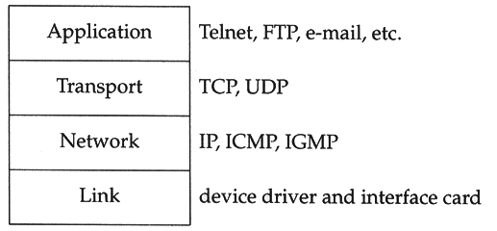
Introduction (1)
TCP/IP
  Used to provide data communication between hosts
    How to delivery data reliably
    How to address remote host on the network
    How to handle different type of hardware device
  4 layers architecture
    Each layer perform certain tasks
    Each layer only need to know how to pass data to adjacent layers

Slide 6
Introduction (2)
Four layer architecture
  Link Layer (Data Link Layer)
    Network Interface Card + Driver
    Handle all the hardware detail of whatever type of media
  Network Layer (Internet Layer)
    Handle the movement of packets on the network
  Transport Layer
    Provide end-to-end data delivery services
  Application Layer
    Handle details of the particular application

Slide 7
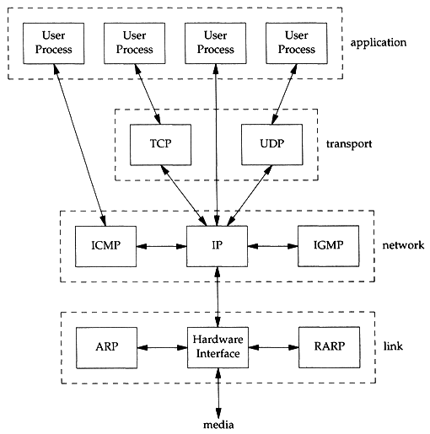
Introduction (3)
Each layer has several protocols
  A layer define a data communication function that may be performed by certain protocols
  A protocol provides a service suitable to the function of that layer

Slide 8
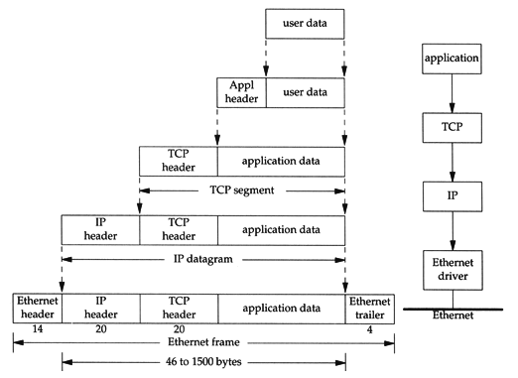
Introduction (4)
Send data
  encapsulation

Slide 9
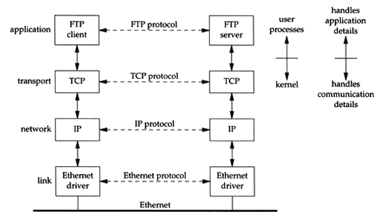
Introduction (5)
Addressing
  Nearby (same network)

Slide 10
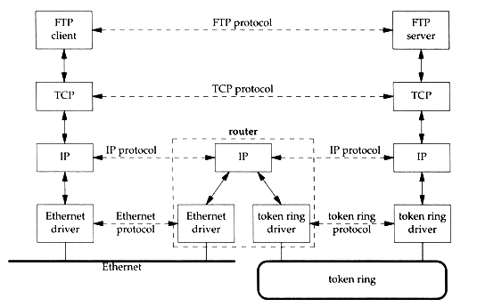
Introduction (6)
Addressing
  Faraway (across network)

Slide 11
Introduction (7)
Addressing
  MAC Address
    Media Access Control Address
    48-bit Network Interface Card Hardware Address
      24bit manufacture ID
      24bit serial number
    Ex:
      00:07:e9:10:e6:6b
  IP Address
    32-bit Internet Address (IPv4)
    Ex:
      140.113.209.64
  Port
    16-bit uniquely identify application (1 ~ 65536)
    Ex:
      FTP port 21, ssh port 22, telnet port 23

Slide 12
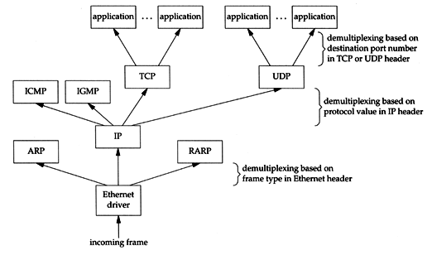
Introduction (8)
Receive Data
  Demultiplexing
Notes:
Remove header and pass to the next upper layer

Slide 13
Link Layer

Slide 14
Link Layer
– Introduction of Link Layer
Purpose of the link layer
  Send and receive IP datagram for IP module
  ARP request and reply
  RARP request and reply
TCP/IP support various link layers, depending on the type of hardware used:
  Ethernet
    Teach in this class
  Token Ring
  FDDI (Fiber Distributed Data Interface)
  Serial Line

Slide 15
Link Layer
– Ethernet
Features
  Predominant form of local LAN technology used today
  Use CSMA/CD
    Carrier Sense, Multiple Access with Collision Detection
  Use 48bit MAC address
  Operate at 10 Mbps
    Fast Ethernet at 100 Mbps
    Gigabit Ethernet at 1000Mbps
  Ethernet frame format is defined in RFC894
    This is the actually used format in reality

Slide 16
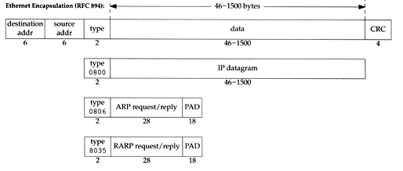
Link Layer
– Ethernet Frame Format
48bit hardware address
  For both destination and source address
16bit type is used to specify the type of following data
  0800 → IP datagram
  0806 → ARP, 8035 → RARP

Slide 17
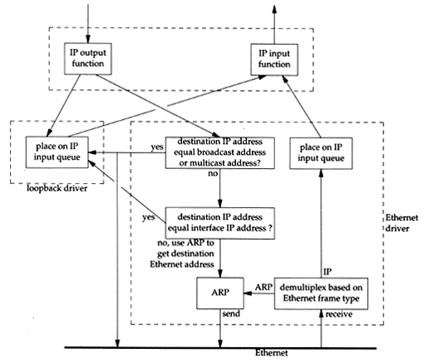
Link Layer
– Loopback Interface
Pseudo NIC
  Allow client and server on the same host to communicate with each other using TCP/IP
  IP
    127.0.0.1
  Hostname
    localhost

Slide 18
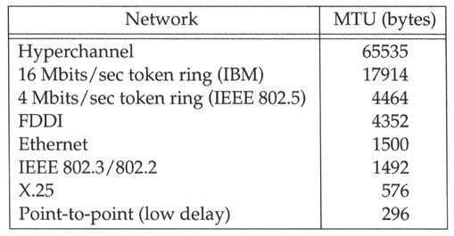
Link Layer
– MTU
Maximum Transmission Unit
  Limit size of payload part of Ethernet frame
    1500 bytes
  If the IP datagram is larger than MTU,
    IP performs “fragmentation”
MTU of various physical device
Path MTU
  Smallest MTU of any data link MTU between the two hosts
  Depend on route
Notes:
Path MTU 並不一定要 constant , 得要看當時的 route 來決定

Slide 19
Link Layer
– MTU
x:~ -lwhsu- ifconfig
em0: flags=8843<UP,BROADCAST,RUNNING,SIMPLEX,MULTICAST> mtu 9000
options=b<RXCSUM,TXCSUM,VLAN_MTU>
inet 192.168.7.1 netmask 0xffffff00 broadcast 192.168.7.255
ether 00:0e:0c:01:d7:c8
media: Ethernet autoselect (1000baseTX <full-duplex>)
status: active
fxp0: flags=8843<UP,BROADCAST,RUNNING,SIMPLEX,MULTICAST> mtu 1500
options=b<RXCSUM,TXCSUM,VLAN_MTU>
inet 140.113.17.24 netmask 0xffffff00 broadcast 140.113.17.255
ether 00:02:b3:99:3e:71
media: Ethernet autoselect (100baseTX <full-duplex>)
status: active
Notes:
Path MTU 並不一定要 constant , 得要看當時的 route 來決定

Slide 20
Network Layer

Slide 21
Network Layer
– Introduction to Network Layer
Unreliable and connectionless datagram delivery service
  IP Routing
  IP provides best effort service (unreliable)
  IP datagram can be delivered out of order (connectionless)
Protocols using IP
  TCP, UDP, ICMP, IGMP

Slide 22
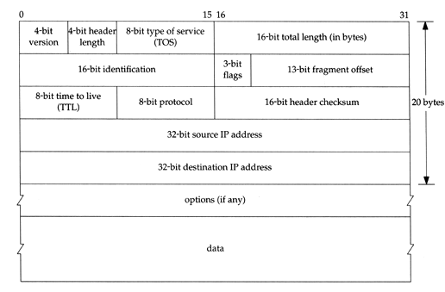
Network Layer
– IP Header (1)
20 bytes in total length, excepts options

Slide 23
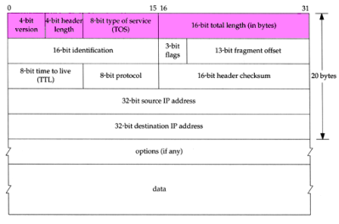
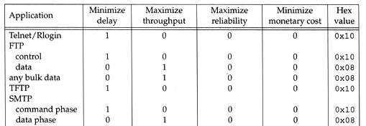
Network Layer
– IP Header (2)
Version (4bit)
  4 for IPv4 and 6 for IPv6
Header length (4bit)
  The number of 32bit words in the header (15*4=60bytes)
  Normally, the value is 5 (no option)
TOS-Type of Service (8bit)
  3bit precedence + 4bit TOS + 1bit unused
Total length (16bit)
  Total length of the IP datagram in bytes

Slide 24
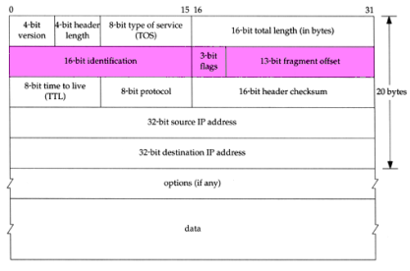
Network Layer
– IP Header (3)
Identification (16bit)
Fragmentation offset (13bit)
Flags (3bit)
  All these three fields are used for fragmentation

Slide 25
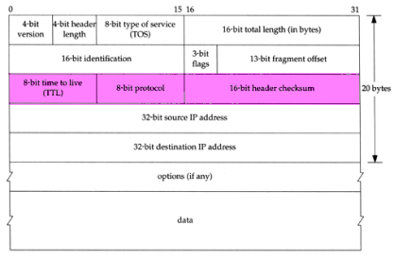
Network Layer
– IP Header (4)
TTL (8bit)
  Limit of next hop count of routers
Protocol (8bit)
  Used to demultiplex to other protocols
  TCP, UDP, ICMP, IGMP
Header checksum (16bit)
  Calculated over the IP header only
  If checksum error, IP discards the datagram and no error message is generated

Slide 26
Network Layer
– IP Routing (1)
Difference between Host and Router
  Router forwards datagram from one of its interface to another, while host does not
  Almost every Unix system can be configured to act as a router or both
Router
  IP layer has a routing table, which is used to store the information for forwarding datagram
  When router receiving a datagram
    If Dst. IP = my IP, demultiplex to other protocol
    Other, forward the IP based on routing table

Slide 27
Network Layer
– IP Routing (2)
Routing table information
  Destination IP
  IP address of next-hop router or IP address of a directly connected network
  Flags
  Next interface
IP routing
  Done on a hop-by-hop basis
  It assumes that the next-hop router is closer to the destination
  Steps:
    Search routing table for complete matched IP address
      Send to next-hop router or to the directly connected NIC
    Search routing table for matched network ID
      Send to next-hop router or to the directly connected NIC
    Search routing table for default route
      Send to this default next-hop router
    host or network unreachable

Slide 28
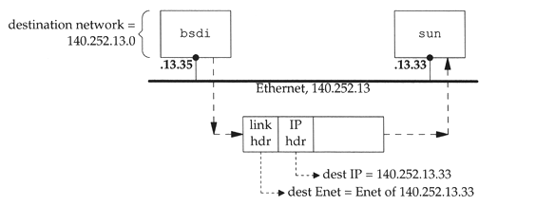
Network Layer
– IP Routing (3)
Ex1: routing in the same network
  bsdi: 140.252.13.35
  sun: 140.252.13.33
Ex Routing table:
140.252.13.33 00:d0:59:83:d9:16 UHLW fxp1

Slide 29
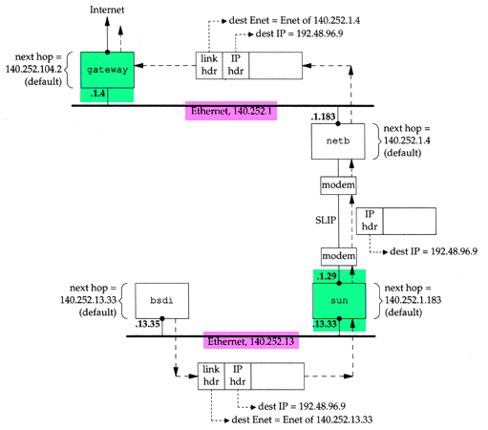
Network Layer
– IP Routing (4)
Ex2:
  routing across multi-network

Slide 30
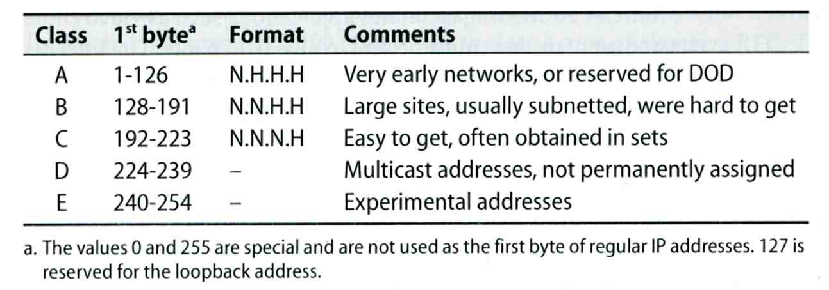
Network Layer
– IP Address (1)
Ex:
  NCTU
    Class B address: 140.113.0.0
    Network ID: 140.113
    Number of hosts: 255*255 = 65535
32-bit long
  Network part
    Identify a logical network
  Host part
    Identify a machine on certain network
IP address category

Slide 31
Network Layer
– Subnetting, CIDR, and Netmask (1)
Problems of Class A or B network
  Number of hosts is enormous
  Hard to maintain and management
  Solution ➔ Subnetting
Problems of Class C network
  255*255*255 number of Class C network make the size of Internet routes huge
  Solution ➔ Classless Inter-Domain Routing

Slide 32
Network Layer
– Subnetting, CIDR, and Netmask (2)
Subnetting
  Borrow some bits from network ID to extends hosts ID
  Ex:
    ClassB address : 140.113.0.0
    = 256 ClassC-like IP addresses
    in N.N.N.H subnetting method
    140.113.209.0 subnet
  Benefits of subnetting
    Reduce the routing table size of Internet’s routers
    Ex:
      All external routers have only one entry for 140.113 Class B network

Slide 33
Network Layer
– Subnetting, CIDR, and Netmask (3)
Netmask
  Specify how many bits of network-ID are used for network-ID
  Continuous 1 bits form the network part
  Ex:
    255.255.255.0 in NCTU-CS example
      256 hosts available
    255.255.255.248 in ADSL example
      Only 8 hosts available
  Shorthand notation
    Address/prefix-length
      Ex: 140.113.209.8/24

Slide 34
Network Layer
– Subnetting, CIDR, and Netmask (4)
How to determine your network ID?
  Bitwise-AND IP and netmask
  Ex:
    140.113.214.37 & 255.255.255.0 ➔ 140.113.214.0
    140.113.209.37 & 255.255.255.0 ➔ 140.113.209.0
    140.113.214.37 & 255.255.0.0 ➔ 140.113.0.0
    140.113.209.37 & 255.255.0.0 ➔ 140.113.0.0
    211.23.188.78 & 255.255.255.248 ➔ 211.23.188.72
      78 = 01001110
      78 & 248= 01001110 & 11111000 =72

Slide 35
Network Layer
– Subnetting, CIDR, and Netmask (5)
In a subnet, not all IP are available
  The first one IP ➔ network ID
  The last one IP ➔ broadcast address
  Ex:
Netmask 255.255.255.0
140.113.209.32/24
140.113.209.0 ➔ network ID
140.113.209.255 ➔ broadcast address
1 ~ 254, total 254 IPs are usable
Netmask 255.255.255.252
211.23.188.78/29
211.23.188.72 ➔ network ID
211.23.188.79 ➔ broadcast address
73 ~ 78, total 6 IPs are usable

Slide 36
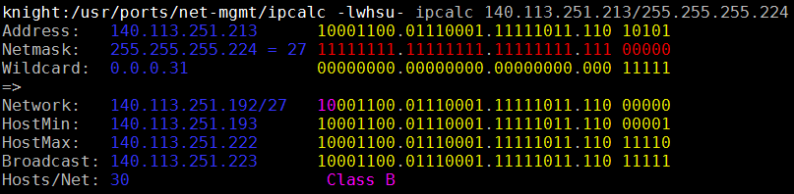
Network Layer
– Subnetting, CIDR, and Netmask (6)
The smallest subnetting
  Network portion : 30 bits
  Host portion : 2 bits
  ➔ 4 hosts, but only 2 IPs are available
ipcalc
  /usr/ports/net-mgmt/ipcalc

Slide 37
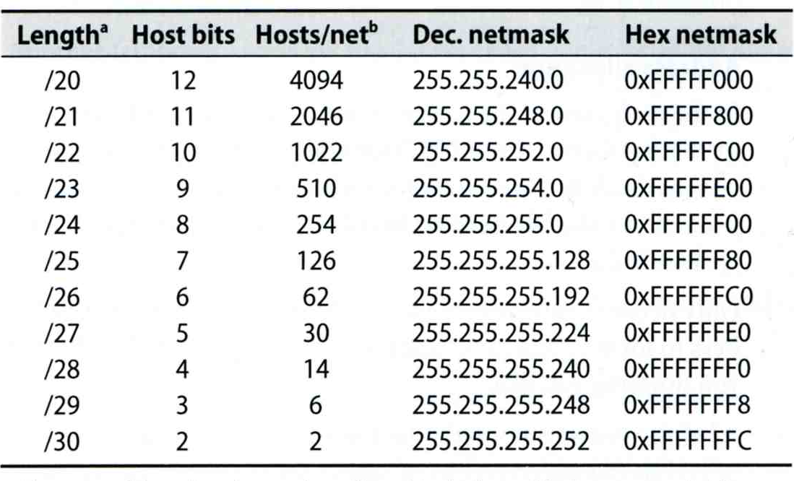
Network Layer
– Subnetting, CIDR, and Netmask (7)
Network configuration for various lengths of netmask

Slide 38
Network Layer
– Subnetting, CIDR, and Netmask (8)
CIDR (Classless Inter-Domain Routing)
  Use address mask instead of old address classes to determine the destination network
  CIDR requires modifications to routers and routing protocols
    Need to transmit both destination address and mask
  Ex:
    We can merge two ClassC network:
    203.19.68.0/24, 203.19.69.0/24 ➔ 203.19.68.0/23
  Benefit of CIDR
    We can allocate continuous ClassC network to organization
      Reflect physical network topology
      Reduce the size of routing table

Slide 39
ARP and RARP
Something between
MAC (link layer)
&
IP (network layer)

Slide 40
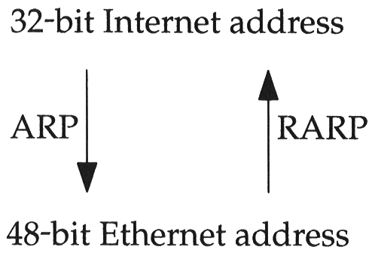
ARP and RARP
ARP – Address Resolution Protocol and
RARP – Reverse ARP
  Mapping between IP and Ethernet address
When an Ethernet frame is sent on LAN from one host to another,
  It is the 48bit Ethernet address that determines for which interface the frame is destined

Slide 41
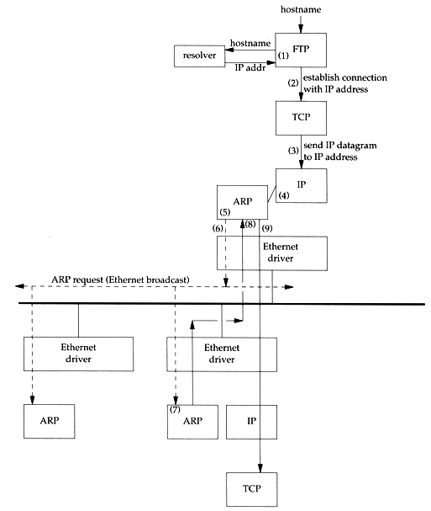
ARP and RARP
– ARP Example
Example
  % ftp bsd1
  (4) next-hop or direct host
  (5) Search ARP cache
  (6) Broadcast ARP request
  (7) bsd1 response ARP reply
  (9) Send original IP datagram

Slide 42
ARP and RARP
– ARP Cache
Maintain recent ARP results
  come from both ARP request and reply
  expiration time
    Complete entry = 20 minutes
    Incomplete entry = 3 minutes
  Use arp command to see the cache
  Ex:
    % arp –a
    % arp –da
    % arp –S 140.113.235.132 00:0e:a6:94:24:6e
csduty /home/lwhsu] -lwhsu- arp -a
cshome (140.113.235.101) at 00:0b:cd:9e:74:61 on em0 [ethernet]
bsd1 (140.113.235.131) at 00:11:09:a0:04:74 on em0 [ethernet]
? (140.113.235.160) at (incomplete) on em0 [ethernet]

Slide 43
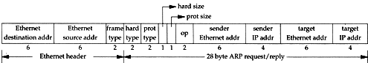
ARP and RARP
– ARP/RARP Packet Format
Ethernet destination addr: all 1’s (broadcast)
Known value for IP <-> Ethernet
  Frame type: 0x0806 for ARP, 0x8035 for RARP
  Hardware type: type of hardware address (1 for Ethernet)
  Protocol type: type of upper layer address (0x0800 for IP)
  Hard size: size in bytes of hardware address (6 for Ethernet)
  Protocol size: size in bytes of upper layer address (4 for IP)
  Op: 1, 2, 3, 4 for ARP request, reply, RARP request, reply

Slide 44
ARP and RARP
– Use tcpdump to see ARP
Host 140.113.17.212 → 140.113.17.215
  Clear ARP cache of 140.113.17.212
    % sudo arp -d 140.113.17.215
  Run tcpdump on 140.113.17.215 (00:11:d8:06:1e:81)
    % sudo tcpdump –i sk0 –e arp
    % sudo tcpdump –i sk0 –n –e arp
    % sudo tcpdump –i sk0 –n –t –e arp
  On 140.113.17.212, ssh to 140.113.17.215
15:18:54.899779 00:90:96:23:8f:7d > Broadcast, ethertype ARP (0x0806), length 60:
arp who-has nabsd tell zfs.cs.nctu.edu.tw
15:18:54.899792 00:11:d8:06:1e:81 > 00:90:96:23:8f:7d, ethertype ARP (0x0806), length 42:
arp reply nabsd is-at 00:11:d8:06:1e:81
15:26:13.847417 00:90:96:23:8f:7d > ff:ff:ff:ff:ff:ff, ethertype ARP (0x0806), length 60:
arp who-has 140.113.17.215 tell 140.113.17.212
15:26:13.847434 00:11:d8:06:1e:81 > 00:90:96:23:8f:7d, ethertype ARP (0x0806), length 42:
arp reply 140.113.17.215 is-at 00:11:d8:06:1e:81
00:90:96:23:8f:7d > ff:ff:ff:ff:ff:ff, ethertype ARP (0x0806), length 60:
arp who-has 140.113.17.215 tell 140.113.17.212
00:11:d8:06:1e:81 > 00:90:96:23:8f:7d, ethertype ARP (0x0806), length 42:
arp reply 140.113.17.215 is-at 00:11:d8:06:1e:81

Slide 45
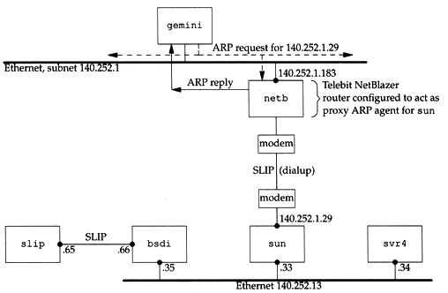
ARP and RARP
– Proxy ARP
Let router answer ARP request on one of its networks for a host on another of its network

Slide 46
ARP and RARP
– Gratuitous ARP
Gratuitous ARP
  The host sends an ARP request looking for its own IP
  Provide two features
    Used to determine whether there is another host configured with the same IP
    Used to cause any other host to update ARP cache when changing hardware address

Slide 47
ARP and RARP
– RARP
Principle
  Used for the diskless system to read its hardware address from the NIC and send an RARP request to gain its IP
RARP Server Design
  RARP server must maintain the map from hardware address to an IP address for many host
  Link-layer broadcast
    This prevent most routers from forwarding an RARP request

Slide 48
ICMP –
Internet Control Message Protocol

Slide 49
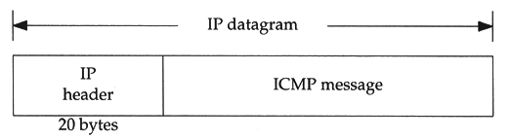
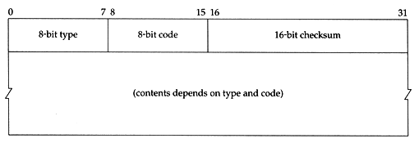
ICMP
– Introduction
Part of the IP layer
  ICMP messages are transmitted within IP datagram
  ICMP communicates error messages and other conditions that require attention for other protocols
ICMP message format

Slide 50
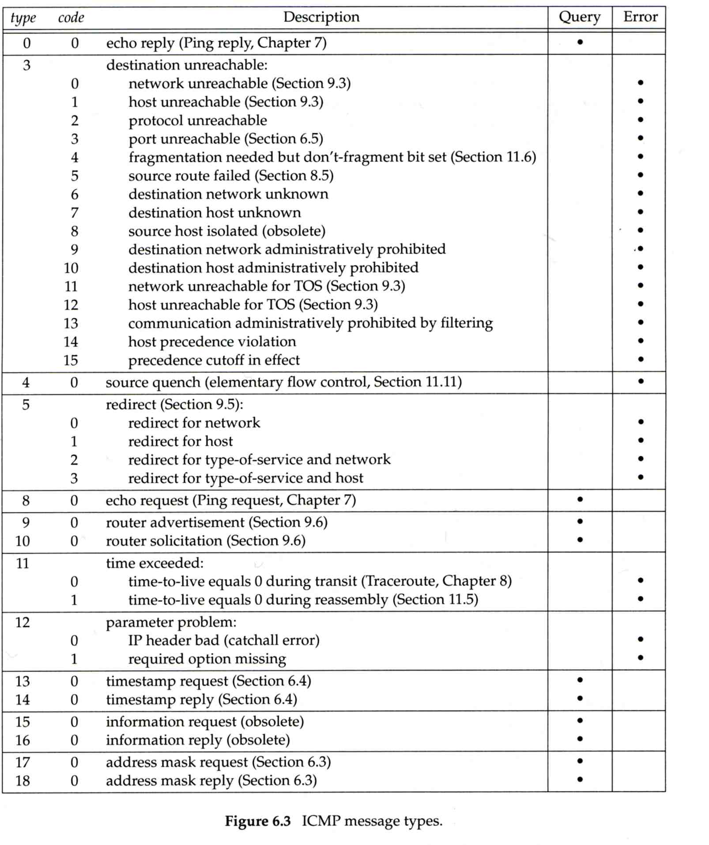
ICMP
– MESSAGE TYPE (1)

Slide 51
ICMP
– MESSAGE TYPE (2)

Slide 52
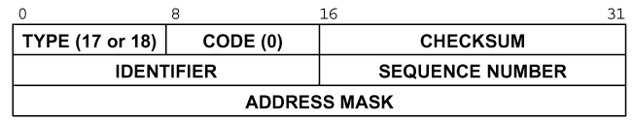
ICMP – Query Message
– Address Mask Request/Reply (1)
Address Mask Request and Reply
  Used for diskless system to obtain its subnet mask
  Identifier and sequence number
    Can be set to anything for sender to match reply with request
  The receiver will response an ICMP reply with the subnet mask of the receiving NIC

Slide 53
ICMP – Query Message
– Address Mask Request/Reply (2)
Ex:
zfs [/home/lwhsu] -lwhsu- ping -M m sun1.cs.nctu.edu.tw
ICMP_MASKREQ
PING sun1.cs.nctu.edu.tw (140.113.235.171): 56 data bytes
68 bytes from 140.113.235.171: icmp_seq=0 ttl=251 time=0.663 ms mask=255.255.255.0
68 bytes from 140.113.235.171: icmp_seq=1 ttl=251 time=1.018 ms mask=255.255.255.0
68 bytes from 140.113.235.171: icmp_seq=2 ttl=251 time=1.028 ms mask=255.255.255.0
68 bytes from 140.113.235.171: icmp_seq=3 ttl=251 time=1.026 ms mask=255.255.255.0
^C
--- sun1.cs.nctu.edu.tw ping statistics ---
4 packets transmitted, 4 packets received, 0% packet loss
round-trip min/avg/max/stddev = 0.663/0.934/1.028/0.156 ms
zfs [/home/lwhsu] -lwhsu- icmpquery -m sun1
sun1 : 0xFFFFFF00
※ icmpquery can be found in /usr/ports/net-mgmt/icmpquery

Slide 54
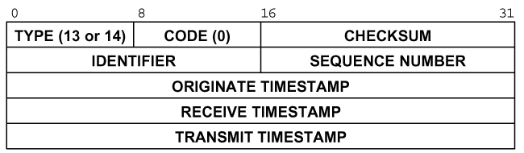
ICMP – Query Message
– Timestamp Request/Reply (1)
Timestamp request and reply
  Allow a system to query another for the current time
  Milliseconds resolution, since midnight UTC
  Requestor
    Fill in the originate timestamp and send
  Reply system
    Fill in the receive timestamp when it receives the request and the transmit time when it sends the reply

Slide 55
ICMP – Query Message
– Timestamp Request/Reply (2)
Ex:
zfs [/home/lwhsu] -lwhsu- ping -M time nabsd
ICMP_TSTAMP
PING nabsd.cs.nctu.edu.tw (140.113.17.215): 56 data bytes
76 bytes from 140.113.17.215: icmp_seq=0 ttl=64 time=0.663 ms
tso=06:47:46 tsr=06:48:24 tst=06:48:24
76 bytes from 140.113.17.215: icmp_seq=1 ttl=64 time=1.016 ms
tso=06:47:47 tsr=06:48:25 tst=06:48:25
zfs [/home/lwhsu] -lwhsu- icmpquery -t nabsd
nabsd : 14:54:47
nabsd [/home/lwhsu] -lwhsu- sudo tcpdump -i sk0 -e icmp
tcpdump: verbose output suppressed, use -v or -vv for full protocol decode
listening on sk0, link-type EN10MB (Ethernet), capture size 96 bytes
14:48:24.999106 00:90:96:23:8f:7d > 00:11:d8:06:1e:81, ethertype IPv4 (0x0800), length 110:
zfs.csie.nctu.edu.tw > nabsd: ICMP time stamp query id 18514 seq 0, length 76
14:48:24.999148 00:11:d8:06:1e:81 > 00:90:96:23:8f:7d, ethertype IPv4 (0x0800), length 110:
nabsd > zfs.csie.nctu.edu.tw: ICMP time stamp reply id 18514 seq 0: org 06:47:46.326,
recv 06:48:24.998, xmit 06:48:24.998, length 76
14:48:26.000598 00:90:96:23:8f:7d > 00:11:d8:06:1e:81, ethertype IPv4 (0x0800), length 110:
zfs.csie.nctu.edu.tw > nabsd: ICMP time stamp query id 18514 seq 1, length 76
14:48:26.000618 00:11:d8:06:1e:81 > 00:90:96:23:8f:7d, ethertype IPv4 (0x0800), length 110:
nabsd > zfs.csie.nctu.edu.tw: ICMP time stamp reply id 18514 seq 1: org 06:47:47.327,
recv 06:48:25.999, xmit 06:48:25.999, length 76

Slide 56
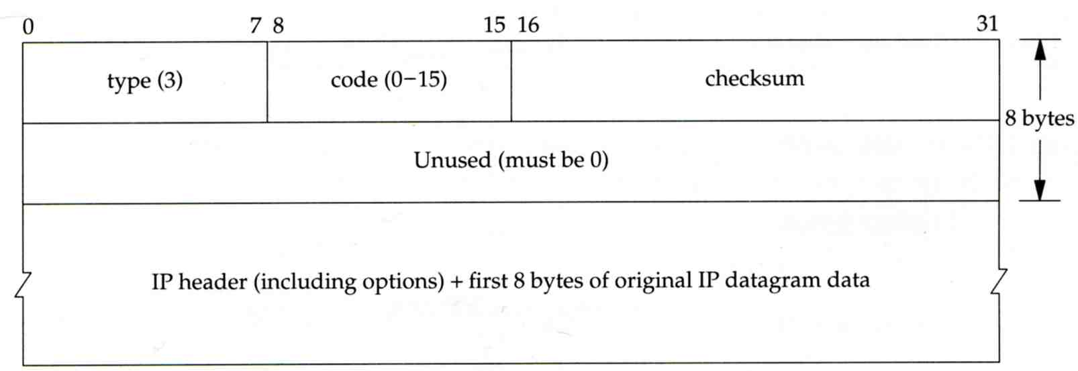
ICMP – Error Message
– Unreachable Error Message
Format
  8bytes ICMP Header
  Application-depend data portion
    IP header
      Let ICMP know how to interpret the 8 bytes that follow
    first 8bytes that followed this IP header
      Information about who generates the error

Slide 57
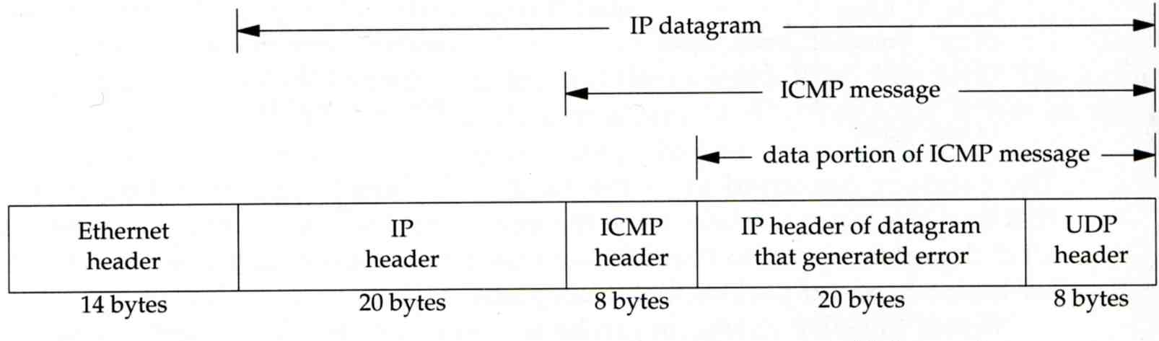
ICMP – Error Message
– Port Unreachable (1)
ICMP port unreachable
  Type = 3 , code = 3
  Host receives a UDP datagram but the destination port does not correspond to a port that some process has in use

Slide 58
ICMP – Error Message
– Port Unreachable (2)
Ex:
  Using TFTP (Trivial File Transfer Protocol)
    Original port: 69
zfs [/home/lwhsu] -lwhsu- tftp
tftp> connect localhost 8888
tftp> get temp.foo
Transfer timed out.
tftp>
zfs [/home/lwhsu] -lwhsu- sudo tcpdump -i lo0
tcpdump: verbose output suppressed, use -v or -vv for full protocol decode
listening on lo0, link-type NULL (BSD loopback), capture size 96 bytes
15:01:24.788511 IP localhost.62089 > localhost.8888: UDP, length 16
15:01:24.788554 IP localhost > localhost:
ICMP localhost udp port 8888 unreachable, length 36
15:01:29.788626 IP localhost.62089 > localhost.8888: UDP, length 16
15:01:29.788691 IP localhost > localhost:
ICMP localhost udp port 8888 unreachable, length 36

Slide 59
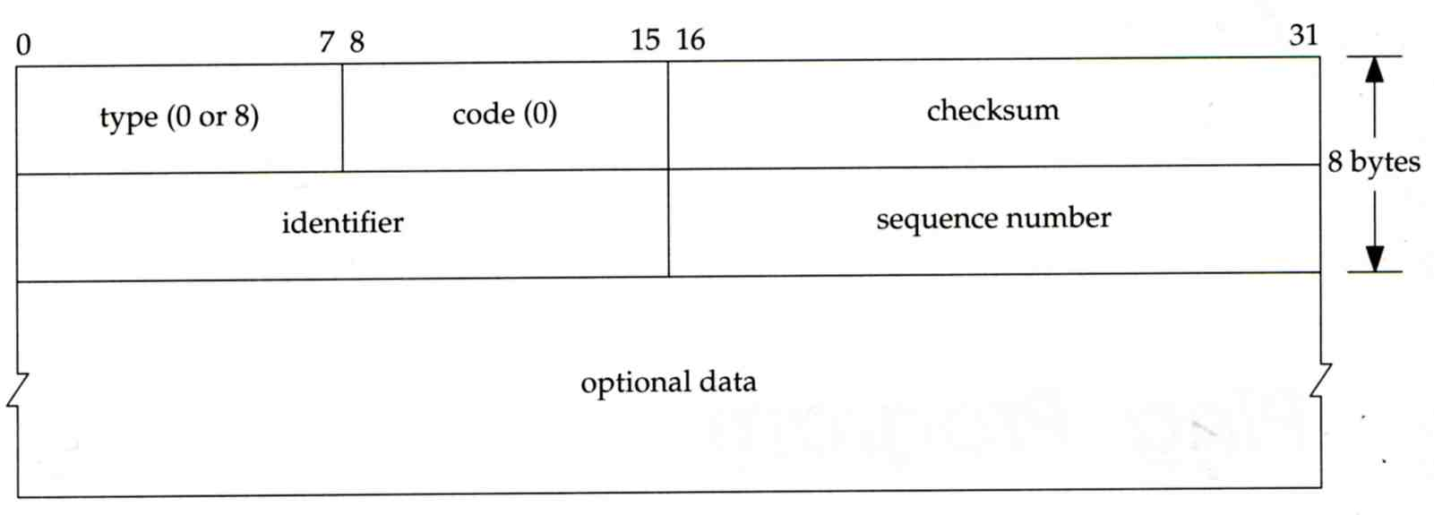
ICMP
– Ping Program (1)
Use ICMP to test whether another host is reachable
  Type 8, ICMP echo request
  Type 0, ICMP echo reply
ICMP echo request/reply format
  Identifier: process ID of the sending process
  Sequence number: start with 0
  Optional data: any optional data sent must be echoed

Slide 60
ICMP
– Ping Program (2)
Ex:
  zfs ping nabsd
  execute “tcpdump -i sk0 -X -e icmp” on nabsd
zfs [/home/lwhsu] -lwhsu- ping nabsd
PING nabsd.cs.nctu.edu.tw (140.113.17.215): 56 data bytes
64 bytes from 140.113.17.215: icmp_seq=0 ttl=64 time=0.520 ms
15:08:12.631925 00:90:96:23:8f:7d > 00:11:d8:06:1e:81, ethertype IPv4 (0x0800), length 98:
zfs.csie.nctu.edu.tw > nabsd: ICMP echo request, id 56914, seq 0, length 64
0x0000: 4500 0054 f688 0000 4001 4793 8c71 11d4 E..T....@.G..q..
0x0010: 8c71 11d7 0800 a715 de52 0000 45f7 9f35 .q.......R..E..5
0x0020: 000d a25a 0809 0a0b 0c0d 0e0f 1011 1213 ...Z............
0x0030: 1415 1617 1819 1a1b 1c1d 1e1f 2021 2223 .............!"#
0x0040: 2425 2627 2829 2a2b 2c2d 2e2f 3031 3233 $%&'()*+,-./0123
0x0050: 3435 45
15:08:12.631968 00:11:d8:06:1e:81 > 00:90:96:23:8f:7d, ethertype IPv4 (0x0800), length 98:
nabsd > zfs.csie.nctu.edu.tw: ICMP echo reply, id 56914, seq 0, length 64
0x0000: 4500 0054 d97d 0000 4001 649e 8c71 11d7 E..T.}..@.d..q..
0x0010: 8c71 11d4 0000 af15 de52 0000 45f7 9f35 .q.......R..E..5
0x0020: 000d a25a 0809 0a0b 0c0d 0e0f 1011 1213 ...Z............
0x0030: 1415 1617 1819 1a1b 1c1d 1e1f 2021 2223 .............!"#
0x0040: 2425 2627 2829 2a2b 2c2d 2e2f 3031 3233 $%&'()*+,-./0123
0x0050: 3435 45

Slide 61
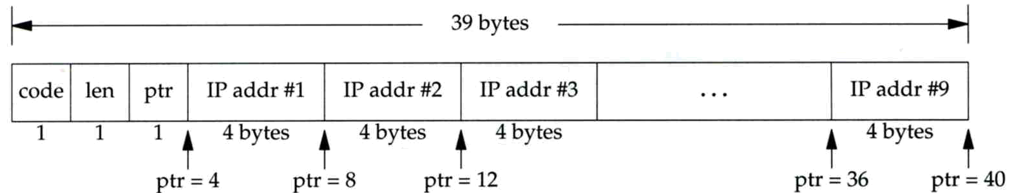
ICMP
– Ping Program (3)
To get the route that packets take to network host
  Taking use of “IP Record Route Option”
  Command: ping -R
  Cause every router that handles the datagram to add its (outgoing) IP address to a list in the options field.
  Format of Option field for IP RR Option
    code: type of IP Option (7 for RR)
    len: total number of bytes of the RR option
    ptr:4 ~ 40 used to point to the next IP address
  Only 9 IP addresses can be stored
    Limitation of IP header

Slide 62
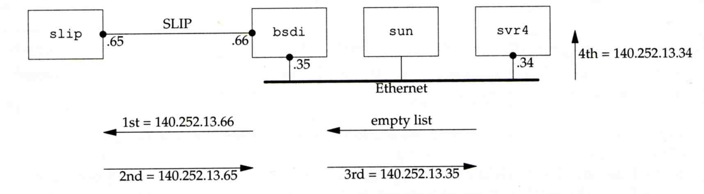
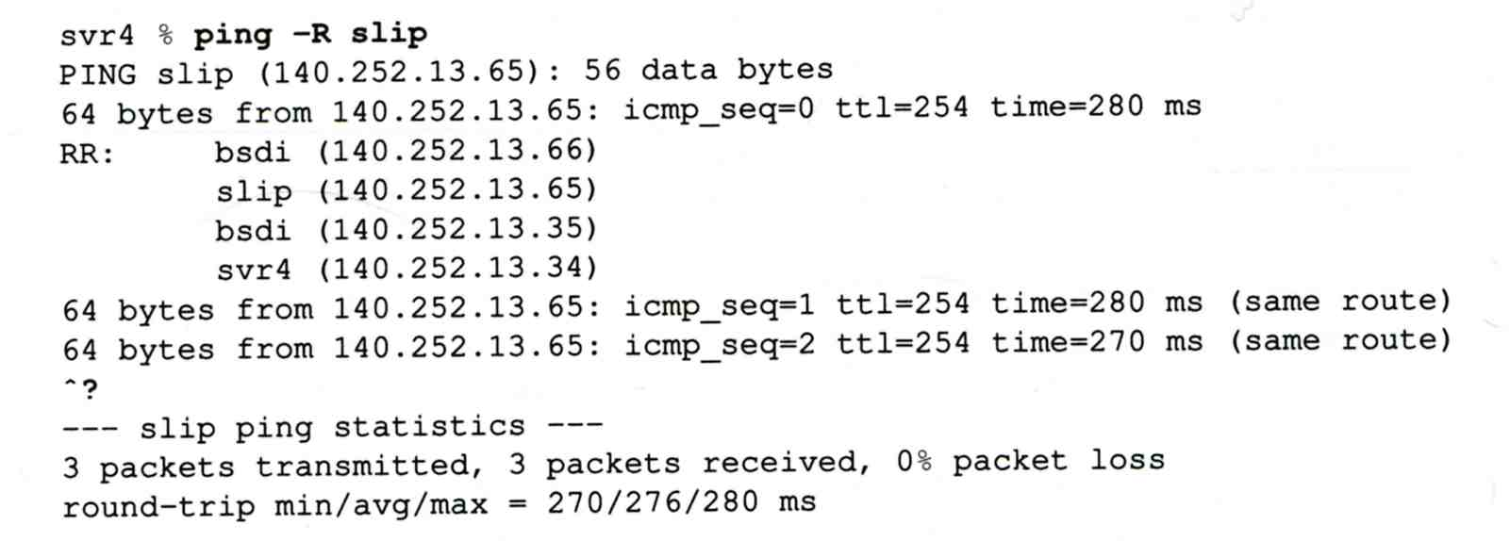
ICMP
– Ping Program (4)
Example:

Slide 63
ICMP
– Ping Program (5)
Example
zfs [/home/lwhsu] -lwhsu- ping -R www.nctu.edu.tw
PING www.nctu.edu.tw (140.113.250.5): 56 data bytes
64 bytes from 140.113.250.5: icmp_seq=0 ttl=61 time=2.361 ms
RR: ProjE27-253.NCTU.edu.tw (140.113.27.253)
140.113.0.57
CC250-gw.NCTU.edu.tw (140.113.250.253)
www.NCTU.edu.tw (140.113.250.5)
www.NCTU.edu.tw (140.113.250.5)
140.113.0.58
ProjE27-254.NCTU.edu.tw (140.113.27.254)
e3rtn.csie.nctu.edu.tw (140.113.17.254)
zfs.csie.nctu.edu.tw (140.113.17.212)
64 bytes from 140.113.250.5: icmp_seq=1 ttl=61 time=3.018 ms (same route)
zfs [/home/lwhsu] -lwhsu- sudo tcpdump -v -n -i dc0 -e icmp
tcpdump: listening on dc0, link-type EN10MB (Ethernet), capture size 96 bytes
22:57:04.507271 00:90:96:23:8f:7d > 00:90:69:64:ec:00, ethertype IPv4 (0x0800), length 138:
(tos 0x0, ttl 64, id 17878, offset 0, flags [none], proto: ICMP (1), length: 124,
options ( RR (7) len 390.0.0.00.0.0.00.0.0.00.0.0.00.0.0.00.0.0.00.0.0.00.0.0.00.0.0.0EOL
(0) len 1 )) 140.113.17.212 > 140.113.250.5: ICMP echo request, id 45561, seq 0, length 64
22:57:04.509521 00:90:69:64:ec:00 > 00:90:96:23:8f:7d, ethertype IPv4 (0x0800), length 138:
(tos 0x0, ttl 61, id 33700, offset 0, flags [none], proto: ICMP (1), length: 124,
options ( RR (7) len 39140.113.27.253, 140.113.0.57, 140.113.250.253, 140.113.250.5,
140.113.250.5, 140.113.0.58, 140.113.27.254, 140.113.17.254, 0.0.0.0EOL (0) len 1 ))
140.113.250.5 > 140.113.17.212: ICMP echo reply, id 45561, seq 0, length 64

Slide 64
Traceroute Program (1)
To print the route packets take to network host
Drawbacks of IP RR options (ping -R)
  Not all routers have supported the IP RR option
  Limitation of IP header length
Background knowledge of traceroute
  When a router receive a datagram, , it will decrement the TTL by one
  When a router receive a datagram with TTL = 0 or 1,
    it will through away the datagram and
    sends back a “Time exceeded” ICMP message
  Unused UDP port will generate a “port unreachable” ICMP message

Slide 65
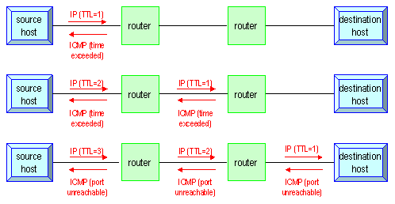
Traceroute Program (2)
Operation of traceroute
  Send UDP with port > 30000, encapsulated with IP header with TTL = 1, 2, 3, … continuously
  When router receives the datagram and TTL = 1, it returns a “Time exceed” ICMP message
  When destination host receives the datagram and TTL = 1, it returns a “Port unreachable” ICMP message

Slide 66
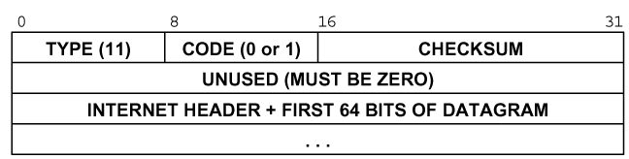
Traceroute Program (3)
Time exceed ICMP message
  Type = 11, code = 0 or 1
    Code = 0 means TTL=0 during transit
    Code = 1 means TTL=0 during reassembly
  First 8 bytes of datagram
    UDP header

Slide 67
Traceroute Program (4)
Ex:
nabsd [/home/lwhsu] -lwhsu- traceroute bsd1.cs.nctu.edu.tw
traceroute to bsd1.cs.nctu.edu.tw (140.113.235.131), 64 hops max, 40 byte packets
1 e3rtn.csie.nctu.edu.tw (140.113.17.254) 0.377 ms 0.365 ms 0.293 ms
2 ProjE27-254.NCTU.edu.tw (140.113.27.254) 0.390 ms 0.284 ms 0.391 ms
3 140.113.0.58 (140.113.0.58) 0.292 ms 0.282 ms 0.293 ms
4 140.113.0.165 (140.113.0.165) 0.492 ms 0.385 ms 0.294 ms
5 bsd1.cs.nctu.edu.tw (140.113.235.131) 0.393 ms 0.281 ms 0.393 ms
nabsd [/home/lwhsu] -lwhsu- sudo tcpdump -i sk0 -t icmp
tcpdump: verbose output suppressed, use -v or -vv for full protocol decode
listening on sk0, link-type EN10MB (Ethernet), capture size 96 bytes
IP e3rtn.csie.nctu.edu.tw > nabsd: ICMP time exceeded in-transit, length 36
IP e3rtn.csie.nctu.edu.tw > nabsd: ICMP time exceeded in-transit, length 36
IP e3rtn.csie.nctu.edu.tw > nabsd: ICMP time exceeded in-transit, length 36
IP ProjE27-254.NCTU.edu.tw > nabsd: ICMP time exceeded in-transit, length 36
IP ProjE27-254.NCTU.edu.tw > nabsd: ICMP time exceeded in-transit, length 36
IP ProjE27-254.NCTU.edu.tw > nabsd: ICMP time exceeded in-transit, length 36
IP 140.113.0.58 > nabsd: ICMP time exceeded in-transit, length 36
IP 140.113.0.58 > nabsd: ICMP time exceeded in-transit, length 36
IP 140.113.0.58 > nabsd: ICMP time exceeded in-transit, length 36
IP 140.113.0.165 > nabsd: ICMP time exceeded in-transit, length 36
IP 140.113.0.165 > nabsd: ICMP time exceeded in-transit, length 36
IP 140.113.0.165 > nabsd: ICMP time exceeded in-transit, length 36
IP bsd1.cs.nctu.edu.tw > nabsd: ICMP bsd1.cs.nctu.edu.tw udp port 33447 unreachable, length 36
IP bsd1.cs.nctu.edu.tw > nabsd: ICMP bsd1.cs.nctu.edu.tw udp port 33448 unreachable, length 36
IP bsd1.cs.nctu.edu.tw > nabsd: ICMP bsd1.cs.nctu.edu.tw udp port 33449 unreachable, length 36

Slide 68
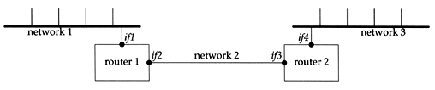
Traceroute Program (5)
The router IP in traceroute is the interface that receives the datagram. (incoming IP)
  Traceroute from left host to right host
    if1, if3
  Traceroute from right host to left host
    if4, if2

Slide 69
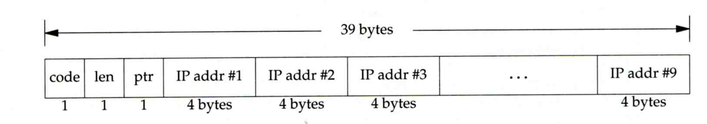
Traceroute Program –
IP Source Routing Option (1)
Source Routing
  Sender specifies the route
Two forms of source routing
  Strict source routing
    Sender specifies the exact path that the IP datagram must follow
  Loose source routing
    As strict source routing, but the datagram can pass through other routers between any two addresses in the list
Format of IP header option field
  Code = 0x89 for strict and code = 0x83 for loose SR option

Slide 70
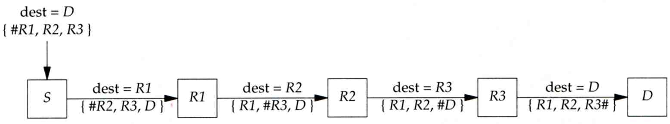
Traceroute Program –
IP Source Routing Option (2)
Scenario of source routing
  Sending host
    Remove first entry and append destination address in the final entry of the list
  Receiving router != destination
    Loose source route, forward it as normal
  Receiving router = destination
    Next address in the list becomes the destination
    Change source address
    Increment the pointer

Slide 71
Traceroute Program –
IP Source Routing Option (3)
Traceroute using IP loose SR option
Ex:
nabsd [/home/lwhsu] -lwhsu- traceroute u2.nctu.edu.tw
traceroute to u2.nctu.edu.tw (211.76.240.193), 64 hops max, 40 byte packets
1 e3rtn-235 (140.113.235.254) 0.549 ms 0.434 ms 0.337 ms
2 140.113.0.166 (140.113.0.166) 108.726 ms 4.469 ms 0.362 ms
3 v255-194.NTCU.net (211.76.255.194) 0.529 ms 3.446 ms 5.464 ms
4 v255-229.NTCU.net (211.76.255.229) 1.406 ms 2.017 ms 0.560 ms
5 h240-193.NTCU.net (211.76.240.193) 0.520 ms 0.456 ms 0.315 ms
nabsd [/home/lwhsu] -lwhsu- traceroute -g 140.113.0.149 u2.nctu.edu.tw
traceroute to u2.nctu.edu.tw (211.76.240.193), 64 hops max, 48 byte packets
1 e3rtn-235 (140.113.235.254) 0.543 ms 0.392 ms 0.365 ms
2 140.113.0.166 (140.113.0.166) 0.562 ms 9.506 ms 0.624 ms
3 140.113.0.149 (140.113.0.149) 7.002 ms 1.047 ms 1.107 ms
4 140.113.0.150 (140.113.0.150) 1.497 ms 6.653 ms 1.595 ms
5 v255-194.NTCU.net (211.76.255.194) 1.639 ms 7.214 ms 1.586 ms
6 v255-229.NTCU.net (211.76.255.229) 1.831 ms 9.244 ms 1.877 ms
7 h240-193.NTCU.net (211.76.240.193) 1.440 ms !S 2.249 ms !S 1.737 ms !S

Slide 72
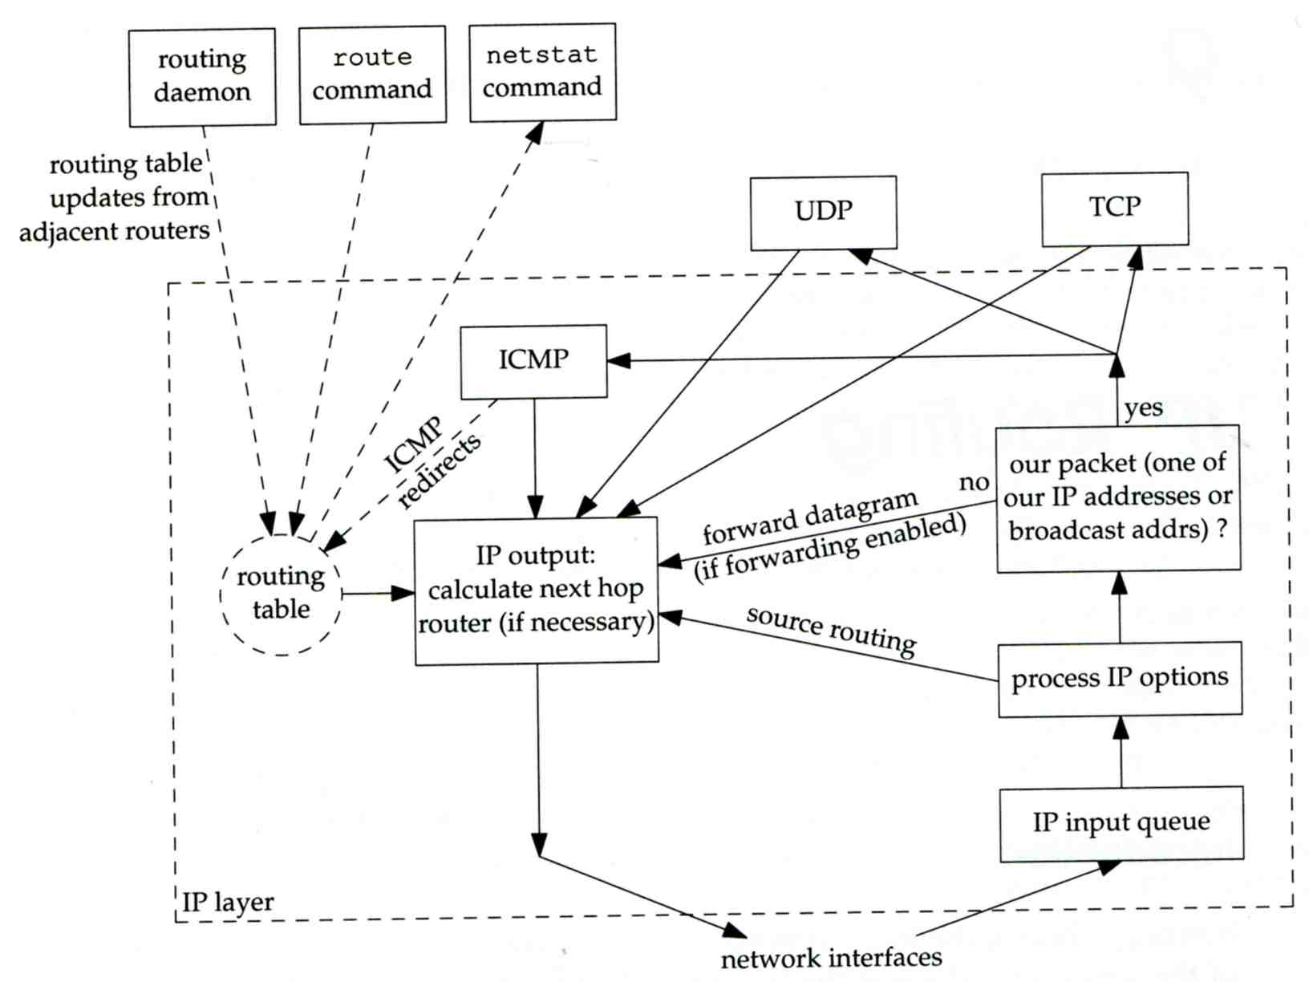
IP ROUTING
– PROCESSING IN IP LAYER

Slide 73
IP Routing
– Routing Table (1)
Routing Table
  Command to list: netstat -rn
  Flag
    U: the route is up
    G: the route is to a router (indirect route)
      Indirect route: IP is the dest. IP, MAC is the router’s MAC
    H: the route is to a host (Not to a network)
      The dest. filed is either an IP address or network address
  Refs: number of active uses for each route
  Use: number of packets sent through this route
nabsd [/home/lwhsu] -lwhsu- netstat -rn
Routing tables
Internet:
Destination Gateway Flags Refs Use Netif Expire
default 140.113.17.254 UGS 0 178607 sk0
127.0.0.1 127.0.0.1 UH 0 240 lo0
140.113.17/24 link#1 UC 0 0 sk0
140.113.17.5 00:02:b3:4d:44:c0 UHLW 1 12182 sk0 1058
140.113.17.212 00:90:96:23:8f:7d UHLW 1 14 sk0 1196
140.113.17.254 00:90:69:64:ec:00 UHLW 2 4 sk0 1200

Slide 74
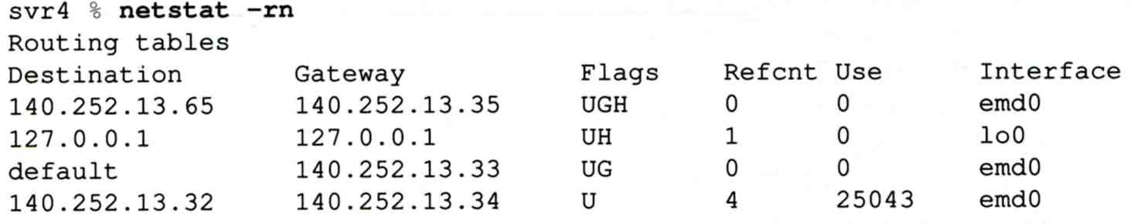
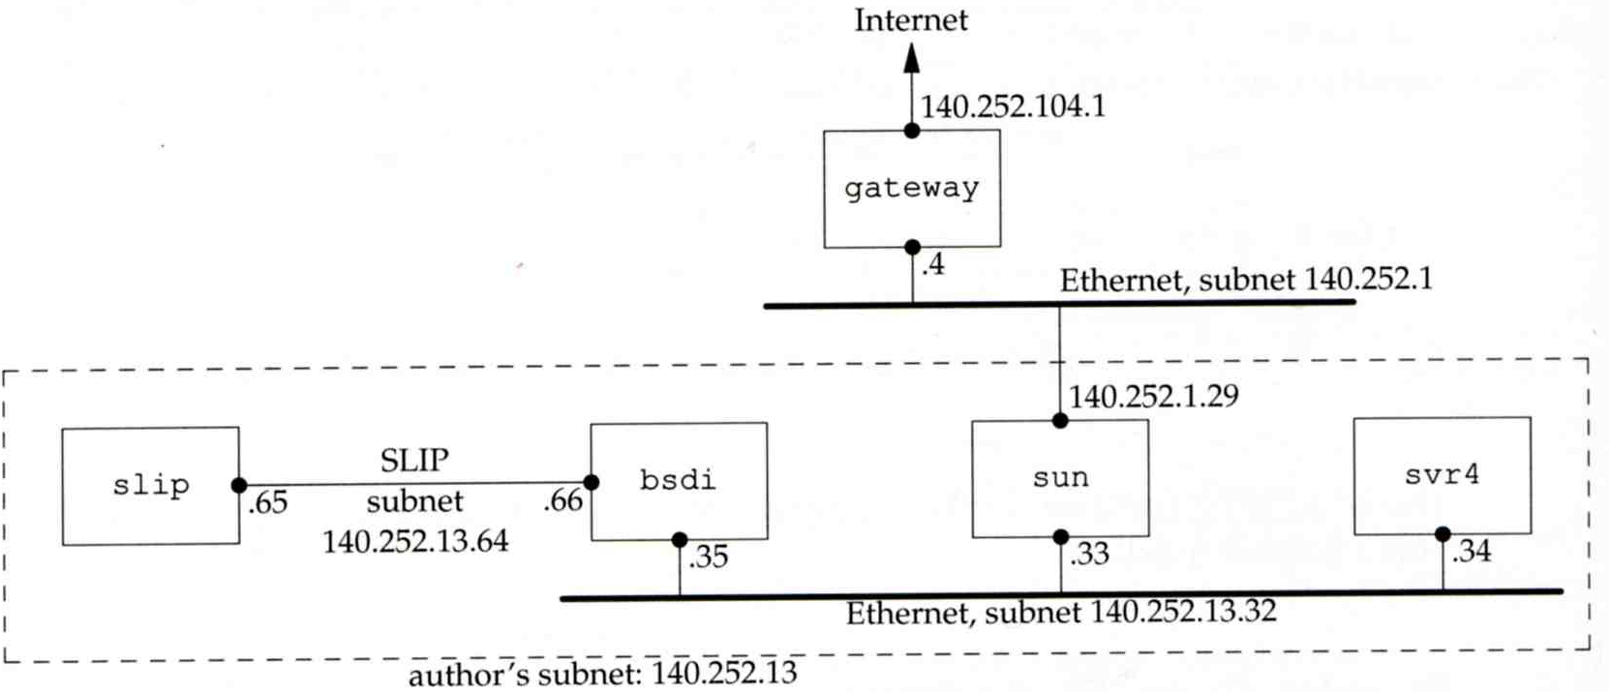
IP Routing
– Routing Table (2)
dst. = sun
dst. = slip
dst. = 192.207.117.2
dst. = svr4 or 140.252.13.34
dst. = 127.0.0.1
Ex:
loopback

Slide 75
ICMP
– No Route to Destination
If there is no match in routing table
  If the IP datagram is generated on the host
    “host unreachable” or “network unreachable”
  If the IP datagram is being forwarded
    ICMP “host unreachable” error message is generated and sends back to sending host
    ICMP message
      Type = 3, code = 0 for host unreachable
      Type = 3, code = 1 for network unreachable

Slide 76
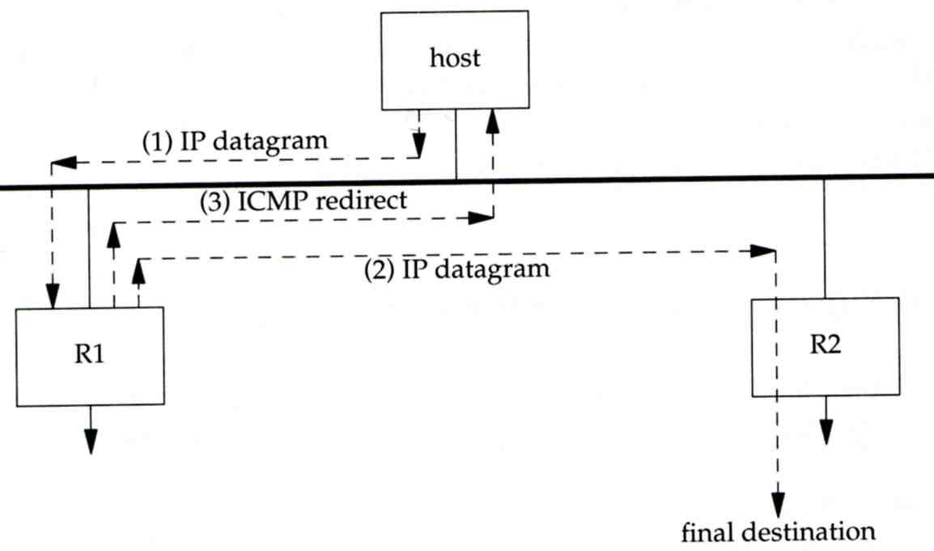
ICMP
– Redirect Error Message (1)
Concept
  Used by router to inform the sender that the datagram should be sent to a different router
  This will happen if the host has a choice of routers to send the packet to
    Ex:
      R1 found sending and receiving interface are the same

Slide 77
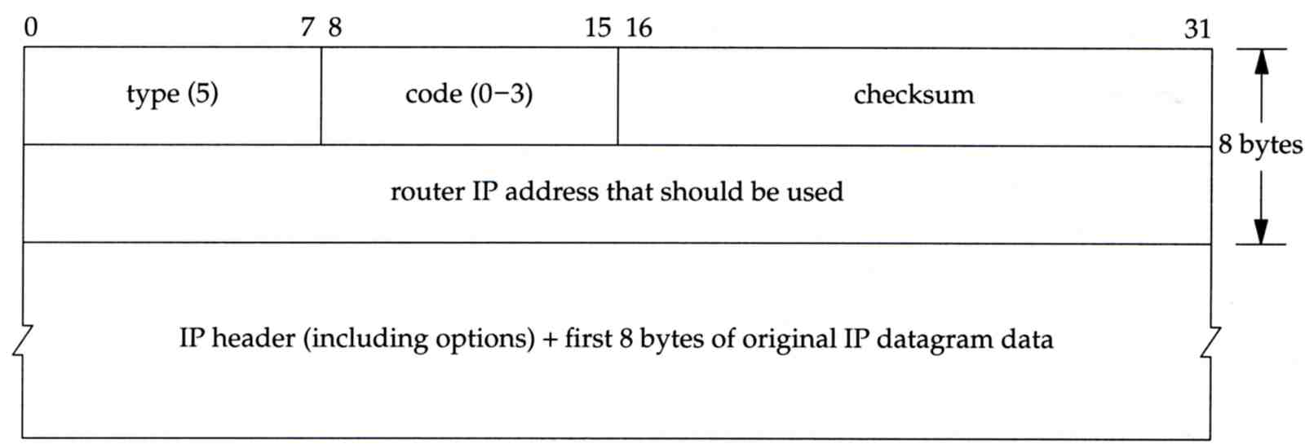
ICMP
– Redirect Error Message (2)
ICMP redirect message format
  Code 0: redirect for network
  Code 1: redirect for host
  Code 2: redirect for TOS and network (RFC 1349)
  Code 3: redirect for TOS and hosts (RFC 1349)

Slide 78
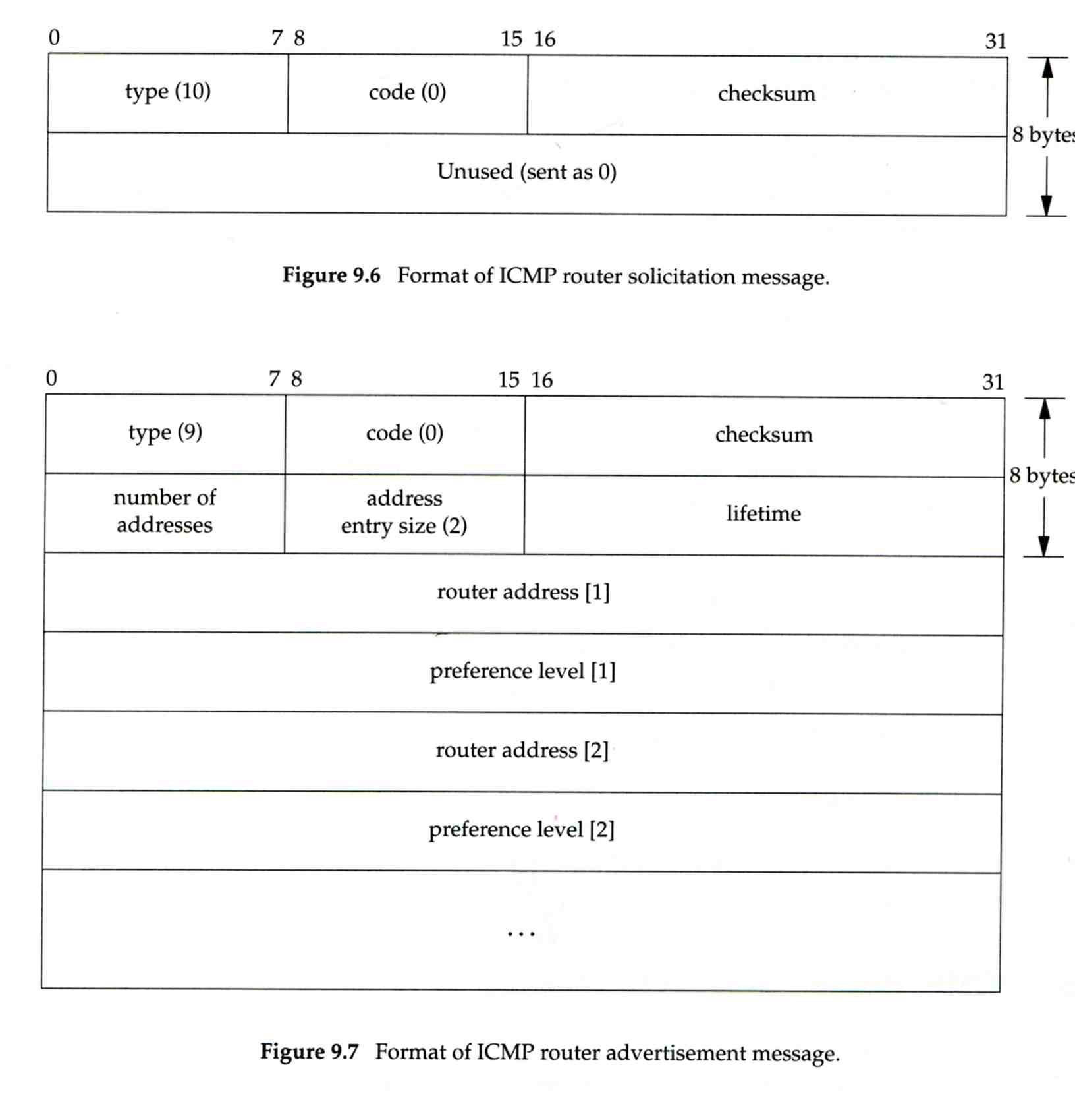
ICMP
– Router Discovery Messages (1)
Dynamic update host’s routing table
  ICMP router solicitation message (懇求)
    Host broadcast or multicast after bootstrapping
  ICMP router advertisement message
    Router response
    Router periodically broadcast or multicast
Format of ICMP router solicitation message

Slide 79
ICMP
– Router Discovery Messages (2)
Format of ICMP router advertisement message
  Router address
    Must be one of the router’s IP address
  Preference level
    Preference as a default router address

Slide 80
UDP –
User Datagram Protocol

Slide 81
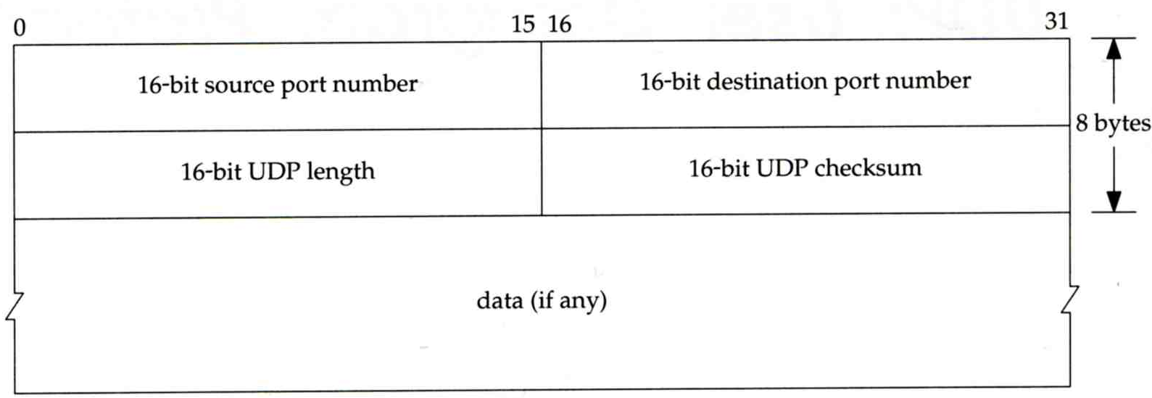
UDP
No reliability
  Datagram-oriented, not stream-oriented protocol
UDP header
  8 bytes
    Source port and destination port
      Identify sending and receiving process
    UDP length: ≧ 8

Slide 82
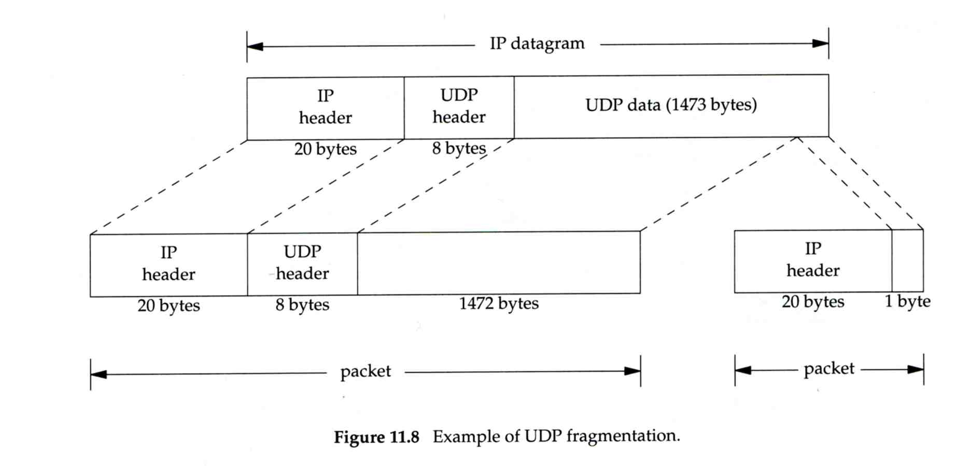
IP Fragmentation (1)
MTU limitation
  Before network-layer to link-layer
    IP will check the size and link-layer MTU
    Do fragmentation if necessary
  Fragmentation may be done at sending host or routers
  Reassembly is done only in receiving host
1501 bytes
1500 bytes

Slide 83
IP Fragmentation (2)
identification: which unique IP datagram
flags: more fragments?
fragment offset offset of this datagram from the beginning of original datagram
identification: the same
flags: more fragments
fragment offset 0
identification: the same
flags: end of fragments
fragment offset 1480

Slide 84
IP Fragmentation (3)
Issues of fragmentation
  One fragment lost, entire datagram must be retransmitted
  If the fragmentation is performed by intermediate router, there is no way for sending host how fragmentation did
  Fragmentation is often avoided
    There is a “don’t fragment” bit in flags of IP header

Slide 85
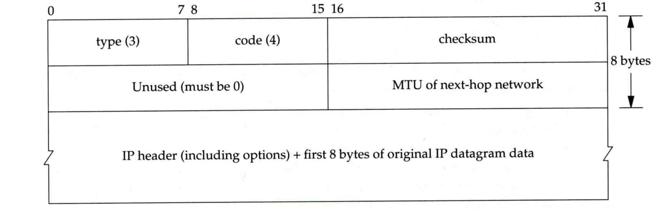
ICMP Unreachable Error –
Fragmentation Required
Type=3, code=4
  Router will generate this error message if the datagram needs to be fragmented, but the “don’t fragment” bit is turn on in IP header
Message format

Slide 86
ICMP
– Source Quench Error
Type=4, code=0
  May be generated by system when it receives datagram at a rate that is too fast to be processed
  Host receiving more than it can handle datagram
    Send ICMP source quench or
    Throw it away
  Host receiving UDP source quench message
    Ignore it or
    Notify application

Slide 87
TCP –
Transmission Control Protocol

Slide 88
TCP
Services
  Connection-oriented
    Establish TCP connection before exchanging data
  Reliability
    Acknowledgement when receiving data
    Retransmission when timeout
    Ordering
    Discard duplicated data
    Flow control

Slide 89
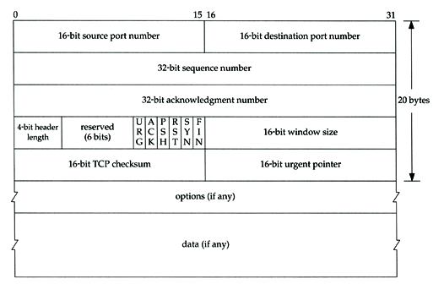
TCP
– HEADER (1)

Slide 90
TCP
– Header (2)
Flags
  SYN
    Establish new connection
  ACK
    Acknowledgement number is valid
    Used to ack previous data that host has received
  RST
    Reset connection
  FIN
    The sender is finished sending data

Slide 91
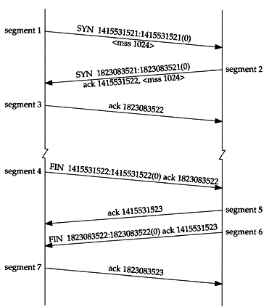
TCP CONNECTION
ESTABLISHMENT AND TERMINATION
Three-way handshake
TCP’s half close

Slide 92

Appendix of IP Options: IP Timestamp Option
IP Timestamp Option
  Similar to RR option
  Record Timestamp in option filed
    code, len, ptr are the same as IP RR option
    OF
      Overflow field
      Router will increment OF if it can’t add a timestamp because of no room left
    FL
      Flags
      0: only timestamp
      1: both timestamp and IP address
      3: the sender initiates the options with up to 4
      pairs of IP address and timestamp
※

Slide 93
Routing

Slide 94


Why dynamic route ? (1)
Static route is ok only when
  Network is small
  There is a single connection point to other network
  No redundant route

Slide 95

Why dynamic route ? (2)
Dynamic Routing
  Routers update their routing table with the information of adjacent routers
  Dynamic routing need a routing protocol for such communication
  Advantage:
    They can react and adapt to changing network condition

Slide 96
Routing Protocol
Used to change the routing table according to various routing information
  Specify detail of communication between routers
  Specify information changed in each communication,
    Network reachability
    Network state
    Metric
Metric
  A measure of how good a particular route
    Hop count, bandwidth, delay, load, reliability, …
Each routing protocol may use different metric and exchange different information

Slide 97


Autonomous System
Autonomous System (AS)
  Internet is organized in to a collection of autonomous system
  An AS is a collection of networks with same routing policy
    Single routing protocol
    Normally administered by a single entity
      Corporation or university campus
    All depend on how you want to manage routing

Slide 98
Category of Routing Protocols – by AS
AS-AS communication
  Communications between routers in different AS
  Interdomain routing protocols
  Exterior gateway protocols (EGP)
  Ex:
    BGP (Border Gateway Protocol)
Inside AS communication
  Communication between routers in the same AS
  Intradomain routing protocols
  Interior gateway protocols (IGP)
  Ex:
    RIP (Routing Information Protocol)
    IGRP (Interior Gateway Routing Protocol)
    OSPF (Open Shortest Path First Protocol)

Slide 99

Category of Routing Protocols – by information changed (1)
Distance-Vector Protocol
  Message contains a vector of distances, which is the cost to other network
  Each router updates its routing table based on these messages received from neighbors
  Protocols:
    RIP
    IGRP
    BGP

Slide 100

Category of Routing Protocols – by information changed (2)
Link-State Protocol
  Broadcast their link state to neighbors and build a complete network map at each router using Dijkstra algorithm
  Protocols:
    OSPF

Slide 101


Difference between
Distance-Vector and Link-State
 | Distance-Vector | Link-State
Update | updates neighbor (propagate new info.) | update all nodes
Convergence | Propagation delay cause slow convergence | Fast convergence
Complexity | simple | Complex
Difference
Information update sequence
Link-State
Distance-Vector

Slide 102
Routing Protocols
        RIP IGP,DV
        IGRP IGP,DV
        OSPF IGP,LS
        BGP EGP

Slide 103
RIP
RIP
  Routing Information Protocol
Category
  Interior routing protocol
  Distance-vector routing protocol
    Using “hop-count” as the cost metric
Example of how RIP advertisements work
Destination network | Next router | # of hops to destination
1 | A | 2
20 | B | 2
30 | B | 7
Destination network | Next router | # of hops to destination
30 | C | 4
1 | -- | 1
10 | -- | 1
Destination network | Next router | # of hops to destination
1 | A | 2
20 | B | 2
30 | A | 5
Routing table in router before
Receiving advertisement
Advertisement from router A
Routing table after
receiving advertisement

Slide 104

RIP
– Example
Another example

Slide 105

RIP
– Message Format
RIP message is carried in UDP datagram
  Command: 1 for request and 2 for reply
  Version: 1 or 2 (RIP-2)
20 bytes per
route entry

Slide 106
RIP
– Operation
routed – RIP routing daemon
  Operated in UDP port 520
Operation
  Initialization
    Probe each interface
    send a request packet out each interface, asking for other router’s complete routing table
  Request received
    Send the entire routing table to the requestor
  Response received
    Add, modify, delete to update routing table
  Regular routing updates
    Router sends out their routing table to every neighbor every 30 minutes
  Triggered updates
    Whenever a route entry’s metric change, send out those changed part routing table

Slide 107

RIP
– Problems of RIP
Issues
  15 hop-count limits
  Take long time to stabilize after the failure of a router or link
  No CIDR
RIP-2
  EGP support
    AS number
  CIDR support

Slide 108

IGRP (1)
IGRP – Interior Gateway Routing Protocol
Similar to RIP
  Interior routing protocol
  Distance-vector routing protocol
Difference between RIP
  Complex cost metric other than hop count
    delay time, bandwidth, load, reliability
    The formula
  Use TCP to communicate routing information
  Cisco System’s proprietary routing protocol

Slide 109
IGRP (2)
Advantage over RIP
  Control over metrics
Disadvantage
  Still classful and has propagation delay

Slide 110
OSPF (1)
OSPF
  Open Shortest Path First
Category
  Interior routing protocol
  Link-State protocol
Each interface is associated with a cost
  Generally assigned manually
  The sum of all costs along a path is the metric for that path
Neighbor information is broadcast to all routers
  Each router will construct a map of network topology
  Each router run Dijkstra algorithm to construct the shortest path tree to each routers

Slide 111

OSPF
– Dijkstra Algorithm
Single Source Shortest Path Problem
  Dijkstra algorithm use “greedy” strategy
  Ex:

Slide 112



OSPF
– ROUTING TABLE UPDATE EXAMPLE (1)

Slide 113


OSPF
– ROUTING TABLE UPDATE EXAMPLE (2)

Slide 114
OSPF
– Summary
Advantage
  Fast convergence
  CIDR support
  Multiple routing table entries for single destination, each for one type-of-service
    Load balancing when cost are equal among several routes
Disadvantage
  Large computation

Slide 115
BGP
BGP
  Border Gateway Protocol
Exterior routing protocol
  Now BGP-4
  Exchange network reachability information with other BGP systems
Routing information exchange
  Message:
    Full path of autonomous systems that traffic must transit to reach destination
    Can maintain multiple route for a single destination
  Exchange method
    Using TCP
    Initial: entire routing table
    Subsequent update: only sent when necessary
    Advertise only optimal path
Route selection
  Shortest AS path

Slide 116

BGP
– Operation Example
How BGP work
  The whole Internet is a graph of autonomous systems
  X→Z
    Original: X→A→B→C→Z
    X advertise this best path to his neighbor W
  W→Z
    W→X→A→B→C→Z
W
X
Z

Slide 117

ROUTING PROTOCOLS COMPARISON
Notes:
Updates
Per. Periodic updates
Trig. Occurred based on information change
Load Balance
Multiple path & balance between equal-cost routes

Slide 118
routed

Slide 119

routed
Routing daemon
  Speak RIP (v1 and v2)
  Supplied with most every version of UNIX
  Two modes
    Server mode (-s) & Quiet mode (-q)
    Both listen for broadcast, but server will distribute their information
  routed will add its discovered routes to kernel’s routing table
  Support configuration file - /etc/gateways
    Provide static information for initial routing table

Slide 120
Network Hardware

Slide 121
Network Performance Issues
Three major factors
  Selection of high-quality hardware
  Reasonable network design
  Proper installation and documentation

Slide 122
Hardware Selection –
Classification of market
LAN
  Local Area Network
  Networks that exist within a building or group of buildings
  High-speed, low-cost media
WAN
  Wide Area Network
  Networks that endpoints are geographically dispersed
  High-speed, high-cost media
MAN
  Metropolitan Area Network
  Networks that exist within a city or cluster of cities
  High-speed, medium-cost media

Slide 123

Hardware Selection –
LAN Media (1)
Evolution of Ethernet
Coaxial cable
UTP
Fiber

Slide 124


Hardware Selection –
LAN Media (2)
Coaxial cable
  Cooperated with BNC connector
  Speed: 10 Mbps
  Coaxial cable used in LAN
    RG11 (10Base5, 500m)
    RG58 (10Base2, 200m)

Slide 125


Hardware Selection –
LAN Media (3)
Twisted Pair Cable
  UTP (Unshielded) and STP (Shielded)
    STP has conductive shield
      More expensive but good in resisting cross talk
  Cooperated with RJ45 connector
  Categories
    From CATEGORY-1 ~ CATEGORY-7, CATEGORY-5E
      Cat3 up to 10Mbps (10BaseT, 100m)
      Cat5 up to 100Mbps (100BaseTX, 100m)
      Cat5e / Cat6 up to 1000Mbps (1000BaseT, 100m)

Slide 126
Hardware Selection –
LAN Media (4)
  UTP cable wiring standard
    TIA/EIA-568A, 568B
1 2 3 4 5 6 7 8
白 橘 白 綠 白 藍 白 棕
橘 綠 藍 棕
=======================================
白 橘 白 藍 白 綠 白 棕 EIA/TIA-568B
橘 綠 藍 棕
========================================
1-3 對調, 2-6 對調 EIA/TIA-568A
B-B 一般網路線
A-B 跳線

Slide 127
Hardware Selection –
LAN Media (5)
Fiber Optical Cable
  Mode
    Bundle of light rays that enter the fiber at particular angle
  Two mode
    Single-mode (exactly one frequency of light)
      One stream of laser-generated light
      Long distance, cheaper
    Multi-mode (allow multiple path in fiber)
      Multiple streams of LED-generated light
      Short distance, more expensive
  Wavelength
    0.85, 1.31, 1.55 μm
Connector
  ST, SC, MT-RJ

Slide 128

Hardware Selection –
LAN Media (6)
  1000BaseLX (Long wavelength, 1.31μm)
    Single mode
    Multi mode
  1000BaseSX (Short wavelength, 0.85 μm)
    Multimode

Slide 129



Hardware Selection –
LAN Media (7)
Fiber connector

Slide 130
Hardware Selection –
LAN Media (8)
Wireless
  802.11a
    5.4GHz
    Up to 22Mbps
  802.11b
    2.4GHz
    Up to 11Mbps
  802.11g
    2.4GHz
    Up to 54Mbps
  802.11n
    Draft 2.0 (~2007/1)
    Up to 100Mbps
    MIMO

Slide 131
Hardware Selection –
LAN Device (1)
Connecting and expanding Ethernet
  Layer1 device
    Physical layer
    Repeater, Transceiver, HUB
      Does not interpret Ethernet frame
  Layer2 device
    Data-link layer
    Switch, Bridge
      Transfer Ethernet frames based on hardware address
  Layer3 device
    Network layer
    Router
      Route message based on IP address

Slide 132

Hardware Selection –
LAN Device (2)
HUB
  Layer1 device
  Multi-port repeater
  Increasing collision domain size
  MDI and MDI-X ports
    (Media Dependent Interface Crossover)
    Auto-sense now
  5-4-3 rules in 10Mbps
    More severe in 100Mbps ~
Switching HUB
  Layer1 device but forward to
  required port

Slide 133

Hardware Selection –
LAN Device (3)
Bridge
  Layer2 device
  Forward Ethernet frames among different segments
  Bridge table
    Fewer collisions
  STP (Spanning Tree Protocol)
    Loop avoidances
    Including
      STA
      (Spanning Tree Algorithm)
      BPDUs
      (Bridge Protocol Data Units)

Slide 134
Hardware Selection –
LAN Device (4)
Switch (layer2)
  Layer2 device
  Multi-port bridge
    Each port is a single collision domain
    Learning
      Each port can learn 1024 Ethernet Address
    Store-and-Forward
  Port Trunks
    Aggregate multi-ports to form a logical one
      Bandwidth
      Reliability

Slide 135
VLAN – Virtual LAN
VLAN
  Spilt a physical switch into several logical switches
  Static VLAN
    Administratively assign which port to which VLAN
  Trunking
    IEEE 802.1Q Tagging
    Cisco's Inter-Switch Link Tagging
    3COM’s VLT Tagging

Slide 136
Last Mile Solution
xDSL
  Digital Subscriber Line
  ADSL for asymmetric DSL
  Use ordinary telephone wire to transmit data
Cable Modem
  Use TV cable to transmit data
Dedicated phone connection
  T1 (DS1 line)
    1.544Mbps, 24 channels, each channel 64Kbps
  T2 (DS2 line)
    6.1Mpbs, 96 channels, each channel 64Kbps
  T3 (DS3 line)
    43Mbps, 672 channels, each channel 64Kbps
FTTx (Fiber To The Home)
  FTTH for home, FTTB for building, FTTC for Curb

