Slide 1
SA-NA Junction

Slide 2
FreeBSD Branches/Tags
Three parallel development branches:
  -RELEASE
    Latest Release version
      7.0 January 2009, 6.3 November 2008
    http://www.freebsd.org/releases/
  -STABLE: Tested new features and bug fixes
    ABI-compatibility
    MFC: Merge From Current
  -CURRENT: Working space for FreeBSD developers
    Current version
      8.0-CURRENT

Slide 3
FreeBSD Version
FreeBSD-A.B.C–Type
  A: major version Number
  B: minor version Number
  C: slight patch version number
Type: version type
  -PRELEASE
  -BETA
  -RC (0, 1, 2…)
  -RELEASE
  -STABLE
  -CURRENT
Choosing the FreeBSD Version That Is Right For You:
  http://www.freebsd.org/doc/en/articles/version-guide/index.html

Slide 4
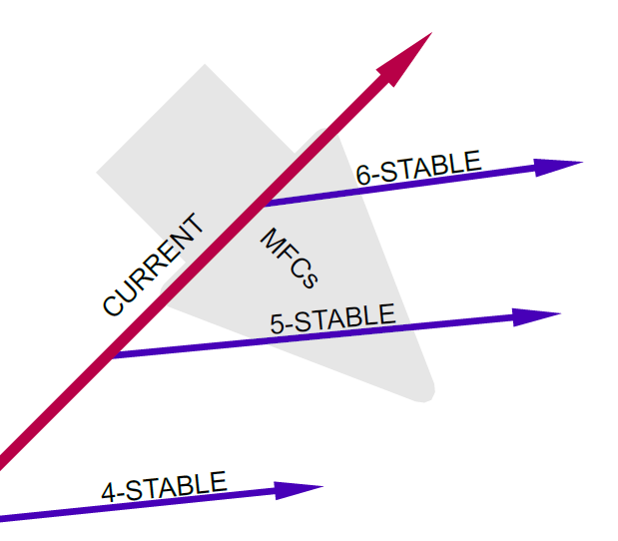
FreeBSD Development Branches
Simultaneous parallel development
Divergence
based on
feature maturity
“MFC” merges
changes from
CURRENT to
STABLE branches
http://www.watson.org/~robert/freebsd/2007asiabsdcon/20070310-asiabsdcon2007-how-freebsd-works.pdf

Slide 5
FreeBSD Release Cycle
Most of the tome open development
Release cycle on STABLE branches
  Code slush
  Code freeze
  Beta series, branching (-BETA)
  Release candidate series (-RC)
  Release (-RELEASE)
  Errata/Security advisories
Big "dot zero" release less frequently
http://www.watson.org/~robert/freebsd/2007asiabsdcon/20070310-asiabsdcon2007-how-freebsd-works.pdf

Slide 6
FreeBSD Release Engineering
Release Engineering Information
  http://www.freebsd.org/releng/
Upcoming Release Schedule
  To be defined FreeBSD 7.2
  June 2009 FreeBSD 8.0
Code-Freeze Status
Branch | Status | Contact | Notes
HEAD | Open | Committers | Active development branch for 8-CURRENT.
RELENG_7 | Open | Committers | Development branch for 7-STABLE.
RELENG_7_1 | Frozen | security-officer@FreeBSD.org | FreeBSD 7.1 supported errata fix branch.
RELENG_6_2 | Frozen | security-officer@FreeBSD.org | FreeBSD 6.2 errata fix branch (not officially supported).
RELENG_5 | Open | Committers | Maintenance branch for 5-STABLE (not officially supported).

Slide 7
Documentation
Handbook
  http://www.freebsd.org/doc/en/books/handbook/
Chinese resources
  http://freebsddoc.twbbs.org
  https://opensvn.csie.org/traccgi/freebsddoc
Wiki
  http://wiki.freebsd.org

Slide 8
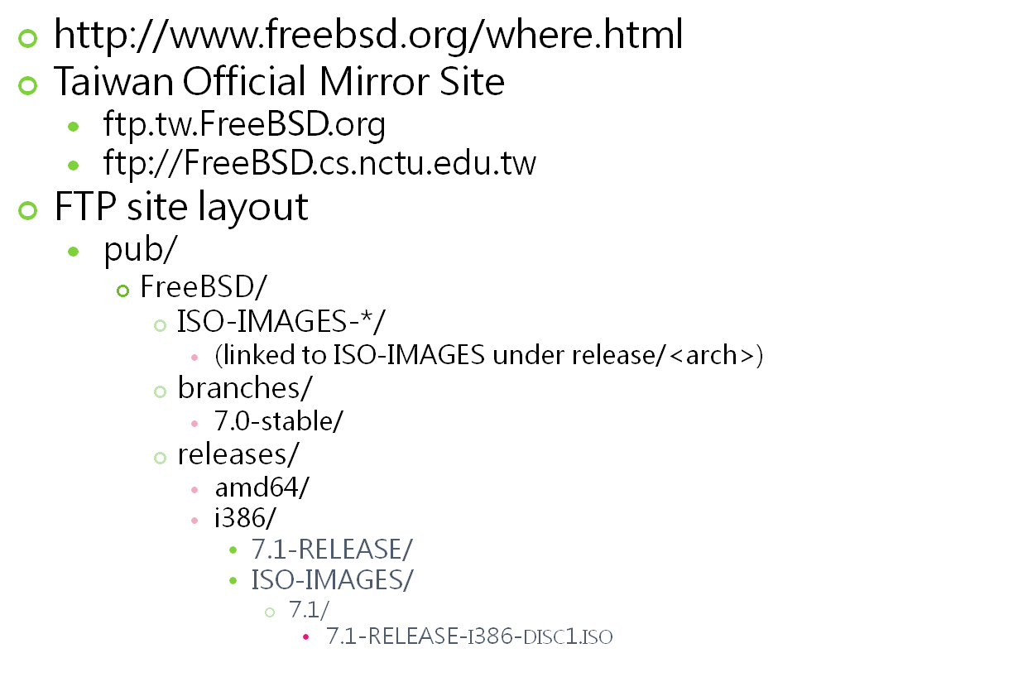
Getting FreeBSD

Slide 9
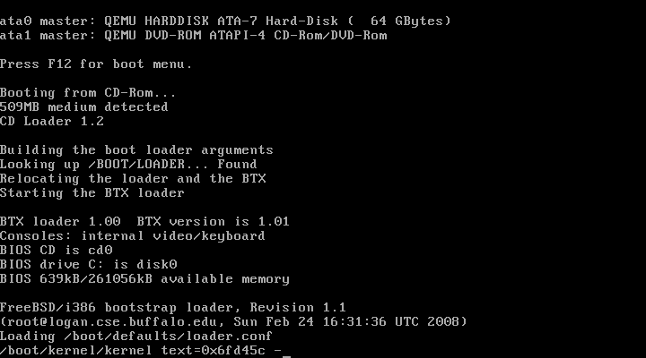
Booting

Slide 10
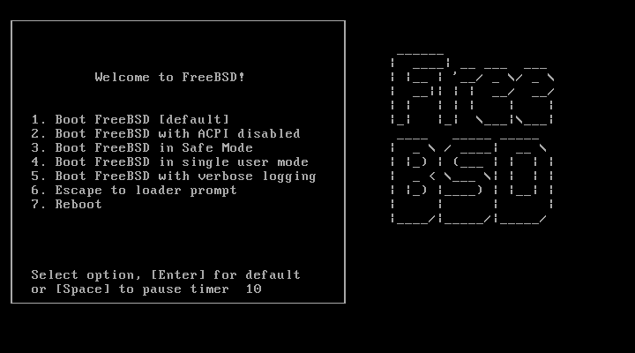
Booting…
Just press Enter
“loader prompt”: some custom/special settings
Ex: loading modules, loader tunables
Notes:
Note that “sysctl value” and “loader tunable” are different, even they usually happen to have same name …

Slide 11
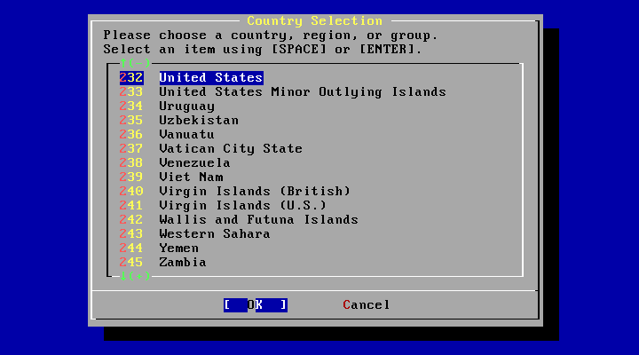
Country Selection
Just use default or…

Slide 12
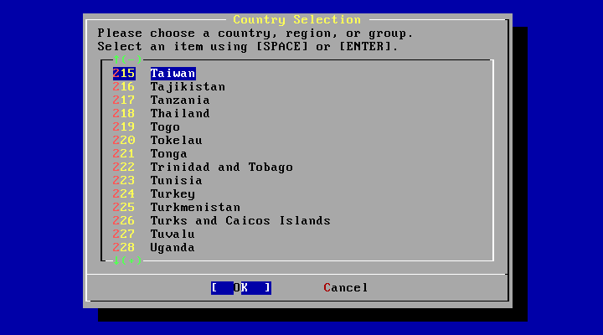
Country - Taiwan
This is loving Taiwan!

Slide 13
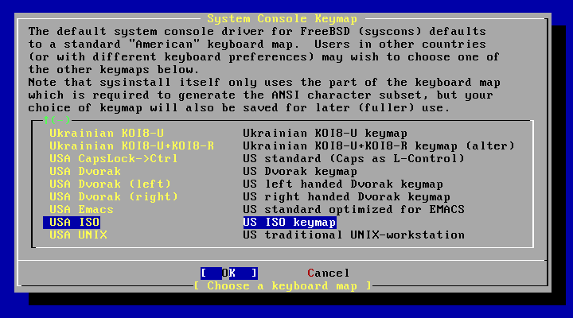
Keymap
Use USA ISO keymap because we don't have our keyboard layout…

Slide 14
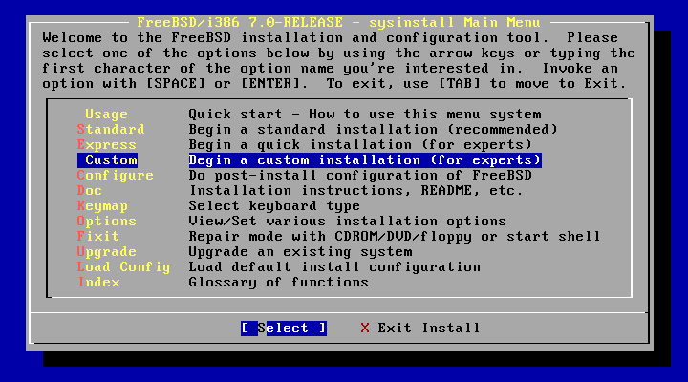
Sysinstall Main Menu
Being experts!

Slide 15
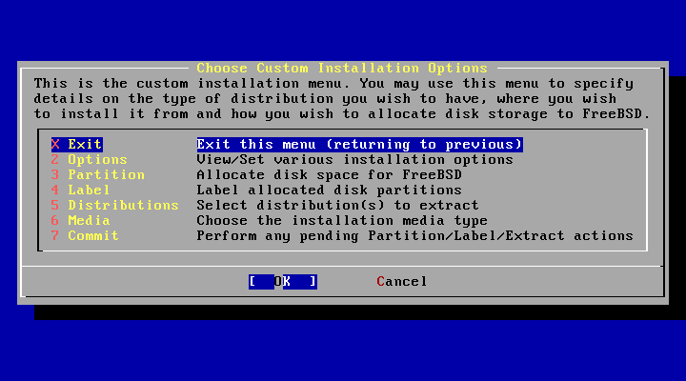
Custom Installation
Installation variables
Partition your disk
Label your disk
What to install
How to install
Do it!

Slide 16
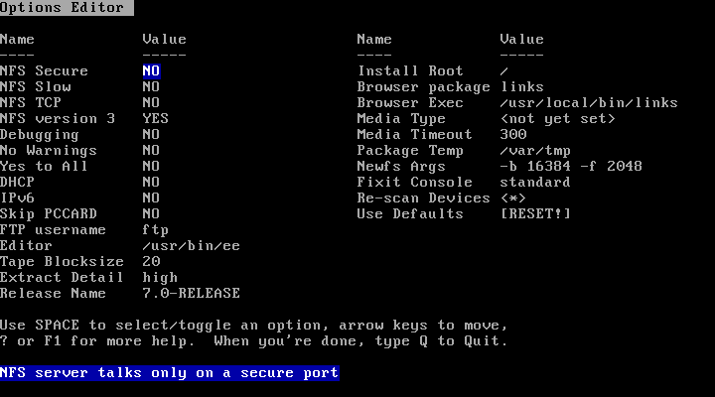
Options
Sometimes you can change "Release Name“
Leave default is enough
Only change things when you know what you're doing

Slide 17
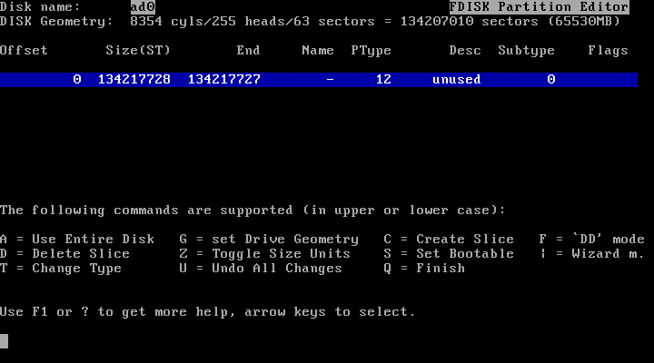
Partition
C = Create
D = Delete
W = Write
Q = Finish

Slide 18
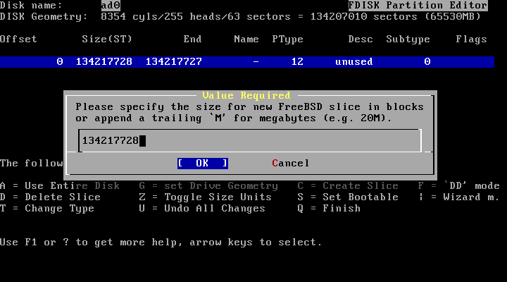
Partition
Size of the partition
Default value: entire free space

Slide 19
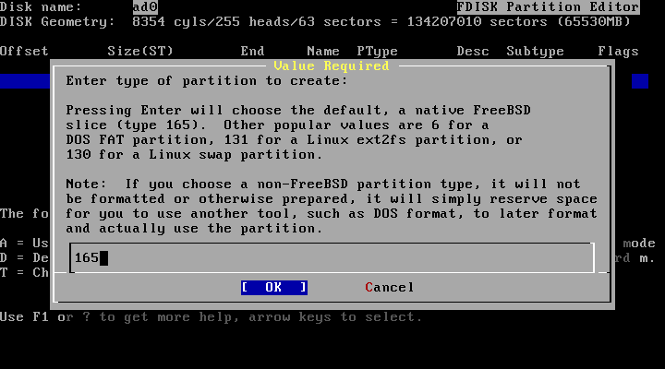
Partition
165 - FreeBSD's magic number

Slide 20
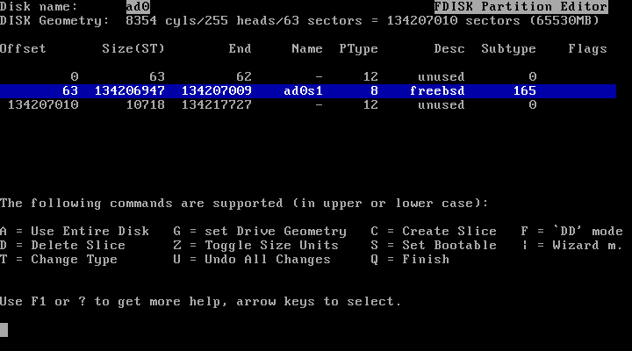
Partition
Partition hard disk as only one partition

Slide 21
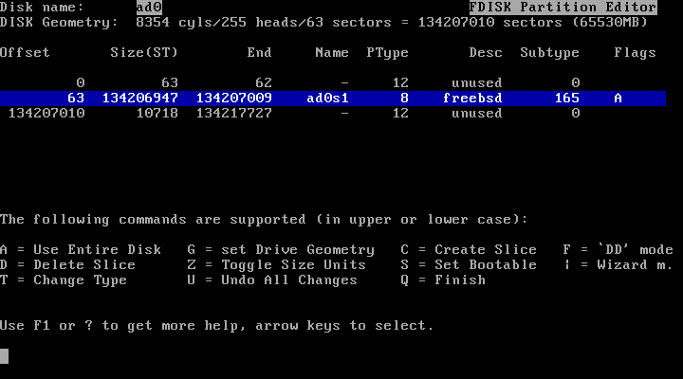
Partition
S = Set bootable

Slide 22
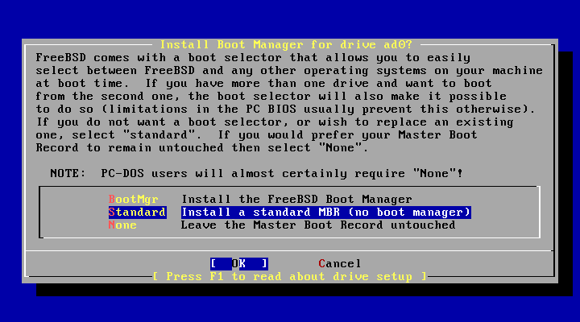
Partition - Boot Manager
BootMgr - install a simple boot manager to disk MBR
Standard - write to disk MBR
None - leave it unchanged

Slide 23
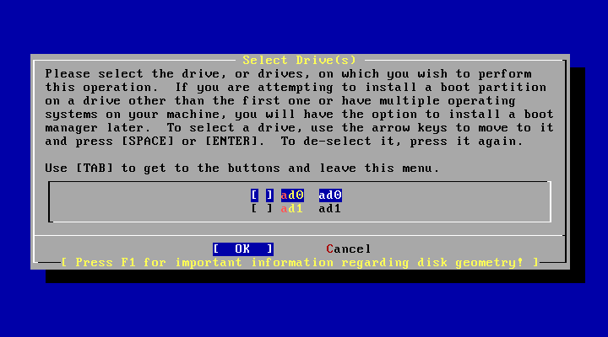
Partition - More than 1 HDs
Be aware which disk is your right target!

Slide 24
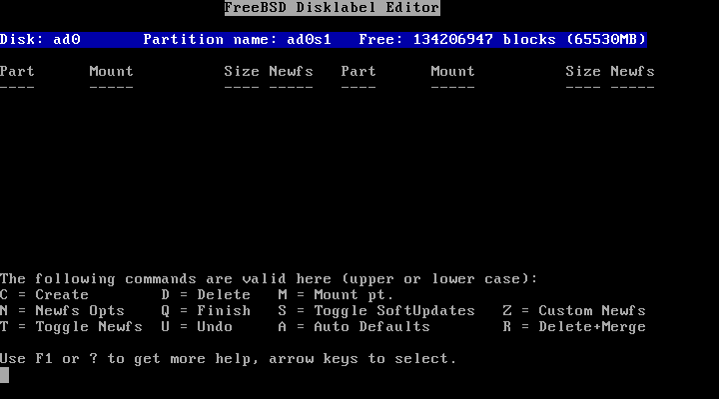
Label
C = Create
D = Delete
Q = Finish

Slide 25
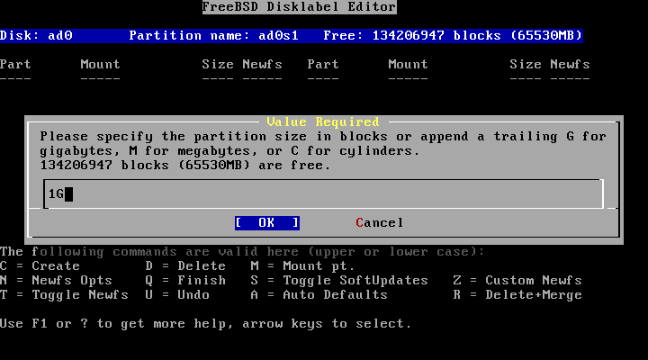
Label
Allocation space for swap:
Typically is 2x of your memory size.
But this is not the absolute rule!

Slide 26
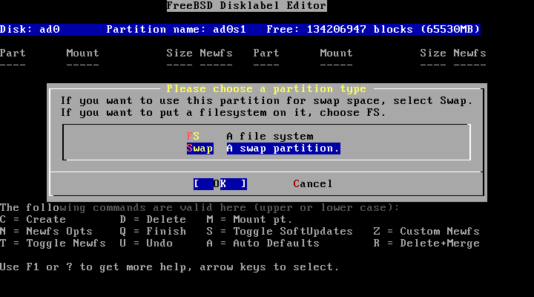
Label
Set to be used for swap
Swap spaces can be distributed on different disks
  Good practice when you have more than one disk
Notes:
FreeBSD will actively swap from memory to swap

Slide 27
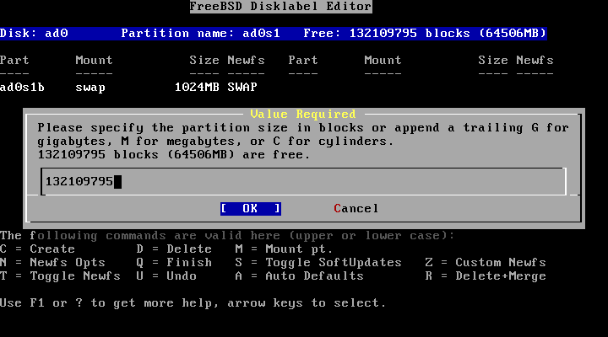
Label
Default is all that remained…

Slide 28
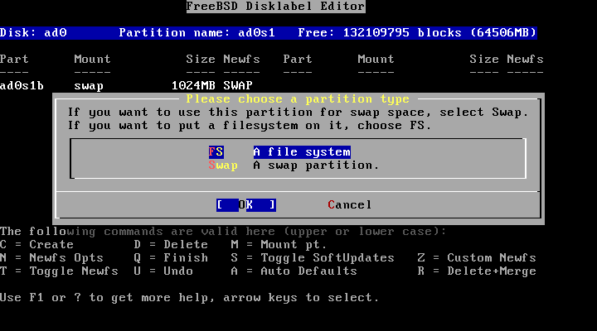
Label
File system type, for data storage

Slide 29
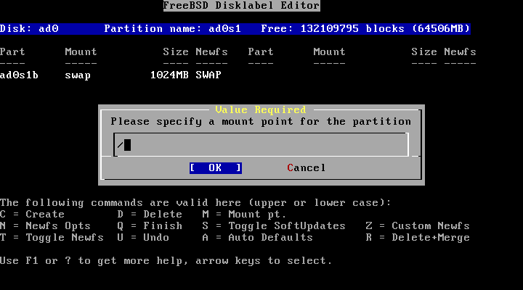
Label
Setting mount point
For learning ‘/’ is enough.
(Not so good for practical using,
unless all other things are on other machines)

Slide 30
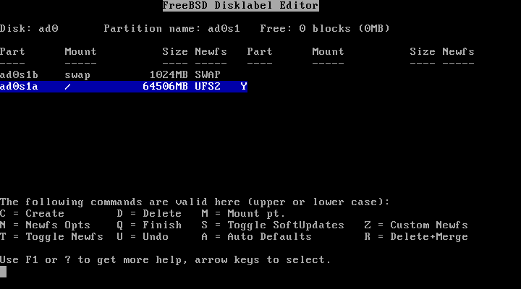
Label
Then we have two labels for meet minimal requirement

Slide 31
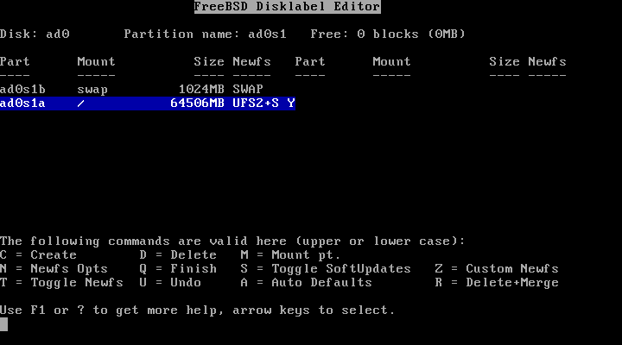
Label
S = Toggle SoftUpdates (something like journaling)
http://en.wikipedia.org/wiki/Soft_updates
http://www.mckusick.com/softdep/

Slide 32
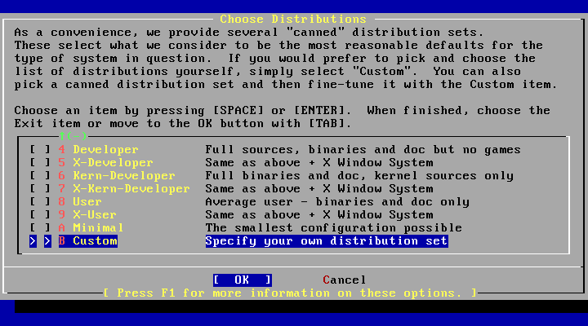
Distributions

Slide 33
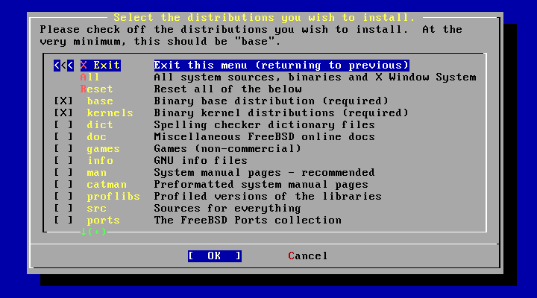
Distributions
Minimum: base and kernel
Also be good: src and ports

Slide 34
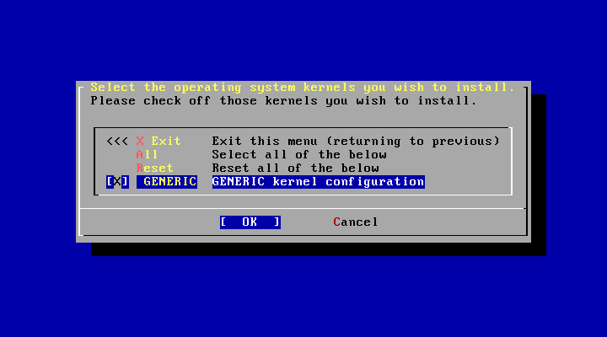
Distributions - kernel
SMP

Slide 35
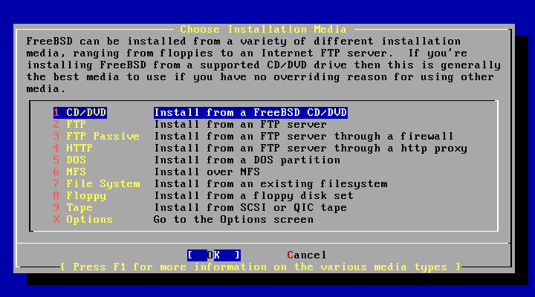
Media - CD/DVD

Slide 36
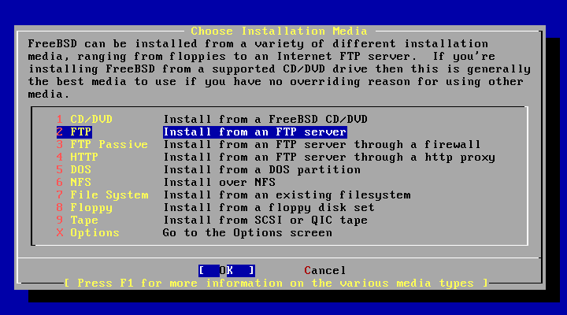
Media - FTP
Passive Mode:
  Server opens the port and let client to connect to.
  (recommended)

Slide 37
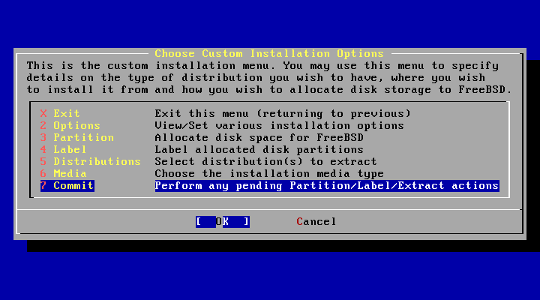
Commit
Just do it!

Slide 38
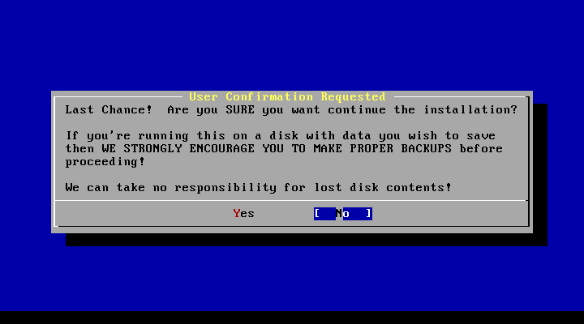
Last Chance!
We can take no responsibility for lost disk contents!
Don't forget backup!

Slide 39
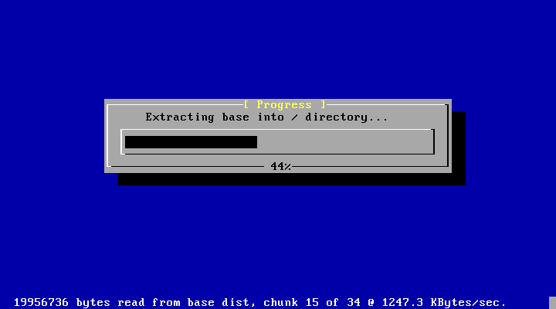
Installing…

Slide 40
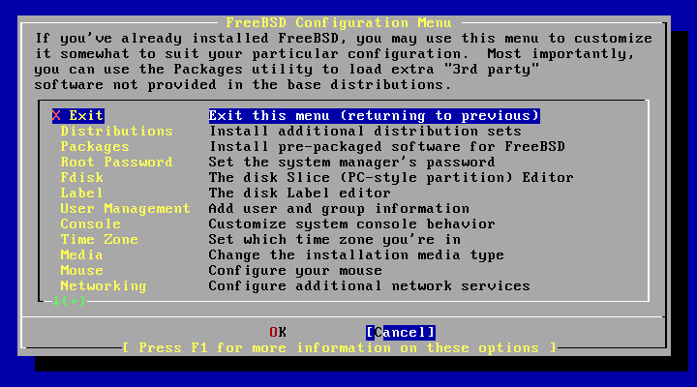
Configuration
Root Password
User Management
Time Zone
Networking

Slide 41
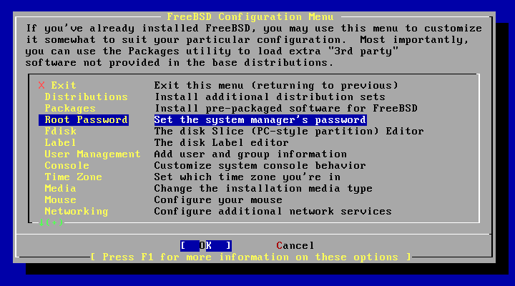
Root Password
Or your computer will be cracked barely by hitting one [Enter]

Slide 42
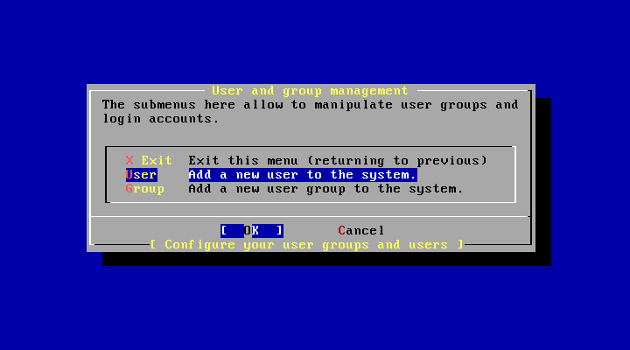
User Management
Create a user different than root for remote login

Slide 43
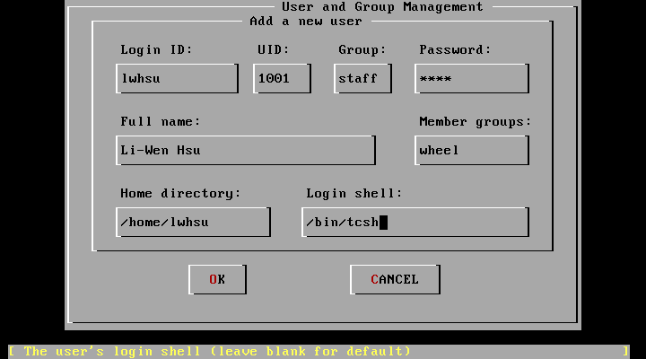
User Management
For administration user, "staff" is a good group.
If you want to become root, be sure you are in "wheel" group.

Slide 44
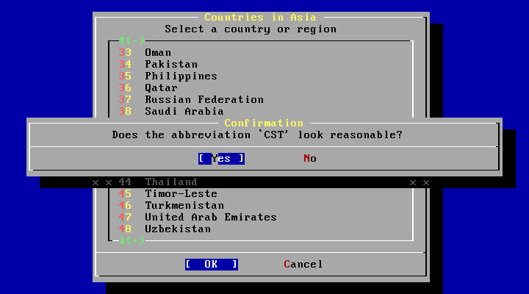
Time Zone
Asia -> Taiwan
Is BIOS time UTC? No
CST? Yes

Slide 45
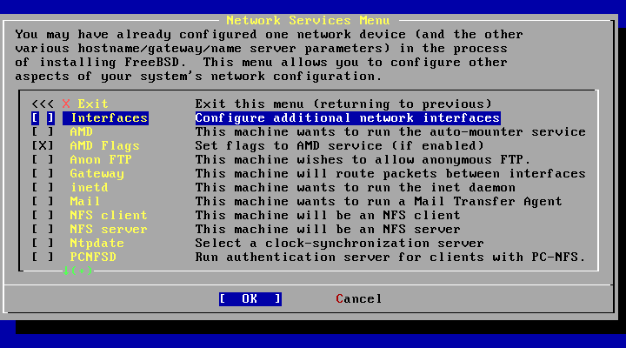
Network Services
Interface
sshd

Slide 46
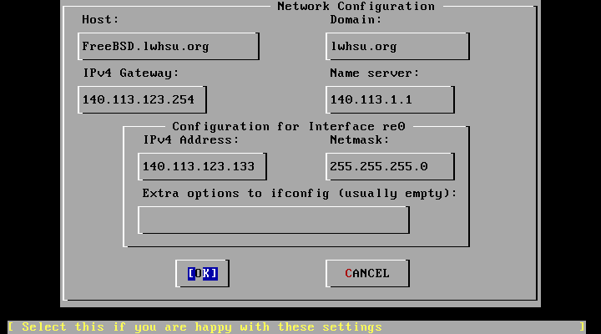
Network Services - Interface
DHCP?
IPv6?

Slide 47
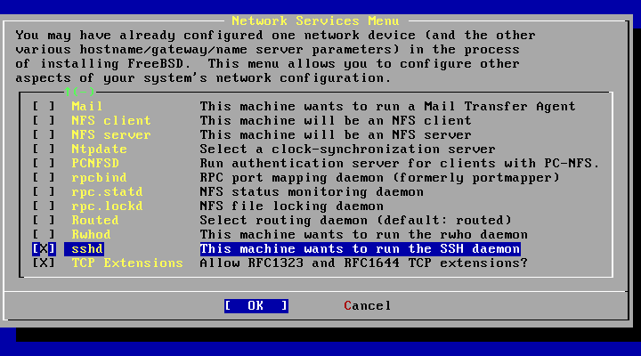
Network Services - sshd
Open a way for remote login

Slide 48
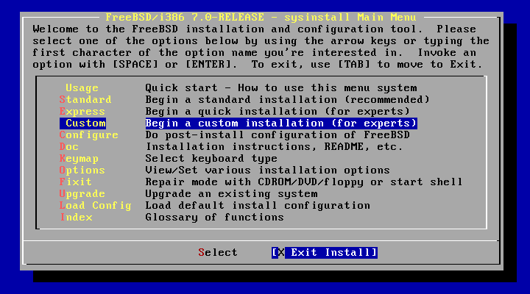
Done!

Slide 49
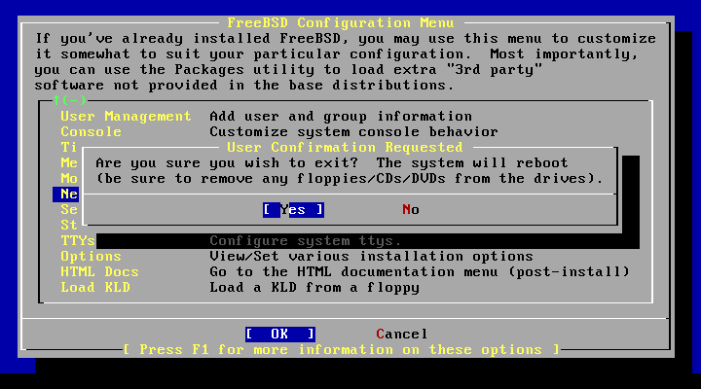
Last Step…
Be sure to remove booting media.
Finally, reboot and enjoy!

Slide 50
Keeping Updating
-build world and kernel

Slide 51
CVS Tags
Branch Tags
  HEAD (.) (-CURRENT)
  RELENG_7 (-STABLE)
  RELENG_7_1 (-RELEASE)
    RELENG_7_1_BP
Release Tags
  RELENG_7_1_0_RELEASE
http://www.freebsd.org/doc/en_US.ISO8859-1/books/handbook/cvs-tags.html

Slide 52
CVSup Configuration File
/usr/share/examples/cvsup/
  standard-supfile
*default host=cvsup.tw.FreeBSD.org
*default base=/var/db
*default prefix=/usr
*default release=cvs tag=RELENG_7_1
*default delete use-rel-suffix
csup <supfile>
csup(1)

Slide 53
Make configuration file
/etc/make.conf:
SUP_UPDATE= yes
SUP= /usr/bin/csup
SUPFLAGS= -L 2
SUPFILE= /usr/local/etc/src-supfile
#PORTSSUPFILE= /usr/local/etc/ports-supfile
KERNCONF= SABSD
CPUTYPE= core2
/usr/share/examples/etc/make.conf
/usr/share/mk/bsd.cpu.mk

Slide 54
Make configuration file (advanced)
NO_CLEANDIR=yes
NO_CLEAN=yes
NO_KERNELCLEAN= yes
#NO_MODULES= yes
#MODULES_WITH_WORLD= true
NO_PORTSUPDATE= yes
Use these options carefully!
/usr/src/Makefile.inc1

Slide 55
Steps
(Read /usr/src/UPDATING)
cd /usr/src
make update
mergemaster -p (Pre-buildworld mode)
Make (-s) (-jN) buildworld
make (-s) (-jN) kernel (buildkernel, installkernel)
(reboot and boot in single user mode)
make installworld
mergemaster (or mergemaster -Ui)
(make check-old, make delete-old)
Reboot
/usr/src/Makefile, mergemaster(8)

Slide 56
Kernel configuration file
Kernel configure file
  cd /usr/src/sys/{i386,amd64}/conf/
“LINT”
  make LINT
Make your own kernel configuration file
  cp GENERIC "YOUR-KERNEL-NAME"
Edit your configuration file
Edit /etc/make.conf

Slide 57
Reboot & Check
Reboot and enjoy it
  # reboot
Check
  # uname -a

Slide 58
If Something Goes Wrong
Boot from old kernel
  “6. Escape to loader prompt”
  Boot /boot/kernel.old/kernel
  cd /boot
  cp -R kernel.old kernel.ok
  rm -fr kernel
  mv kernel.old krenel

Slide 59
Handbook!
Chapter 8 Configuring the FreeBSD Kernel
  http://www.freebsd.org/doc/en/books/handbook/kernelconfig.html
23.4 Rebuilding "world"
  http://www.freebsd.org/doc/en/books/handbook/makeworld.html
8.7 If Something Goes Wrong
  http://www.freebsd.org/doc/en/books/handbook/kernelconfig-trouble.html

Slide 60
Make FreeBSD more useable
-Install 3rd party software

Slide 61
FreeBSD ports/package
Package
  Pre-built ports
  pkg_add, pkg_delete, pkg_deinstall, pkg_info, pkg_version
Ports
  cd /usr/ports, make search, make install clean
  ports/ports-mgmt/portupgrade
    portinstall, portupgrade, portversion
    /usr/local/etc/pkgtools.conf
  Ports/ports-mgmt/portmaster
Notes:
No body uses packages on CD

Slide 62
CVSup Configuration File
/usr/share/examples/cvsup/
  ports-supfile
*default host=cvsup.tw.FreeBSD.org
*default base=/var/db
*default prefix=/usr
*default release=cvs tag=.
*default delete use-rel-suffix

Slide 63
Updating Ports Tree
Update your ports tree every time you want to install/upgrading software
Read /usr/ports/UPDATING
CVSup
csup <ports-supfile>
cd /usr/ports && \
make update && \
make fetchindex

Slide 64
portsnap
/etc/portsnap.conf
  portsnap.freebsd.org -> portsnap.tw.freebsd.org
first time
  portsnap fetch extract
update
  portsnap fetch update
portsnap(8)

Slide 65
Ports system
Find your application
  cd /usr/ports
  make search name=program name
  make search key=string
change to the directory for the port you want to install
Type "make install clean" to install your application
  make
  make install
  make clean
/usr/ports/Mk/bsd.port.mk
  "Default targets and their behaviors"

Slide 66
Package System
pkg_add(1)
  pkg_add pkg_name
    # pkg_add lsof-4.56.4.tgz
  pkg_add -r pkg_name
    If you don't have a source of local packages
    If you are using FreeBSD-CURRENT or FreeBSD-STABLE, pkg_add will download the latest version of your application
    If your are using FreeBSD-RELEASE, it will grab the version of the package that was built with your release
    PACKAGESITE environment variable

Slide 67
Managing Packages
pkg_info(1)
pkg_version(1)
pkg_delete(1)
# pkg_delete xchat-1.7.1
x:~ -lwhsu- pkg_info
adns-1.4 Easy to use, asynchronous-capable DNS client library and ut
amap-5.2 Application mapper
apache-2.2.6_1 Version 2.2 of Apache web server with prefork MPM.
apr-gdbm-db42-1.2.7_1 The Apache Group's Portability Library
autoconf-2.61_2 Automatically configure source code on many Un*x platforms
x:~ -lwhsu- pkg_version -IvL =
adns-1.4 < needs updating (index has 1.4_1)
apache-2.2.6_1 < needs updating (index has 2.2.9)
apr-gdbm-db42-1.2.7_1 < needs updating (index has 1.3.3.1.3.4)
autoconf-2.61_2 < needs updating (index has 2.62)

Slide 68
More port utilities
All under "ports-mgmt" catalog
Search ports
  Psearch
Delete unnecessary ports
  pkg_cutleaves
  pkg_rmleaves
Upgrading
  portsupgrade
  Portmaster
Security
  portaudit

Slide 69
Miscellaneous

Slide 70
__FreeBSD_version values
/usr/src/sys/sys/param.h
http://www.freebsd.org/doc/en_US.ISO8859-1/books/porters-handbook/freebsd-versions.html
/*
* __FreeBSD_version numbers are documented in the Porter's Handbook.
* If you bump the version for any reason, you should update the documentation
* there.
* Currently this lives here:
*
* doc/en_US.ISO8859-1/books/porters-handbook/book.sgml
*
* scheme is: <major><two digit minor>Rxx
* 'R' is 0 if release branch or x.0-CURRENT before RELENG_*_0
* is created, otherwise 1.
*/
#undef __FreeBSD_version
#define __FreeBSD_version 701100 /* Master, propagated to newvers */

Slide 71
Maintenance
Root Mails
  Daily run output
  Security run output
    packages with security vulnerabilities
  Monthly run output
Read mailing-lists
  -announce
  -stable
  -ports
  -cvs
  -svn

