Slide 1
USENET

Slide 2
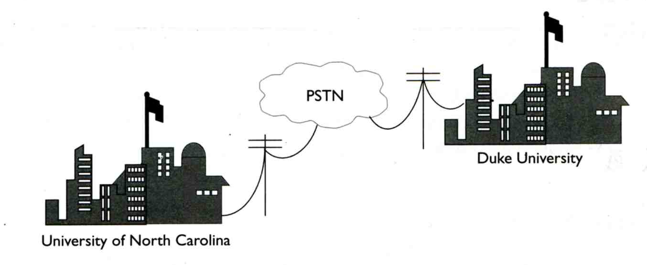
History (1)
The first USENET
  In 1979
  Tom Truscott, Jim Ellis, Steve Bellovin
  Script-based software in the very first time
  Communicate with UUCP via standard phone line and modems
The ANEWS version
  In 1980
  Rewrite with C language
  Steve Bellovin, Tom Truscott, Daniels
The BNEWS version
  In 1981
  Mark Horton, Matt Glickman, Rick Adams
  Rewrite ANEWS to handle more news traffic
  Complied with RFC822 message format

Slide 3
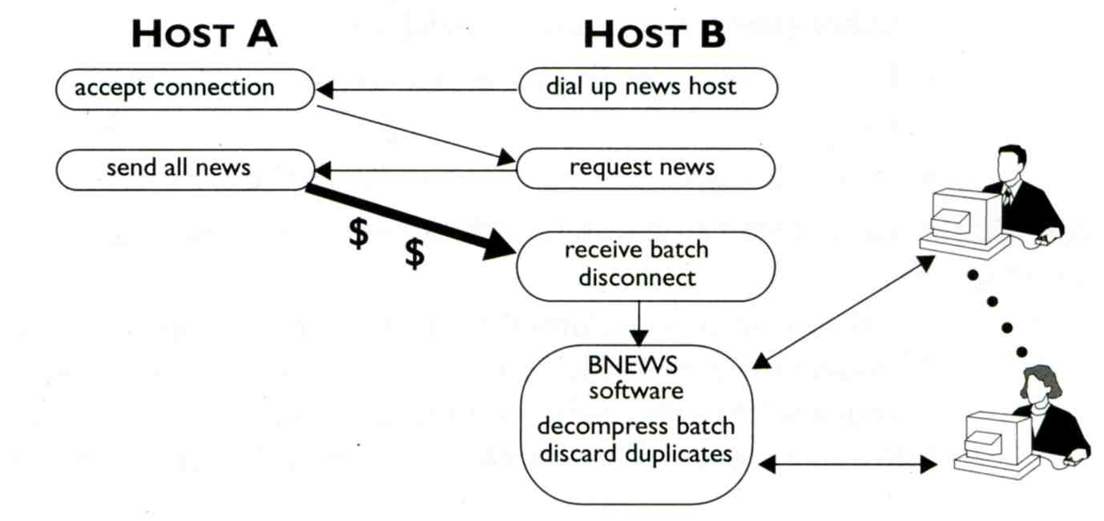
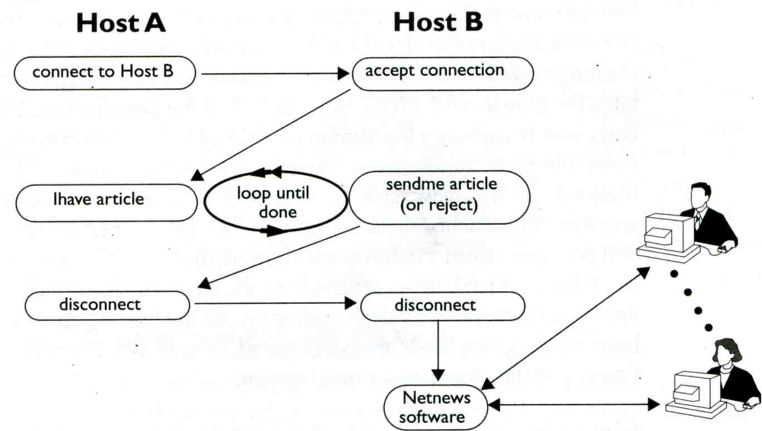
History (2)
UUCP vs. NNTP
  UUCP
    UNIX-to-UNIX Copy
    Via telephone line
    Store-and-forward batch
    Duplicate articles
  NNTP
    Networks News Transfer
    Via TCP/IP connections
    Sending required articles

Slide 4
History (3)
The CNEWS version
  In 1987
  Geoff Collyer, Henry Spencer
  Rewrite of BNEWS to speed up news exchange and processing
INN (InterNet News)
  In 1992
  Rich Salz
  NNTP and UUCP support
DNEWS
  In 1995
  Commercial news software developed by NetWin Inc.
  Handle both Ihave-style and Sucking-style news feed
    Sucking-style feed pulls only those newsgroups actively being read

Slide 5
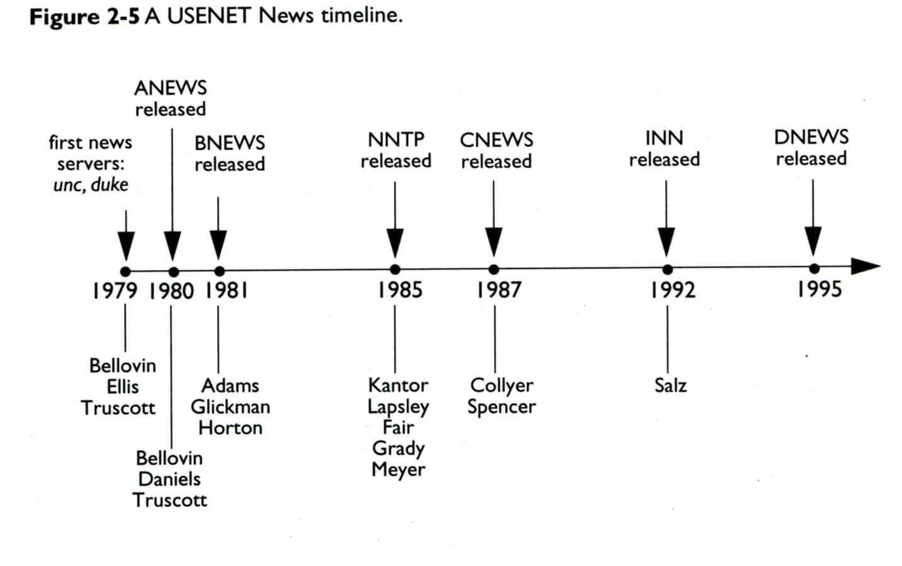
History (4)

Slide 6
News background –
News Article
Two components
  Body
  Header
    RFC1036
      All USENET news messages must be formatted as valid Internet mail message (RFC822)
      RFC1036 is more restrictive
Path: netnews2.csie.nctu.edu.tw!not-for-mail
From: Ya-Lin Huang <huangyl@csie.nctu.edu.tw>
Newsgroups: csie.help
Subject: 無法登入ccbsd8
Date: Mon, 28 Mar 2005 06:36:19 +0000 (UTC)
Organization: Computer Science & Information Engineering NCTU
Lines: 3
Sender: Ya-Lin Huang <huangyl@ccbsd1.csie.nctu.edu.tw>
Message-ID: <d288l3$29sa$1@netnews2.csie.nctu.edu.tw>
NNTP-Posting-Host: huangyl@ccbsd1.csie.nctu.edu.tw
Mime-Version: 1.0
Content-Type: text/plain; charset=Big5
Content-Transfer-Encoding: 8bit

Slide 7
News background –
Newsgroups
Top-level newsgroups
  comp, humanities, misc, news, rec, sci, soc, talk
  New sub-newsgroup will be created within the original newsgroup when articles get too specific
    New newsgroup creation may need to:
      subject a proposal and hold a vote.
      Final judged by news server administrators
The alt top-level newsgroup
  Alternative newsgroups
  Newsgroup creation requires little formality, maybe done by sending a control message to news server
Thread
  Back-and-forth conversation
News moderation
  Messages will be diverted to a moderator for further processing

Slide 8
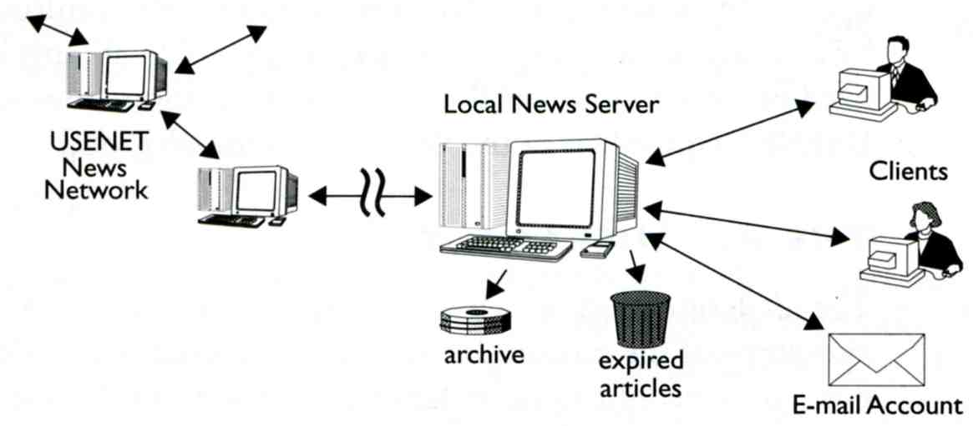
News background –
News Server
Primary role
  Receive and send news to and from other news server
  Store news in database
  Delete or archive old news articles
Common news server
  INN, DNEWS

Slide 9
News background –
News Reader
Client software that used to
  Read and post news
  Filter news
  Navigate news thread
Common news reader
  tin, outlook express, rn, trn, strn, nn, xrn, …

Slide 10
NNTP (1)
Command and response
  Response can be textual or status code
  Ex:
    2xx means command ok
    3xx means command ok, but need rest information
    4xx means command ok, but couldn’t be performed
    5xx means command unimplemented, incorrect
Commonly used commands
  GROUP [newsgroup]
    211 n f l s group selected
    411 no such news groups
  ARTICLE <message-id>
  ARTICLE [nnn]
    2xx
    412 no newsgroup has been selected
    420 no current article has been selected
    423 no such article number
    430 no such article found
  HEAD, BODY, STAT commands

Slide 11
NNTP –
GROUP and ARTICLE
tytsai@mailgate:~> telnet netnews2 119
Trying 140.113.209.3...
Connected to netnews2.
Escape character is '^]'.
200 netnews2.csie.nctu.edu.tw InterNetNews NNRP server INN 2.4.1 ready (posting ok).
ihave <d288l3$29sa$1@netnews.csie.nctu.edu.tw>
502 Permission denied
group csie.test
211 5745 31503 37524 csie.test
article <d288l3$29sa$1@netnews.csie.nctu.edu.tw>
220 0 <d288l3$29sa$1@netnews.csie.nctu.edu.tw> article
path: netnews2.csie.nctu.edu.tw!netnews.csie.nctu.edu.tw!tytsai
From: tytsai@csie.nctu.edu.tw <Tsung-Yi Tsai>
Newsgroups: csie.test
Subject: post demo1
Date: 25 May 2005 15:30:28 GMT
Message-ID: <d288l3$29sa$1@netnews.csie.nctu.edu.tw>
Xref: netnews2.csie.nctu.edu.tw csie.test:37524
Test From Tsung-Yi Tsai
.
quit
205 .
Connection closed by foreign host.

Slide 12
NNTP (2)
  ihave <message-id>
    Inform the server that client has an article
    Used to transform already-posted article
    Used by news server to propagate articles to peer
    Response
      235 article transfer ok
      335 send article to be transferred
      435 article not wanted
      436 transfer failed
      437 article rejected

Slide 13
NNTP – ihave command
[tytsai@netnews]/home/inn/news/db> telnet netnews2 119
Trying 140.113.209.3...
Connected to netnews2.
Escape character is '^]'.
200 netnews2.csie.nctu.edu.tw InterNetNews server INN 2.4.1 ready
ihave <d288l3$29sa$1@netnews2.csie.nctu.edu.tw>
435 Duplicate
ihave <d288l3$29sa$1@netnews.csie.nctu.edu.tw>
335
path: netnews.csie.nctu.edu.tw!tytsai
From: tytsai@csie.nctu.edu.tw <Tsung-Yi Tsai>
Newsgroups: csie.test
Subject: post demo1
Date: 25 May 2005 15:30:28 GMT
Message-ID: <d288l3$29sa$1@netnews.csie.nctu.edu.tw>
Test From Tsung-Yi Tsai
.
235
quit
205 .
Connection closed by foreign host.

Slide 14
NNTP (3)
  post
    Post a new article
    Used for client to post a new article via news reader software
    Response
      240 article posted ok
      340 send article to be posted
      440 posting not allowed
      441 posting failed

Slide 15
NNTP – post command
tytsai@mailgate:~> telnet netnews2 119
Trying 140.113.209.3...
Connected to netnews2.
Escape character is '^]'.
200 netnews2.csie.nctu.edu.tw InterNetNews NNRP server INN 2.4.1 ready (posting ok).
post
340 Ok, recommended ID <d71imt$1fj4$1@netnews2.csie.nctu.edu.tw>
From: test@test.from.mailgate
Newsgroups: csie.test
Subject: post demo2
Test
.
240 Article posted <d71imt$1fj4$1@netnews2.csie.nctu.edu.tw>
quit
205 .
Connection closed by foreign host.

Slide 16
NNTP (4)
  LIST [active|active.times|newsgroups|…]
    List the db files
  NEWSGROUPS YYMMDD HHMMSS [GMT]
    List newsgroups created since date and time
  NEWNEWS newsgroups YYMMDD HHMMSS [GMT]
    List message-ids of articles to specified newsgroup since date and time

Slide 17
INN –
InterNet News

Slide 18
What is INN (1)
InterNetNews
  Written by Rich Salz
  Flexible and configurable Usenet news server
    Accept articles from other servers and store on disk
    Send articles to other servers and readers
    Delete or archive old news articles
  Support NNTP and UUCP
    innd: handle NNTP incoming feeding connections directly
    rnews: hand articles via UUCP off to innd
    innfeed: handle outgoing feeding articles
    nntpsend, innxmit: send batches of news via TCP/IP
    nnrpd: handle connections from news readers

Slide 19
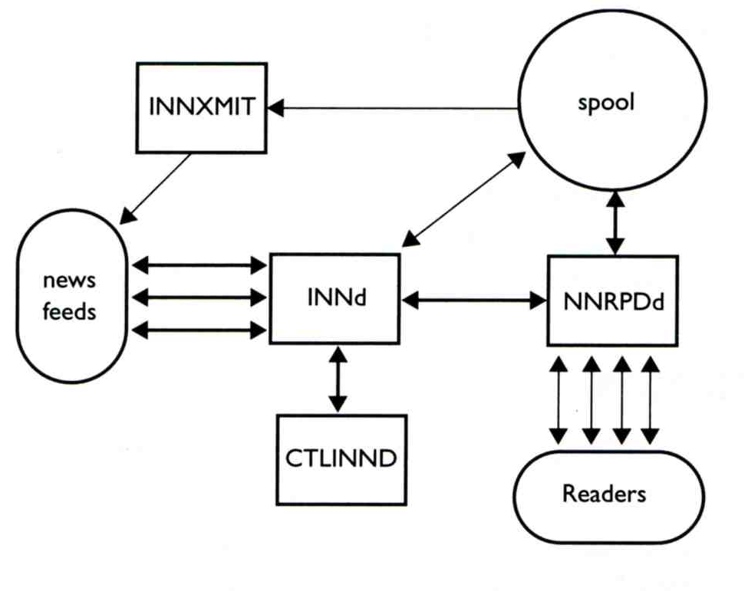
What is INN (2)
Interactions between INN components
  innd
    It would spawn NNRPd process for news readers
  ctlinnd
    Handle all communications with innd
      Such as shutdown, pauses, newgroup …
  nnrpd
    Handle sending and receiving articles to and from news readers

Slide 20
What is INN (3)
Newsgroup db (under ~news/db directory)
  active
    List of newsgroups carried by INN
    Syntax
      <name> <high-mark> <low-mark> <flag>
      csie.course.sysadmin 0000006093 0000005728 y
      csie.cp91 0000002005 0000001672 y
  active.time
    List of local creation times of newsgroups
    Syntax
      <name> <time> <creator>
      csie.cp91 1027602994 jwwang@mailgate.csie.nctu.edu.tw
  newsgroups
    List of newsgroup description
    Syntax
      <name> <description>
      csie.announce [重要公告] Announcing Bulletin for CSIE

Slide 21
What is INN (4)
  history
    Record of currently stored articles and
    Record of recently expired articles
    Syntax
      [hash] \t date \t token
      [064BDA203F2F15D72D49321DEC605D38] 992932846~-~992932846 @050200001C21000002D90000000000000000@
      [8A2C8E2CAA8FDE19F315025D3AB04ED7] 992932902~-~992932902 @050200001C2200000B850000000000000000@

Slide 22
What is INN (5)
When an articles is received
  Check “active” file to see if this newsgroup is allowed
    If it does not exist, send to junk or reject
    If it does exist, write this article in to “spool” directory with a highest number as file name
      This number is maintained in active file
  Add an entry into “history” file
  Add an entry into a batch file for feeding other site

Slide 23
Installing INN
ftp://ftp.isc.org/isc/inn/inn-2.4.1.tar.gz
  ./configure --help
    --prefix=/home/inn/news
    --enable-largefiles
    --with-perl
  make and make install

Slide 24
Installing INN –
Choosing article storage format (1)
4 supported formats
  tradspool
    Articles are store as individual text files and named as article number
      Ex: news/software/nntp/12345
  timehash
    The same as “tradspoon”, but files are divided into directories based on arrival time
  timecaf
    Similar to “timehash”, but multiple articles are put in the same file
  cnfs
    Articles are stored sequentially in pre-configured buffer files.
    When buffer end is reached, new articles are stored from the beginning of the buffer.
      Adv:
        no need to create files to store articles
        No need to maintain expiration
        Disk space will not be a issues
      Disadv:
        Hard to control file expiration
        Flooding messages may cause wanted articles disappeared

Slide 25
Installing INN –
Choosing article storage format (2)
Which is best
  Transit news server
    Just accept news and send it out to other servers
    CNFS
  Newsgroups that no need to keep very long
    CNFS
  Others
    timehash, timecaf, tradspool
INN can support all four at the same time

Slide 26
Installing INN –
Choosing overview storage format
Overview
  Summary information about articles in a newsgroup
  Let readers to review summary information before taking time to download entire article
    nntp XOVER command
  Items in overview
    Subject, From, Date, References, Message-ID, byte count, line count
Overview storage methods
  tradindexed
  buffindexed
  ovdb
    Store overview data in Berkeley DB database

Slide 27
Installing INN – configurations (1)
Configuration files
  Under ~news/etc/
    All configuration files has man page under ~news/man
    Set MANPATH to include ~new/man
  inn.conf
    General configuration files for all InterNetNews programs
  newsfeeds
    How to distribute articles to others, including
      News servers, local program, local file
  incoming.conf
    Specify which machines are permitted to feed us news
  storage.conf
    Determine where and how incoming articles will be stored
  expire.ctl
    Set the expiration policy
  readers.conf
    nnrpd uses this to determine whether a given connection is allowed
  control.ctl
    Specify how to handle Usenet control messages

Slide 28
Installing INN – configurations (2)
  overview.fmt
    Format of news overview database
  innfeed.conf
    Configuration file for innfeed
  cycbuff.conf
    Configuration file for INN CNFS storage method
  buffindexed.conf
    Configuration file for INN buffindexed storage method
  ovdb.conf
    Configuration file for OVDB overview method

Slide 29
Installing INN – configurations (3)
INN outgoing feeds
  newsfeeds, nntpsend.ctl, innfeed.cnf
INN incoming feeds
  incoming.conf, readers.conf
Article storage methods
  storage.conf, cycbuff.conf
Overview storage methods
  overfiew.fmt, buffindexed.conf ovdb.conf
Expiration control
  expire.ctl
Control message
  control.ctl
Moderators
  moderators

Slide 30
INN Configuration

Slide 31
Configure INN – inn.conf (1)
news/etc/inn.conf
  General configuration file for all INN programs
  Each line is a <key: value> pair
  Categories
    General Settings
    Feed configuration
    Article storage
    Reading
    Posting
    Monitoring
    Logging
    System tuning
    Path and File names

Slide 32
Configure INN – inn.conf (1)
General
  domain: csie.nctu.edu.tw
  pathhost: netnews.csie.nctu.edu.tw
  server: netnews.csie.nctu.edu.tw
  mailcmd: /home1/inn/news/bin/innmail
  mta: "/usr/sbin/sendmail -oi -oem %s“
Feed
  artcutoff: 14 (articles older than this are dropped)
  maxartsize: 1000000
  pathalias: (before pathhost)
  port: 119
  sourceaddress: (outgoing NNTP sockets)
  bindaddress: (what innd binds)
  verifycancels: true
  remembertrash: yes ( record rejected articles in mem)
  wanttrash: false (file articles posted to unknown )

Slide 33
Configure INN – inn.conf (2)
Article storage
  enableoverview
  ovmethod: tradindexed
  hismethod: hisv6
Reading
  allownewnews
  initialtimeout: 10
  clienttimeout: 600
  noreader: false
  readerswhenstopped: false
  nnrpdloadlimit: 16
Posting
  addnntppostingdate: true (NNTP-Posting-Date header)
  addnntppostinghost: true (NNTP-Posting-Host header)
  moderatormailer: ta@csie.nctu.edu.tw
  organization: netnews.csie.nctu.edu.tw (Organization header)
Path
  pathoutgoing: /home/inn/news/spool/outoing
  pathoverview: /home/inn/news/spool/overview

Slide 34
INN outgoing feeds – newsfeeds (1)
etc/newsfeeds
  Specify what batch files should be created and then used by innfeed to feed articles to remote sites
  Syntax
    sitename[/exclude,exclude,…]\
    :pattern,pattern, …\
    :flag,flag,..\
    :parameter
  Ex:
    netnews2.csie/netnews2.csie.nctu.edu.tw\
    :*,!control*,!junk,!alt.binaries.*,!news.lists.filters\
    :Tm:innfeed!

Slide 35
INN outgoing feeds – newsfeeds (2)
  flags
    < size
    > size
    A checks
      c, C, d, e, …
    B high/low (Use buffer to gain performance)
    Ttype (how to feed for this site)
      f file (Designed for use by external program)
      l log entry only (The same as Tf:/dev/null)
      p program (spawn a given program for each article)
      c channel (spawn once)
      m funnel
      x exploder
    W items (information sent to this site)
      b, e, f, g, ….

Slide 36
INN outgoing feeds – newsfeeds (3)
  Example
    ME:!*/!local,!collabra-internal::
    innfeed!\
    :!*\
    :Tc,Wnm*:/home/inn/news/bin/startinnfeed
    n2m!:!*\
    :Tc,Ac,Wng*:/home/inn/news/bin/news2mail
    netnews2.csie/netnews2.csie.nctu.edu.tw\ :*,!control*,!junk,!alt.binaries.*,!news.lists.filters \
    :Tm:innfeed!\
    network-programming@java.csie.nctu.edu.tw\
    :csie.course.network-programming\
    :Tm:n2m!
    tybsd.csie/tybsd.csie.nctu.edu.tw\
    :csie.course.netadm:Tf,Wnm,B4096/1024:

Slide 37
INN outgoing feeds – innfeed.conf and nntpsend.ctl (1)
Related to newsfeeds
  File feeds use nntpsend.ctl and funnel feeds use innfeed.conf
innfeed.conf
  Three types of entries:
    Key: value (global setting to peer and group)
    group (one group may contains many peers)
    peer (can be individual or within one group)
max-connections: 5
group csie-news-sites {
peer netnews2.csie {
max-connections: 5
ip-name: netnews2.csie.nctu.edu.tw
}
}
peer java.csie {
ip-name: java.csie.nctu.edu.tw
}

Slide 38
INN outgoing feeds – innfeed.conf and nntpsend.ctl (2)
  Key-value pairs in innfeed.conf
    Global values that apply to the process
      news-spool, pid-file, debug-level, log-file, …
      initial-reconnect-time, max-reconnect-time, …
    Global peer defaults
      article-timeout, response-timeout, ..
      initial-connections, max-connections, ..
    Peer value
      ip-name (FQDN or IP)
nntpsend.ctl
  nntpsend is a front-end that invokes innxmit to send articles to remote NNTP site
  Syntax
    site_name:fqdn:max_size:args_to_innxmit
  Ex:
    tybsd.csie:tybsd.csie.nctu.edu.tw::-T1800 –t300

Slide 39
INN incoming feeds – incoming.conf
incoming.conf
  Names and addresses that feed us news
  Three types of entries
    Key: value
    group
    peer
  Key-value pairs in incoming.conf
    Hostname, max-connections, password, patterns, ..
max-connections: 8 # per feed
peer ME {
hostname: "localhost, 127.0.0.1"
}
peer netnews2.csie {
hostname: "netnews2.csie.nctu.edu.tw, 140.113.209.3"
}

Slide 40
INN incoming feeds – readers.conf (1)
Access control for nnrpd
  auth configuration
    Identity of the news readers
    syntax
    auth “name” {
    hosts: “hostlist”
    auth: “authprog”
    res: “resprog”
    default: “default-identity”
    default-domain: “emaildomain”
    }
  access configuration
    Determine what each identity can do
    Syntax
    access “name” {
    users: “userlist”
    newsgroups: “newsgrups”
    read: “read-list”
    post: “post-list”
    access: “permission”
    }

Slide 41
INN incoming feeds – readers.conf (2)
Both auth and access groups are last matching
Ex:
auth "nctu" {
hosts: "*.nctu.edu.tw"
default: <nctu>
default-domain: nctu
}
auth "csie" {
hosts: "*.csie.nctu.edu.tw"
default: <csie>
default-domain: csie
}
access "nctu" {
users: "*@nctu"
read: "*, !csie.*, csie.course.*, !alt.binaries.*, !junk, !twbbs.*, !control, !control.*"
post: "*, !csie.*, csie.course.*, !alt.binaries.*, !junk, !twbbs.*, !control, !control.*"
}
access "csie csiespec sec" {
users: "*@csie,*@csiespec,*@sec"
newsgroups: "*, !junk,!csie.cc.*, !twbbs.*, !control, !control.*"
}

Slide 42
Article Storage – storeage.conf (1)
Storage methods for articles
  Each entry is a storage method
  Articles that match the rules of certain storage method is saved using that method
    First match if multiple match
  Syntax
    method “methodname” {
    class: storage_class
    newsgroups: group_list
    size: minsize[,maxisze]
    options: option_list
    }
  Storage methods
    tradspool: patharticles/news.group.path/nnnn
    timehash: patharticles/time-nn/bb/cc/yyyy-aadd
    timecaf: patharticles/timecaf-nn/bb/aacc.CF
    cnfs: metacycbuff

Slide 43
Article Storage – storeage.conf (2)
Ex:
method tradspool {
newsgroups: csie.cc.*
class: 2
}
method cnfs {
newsgroups: csie.*,nctu.*,nthu.*,ncu.*,ntu.*,ccu.*,nccu.*,ntou.*,ntnu.*,ncku*, eecsep.*
class: 9
size: 0,8191
options: CSIEAREA
}
method cnfs {
newsgroups: comp.*,news.*,linux.*
class: 7
size: 0,8191
options: DIGEST
}
metacycbuff in cycbuff.conf

Slide 44
Article Storage – cycbuff.conf
cycbuff:BUF09H:/home2/CNFS/CSIE:960000
cycbuff:BUF11H:/home2/CNFS/DIGEST:1152000
cycbuff:GENERAL:/home2/CNFS/GENERAL:1920000
metacycbuff:CSIEAREA:BUF09H
metacycbuff:DIGEST:BUF11H
metacycbuff:NORMAL:GENERAL
Four entries
  cycbuffupdate:<interval>
  refreshinterval:<interval>
  cycbuff:<name>:<file>:<size>
  metacycbuff:<name>:<buffer>[,<buffer>,…]
    If > 1 buffer
      Round-robin
      Sequential
Create cycbuffer file
  dd if=/dev/zero of=/home2/CNFS/CSIE bs=1024 count=960000

Slide 45
Overview storage – overview.fmt
Specify the organization of overview
  Use “makehistory” to rebuild the overview database
  Ex:
Subject:
From:
Date:
Message-ID:
References:
Bytes:
Lines:
Xref:full

Slide 46
Expiration Control – expire.ctl
Two purposes:
  History expiration control for expired or rejected articles
  Article expiration
History expiration
  Used to reject old articles from other peers
  /remember/:10
Article expiration
  Class-based expiry (groupbaseexpiry=false in inn.conf)
    <class-num>:<keep>:<default>:<purge>
  Group-based expiry (groupbaseexpiry=true)
    <pattern>:<flag>:<keep>:<default>:<purge>
    flags
      M (only moderated), U (only unmoderated), A (All)
      X (remove the article from all groups it appears in)

Slide 47
Control message (1)
Arriving articles that have a Control header
  Handled by “controlchan(8)” via feed set up in newsfeeds
  Put into the pseudo-newsgroup “control”
    Or “control.command”
  Such as
    cancel, newgroup, rmgroup, checkgroups
  Pseudo newsgroup in active file
    control
    control.cancel
    control.newgroup
    control.rmgroup
    junk

Slide 48
Control message (2)
Ex:
Path: netnews.csie.nctu.edu.tw!netnews2.csie.nctu.edu.tw!mailgate.csie.nctu.edu.tw!jwwang
From: <solobosouvpe@prodigy.com>
Newsgroups: csie.cc.ta-eval
Subject: cmsg cancel <bju8an$1k8p$1@netnews.csie.NCTU.edu.tw>
Control: cancel <bju8an$1k8p$1@netnews.csie.NCTU.edu.tw>
Date: Sat, 13 Sep 2003 05:38:35 +0000 (UTC)
Organization: Computer Science & Information Engineering NCTU
Lines: 1
Path: netnews2.csie.nctu.edu.tw!tytsai
From: Tsung-Yi Tsai <tytsai@csie.nctu.edu.tw>
Newsgroups: csie.help
Subject: cmsg newgroup csie.course.realtime-rendering
Control: newgroup csie.course.realtime-rendering
Date: Wed, 02 Mar 2005 08:50:38 +0000 (UTC)
Organization: Computer Science & Information Engineering NCTU
Approved: tytsai@csie.nctu.edu.tw
Message-ID: 96r4f2$3f0$1@netnews2.csie.NCTU.edu.tw
For your newsgroups file:
csie.course.realtime-rendering [及時顯像技術]

Slide 49
Control message (3)
Determine what action is taken when a control message is received
  Read by controlchan
  Syntax:
    <type>:<from>:<newsgroups>:<action>
    <type>= cancel, newgroup, rmgroup, all, …
    <action>= doit, doit=file, doit=mail
    drop , log, mail, verify-*, verify-*=file
## DEFAULT
all:*:*:mail
## Default (for any group)
newgroup:*:*:log=newgroup
rmgroup:*:*:log=rmgroup
checkgroups:*:*:mail
# for csie.*
newgroup:tytsai@csie.nctu.edu.tw:csie.*:doit=mail
rmgroup:tytsai@csie.nctu.edu.tw:csie.*:doit=mail
# for tw.bbs.*
newgroup:ltc@news.cc.nctu.edu.tw:tw.bbs.*:doit=mail

Slide 50
moderators
Send unaprroved articles to some email address
  Syntax
    <newsgroup>:<mail-address>
    %s in mail-address will be changed to newsgroup name with dashes connected each components
  Ex:
    csie.forgery:anon@anon.csie.nctu.edu.tw
    tw.bbs.*:%s@csie.nctu.edu.tw
  Manual or automatic processing

Slide 51
INN log and cron
Log
  /etc/syslog.conf news.crit /usr/local/news/log/news.crit
    news.err /usr/local/news/log/news.err
    news.notice /usr/local/news/log/news.notice
    Add news.none to all entry starts with *
Cron
  Run news.daily which performs dail server maintenance
    Status report, removing expire articles, renumbering the active file, rotate the log…
      0 5 * * * /home/inn/news/bin/news.daily expireover lowmark
      0 6 * * * /home/inn/news/bin/cnfsstat –a
      0 8 * * * /home/inn/news/bin/actsync netnews2

Slide 52
Create database files
Files under news/db
  active, active.times, newsgroups
    Can be download from ftp://ftp.isc.org/pub/usenet/CONFIG/
    Create your-own newsgroups
    Required-newsgroups: control* and junk
  history
    % cd ~news/db
    % touch history
    % makedbz –i
      history.n.dir, history.n.hash, history.n.index
    Rename each history file to eliminate n.
    % chmod 644 *

Slide 53
INN Basic Operation (1)
Do it witl “news” identity
  % su – news –c
innd will be in three states
  running
  throttled (close connections and reject new one)
  pause (reject new one but not shut down existing connections)
Start
  % /home/inn/news/bin/inndstart
  % /home/inn/news/bin/rc.news
Stop
  % /home/inn/news/bin/ctlinnd shutdown ‘your-reason’
  % /home/inn/news/bin/rc.news stop
Throttle
  % /home/inn/news/bin/ctlinnd throttle ‘your-reason’
Go
  % /home/inn/news/bin/ctlinnd go ‘the-same-given-in-stop-or-throttle’

Slide 54
INN Basic Operation (2)
Create and remove newsgroups
  Method1: use control message
  Method2: use ctlinnd
    Create
      % bin/ctlinnd newgroup <groupname> <rest> <creator>
      Add description in db/newsgroups
    Delete
      % bin/ctlinnd rmgroup <groupname>
      Remove description

