Slide 1
Routing

Slide 2
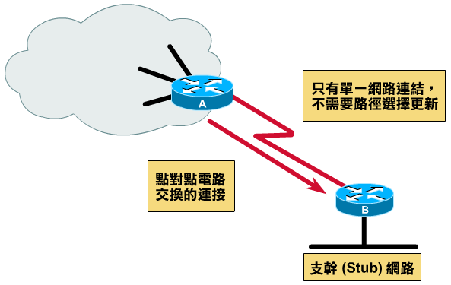
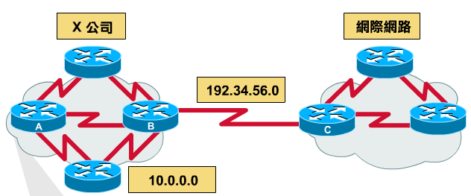
Why dynamic route ? (1)
Static route is ok only when
  Network is small
  There is a single connection point to other network
  No redundant route

Slide 3
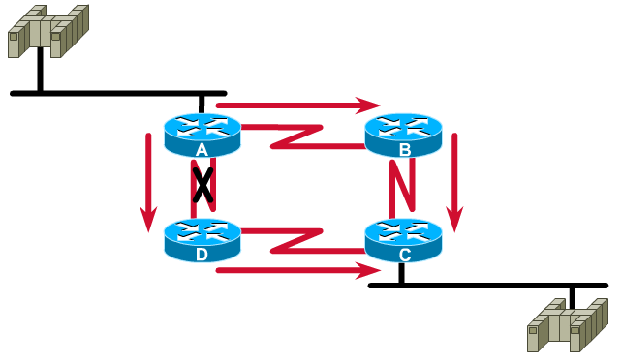
Why dynamic route ? (2)
Dynamic Routing
  Routers update their routing table with the information of adjacent routers
  Dynamic routing need a routing protocol for such communication
  Advantage:
    They can react and adapt to changing network condition

Slide 4
Routing Protocol
Used to change the routing table according to various routing information
  Specify detail of communication between routers
  Specify information changed in each communication,
    Network reachability
    Network state
    Metric
Metric
  A measure of how good a particular route
    Hop count, bandwidth, delay, load, reliability, …
Each routing protocol may use different metric and exchange different information

Slide 5
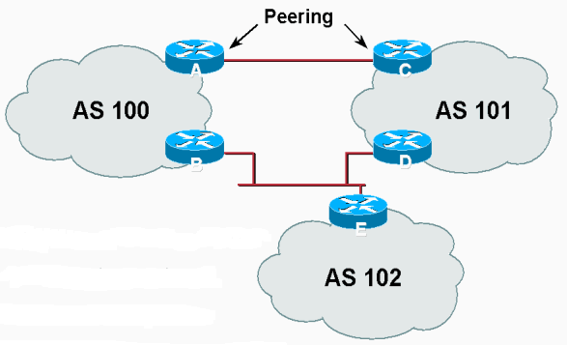
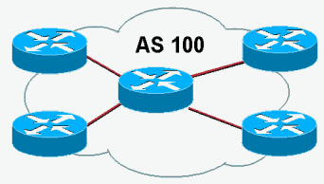
Autonomous System
Autonomous System (AS)
  Internet is organized into a collection of autonomous system
  An AS is a collection of networks with same routing policy
    Single routing protocol
    Normally administered by a single entity
      Corporation or university campus
    All depend on how you want to manage routing

Slide 6
Category of Routing Protocols – by AS
AS-AS communication
  Communications between routers in different AS
  Interdomain routing protocols
  Exterior gateway protocols (EGP)
  Ex:
    BGP (Border Gateway Protocol)
Inside AS communication
  Communication between routers in the same AS
  Intradomain routing protocols
  Interior gateway protocols (IGP)
  Ex:
    RIP (Routing Information Protocol)
    IGRP (Interior Gateway Routing Protocol)
    OSPF (Open Shortest Path First Protocol)

Slide 7

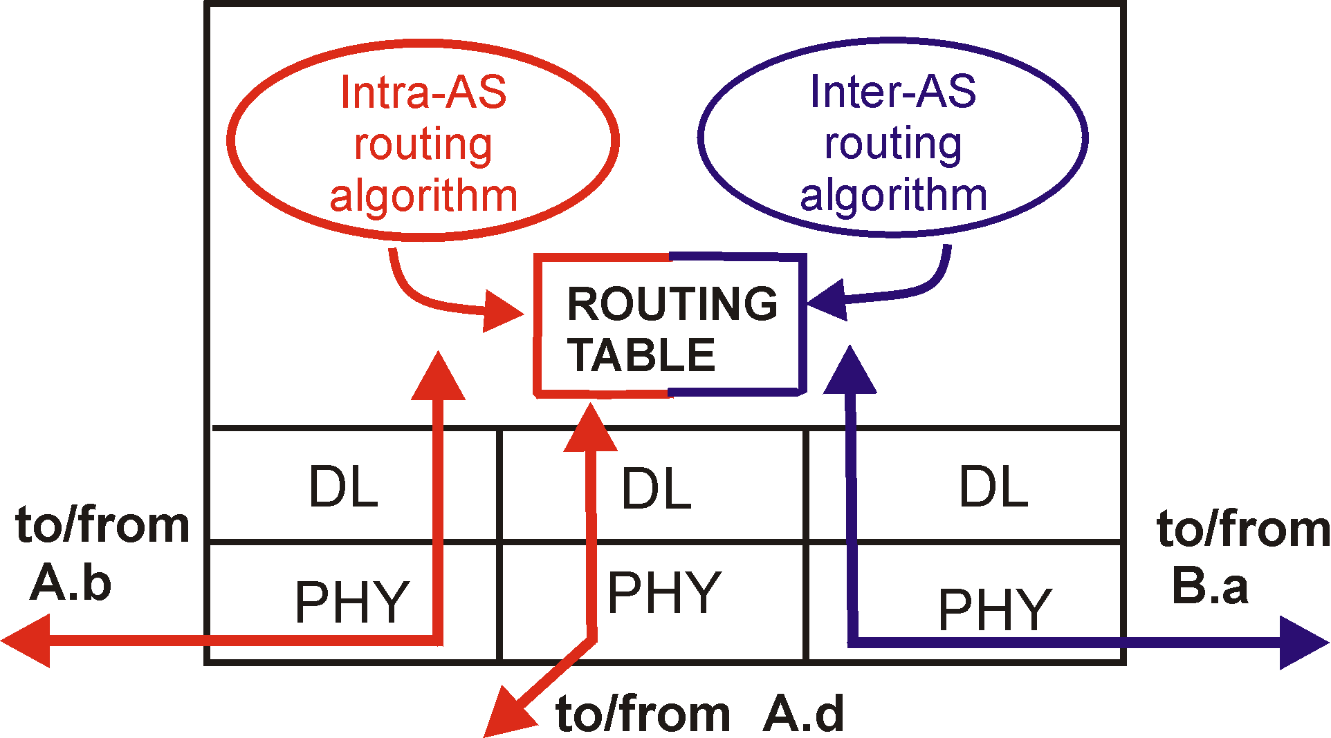
Intra-AS and Inter-AS routing
Inter-AS
routing
between
A and B
C.b
B.a
A.a
Host
h2
b
A.c
c
a
C
a
b
a
B
Host
h1
d
c
Intra-AS routing
within AS B
A
b
Intra-AS routing
within AS A
network layer
inter-AS, intra-AS routing in
gateway A.c
link layer
physical layer

Slide 8
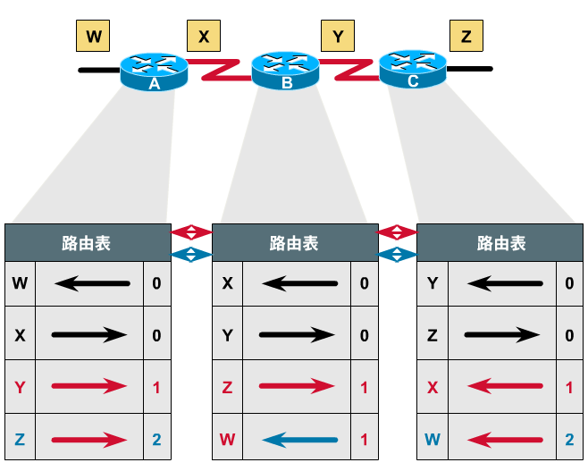
Category of Routing Protocols – by information changed (1)
Distance-Vector Protocol
  Message contains a vector of distances, which is the cost to other network
  Each router updates its routing table based on these messages received from neighbors
  Protocols:
    RIP
    IGRP
    BGP

Slide 9
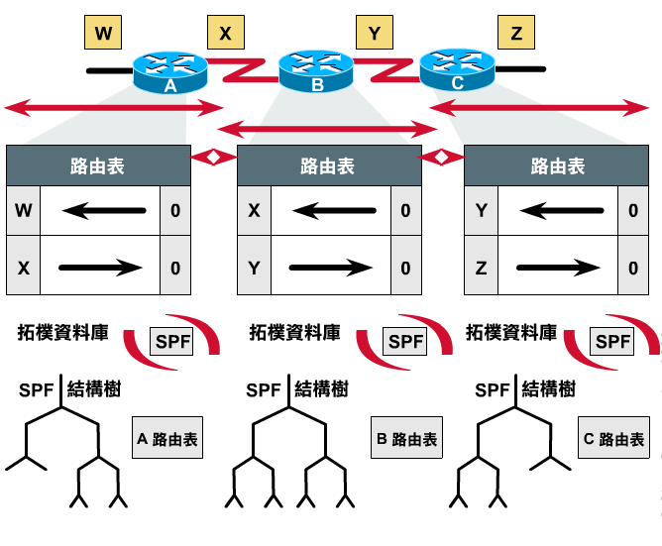
Category of Routing Protocols – by information changed (2)
Link-State Protocol
  Broadcast their link state to neighbors and build a complete network map at each router using Dijkstra algorithm
  Protocols:
    OSPF

Slide 10
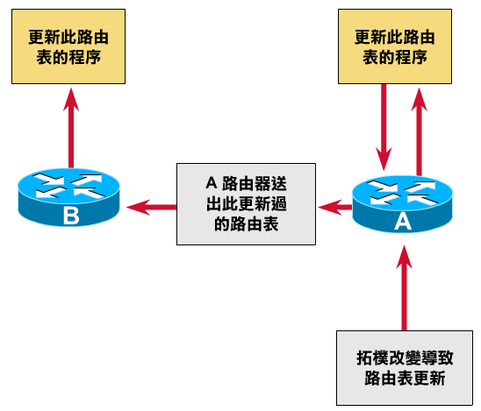
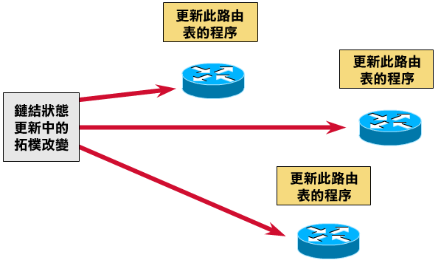
Difference between
Distance-Vector and Link-State
Difference
Information update sequence
 | Distance-Vector | Link-State
Update | updates neighbor (propagate new info.) | update all nodes
Convergence | Propagation delay cause slow convergence | Fast convergence
Complexity | simple | Complex
Link-State
Distance-Vector

Slide 11
Routing Protocols
        RIP IGP,DV
        IGRP IGP,DV
        OSPF IGP,LS
        BGP EGP

Slide 12
RIP
RIP
  Routing Information Protocol
Category
  Interior routing protocol
  Distance-vector routing protocol
    Using “hop-count” as the cost metric
Example of how RIP advertisements work
Destination network | Next router | # of hops to destination
1 | A | 2
20 | B | 2
30 | B | 7
Destination network | Next router | # of hops to destination
30 | C | 4
1 | -- | 1
10 | -- | 1
Destination network | Next router | # of hops to destination
1 | A | 2
20 | B | 2
30 | A | 5
Routing table in router before
Receiving advertisement
Advertisement from router A
Routing table after
receiving advertisement

Slide 13
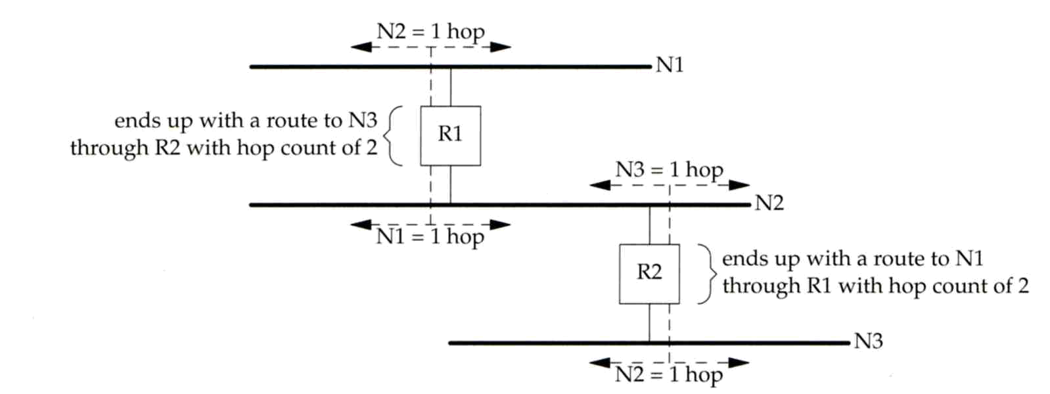
RIP
– Example
Another example

Slide 14
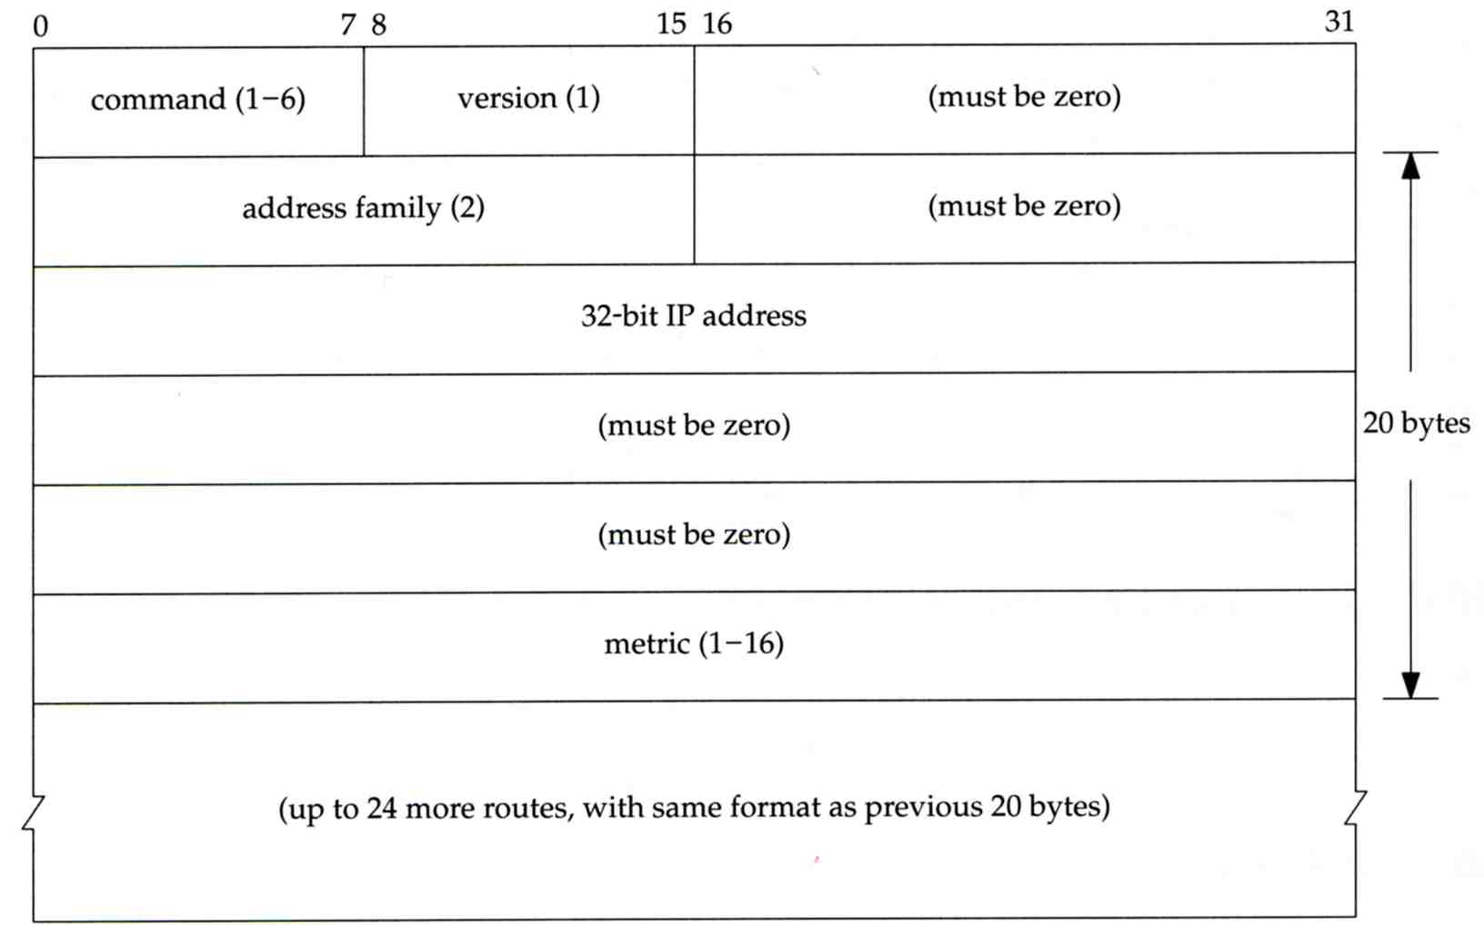
RIP
– Message Format
RIP message is carried in UDP datagram
  Command: 1 for request and 2 for reply
  Version: 1 or 2 (RIP-2)
20 bytes per
route entry

Slide 15
RIP
– Operation
routed – RIP routing daemon
  Operated in UDP port 520
Operation
  Initialization
    Probe each interface
    send a request packet out each interface, asking for other router’s complete routing table
  Request received
    Send the entire routing table to the requestor
  Response received
    Add, modify, delete to update routing table
  Regular routing updates
    Router sends out their routing table to every neighbor every 30 minutes
  Triggered updates
    Whenever a route entry’s metric change, send out those changed part routing table

Slide 16
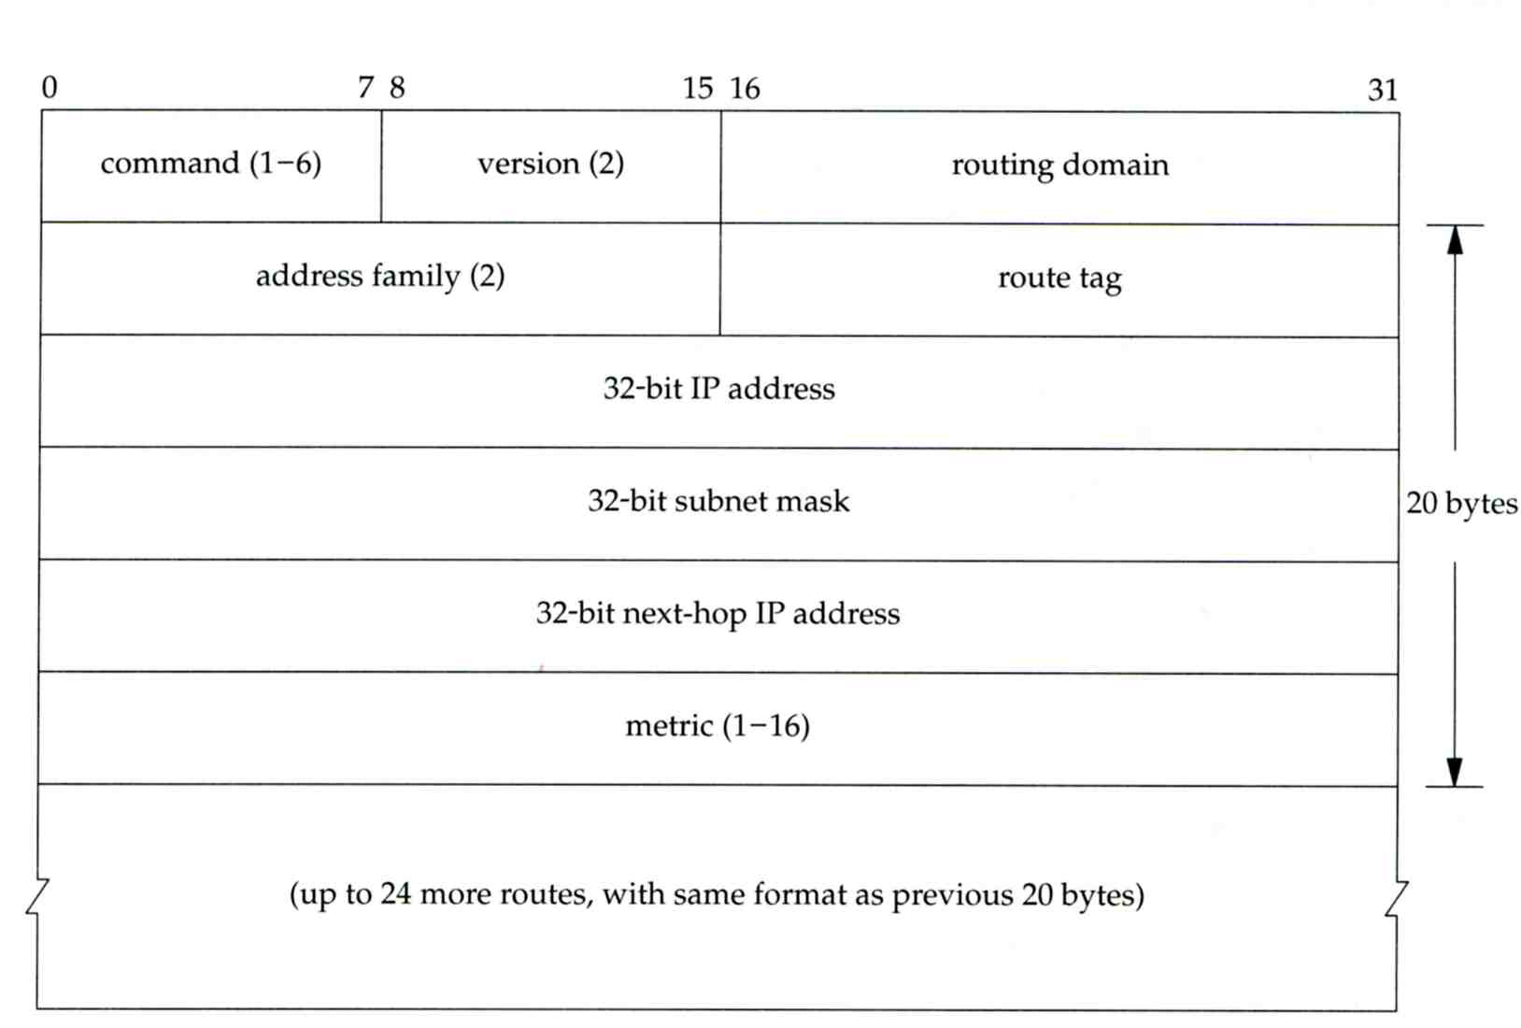
RIP
– Problems of RIP
Issues
  15 hop-count limits
  Take long time to stabilize after the failure of a router or link
  No CIDR
RIP-2
  EGP support
    AS number
  CIDR support

Slide 17
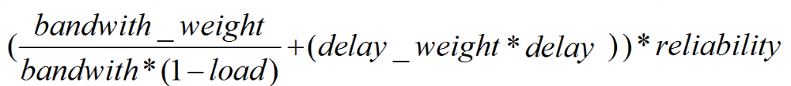
IGRP (1)
IGRP – Interior Gateway Routing Protocol
Similar to RIP
  Interior routing protocol
  Distance-vector routing protocol
Difference between RIP
  Complex cost metric other than hop count
    delay time, bandwidth, load, reliability
    The formula
  Use TCP to communicate routing information
  Cisco System’s proprietary routing protocol

Slide 18
IGRP (2)
Advantage over RIP
  Control over metrics
Disadvantage
  Still classful and has propagation delay

Slide 19
OSPF (1)
OSPF
  Open Shortest Path First
Category
  Interior routing protocol
  Link-State protocol
Each interface is associated with a cost
  Generally assigned manually
  The sum of all costs along a path is the metric for that path
Neighbor information is broadcast to all routers
  Each router will construct a map of network topology
  Each router run Dijkstra algorithm to construct the shortest path tree to each routers

Slide 20
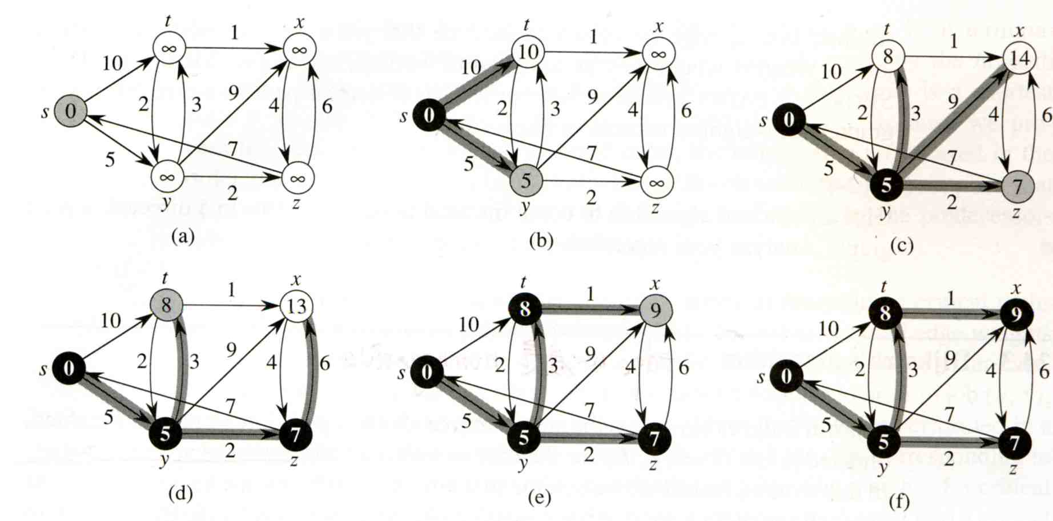
OSPF
– Dijkstra Algorithm
Single Source Shortest Path Problem
  Dijkstra algorithm use “greedy” strategy
  Ex:

Slide 21
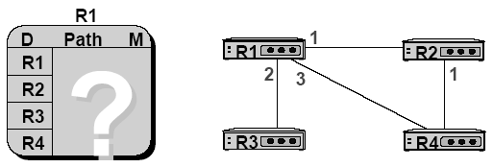
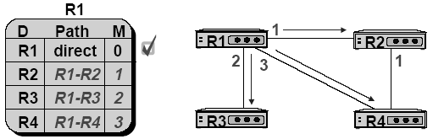
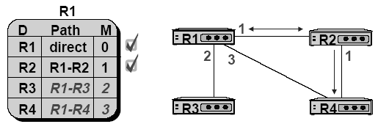
OSPF
– Routing table update example (1)

Slide 22
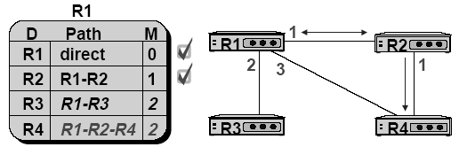
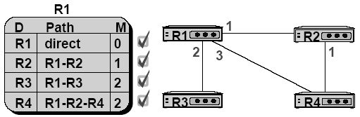
OSPF
– Routing table update example (2)

Slide 23
OSPF
– Summary
Advantage
  Fast convergence
  CIDR support
  Multiple routing table entries for single destination, each for one type-of-service
    Load balancing when cost are equal among several routes
Disadvantage
  Large computation

Slide 24
BGP
BGP
  Border Gateway Protocol
Exterior routing protocol
  Now BGP-4
  Exchange network reachability information with other BGP systems
Routing information exchange
  Message:
    Full path of autonomous systems that traffic must transit to reach destination
    Can maintain multiple route for a single destination
  Exchange method
    Using TCP
    Initial: entire routing table
    Subsequent update: only sent when necessary
    Advertise only optimal path
Route selection
  Shortest AS path

Slide 25
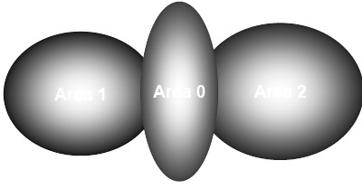
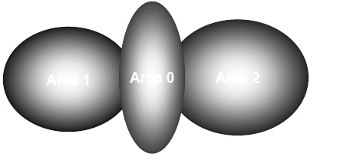
BGP
– Operation Example
How BGP work
  The whole Internet is a graph of autonomous systems
  X→Z
    Original: X→A→B→C→Z
    X advertise this best path to his neighbor W
  W→Z
    W→X→A→B→C→Z
W
X
Z

Slide 26
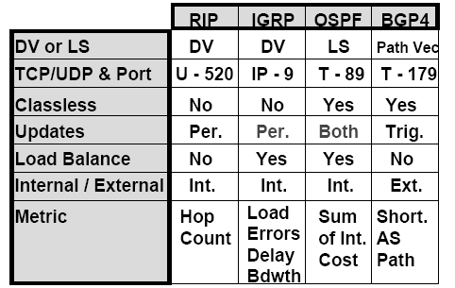
Routing Protocols Comparison
Notes:
Updates
Per. Periodic updates
Trig. Occurred based on information change
Load Balance
Multiple path & balance between equal-cost routes

Slide 27
routed

Slide 28

routed
Routing daemon
  Speak RIP (v1 and v2)
  Supplied with most every version of UNIX
  Two modes
    Server mode (-s) & Quiet mode (-q)
    Both listen for broadcast, but server will distribute their information
  routed will add its discovered routes to kernel’s routing table
  Support configuration file - /etc/gateways
    Provide static information for initial routing table

