Slide 1
Network Administration
Homework 1
2012 Perl Scripts

Slide 2
Outline
Part 1: Log parsing (40%+10%)
Part 2: Plurk Bot (50%+10%)

Slide 3
Part 1: Log Parsing – (1)
Write a perl program to parse log for ssh bruteforce
Print the Users and times descending
Syntax
  logparser.pl [-wur] [ -h host | -n # | -t # -g filename] [file …]
    -w mark the user exists in your system
    -u sort by username
    -r sort in reverse order
    -h show only the user attack from the host
    -n show only the user of the most #-th times
    -t show only the # user of the most attacking times
    -g output the graphic instead of text
    files log file(s), if none, read from standard input
    -? You can design any other fancy, fun(ny), or useful functionalitie

Slide 4
Part 1: Log Parsing – (2)
SSH bruteforce log
  Only parse these four (plus one) formats
    Sep 1 15:46:39 NetAdm sshd[65884]: error: PAM: authentication error for illegal user yabc from
    140.113.235.102
    Sep 1 17:56:58 NetAdm sshd[86323]: error: PAM: authentication error for illegal user pabcd from
    140.113.235.102
    Sep 6 01:04:07 NetAdm sshd[28362]: error: PAM: authentication error for root from 60.29.39.243
    Sep 6 01:04:08 NetAdm sshd[2874]: error: PAM: authentication error for root from 60.29.39.243
    Sep 6 01:11:36 NetAdm sshd[71712]: Failed keyboard-interactive/pam for invalid user bart from
    60.29.39.243 port 1625 ssh2
    Sep 6 01:11:39 NetAdm sshd[20535]: Failed keyboard-interactive/pam for invalid user bash from
    60.29.39.243 port 1782 ssh2
    Sep 6 01:21:25 NetAdm last message repeated 21 times
    Sep 9 00:06:55 NetAdm sshd[2726]: Invalid user edu29 from 140.127.112.188
    Sep 9 00:06:55 NetAdm sshd[4556]: Invalid user edu04 from 140.127.112.188
    Sep 9 00:06:55 NetAdm sshd[187]: Invalid user edu05 from 140.127.112.188

Slide 5
Part 1: Log Parsing – (3)
Hints
  Perl Regular Expression
  Hash
  Sorting
  p5-GD
  Getopt::Std
  …

Slide 6
Part 2: Plurk Bot
Bot must reply the msg beginning with
  %Dict%: string
  %Find%: userid,keyword
%Dict%: apple
  Reply the meaning of “apple” in Chinese
%Find%: userid,apple
  Reply the url of jeffxx's talks that contain 'apple'

Slide 7
Part 2: Plurk Bot – (2)
%Dict%:
  Use ydict’s output to reply
  Only show chinese , no english
  Reply Each type

Slide 8
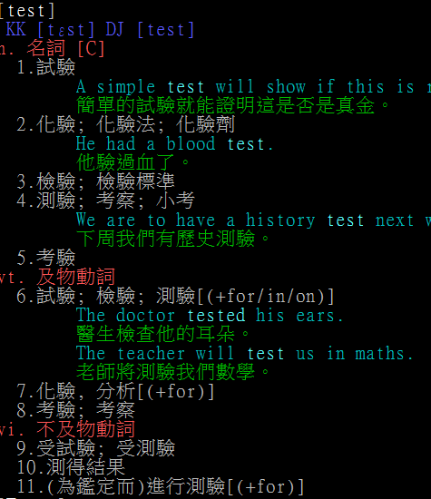
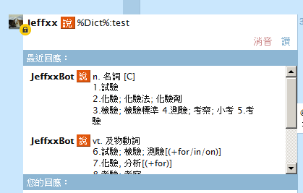

Slide 9
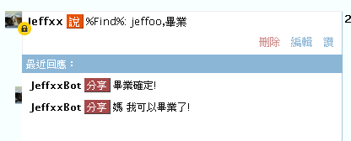
Part 2: Plurk Bot – (3)
%Find%:
  Search the user’s timeline ,reply the message containing keyword.
  Only Need Search 50 Public plurks .
Notes:
只需要搜尋機器人有權限看的

Slide 10
Part 2: Plurk Bot – (4)
Something Useful
  http://www.plurk.com/API
  http://blog.urdada.net/2011/10/28/426/
  /usr/ports/chinese/ydict
  …

