Slide 1
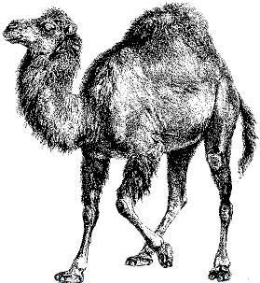
Perl Programming

Slide 2
Slides Contents
Introduction
Data Types
  Scalar
  List, Array and Hash
  More on variables
Flow Control
Subroutine
Basic I/O
File Handle
Regular Expression
Sorting
CPAN
Complex Data Structure
Reference Reading
Appendix

Slide 3
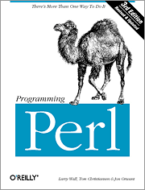
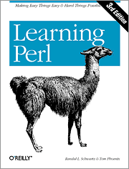

Introduction
There’s More Than One Way To Do It
Making Easy Things Easy and Hard Things Possible
Notes:
Perl Poetry:
http://www.perlmonks.org/index.pl?node=Perl%20Poetry

Slide 4

Introduction (1)
Scripting language
  Perl、Python、Ruby、PHP(?)、…
PERL
  Practical Extraction and Report Language
  Created by Larry Wall and first released in 1987
Useful in
  Text manipulation
  Web development
  Network programming
  GUI development
  System Prototyping
  anything to replace C, shell, or whatever you like
Notes:
PEARL was used by another language
http://news.ols3.net/techdoc/old/perl_intro/

Slide 5
Introduction (2)
Built-in in most unix-like operation systems, but…
  /usr/ports/lang/perl5.{12,14}
Compiled and interpreted
  Efficient
Syntax Sugar
  die unless $a == $b;
Modules
  Object oriented
  CPAN
Perl6
  http://dev.perl.org/perl6/
  Pugs – http://www.pugscode.org/
  Parrot – http://www.parrotcode.org/ (/usr/ports/lang/parrot)

Slide 6
Introduction－Hello World (1)
#!/usr/bin/perl
#!/usr/bin/perl
use warnings;
use strict;
# My First Perl Program
print “Hello”, “ world!\n”; # Comments
  The location of perl
  interpreter
  Enable all warnings
  It is nice to be
  Comment, to the end of line
  Built-in function for output to STDOUT
C-like “;” termination
use warnings;
use strict;
# My First Perl Program
print “Hello”, “ world!\n”; # Comments

Slide 7
Introduction－Hello World (2)
name.pl
scalar variable = <STDIN>
  Read ONE line from standard input
chomp
  Remove trailing “\n” if exists
Variables are global unless otherwise stated
Run Perl Program
$name = <STDIN>;
chomp $name;
chomp is not pass by value
#!/usr/bin/perl
print “What is your name? ”;
chomp($name = <STDIN>);
print(“Hello, $name!\n”);
Value interpolation into string
% perl name.pl (even no +x mode or perl indicator)
% ./name.pl (Need +x mode and perl indicator)

Slide 8
Scalar Data
1 + 1 == 10

Slide 9
Scalar Data (1)－Types
Use prefix ‘$’ in the variable name of a scalar data
  $scalar_value
Numerical literals
  Perl manipulates numbers as double-decision float point values
  Float / Integer constants, such as:
    12, -8, 1.25, -6.8, 6.23e23, 0377, 0xff, 0b00101100
Strings
  Sequence of characters
  Single-Quoted Strings (No interpolation)
    ‘$a\n is printed as is’, ‘don\’t’
  Double-Quoted Strings (With interpolation)
    “$a will be replaced by its value.\n”
    Escape characters
      \a, \b, \n, \r, \t

Slide 10
Scalar Data (2)－Operators
Operators for Numbers
  Arithmetic
    +, -, *, /, %, **
  Numerical comparison
    <, <=, ==, >=, >, !=
Operators for Strings
  Concatenation “.”
    “Hello” . “ ” . “world!” ➔ “Hello world!”
  Repetition “x”
    “abc” x 4 ➔ “abcabcabcabc”
  Comparison
    lt, le, eq, ge, gt, ne
perlop(1)

Slide 11
Scalar Data (3)－Assignments
Operators for assignment
  Ordinary assignment
    $a = 17
    $b = “abc”
  Short-cut assignment operators
    Number: +=, -=, *=, /=, %=, **=
    String: .=, x=
      $str .= “.dat” ➔$str = $str . “.dat”
  Auto-increment and auto-decrement
    $a++, ++$a, $a--, --$a

Slide 12
Scalar Data (4)－Conversion
Implicit conversion depending on the context
  Number wanted? ( 3 + “15” )
    Automatically convert to equivalent numeric value
    Trailing nonnumeric are ignored
      “123.45abc” ➔ 123.45
  String wanted?
    Automatically convert to equivalent string
    “x” . (4 * 5) ➔”x20”

Slide 13
Scalar Data (5)－String Related Functions
Find a sub-string
  index(original-str, sub-str [,start position])
Sub-string
  substr(string, start, length)
Formatting data
  sprintf (C-like sprintf)
perlfunc(1)
  $ perldoc -f index
index(“a very long string”, “long”); # 7
index(“a very long string”, “lame”); # -1
index(“hello world”, “o”, 5); # 7
index(“hello world”, “o”, 8); # -1
substr(“a very long string”, 3, 2); # “er”
substr(“a very long string”, -3, 3); # “ing”

Slide 14
List, Array, and Hash

Slide 15
List
Ordered scalars
List literal
  Comma-separated values
  Ex:
    (1, 2, 3, 4, 5)
    ($a, 8, 9, “hello”)
    ($a, $b, $c) = (1, 2, 3)
    ($a, $b) = ($b, $a) ➔ swap
List constructor
  Ex:
    (1 .. 5) ➔ (1,2,3,4,5)
    (“a” .. “z”) (“a” .. “A”) ➔ (a,b,c,d,e,…,z)
    (1.3 .. 3.1) (1.1 .. 3.1) ➔ (1,2,3)
    (3 .. 1) ➔ ()
    (“aa” .. “ag”) ➔ (aa, ab, ac, ad, ae, af, ag)
    (“aa” .. “aZ”) (“a” .. “ZZ”) ➔ …
    ($a .. $b) ➔ depend on values of $a and $b

Slide 16
Array (1)
An indexed list, for random access
Use prefix ‘@’ in the variable name of an array
  @ary = (“a”, “b”, “c”)
  @ary = qw(a b c)
  @ary2 = @ary
  @ary3 = (4.5, @ary2, 6.7) ➔ (4.5, “a”, “b”, “c”, 6.7)
  $ary3[-1] ➔ The last element of @ary3
  $ary3[$#ary3] ➔ $#ary3 is the last index
  ($d, @ary4) = ($a, $b, $c) ➔ $d = $a, @ary4 = ($b, $c)
  ($e, @ary5) = @ary4 ➔ $e = $b, @ary5 = ($c)
  $count = @ary3 ➔ 5, scalar context returns the length of an array
  ($count) = @ary3 ➔ $count = 4.5, the 1st element of @ary3
  (@a, @b) = (@b, @a) ➔ @a = (@b, @a), @b = ()

Slide 17
Array (2)
Slice of array
  Still an array, use prefix ‘@’
  Ex:
    @a[3] = (2)
    @a[0,1] = (3, 5)
    @a[1,2] = @a[0,1]
Beyond the index
  Access will get “undef”
    @ary = (3, 4, 5)
    $a = $ary[8]
  Assignment will extend the array
    @ary = (3, 4, 5)
    $ary[5] = “hi” ➔ @ary = (3, 4, 5, undef, undef, “hi”)

Slide 18
Array (3)
Interpolation by inserting whitespace
  @ary = (“a”, “bb”, “ccc”, 1, 2, 3)
  $all = “Now for @ary here!”
    “Now for a bb ccc 1 2 3 here!”
  $all = “Now for @ary[2,3] here!”
    “Now for ccc 1 here!”
Array context for file input
  @ary = <STDIN>
    Read multiple lines from STDIN, each element contains one line, until the end of file.
  print @ary ➔ Print the whole elements of @ary
  without whitespace inserted
  print “@ary” ➔ with whitespace inserted

Slide 19
Array (4)
Initially, @a = (1, 2);
Array operations
  Push, pop and shift
    Use array as a stack
      push @a, 3, 4, 5 ➔ @a = (1, 2, 3, 4, 5)
      $top = pop @a ➔ $top = 5, @a = (1, 2, 3, 4)
    As a queue
      $a = shift @a ➔ $a = 1, @a = (2, 3, 4)
  Reverse list
    Reverse the order of the elements
      @a = reverse @a ➔ @a = (4, 3, 2)
  Sort list
    Sort elements as strings in ascending ASCII order
      @a = (1, 2, 4, 8, 16, 32, 64)
      @a = sort @a ➔ (1, 16, 2, 32, 4, 64, 8)
  Join list
      @a=(1,2,3); $b = join ":", @a ➔ $b = “1:2:3”

Slide 20
Hash (1)
Collation of scalar data
  An array whose elements are in <key, value> orders
  Key is a string index, value is any scalar data
  Use prefix “%” in the variable name of a hash
  Ex:
    %age = (john => 20, mary => 30, ); ➔ same as (“john”, 20, “mary”, 30)
    $age{john} = 21; ➔ “john” => 21
    %age = qw(john 20 mary 30)
    print “$age{john} \n”

Slide 21
Hash (2)
Hash operations
  keys
    Yield a list of all current keys in hash
      keys %age ➔ (“john”, “mary”)
  values
    Yield a list of all current values in hash
      values %age ➔ (20, 30)
  each
    Return key-value pair until all elements have been accessed
      each(%age) ➔ (“john”, 20)
      each(%age) ➔ (“mary”, 30)
  delete
    Remove hash element
      delete $age{“john”} ➔ %age = (mary => 30)
%age = (john => 20, mary => 30, );

Slide 22
More on Variables

Slide 23
More on Variables (1)－undef
Scalar data can be set to undef
  $a = undef
  $ary[2] = undef
  $h{“aaa”} = undef
  undef is convert to 0 in numeric, or empty string “” in string
You can do undef on variables
  undef $a ➔ $a = undef
  undef @ary ➔ @ary = empty list ()
  undef %h ➔ %h has no <key, value> pairs
Test whether a variable is defined
  if (defined $var) {…}

Slide 24
More on Variables (2)－use strict
#!/usr/bin/perl
use warnings;
use strict;
“use strict” contains
  use strict vars
    Need variable declaration, prevent from typo
  use strict subs
  use strict refs
    perlreftut(1)
“no strict” to close the function
Use “use warnings” pragma to enable warnings
  Variables without initialized occur warnings
  “use diagnostics;” can produce verbose warning diagnostics
use strict;
my ($x); # Use ‘my’ to declaration
use vars qw($y) # Use ‘use vars’ to declaration

Slide 25
Predefined variables
  $_ ➔ default input and pattern-searching space
  $, ➔ output field separator for print
  $/ ➔ input record separator (default: newline)
  $$ ➔ pid
  $< ➔ uid
  $> ➔ euid
  $0 ➔ program name (like $0 in shell-script)
  $! ➔ errno, or the error string corresponding to the errno
  %ENV ➔ Current environment variables (Appendix)
  %SIG ➔ signal handlers for signals (Appendix)
  @ARGV ➔ command line arguments (1st argument in $ARGV[0])
  $ARGV ➔ current filename when reading from <> (Basic I/O)
  @_ ➔ parameter list (subroutines)
  STDIN, STDOUT, STDERR ➔ file handler names

Slide 26
Flow Control

Slide 27
Branches－if / unless
True and False
  0, “0”, “”, or undef are false, others are true
  “00”, “0.00” are true, but 00, 0.00 are false
if-elsif-else
unless: short cut for if (! ….)
print “Good-bye” if $gameOver;
Keep_shopping() unless $money == 0;
if( $state == 0 ) {
statement_1; statement_2; …; statement_n
} elsif( $state == 1 ) {
statements;
} else {
statements;
}
unless( $weather eq “rain” ) {
go-home;
}
if( ! $weather eq “rain” ) {
go-home;
}

Slide 28
Relational Operators
if ($a == 1 && $b == 2) {…}
if ($a == 1 || $b == 2) {…}
if ($a == 1 && (! $b == 2)){…}
if (not ($a == 1 and $b == 2) or ($c == 3)) {…}
  not > and > or
|| > = > or
  $a = $ARGV[0] || 40; ➔ if $ARGV[0] is false, then $a = 40
  $a = $ARGV[0] or 40; ➔ $a = $ARGV[0]
open XX, “file” or die “open file failure!”;
  or can be used for statement short-cut.
perlop(1)

Slide 29
Flow Control －while / until
while and do-while
until and do-until
  until (…) = while (! …)
$a = 10; while ( $a ) { print “$a\n”; --$a }
$a = 10; print “$a\n” and --$a while $a ;
do {
statements-of-true-part;
} while (condition);
$a = 10; until ($a == 0) { print “$a\n”; --$a }
do {
statements-of-false-part;
} until (expression);

Slide 30
Flow Control －for / foreach
@a = (1, 2, 3, 4, 5)
for
foreach
  For example:
  The "foreach" keyword is actually a synonym for the "for" keyword
for (my $i = 0; $i <= $#a; ++$i) {
print “$a[$i]\n”;
}
%age = (john => 20, mary => 30, );
foreach $name (keys %age) {
print “$name is $age{$name} years old.\n”;
}
foreach (keys %age) {
print “$_ is $age{$_} years old.\n”;
}

Slide 31
Flow Control －last, next, redo
Loop-control
  last
    Like C “break”
  next
    Like C “continue”
  redo
    Jump to the beginning of the current loop block without revaluating the control expression
    Ex:
for($i=0;$i<10;$i++) { # infinite loop
if($i == 1) {
redo;
}
}

Slide 32
Flow Control －Labeled Block
Give name to block to archive “goto” purpose
Use last, next, redo to goto any labeled block
Example:
1 1 1
1 1 2
1 1 3
1 2 1
1 2 2
1 2 3
2 1 1
2 1 2
2 1 3
2 2 1
2 2 2
2 2 3
2 3 1
3 1 1
3 1 2
3 2 1
…
LAB1: for($i=1;$i<=3;$i++) {
LAB2: for($j=1;$j<=3;$j++) {
LAB3: for($k=1;$k<=3;$k++) {
print “$i $j $k\n”;
if(($i==1)&&($j==2)&&($k==3)) {last LAB2;}
if(($i==2)&&($j==3)&&($k==1)) {next LAB1;}
if(($i==3)&&($j==1)&&($k==2)) {next LAB2;}
}
}
}

Slide 33
Subroutine

Slide 34
Subroutine (1)
Definition
Return value
  Either single scalar value or a list value
Arguments
  @_ contains the subroutine’s invocation arguments, and is private to the subroutine
  $_[0], $_[1], …, $[$#_] to access individual arguments
  Pass by value
  perlsub(1): Pass by Reference
sub max {
my ($a, $b) = @_;
return $a if $a > $b;
$b;
}
print &max (20, 8);
The value of the last statement will be returned

Slide 35
Subroutine (2)
Variables in subroutine
  Private variables
    Use “my” operator to create a list of private variables
  Semi-private variables
    Private, but visible within any subroutines calls in the same block
    Use “local” to create a list of semi-private variables
sub add;
sub rev2 {
local($::n1, $::n2) = @_;
my ($n3) = add;
return ($::n2, $::n1, $n3);
}
sub add {
return ($::n1 + $::n2);
}

Slide 36
Subroutine (3)
To call subroutines
  NAME(LIST);
    & is optional with parentheses.
  NAME LIST;
    Parentheses optional if predeclared/imported.
  &NAME(LIST);
    Circumvent prototypes.
  &NAME;
    Makes current @_ visible to called subroutine.
  NAME;
    Like NAME() iff sub foo pre-declared, else “NAME"

Slide 37
Input/Output
Standard I/O
File I/O

Slide 38
Basic I/O (1)－Input
Using <STDIN>
  In scalar context, return the next line or undef
  In list context, return all remaining lines as a list, end by EOF
    Including array and hash
while( $line = <STDIN>) {
# process $line
}
while(<STDIN>) {
# process $_
}

Slide 39
Basic I/O (2)－Output
print LIST
  Take a list of strings and send each string to STDOUT in turn
  A list of strings are separated by $, ($, = “ ”)
    Ex:
      print(“hello”, $abc, “world\n”);
      print “hello”, $abc, “world\n”;
      print “hello $abc world\n”;
printf
  C-like printf
    printf “%15s, %5d, %20.2f”, $name, $int, $float;

Slide 40
File (1)－open and close
Automatically opened file handlers
  STDIN, STDOUT, STDERR
Open
Open with status checked
Use <FILEHD> to read from file handlers, just like <STDIN>
Output ex:
open FILEHD, “<”, “filename”; # open for read
open FILEHD, “>”, “filename”; # open for write
open FILEHD, “>>”, “filename”; # open for append
open(FILEHD, “<”, “filename”) || die “error-message: $!”;
open FILEHD, “<”, “filename” or die “error-message: $!”;
open FH, “>>”, “file”;
print FH ”abc”; # output “abc” to file handler FH
close FH; # close file handler

Slide 41
File (2)
Open with redirection
  Open with redirection for read
  Open with redirection for write
    After the file handler closed, start the redirection.
Directory
  chdir function
  Globbing (Do the same as csh)
open FD, “-|”, “who”;
open FD, “|-”, “mail –s \“Test Mail\” liuyh@cs.nctu.edu.tw”;
close FD;
chdir(“/home”) || die “cannot cd to /home ($!)”;
@a = </etc/host*>;
@b = glob(“/etc/host*”); # @a = @b

Slide 42
File (3)－File and Directory Manipulation
unlink(filename-list) ➔ remove files
rename(old-filename, new-filename) ➔ rename a file
Create a link
  link(origin, link-file) ➔ create a hard link
  symlink(origin, link-file) ➔ create a symbolic link
mkdir(dirname, mode) ➔ create a directory
rmdir(dirname) ➔ remove a directory
chmod(mode, filename) ➔ change file modes
chown(UID, GID, filename) ➔ change ownership
unlink(“data1.dat”, “hello.pl”);
unlink(“*.o”);
mkdir(“test”, 0777);

Slide 43
File Handler
An interface to file access
File handler in C
File handler in Perl
File Name
Read, write
User
File Handler
Access Mode
Flags
FILE *fp = fopen("count.dat","r");
fgets(numb, 8, fp);
open FH, “<“, “count.dat” or die “open file failure: $!”;
$numb = <FH>;

Slide 44
File Handler: <>
while (<>) { print }
Using diamond operator <>
  Get data from files specified on the command line
    $ARGV records the current filename
    @ARGV shifts left to remove the current filename
  Otherwise read from STDIN
while (<FH>) { print }
  Read from file handler FH

Slide 45
Regular Expression
String pattern matching & substitution

Slide 46
Regular Expression
String pattern
  What is the common characteristic of the following set of strings?
  {goodboy, goodgirl, badboy, goodbadgirl, goodbadbadboy, …}
  Basic regex: R₁ = “good”, R₂ = “bad” , R₃ = “boy” , R₄ = “girl”
If R_{x} and R_{y} are regular expressions, so are the following
  (R_{x} or R_{y})
      R₅= (R₁ or R₂) gives {good, bad}
      R₆= (R₃ or R₄) gives {boy, girl}
  (R_{x} . R_{y})➔ R₇ =(R₅ . R₆) gives {goodboy, goodgirl, badboy, badgirl}
  (R_{x}* ) : repeat R_{x} as many times as you want, including 0 times
      R₈ =R₅* gives {good, bad, goodgood, goodbad, badgood, badbad, …}
Our final pattern is: (“good” or “bad”)* . (“boy” or “girl”)
Regular expressions can be recognized very efficiently

Slide 47
Regular Expression in Perl (1)
if ($string =~ /(good|bad)*(boy|girl)/) {…}
  Return true if any substring of $string matches
  /^hello$/ will match the entire string
  if (/xxxxx/) {…} matches $_
Match single character
  /a/, /./, /[abc]/, /[0-9]/, /[a-zA-Z0-9]/, /[^0-9]/, /[abc\]]/
  Predefined character class abbreviations
    digit
      \d ➔ [0-9] \D ➔ [^0-9]
    word
      \w ➔ [a-zA-Z0-9_] \W ➔ [^a-zA-Z0-9_]
    whitespace
      \s ➔ [ \r\t\n\f] \S ➔ [^ \r\t\n\f]

Slide 48
Regular Expression in Perl (2)
Match more than one character
  Multipliers
    {m,n} ➔ m ~ n times, inclusive
    * ➔ {0,}
    ? ➔ {0,1}
    + ➔ {1,}
    {m,} ➔ >=m times.
    {m} ➔ =m times.
/fo+ba?r/ # f, one or more o, b, optional a, r
/a.{5}b/ # a, any five non-newline char, b

Slide 49
Regular Expression in Perl (3)
Grouping sub-regex by (…)
  Besides matching, also remember the matched string for future reference
  \g1 refer to 1st grouping, \g2 for 2nd, …
  Ex:
    /a(.*)b\g1c/ # match aXYbXYc or abc, but not aXbc
$1, $2, $3, …
  The same value as \g1, \g2, \g3, but can be used outside /xxx/
  Ex:
$_ = “this is a test”;
/(\w+)\W+(\w+)/; # match first two words,
# $1 = “this”, $2 = “is”
print “$1, $2\n”;

Slide 50
Regular Expression in Perl (4)
$`, $&, $’
  Store before-matched, matched, after-matched strings
  Ex:
$_ = “this is a sample string”;
/sa.*le/; # $` = “this is a ”
# $& = “sample”
# $’ = “ string”

Slide 51
Regular Expression in Perl (5)－Substitution
Sed-like
  s/pattern/replacement/
Ex:
$_ = “foot fool buffoon”;
s/foo/bar/g; # $_ = “bart barl bufbarn”
$sc = “this is a test”;
$sc =~ s/(\w+) \g1/<$1>/g;
# $sc = “th<is> a test”
$war3 = “WAR War war”;
$war3 =~ s/war/peace/gi;
# $war3 = “peace peace peace”

Slide 52
Regular Expression in Perl (6)－Translation
tr/search-list/replacement-list/
  A little bit like tr command
Ex:
$t = “This is a secret”;
$t =~ tr/A-Za-z/N-ZA-Mn-za-m/;
# rotate right 13 encrypt
$r = “bookkeeper”;
$r =~ tr/a-zA-Z//s; # squash duplicate [a-zA-Z]
$a = “TTestt thiiis ccasse”;
$a =~ tr/Ttic/0123/s; # $e = “0es1 1h2s 3asse”
$n = “0123456789”;
$n =~ tr/0-9/987654/d;
# delete found but not given a replacement
# $n = “987654”
$n =~ tr/4-9/0-2/; # $n = “222210”

Slide 53
Regular Expression in Perl (7)
Related functions
  split(separator, string)
    You can specify the delimit as regular expression
    Unmatched string will form a list
    Ex:
$s = “sshd:*:22:22:ssh:/var/empty:/sbin/nologin”
@fields = split(/:/, $s);

Slide 54

Regular Expression Example –
Date Extraction
#!/usr/bin/perl
$date = `date`;
print "$date"; # 2012年 3月 7日 周三 11時17分03秒 CST
$date =~ /^(\d+)\D+(\d+)\D+(\d+)\S+\s+周(\S+)/;
%hash = (
year => $1, month => $2, day => $3, weekday => $4,
);
for (keys %hash) {
print "$_ => $hash{$_}\n";
}

Slide 55
Sort

Slide 56
Sort
# perldoc –f sort
Without any modification, sort is based on ASCII code
Sort by number, you can do the following
You can sort by specifying your own method, defined as subroutine, use $a, $b, and return negative, 0, and positive
@list = (1, 2, 4, 8, 16, 32);
@sorted = sort {$a <=> $b} @list;
sub by_number {
if($a < $b) {
return 1; # means changing to $b, $a
} elsif($a == $b) {
return 0; # means the same
} else {
return -1; # means remaining $a, $b
}
}

Slide 57
CPAN

Slide 58
CPAN (1)
Comprehensive Perl Archive Network
  http://www.cpan.org/
  http://search.cpan.org/
常用的五十個CPAN模組
  http://perl.hcchien.org/app_b.html
/usr/ports
  p5-*
    s/::/-/
  Use “psearch” to find them out
Contributing to CPAN
  http://www.cpan.org/misc/cpan-faq.html#How_contribute_scripts

Slide 59
CPAN (2)
Install CPAN
  Search the name of perl modules in CPAN
  The LWP::Simple is in the libwww module
  Use psearch “p5-<name>” to find the perl module in freebsd ports tree
  Install it
Use CPAN
  manual pages installed, you can use such as perldoc LWP::Simple
  When you search the module name, the results are the same as the manual page

Slide 60
CPAN (3)
A simple HTTP Proxy (with EVIL power!)
#!/usr/bin/perl
use HTTP::Proxy;
use HTTP::Recorder;
my $proxy = HTTP::Proxy->new();
# create a new HTTP::Recorder object
my $agent = new HTTP::Recorder;
# set the log file (optional)
$agent->file(“/tmp/myfile”);
# set HTTP::Recorder as the agent for the proxy
$proxy->agent($agent);
# start proxy
$proxy->start();

Slide 61
CPAN (4)
If you see similar errors on execution of perl…
  Your @INC is incorrect, or
  You need to install the required modules
We can install modules from command line tool
  cpan
Useful tool to install modules in CYGWIN

Slide 62
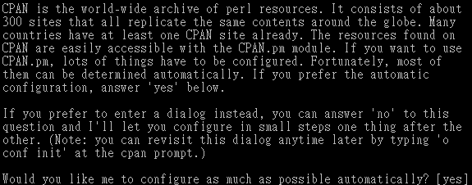
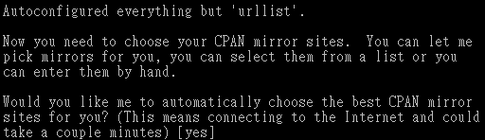
cpan tool – (1)
<Enter>
<Enter>

Slide 63
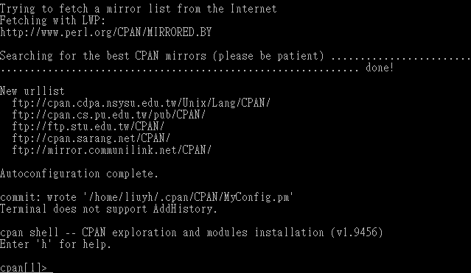
cpan tool – (2)

Slide 64
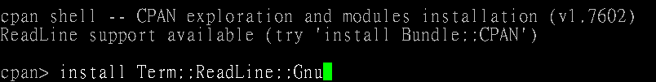
cpan tool – (3)
Install desired modules
  "q" to exit cpan shell

Slide 65
Complex Data Structure

Slide 66
Reference
Create reference: store address of a variable
  $scalarref = \$foo;
  $arrayref = \@ARGV;
  $hashref = \%ENV;
  $coderef = \&subroutine;
Use reference
  $bar = $$scalarref;
  push(@$arrayref, $filename);
  $$arrayref[0] = "January";
  $$hashref{"KEY"} = "VALUE";
  &$coderef(1,2,3);

Slide 67
Multi-Dimension Array
Anonymous array
  $arrayref = [1, 2, 3];
  $foo = $$arrayref[1];
2D array
  @a = ([1, 2], [3, 4, 5]);
  $a[0][1] == 2
  What if @a = ((1, 2), (3, 4, 5));
$arrayref = [1, 2, ['a', 'b', 'c']];
  $$arrayref[2][1] == ‘b’
  Another way to use reference by -> operator
  $arrayref -> [2] ->[1] == ‘b’
  $arrayref -> [2][1] == ‘b’ ➔ the 1st -> cannot be ignored
[0]
[1]
[2]
$a[0]
1
2
$a[1]
3
4
5

Slide 68
Anonymous Hash
$hashref = { john => 20, mary => 22};
  $$hashref{john} == 20
  $hashref->{john} == 20
%student = (
age => {john => 20, mary => 22},
ident => {john => 0, mary => 1},
NA_score => [ 99, 98 ],
);
$student{age}{john} == 20
$student{ident}{mary} == 1
$student{NA_score}[1] == 98

Slide 69
Anonymous Subroutine
$coderef = sub { print "Boink $_[0]!\n" };
&$coderef (“XD”);
$coderef->(“XD”);

Slide 70
Package – A Different Namespace
package main; # the default namespace
$life = 3;
package Mouse; # switch to our package
$life = 1;
package main; # switch back
print “$life\n”; # shows 3

Slide 71
Perl Object Usage
We have two files in the same directory
  main.pl ➔ The main script, will be run as ./main.pl
  Mouse.pm ➔ Definition of Mouse object
In main.pl,
#!/usr/bin/perl -w
use Mouse;
$mouse = new Mouse( “Mickey” );
$mouse -> speak;
print “Age: ”, $mouse->{age}, "\n";
Tell perl to load the object definition in Mouse.pm
Create new object instance and store the reference to this object in $mouse
2. Pass “Mickey” to the constructor “new”
Call method and pass $mouse as the 1st argument

Slide 72
Perl Object Definition: Mouse.pm
Class name used in creating object
package Mouse;
sub new {
my $class = shift;
my $self = { name => $_[0], age => 10, };
bless $self, $class;
}
sub speak {
my $self = shift;
print “My name is ”, $self->{name}, “\n”;
}
1;
Constructor
Data structure for this object
Associate the reference $self to the class Mouse, so we can
call methods of Mouse on this reference, eg. $self->speak
Return the blessed reference $self
Retrieve its object data
Perl module must return true at the end of script

Slide 73
Reference Reading

Slide 74
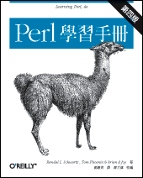
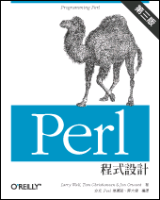

Reference (1)－Document
Book
  Learning Perl
  Programming Perl
  Perl 學習手札
Manual pages
perldoc
  perldoc –f PerlFunc
  perldoc –q FAQKeywords
  perldoc IO::Select
Webs
  http://perl.hcchien.org/TOC.html
  http://linux.tnc.edu.tw/techdoc/perl_intro/
  http://www.unix.org.ua/orelly/perl/sysadmin/

Slide 75
Reference (2)－manual pages
Man Page
  man perl
  man perlintro ➔ Perl introduction for beginners
  man perlrun ➔ Perl execution and options
  man perldata ➔ Perl data structures
  man perlop ➔ Perl operators and precedence
  man perlsub ➔ Perl subroutines
  man perlfunc ➔ Perl built-in functions
  man perlvar ➔ Perl predefined variables
  man perlsyn ➔ Perl syntax
  man perlre ➔ Perl regular expressions, the rest of the story
  man perlopentut ➔ Perl open() tutorial
  man perlform ➔ Perl formats

Slide 76
Reference (3)－perldoc
Autrijus 大師的話，說 perldoc 要照下列順序讀
  intro, toc, reftut, dsc, lol, requick, retut, boot, toot, tooc, boot, style, trap, debtut, faq[1-9]?, syn, data, op, sub, func, opentut, packtut, pod, podspec, run, diag, lexwarn, debug, var, re, ref, form, obj, tie, dbmfilter, ipc, fork, number, thrtut, othrtut, port, locale, uniintro, unicode, ebcdic, sec, mod, modlib, modstyle, modinstall, newmod, util, compile, filter, embed, debguts, xstut, xs, clib, guts, call, api, intern, iol, apio, hack.
  這樣讀完, 瞭解的會比 Programming Perl 要來得深入的多

Slide 77
Appendix

Slide 78
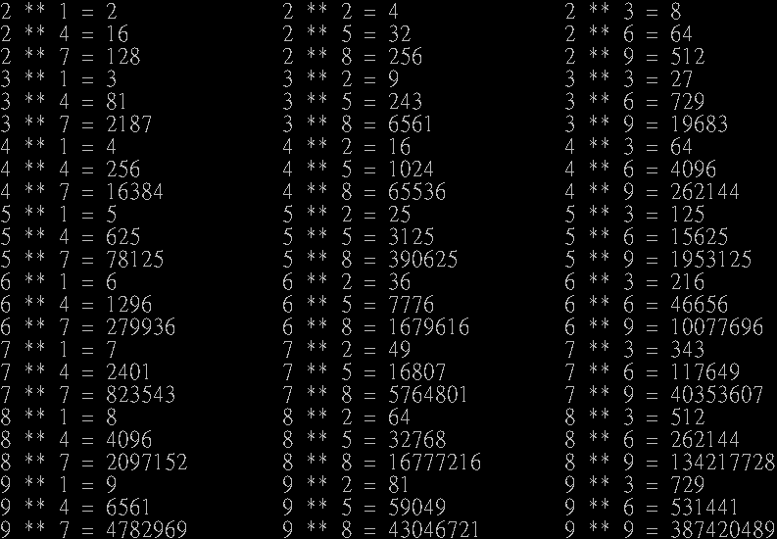

Appendix 1－One-Line Perl Execution

Slide 79
Appendix 2－Process
system() function
  system() will fork a /bin/sh shell to execute the command specified in the argument
  STDIN, STDOUT, and STDERR are inherited from the perl process
Backquote
  Execute the command and replace itself with execution result
fork()、exec() function
system(“date”);
system(“date ; who > $savehere”);
foreach $_ (`who`) {
($who, $where, $when) = /^(\S+)\s+(\S+)\s+(.*)$/;
print “$who on $where at $when”;
}

Slide 80
Appendix 3－Signals
Catch the signal in your program
  Using %SIG predefined hash
  Using signal name in signal(3) without prefix “SIG” as the key
    Ex: $SIG{‘INT’}, $SIG{‘TERM’}
  Set the value to “DEFAULT”, “IGNORE”, or your subroutine name
Sending the signal
  kill(signal, pid-list)
$SIG{‘TERM’} = ‘my_TERM_catcher’;
sub my_TERM_catcher {
print “I catch you!\n”;
}
kill(1, 234, 235); # or kill(‘HUP’, 234, 235);

Slide 81
Appendix 4－Built-in functions
perlfunc(1)
  Scalars
    chomp, chop, index, length, sprintf, substr, …
  Numeric
    abs, exp, log, hex, int, oct, rand, sin, cos, sqrt, …
  For @
    pop, push, shift, splice, unshift
  For %
    delete, each, exists, keys, values
  I/O
    open, close, read, write, print, printf, select, …
  Time-related
    gmtime, localtime, time, times
  Network
    bind, socket, accept, connect, listen, getsockopt, setsockopt, …
  User and group information
    getpwent, setpwent, getpwuid, getpwnam, getgrent, setgrent, …

Slide 82
Appendix 5－Feature
Starting from Perl 5.10, you can say
  use feature ":5.10";
    say
    switch
      given / when
    state
    unicode_strings
      starting with
      5.11.3.
      fully implemented
      5.13.8.
use feature ":5.10";
given($foo) {
when (undef) {
say '$foo is undefined';
}
when ("foo") {
say '$foo is the string "foo"';
}
when ([1,3,5,7,9]) {
say '$foo is an odd digit';
continue; # Fall through
}
when ($_ < 100) {
say '$foo is numerically less than 100';
}
default {
die q(I don't know what to do with $foo);
}
}

