Slide 1
Postfix

Slide 2
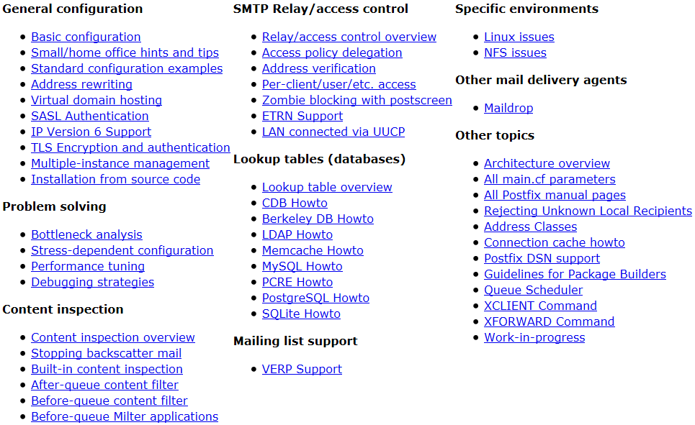
Postfix
Postfix v2.9.2
  /usr/ports/mail/postfix
http://www.postfix.org
  http://www.postfix.org/documentation.html

Slide 3
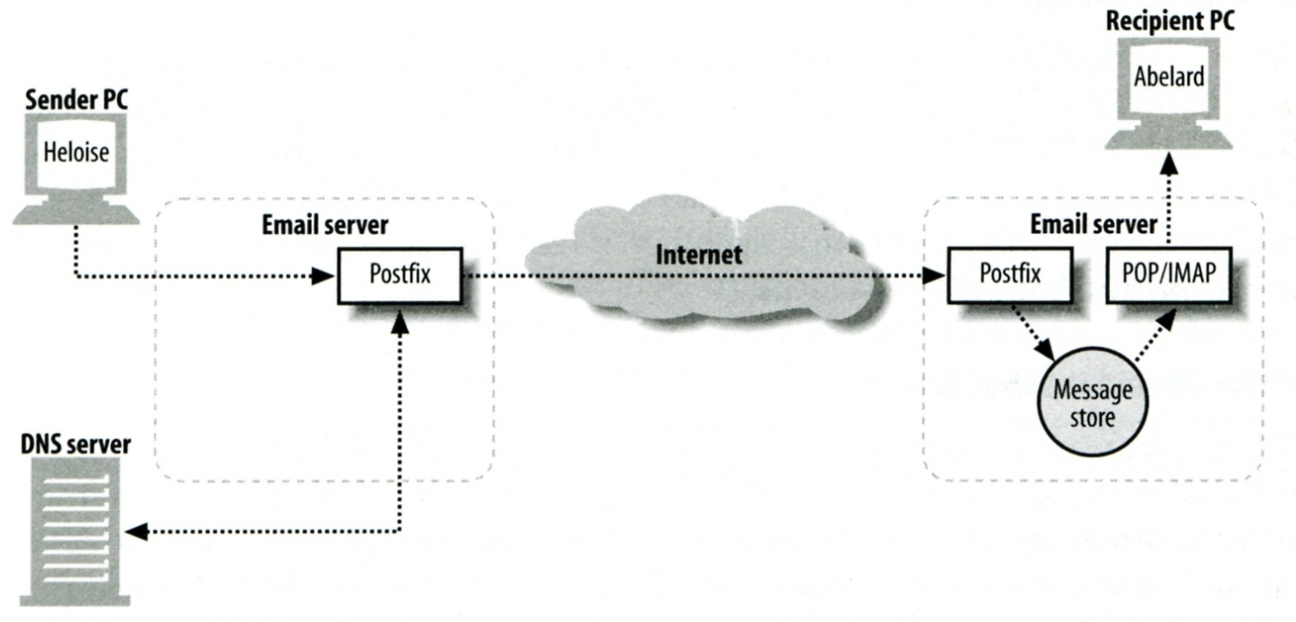
Role of Postfix
MTA that
  Receive and deliver email over the network via SMTP
  Local delivery directly or use other mail delivery agent
  http://www.postfix.org/OVERVIEW.html

Slide 4
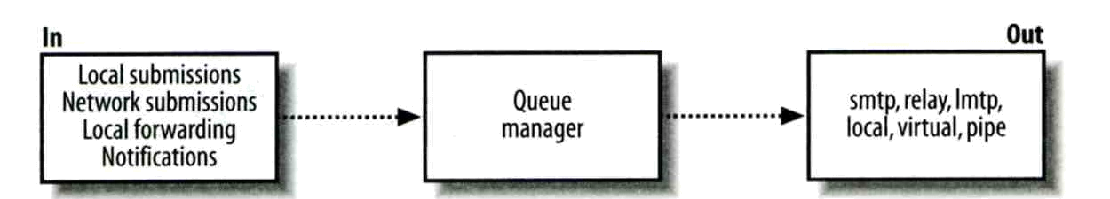
Postfix Architecture
Modular-design MTA
  Not like sendmail of monolithic system
  Decompose into several individual program that each one handle specific task
  The most important daemon: master daemon
    Reside in memory
    Get configuration information from master.cf and main.cf
    Invoke other process to do jobs
Major tasks
  Receive mail and put in queue
  Queue management
  Delivery mail from queue

Slide 5
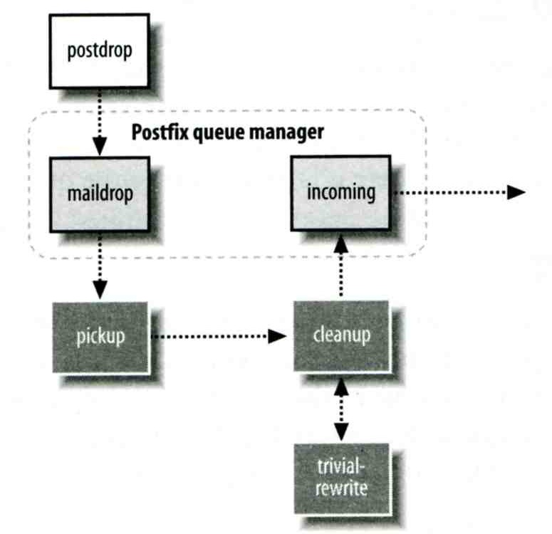
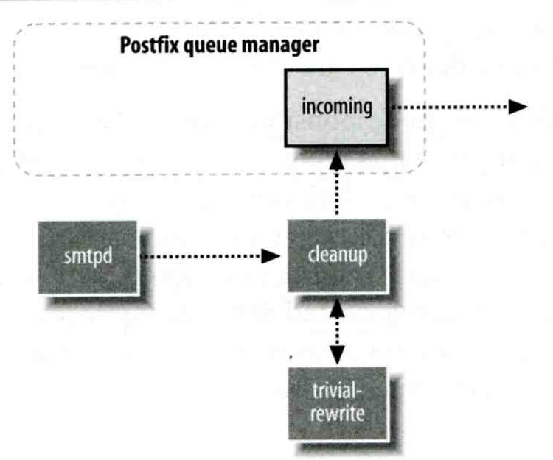
Postfix Architecture –
Message IN
Four ways
  Local submission
    postdrop command
    maildrop queue
    pickup daemon
    cleanup daemon
      Header validation
      address translation
    incoming queue
  Network submission
    smtpd daemon
  Local forwarding
    Resubmit for such as .forward
    Envelope “to” is changed
  Notification
Local submission
Network submission

Slide 6
Postfix Architecture –
Queue
Five different queues
  incoming
    The first queue that every incoming email will stay
  active
    Queue manager will move message into active queue whenever there is enough system resources
    Queue manager then invokes suitable DA to delivery it
  deferred
    Messages that cannot be delivered are moved here
    These messages are sent back either with bounce or defer daemons
  corrupt
    Used to store damaged or unreadable message
  hold
http://www.postfix.org/QSHAPE_README.html#queues

Slide 7
Postfix Architecture –
Message OUT – Part I
Address classes
  Used to determine which destinations to accept for delivery
  How the delivery take place
Main address classes
  Local delivery
    Domain names in “mydestination” is local delivered
    Ex:
      mydestination = nasa.cs.nctu.edu.tw localhost
    It will check alias and .forward file to do further delivery
  Relay
    Transfer mail for others to not your domain
    It is common for centralize mail architecture to relay trusted domain
  Deliver mail to other domains for authorized user
    The queue manager will invoke the smtp DA to deliver this mail
  Virtual alias
  Virtual mailbox

Slide 8
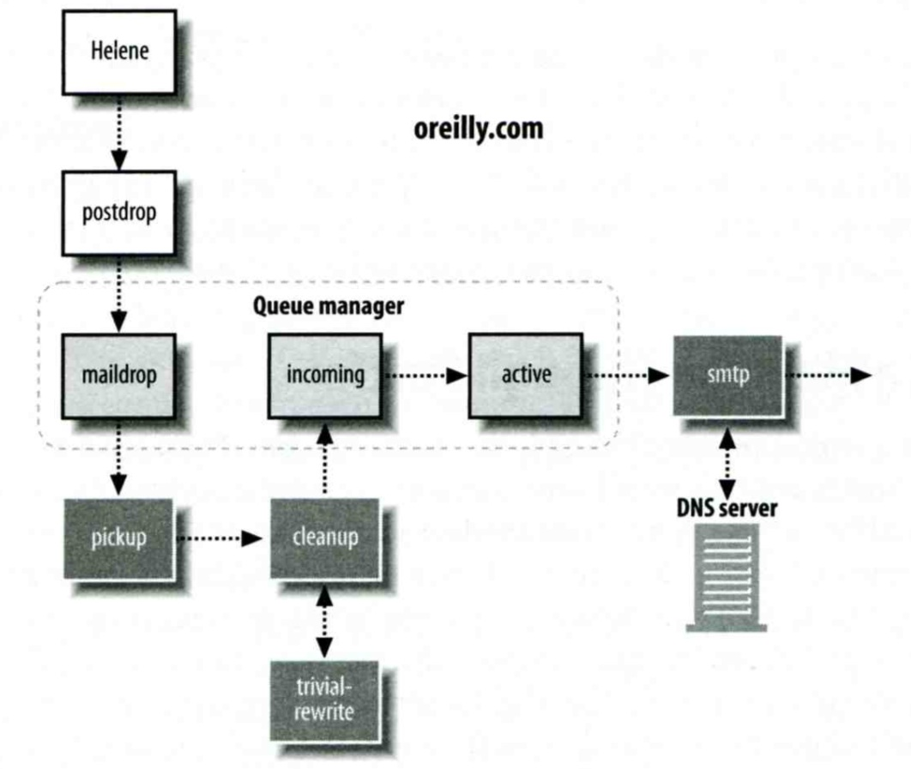
Message Flow in Postfix (1)
Example
  helene@oreilly.com → frank@postfix.org (doel@onlamp.com)
  Phase1:
    Helene compose mail using her MUA, and then call postfix’s sendmail command to send it

Slide 9
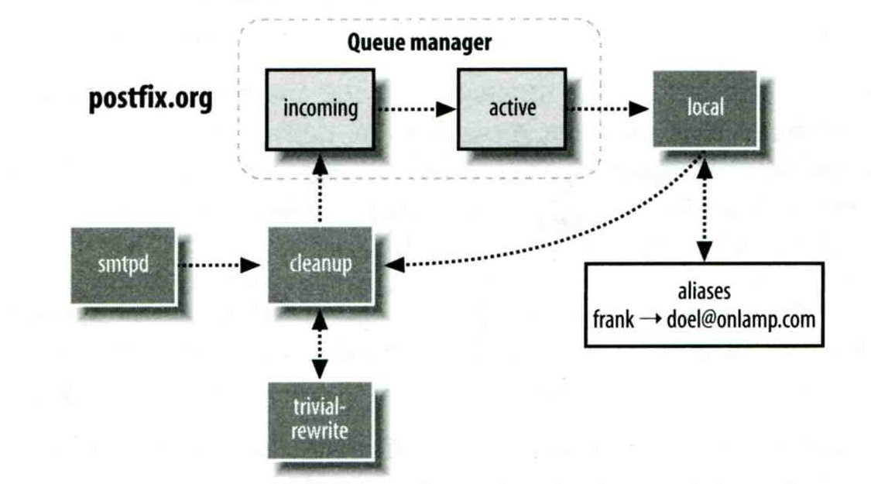
Message Flow in Postfix (2)
Example
  frank@postfix.org → doel@onlamp.com
  Phase2:
    The smtpd on postfix.org takes this message and invoke cleanup then put in incoming queue
    The local DA find that frank is an alias, so it resubmits it through cleanup daemon for further delivery

Slide 10
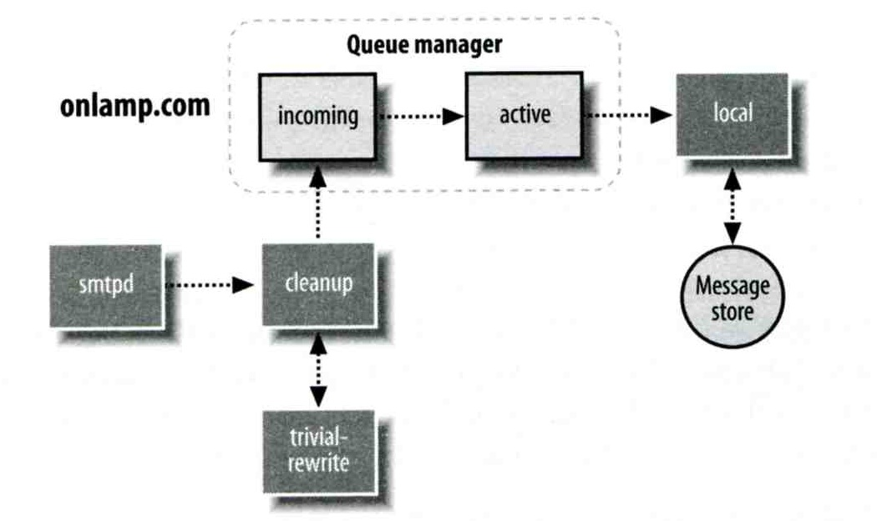
Message Flow in Postfix (3)
Example
  frank@postfix.org → doel@onlamp.com
  Phase3
    The smtpd on onlamp.com takes this message and invoke cleanup then put in incoming queue
    Local delivery to message store

Slide 11
Message Store Format
The Mbox format
  Store messages in single file for each user
  Each message start with “From ” line and continued with message headers and body
  Mbox format has file-locking problem
The Maildir format
  Use structure of directories to store email messages
  Each message is in its owned file
  Three subdirectories - cur, new, and tmp
  Maildir format has scalability problem
    locate and delete mails quickly, but waste amounts of fd, inodes, space
    Problems of quota and backup
Related parameters (in main.cf)
  mail_spool_directory = /var/mail (Mbox)
  mail_spool_directory = /var/mail/ (Maildir)

Slide 12
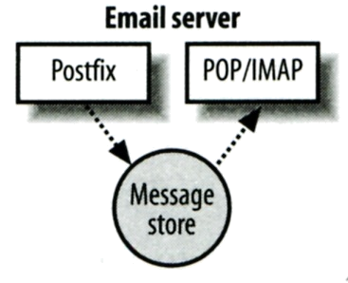
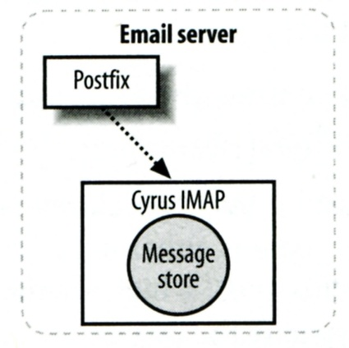
Postfix & POP3/IMAP
POP3 vs. IMAP
  Both are used to retrieve mail from server for remote clients
  POP3 has to download entire message, while IMAP can download headers only
  POP3 can download only single mailbox, while IMAP can let you maintain multiple mailboxes and folders on server
Postfix works together with POP3/IMAP
  Postfix and POP3/IMAP must agree on the type of mailbox format and style of locking
    Standard message store
    Non-standard message store (using LMTP)
      Such as Cyrus IMAP or Dovecot

Slide 13
Postfix Configuration
Two most important configuration files
  /usr/local/etc/postfix/main.cf – postconf(5)
    Core configuration
  /usr/local/etc/postfix/master.cf – master(5)
    Which postfix service should invoke which program
Edit main.cf
  Using text editor
  postconf
    % postconf [–e] "myhostname = nasa.cs.nctu.edu.tw"
    % postconf –d myhostname (print default setting)
    % postconf myhostname (print current setting)
Reload postfix whenever there is a change
  # postfix reload

Slide 14
Postfix Configuration –
Lookup tables (1)
Parameters that use external files to store values
  Such as mydestination, mynetwork, relay_domains
  Text-based table is ok, but time-consuming when table is large
Lookup tables syntax
  Key values
Database format
  % postconf –m
    List all available database format
  In main.cf
    default_database_type
  http://www.postfix.org/DATABASE_README.html
% postconf -m
btree
cidr
environ
hash
internal
proxy
regexp
static
tcp
texthash
unix
% postconf default_database_type
default_database_type = hash
% postconf -h default_database_type
hash

Slide 15
Postfix Configuration –
Lookup tables (2)
Use databased-lookup table in main.cf
  syntax
    parameter = type:name
  Ex:
    In main.cf
    canonical_maps = hash:/usr/local/etc/postfix/canonical
    After execute postmap
    /usr/local/etc/postfix/canonical.db
postmap command
  Generate database
    # postmap hash:/usr/local/etc/postfix/canonical
  Query
    % postmap –q nctu.edu.tw hash:/usr/local/etc/postfix/canonical

Slide 16
Postfix Configuration –
Lookup tables (3)
Regular expression tables
  More flexible for matching keys in lookup tables
    Sometimes you cannot list all the possibilities
  Two regular expression libraries used in Postfix
    POSIX extended regular expression (regexp, default)
    Perl-Compatible regular expression (PCRE)
  Usage
    /pattern/ value
    Do some content checks, such as
      header_checks
      body_checks
    Design some features
      /(\S+)\.(\S+)@nasa\.cs\.nctu\.edu\.tw/ $1@nasa.cs.nctu.edu.tw

Slide 17
Postfix Configuration –
Categories
Categories
  Server identities
    my...
  Mail rewriting
    for incoming/outgoing mails
  Access control
    restrictions
  Mail processing
    filter
  Operation details
    …

Slide 18
Postfix Configuration –
MTA Identity
Four related parameters
  myhostname
    myhostname = nasa.cs.nctu.edu.tw
    If un-specified, postfix will use ‘hostname’ command
  mydestination
    List all the domains that postfix should accept for local delivery
    mydestination = $myhostname, localhost.$mydomain $mydomain
      This is the CS situation that mx will route mail to mailgate
    mydestination = $myhostname www.$mydomain, ftp.$mydomain
  mydomain
    mydomain = cs.nctu.edu.tw
    If un-specified, postfix use myhostname minus the first component
  myorigin
    myorigin = $mydomain (default is $myhostname)

Slide 19
Postfix Configuration –
System-wide aliases files
Using aliases in Postfix (first-matching)
  alias_maps = hash:/etc/aliases
  alias_maps = hash:/etc/aliases, nis:mail.aliases
  alias_database = hash:/etc/aliases
    Tell newaliases command which aliases file to build
To Build alias database file
  % postalias /etc/aliases
Alias file format (same as sendmail)
  RHS can be
    Email address, filename, |command, :include:
Alias restriction
  allow_mail_to_commands = alias, forward
  allow_mail_to_files = alias, forward

Slide 20
Postfix Configuration –
Virtual Alias Maps
Virtual Alias Map
  It recursively rewrites envelope recipient addresses for all local, all virtual, and all remote mail destinations.
  virtual_alias_domains = $virtual_alias_maps (default)
  virtual_alias_maps = hash:/usr/local/etc/postfix/virtual
    src-address dst-address
    chwong@csie.nctu.edu.tw @chbsd.cs.nctu.edu.tw
    chwong ch0nsi@gmai1.com
    @csie.nctu.edu.tw @cs.nctu.edu.tw
  Applying regular expression
    virtual_alias_maps = pcre:/usr/local/etc/postfix/virtual
    /^root(\..+)?@(t)?(cs|np)?bsd\d*\.cs\.nctu\.edu\.tw$/ bsdta@cs.nctu.edu.tw
    /^root(\..+)?@(t)?(cs|np)?linux\d*\.cs\.nctu\.edu\.tw$/ linuxta@cs.nctu.edu.tw
    /^root(\..+)?@(t)?csmail\w*\d*\.cs\.nctu\.edu\.tw$/ mailta@cs.nctu.edu.tw

Slide 21
Postfix Configuration –
Relay Control (1)
Open relay
  A mail server that permit anyone to relay mails
  By default, postfix is not an open relay
A mail server should
  Relay mail for trusted user
    Such as liuyh@smtp.cs.nctu.edu.tw
  Relay mail for trusted domain
    Ex. smtp.cs.nctu.edu.tw trusts nctu.edu.tw

Slide 22
Postfix Configuration –
Relay Control (2)
Restricting relay access by mynetworks_style
  mynetworks_style = subnet
    Allow relaying from other hosts in the same subnet, configured in this machine
  mynetworks_style = host
    Allow relaying for only local machine
  mynetworks_style = class
    Any host in the same class A, B or C
Restricting relay access by mynetworks (override mynetworks_style)
  List individual IP or subnets in network/netmask notation
  Ex: in /usr/local/etc/postfix/mynetworks
    127.0.0.0/8
    140.113.0.0/16
    10.113.0.0/16
Relay depends on the type of your mail server
  smtp.cs.nctu.edu.tw will be different from csmx1.cs.nctu.edu.tw

Slide 23
Postfix Configuration –
Receiving limits
Enforce limits on incoming mail
  The number of recipients for single delivery
    smtpd_recipient_limit = 1000
  Message size
    message_size_limit = 10240000

Slide 24
Postfix Configuration –
Rewriting address (1)
For unqualified address
  To append “myorigin” to local name.
    append_at_myorigin = yes
  To append “mydomain” to address that contain only host.
    append_dot_mydomain = yes
Masquerading hostname
  Hide the names of internal hosts to make all addresses appear as if they come from the same mail server
  It is often used in out-going mail gateway
    masquerade_domains = cs.nctu.edu.tw
    masquerade_domains = !chairman.cs.nctu.edu.tw cs.nctu.edu.tw
    masquerade_exceptions = admin, root
  Rewrite to all envelope and header address excepts envelope recipient address
    masquerade_class = envelope_sender, header_sender, header_recipient

Slide 25
Postfix Configuration –
Rewriting address (2)
Canonical address – canonical(5)
  Rewrite both header and envelope recursively invoked by cleanup daemon
  In main.cf
    canonical_maps = hash:/usr/local/etc/postfix/canonical
    canonical_classes = envelope_sender, envelope_recipient,
    header_sender, header_recipient
  In canonical
    /^(.*)@(t)?(cs)?(bsd|linux|sun)\d*\.cs\.nctu\.edu\.tw$/ $1@cs.nctu.edu.tw
  Simlar configurations
    sender_canonical_maps、sender_canonical_classes
    recipient_canonical_maps、recipient_canonical_classes

Slide 26
Postfix Configuration –
Rewriting address (3)
Relocated users
  Used to inform sender that the recipient is moved
  In main.cf
    relocated_maps = hash:/usr/local/etc/postfix/relocated
  In relocated
    andy@nasa.cs.nctu.edu.tw andyliu@abc.com
    liuyh EC319, NCTU, ROC
    @nabsd.cs.nctu.edu.tw zfs.cs.nctu.edu.tw
Unknown users
  Not local user and not found in maps
  Default action: reject

Slide 27
Postfix Configuration – master.cf (1)
/usr/local/etc/postfix/master.cf
  Define services that master daemon can invoke
  Each row defines a service and
  Each column contains a specific configuration option
# ==========================================================================
# service type private unpriv chroot wakeup maxproc command + args
# (yes) (yes) (yes) (never) (100)
# ==========================================================================
smtp inet n - n - - smtpd
pickup fifo n - n 60 1 pickup
cleanup unix n - n - 0 cleanup
rewrite unix - - n - - trivial-rewrite
smtp unix - - n - - smtp
local unix - n n - - local
virtual unix - n n - - virtual
relay unix - - n - - smtp
-o smtp_fallback_relay=
lmtp unix - - n - - lmtp
maildrop unix - n n - - pipe
flags=DRhu user=vmail argv=/usr/local/bin/maildrop -d ${recipient}

Slide 28
Postfix Configuration – master.cf (2)
Configuration options
  Service name
  Service type
    inet, unix, fifo, or pass
  Private
    Access to this component is restricted to the Postfix system
      inet cannot be private
  Unprivileged
    Run with the least amount of privilege required
      y will run with the account defined in “mail_owner”
      n will run with root privilege
        local, pipe, spawn, and virtual

Slide 29
Postfix Configuration – master.cf (3)
Configuration options
  Chroot
    chroot location is defined in “queue_directory”
  Wake up time
    Automatically wake up the service after the number of seconds
  Process limit
    Number of processes that can be executed simultaneously
    Default count is defined in “default_process_limit”
  command + args
    Default path is defined in “daemon_directory”
      /usr/libexec/postfix

Slide 30
Postfix Architecture –
Message OUT – Part II
Local delivery
Relay to the destinations
Other delivery agent (MDA)
  Specify in /usr/local/etc/postfix/master.cf
    How a client program connects to a service and what daemon program runs when a service is requested
  lmtp
    Local Mail Transfer Protocol (Limited SMTP)
      No queue
      One recipient at once
    Used to deliver to mail systems on the same network or even the same host
  pipe
    Used to deliver message to external program

Slide 31
Mail Relaying –
Transport Maps (1)
Transport maps – transport(5)
  It override default transport method to deliver messages
  In main.cf
    transport_maps = hash:/usr/local/etc/postfix/transport
  In transport file
    domain_or_address transport:nexthop
    csie.nctu.edu.tw smtp:[mailgate.csie.nctu.edu.tw]
    cs.nctu.edu.tw smtp:[csmailgate.cs.nctu.edu.tw]
    cis.nctu.edu.tw smtp:[mail.cis.nctu.edu.tw]
    example.com smtp:[192.168.23.56]:20025
    orillynet.com smtp
    ora.com maildrop
    kdent@ora.com error:no mail accepted for kdent

Slide 32
Mail Relaying –
Transport Maps (2)
Usage in transport map
  MX → Local delivery mail server
  mailpost to bbs/news
  Postponing mail relay
    Such as ISP has to postpone until customer network is online
    In transport:
    abc.com ondemand
    In /usr/local/etc/postfix/master.cf
    ondemand unix - - n - - smtp
    In /usr/local/etc/postfix/main.cf
    defer_transports = ondemand
    transport_maps = hash:/usr/local/etc/postfix/transport
    Whenever the customer network is online, do
      # postqueue -s abc.com

Slide 33
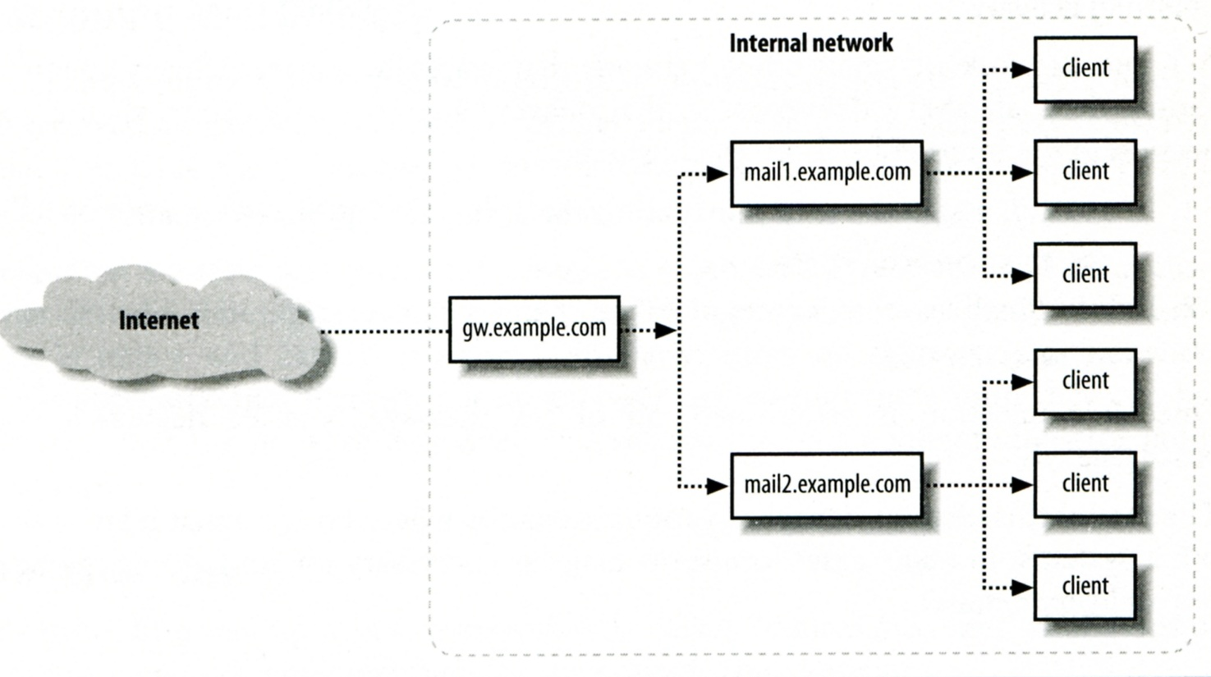
Mail Relaying –
Inbound Mail Gateway (1)
Inbound Mail Gateway (MX)
  Accept all mail for a network from the Internet and relays it to internal mail systems
  Ex:
    csmx1.cs.nctu.edu.tw is a IMG
    csmailgate.cs.nctu.edu.tw is internal mail system

Slide 34
Mail Relaying –
Inbound Mail Gateway (2)
To be IMG, suppose
  You are administrator for cs.nctu.edu.tw
  You have to be the IMG for secureLab.cs.nctu.edu.tw and javaLab.cs.nctu.edu.tw
    Firewall only allow outsource connect to IMG port 25
  The MX record for secureLab.cs.nctu.edu.tw and javaLab.cs.nctu.edu.tw should point to csmx1.cs.nctu.edu.tw
  In csmx1.cs.nctu.edu.tw,
  relay_domains = secureLab.cs.nctu.edu.tw javaLab.cs.nctu.edu.tw
  transport_maps = hash:/usr/local/etc/postfix/transport
  secureLab.cs.nctu.edu.tw relay:[secureLab.cs.nctu.edu.tw]
  javaLab.cs.nctu.edu.tw relay:[javaLab.cs.nctu.edu.tw]
  In secureLab.cs.nctu.edu.tw ( and so do javaLab.cs.nctu.edu.tw)
  mydestination = secureLab.cs.nctu.edu.tw
Notes:
1

Slide 35
Mail Relaying –
Outbound Mail Gateway
Outbound Mail Gateway
  Accept mails from inside network and relay them to Internet hosts
To be OMG, suppose
  You are administrator for cs.nctu.edu.tw
  You have to be the OMG for secureLab.cs.nctu.edu.tw and javaLab.cs.nctu.edu.tw
  In main.cf of csmailer.cs.nctu.edu.tw
  mynetworks = hash:/usr/local/etc/postfix/mynetworks
  secureLab.cs.nctu.edu.tw
  javaLab.cs.nctu.edu.tw
  All students in secureLab/javaLab will configure there MUA to use secureLab/javaLab.cs.nctu.edu.tw to be the SMTP server
  In main.cf of secureLab/javaLab.cs.nctu.edu.tw,
  relayhost = [csmailer.cs.nctu.edu.tw]

Slide 36
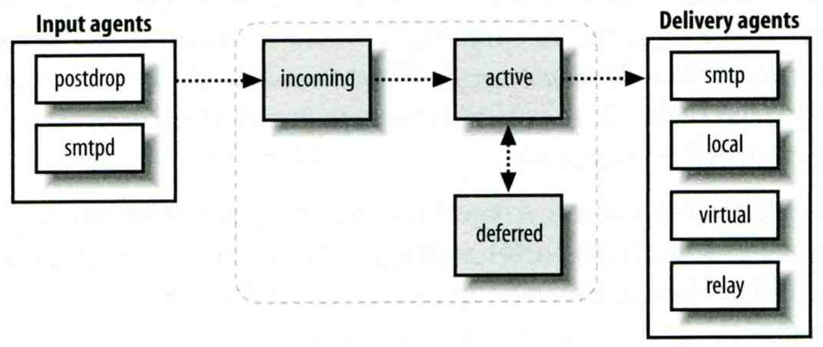
Queue Management
The queue manage daemon
  qmgr daemon
  Unique queue ID
  Queue directories (/var/spool/postfix/*)
    active, bounce, corrupt, deferred, hold
Message movement between queues
  Temporary problem → deferred queue
  qmgr takes messages alternatively between incoming and deferred queue to active queue

Slide 37
Queue Management –
Queue Scheduling
Double delay in deferred messages
  Between
    minimal_backoff_time = 300s
    maximal_backoff_time = 4000s
  qmgr daemon periodically scan deferred queue for reborn messages
    queue_run_delay = 300s
Deferred → bounce
  maximal_queue_lifetime = 5d

Slide 38
Queue Management –
Message Delivery
Controlling outgoing messages
  When there are lots of messages in queue for the same destination, it should be careful not to overwhelm it
  If concurrent delivery is success, postfix can increase concurrency between:
    initial_destination_concurrency = 5
    default_destination_concurrency_limit = 20
    Under control by
      maxproc in /usr/local/etc/postfix/master.cf
    You can override the default_destination_concurrency_limit for any transport mailer:
      smtp_destination_concurrency_limit = 25
      local_destination_concurrency_limit = 10
  Control how many recipients for a single outgoing message
    default_destination_recipient_limit = 50
    You can override it for any transport mailer in the same idea:
      smtp_destination_recipient_limit = 100

Slide 39
Queue Management –
Error Notification
Sending error messages to administrator
  Set notify_classes parameter to list error classes that should be generated and sent to administrator
    Ex: notify_classes = resource, software
  Error classes
Error Class | Description | Noticed Recipient (all default to postmaster)
bounce | Send headers of bounced mails | bounce_notice_recipient
2bounce | Send undeliverable bounced mails | 2bounce_notice_recipient
delay | Send headers of delayed mails | delay_notice_recipient
policy | Send transcript when mail is reject due to anti-spam restrictions | error_notice_recipient
protocol | Send transcript that has SMTP error | error_notice_recipient
resource | Send notice because of resource pro. | error_notice_recipient
software | Send notice because of software pro. | error_notice_recipient

Slide 40
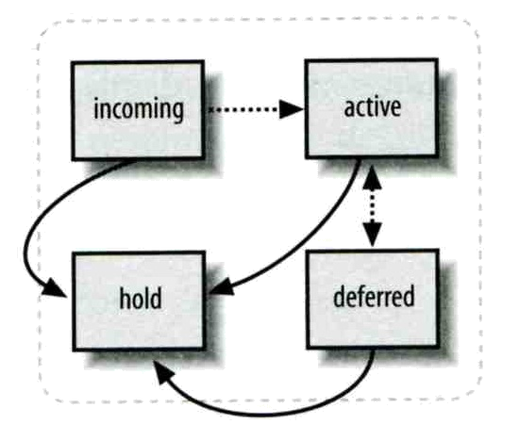
Queue Management –
Queue Tools (1)
postqueue command
  postqueue –p
    Generate sendmail mailq output
  postqueue –f
    Attempt to flush(deliver) all queued mail
  postqueue –s cs.nctu.edu.tw
    Schedule immediate delivery of all mail queued for site
postsuper command
  Delete queued messages
    postsuper –d E757A3428C6 (from incoming, active, deferred, hold)
    postsuper –d ALL
  Put messages “on hold” so that no attempt is made to deliver it
    postsuper –h E757A3428C6 (from incoming, active, deferred)
  Release messages in hold queue
    postsuper –H ALL
  Requeue messages into maildrop queue (maildrop → pickup → cleanup → incoming)
    postsuper –r E757A3428C6
    postsuper –r ALL

Slide 41
Queue Management –
Queue Tools (2)
postcat
  Display the contents of a queue file
nasa [/home/liuyh] -liuyh- mailq
-Queue ID- --Size-- ----Arrival Time---- -Sender/Recipient-------
3314234284A 602 Sat May 19 04:16:20 root@nasa.cs.nctu.edu.tw
(connect to csmx1.cs.nctu.edu.tw[140.113.235.104]:25: Operation timed out)
liuyh@cs.nctu.edu.tw
nasa [/home/liuyh] -liuyh- sudo postcat -q 3314234284A
*** ENVELOPE RECORDS deferred/3/3314234284A ***
message_size: 602 214 1 0 602
message_arrival_time: Sat May 19 04:16:20 2012
create_time: Sat May 19 04:16:20 2012
sender: root@nasa.cs.nctu.edu.tw
named_attribute: rewrite_context=local
original_recipient: root
recipient: liuyh@cs.nctu.edu.tw
*** MESSAGE CONTENTS deferred/3/3314234284A ***
Received: by nasa.cs.nctu.edu.tw (Postfix)
id 3314234284A; Sat, 19 May 2012 04:16:20 +0800 (CST)
Delivered-To: root@nasa.cs.nctu.edu.tw
Received: by nasa.cs.nctu.edu.tw (Postfix, from userid 0)
id 2CB713427A5; Sat, 19 May 2012 04:16:20 +0800 (CST)
To: root@nasa.cs.nctu.edu.tw
Subject: nasa.cs.nctu.edu.tw weekly run output
Message-Id: <20120518201620.2CB713427A5@nasa.cs.nctu.edu.tw>
Date: Sat, 19 May 2012 04:16:20 +0800 (CST)
From: root@nasa.cs.nctu.edu.tw (NASA Root)
Rebuilding locate database:
Rebuilding whatis database:
…

Slide 42
Multiple Domains
Use single system to host many domains
  Ex:
    We use csmailgate.cs.nctu.edu.tw to host both
      cs.nctu.edu.tw
      csie.nctu.edu.tw
  Purpose
    Can be used for final delivery on the machine or
    Can be used for forwarding to destination elsewhere
Important considerations
  Does the same user id with different domain should go to the same mailbox or different mailbox ?
    YES (shared domain)
    NO (Separate domain)
  Does every user require a system account in /etc/passwd ?
    YES (system account)
    NO (virtual account)

Slide 43
Multiple Domains –
Shared Domain with System Account
Situation
  The mail system should accept mails for both canonical and virtual domains and
  The same mailbox for the same user id
Procedure
  Modify “mydomain” to canonical domain
  Modify “mydestination” parameter to let mails to virtual domain can be local delivered
  Ex:
    mydomain = cs.nctu.edu.tw
    mydestination = $myhostname, $mydomain, csie.nctu.edu.tw
    ※ In this way, mail to both chwong@cs.nctu.edu.tw and chwong@csie.nctu.edu.tw will go to csmailgate:/var/mail/chwong
Limitation
  Can not separate chwong@cs.nctu.edu.tw from chwong@csie.nctu.edu.tw

Slide 44
Multiple Domains –
Separate Domains with System Accounts
Situation
  The mail system should accept mails for both canonical and virtual domains and
  Mailboxes are not necessarily the same for the same user id
Procedure
  Modify “mydomain” to canonical domain
  Modify “virtual_alias_domains” to accept mails to virtual domains
  Create “virtual_alias_mas” map
  Ex:
    mydomain = cs.nctu.edu.tw
    virtual_alias_domains = abc.com.tw, xyz.com.tw
    virtual_alias_maps = hash:/usr/local/etc/postfix/virtual
    In /usr/local/etc/postfix/virtual
      CEO@abc.com.tw andy
      @xyz.com.tw jack
Limitation
  Need to maintain UNIX account for virtual domain user

Slide 45
Multiple Domains –
Separate Domains with Virtual Accounts (1)
Useful when users in virtual domains:
  Do not need to login to system
  Only need to retrieve mail through POP/IMAP server
Procedure
  Modify “virtual_mailbox_domains” to let postfix know what mails it should accepts
  Modify “virtual_mailbox_base” and create related directory to put mails
  Create “virtual_mailbox_maps” map
  Ex:
    virtual_mailbox_domain = abc.com.tw, xyz.com.tw
    virtual_mailbox_base = /var/vmail
    Create /var/vmail/abc-domain and /var/vmail/xyz-domain
    virtual_mailbox_maps = hash:/usr/local/etc/postfix/vmailbox
    In /usr/local/etc/postfix/vmailbox
      CEO@abc.com.tw abc-domain/CEO (Mailbox format)
      CEO@xyz.com.tw xyz-domain/CEO/ (Maildir format)

Slide 46
Multiple Domains –
Separate Domains with Virtual Accounts (2)
Ownerships of virtual mailboxes
  Simplest way:
    The same owner of POP/IMAP Servers
  Flexibility in postfix
    virtual_uid_maps and virtual_gid_maps
    Ex:
      virtual_uid_maps = static:1003
      virtual_gid_maps = static:105
      virtual_uid_maps = hash:/usr/local/etc/postfix/virtual_uids
      virtual_uid_maps = hash:/usr/local/etc/postfix/virtual_uids static:1003
      In /usr/local/etc/postfix/virtual_uids
        CEO@abc.com.tw 1004
        CEO@xyz.com.tw 1008

