Slide 1
Postfix, past present and future
Wietse Venema
IBM T. J. Watson Research Center
Hawthorne, NY, USA

Slide 2
Postfix in a nutshell
Who runs Postfix:
  Providers with 10+M mailboxes (Outblaze, UOL).
  Desktops & servers (MacOS X, Ubuntu, NetBSD).
  Appliances (Brightmail, Frontbridge, etc.).
Who provides Postfix:
  Yours truly, helped by small number of volunteers with input from a small core of active users.
  Code contributions are accepted. Sometimes as is, usually after some editing.
Postfix, past present and future

Slide 3
Overview
Why (not) write another UNIX mail system.
Postfix low-level implementation.
Extensibility as a proverbial life saver.
Catching up on Sendmail.
Recent development: postscreen zombie blocker.
Conclusion.
Postfix, past present and future

Slide 4
Why (not) write yet another UNIX mail system
Idealism versus real-world compatibility.
Postfix, past present and future

Slide 5
Traditional (BSD) UNIX mail delivery architecture
(impersonation requires privileges; monolithic model hinders damage control)
Sendmail*
from network
to network
to |command**
to /file/name**
/bin/mail*
local submission
must execute with recipient privileges
local delivery
mailbox file
accessible only by the recipient
* uses “root” privileges
** in per-user .forward files and in per-system aliases database
Plan for failure
Postfix, past present and future

Slide 6
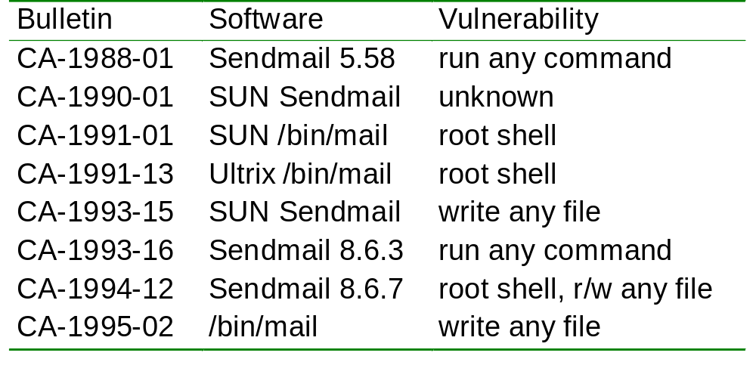
CERT/CC UNIX email advisories (part 1 of 3)
Plan for failure
Postfix, past present and future

Slide 7
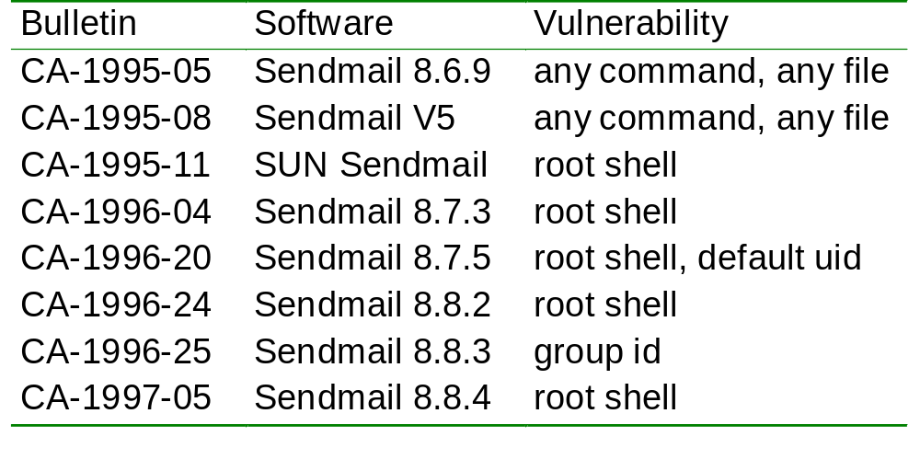
CERT/CC UNIX email advisories (part 2 of 3)
Plan for failure
Postfix, past present and future

Slide 8
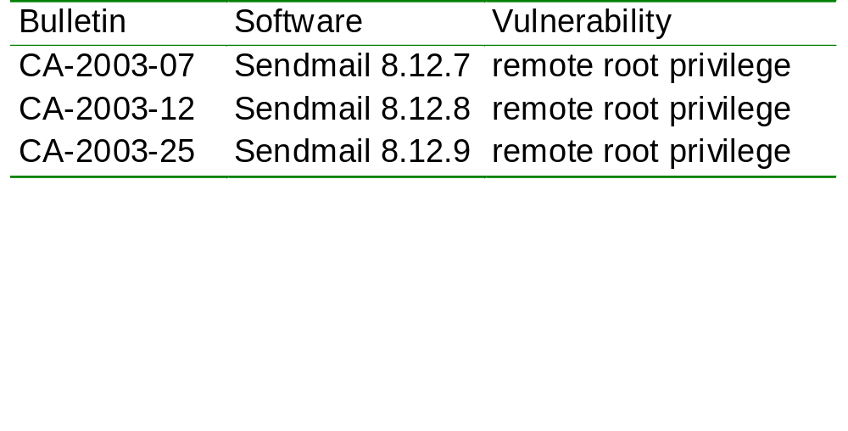
CERT/CC UNIX email advisories (part 3 of 3)
Plan for failure
Postfix, past present and future

Slide 9
Monolithic and privileged: no damage control
One mistake can be fatal:
  A remote client can execute any command with “root” privilege, or can read/write any file they choose.
No internal barriers:
  Very convenient to implement (not really, see later).
  Very convenient to break into (yes, really).
Plan for failure
Postfix, past present and future

Slide 10
Postfix distributed security architecture
(omitted: non-daemon programs for submission and system management)
input interfaces
core
output interfaces
smtp
server
smtp/lmtp
client
smtpd
smtp
client
mail store
network
smtpd
smtpd
smtpd
network
unprivileged
16 other
daemons
unprivileged
unprivileged
local
delivery
smtpd
mailbox
|command
/file/name
local
pickup
smtpd
unprivileged
privileged
mail
queue
to external
transports
uucp
fax
pager
(local submission)
smtpd
smtpd
= root privilege
= postfix privilege
privileged
Plan for failure
Postfix, past present and future

Slide 11
Major influences on Postfix architecture
TIS Firewall smap/smapd
  Low privilege, chroot jail, “air gap” between mail receiving and mail delivering processes.
qmail: parallel deliveries, maildir file format.
Apache: reuse processes multiple times.
Sendmail
  User interface; lookup table interface; some things to avoid.
Network routers
  Multiple interface types, but no queue-skipping fast path :-(
Plan for failure
Postfix, past present and future

Slide 12
Postfix low-level implementation
“I learned to program carefully for selfish reasons. I did not want to sleep on the floor next to my physics experiments”.
Wietse, date unknown
Postfix, past present and future

Slide 13
Optimization is the root of evil
When a server is exposed to the Internet, the worst case will become the normal case, and vice versa.
  Postfix is designed to deliver mail fast.
    Not optimal when >90% of mail is spam ☹
  Postfix assumes that SMTP clients move quickly.
    Buggy Storm zombies clog up all SMTP server ports.
Don’t improve the common case at the cost of the worst case (example: Postfix content filter).
Postfix implementation
Postfix, past present and future

Slide 14
How to implement SMTP without screwing up
Multi-protocol: SMTP/DNS/TLS/LDAP/SQL/Milter.
Broken implementations: clients, servers, proxies.
Concurrent mailbox “database” access.
Complex email address syntax <@x,@y:a%b@c>.
Queue management (thundering herd).
SPAM and Virus control.
Anti-spoofing: DKIM, SenderID, etc., etc.
Postfix implementation
Postfix, past present and future

Slide 15
Strategies: divide and conquer
Juggle fewer balls, basically
Partitioned “least privilege” architecture.
More-or-less safe extension mechanisms:
  Use SMTP or “pipe-to-command” for content inspection; let other people provide applications that do the work.
  Simple SMTP access policy protocol; let other people provide SPF, greylist etc. applications.
  Adopt Sendmail Milter protocol; let other people provide DKIM, SenderID etc. applications.
More-or-less safe C programming API (example).
Postfix implementation
Postfix, past present and future

Slide 16
Example: buffer overflow defense
80-Column punch cards become obsolete years ago.
  Fixed buffers are either too small or too large.
Dynamic buffers are not the whole solution.
  IBM httpd (and qmail 1.03 on contemporary platforms):
    forever { send “XXXXXX....”; }
Postfix has bounds on memory object count and size.
  Don’t run out of memory under increasing load.
Postfix implementation
Postfix, past present and future

Slide 17
Adding anti-spam/virus support, part 1: Use standard protocols where you can.
“Junk mail is war. RFCs do not apply.”
  Wietse on Postfix mailing list, 2001
Postfix, past present and future

Slide 18
1999 - Melissa ravages the Internet
You can run from Windows but you can’t hide: Postfix becomes a vehicle for malware distribution.
  Short term: block “known to be bad” strings in message.
    /^Subject:.*Important Message From/ REJECT
  Long-term: delegate deep inspection to third-party code.
Emergence of specialized protocols: CVP, Milter, etc.
  We already use SMTP for email distribution world-wide.
    Why can’t we also use SMTP to plug in anti-spam/virus?
Invent sparingly
Postfix, past present and future

Slide 19
Postfix content filter via SMTP (after-queue)
Postfix
not Postfix
Postfix
MTA 1
smtp
Filter
smtp
MTA 2
in
out
queue 1
queue 2
  MTA = Mail Transport Agent.
  Red = dirty, green = clean.
  But it can’t be that simple, right?
  Using two MTAs must be wasteful!
Invent sparingly
Postfix, past present and future

Slide 20
After-queue content filter support
Postfix
not Postfix
Postfix
Advantage of after-queue content filters:
  Performance: 10 after-queue filter processes can handle the traffic from 100 before-queue SMTP sessions.
Disadvantage: after-queue filter must quarantine or discard bad mail, instead of reject (don’t become a backscatter source).
    Problem: discarding mail is problematic e.g. in Europe.
MTA 1
smtp
Filter
smtp
MTA 2
in
out
queue 1
queue 2
Invent sparingly
Postfix, past present and future

Slide 21
Postfix content filter via SMTP (after-queue)
Two MTAs combined into one – optimization is the root of evil
One Postfix instance
smtp server
MTA1 = MTA2
smtp client
network
network
mailbox command file
local submit
local pickup
mail queue
local delivery
smtp server
smtp client
content filter
not Postfix
  Combining two MTAs into one increases complexity.
    Two MTA behaviors, but only one set of configuration files.
Invent sparingly
Postfix, past present and future

Slide 22
Before-queue content inspection via SMTP
Responding to popular demand, despite performance limitation
Postfix, part 1
same Postfix, part 2
not Postfix
smtp
smtp server
smtp
content filter
smtp
smtp server
mail queue
in
Before-queue spam/virus filtering is needed in Europe.
  Reject bad mail before it is accepted into the mail queue.
    Once you accept mail, you can’t discard it.
One content filter per SMTP client is expensive.
  Reduce filter count with ~40%, by receiving the complete message before delivering it to the filter.
Invent sparingly
Postfix, past present and future

Slide 23
Adding anti-spam/virus support part 2: Embrace de-facto standards.
  “It's not the spammers who destroy [email], it's well-meaning people who insist on broken anti-spam measures.”
  Wietse on Postfix mailing list, 2003
Postfix, past present and future

Slide 24
2005 - Proliferation of authentication technologies
Alphabet soup: SPF, SenderID, DomainKeys, DKIM, BATV, SRS, ADSP, and the end is not in sight.
  Building everything into Postfix is not practical.
    Some distributions are two or more years behind on Postfix.
  Using SMTP-based filters to sign or verify is overkill.
Solution: adopt Sendmail Milter protocol and open up access to a large collection of available applications.
Plan for change
Postfix, past present and future

Slide 25
Retrofitting Milter support into a distributed MTA
Postfix
local submit
local pickup
queue inject¹
mail queue
network
smtp server
add/del/change header replace body...
connect helo mail rcpt data quit
milter application
milter
header, body, end-of-data
Red = dirty, green = clean.
The effort was heroic, but the reward was sweet.
¹With local submission, sends surrogate connect/helo/mail/etc events
Plan for change
Postfix, past present and future

Slide 26
Postfix author receives Sendmail innovation award
MOUNTAIN VIEW, Calif. October 25th, 2006 Today at its 25
Years of Internet Mail celebration event, taking place at the
Computer History Museum in Mountain View, California, Sendmail,
Inc., the leading global provider of trusted messaging, announced
the recipients of its inaugural Innovation Awards.
. . .
Wietse Venema, author, for his contribution of extending Milter
functionality to the Postfix MTA.
http://www.sendmail.com/pdfs/pressreleases/Sendmail%20Innovation%20Awards_10%2025%2006_FINAL.pdf
Plan for change
Postfix, past present and future

Slide 27
Catching up on Sendmail
  Why Postfix did not become a bloated mess.
Postfix, past present and future

Slide 28
How Postfix has grown in size
Initial trigger: the Postfix source tar/zip file was larger than the Sendmail source tar/zip file.
  Marcus Ranum asked if I had dragged in an XML parser.
Analyze Sendmail, Postfix, and qmail source code:
  Strip comments (shrinking Postfix by 45% :-).
  Format according to “Kernighan and Ritchie” style (expanding qmail by 25% :-).
  Delete repeating (mostly empty) lines.
Catching up on Sendmail
Postfix, past present and future

Slide 29

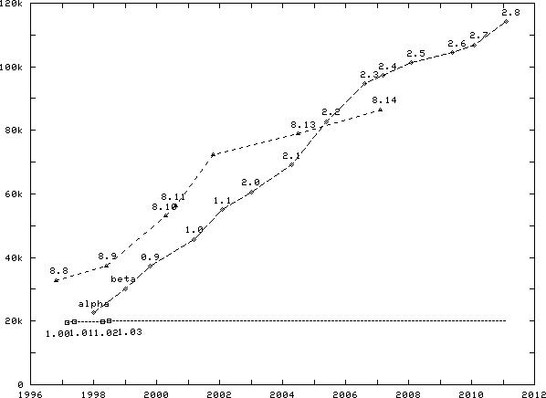
MTA Source lines versus time
Adding functionality with fewer lines of code
Postfix “complete”
Sendmail
Line count (K&R, no comments)
Postfix
qmail
Time (year)
Catching up on Sendmail
Postfix, past present and future

Slide 30
Why Postfix did not become a bloated mess
Benefits from a partitioned architecture
Small programs are easier to maintain.
  That is, after you build the communication infrastructure.
  Minor features: easier to modify a small program.
  Major features: easier to add a small program.
    Present breakdown: 25 daemons, 13 commands.
  Small is a relative term.
    The SMTP server daemon now weighs in at almost 10k lines, half the size of the entire Postfix alpha release.
Catching up on Sendmail
Postfix, past present and future

Slide 31
  Recent developments
Postfix, past present and future

Slide 32
Developments since the 2009 conference
See RELEASE_NOTES-2.* for details
Postfix 2.7:
  Speed-adjust (before-queue content filter)
    Receive the entire message before connecting to content filter.
  Per-sender IP reputation.
    Use different source IP address for different sender class.
  milter_header_checks (on request by AOL).
Postfix 2.8:
  DNSWL support, DNSBL/WL reply filter patterns.
  smtpd_reject_footer (helpful information in “reject” messages).
  postscreen zombie blocker.
Postfix, past present and future

Slide 33
  Current developments
  “Zombies suck the life out of the mail server.”
  Wietse at mailserver conference, 2009
Postfix, past present and future

Slide 34
Changing threats
1999: You built a mail system that runs on UNIX, so you didn’t have to worry about Windows viruses.
  Problem: your UNIX-based mail system becomes a major distribution channel for Windows malware (Melissa).
    Solution: outsource the job to external content filters.
Changing threats
Postfix, past present and future

Slide 35
Changing threats
2009: You built a mail system that has world-class email delivery performance.
  Problem: your world-class performing mail system is now spending most of its resources not delivering mail.
    Solution: work smarter. Stop the bots before the mail server.
Changing threats
Postfix, past present and future

Slide 36
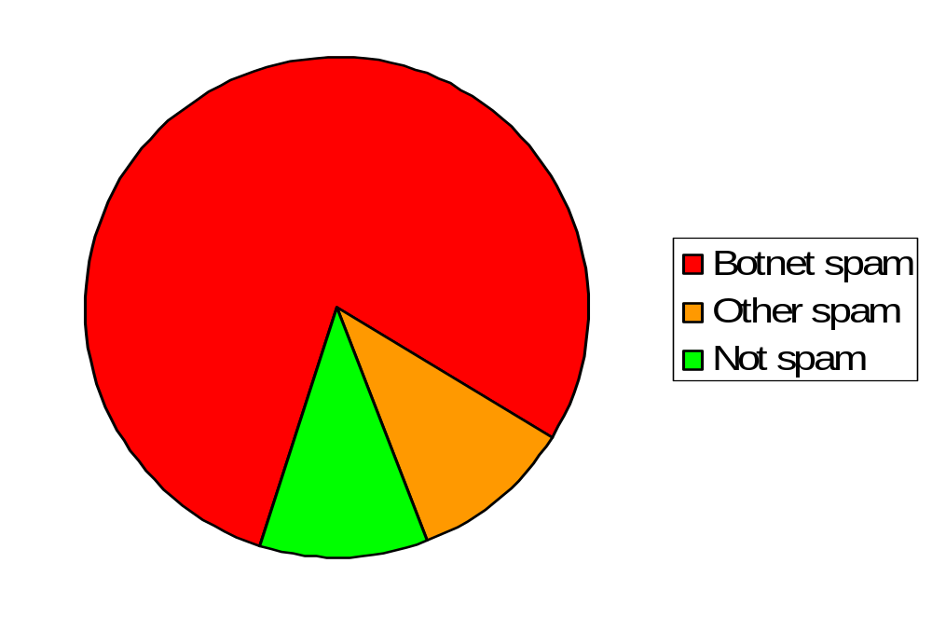
89% Of email is spam, 88% of spam from botnets
Source: MessageLabs Intelligence 2010 Annual Security Report
Changing threats
Postfix, past present and future

Slide 37
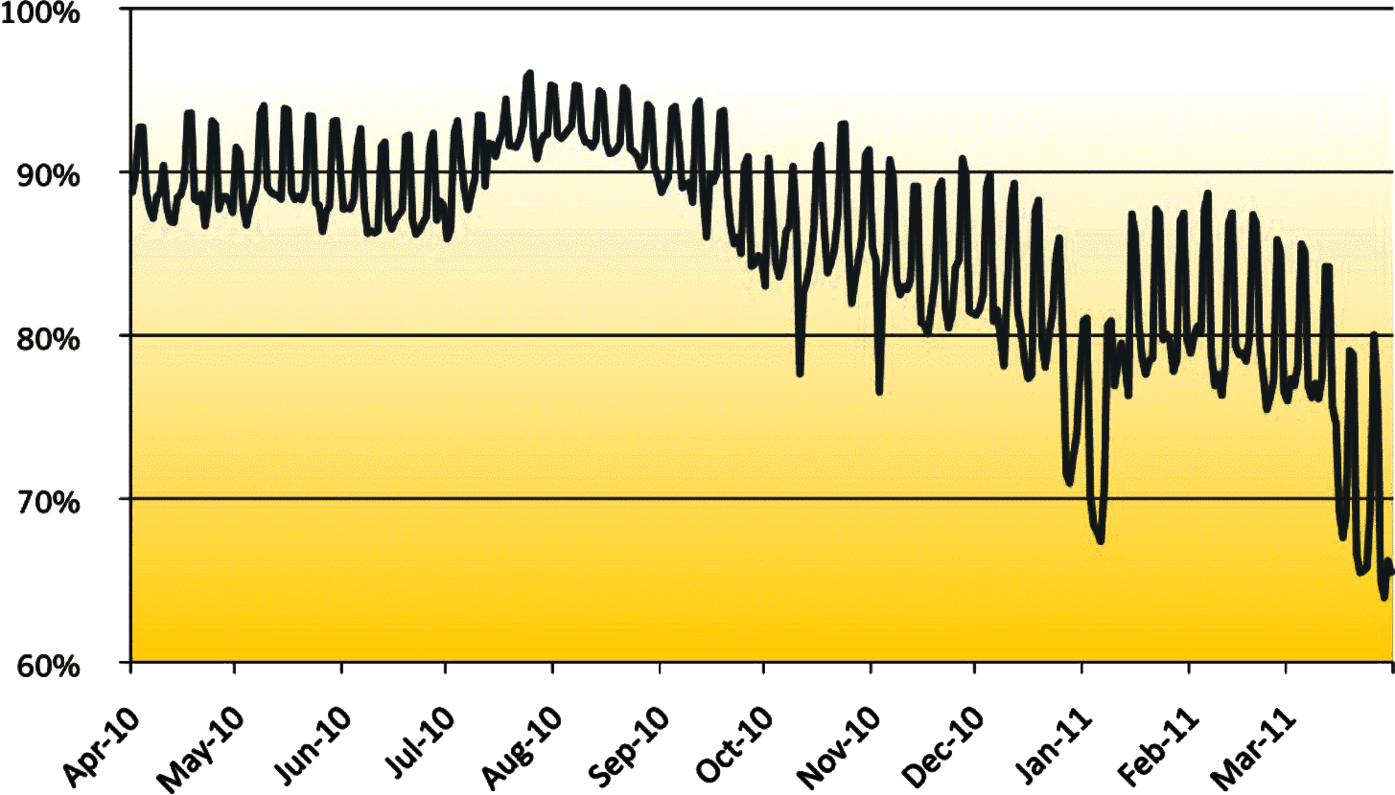
Global spam percentage drop from ~90% to ~70%
Major drops December + March when Rustock botnet stopped sending
Source: Symantec state of spam and phishing report, April 2011
Changing threats
Postfix, past present and future

Slide 38
Zombies keep mail server ports busy
Connections waiting for service (queued in the kernel)
Connections handled by server (Postfix default: 100 sessions)
zombie
other
zombie
zombie
smtpd
zombie
zombie
other
zombie
smtpd
other
zombie
. . .
. . .
other
smtpd
zombie
other
zombie
zombie
smtpd
zombie
zombie
zombie
Changing threats
Postfix, past present and future

Slide 39
Zombies suck the life out of the mail server
Worst-case example: Storm botnet.
  RFC 5321 recommends 5-minute server-side timeout.
    Postfix implements SMTP according to the standard.
      Result: all SMTP server ports kept busy by Storm zombies.
13:01:36 postfix/smtpd: connect from [x.x.x.x]
13:01:37 postfix/smtpd: reject: RCPT from [x.x.x.x]: 550 5.7.1 blah blah blah
13:06:37 postfix/smtpd: timeout after RCPT from [x.x.x.x]
Changing threats
Postfix, past present and future

Slide 40
Mail server overload strategies
Assumption: the zombie problem will get worse before things improve (if ever).
Temporary overload:
  Work faster: spend less time per SMTP client.
Persistent overload:
  Work harder: handle more SMTP clients (forklift solution).
  Work smarter: stop spambots up-stream (postscreen).
Postfix, past present and future

Slide 41
Temporary overload strategy
Work faster: spend less time per SMTP client.
  Reduce time limits, number of rejected commands, etc.
  Will delay some legitimate email, temporarily.
    From sites with large network latency or packet loss.
    From list managers with aggressive timeouts.
  Better to receive some legitimate mail, than no mail.
    OK as long as the overload condition is temporary.
Changing threats
Postfix, past present and future

Slide 42
Temporary overload implementation
Postfix master(8) daemon detects “all SMTP ports busy” and updates SMTP daemon command lines¹:
Default parameter settings (Postfix 2.6 and later):
smtpd -o stress=yes
smtpd_timeout = ${stress?10}${stress:300}s
smtpd_hard_error_limit = ${stress?1}${stress:20}
¹Feature is called “stress”, and implemented in 21 lines, because of author overload.
Changing threats
Postfix, past present and future

Slide 43
Persistent overload strategies
Work harder: configure more mail server processes.
  The brute-force, fork-lift approach for rich people.
    OK if you can afford the network, memory, disk, and CPU.
Work smarter: keep the zombies away from the server.
  Before-server connection filter.
    More SMTP processes stay available for legitimate email.
Changing threats
Postfix, past present and future

Slide 44
Persistent overload - before-smtpd connection filter
Prior work: OpenBSD spamd, MailChannels TrafficControl, M.Tokarev
zombie
One screening process
Postfix default: 100 sessions
other
zombie
post-
screen
other
smtpd
zombie
zombie
other
other
smtpd
other
zombie
. . .
. . .
zombie
smtpd
zombie
other
zombie
other
smtpd
zombie
zombie
zombie
Changing threats
Postfix, past present and future

Slide 45
Postscreen – reducing the cost of spam elimination
First layer of a four-layer defense.
    Postscreen connection filter (least expensive)
      Block spambots that send ~90% of all SPAM.
    Postfix SMTP server
      Block SPAM with more complex SMTP-level access policies.
    Header/body patterns
      Block SPAM and backscatter with simple signatures.
    Deep content inspection (most expensive)
      Block SPAM that remains.
This talk: survey of first-layer blocking techniques.
Postfix, past present and future

Slide 46
postscreen opportunities and challenges
Zombies are blacklisted within hours¹.
  Opportunity: reject clients that are in a hurry to send mail.
    Pregreet, command pipelining, ignoring 5XX replies.
    Connecting to backup MX hosts only.
    Other protocol violations.
Zombies avoid spamming the same site repeatedly.
  Challenge: decide “it’s a zombie” for a single connection.
    Use DNS white- and blacklists as shared intelligence source.
¹Chris Kanich et al., Spamalytics: An Empirical Analysis of Spam Marketing Conversion, CCS 2008.
Postfix, past present and future

Slide 47
Workflow - tests before the SMTP handshake
One daemon screens multiple connections simultaneously
Fast path: ~0.1 ms
Accept connection
Dummy SMTP and TLS engine
Slow path: up to ~6 seconds
Static W/B list DNS W/B list Pregreet test Primary MX test
Reject or defer mail (and log from, to, client, helo)
Is client in temp whitelist
Fail
No
Yes
Pass
Hand-off to real SMTP server
Add client to temp whitelist
Close connection
Changing threats
Postfix, past present and future

Slide 48
Postscreen DNSBL/DNSWL support
Parallel DNS lookups.
Weight factors (to whitelist, use negative numbers).
Reply filters.
postscreen_dnsbl_sites = zen.spamhaus.org*2, bl.spamcop.net*1, b.barracudacentral.org*1, dnsbl.njabl.org*1
postscreen_dnsbl_threshold = 2
postscreen_dnsbl_sites = zen.spamhaus.org=127.0.0.4 ...
postscreen_dnsbl_sites = zen.spamhaus.org=127.0.0.[1..11] ...
Postfix, past present and future

Slide 49
Detecting spambots that speak to early (pregreet)
Good SMTP clients wait for the SMTP server greeting:
Sendmail greet_pause approach: wait several seconds before sending the 220 greeting.
  Very few clients greet spontaneously.
  Some clients give up after waiting several seconds.
  Poor performance under load (“all ports busy” condition).
  Requires manual whitelisting.
SMTP server: 220 server.example.com ESMTP Postfix<CR><LF>
SMTP client: EHLO client.example.org<CR><LF>
Changing threats
Postfix, past present and future

Slide 50

Question for dog catchers
Q: How do I quickly find out if a house has a dog?
A: Ring the doorbell, and the dog barks immediately.
postscreen uses a similar trick with botnet zombies.
Changing threats
Postfix, past present and future

Slide 51
Making zombies bark - multi-line greeting trap
Good clients wait for the full multi-line server greeting:
Many spambots talk immediately after the first line of the multi-line server greeting:
postscreen: 220–server.example.com ESMTP Postfix<CR><LF>
smtp server: 220 server.example.com ESMTP Postfix<CR><LF>
good client: HELO client.example.org<CR><LF>
postscreen: 220–server.example.com ESMTP Postfix<CR><LF>
spambot: HELO i-am-a-bot<CR><LF>
Changing threats
Postfix, past present and future

Slide 52
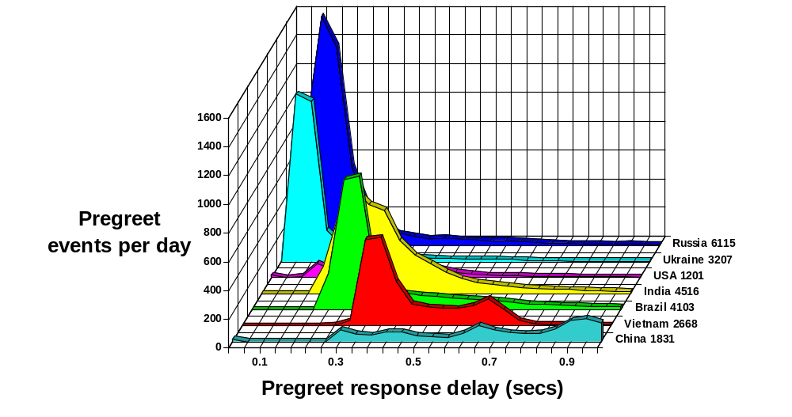
Over 60% of bots pregreet at mail.charite.de 8% Not on DNS blacklists. Berlin, Aug 26 – Sep 29, 2010
Postfix, past present and future

Slide 53
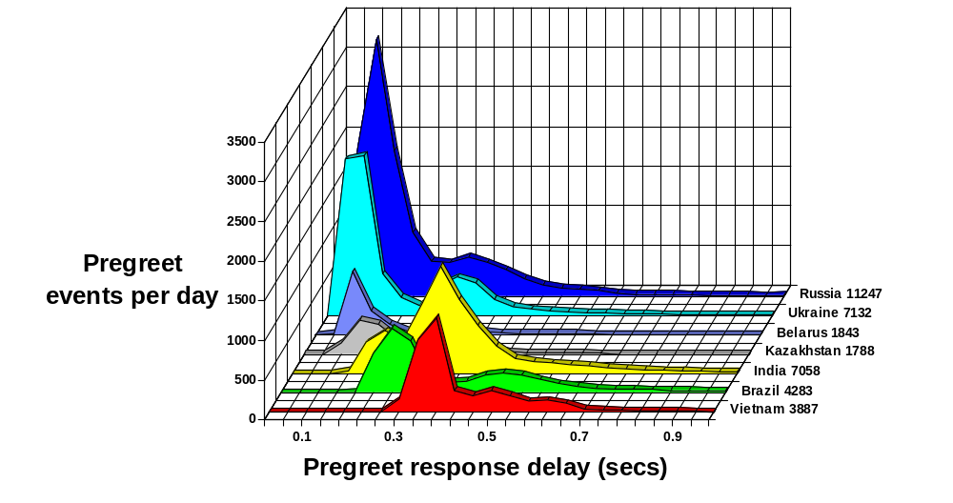
Over 70% of bots pregreet at mail.python.org
1% Not on DNS blacklists. Amsterdam, Sep 16 – 29, 2010
Postfix, past present and future

Slide 54
Primary/backup MX policy test
Good SMTP clients:
  First, try to deliver to primary MX host(s).
    Only if no primary MX is available, deliver to backup MX.
Bad SMTP clients:
  Connect only to backup MX hosts (exploit weaker defense).
postscreen solution:
  Listen on primary and backup MX address on the same host.
  Don’t temp-whitelist clients on backup MX address (reply 4XX).
  About 14% of spambots fall into this trap.
Postfix, past present and future

Slide 55
Postscreen workflow for backup MX connections
Don’t temp-whitelist clients on the backup MX address
Fast path: ~0.1 ms
Accept connection
Dummy SMTP and TLS engine
Slow path: up to ~6 seconds
Static W/B list DNS W/B list Pregreet test Primary MX test
Reject or defer mail (and log from, to, client, helo)
Is client in temp whitelist
Fail
No
Yes
Pass
Hand-off to real SMTP server
Add client to temp whitelist
Close connection
Changing threats
Postfix, past present and future

Slide 56
“Deep protocol” tests after the SMTP handshake
Currently, too little gain for the pain
Announce STARTTLS just like real SMTP server.
Don’t announce PIPELINING support in EHLO.
  1% of spambots¹ pipelines anyway.
Don’t allow non-SMTP commands.
  3% of spambots¹ ignores 5XX and sends header/body anyway.
Pain: no “good client” hand-off to SMTP server.
  Instead, reply with 4XX and wait until the client hangs up.
    Use second MX address on the same host to avoid “retry” delays.
¹Most of these spambots are already listed on DNSBLs.
Postfix, past present and future

Slide 57
Workflow for tests before+after SMTP handshake
Accept connection
Local W/B list DNS W/B list Pregreet test Primary MX test
Is client in temp whitelist
No
Dummy SMTP and TLS engine
Fail
Yes
Pass
Hand-off to real SMTP server
Pipelining, non-SMTP command, bare newline
Fail
Reject or defer mail (and log from, to, client, helo)
Pass
Add client to temp whitelist
Defer
Close connection
Changing threats
Postfix, past present and future

Slide 58
SPAM load varies by receiver, time of day, year
SPAM load at different sites:
  Charite.de (Berlin) and Python.org (Amsterdam). Thanks, Ralf.
    A handful countries sends most of today’s spam, but different receivers see different sender volumes.
SPAM load at different times of day:
  SPAM is a 24-hour operation, but most spambots are not.
SPAM load longer-term variations.
  At these sites, SPAM load dropped more than world average.
  At my personal domain, SPAM load dropped less, if at all.
Postfix, past present and future

Slide 59
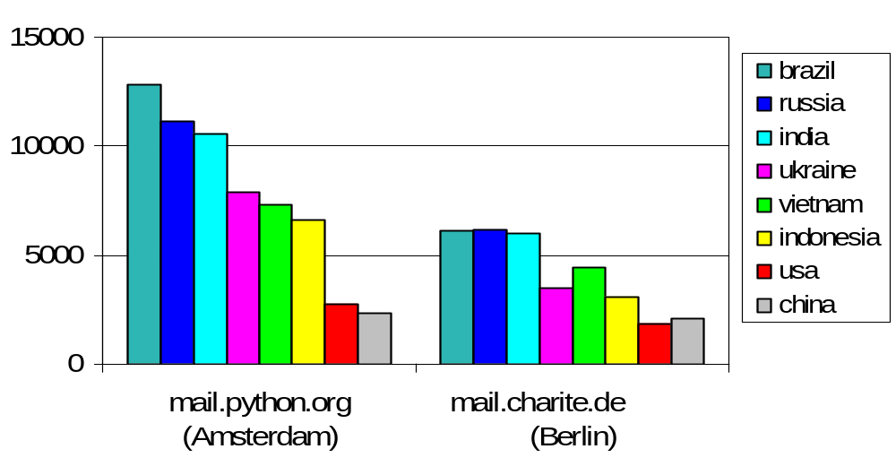
Spam connections/day Sep 3 – 23, 2010
Spam according to zen.spamhaus.org
total:108k/day
total: 60k/day
Changing threats
Postfix, past present and future

Slide 60
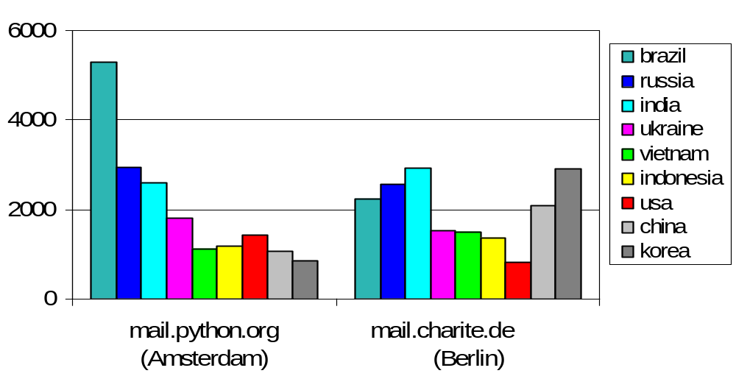
Spam connections/day Apr 13 – May 15, 2011
Spam according to zen.spamhaus.org
total: 34k/day
total: 32k/day
Changing threats
Postfix, past present and future

Slide 61
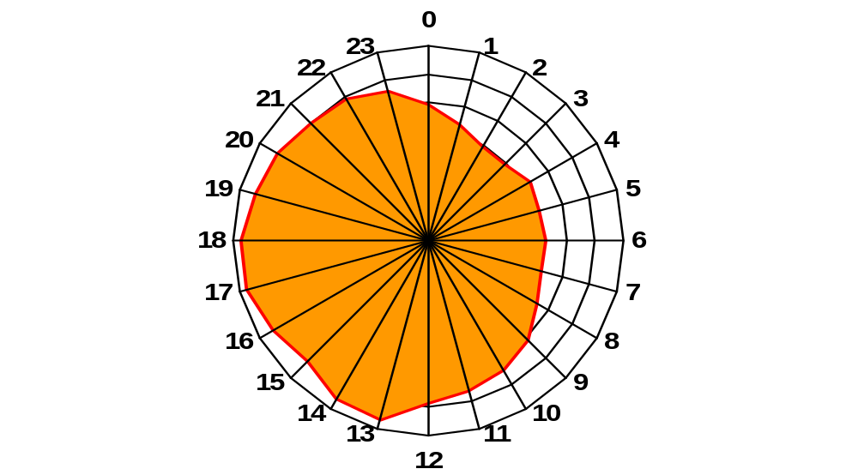
SPAM is a 24-hour operation...
Spam connections to Charite.de (Berlin) Aug 26 – Sep 29, 2010. Time in UTC.
Postfix, past present and future

Slide 62
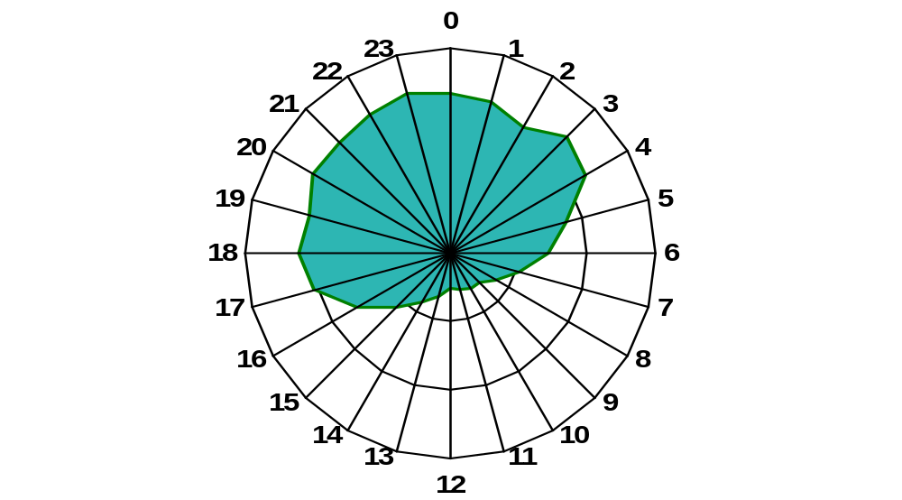
... but most spambots are not
Spam connections from Brazil to Charite.de (Berlin) Aug 26 – Sep 29, 2010. Time in UTC.
Postfix, past present and future

Slide 63
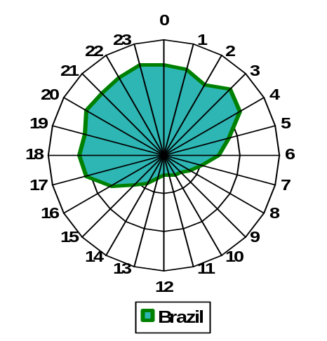
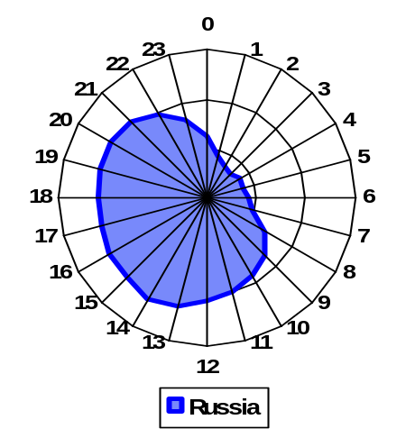
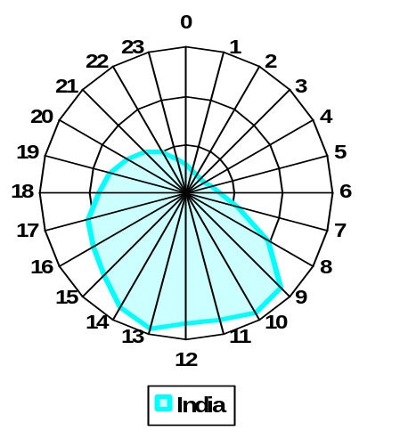
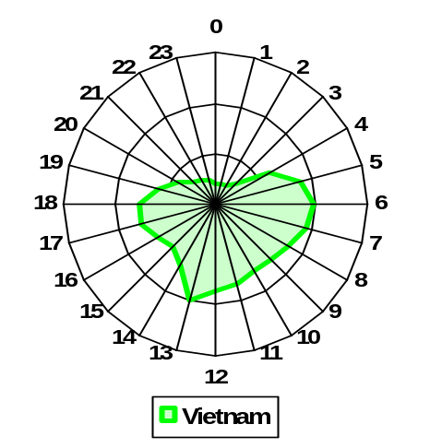
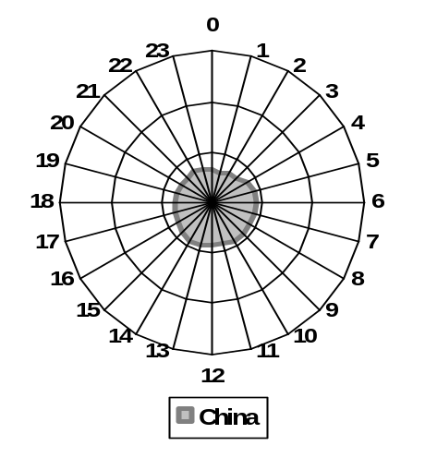
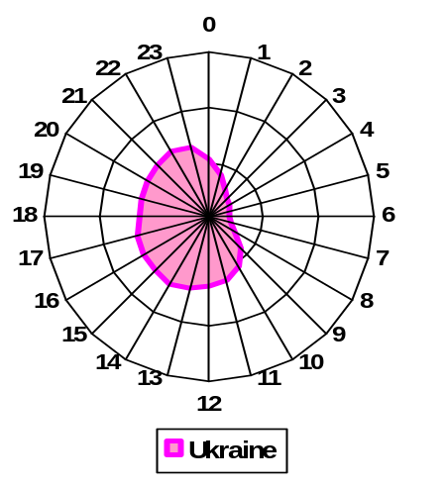
Spam connections/hour at mail.charite.de (UTC)
Spam according to zen.spamhaus.org, Aug 26 – Sep 29, 2010
Changing threats
Postfix, past present and future

Slide 64
Postscreen - results and status
Focus on performance and scalability:
  Dynamic “fast path” cache minimizes delays for “good” clients.
  Parallel, weighted, DNS white/blacklist lookup; static white/blacklist.
  STARTTLS support, stress-dependent limits, no SASL AUTH support.
    Use postscreen on smtp port (MTA-to-MTA), use AUTH on submission port.
Pilot results (small sites, up to 200k connections/day):
  Pregreet (talk early): 60+% of spambots (~10% not in DNSBL).
  Connect to backup MX only: ~14% of spambots.
  “Deep protocol” tests catch only a few percent of spambots.
Included with the Postfix 2.8 stable release (Jan. 2011).
Changing threats
Postfix, past present and future

Slide 65
Concluding remarks
Postfix, past present and future

Slide 66
Postfix lessons learned
Don’t re-invent mechanisms that already work. E.g., SMTP, Milter, maildir, lookup tables. Invent sparingly.
Build the stable protocols into Postfix: SMTP, LMTP, TLS, SASL, IPv6, DSN, MIME, LDAP, SQL.
Use plug-ins for future proofing: Anti-Spam, Anti-Virus, DKIM, SenderID, SPF, greylist, etc. Plan for change.
Optimize both the worst case and the common case. Worst cases become normal cases.
Don’t let a C prototype become the final implementation.
Conclusion
Postfix, past present and future

Slide 67
Conclusion
Postfix has matured well. With a system implemented by small programs, many features can be added by changing a small program or adding a small program.
Extensibility is a life saver¹. It eliminates the pressure to implement everything within Postfix itself, and it gives the user more choice.
The battle continues. For the near future, postscreen before-server connection filter keeps mail servers operable under increasing zombie loads.
¹For both author and software.
Conclusion
Postfix, past present and future

