Slide 1
Homework 04 Hint
Mail System

Slide 2
Software
Postfix
  mail/postfix
POP/IMAP
  mail/dovecot
MTA filter
  security/amavisd-new
MDA filter
  mail/procmail
Greylisting
  mail/postgrey
Anti-virus
  security/clamav
DKIM signature
  mail/dkimproxy
SPF
  mail/sid-milter
  mail/postfix-policyd-spf-perl
  mail/postfix-policyd-spf-python
Webmail
  www/horde-base
  mail/roundcube
  mail/squirrelmail

Slide 3
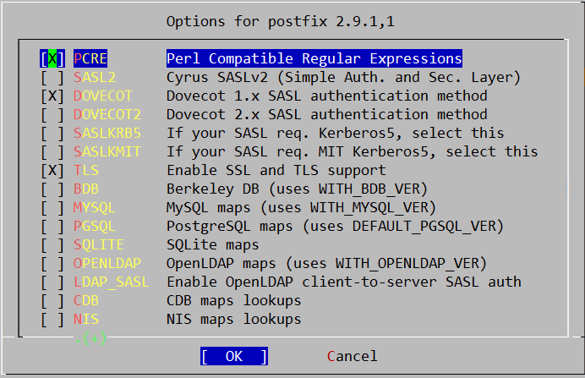
Postfix – Installation
Options
  make config

Slide 4
Postfix – Installation (Cont.)
Execute the Postfix sendmail program
install -o root -g wheel -m 555 /tmp/WRKDIR/usr/ports/mail/postfix/work/postfix-2.9.1/auxiliary/rmail/rmail /usr/local/bin/rmail
install -o root -g wheel -m 555 /tmp/WRKDIR/usr/ports/mail/postfix/work/postfix-2.9.1/auxiliary/qshape/qshape.pl /usr/local/bin/qshape
install -o root -g wheel -m 444 /tmp/WRKDIR/usr/ports/mail/postfix/work/postfix-2.9.1/man/man1/qshape.1 /usr/local/man/man1
===> Installing rc.d startup script(s)
Would you like to activate Postfix in /etc/mail/mailer.conf [n]?y

Slide 5
Postfix – Configuration
Stop sendmail
Edit /etc/rc.conf
Edit /etc/periodic.conf
  If it does not exist please create it
  Disable some sendmail specific daily maintenance routines
/etc/rc.d/sendmail stop
sendmail_enable="NO"
sendmail_submit_enable="NO"
sendmail_outbound_enable="NO"
sendmail_msp_queue_enable="NO "
postfix_enable=“YES”
daily_clean_hoststat_enable="NO"
daily_status_mail_rejects_enable="NO"
daily_status_include_submit_mailq="NO"
daily_submit_queuerun="NO"

Slide 6
Postfix – Configuration (Cont.)
Edit /usr/local/etc/postfix/master.cf
  Enable postscreen
    Whitelist
    RBL
Edit /usr/local/etc/postfix/main.cf
  smtpd_client_restrictions
    Deny from dynamic host
Start Postfix
Troubleshooting
  Check log
    /var/log/maillog
    /var/log/messages
/usr/local/etc/rc.d/postfix start

Slide 7
Postfix – Postscreen
postscreen_dnsbl_sites
  Allows to weigh black/whitelists
postscreen_dnsbl_threshold
  When a client's score is equal to or greater than threshold, the message will be rejected
postscreen_dnsbl_threshold = 2
postscreen_dnsbl_sites = zen.spamhaus.org*2,
bl.spamcop.net*1,
b.barracudacentral.org*1,
list.dnswl.org*-1,
swl.spamhaus.org*-1,
dwl.spamhaus.org*-1

Slide 8
Dovecot
POP3(s)/IMAP(s)
  SSL support
SASL Authentication
  SASL support in the SMTP server
Configuring the following files
  /usr/local/etc/dovecot.conf
  /usr/local/etc/postfix/main.cf
Edit /etc/rc.conf
Start Dovecot
zfs [~] -wangth- postconf -a
dovecot
dovecot_enable=“YES”
/usr/local/etc/rc.d/dovecot start

Slide 9
Amavisd-new
Interface to MTA
Anti-virus
  supports daemonized virus and scanners accessible via Perl modules
Anti-spam
  SpamAssassin
DKIM signing and verification
SPF verification check

Slide 10
Amavisd-new (Cont.)
Configuring the following files
  /usr/local/etc/amavisd.conf
  /usr/local/etc/postfix/main.cf
  /usr/local/etc/postfix/master.cf
Run the sa-update command at the first time
  Automate SpamAssassin rule updates
Edit /etc/rc.conf
Start Amavisd
amavisd_enable=“YES”
/usr/local/etc/rc.d/amavisd start

Slide 11
Procmail
Configuring the following file
  /usr/local/etc/procmailrc
mmencode
  converters/mmencode
  Translate to and from mail-oriented encoding formats
    Base64
    Quote-Printable
zh-pm-lib
  https://github.com/linpc/zh-pm-lib
zfs [~] -wangth- echo –n "蘭迪" | mmencode
6Jit6L+q
zfs [~] -wangth- echo –n "蘭迪" | mmencode -q
=E8=98=AD=E8=BF=AA=

Slide 12
DKIM signing
Create configuration files
Configuring the following files
  /usr/local/etc/dkimproxy_out.conf
  /usr/local/etc/postfix/master.cf
Edit /etc/rc.conf
Start dkimproxy
zfs [/usr/local/etc] -wangth- sudo cp dkimproxy_in.conf.sample\ dkimproxy_in.conf
zfs [/usr/local/etc] -wangth- sudo cp dkimproxy_out.conf.sample\ dkimproxy_out.conf
dkimproxy_out_enable="YES"
/usr/local/etc/rc.d/dkimproxy_out start

Slide 13
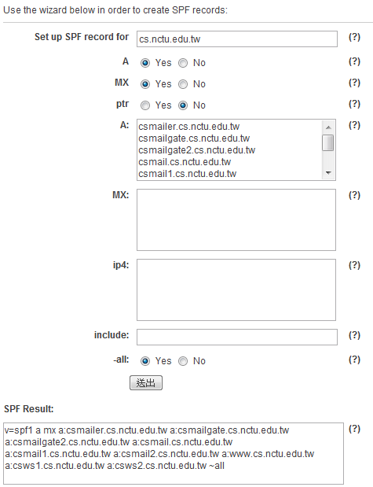
SPF
SPF record
  Add a TXT record to your zone file
  SPF wizard
    http://www.mailradar.com/spf/
SPF check
  sid-milter
    An sid and spf milter for Sendmail
  Postfix configuration parameter
    smtpd_milters

Slide 14

DNSBL filtering – Spamhaus
http://www.spamhaus.org
Safe DNSBLs for safe filters
  IP-based blacklist
    SBL (Spamhaus Block List)
    XBL (Exploits Blocks List)
    PBL (Policy Block List)
    ZEN (禪)
  Domain-based blacklist
    DBL

Slide 15
DNSBL filtering – Spamhaus (Cont.)
SBL
  Static UBE sources, verified spam services and ROKSO spammers
XBL
  Illegal 3rd party exploits, including proxies, worms and trojan exploits
PBL
  End-user Non-MTA IP addresses set by ISP outbound mail policy
ZEN
  The combination of all Spamhaus IP-based DNSBLs
    SBL, SBLCSS, XBL and PBL blocklists
UBE: Unsolicited Bulk Email
ROKSO: The Register of Known Spam Operations
SBLCSS: Spamhaus Block List Composite SnowShoes

Slide 16
OpenSSL s_client
A generic SSL/TLS client which connects to a remote host using SSL/TLS
  very useful diagnostic tool for SSL servers.
zfs [/usr/local/etc] -wangth- openssl s_client -connect mail.cs.nctu.edu.tw:993
CONNECTED(00000004)
…
---
SSL handshake has read 3859 bytes and written 337 bytes
---
New, TLSv1/SSLv3, Cipher is DHE-RSA-AES256-SHA
Server public key is 1024 bit
Secure Renegotiation IS supported
Compression: NONE
Expansion: NONE
SSL-Session:
Protocol : TLSv1
Cipher : DHE-RSA-AES256-SHA
Session-ID: 5A29EC41C046F1A1090F5304229149A98FC8738FF9708176FDC4912DA0BF296E
Session-ID-ctx:
Master-Key: ...
Key-Arg : None
Start Time: 1337751796
Timeout : 300 (sec)
Verify return code: 20 (unable to get local issuer certificate)
---
* OK [CAPABILITY IMAP4rev1 LITERAL+ SASL-IR LOGIN-REFERRALS ID ENABLE AUTH=PLAIN AUTH=LOGIN] NCTU CS Dovecot ready.

Slide 17
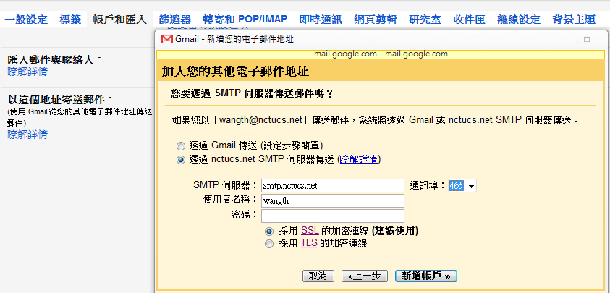
Webmail – Gmail
SMTP over SSL
SMTP authentication

Slide 18
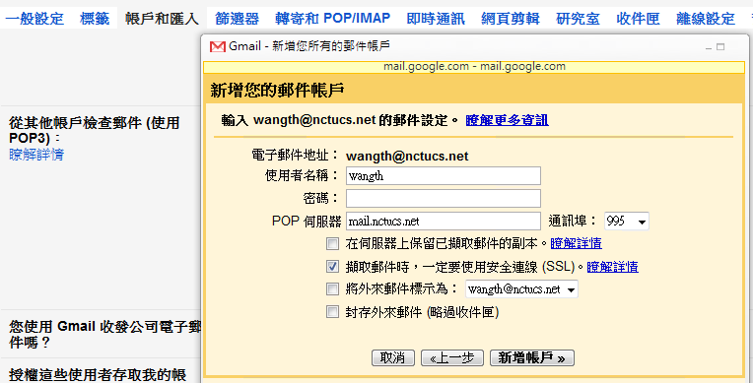
Webmail – Gmail
POP3 over SSL
IMAP over SSL

Slide 19
Reference
Postfix Postscreen Howto
  http://www.postfix.org/POSTSCREEN_README.html
Postfix SASL Howto
  http://www.postfix.org/SASL_README.html
設定 - 郵件過濾設定
  http://help.cs.nctu.edu.tw/help/index.php/設定_-_郵件過濾設定
Mail-DKIM and DKIMproxy
  http://dkimproxy.sourceforge.net/usage.html
Setting up DKIM mail signing and verification
  http://www.ijs.si/software/amavisd/amavisd-new-docs.html#dkim

