Slide 1
Network administration HW3
吳宗翰 wutzh

Slide 2
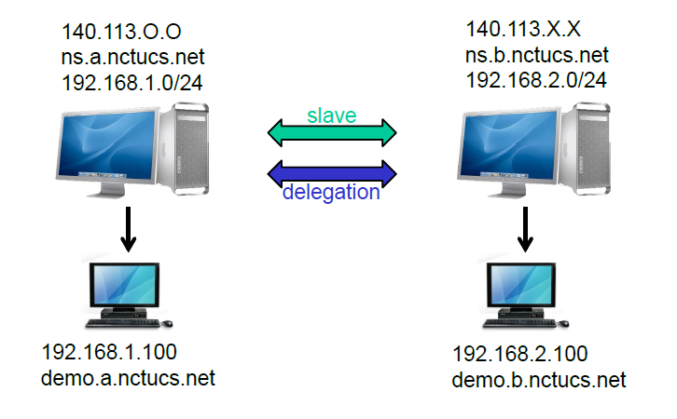
Architecture

Slide 3
Requirements
Setup a DNS server with BIND
Delegation
Reverse zone
Serve your own domain A
Serve your teammate B’s domain as a slave
( Update should be synchronized )
Delegate a sub-domain to your teammate
demo.sub.{your teammate domain} -> 192.168.a.105
demo.{your domain} -> 192.168.a.100

Slide 4
View
Logging
Security
Create TA.{your.domain} A record
For queries from 192.168.a.0/24, answer 192.168.0.254
Otherwise, answer your public IP
Record all records to /var/log/named.log
You might be asked to explain the meaning of each log entry
Only allow AXFR request from 140.113.235.0/24

Slide 5
Help
Nctucs.net http://www.nctucs.net/ 使用系計中帳號申請
no-ip http://www.noip.com/ 免費網域 30 天
IRC channel #nctuNASAon freenode
E3寄信詢問

