Slide 1
SNMP
Simple Network Management Protocol

Slide 2
Network Management
The network management is to
  Monitor the network
  Ensure the operations over the network are functional
  Assure the network works efficiently
An ounce of prevention is worth a pound of cure
  Something wrong
    Service down, fix the problem, resume the service
  Nothing wrong
    Service is somewhat abnormal, try to fix it online
Requirements
  FCAPS

Slide 3
Requirements of Network Management
Fault Management
  Detect, isolate, reconfigurate and repair the abnormal network environment
  Problem tracking and control
Configuration and Name Management
  Startup, shutdown, reconfigure network component when
    Upgrade, fault recovery or security checks
Accounting Management
  Track the use of network resources by end-user to provide
    Impropriate usage tracing, charging, statistics
Performance Management
  Capacity utilization, throughput, response time, bottleneck
    Collect information and assess current situation
Security Management
  Information protection and access control

Slide 4
In that time
Network environment is simple
  ICMP is the only way to do network investigation
    ping, traceroute, ….

Slide 5
Introduction
SNMP – Simple Network Management Protocol
  A set of standards for network management
    Protocol
    Database structure specification
    Data objects
  A set of standardized tools that
    Control costs of network management
    Across various product types
      End system, bridges, routers, telecommunications, …
  Two roles
    Network management station: SNMP collector, manager
    SNMP agent

Slide 6
History
In 1989
  SNMP was adopted as TCP/IP-based Internet standards
In 1991
  RMON – Remote network MONitoring
    Supplement to SNMP to include management of LAN and WAN packet flow
In 1995
  SNMPv2 (2c)
    Functional enhancements to SNMP
    SNMP on OSI-based networks
  RMON2
    Network layer and application layer
In 1998
  SNMPv3
    Precise definition, but the content is the same as SNMPv2
    Security capability for SNMP

Slide 7
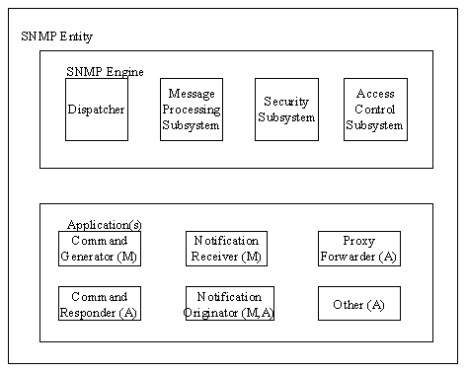
The roles in SNMPv3
Notes:
http://www.tml.tkk.fi/Opinnot/Tik-110.551/1999/papers/12ManagementOfIPngCore/ipcore.html

Slide 8
Network Management System (1)
A collection of tools for
  Network monitoring
  Network control
These tools must be integrated
  Single operator interface with powerful but user-friendly
  Support of managed equipments.

Slide 9
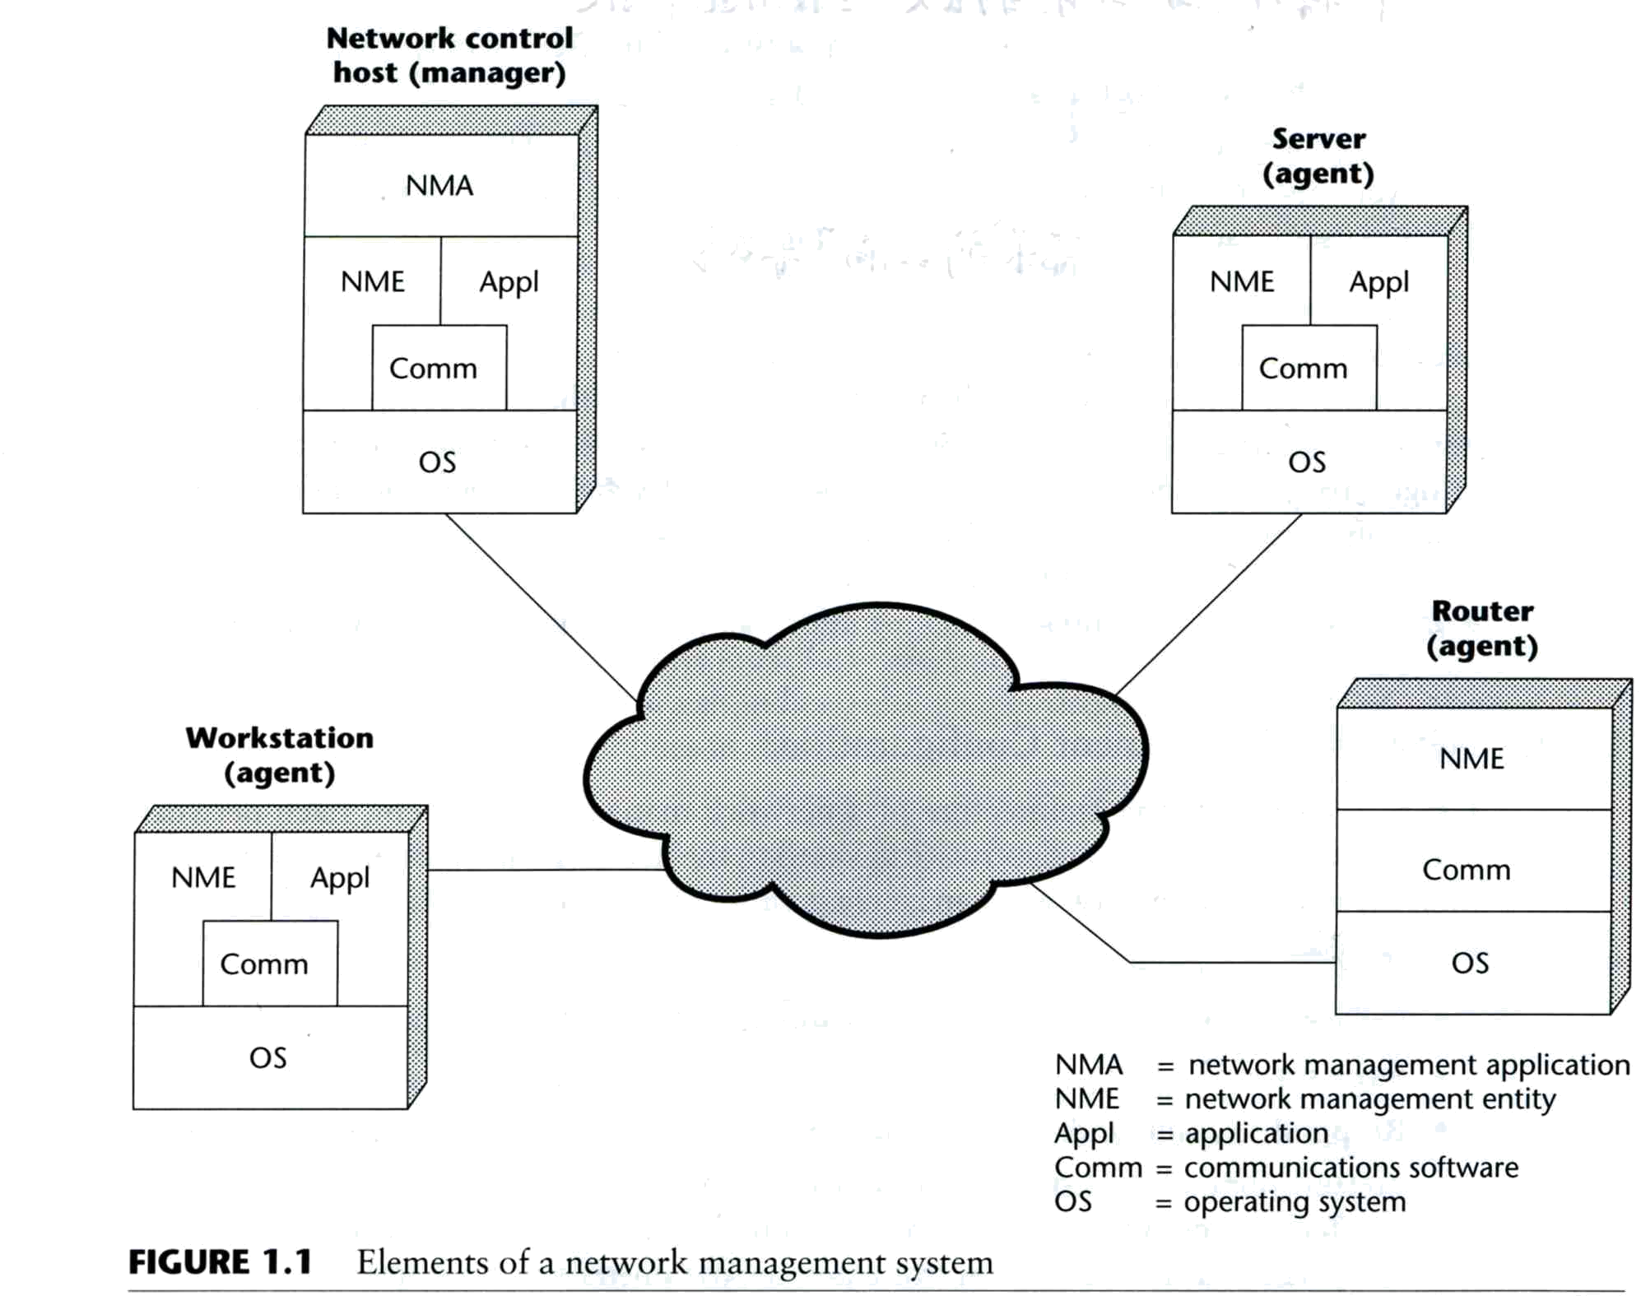
Network Management System (2)
Architecture of NMS
  NMA
    Operator interface
  NME
    Collect statistics
    Response to NMA
    Alert NMA when
    environment changing

Slide 10
SNMP Concepts

Slide 11
SNMP Architecture (1)
4 key elements
  Management station
    Serve as the interface between manager and devices
      Management applications
      User-friendly interface
      Translate manager’s requirements into actual monitoring or control operations
      Database extracted from MIBs of all managed device
  Management Agent
    Respond to request from management station
    Change settings in MIB of managed device
    Asynchronously report abnormal event (Trap)
  Management Information Base (MIB)
    Each resource is represented as an object and MIB is a collection of objects
  Network Management Protocol
    get, setnext, set, getresponse, trap, ...

Slide 12
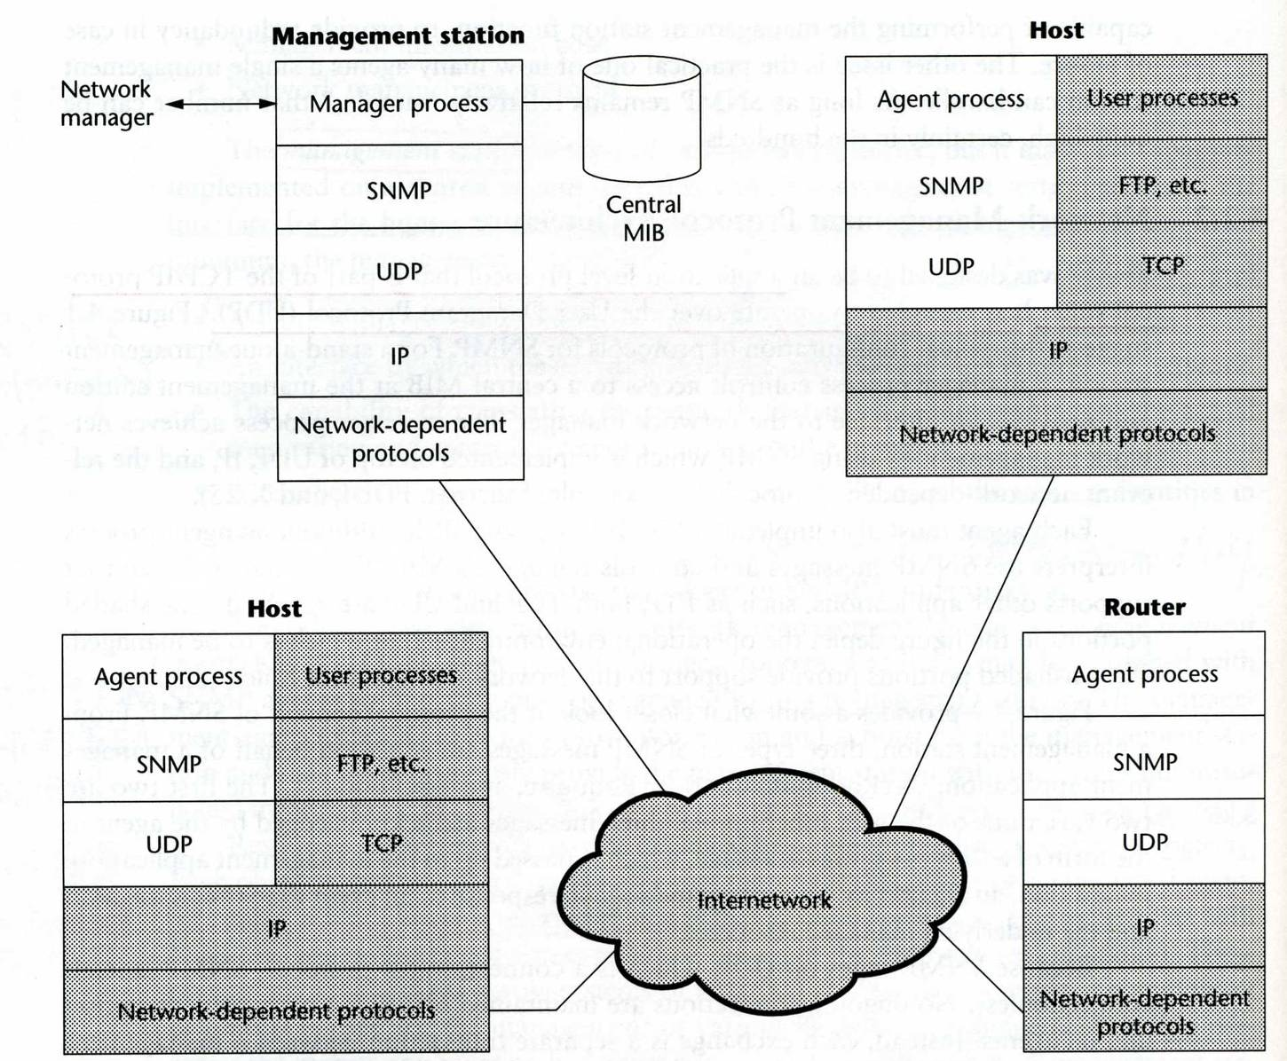
SNMP Architecture (2)
SNMP
  UDP
  TCP
  Port 161(snmp)
  Port 162(snmp-trap)

Slide 13
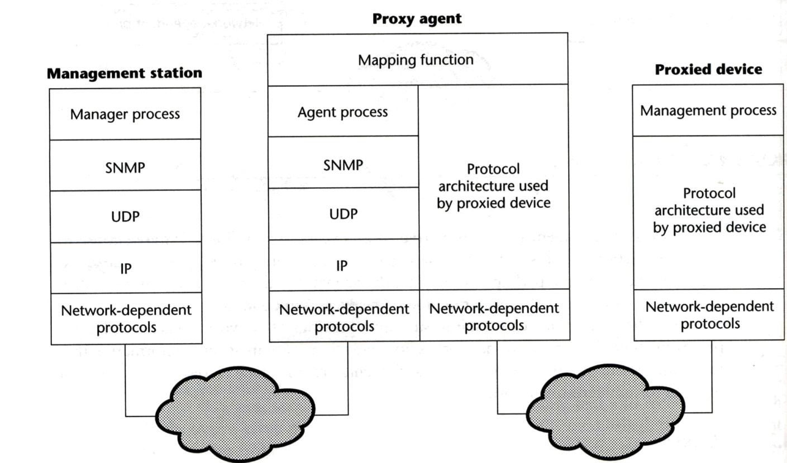
SNMP Architecture (3)
SNMP proxy
  Devices that do not support UDP/IP
    ex: Bridge, Modem
  Devices that do not want to add burden of SNMP agent
    ex: PC, programmable controller

Slide 14
SNMP Message Information
Message Information Base (MIB)
  Collection of objects
  Each object represents certain resource of managed device
Interoperability of MIB
  Object that represents a particular resource should be the same cross various system
    What objects
    (MIB-I) and MIB-II
  Common representation format
    SMI (Structure of Management Information)

Slide 15
SNMP Message Information –
SMI (1)
SMI
  Structure of Management Information
  Identify the data type that can be used in MIB
  How resources are represented and named, including
    MIB structure
    Syntax and value of each object
    Encoding of object value

Slide 16
SNMP Message Information –
SMI (2)
MIB structure
  Rooted tree
    The leaves are the actual managed objects
    Each object has an identifier (OBJECT IDENTIFIER)
      Number with dot as delimiter
    The internet node
      iso(1) -> org(3) -> dod(6) -> internet(1)
      object identifier of internet node: 1.3.6.1
    Under internet node
      directory(1) :OSI X.500 directory
      mgmt(2): used for objects defined in IAB (Internet Activities Board)
      experimental(3): used for internet experiments
      private(4): unilaterally usage

Slide 17
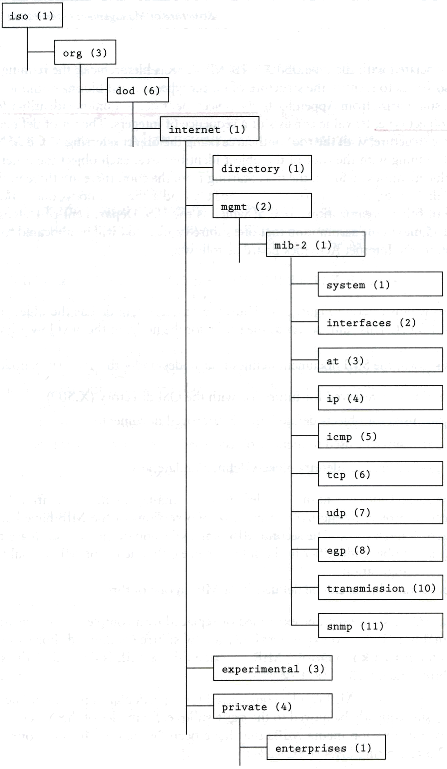
SNMP Message Information –
SMI (3)
  MIB Tree
  Define additional objects
    Under mib-2
      1.3.6.1.2.1
    Under experimental
      1.3.6.1.3
    Under enterprises
      1.3.6.1.4.1

Slide 18
SNMP Message Information –
Object Syntax (1)
Definition of object
  Data type
    Application-independent type (UNIVERSAL type)
      integer, octetstring, null, object identifier, sequence
    Application-wide types (RFC 1155)
      Networkaddress → IP Address
      counter (0 ~ 2³² -1), increasing only, wrap to 0
      gauge (0 ~ 2³² -1)
      timeticks
      opaque (encoded as OCTET STRING for transmission)
      threshold
  Value ranges
  Relationship with other objects in MIB

Slide 19
SNMP Message Information –
Object Syntax (2)
ASN.1
  Abstract Syntax Notation One
  A formal language developed by CCITT and ISO
  In SNMP, we use macro to define other types used to define managed objects
    Macro definition (template)
    Macro instance (particular type)
    Macro instance value

Slide 20
SNMP Message Information –
Object Syntax (3)
Example: /usr/share/snmp/mibs/BEGEMOT-HOSTRES-MIB.txt
-- Additional stuff for the HOST-RESOURCES MIB.
BEGEMOT-HOSTRES-MIB DEFINITIONS ::= BEGIN
IMPORTS
MODULE-IDENTITY, OBJECT-TYPE, TimeTicks
FROM SNMPv2-SMI
begemot
FROM BEGEMOT-MIB;
begemotHostres MODULE-IDENTITY
….
::= { begemot 202 }
begemotHostresObjects OBJECT IDENTIFIER ::= { begemotHostres 1 }
begemotHrStorageUpdate OBJECT-TYPE
SYNTAX TimeTicks
MAX-ACCESS read-write
STATUS current
DESCRIPTION
"The maximum number of ticks the storage table is cached."
::= { begemotHostresObjects 1 }

Slide 21
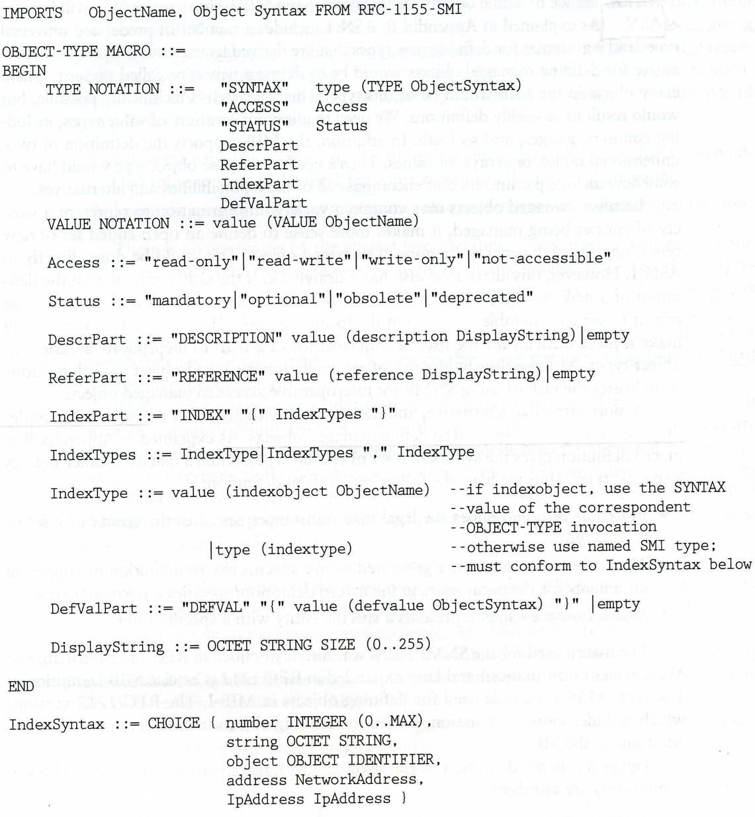
SNMP Message Information –
Object Syntax (4)
OBJECT-Type
macro

Slide 22
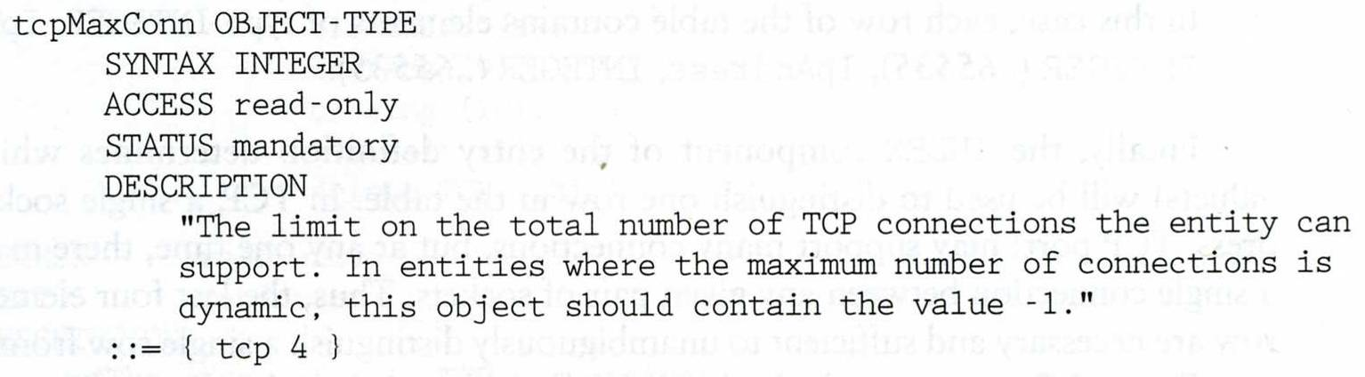
SNMP Message Information –
Object Syntax (5)
Example of object definition
  iso.org.dod.internet.mgmt.mib-2.tcp.tcpMaxConn
  1.3.6.1.2.1.6.4

Slide 23
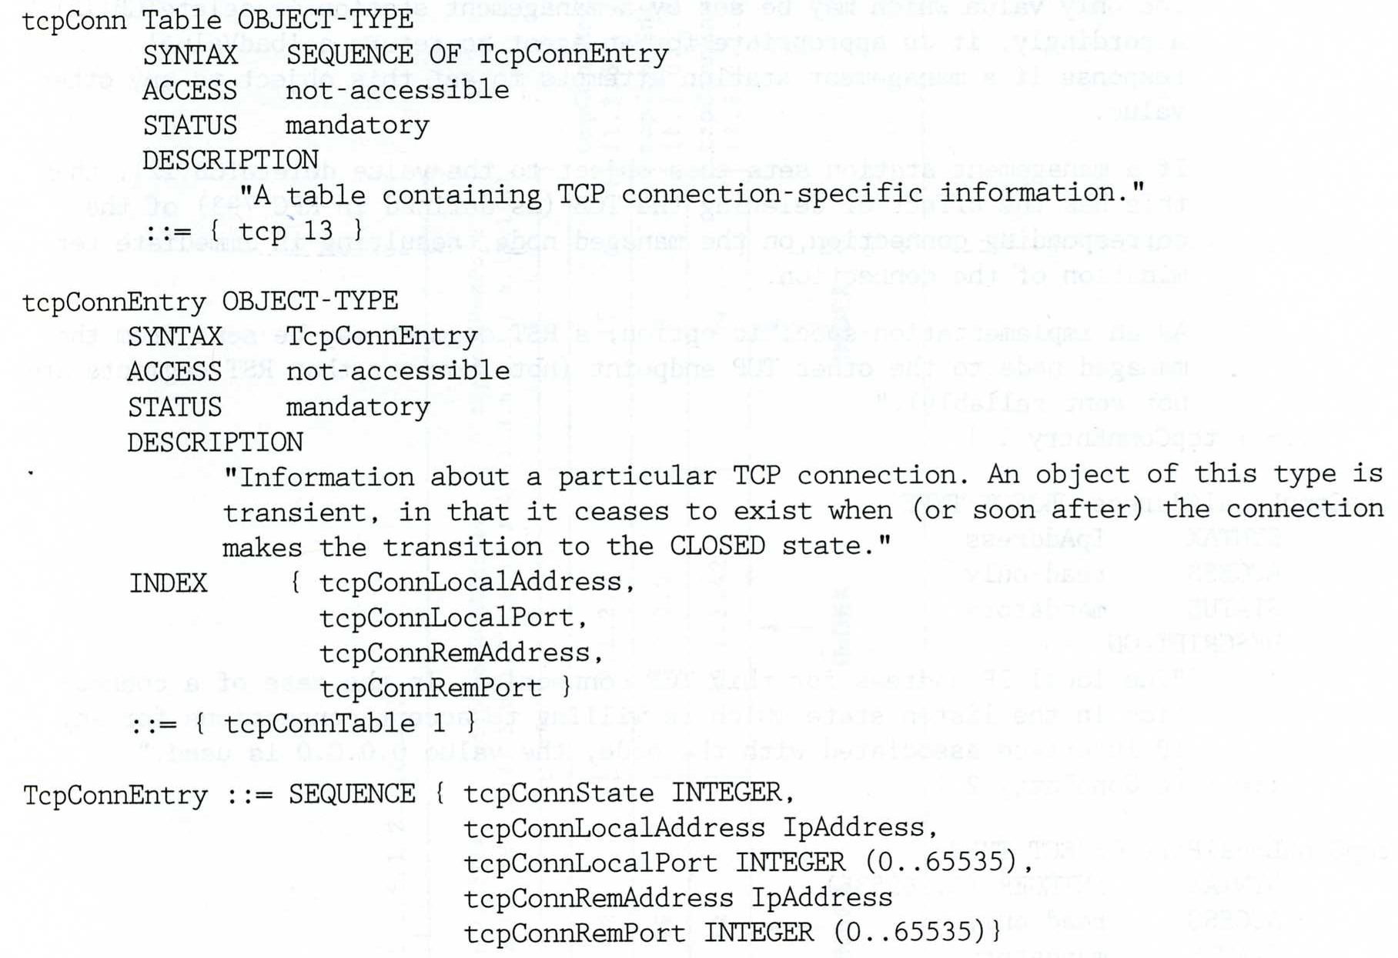
SNMP Message Information –
Object Syntax (6)
2-D table
  Two-dimensional array with scalar-valued entries
  Ex: tcpConnTable (RFC1213)

Slide 24
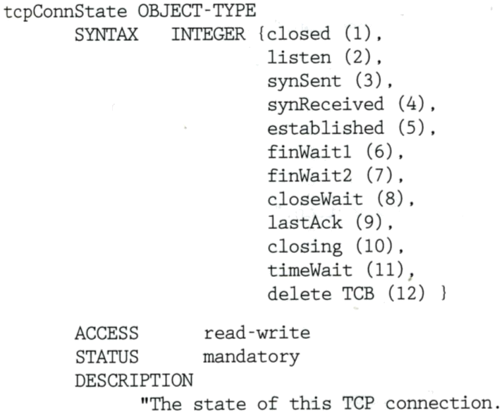
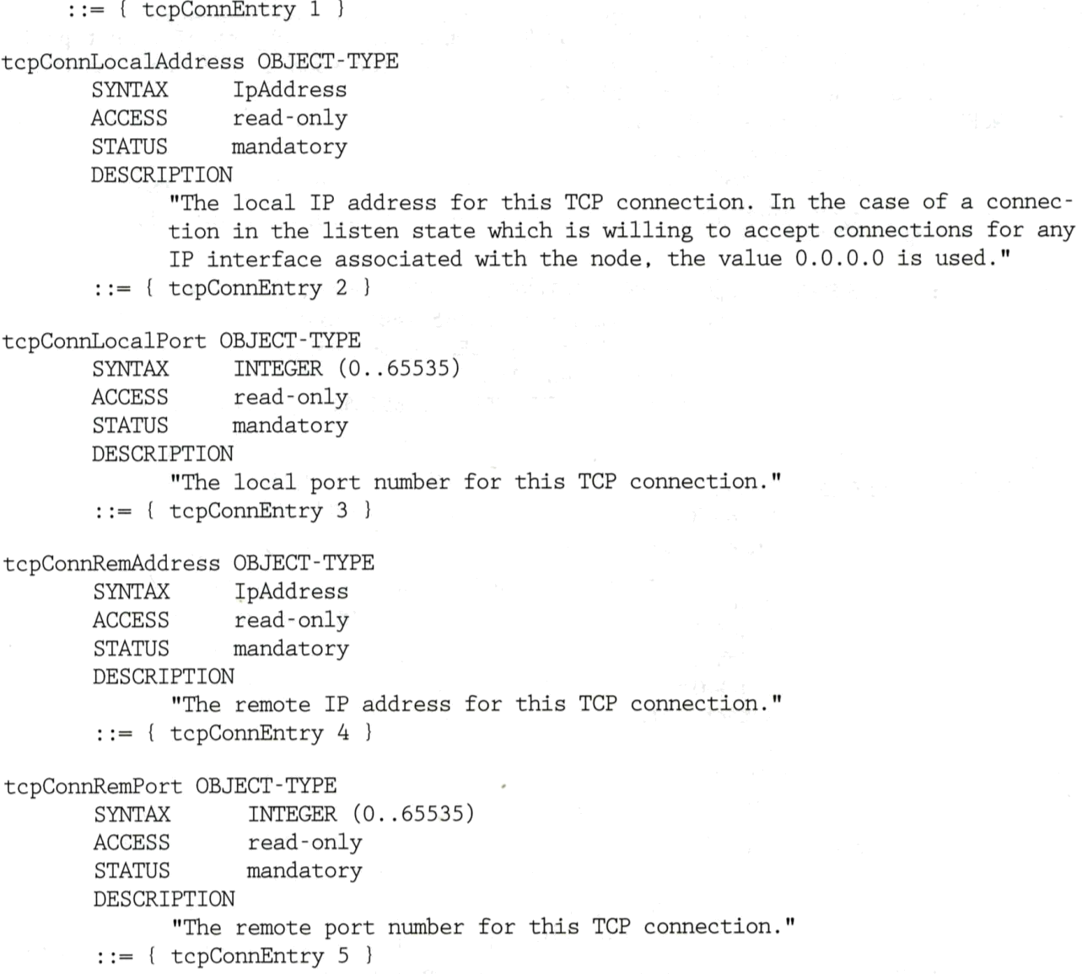
SNMP Message Information –
Object Syntax (7)

Slide 25
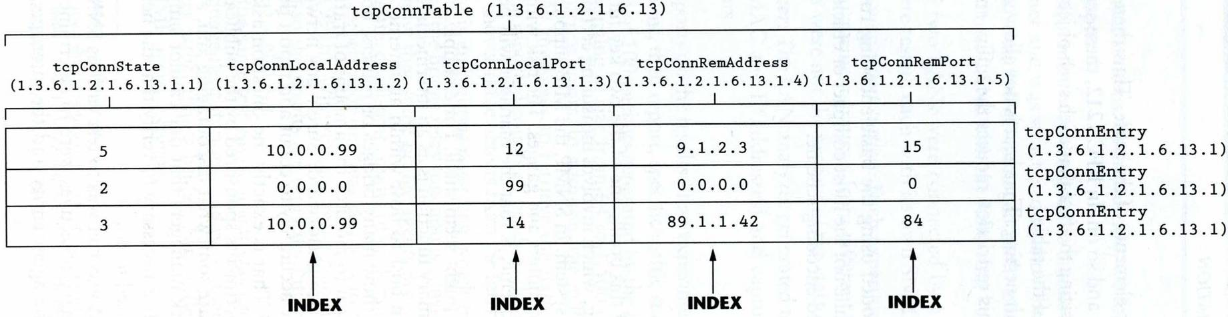
SNMP Message Information –
Object Syntax (8)
  iso (1) -> org (3) -> dod (6) -> internet (1) -> mgmt (2)
    mib-2 (1) -> tcp (6) -> tcpConnTable(13)

Slide 26
Standard MIBs

Slide 27
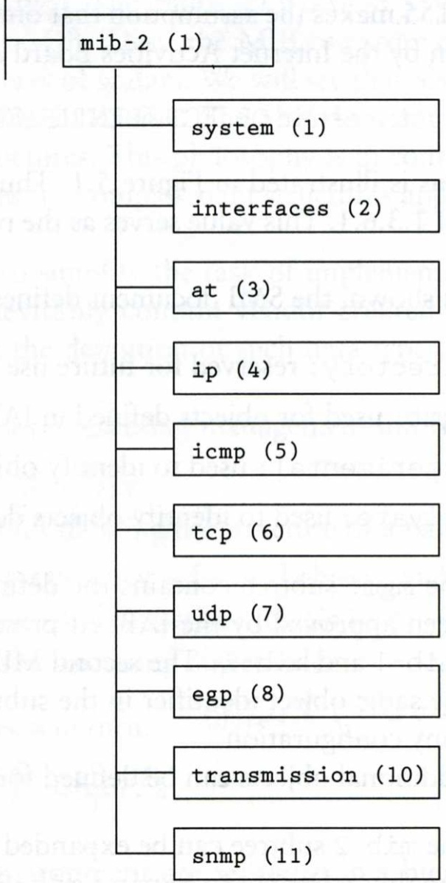
MIB-II (1)
RFC1213
  MIB-I (RFC 1156)
  MIB-II is a superset of MIB-I with
  some additional objects and groups

Slide 28
MIB-II (2)
First layer under mib-2
  1.3.6.1.2.1 (iso.org.dod.internet.mgmt.mib-2)
  system
    Overall information about the system
  interfaces
    Information about each interface
  at
    Address translation (obsolete)
  ip, icmp, tcp, udp, egp
  transmission
    Transmission schemes and access protocol at each system interface
  snmp

Slide 29
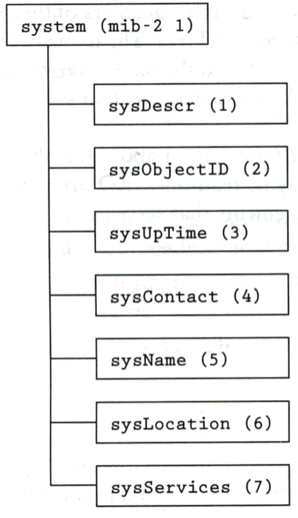
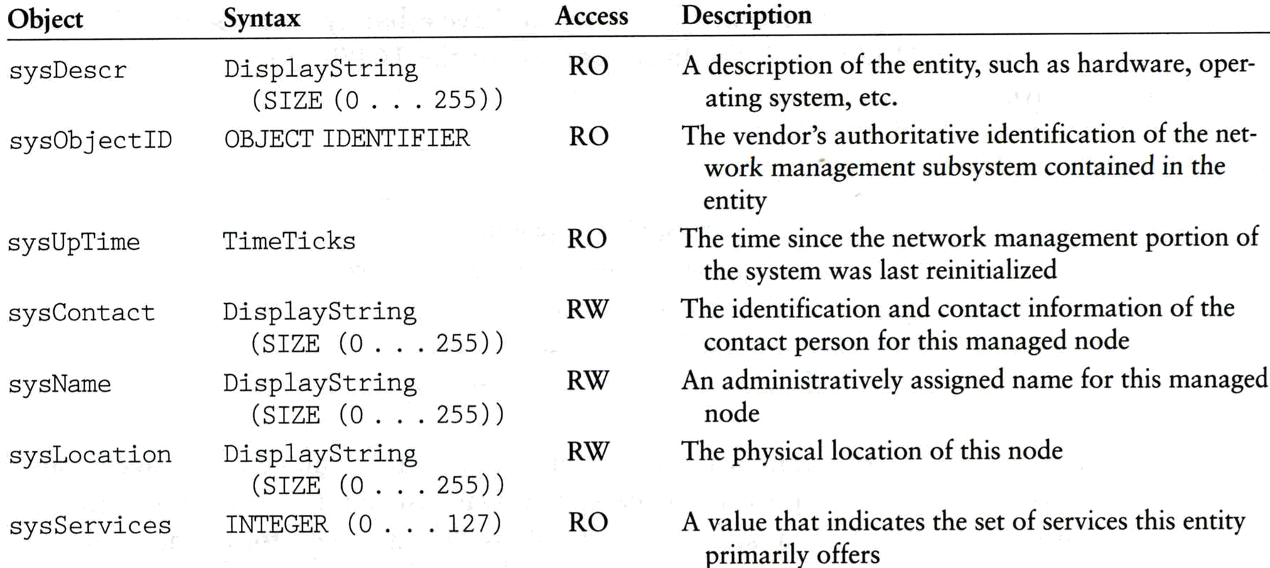
MIB-II system group
sysServices
  1 physical (ex: repeater)
  2 datalink/subnetwork (ex: bridge)
  3 internet (ex: router)
  4 end-to-end (ex: IP hosts)
  7 applications (ex: mail relays)

Slide 30
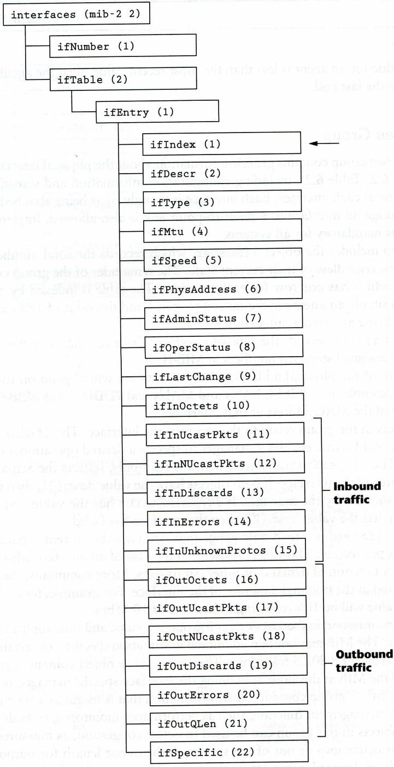
MIB-II interface group (1)

Slide 31
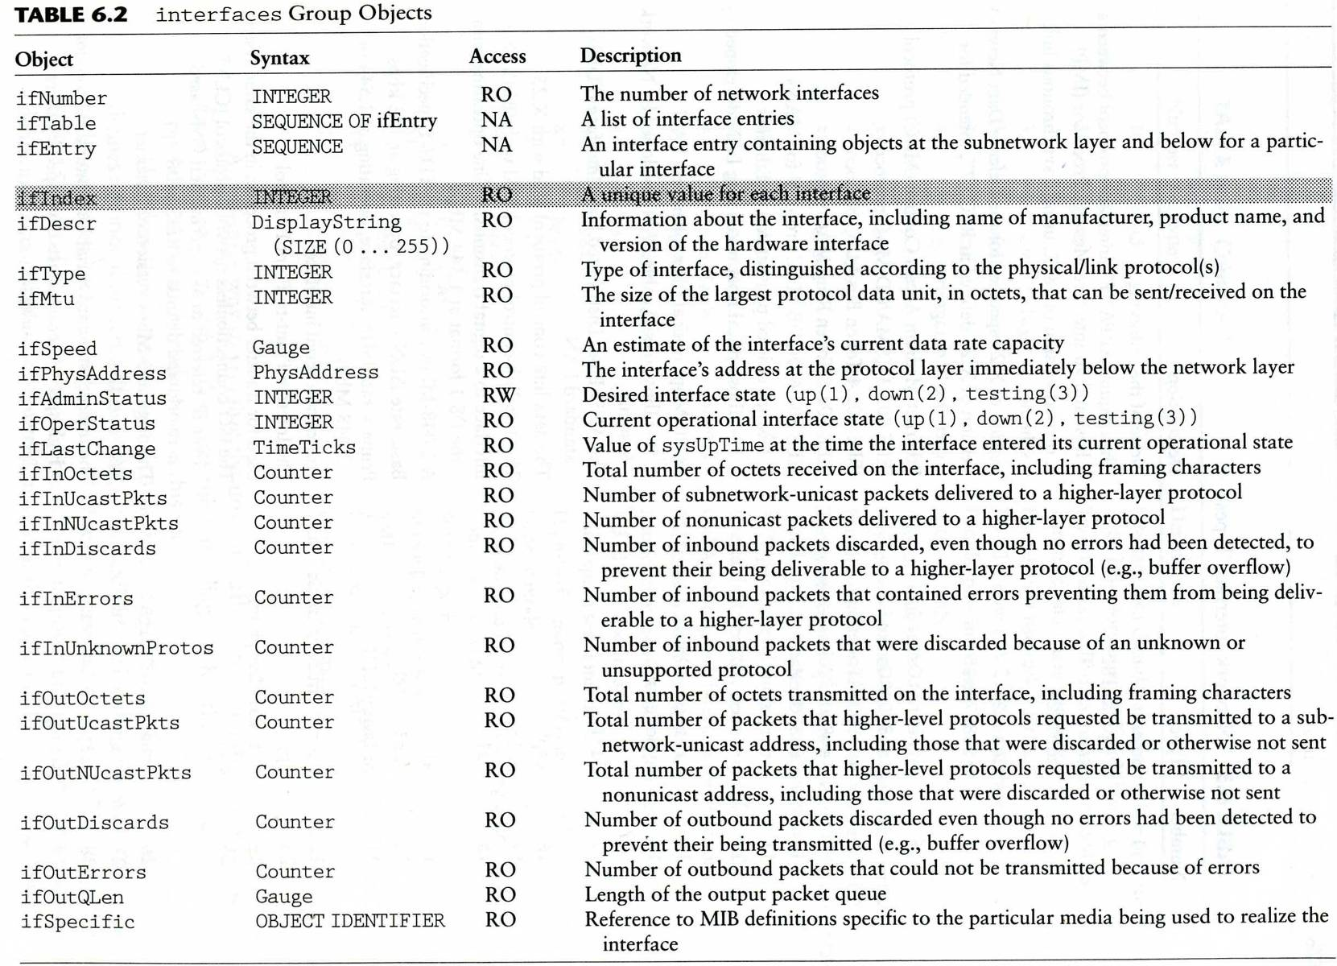
MIB-II interface group (2)

Slide 32
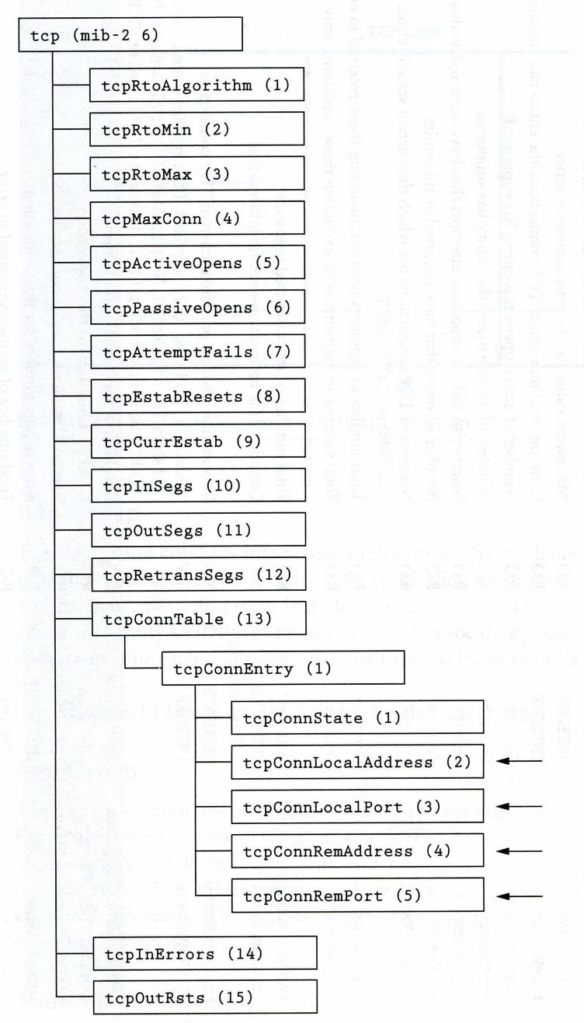
MIB-II tcp group

Slide 33
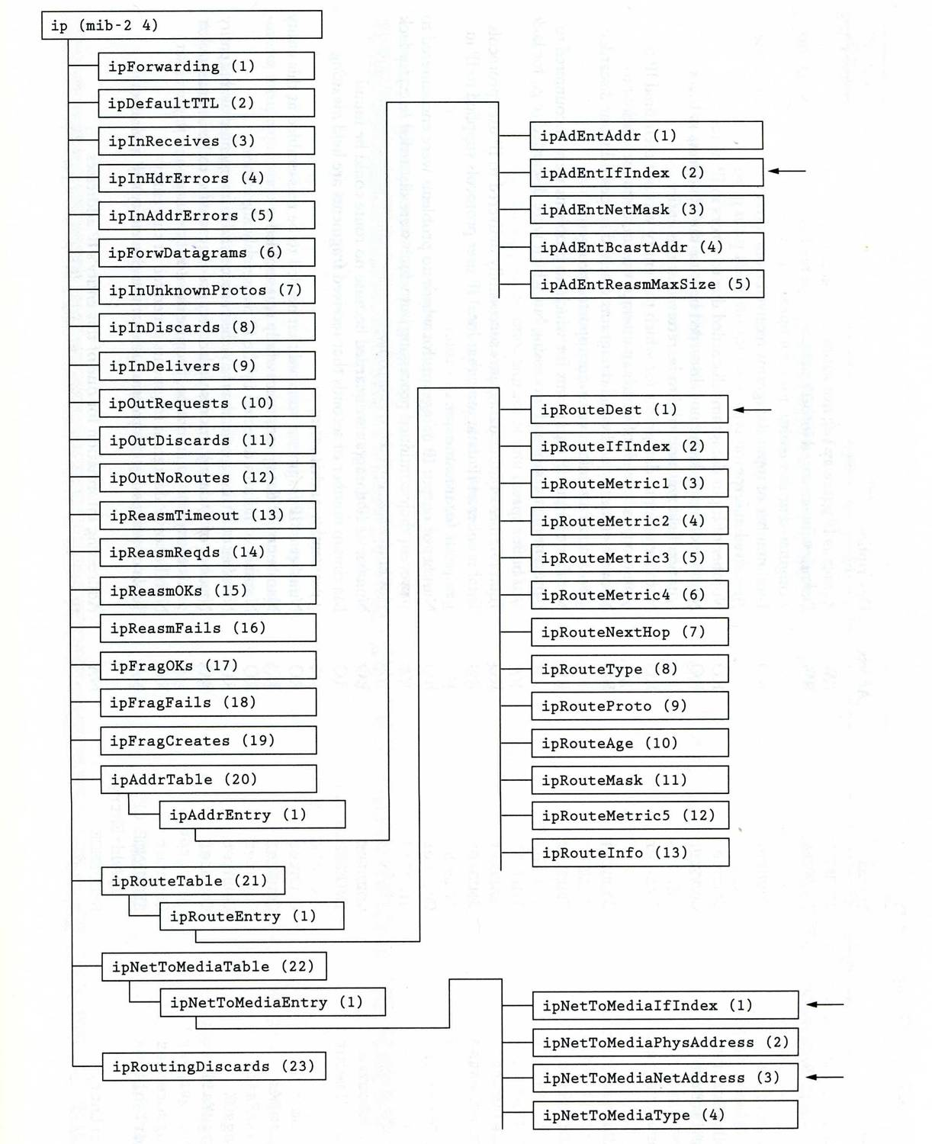
MIB-II ip group

Slide 34
Host Resource MIB
RFC2790
  host OBJECT IDENTIFIER ::= { mib-2 25 }
  hrSystem OBJECT IDENTIFIER ::= { host 1 }
  hrStorage OBJECT IDENTIFIER ::= { host 2 }
  hrDevice OBJECT IDENTIFIER ::= { host 3 }
  hrSWRun OBJECT IDENTIFIER ::= { host 4 }
  hrSWRunPerf OBJECT IDENTIFIER ::= { host 5 }
  hrSWInstalled OBJECT IDENTIFIER ::= { host 6 }
  hrMIBAdminInfo OBJECT IDENTIFIER ::= { host 7 }

Slide 35
SNMP Protocol

Slide 36
SNMP Protocol
Supported operations
  get, getnext, set, getresponse, trap, …
Simplicity vs. limitations
  Not possible to change the structure of MIB by adding or deleting object instances
  Access is provided only to leaf objects

Slide 37
SNMP Protocol – security concern
In management environment
  The management station and managed agent
    One-to-many relationship
    One station may manage all or a subset of target
  The managed station and management station
    One-to-many relationship
    Each managed agent controls its local MIB and must be able to control the use of that MIB
    Three aspects
      Authentication service
      Access policy
      Proxy service

Slide 38
SNMP Protocol – communities (1)
An SNMP community
  A relationship between an SNMP agent and a set of SNMP managers that defines
    Authentication, access control and proxy
  The managed system establishes one community for each combination of authentication, access control and proxy
  Each community has a unique “community name”
  Management station use certain community name in all get and set operations

Slide 39
SNMP Protocol – communities (2)
Authentication
  The community name (password)
Access policy
  Community profile
    SNMP MIB view
      A subset of MIB objects
    SNMP access mode
      read-only, read-write, write-only, non-accessible

Slide 40
SNMP Protocol –
Where is the security
SNMPv3
  User-based Security Model (USM)
    Message Authentication
      HMAC
        MD5, SHA-1
        Authentication passphrase, secret key
    Encryption
      CBC-DES
  View-based Access Control Model (VACM)
    Context table
    Security to group table
    Access table
    View tree family table

Slide 41
Net-SNMP
previously known as "ucd-snmp"

Slide 42
Net-SNMP (1)
Install net-snmp
  net-mgmt/net-snmp
  # make [OPTIONS] install clean
  Firewall allows
    snmpd: udp 161
    snmptrapd: udp 162
DEFAULT_SNMP_VERSION="3" Default version of SNMP to use.
NET_SNMP_SYS_CONTACT="nobody@nowhere.invalid"
Default system contact.
NET_SNMP_SYS_LOCATION="somewhere"
Default system location.
NET_SNMP_LOGFILE="/var/log/snmpd.log"
Default log file location for snmpd.
NET_SNMP_PERSISTENTDIR="/var/net-snmp"
Default directory for persistent data storage.

Slide 43
Net-SNMP (2)
After installing…
  /usr/local/share/snmp/snmpd.conf.example
If you want to invoke snmpd and/or snmptrapd at startup, put these
lines into /etc/rc.conf.
snmpd_enable="YES"
snmpd_flags="-a"
snmpd_conffile="/usr/local/share/snmpd.conf /etc/snmpd.conf"
snmptrapd_enable="YES"
snmptrapd_flags="-a -p /var/run/snmptrapd.pid"
# Full access from the local host
# rocommunity public localhost
# Default access to basic system info
rocommunity public default -V systemonly

Slide 44
Net-SNMP (3)
Use snmpconf command to generate the configuration files
  snmpconf -g basic_setup
  snmpconf
    System Information Setup
      Location, contact, service
    Access Control Setup
      SNMPv3 or SNMPv1 access community
    Trap Destination
      Where to send the trap
    Monitor Various Aspects of the Running Host
      Process, disk space, load, file
    Extending the Agent
      Let snmp agent to return information that yourself define
    Agent Operating Mode
      User/group, IP port,…

Slide 45
Net-SNMP (4)
To get various value
  man snmpget, snmpgetnext, snmptable
    % snmpget -c public -v 1 nasa system.sysContact.0
    % snmpgetnext –c public –v 1 nasa system.sysContact.0
    % snmptable -c public -v 1 nasa mib-2.tcp.tcpConnTable
    % snmpwalk –c public –v 1 nasa system
    % snmpwalk -c public -v 1 nasa iso.org.dod.internet.private.enterprises

Slide 46
RRDTool

Slide 47
RRDTool (1)
Round-robin database.
Data logging / graphing.
Easy integration.
  Bindings for Python, Perl, Ruby, Lua, ...
  Command line tools also enable integration with shell scripts.
FreeBSD port: databases/rrdtool
http://oss.oetiker.ch/rrdtool/doc/index.en.html

Slide 48
RRDTool (2)
Create RRD
database
Create
  Create new RRD database.
  $ rrdtool create
Fetch data
Update
  Update the database.
  $ rrdtool update
Graph
  Graph the result from database.
  $ rrdtool graph
Fetch data
Update
Graphing

Slide 49
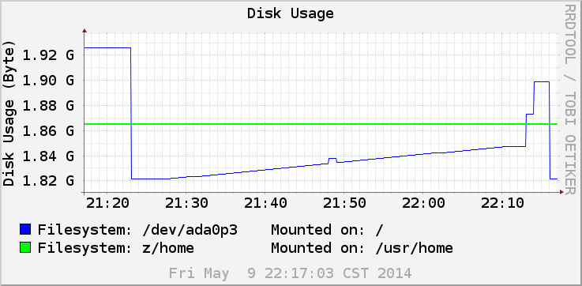
RRDTool (3)

Slide 50
Cacti

Slide 51
Cacti(1)
About
  Cacti is a complete network graphing solution designed to harness the power of RRDTool's data storage and graphing functionality.
  Cacti provides a fast poller, advanced graph templating, multiple data acquisition methods, and user management features out of the box.
  All of this is wrapped in an intuitive, easy to use interface that makes sense for LAN-sized installations up to complex networks with hundreds of devices.
Install cacti
  /usr/ports/net-mgmt/cacti

Slide 52
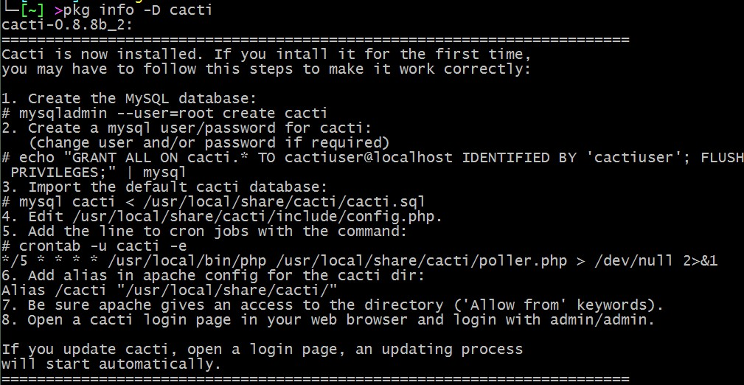
Cacti(2)

Slide 53
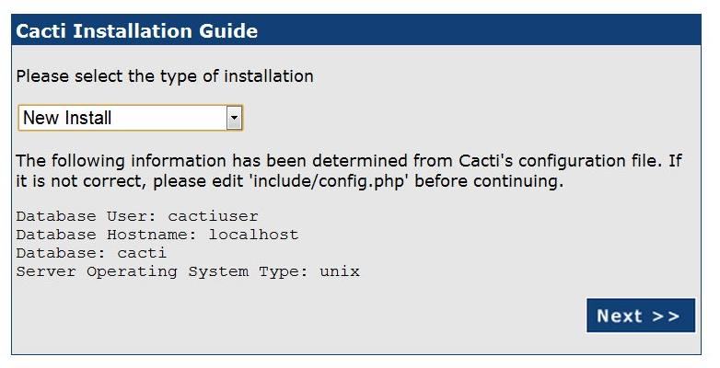
Cacti(3)

Slide 54
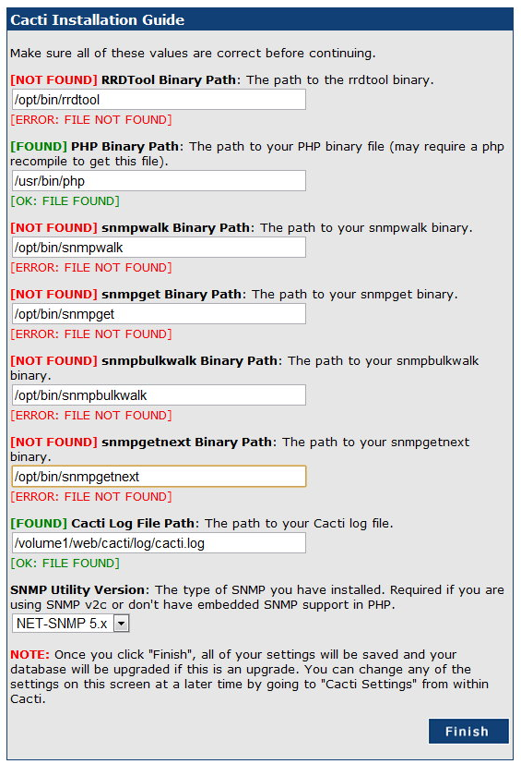
Cacti(4)

Slide 55
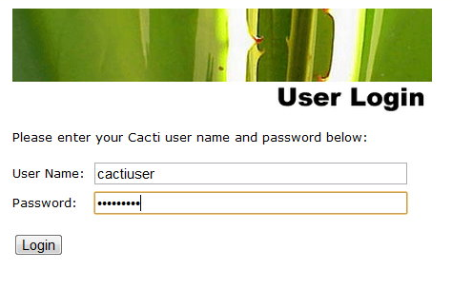
Cacti(5)
Default account/pwd
  admin/admin

Slide 56
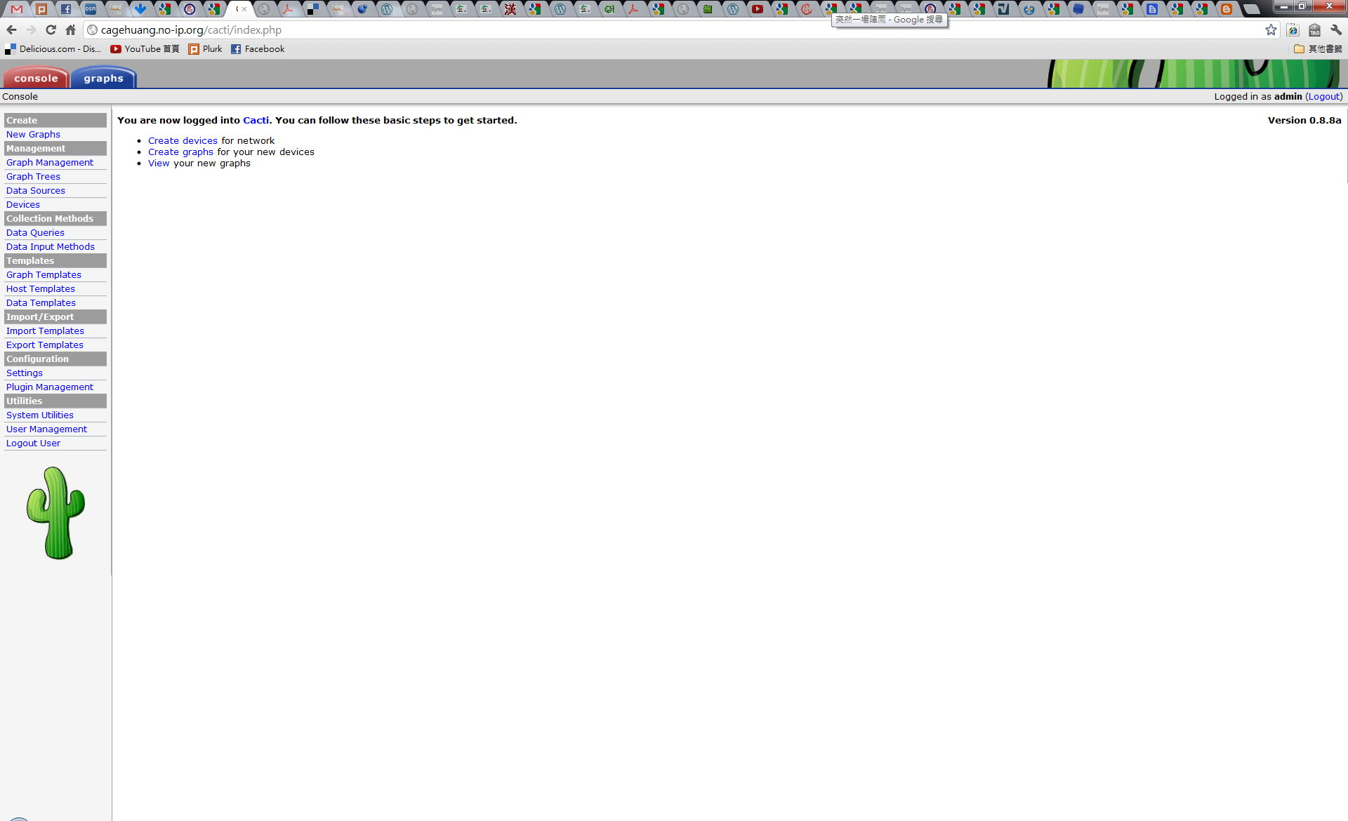
Cacti(6)

Slide 57
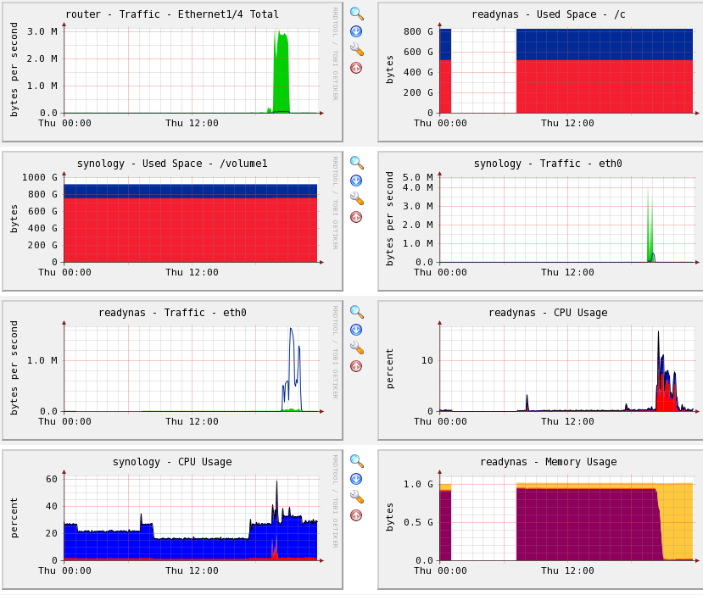
Cacti(7)

