Slide 1
Network Administration
pmli

Slide 2

Syllabus
Website:
  e3.nctu.edu.tw
Instructor:
  李柏明
Time:
  Mon. IJK (PM 6:30 ~ 9:20)
Place:
  EC115
English Slides and Exams, Chinese Lecture (TAs can support)
TAs:
  Email to TAs: ta@nasa.cs.nctu.edu.tw
  IRC channel #nctuNASA on freenode → for interactive experience
  Newsgroup cs.course.sysadmin → for longer discussion, and also for your classmates.
  BBS bs2.to board CS-NetAdmin
資安學程 http://isc.cs.nctu.edu.tw/
大學部雲端系統學分學程 http://delta.nctu.edu.tw/

Slide 3






Syllabus –
Course Textbook and Reference
Textbook
  UNIX and Linux System Administration Handbook, 4th ed.
  Slides
Reference book
  TCP/IP Illustrated Volume 1
  Programming Perl
  Postfix
  DNS and BIND
  SNMP, SNMPv2, SNMPv3 and RMON 1, 2

Slide 4
Syllabus –
Course Overview
Main topics
  Perl Programming & Python Programming
  Networking
    TCP/IP Networking
    Network Environment
    NAT, DHCP, Firewall, FTP, VPN, Proxy, …
  DNS – BIND (Berkeley Internet Name Domain)
  Mail System -- Postfix
    SPF (Sender Policy Framework)
    DKIM (DomainKeys Identified Mail)
    …
  PGP (Pretty Good Privacy)
  Usenet News – INN (InterNetNews)
  Network Management

Slide 5
Syllabus – Grade Policy
Mid
  20%
Final
  20%
Exercise
  60 ~ 72%
    No Delay Work
    5 exercises

Slide 6
Syllabus –
Prerequisite
Background Knowledges
  It is better to have taken
    “System Administration” (計算機系統管理)
    “Introduction to Networking” (計算機網路概論)
  At least
    Experience of using Unix-like environment
Environment
  One dedicated PC (Or dual OS in your PC, VM is also accepted.)
    With Unix-like OS installed (e.g. FreeBSD, Linux, Sun OS, …etc.)
    FreeBSD is recommended for the reason: TA supports.

Slide 7

Attitude
Attend every class
Do every exercise
  As early as possible
  On your own
Read book and practice at least 6 hours every week
  Use unix-like environment
  Recommend: more than 1.5 hours/day averagely.
Collect information on the internet
  The newer, the better.

Slide 8
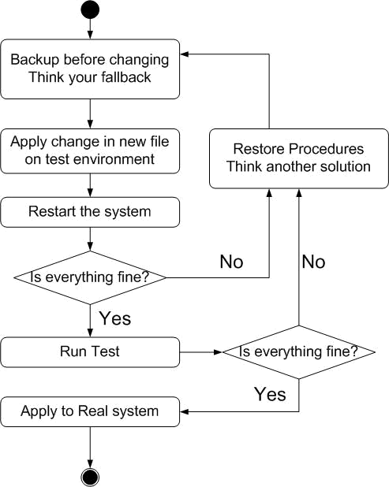
When You Perform Any Changes…
Flow of Change

Slide 9
SA-NA Junction
FreeBSD
  9.1-RELEASE
    http://people.cs.nctu.edu.tw/~huanghs/course/sysadm2012/slides/01_Install_FreeBSD.ppt
Install OS and software (ports)
  http://www.cs.nctu.edu.tw/~huanghs/course/sysadm2012/
    http://people.cs.nctu.edu.tw/~huanghs/course/sysadm2012/slides/02_Installing_Applications.ppt

Slide 10
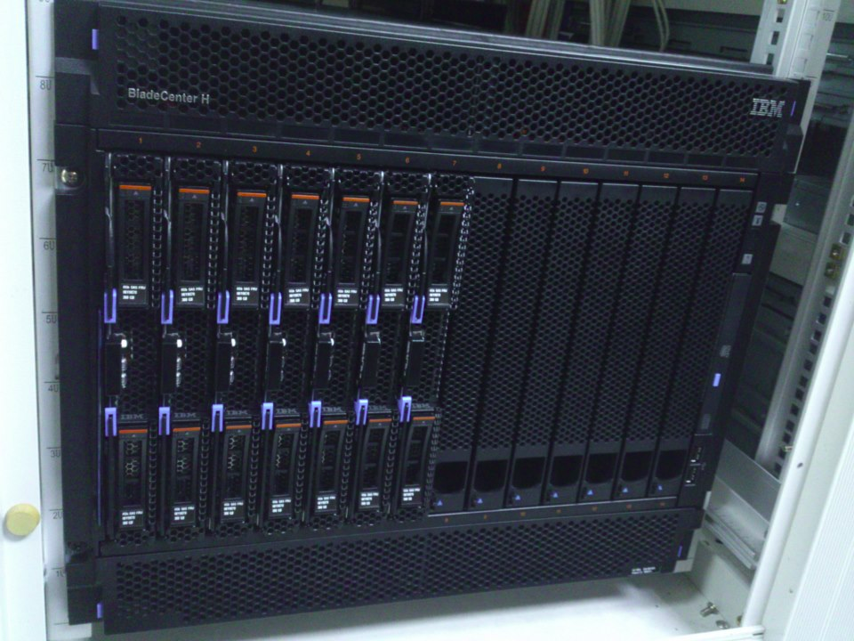

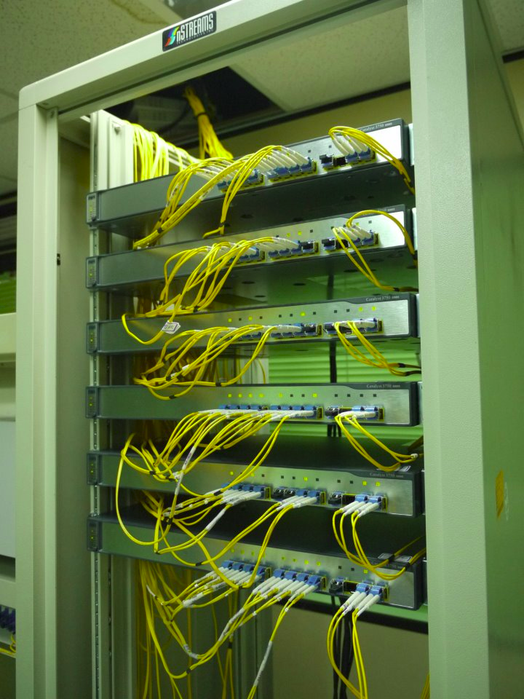
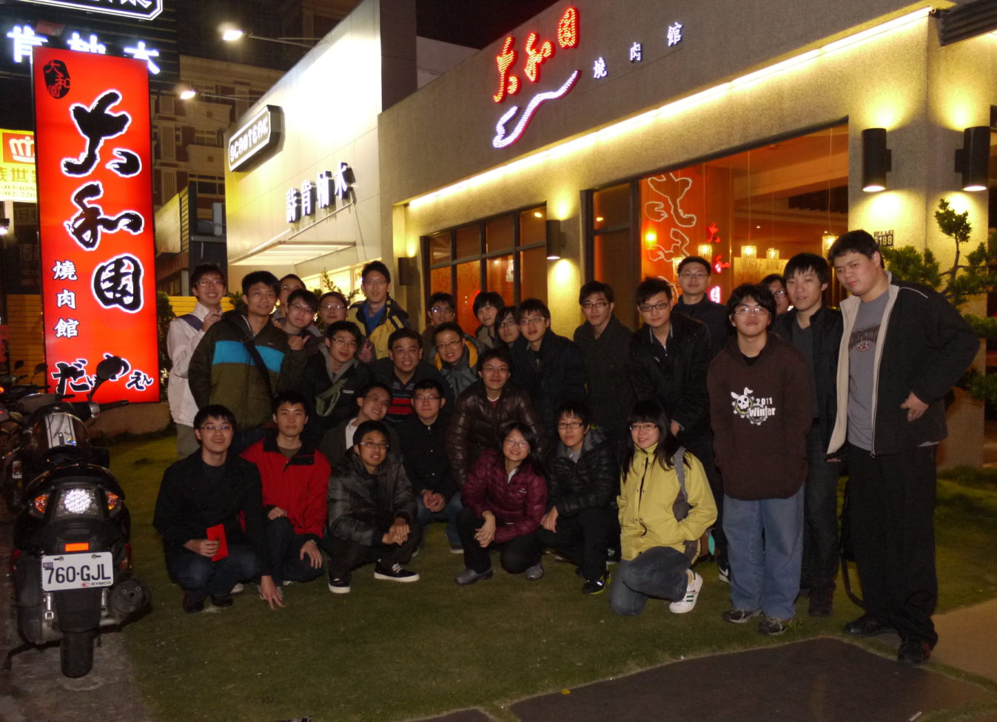
We Want You!

