Slide 1
Virtual Private Network
pmli

Slide 2
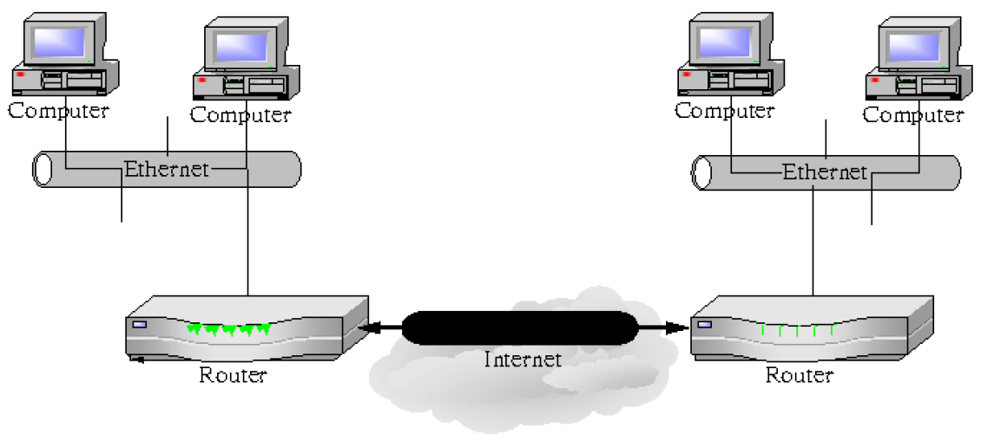
What is a VPN
Used to connect two private networks together via the Internet

Slide 3
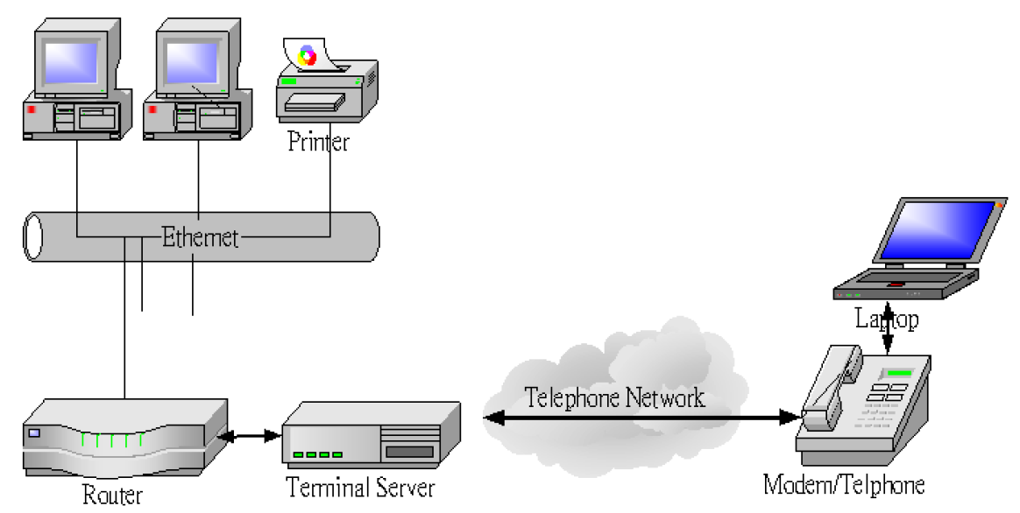
What is a VPN
Used to connect remote users to a private network via the Internet

Slide 4
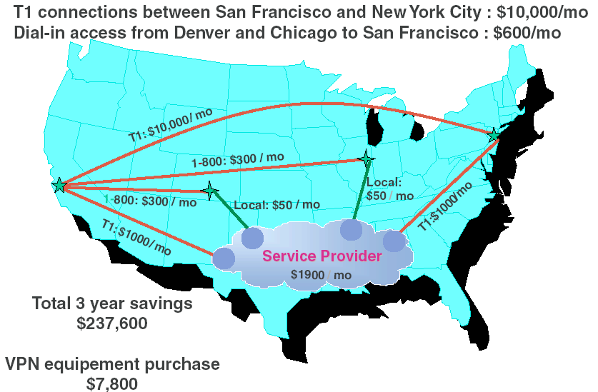
Why ?

Slide 5
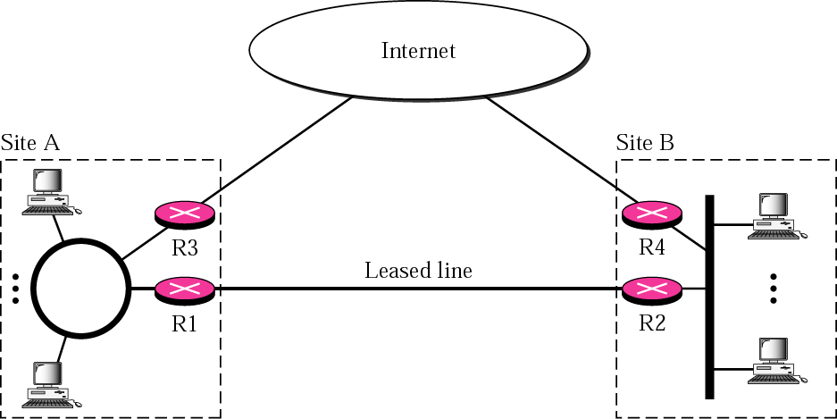
Virtual Private Network
VPN connects the components of one network over another network by tunnel through the public network with security and features formerly available only in private network
VPN saves the cost of dedicated line
Brief: VPN is Secure Tunnel

Slide 6
What a VPN needs ?
VPNs must be encrypted
  so no one can read it
VPNs must be authenticated
No one outside the VPN can alter the VPN
All parties to the VPN must agree on the security properties

Slide 7
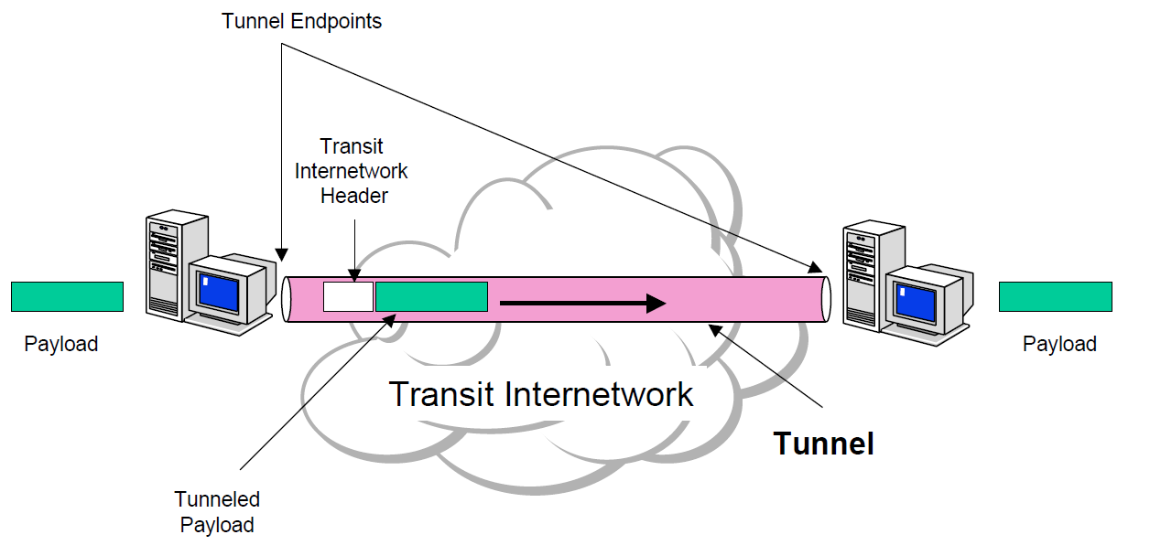
Tunneling
Core technology
  VPN consists of a set of point to point connections tunnelled over the Internet

Slide 8
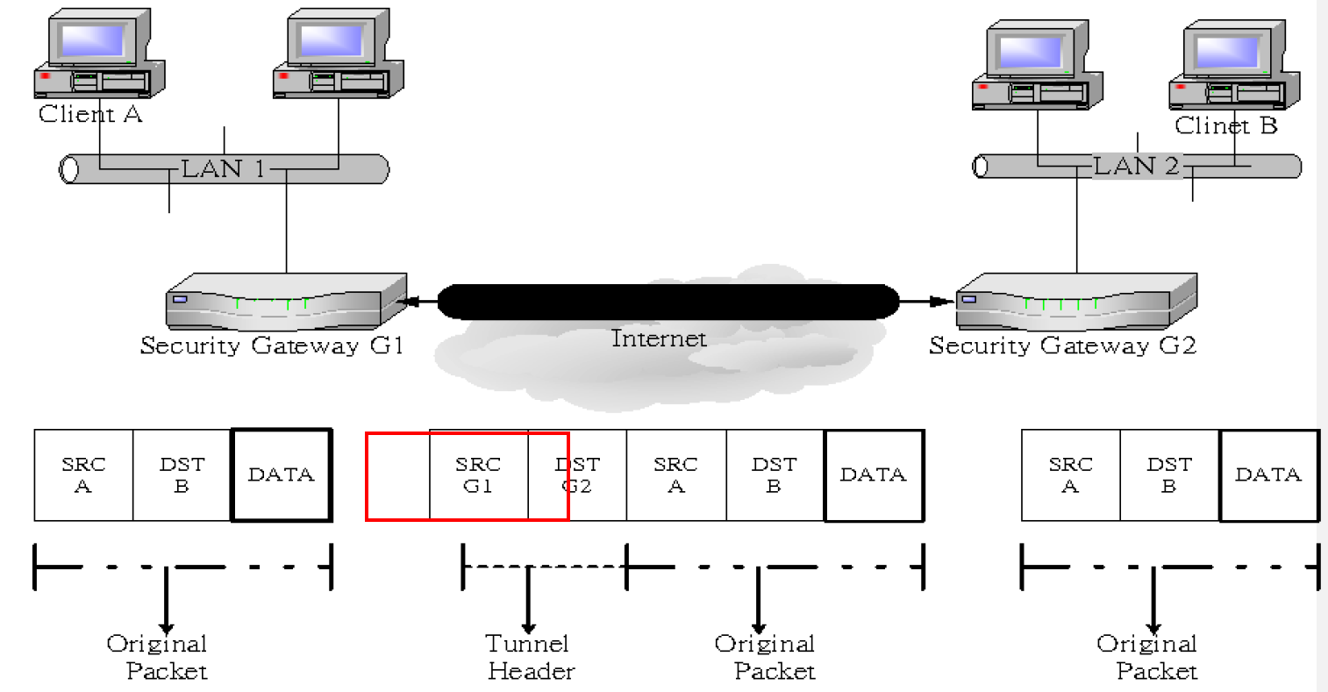
Encapsulation
In order to achieve tunneling, the packets are encapsulated as the payload of packets
  Payloads, to and from addresses, port numbers and other standard protocol packet headers
  As seen by the external routers carrying the connection

Slide 9
Implementations
Point-to-Point Tunneling Protocol (PPTP)
  RFC 2637
Layer 2 Tunneling Protocol (L2TP)
  RFC 2661
IPSec Tunnel Mode
  RFC 2401
Secure Socket Tunneling Protocol (SSTP)

Slide 10
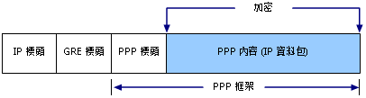
PPTP
Point-to-Point Tunneling Protocol (PPTP) is a method for implementing VPN
  PPTP doesn’t describe encryption or authentication
    Rely on the PPP protocol
  PPTP was the first VPN protocol that was supported by Microsoft Dial-up Networking
  Microsoft 2003 and higher also support the PPTP protocol
  In Microsoft, the tunneled PPP traffic can be authenticated with PAP, CHAP, Microsoft CHAP V1/V2

Slide 11
Security of PPTP protocol
PPTP has been the subject of many security analyses and serious security vulnerabilities have been found
  MSCHAP-v1 is fundamentally insecure
  MSCHAP-v2 is vulnerable to dictionary attack on the captured challenge response packets
The PPP payload can be encrypted by using Microsoft Point to Point Encryption (MPPE) when using MSCHAPv1/v2
EAP-TLS is the superior authentication choice for PPTP

Slide 12
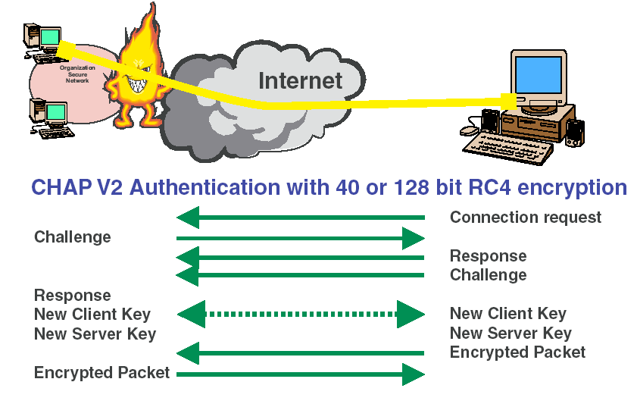
PPTP: Security

Slide 13
mpd
Mpd is a netgraph(4) based implementation of the multi-link PPP protocol for FreeBSD
  /usr/ports/net/mpd5
startup
  vi /etc/rc.conf
Configuration files
  /usr/local/etc/mpd5/
    mpd.conf
    mpd.secret
gateway_enable="YES“
mpd_flags="-b“
mpd_enable="YES"
/usr/local/etc/rc.d/mpd5 {start|stop|restart|rcvar|status}

Slide 14
mpd authentication
/usr/local/etc/mpd5/mpd.secret
  plain text
  chmod 600 mpd.secret
vpn “vpn_passwd” 140.113.0.0/16
foo1 “foofoo” 1.2.3.4/32

Slide 15
mpd configuration
mpd.conf
  Consists of a label followed by a sequence of mpd commands
  A label begins at the first column and ends with a colon character
  Commands are indented with a tab character and follow the label on the next and subsequent lines
client:
create bundle template B1
create link static L1 modem
set modem device /dev/cuad0
set modem speed 115200
set modem script DialPeer
set modem idle-script AnswerCall
set modem var $DialPrefix "DT"
set modem var $Telephone "1234567"
set link no pap chap eap
set link accept pap
set auth authname "MyLogin"
set auth password "MyPassword"
set link max-redial 0
set link action bundle B1
open

Slide 16
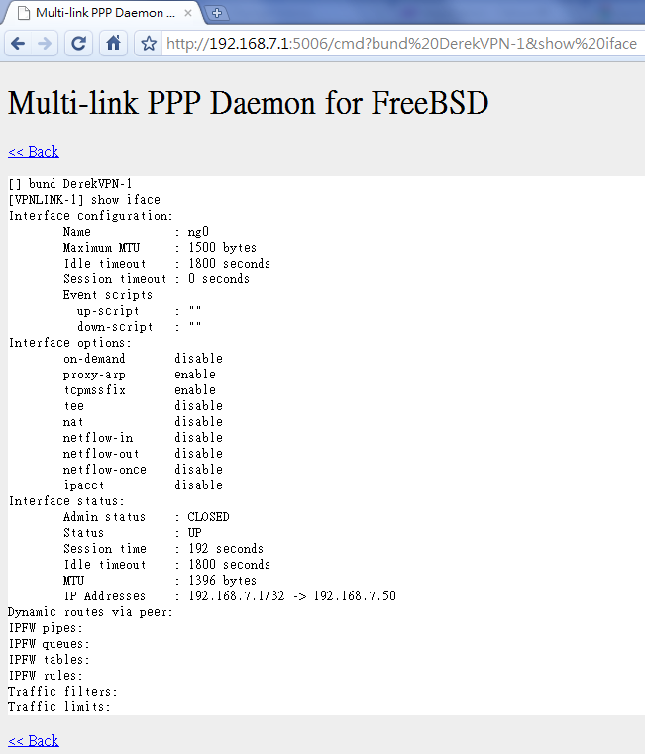
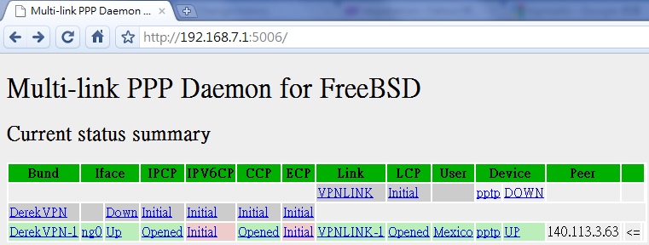
mpd configuration
startup section
  Version 4.0b2
    Added a new startup section to the config-file, wich is loaded once at startup
startup:
# configure mpd users
set user foo1 bar1
# configure the console
set console self 127.0.0.1 5005
set console open
# configure the web server
set web self 0.0.0.0 5006
set web open

Slide 17
mpd configuration
default section
  Set interface
    ip range
  Set bundle name
  Link layer configuration
mpd layers
interface -> ipcp -> compression -> encryption -> bundle -> links
default:
load pptp_server
pptp_server:
# Define dynamic IP address pool.
set ippool add VPNPOOL 192.168.1.50 192.168.1.99
# Create clonable bundle template
create bundle template VPN
set iface enable proxy-arp
set iface idle 1800
set iface enable tcpmssfix # adjust incoming and outgoing TCP SYN segments (MTU)
set ipcp yes vjcomp # Van Jacobson TCP header compression
# Specify IP address pool for dynamic assigment.
set ipcp ranges 192.168.1.1/32 ippool VPNPOOL

Slide 18
mpd configuration
default section
  Link layer configuration
pptp_server:
…. (skip)
# Create clonable link template named L
create link template VPNLINK pptp
# Set bundle template to use
set link action bundle VPN
# Multilink adds some overhead, but gives full 1500 MTU.
set link enable multilink
# Address and control field compression, save 2 bytes,
# Protocol field compression, save 1 byte
set link yes acfcomp protocomp
set link keep-alive 10 60
# Configure PPTP
set pptp self 1.2.3.4
set link enable incoming

Slide 19
Encryption
Microsoft Point-to-point compression (MPPC) CCP subprotol
  'mppc' option should be enabled at the CCP layer
# The five lines below enable Microsoft Point-to-Point encryption
# (MPPE) using the ng_mppc(8) netgraph node type.
set bundle enable compression
set ccp yes mppc
set mppc yes e40
set mppc yes e128
set mppc yes stateless

Slide 20
mpd configuration
Minimum configuration
startup:
default:
set ippool add VPNPOOL 192.168.1.11 192.168.1.15
create bundle template NAVPN
set ipcp ranges 192.168.1.1/32 ippool VPNPOOL
create link template VPNLINK pptp
set link action bundle NAVPN
set link no pap chap eap
set link enable chap-msv2
set pptp self 1.2.3.4
set link enable incoming
http://mpd.sourceforge.net/doc5/mpd.html

Slide 21
syslog
Modify /etc/syslog.conf
touch /var/log/mpd.log
/etc/rc.d/syslogd reload
!mpd
*.* /var/log/mpd.log

Slide 22
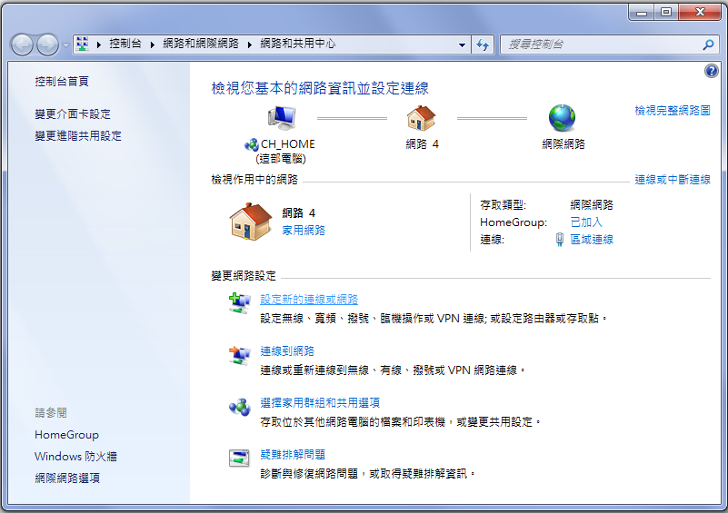
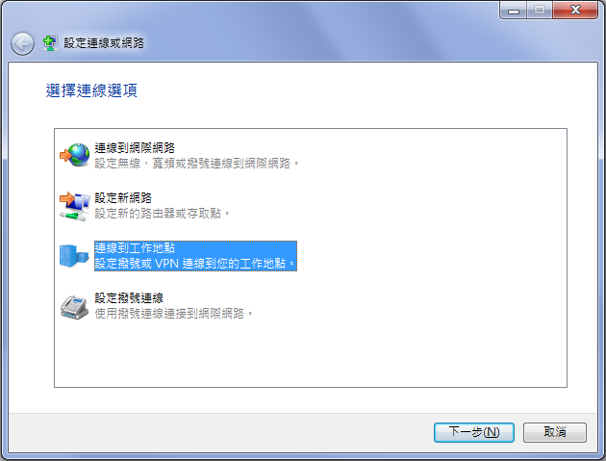
VPN client
建立新的連線

Slide 23
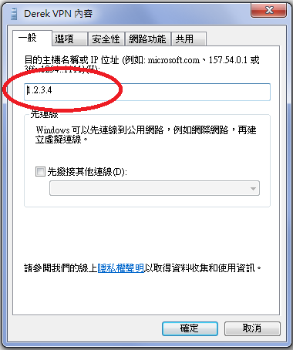
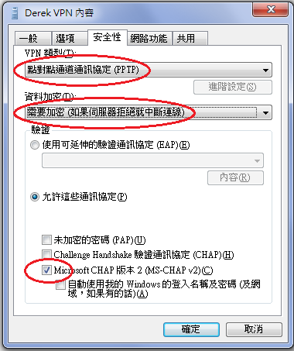
VPN client

