Slide 1
Homework 02
NAT、DHCP、Firewall、Proxy

Slide 2
Basic Knowledge
DHCP
  Dynamically assigning IPs to clients
NAT
  Translating addresses for clients
Firewall
  Traffic filtering
Proxy
  Intermediary of client and server to translate requests

Slide 3




Architecture Overview
Network card
Internet
IP0 - public
Server
IP1 – private
Private IP domain
HostA - GUI based host
HostB - FTP server
IP2 – private
IP3 – private

Slide 4
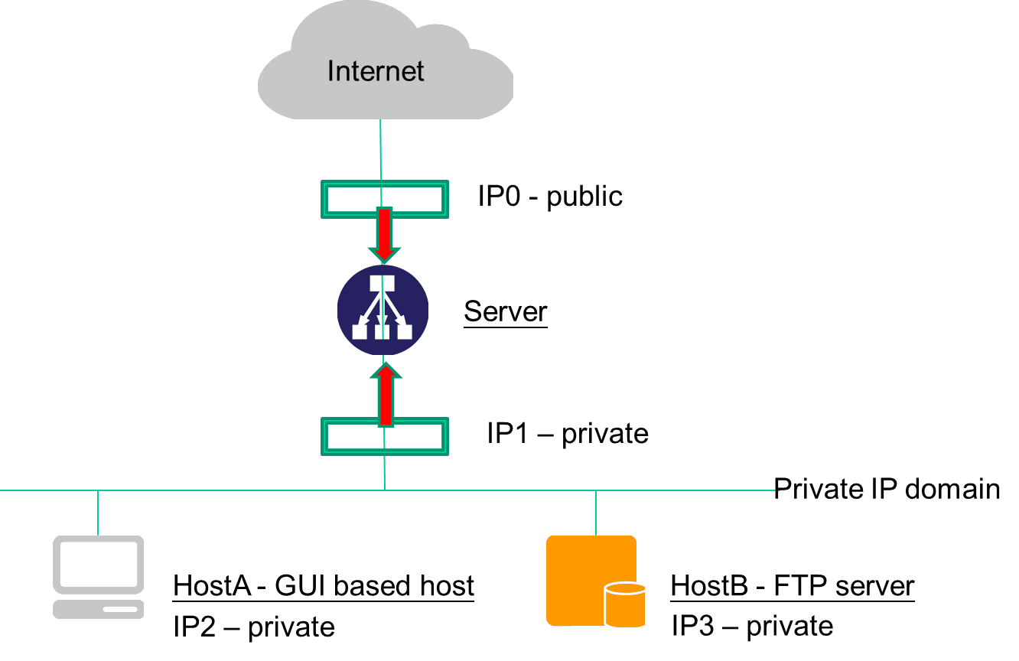
Architecture
Server
  UNIX-based OS
  Act as a gateway for all services
  DHCP & NAT server
  A dedicated Public IP and a static private IP
HostA
  Any OS
  A private IP via DHCP
HostB
  An isolated execution environment on Server
  Runs FTP service
  A static private IP

Slide 5
Requirement – NAT & DHCP
NAT
  HostA & HostB can access Internet via Server
DHCP
  Provided by Server
  Static range should be excluded

Slide 6
Requirement – Firewall
Firewall
  Deny all connections come from <BadHost>
  Allow the connection from linux1-6 (linux1.cs.nctu.edu.tw ~ linux6.cs.nctu.edu.tw) to access HostB’s FTP server
  Drop packets from bsd1-6 (bsd1.cs.nctu.edu.tw ~ bsd6.cs.nctu.edu.tw) to access HostB’s FTP server, and response TCP RST/ICMP unreachable
  Allow the connection from linux1-6 (linux1.cs.nctu.edu.tw ~ linux6.cs.nctu.edu.tw) to access HostB’s SSH server (Server will redirect the request for port 222 to HostB’s SSH server)
  The connection from other public IP to access HostB’s FTP and SSH server should be denied and not response TCP RST/ICMP unreachable
  All public IP can’t send ICMP echo request packets to Server (will not response ICMP ECHO-REPLY packets)

Slide 7
Requirement – Proxy
FTP proxy
  Setup an FTP proxy on Server
  All FTP requests should be proxied to HostB

Slide 8
Hand-in
Due
  4/28
如果非本系，沒有帳號可以到資工系三樓系計中申請帳號

