Slide 1
Homework 03
DNS

Slide 2

Architecture
ns.b.nctucs.net
140.113.b.b
192.168.2.0/24
ns.a.nctucs.net
140.113.a.a
192.168.1.0/24
slave
delegation
demo.b.nctucs.net
192.168.2.100
demo.a.nctucs.net
192.168.1.100

Slide 3
Requirement
Setup a DNS server with BIND
  Serve your own domain A
  Serve your teammate B’s domain as a slave
    Updates should be synchronized
Delegation
  Delegate a sub-domain to your teammate B
    demo.sub.{your teammate domain} -> 192.168.a.105
Reverse zone
  192.168.a.100 -> demo.{your domain}
    and demo.{your domain} -> 192.168.a.100 in forward zone of course
Notes:
Nctucs.net
Twbbs.org

Slide 4
Requirement (Cont.)
View
  Create ta.{your.domain} A record
  For queries from 192.168.a.0/24, answer 192.168.0.254
  Otherwise, answer your public IP
Logging
  Record all records to /var/log/named.log
  You might be asked to explain the meaning of each log entry
Security
  Only allow AXFR request from 140.113.235.0/24

Slide 5
Bonus – Samba AD (20%)
use BIND as backend DNS
can login Windows with user@{your domain}

Slide 6
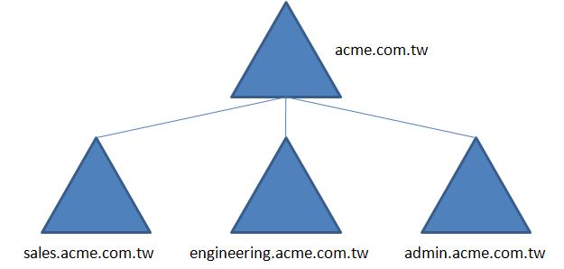
Active Directory
Build in Windows server from Windows 2000
Use DNS for domain controller
LDAP
The forest, tree, and domain are the logical divisions in an Active Directory network

Slide 7
Samba AD
Since version 4.0.0, Samba can also act as a Domain Controller that is compatible with Microsoft Active Directory.
https://wiki.samba.org/index.php/Samba_AD_DC_HOWTO

Slide 8
Hand-in
Demo
  5/25 - 5/29
Book Demo
  5/18 - 5/22

Slide 9
Help
domain apply
  nctucs.net http://www.nctucs.net/ 使用系計中帳號申請
  twbbs.org
IRC channel #nctuNASAon freenode
BBS bs2.to board CS-SysAdmin
Email ta@nasa.cs.nctu.edu.tw
Goto CSCC to ask professional 3F at office hour!

