Slide 1
DHCP, Firewall and NAT

Slide 2
DHCP –
Dynamic Host Configuration Protocol

Slide 3
DHCP introduction
DHCP
  Dynamic Host Configuration Protocol
  A system can connect to a network and obtain the necessary information dynamically
Client-Server architecture
  DHCP client broadcasts request for configuration info.
    UDP port 68
  DHCP server reply on UDP port 67, including
    IP, netmask, DNS, router, IP lease time, etc.
RFC
  RFC 2131 – Dynamic Host Configuration Protocol
  RFC 2132 – DHCP Options

Slide 4
DHCP Protocol (1)
client
server
DHCP Discover
  Broadcasted by client to find available server.
  Client can request its last-known IP, but the server can ignore it.
DHCP Offer
  Server find IP for client based on clients hardware address (MAC)
DHCP Request
  Client request the IP it want to the server.
DHCP Acknowledge
  Server acknowledges the client, admit him to use the requested IP.
※ Question
  Why not use the IP after DHCP offer?
廣播：我要IP
DHCP Discover
src: 0.0.0.0 port: 68
dst: 255.255.255.255 port: 67
你可以用 IP₁
IP=192.168.1.100
netmask=255.255.255.0
router=192.168.1.1
dns=192.168.1.1
IP lease time=1 day
DHCP Offer
src: 192.168.1.1 port: 67
dst: 255.255.255.255 port: 68
DHCP option
請給我IP₁
DHCP Request
src: 0.0.0.0 port: 68
dst: 255.255.255.255 port: 67
DHCP option
Request IP=192.168.1.100
DHCP Server=192.168.1.1
給你用 IP₁
IP=192.168.1.100
netmask=255.255.255.0
router=192.168.1.1
dns=192.168.1.1
IP lease time=1 day
DHCP Ack
src: 192.168.1.1 port: 67
dst: 255.255.255.255 port: 68
DHCP option

Slide 5
DHCP Protocol (2)
DHCP inform
  Request more information than the server sent.
  Repeat data for a particular application.
  ex. browser request proxy info. from server.
  It does not refresh the IP expiry time in server’s database.
DHCP Release
  Client send this request to server to releases the IP, and the client will un-configure this IP.
  Not mandatory.

Slide 6
DHCP server on FreeBSD (1)
Kernel support (in GENERIC)
# The `bpf' device enables the Berkeley Packet Filter.
# Be aware of the administrative consequences of enabling this!
# Note that 'bpf' is required for DHCP.
device bpf # Berkeley packet filter
Install DHCP server
  cd/usr/ports/net/isc-dhcp3-server/
  cd /usr/local/etc
  cp dhcpd.conf.sample dhcpd.conf
Enable DHCP server in /etc/rc.conf
    dhcpd_enable="YES"
    #dhcpd_flags="-q"
    #dhcpd_conf="/usr/local/etc/dhcpd.conf"
    #dhcpd_ifaces=""
    #dhcpd_withumask="022"

Slide 7
DHCP server on FreeBSD (2)
Option definitions
  option domain-name "cs.nctu.edu.tw";
  option domain-name-servers 140.113.235.107, 140.113.1.1;
  default-lease-time 600;
  max-lease-time 7200;
  ddns-update-style none;
  log-facility local7;
/etc/syslogd.conf
/etc/newsyslog.conf

Slide 8
DHCP server on FreeBSD (3)
Subnet definition
  subnet 192.168.1.0 netmask 255.255.255.0 {
  range 192.168.1.101 192.168.1.200;
  option domain-name "cs.nctu.edu.tw";
  option routers 192.168.1.254;
  option broadcast-address 192.168.1.255;
  option domain-name-servers 140.113.235.107, 140.113.1.1;
  default-lease-time 3600;
  max-lease-time 21600;
  }
Host definition
  host fantasia {
  hardware ethernet 08:00:07:26:c0:a5;
  fixed-address 192.168.1.30;
  }
  host denyClient {
  hardware ethernet 00:07:95:fd:12:13;
  deny booting;
  }

Slide 9
DHCP server on FreeBSD (4)
Important files
  /usr/local/sbin/dhcpd
  /usr/local/etc/dhcpd.conf
  /var/db/dhcpd/dhcpd.leases (leases issued)
  /usr/local/etc/rc.d/isc-dhcpd
  http://www.freebsd.org/doc/en/books/handbook/network-dhcp.html

Slide 10
PXE (Preboot Execution Environment)
/usr/local/etc/dhcpd.conf
subnet 192.168.7.0 netmask 255.255.255.0 {
option subnet-mask 255.255.255.0;
range dynamic-bootp 192.168.7.100 192.168.7.109;
option root-path "/home/tftproot";
next-server 192.168.7.254;
server-identifier 192.168.7.254;
filename "/boot/pxeboot";
option routers 192.168.7.254;
}
/etc/inetd.conf
tftp dgram udp wait root /usr/libexec/tftpd tftpd -l -s /home/tftproot
/etc/exports
/home/tftproot -ro -maproot=nobody -network 192.168.7.0 -mask 255.255.255.0
/home/tftproot
  What in the CD
  gzip -d boot/mfsroot.gz
  http://www.freebsd.org/doc/en/articles/pxe/article.html

Slide 11
Firewalls

Slide 12
Firewalls
Firewall
  A piece of hardware and/or software which functions in a networked environment to prevent some communications forbidden by the security policy.
  Choke point between secured and unsecured network
  Filter incoming and outgoing traffic that flows through your system
How can it be used to do
  To protect your system from unwanted traffic coming in from the public Internet
    Such as telnet, NetBIOS
  To limit or disable access from hosts of the internal network to services of the public Internet
    Such as MSN, ssh, ftp
  To support NAT (Network Address Translation)

Slide 13
Firewalls – Layers of Firewalls
Network Layer Firewalls
  Operate at a low level of TCP/IP stack as IP-packet filters.
  Filter attributes
    Source/destination IP
    Source/destination port
    TTL
    Protocols
    …
Application Layer Firewalls
  Work on the application level of the TCP/IP stack.
  Inspect all packets for improper content, a complex work!
Application Firewalls
  The access control implemented by applications.

Slide 14
Firewall Rules
Two ways to create firewall rulesets
  Exclusive
    Allow all traffic through except for the traffic matching the rulesets
  Inclusive
    Allow traffic matching the rulesets and blocks everything else
    Safer than exclusive one
      reduce the risk of allowing unwanted traffic to pass
      Increase the risk to block yourself with wrong configuration

Slide 15
Firewall Software
FreeBSD
  IPFIREWALL (known as IPFW)
  IPFILTER (known as IPF)
  Packet Filter (known as PF)
Solaris
  IPF
Linux
  ipchains
  iptables

Slide 16
Packet Filter (PF)
Introduction
  Firewall migrated from OpenBSD
  NAT, Bandwidth limit (ALTQ) support
  Load balance
  http://www.openbsd.org/faq/pf/
ADSL 1
Gateway
ADSL 2
LAN
ADSL 3
Round-robin

Slide 17
PF in FreeBSD (1)
Enable PF in /etc/rc.conf
  pf_enable="YES"
  pf_rules="/etc/pf.conf"
Rebuild Kernel (if ALTQ is needed)
  device pf
  device pflog
  device pfsync
  options ALTQ
  options ALTQ_CBQ
  options ALTQ_RED
  ALTQ -- alternate queuing of network packets

Slide 18
PF in FreeBSD (2)
PF command
  pfctl –s <rules|nat|queue|tables> -v
  pfctl /etc/pf.conf
  pfctl –t <table> -T <add|delete> <ip>
  pfctl –t <table> -T show

Slide 19
PF in FreeBSD (3)
PF Configuration File
The last matching rule "wins“
  "quick" keyword
/etc/pf.conf
  Macros
    define common values, so they can be referenced and changed easily.
  Tables
    similar to macros, but more flexible for many addresses.
  Options “set”
    tune the behavior of pf, default values are given.
  Normalization “scrub”
    reassemble fragments and resolve or reduce traffic ambiguities.
  Queueing “altq”, “queue”
    rule-based bandwidth control.
  Translation (NAT) “rdr”, “nat”, “binat”
    specify how addresses are to be mapped or redirected.
  Filtering “antispoof”, “block”, “pass”
    the implicit first two rules are

Slide 20
PF in FreeBSD (4)
# macro definitions
extdev='fxp0‘
intranet='192.168.219.0/24‘
winxp=‘192.168.219.1’
server_int=‘192.168.219.2’
server_ext=‘140.113.214.13’
# options
set limit { states 10000, frags 5000 }
set loginterface $extdev
set block-policy drop
# tables
table <badhosts> persist file “/etc/badhosts.list”
# filtering rules
pass in all
pass out all
block log in on $extdev proto tcp from any to any port {139, 445}
block log in on $extdev proto udp from any to any port {137, 138}
block on $extdev quick from <badhosts> to any
pass in on $extdev proto tcp from 140.113.0.0/16 to any port {139, 445}
pass in on $extdev proto udp from 140.113.0.0/16 to any port {137, 138}
Ex.

Slide 21
PF in FreeBSD (5)
Logging
  pflogd
    /etc/rc.conf
    pflogd_enable="YES"
    pflogd_flags="-f <filename>“
  pflog(4)
    /dev/pflog
    A pseudo‐device which makes visible all packets logged by the packet filter, pf(4).

Slide 22
NAT –
Network Address Translation

Slide 23
NAT (1)
What is NAT?
  Network Address Translation
  Re-write the source and/or destination addresses of IP packets when they pass through a router or firewall.
  What can be re-written?
    Source/destination IPs
    Source/destination ports
What can NAT do?
  Solve the IPv4 address shortage. (the most common purpose)
  Kind of firewall (security)
  Load balancing
  Fail over (for service requiring high availability)
  Transparent proxy

Slide 24
NAT (2)
Address shortage of IPv4
Private addresses space defined by RFC1918
  24-bit block (Class A)
    10.0.0.0/8
  20-bit block (16 contiguous Class B)
    172.16.0.0/12 ~ 172.31.0.0/12
  16-bit block (256 contiguous Class C)
    192.168.0.0/16 ~ 192.168.255.0/16
Operation consideration
  Router should set up filters for both inbound and outbound private network traffic

Slide 25
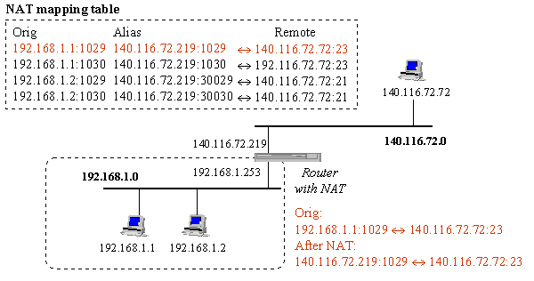
NAT (3)
NAT example:

Slide 26



NAT (4)
SNAT & DNAT
  S: Source D: Destination
  SNAT
    Rewrite the source IP and/or Port.
    The rewritten packet looks like one sent by the NAT server.
S: 192.168.1.1:1234
D: 140.113.235.107:53
S: 140.113.235.250:10234
D: 140.113.235.107:53
NAT Mapping Table:
192.168.1.1:1234 – 140.113.235.250:10234
192.168.1.254
140.113.235.250
192.168.1.1
140.113.235.250

Slide 27
NAT (5)
  DNAT
    Rewrite the destination IP and/or Port.
    The rewritten packet will be redirect to another IP address when it pass through NAT server.
  Both SNAT and DNAT are usually used together in coordination for two-way communication.
S: 140.113.24.107:1357
D: 192.168.1.1:80
S: 140.113.24.107:1357
D: 140.113.235.107:8080
NAT Mapping Table:
140.113.235.250:8080 – 192.168.1.1:80
192.168.1.254
140.113.235.250
192.168.1.1
140.113.24.107

Slide 28
NAT (6)
Types of NAT
  Full cone NAT
    map an internal IP and port to a public port
  A restricted cone NAT
    Full Cone with IP filtering
  A port restricted cone NAT
    Full Cone with IP and port filtering
  A symmetric NAT
    Build IP and port mapping according to a session ID
Problem of NAT

Slide 29
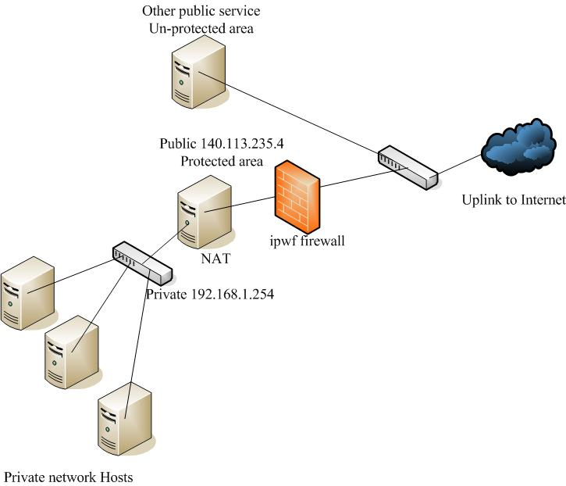
NAT on FreeBSD (1)
Setup
  Network topology
  configuration
  Advanced redirection
  configuration
192.168.1.1
Web server
192.168.1.2
Ftp Server
192.168.1.101
PC1

Slide 30
NAT on FreeBSD (2)
IP configuration (in /etc/rc.conf)
  ifconfig_fxp0="inet 140.113.235.4 netmask 255.255.255.0 media autoselect"
  ifconfig_fxp1="inet 192.168.1.254 netmask 255.255.255.0 media autoselect“
  defaultrouter="140.113.235.254“
Enable NAT
  Here we use Packet Filter (PF) as our NAT server
  Configuration file: /etc/pf.conf
    nat
    rdr
    binat
# macro definitions
extdev='fxp0‘
intranet='192.168.1.0/24‘
webserver=‘192.168.1.1’
ftpserver=‘192.168.1.2’
pc1=‘192.168.1.101’
# nat rules
nat on $extdev inet from $intranet to any -> $extdev
rdr on $extdev inet proto tcp to port 80 -> $webserver port 80
rdr on $extdev inet proto tcp to port 443 -> $webserver port 443
rdr on $extdev inet proto tcp to port 21 -> $ftpserver port 80

Slide 31
NAT on FreeBSD (3)
# macro definitions
extdev='fxp0‘
intranet='192.168.219.0/24‘
winxp=‘192.168.219.1’
server_int=‘192.168.219.2’
server_ext=‘140.113.214.13’
# nat rules
nat on $extdev inet from $intranet to any -> $extdev
rdr on $extdev inet proto tcp to port 3389 -> $winxp port 3389
binat on $extdev inet from $server_int to any -> $server_ext

