Slide 1

Postfix

Slide 2
Postfix
Free and open source mail transfer agent (MTA)
  For the routing and delivery of email
  Intended as a fast, easy-to-administer, and secure alternative to the widely-used Sendmail
  Formerly VMailer / IBM Secure Mailer
    By Wietse Venema at the IBM Thomas J. Watson Research Center
  IBM Public License
First released in mid-1999
http://www.postfix.org
  http://www.postfix.org/documentation.html

Slide 3
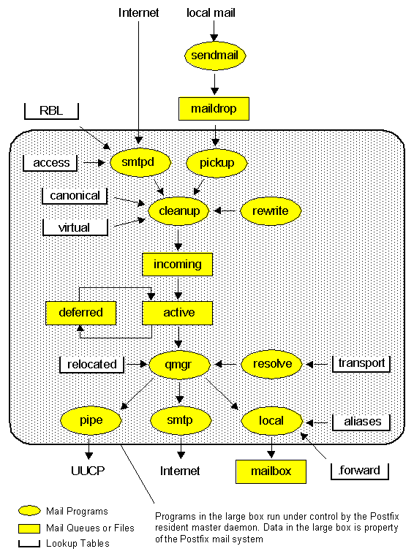
Overview
http://www.postfix.org/OVERVIEW.html

Slide 4
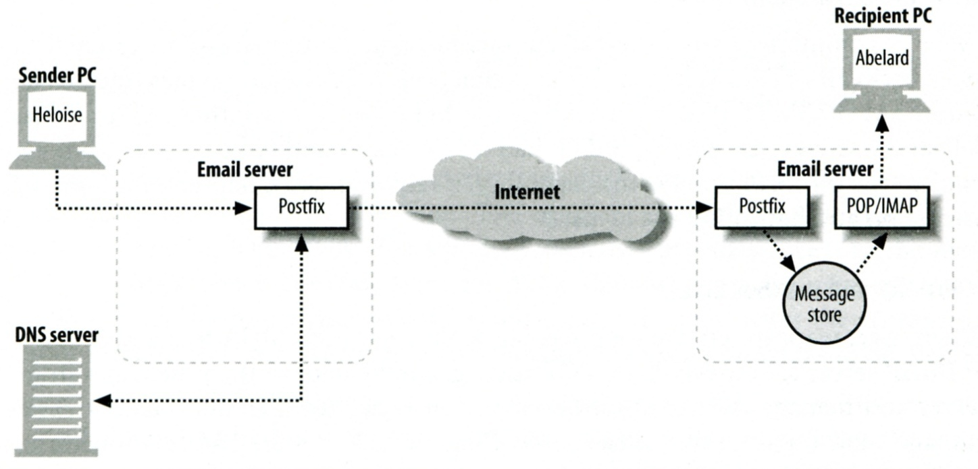
Role of Postfix
MTA that
  Receive and deliver email over the network via SMTP
  Local delivery directly or use other mail delivery agent

Slide 5
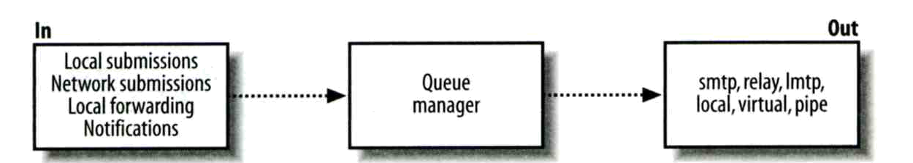
Postfix Architecture
Modular-design MTA
  Not like sendmail of monolithic system
  Decompose into several individual program that each one handle specific task
  The most important daemon: master daemon
    Reside in memory
    Get configuration information from master.cf and main.cf
    Invoke other process to do jobs
Major tasks
  Receive mail and put in queue
  Queue management
  Delivery mail from queue

Slide 6
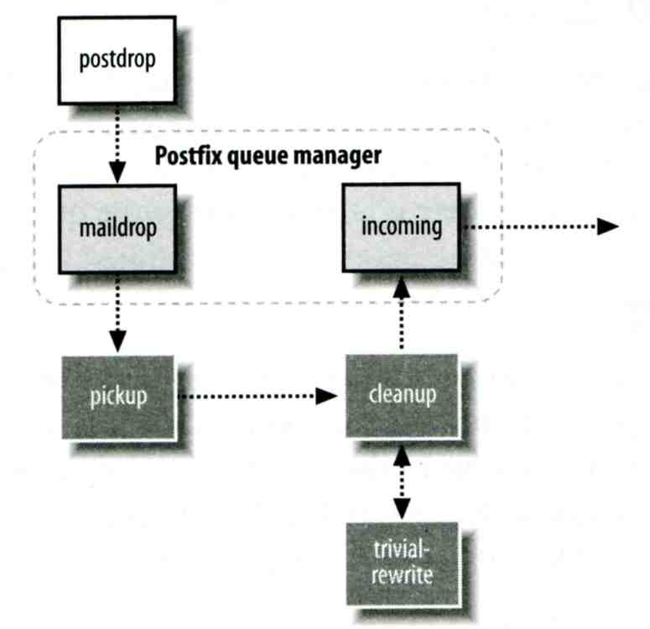
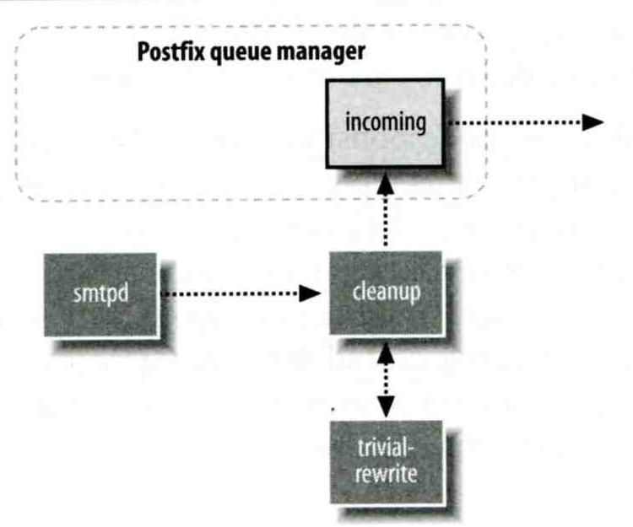
Postfix Architecture –
Message IN
Four ways
  Local submission
    postdrop command
    maildrop directory
    pickup daemon
    cleanup daemon
      Header validation
      address translation
    incoming directory
  Network submission
    smtpd daemon
  Local forwarding
    Resubmit for such as .forward
  Notification
    defer daemon
    bounce daemon
Local submission
Network submission

Slide 7
Postfix Architecture –
Queue
Five different queues
  incoming
    The first queue that every incoming email will stay
  active
    Queue manager will move message into active queue whenever there is enough system resources
    Queue manager then invokes suitable DA to delivery it
  deferred
    Messages that cannot be delivered are moved here
    These messages are sent back either with bounce or defer daemons
  corrupt
    Used to store damaged or unreadable message
  hold
    Define "smtpd" access(5) policies, or cleanup(8) header/body checks to automatically place messages in the "hold" queue
    Messages placed in the "hold" queue stay there until the administrator intervenes
http://www.postfix.org/QSHAPE_README.html#queues

Slide 8
Postfix Architecture –
Message OUT (1)
Address classes
  Used to determine which destinations to accept for delivery
  How the delivery take place
Main address classes
  Local delivery
    Domain names in “mydestination” is local delivered
    Ex:
      mydestination = netadm.cs.nctu.edu.tw localhost
    It will check alias and .forward file to do further delivery
  Virtual alias
    Ex:
      virtual-alias.domain
      user1@virtual-alias.domain address1
  Virtual mailbox
    Each recipient address can have its own mailbox
    Ex:
      virtual_mailbox_base = /var/vmail
      /var/mail/vmail/CSIE, /var/mail/vmail/CS
  Relay
    Transfer mail for others to not yours domain
    It is common for centralize mail architecture to relay trusted domain
  Deliver mail to other domain for authorized user
    The queue manager will invoke the smtp DA to deliver this mail

Slide 9
Postfix Architecture –
Message OUT (2)
Other delivery agent (MDA)
  Specify in /usr/local/etc/postfix/master.cf
      How a client program connects to a service and what daemon program runs when a service is requested
  lmtp
    Local Mail Transfer Protocol
    Used for deliveries between mail systems on the same network even the same host
      Such as postfix → POP/IMAP to store message in store with POP/IMAP proprietary format
  pipe
    Used to deliver message to external program
pickup fifo n - n 60 1 pickup
cleanup unix n - n - 0 cleanup
bounce unix - - n - 0 bounce
defer unix - - n - 0 bounce
smtp unix - - n - - smtp
relay unix - - n - - smtp

Slide 10
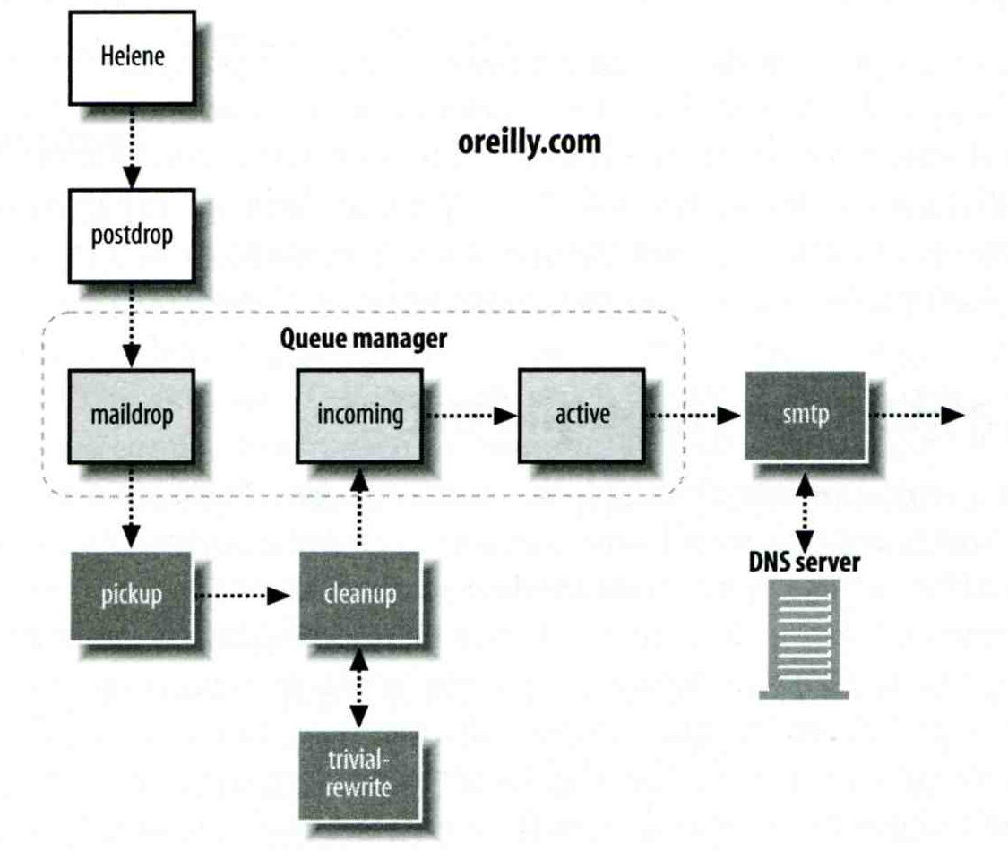
Message Flow in Postfix (1)
Example
  helene@oreilly.com → frank@postfix.org (doel@onlamp.com)
  Phase1:
    Helene compose mail using her MUA, and then call postfix’s sendmail command to send it

Slide 11
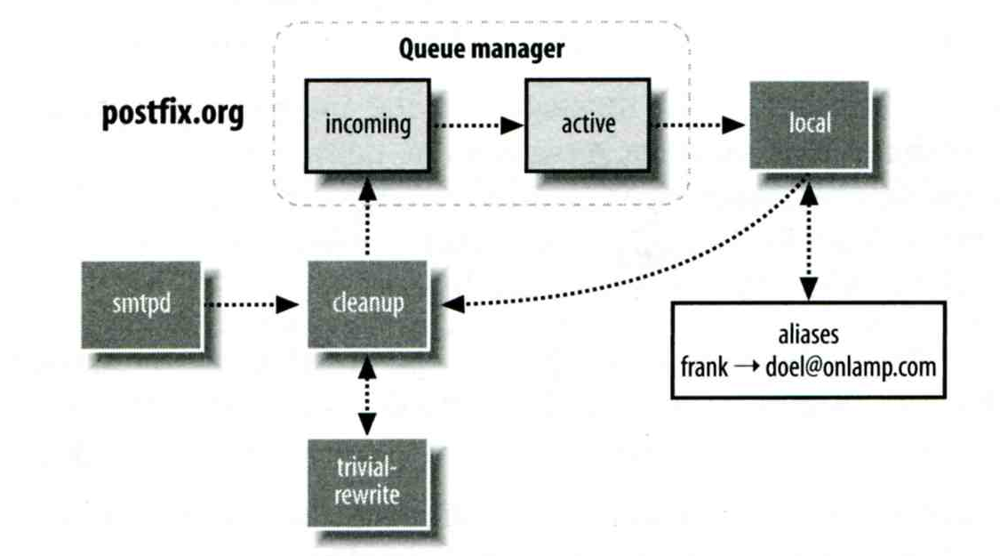
Message Flow in Postfix (2)
  Phase2:
    The smtpd on postfix.org takes this message and invoke cleanup then put in incoming queue
    The local DA find that frank is an alias, so it resubmits it through cleanup daemon for further delivery

Slide 12
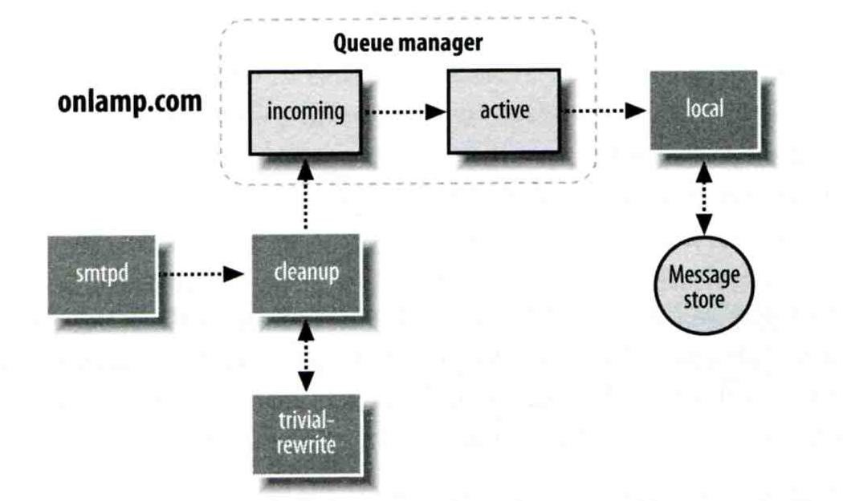
Message Flow in Postfix (3)
  Phase3
    The smtpd on onlamp.com takes this message and invoke cleanup then put in incoming queue
    Local delivery to message store

Slide 13
Message Store Format
The Mbox format
  Store messages in single file for each user
  Each message start with “From ” line and continued with message headers and body
  Mbox format has file-locking problem
The Maildir format
  Use structure of directories to store email messages
  Each message is in its owned file
  Three subdirectories
    cur, new and tmp
  Maildir format has scalability problem
    Quick in locating and deleting
Related parameters (in main.cf)
  mail_spool_directory = /var/spool/mail (Mbox)
  mail_spool_directory = /var/spool/mail/ (Maildir)

Slide 14


Postfix and POP/IMAP
POP vs. IMAP
  Both are used to retrieve mail from server for remote clients
  POP has to download entire message, while IMAP can download headers only
  POP can download only single mailbox, while IMAP can let you maintain multiple mailboxes and folders on server
Cooperation between Postfix and POP/IMAP
  Postfix and POP/IMAP must agree on the type of mailbox format and style of locking
    Standard message store
    Unstandard message store (using LMTP)
      Such as Cyrus IMAP / Dovecot

Slide 15
Postfix Configuration
Two most important configuration files
  /usr/local/etc/postfix/main.cf
    Core configuration
  /usr/local/etc/postfix/master.cf
    Which postfix service should invoke which program
Edit configuration file
  Using text editor
  postconf
    % postconf –e myhostname=netadm.cs.nctu.edu.tw
    % postconf –d myhostname (print default setting)
    % postconf myhostname (print current setting)
Reload postfix whenever there is a change
  # postfix reload
  # /usr/local/etc/rc.d/postfix reload

Slide 16
Postfix Configuration –
Lookup tables (1)
Parameters that use external files to store values
  Such as mydestination, mynetwork, relay_domains
  Text-based table is ok, but time-consuming when table is large
Lookup tables syntax
  Key values
postmap command
  % postmap /etc/access
  (generate database)
  % postmap –q nctu.edu.tw /etc/access
  (query)

Slide 17
Postfix Configuration –
Lookup tables (2)
Database format
  % postconf –m
    List all available database format
  % postconf default_database_type
Use databased-lookup table in
main.cf
  syntax
    Parameter = type:name
  Ex:
  check_client_access hash:/etc/access
% postconf -m
btree
cidr
environ
hash
pcre
proxy
regexp
static
unix
% postconf default_database_type
default_database_type = hash

Slide 18
Postfix Configuration –
Lookup tables (3)
Regular expression tables
  More flexible for matching keys in lookup tables
  Two regular expression libraries used in Postfix
    POSIX extended regular expression (regexp, default)
    Perl-Compatible regular expression (PCRE)
  Usage
    /pattern/ value
    It is useful to use regular expression tables to do checks, such as
      header_checks
      body_checks parameters

Slide 19
Postfix Configuration – system-wide aliases files
Using aliases in Postfix
  alias_maps = hash:/etc/aliases
  alias_maps = hash:/etc/aliases, nis:mail.aliases
  alias_database = hash:/etc/aliases
    Tell newaliases command which aliases file to build
To Build alias database file
  % postalias /etc/aliases
Alias file format (same as sendmail)
  RHS can be
    Email address, filename, command, :include:
Alias restriction
  allow_mail_to_commands = alias, forward
  allow_mail_to_files = alias, forward

Slide 20
Postfix Configuration –
MTA Identity
Four related parameters
  myhostname
    myhostname = netadm.cs.nctu.edu.tw
    If un-specified, postfix will use ‘hostname’ command
  mydomain
    mydomain = cs.nctu.edu.tw
    If un-specified, postfix use myhostname minus the first component
  myorigin
    myorigin = $mydomain (default is myhostname)
    Used to append unqualified address
  mydestination
    List all the domains that postfix should accept for local delivery
    mydestination = $myhostname, localhost.$mydomain $mydomain
    mydestination = $myhostname, localhost.$mydomain
      This is the CSIE situation that mx will route mail to mailgate.csie

Slide 21
Postfix Configuration –
Relay Control (1)
Open relay
  A mail server that permit anyone to relay mails
  By default, postfix is not an open relay
A mail server should
  Relay mail for trusted user
    Such as smtp.cs.nctu.edu.tw
  Relay mail for trusted domain
    Such as smtp.csie.nctu.edu.tw trust nctu.edu.tw

Slide 22
Postfix Configuration –
Relay Control (2)
Restricting relay access by mynetworks_style
  mynetworks_style = subnet
    Allow relaying from other hosts in the same subnet
  mynetworks_style = host
    Allow relaying for only local machine
  mynetworks_style = class
    Any host in the same class A, B or C
Restricting relay access by mynetworks
  List individual IP or subnets in network/netmask notation
  Ex: in /usr/local/etc/postfix/mynetworks
    127.0.0.0/8
    140.113.0.0/16
    10.113.0.0/16
Relay depends on what kind of your mail server is
  smtp.cs.nctu.edu.tw will be different from csmx1.cs.nctu.edu.tw

Slide 23
Postfix Configuration – master.cf (1)
/usr/local/etc/postfix/master.cf
  Define what services the master daemon can invoke
  Each row defines a service
  Each column contains a specific configuration option
# ==========================================================================
# service type private unpriv chroot wakeup maxproc command + args
# (yes) (yes) (yes) (never) (100)
# ==========================================================================
smtp inet n - n - - smtpd
pickup fifo n - n 60 1 pickup
cleanup unix n - n - 0 cleanup
qmgr fifo n - n 300 1 qmgr
tlsmgr unix - - n 1000? 1 tlsmgr
rewrite unix - - n - - trivial-rewrite
bounce unix - - n - 0 bounce
flush unix n - n 1000? 0 flush
127.0.0.1:10025 inet n - n - - smtpd

Slide 24
Postfix Configuration – master.cf (2)
Configuration options
  Service name and transport type
    inet
      Network socket
      In this type, name can be combination of IP:Port
    unix and fifo
      Unix domain socket and named pipe respectively
      Inter-process communication through file
  private
    Access to this component is restricted to the Postfix system
  unpriv
    Run with the least amount of privilege required
      y will run with the account defined in “mail_owner”
      n will run with root privilege

Slide 25
Postfix Configuration – master.cf (3)
  chroot
    chroot location is defined in “queue_directory”
  wakeup
    Periodic wake up to do jobs, such as pickup daemon
  maxproc
    Number of processes that can be invoked simultaneously
    Default count is defined in “default_process_limit”
  command + args
    Default path is defined in “daemon_directory”
    /usr/libexec/postfix

Slide 26
Postfix Configuration –
Receiving limits
Enforce limits on incoming mail
  The number of recipients for single delivery
    smtpd_recipient_limit = 1000
  Message size
    message_size_limit = 10240000
  The number of errors before breaking off communication
    Postfix keep a counter of errors for each client and increase delay time once there is error
    smtpd_error_sleep_time = 1s
    smtpd_soft_error_limit = 10
    smtpd_hard_error_limit = 20

Slide 27
Postfix Configuration –
Rewriting address (1)
For unqualified address
  To append “myorigin” to local name.
    append_at_myorigin = yes
  To append “mydomain” to address that contain only host.
    append_dot_mydomain = yes
Masquerading hostname
  Hide the names of internal hosts to make all addresses appear as if they come from the mail gateway
  It is often used in out-going mail gateway
    masquerade_domains = cs.nctu.edu.tw
    masquerade_domains = !chairman.cs.nctu.edu.tw cs.nctu.edu.tw
    masquerade_exceptions = admin, root
  Rewrite to all envelope and header address excepts envelope recipient address
    masquerade_class = envelope_sender, header_sender, header_recipient

Slide 28
Postfix Configuration –
Rewriting address (2)
Canonical address
  Rewrite both header and envelope recursively invoked by cleanup daemon
  Configuration
    canonical_maps = hash:/usr/local/etc/postfix/canonical
    canonical_classes = envelope_sender, envelope_recipient, header_sender, header_recipient
  /usr/local/etc/postfix/canonical
    lwhsu@cs.nctu.edu.tw lwhsu.netadm@cs.nctu.edu.tw
    lwhsu@cs.nctu.edu.tw lwhsu@netadm.cs.nctu.edu.tw
  Simlar maps
    sender_canonical_maps
    recipient_canonical_maps

Slide 29
Postfix Configuration –
Rewriting address (3)
Relocated users
  Used to inform sender that the recipient is moved
  relocated_maps = hash:/usr/local/etc/postfix/relocated
  Ex:
    @sysadm.cs.nctu.edu.tw netadm.cs.nctu.edu.tw
    andy@lwbsd.cs.nctu.edu.tw andyliu@abc.com
Unknown users
  Not local user and not found in maps
  Default action: reject

Slide 30
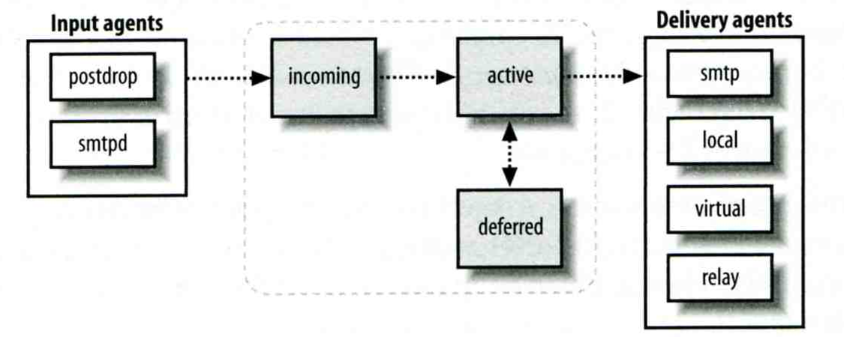
Queue Management
The queue manage daemon
  qmgr daemon
  Queue directories (under /var/spool/postfix)
    active, bounce, corrupt, deferred, hold
Message movement between queues
  Temporary problem → deferred queue
  qmgr takes messages alternatively between incoming and deferred queue to active queue

Slide 31
Queue Management –
Queue Scheduling
Double delay in deferred messages
  Between
    minimal_backoff_time = 1000s
    maximal_backoff_time = 4000s
  qmgr daemon periodically scan deferred queue for reborn messages
    queue_run_delay = 1000s
Deferred → bounce
  maximal_queue_lifetime = 5d

Slide 32
Queue Management –
Message Delivery
Controlling outgoing messages
  When there are lots of messages in queue for the same destination, it should be careful not to overwhelm it
  If concurrent delivery is success, postfix can increase concurrency between:
    initial_destination_concurrency = 5
    default_destination_concurrency_limit = 20
    Under control by
      maxproc in /usr/local/etc/postfix/master.cf
      default_process_limit
    You can override the default_destination_concurrency_limit for any transport mailer:
      smtp_destination_concurrency_limit = 25
      local_destination_concurrency_limit = 10
  Control how many recipients for a single outgoing message
    default_destination_recipient_limit = 50
    You can override it for any transport mailer in the same idea:
      smtp_destination_recipient_limit = 100

Slide 33
QUEUE MANAGEMENT –
ERROR NOTIFICATION
Sending error messages to administrator
  Set notify_classes parameter to list error classes that should be generated and sent to administrator
    Ex: notify_classes = resource, software
  Error classes
Error Class | Description | Noticed Recipient (all default to postmaster)
bounce | Send headers of bounced mails | bounce_notice_recipient
2bounce | Send undeliverable bounced mails | 2boucne_notice_recipient
delay | Send headers of delayed mails | delay_notice_recipient
policy | Send transcript when mail is reject due to anti-spam restrictions | error_notice_recipient
protocol | Send transcript that has SMTP error | error_notice_recipient
resource | Send notice because of resource pro. | error_notice_recipient
software | Send notice because of software pro. | error_notice_recipient

Slide 34
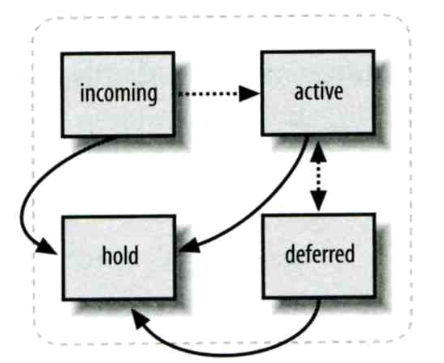
Queue Management –
Queue Tools (1)
postqueue command
  postqueue –p
    Generate sendmail mailq output
  postqueue –f
    Attempt to deliver all queued mail
  postqueue –s cs.nctu.edu.tw
    Schedule immediate delivery of all mail queued for site
postsuper command
  postsuper –d DBA3F1A9 (from incoming, active, deferred, hold)
  postsuper –d ALL
    Delete queued messages
  postsuper –h DBA3F1A9 (from incoming, active, deferred)
  postsuper –h ALL
    Put messages “on hold” so that no attempt is made to deliver it
  postsuper –H DBA3F1A9
  postsuper –H ALL
    Release messages in hold queue
  postsuper –r DBA3F1A9
  postsuper –r ALL
    Requeue messages into maildrop queue

Slide 35
Queue Management –
Queue Tools (2)
postcat
  Display the contents of a queue file
netadm [/home/lwhsu] -lwhsu- sudo postqueue -p
-Queue ID- --Size-- ----Arrival Time---- -Sender/Recipient-------
DEC003B50E2 344 Tue Apr 8 19:58:37 lwhsu@netadm.cs.nctu.edu.tw
(connect to lwbsd.cs.nctu.edu.tw[140.113.17.212]: Connection refused)
lwhsu@lwbsd.cs.nctu.edu.tw
-- 0 Kbytes in 1 Request.
netadm [/home/lwhsu] -lwhsu- sudo postcat -q DEC003B50E2
*** ENVELOPE RECORDS deferred/D/DEC003B50E2 ***
message_size: 344 252 1 0 344
message_arrival_time: Tue May 8 19:58:37 2007
create_time: Tue Apr 8 19:58:37 2007
named_attribute: rewrite_context=local
sender_fullname: Li-Wen Hsu
sender: lwhsu@netadm.cs.nctu.edu.tw
original_recipient: lwhsu@lwbsd.cs.nctu.edu.tw
recipient: lwhsu@lwbsd.cs.nctu.edu.tw
*** MESSAGE CONTENTS deferred/D/DEC003B50E2 ***
Received: by netadm.cs.nctu.edu.tw (Postfix, from userid 1001)
id DEC003B50E2; Tue, 8 May 2007 19:58:37 +0800 (CST)
To: lwhsu@lwbsd.cs.nctu.edu.tw
Subject: Testing Mail
Message-Id: <20070508115837.DEC003B50E2@netadm.cs.nctu.edu.tw>
Date: Tue, 8 Apr 2007 19:58:37 +0800 (CST)
From: lwhsu@netadm.cs.nctu.edu.tw (Tsung-Hsi Weng)
hello
*** HEADER EXTRACTED deferred/D/DEC003B50E2 ***
*** MESSAGE FILE END deferred/D/DEC003B50E2 ***

Slide 36
Mail Relaying –
Transport Maps (1)
Transport maps
  It override default transport types for delivery of messages
  transport_maps = hash:/usr/local/etc/postfix/transport
  Ex:
    domain_or_address transport:nexthop
    csie.nctu.edu.tw smtp:[mailgate.csie.nctu.edu.tw]
    cs.nctu.edu.tw smtp:[csmailgate.cs.nctu.edu.tw]
    cis.nctu.edu.tw smtp:[mail.cis.nctu.edu.tw]
    example.com smtp:[192.168.23.56]:20025
    orillynet.com smtp
    ora.com maildrop
    kdent@ora.com error:no mail accepted for kdent

Slide 37
Mail Relaying –
Transport Maps (2)
One usage in transport map
  Postponing mail relay
    Such as ISP has to postpone until customer network is online
  Ex:
    I am an ISP, and I has a mail server that is MX for abc.com
    In /usr/local/etc/postfix/transport
    abc.com ondemand
    In /usr/local/etc/postfix/master.cf
    ondemand unix - - n - - smtp
    In /usr/local/etc/postfix/main.cf
    defer_transports = ondemand
    transport_maps = hash:/usr/local/etc/postfix/transport
    Whenever the customer network is online, do
    $ postqueue –f abc.com

Slide 38
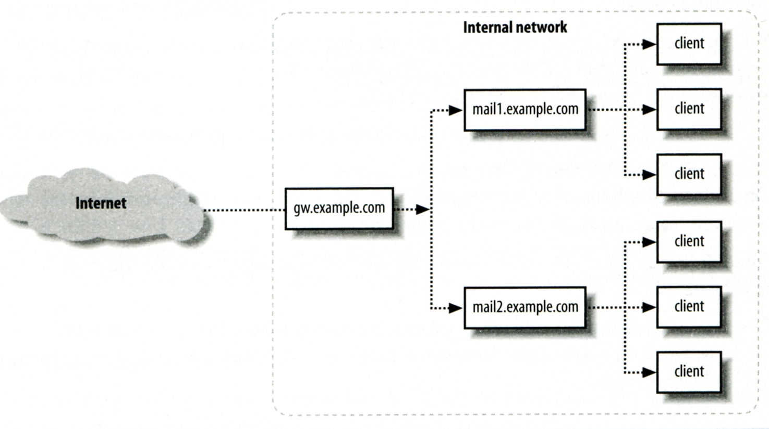
Mail Relaying –
Inbound Mail Gateway (1)
Inbound Mail Gateway
  Accept all mail for a network from the Internet and relays it to internal mail systems
  Ex:
    csmx1.cs.nctu.edu.tw is a IMG
    csmailgate.cs.nctu.edu.tw is internal mail system

Slide 39
Mail Relaying –
Inbound Mail Gateway (2)
To be IMG, suppose
  You are administrator for cs.nctu.edu.tw
  You have to be the IMG for secureLab.cs.nctu.edu.tw and javaLab.cs.nctu.edu.tw
  The MX record for secureLab.cs.nctu.edu.tw and javaLab.cs.nctu.edu.tw should point to csmx1.cs.nctu.edu.tw
  In csmx1.cs.nctu.edu.tw,
  relay_domains = secureLab.cs.nctu.edu.tw javaLab.cs.nctu.edu.tw
  transport_maps = hash:/usr/local/etc/postfix/transport
  secureLab.cs.nctu.edu.tw relay:[secureLab.cs.nctu.edu.tw]
  javaLab.cs.nctu.edu.tw relay:[javaLab.cs.nctu.edu.tw]
  In secureLab.cs.nctu.edu.tw ( and so do javaLab.cs.nctu.edu.tw)
  mydestination = secureLab.cs.nctu.edu.tw
Notes:
1

Slide 40
Mail Relaying –
Outbound Mail Gateway
Outbound Mail Gateway
  Accept mails from inside network and relay them to Internet hosts on behalf of internal mail servers
To be OMG, suppose
  You are administrator for cs.nctu.edu.tw
  You have to be the OMG for secureLab.cs.nctu.edu.tw and javaLab.cs.nctu.edu.tw
  In csmx1.cs.nctu.edu.tw
  mynetworks = hash:/usr/local/etc/postfix/mynetworks
  secureLab.cs.nctu.edu.tw
  javaLab.cs.nctu.edu.tw
  All students in secureLab will configure there MUA (ex. outlook) to use secureLab.cs.nctu.edu.tw to be the SMTP server
  In secureLab.cs.nctu.edu.tw,
  relayhost = [csmx1.cs.nctu.edu.tw]

Slide 41
Advanced Aliasing –
Virtual Alias Maps
Virtual Alias Map
  It rewrites recipient addresses for all local, all virtual, and all remote mail destinations.
  virtual_alias_maps = hash:/usr/local/etc/postfix/virtual
  Ex:
    # domain_or_address transport:nexthop
    @csie.nctu.edu.tw @cs.nctu.edu.tw
    lwhsu@csie.nctu.edu.tw @lwbsd.cs.nctu.edu.tw
  Applying regular expression
    virtual_alias_maps = pcre:/usr/local/etc/postfix/virtual
    /@csie\.nctu\.edu\.tw/ @cs.nctu.edu.tw
    /lwhsu@csie\.nctu\.edu\.tw/ @lwbsd.cs.nctu.edu.tw
    /(\S+)\.(\S+)@netadm\.cs\.nctu\.edu\.tw/ $1@netadm.cs.nctu.edu.tw

Slide 42
Multiple Domains
Use single system to host many domains
  Ex:
    We use csmailgate.cs.nctu.edu.tw to host both
      cs.nctu.edu.tw
      csie.nctu.edu.tw
  Purpose
    Can be used for final delivery on the machine or
    Can be used for forwarding to destination elsewhere
Important considerations
  Does the same user id with different domain should go to the same mailbox or different mailbox ?
    YES (shared domain)
    NO (Separate domain)
  Does every user require a system account in /etc/passwd ?
    YES (system account)
    NO (virtual account)

Slide 43
Multiple Domains –
Shared Domain with System Account
Situation
  The mail system should accept mails for both canonical and virtual domains and
  The same mailbox for the same user id
Procedure
  Modify “mydomain” to canonical domain
  Modify “mydestination” parameter to let mails to virtual domain can be local delivered
  Ex:
    mydomain = cs.nctu.edu.tw
    mydestination = $myhostname, $mydomain, csie.nctu.edu.tw
    ※ In this way, mail to both lwhsu@cs.nctu.edu.tw and lwhsu@csie.nctu.edu.tw will go to csmailgate:/var/mail/lwhsu
Limitation
  Can not separate lwhsu@cs.nctu.edu.tw from lwhsu@csie.nctu.edu.tw

Slide 44
Multiple Domains –
Separate Domains with System Accounts
Situation
  The mail system should accept mails for both canonical and virtual domains and
  Mailboxes are not necessarily the same for the same user id
Procedure
  Modify “mydomain” to canonical domain
  Modify “virtual_alias_domains” to accept mails to virtual domains
  Create “virtual_alias_mas” map
  Ex:
    mydomain = cs.nctu.edu.tw
    virtual_alias_domains = abc.com.tw, xyz.com.tw
    virtual_alias_maps = hash:/usr/local/etc/postfix/virtual
    In /usr/local/etc/postfix/virtual
      CEO@abc.com.tw andy
      @xyz.com.tw jack
Limitation
  Need to maintain UNIX account for virtual domain user

Slide 45
Multiple Domains –
Separate Domains with Virtual Accounts (1)
Useful when users in virtual domains:
  Do not need to login to system
  Only need to retrieve mail through POP/IMAP server
Procedure
  Modify “virtual_mailbox_domains” to let postfix know what mails it should accepts
  Modify “virtual_mailbox_base” and create related directory to put mails
  Create “virtual_mailbox_mas” map
  Ex:
    virtual_mailbox_domain = abc.com.tw, xyz.com.tw
    virtual_mailbox_base = /var/vmail
    Create /var/vmail/abc-domain and /var/vmail/xyz-domain
    virtual_mailbox_maps = hash:/usr/local/etc/postfix/vmailbox
    In /usr/local/etc/postfix/vmailbox
      CEO@abc.com.tw abc-domain/CEO (Mailbox format)
      CEO@xyz.com.tw xyz-domain/CEO/ (Maildir format)

Slide 46
Multiple Domains –
Separate Domains with Virtual Accounts (2)
Ownerships of virtual mailboxes
  Simplest way:
    The same owner of POP/IMAP Servers
  Flexibility in postfix
    virtual_uid_maps and virtual_gid_maps
    Ex:
      virtual_uid_maps = static:1003
      virtual_gid_maps = static:105
      virtual_uid_maps = hash:/usr/local/etc/postfix/virtual_uids
      virtual_uid_maps = hash:/usr/local/etc/postfix/virtual_uids static:1003
      In /usr/local/etc/postfix/virtual_uids
        CEO@abc.com.tw 1004
        CEO@xyz.com.tw 1008

Slide 47
Handling Spam in Postfix

Slide 48
Nature of Spam
Spam
  UBE – Unsolicited Bulk Email
  UCE – Unsolicited Commercial Email
Spam
  There is no relationship between receiver and
    Sender
    Message content
  Opt out instruction
  Conceal trail
    False return address
    Forged header information
  Use misconfigured mail system to be an accomplice
  Circumvent spam filters either encode message or insert random letters

Slide 49
Problems of Spam
Cost
  Waste bandwidth and disk space
  DoS like side-effect
  Waste time and false deletion
  Bounce messages of nonexistent users
    Nonexistent return address
    Forged victim return address
Detection
  Aggressive spam policy may cause high false positive

Slide 50
Anti-Spam –
Client-Based Detection (1)
Client-blocking
  Use IP address, hostnames or email address supplied by clients when they connect to send a message
  Compared with Spammer list
  Problems
    IP address, hostname, email address are forged
    Innocent victim open relay host
DNSBL (DNS-based Blacklist)
  Maintain large database of systems that are known to be open relays or that have been used for spam

Slide 51
Anti-Spam –
Client-Based Detection (2)
What DNSBL maintainers do
  Suppose csie has a Blacklist DNS database
    Suppose DNSBL Domain “dnsbl.cs.nctu.edu.tw”
  If 140.112.23.118 is detected as open relay
    There will be a new entry in cs’s blacklist DB
      118.23.112.140.dnsbl.cs.nctu.edu.tw
  When we receive a connection from 140.112.23.118
    Compose 118.23.112.140.dnsbl.cs.nctu.edu.tw
    DNS query for this hostname
      Successful means this IP address is suspicious
      Failed means ok
Using DNSBL
  Review their service options and policies carefully

Slide 52
Anti-Spam –
Content-Based Detection
Spam patterns in message body
Detection difficulties
  Embed HTML codes within words of their message to break up phrases
  Randomly inserted words
  Content-based detection is slower

Slide 53
Anti-Spam –
Action
When you detect a spam, you can:
  Reject immediately during the SMTP conversation
  Save spam into a suspected spam repository
  Label spam and deliver it with some kind of spam tag
  Ex:
    X-Spam-Status: Yes, hits=18.694 tagged_above=3 required=6.3
    X-Spam-Level: ******************
    X-Spam-Flag: YES

Slide 54
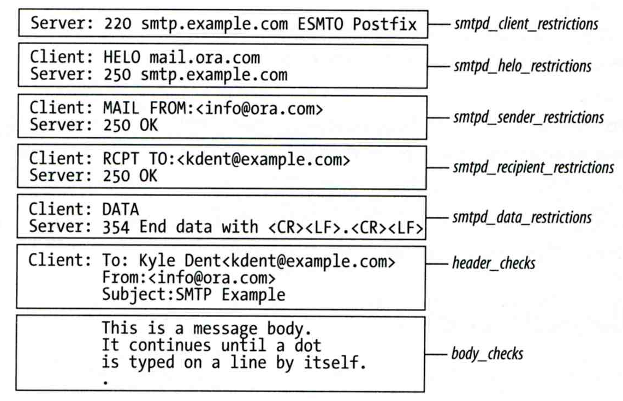
Postfix Anti-Spam configuration
The SMTP Conversation
  info@ora.com → smtp.example.com → kdent@example.com

Slide 55
Postfix Anti-Spam configuration –
Client Detection Rules (1)
Four rules in relative detection position
  Rules and their default values
    smtpd_client_restrictions =
    smtpd_helo_restrictions =
    smtpd_sender_restrictions =
    smtpd_recipient_restrictions =
    permit_mynetworks, reject_unauth_destination
  Each restriction check result can be:
    OK (Accept in this restriction)
    REJECT (Reject immediately without further check)
    DUNNO (do next check)
  There are 5 types of restrictions

Slide 56
Postfix Anti-Spam configuration –
Client Detection Rules (2)
Access maps
  List of IP addresses, hostnames, email addresses
  Can be used in:
  smtpd_client_restrictions = check_client_access hash:/etc/access
  smtpd_helo_restrictions = check_helo access \ hash:/usr/local/etc/postfix/helohost
  smtpd_sender_restrictions = check_sender_access \ hash:/usr/local/etc/postfix/sender_access
  smtpd_recipient_restrictions = check_recipient_access \ hash:/usr/local/etc/postfix/recipient_access
  Actions
    OK, REJECT, DUNNO
    FILTER (redirect to content filter)
    HOLD (put in hold queue)
    DISCARD (report success to client but drop)
    4xx message or 5xx message

Slide 57
Postfix Anti-Spam configuration –
Client Detection Rules (3)
  Example of access maps
    check_client_access hash:/etc/access
    nctu.edu.tw OK
    127.0.0.1 OK
    61.30.6.207 REJECT
    check_helo access hash:/postfix/helohost
    greatdeals.example.com REJECT
    oreillynet.com OK
    check_sender_access hash:/usr/local/etc/postfix/sender_access
    viagra.com 553 Please contact +886-3-5712121-54707.
    aaa@ 553 Invalid MAIL FROM
    sales@ 553 Invalid MAIL FROM
    hchen@ 553 Invalid MAIL FROM
    check_recipient_access hash:/usr/local/etc/postfix/recipient_access
    bin@cs.nctu.edu.tw 553 Invalid RCPT TO command
    ftp@cs.nctu.edu.tw 553 Invalid RCPT TO command
    man@cs.nctu.edu.tw 553 Invalid RCPT TO command

Slide 58
Postfix Anti-Spam configuration –
Client Detection Rules (4)
Special client-checking restrictions
  permit_auth_destination
    Mostly used in “smtpd_recipient_restrictions”
    Permit request if destination address matches:
      The postfix system’s final destination setting
        mydestination, inet_interfaces, vitual_alias_maps, virtual_mailbox_maps
      The postfix system’s relay domain
        relay_domains
    Found ➔ OK, UnFound ➔ DUNNO
  reject_unauth_destination
    Opposite to permit_auth_destination
    Found ➔ REJECT, UnFound ➔ DUNNO
  permit_mynetworks
    Allow a request if interest IP match any address in “mynetworks”
      Used in smtpd_recipient_restrictions
      Used in smtpd_client_restrictions

Slide 59
Postfix Anti-Spam configuration –
Client Detection Rules (5)
Strict syntax restrictions
  Restrictions that does not conform to RFC
  reject_invalid_hostname
    Reject hostname with bad syntax
  reject_non_fqdn_hostname
    Reject hostname not in FQDN format
  reject_non_fqdn_sender
  reject_non_fqdn_recipient
    For “MAIL FROM” and “RCPT TO” command respectively

Slide 60
Postfix Anti-Spam configuration –
Client Detection Rules (6)
DNS restrictions
  Make sure that clients and email envelope addresses have valid DNS information
  reject_unknown_client
    Reject if the client IP has no DNS PTR record
      215.17.113.140 IN PTR netadm.cs.nctu.edu.tw.
  reject_unknown_hostname
    Reject if EHLO hostname has no DNS MX or A record
  reject_unknown_sender_domain
    Reject if MAIL FROM domain name has no DNS MX or A record
  reject_unknown_recipient_domain
    Reject if RCPT TO domain name has no DNS MX or A record

Slide 61
Postfix Anti-Spam configuration –
Client Detection Rules (7)
Real-time blacklists
  Check with DNSBL services
  reject_rbl_client domain.tld
    Reject if client IP is detect in DNSBL
  reject_rhsbl_client domain.tld
    Reject if client hostname has an A record under specified domain
  reject_rhsbl_sender domain.tld
    Reject if sender domain in address has an A record under specified domain
  smtpd_client_restrictions =
  hash:/etc/access, reject_rbl_client relays.ordb.org
  smtpd_sender_restrictions =
  hash:/usr/local/etc/postfix/sender_access, reject_rhsbl_sender dns.rfc-ignorant.org

Slide 62
Postfix Anti-Spam configuration –
Client Detection Rules (8)
Policy Service
  Postfix SMTP server sends in a delegated SMTPD access policy request to one special service (policy serivce).
  Policy service replies actions allowed in Postfix SMTPD access table.
  Usage:
    check_policy_service servicename
  Example: Grey Listing (Using Postgrey)
    Postgrey daemon runs on port:10023
    In main.cf:
      smtpd_recipient_restrictions = check_policy_service inet:127.0.0.1:10023

Slide 63
POSTFIX ANTI-SPAM CONFIGURATION –
CLIENT DETECTION RULES (8)
smtpd_client_restrictions
  check_client_access
  reject_unknown_client
  permit_mynetworks
  reject_rbl_client
  reject_rhsbl_client
smtpd_helo_restrictions
  check_helo_access
  reject_invalid_hostname
  reject_unknown_hostname
  reject_non_fqdn_hostname
smtpd_sender_restrictions
  check_sender_access
  reject_unknown_sender_domain
  reject_rhsbl_sender
smtpd_recipient_restrictions
  check_recipient_access
  permit_auth_destination
  reject_unauth_destination
  reject_unknown_recipient_domain
  reject_non_fqdn_recipient
  check_policy_service

Slide 64
Postfix Anti-Spam configuration
The SMTP Conversation
  info@ora.com → smtp.example.com → kdent@example.com

Slide 65
Postfix Anti-Spam configuration –
Content-Checking rules (1)
4 rules
  header_checks
    Check for message headers
  mime_header_checks
    Check for MIME headers
  nested_header_checks
    Check for attached message headers
  body_check
    Check for message body
All rules use lookup tables
  Ex:
    header_checks = regexp:/usr/local/etc/postfix/header_checks
    body_checks = pcre:/usr/local/etc/postfix/body_checks

Slide 66
Postfix Anti-Spam configuration –
Content-Checking rules (2)
Content-checking lookup table
  Regular_Expression Action
Actions
  REJECT message
  WARN message
    Logs a rejection without actually rejecting
  IGNORE
    Delete matched line of headers or body
  HOLD message
  DISCARD message
    Claim successful delivery but silently discard
  FILTER message
    Send message through a separate content fileter

Slide 67
Postfix Anti-Spam configuration –
Content-Checking rules (3)
Example of header check
  header_checks = regexp:/usr/local/etc/postfix/header_checks
  In /usr/local/etc/postfix/header_checks
  /take advantage now/ REJECT
  /repair your credit/ REJECT
Example of body check
  body_checks = regexp:/usr/local/etc/postfix/body_checks
  In /usr/local/etc/postfix/body_checks
  /lowest rates.*\!/ REJECT
  /[:alpha:]<!--.*-->[:alpha:]/ REJECT

Slide 68
External Filters
Filtering can be done on
  MTA
  MDA
  MUA
  ※ Combination of MTA and MUA
    Adding some extra headers or modifying subject in MTA, and filtering in MUA.
External filters for postfix
  Command-based filtering
    New process is started for every message
    Accept message from STDIN
  Daemon-based filtering
    Stay resident
    Accept message via SMTP or LMTP

Slide 69
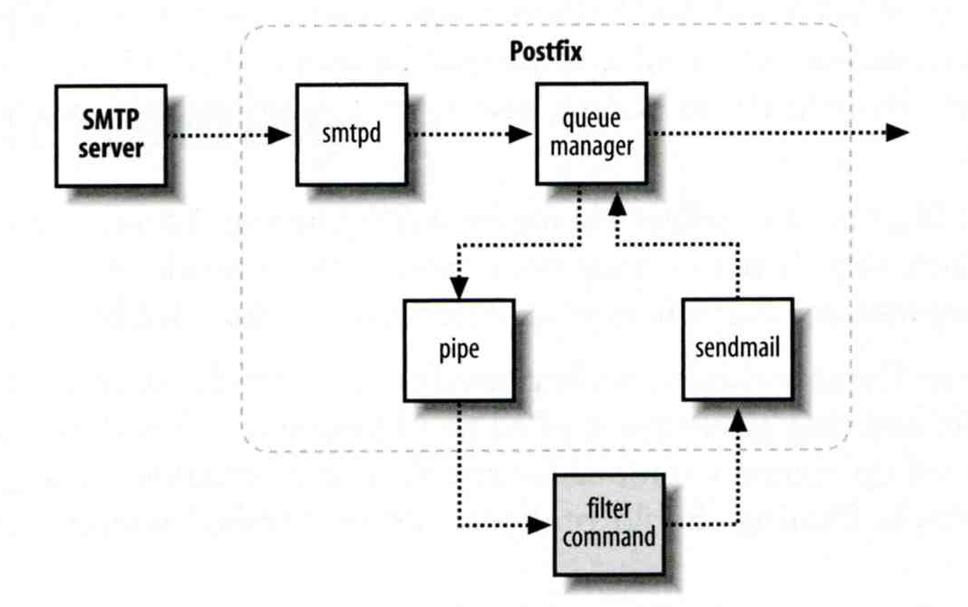
Command-Based Filtering (1)
Usage
  Postfix delivers message to this filter via “pipe” mailer
  Program that accepts content on its STDIN
  Program gives the filtered message back to Postfix using the “sendmail” command

Slide 70
Command-Based Filtering (2)
Configuration
  Prepare your filter program (/usr/local/bin/simple_filt)
  Modify master.cf
#===========================================================================================
# service type private unpriv chroot wakeup maxproc command + args
#===========================================================================================
filter unix - n n - - pipe
flags=Rq user=filter argv=/usr/local/bin/simple_filt -f ${sender} - -${recipient}
smtpd inet n - n - - smtpd
-o content_filter=fileter:

Slide 71
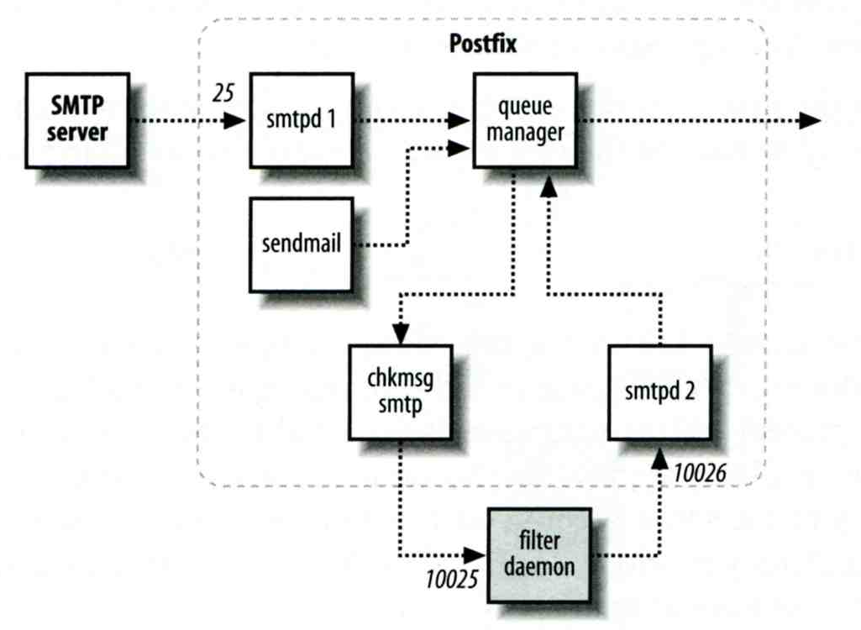
Daemon-Based Filtering (1)
Usage
  Message is passed back and forth between Postfix and filtering daemon via SMTP or LMTP
10025
10024

Slide 72
Daemon-Based Filtering (2)
Configuration
  Install and configure your content filter
    /usr/ports/security/amavisd-new
    Modify amavisd.conf to send message back
      $forward_method = 'smtp:127.0.0.1:10025';
  Edit main.cf to let postfix use filtering daemon
    content_filter = smtp-amavis:[127.0.0.1]:10024
  Edit master.cf to add two additional services
smtp-amavis unix - - n - 10 smtp
-o smtp_data_done_timeout=1200s
-o smtp_never_send_ehlo=yes
-o notify_classes=protocol,resource,software
127.0.0.1:10025 inet n - n - - smtpd
-o content_filter=
-o mynetworks=127.0.0.0/8
-o local_recipient_maps=
-o notify_classes=protocol,resource,software
-o myhostname=localhost
-o smtpd_client_restrictions=
-o smtpd_sender_restrictions=
-o smtpd_recipient_restrictions=permit_mynetworks,reject

Slide 73
Daemon-Based Filtering (3)
  Anti-virus filtering
    amavisd-new supports lots of anti-virus scanner
    Ex:
@av_scanners = (
# ['Sophie',
# \&ask_daemon, ["{}/\n", '/var/run/sophie'],
# qr/(?x)^ 0+ ( : | [\000\r\n]* $)/, qr/(?x)^ 1 ( : | [\000\r\n]* $)/,
# qr/(?x)^ [-+]? \d+ : (.*?) [\000\r\n]* $/ ],
['ClamAV-clamd',
\&ask_daemon, ["CONTSCAN {}\n", "/var/run/clamav/clamd"],
qr/\bOK$/, qr/\bFOUND$/,
qr/^.*?: (?!Infected Archive)(.*) FOUND$/ ],
);

