Slide 1
Homework 01
Announce: 20090325
Due: 20090401

Slide 2
Requirements
Use Perl with CPAN modules to build a web proxy with record feature
Use the logs your recorded to turn web applications to CIL application
  With batch and addition features!
Example
  Dictionary/Wiki lookup
  Search on multiple search engines
  Album grabber
  Auto register
  etc.

Slide 3
Proxy
HTTP::Proxy
  /usr/ports/www/p5-HTTP-Proxy
  http://search.cpan.org/dist/HTTP-Proxy/
HTTP::Recorder
  /usr/ports/www/p5-HTTP-Recoder
  http://search.cpan.org/dist/HTTP-Recorder/
  http://http-recorder/

Slide 4
Example Code
use HTTP::Proxy;
use HTTP::Recorder;
my $proxy = HTTP::Proxy->new(
port => 3128,
host => undef);
my $agent = new HTTP::Recorder;
$agent->file("log");
$proxy->agent( $agent );
$proxy->start();

Slide 5
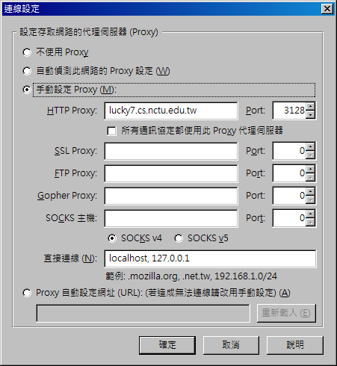
Set Proxy

Slide 6
Get code!
$agent->get('http://www.google.com/dictionary');
$agent->form_name('f');
$agent->field('q', 'Serendipity');
$agent->field('langpair', 'en|zh-TW');
$agent->click();

Slide 7
Bot
WWW::Mechanize
  /usr/ports/www/p5-WWW-Mechanize
  http://search.cpan.org/dist/WWW-Mechanize/

Slide 8
Example Code
use WWW::Mechanize;
my $agent = WWW::Mechanize->new();
#
# Paste and modify what you recorded here
#
# $agent-> …
# …
#

Slide 9
Other CPAN modules
User Interface
  devel/p5-Curses
    devel/p5-Curses-UI
    devel/p5-Curses-*
  devel/p5-Dialog
Parallelization
  www/p5-ParallelUA
Cookies
  www/p5-libwww
    my $cookie = HTTP::Cookies->new();
    my $m = WWW::Mechanize->new(
    cookie_jar => $cookie );

Slide 10
FAQ
“Parsing of undecoded UTF-8 will give garbage when decoding entities at /usr/local/lib/perl5/site_perl/5.8.9/mach/HTML/PullParser.pm line 81.”
  use utf8;
  Set all your environment to UTF-8
HTTP::Recorder doesn’t provide enough information
  http://search.cpan.org/dist/WWW-Mechanize/lib/WWW/Mechanize.pm
    LINK METHODS
    IMAGE METHODS
      find_*()

