Slide 1
TCP/IP Protocols

Slide 2
TCP/IP and the Internet
In 1969
  ARPA funded and created the “ARPAnet” network
    美國高級研究計劃署（Advanced Research Project Agency）
    NCP – network control protocol
      Two disadvantages
In 1973
  How to connect ARPAnet with SAT Net and ALOHAnet
  TCP/IP begun to be developed
In 1983
  TCP/IP protocols replaced NCP as the ARPANET’s principal protocol
  ARPnet → MILNET + ARPnet = Internet
In 1985
  The NSF created the NSFnet to connect to Internet
In 1990
  ARPA passed out of existence, and in 1995, the NSFnet became the primary Internet backbone network
ARPA = Advanced Research Project Agency
NSF = National Science Foundation
Notes:
1983 年時, ARPnet 分成 MILNET 以及較小的 ARPnet
大約從那時候起, 有了 Internet 這個名詞
自從 1985 年, NSFnet 串上 Internet 後, 開始一連串的蓬勃發展
NSFnet 的目的就是希望能夠將網路帶給美國每一位 scientist, engineer

Slide 3

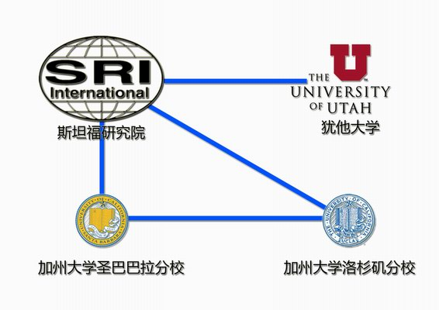
Introduction
– APRANET

Slide 4
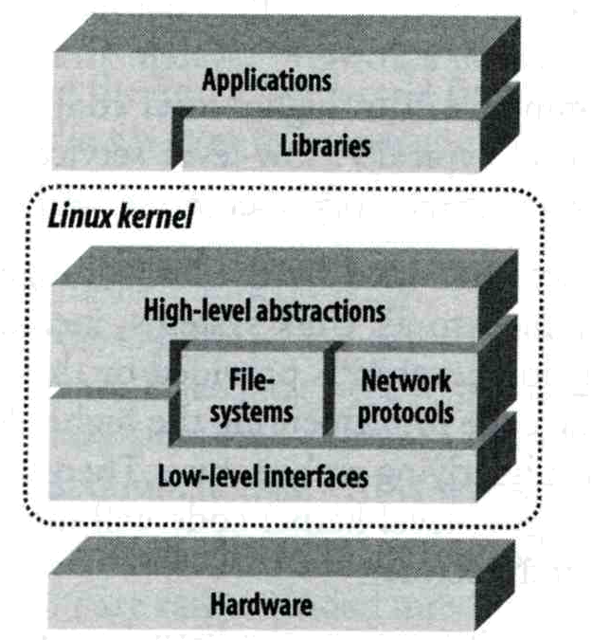
Introduction
– Why TCP/IP ?
The gap between applications and Network
  Network
    802.3 Ethernet
    802.4 Token bus
    802.5 Token Ring
    802.11 Wireless
  Application
    Reliable
    Performance
We need something to do the translating work!
TCP/IP it is!!

Slide 5
Introduction
– Layers of TCP/IP (1)
TCP/IP is a suite of networking protocols
  4 layers Layering architecture
    Link layer (data-link layer)
      Include device drivers to handle hardware details
    Network layer (IP)
      Handle the movement of packets around the network
    Transport layer (Port)
      Handle flow of data between hosts
    Application

Slide 6
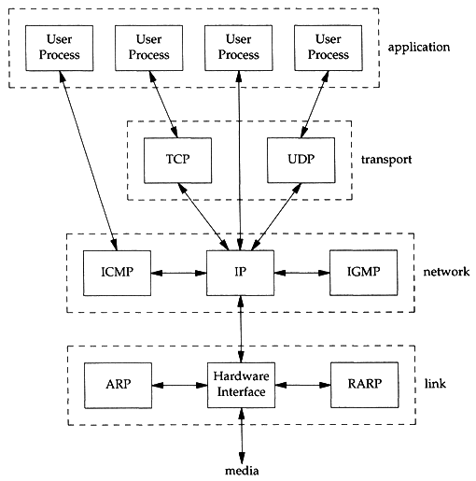
Introduction
– Layers of TCP/IP (2)
Each layer has several protocols
  A layer define a data communication function that may be performed by certain protocols
  A protocol provides a service suitable to the function of that layer

Slide 7
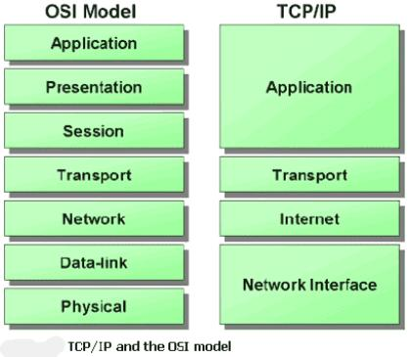
Introduction
– Layers of TCP/IP (3)
ISO/OSI Model and
TCP/IP Model

Slide 8
Introduction
TCP/IP
  Used to provide data communication between hosts
    How to delivery data reliably
    How to address remote host on the network
    How to handle different type of hardware device

Slide 9
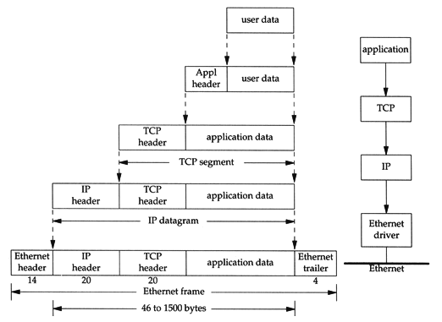
Introduction
– Encapsulation
Send data
  encapsulation

Slide 10
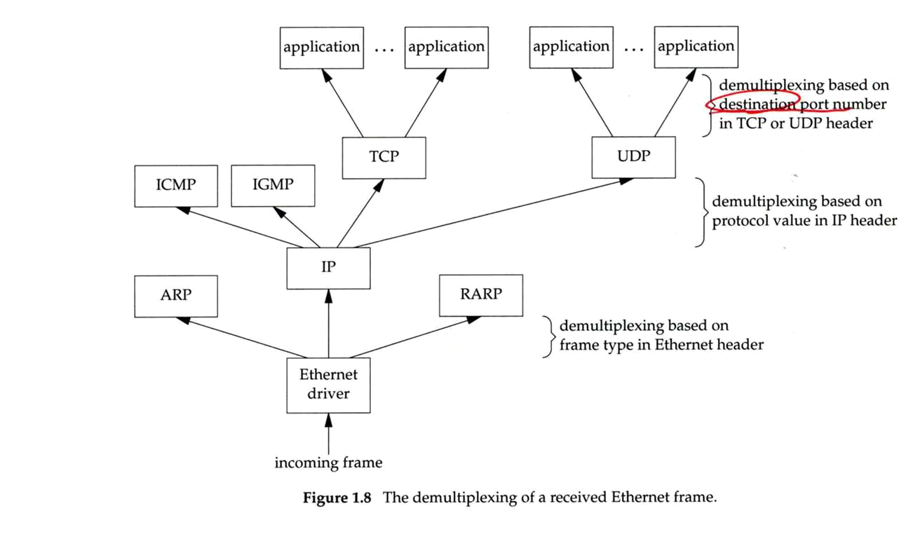
Introduction
– Demultiplex
Demultiplexing

Slide 11
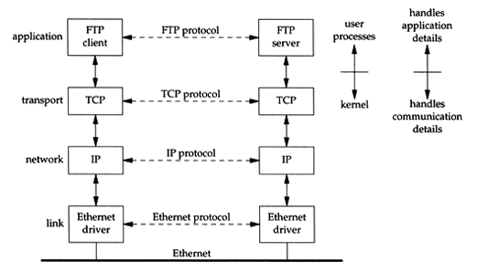
Introduction
– Addressing
Addressing
  Nearby (same network)

Slide 12
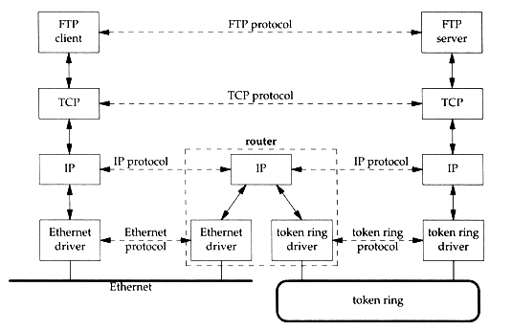
Introduction
– Addressing
Addressing
  Faraway (across network)

Slide 13
Introduction
– Addressing
Addressing
  MAC Address
    Media Access Control Address
    48-bit Network Interface Card Hardware Address
      24bit manufacture ID
      24bit serial number
    Ex:
      00:07:e9:10:e6:6b
  IP Address
    32-bit Internet Address (IPv4)
    Ex:
      140.113.209.64
  Port
    16-bit uniquely identify application (1 ~ 65536)
    Ex:
      FTP port 21, ssh port 22, telnet port 23
sabsd [/home/chwong] -chwong- ifconfig
sk0: flags=8843<UP,BROADCAST,RUNNING,SIMPLEX,MULTICAST> mtu 1500
options=b<RXCSUM,TXCSUM,VLAN_MTU>
inet 140.113.17.215 netmask 0xffffff00 broadcast 140.113.17.255
inet 140.113.17.221 netmask 0xffffffff broadcast 140.113.17.221
ether 00:11:d8:06:1e:81
media: Ethernet autoselect (100baseTX <full-duplex,flag0,flag1>)
status: active
lo0: flags=8049<UP,LOOPBACK,RUNNING,MULTICAST> mtu 16384
inet 127.0.0.1 netmask 0xff000000

Slide 14
Link Layer

Slide 15
Link Layer
– Introduction of Link Layer
Purpose of the link layer
  Send and receive IP datagram for IP module
  ARP request and reply
  RARP request and reply
TCP/IP support various link layers, depending on the type of hardware used:
  Ethernet
    Teach in this class
  Token Ring
  FDDI (Fiber Distributed Data Interface)
  Serial Line

Slide 16
Link Layer
– Ethernet
Features
  Predominant form of local LAN technology used today
  Use CSMA/CD
    Carrier Sense, Multiple Access with Collision Detection
  Use 48bit MAC address
  Operate at 10 Mbps
    Fast Ethernet at 100 Mbps
    Gigabit Ethernet at 1000Mbps
  Ethernet frame format is defined in RFC894
    This is the actually used format in reality

Slide 17
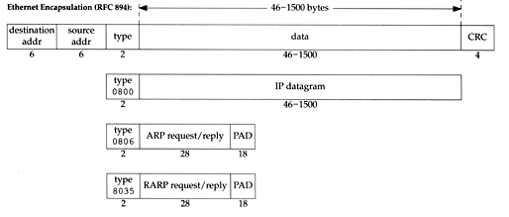
Link Layer
– Ethernet Frame Format
48bit hardware address
  For both destination and source address
16bit type is used to specify the type of following data
  0800 → IP datagram
  0806 → ARP, 8035 → RARP

Slide 18
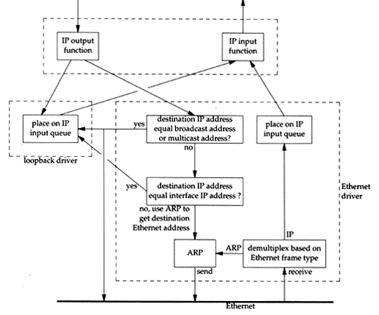
Link Layer
– Loopback Interface
Pseudo NIC
  Allow client and server on the same host to communicate with each other using TCP/IP
  IP
    127.0.0.1
  Hostname
    localhost

Slide 19
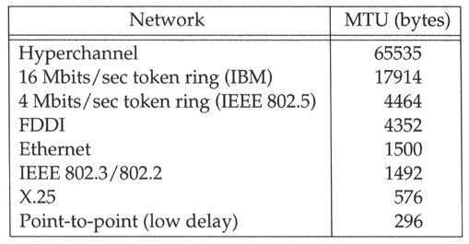
Link Layer
– MTU
Maximum Transmission Unit
  Limit size of payload part of Ethernet frame
    1500 bytes
  If the IP datagram is larger than MTU,
    IP performs “fragmentation”
MTU of various physical device
Path MTU
  Smallest MTU of any data link MTU between the two hosts
  Depend on route
Notes:
Path MTU 並不一定要 constant , 得要看當時的 route 來決定

Slide 20
Link Layer
– MTU
To get MTU info
% ifconfig
em0: flags=8843<UP,BROADCAST,RUNNING,SIMPLEX,MULTICAST> mtu 9000
options=b<RXCSUM,TXCSUM,VLAN_MTU>
inet 192.168.7.1 netmask 0xffffff00 broadcast 192.168.7.255
ether 00:0e:0c:01:d7:c8
media: Ethernet autoselect (1000baseTX <full-duplex>)
status: active
fxp0: flags=8843<UP,BROADCAST,RUNNING,SIMPLEX,MULTICAST> mtu 1500
options=b<RXCSUM,TXCSUM,VLAN_MTU>
inet 140.113.17.24 netmask 0xffffff00 broadcast 140.113.17.255
ether 00:02:b3:99:3e:71
media: Ethernet autoselect (100baseTX <full-duplex>)
status: active

Slide 21
Network Layer

Slide 22
Network Layer
– Introduction to Network Layer
Unreliable and connectionless datagram delivery service
  IP Routing
  IP provides best effort service (unreliable)
  IP datagram can be delivered out of order (connectionless)
Protocols using IP
  TCP, UDP, ICMP, IGMP

Slide 23
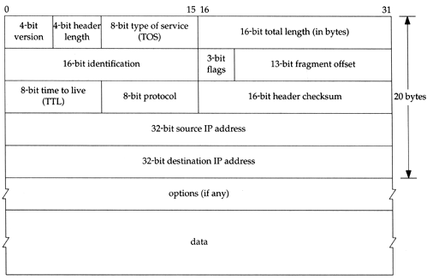
Network Layer
– IP Header (1)
20 bytes in total length, excepts options

Slide 24
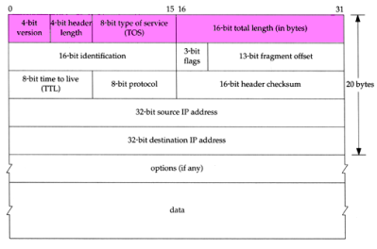
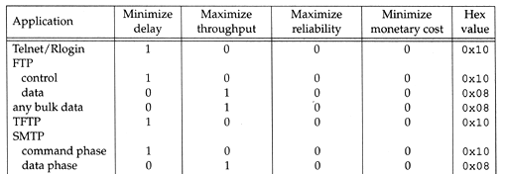
Network Layer
– IP Header (2)
Version (4bit)
  4 for IPv4 and 6 for IPv6
Header length (4bit)
  The number of 32bit words in the header (15*4=60bytes)
  Normally, the value is 5 (no option)
TOS-Type of Service (8bit)
  3bit precedence + 4bit TOS + 1bit unused
Total length (16bit)
  Total length of the IP datagram in bytes

Slide 25
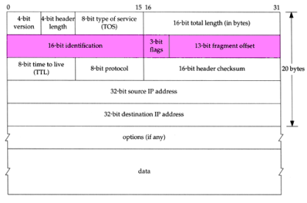
Network Layer
– IP Header (3)
Identification (16bit)
Fragmentation offset (13bit)
Flags (3bit)
  All these three fields are used for fragmentation

Slide 26
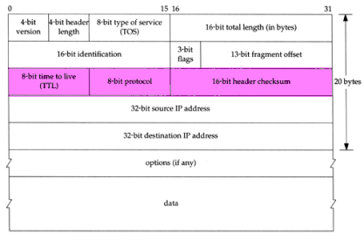
Network Layer
– IP Header (4)
TTL (8bit)
  Limit of next hop count of routers
Protocol (8bit)
  Used to demultiplex to other protocols
  TCP, UDP, ICMP, IGMP
Header checksum (16bit)
  Calculated over the IP header only
  If checksum error, IP discards the datagram and no error message is generated

Slide 27
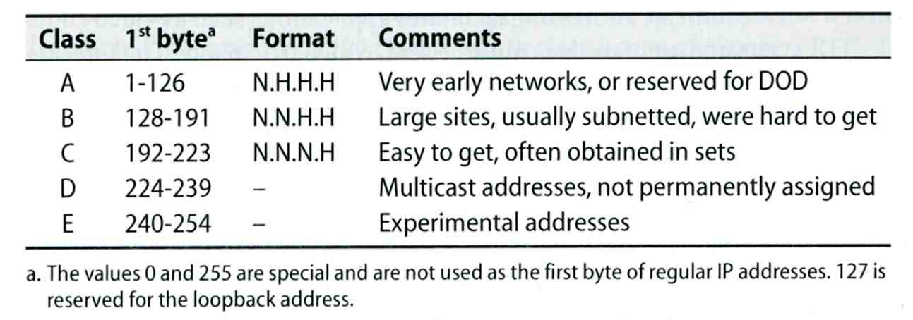
Network Layer
– IP Address (1)
32-bit long
  Network part
    Identify a logical network
  Host part
    Identify a machine on certain network
IP address category
Ex:
  NCTU
    Class B address: 140.113.0.0
    Network ID: 140.113
    Number of hosts: 255*255 = 65535

Slide 28
Network Layer
– Subnetting, CIDR, and Netmask (1)
Problems of Class A or B network
  Number of hosts is enormous
  Hard to maintain and management
  Solution ➔ Subnetting
Problems of Class C network
  255*255*255 number of Class C network make the size of Internet routes huge
  Solution ➔ Classless Inter-Domain Routing

Slide 29
Network Layer
– Subnetting, CIDR, and Netmask (2)
Subnetting
  Borrow some bits from network ID to extends hosts ID
  Ex:
    ClassB address : 140.113.0.0
    = 256 ClassC-like IP addresses
    in N.N.N.H subnetting method
    140.113.209.0 subnet
  Benefits of subnetting
    Reduce the routing table size of Internet’s routers
    Ex:
      All external routers have only one entry for 140.113 Class B network

Slide 30
Network Layer
– Subnetting, CIDR, and Netmask (3)
Netmask
  Specify how many bits of network-ID are used for network-ID
  Continuous 1 bits form the network part
  Ex:
    255.255.255.0 in NCTU-CS example
      256 hosts available
    255.255.255.248 in ADSL example
      Only 8 hosts available
  Shorthand notation
    Address/prefix-length
      Ex: 140.113.209.8/24

Slide 31
Network Layer
– Subnetting, CIDR, and Netmask (4)
How to determine your network ID?
  Bitwise-AND IP and netmask
  Ex:
    140.113.214.37 & 255.255.255.0 ➔ 140.113.214.0
    140.113.209.37 & 255.255.255.0 ➔ 140.113.209.0
    140.113.214.37 & 255.255.0.0 ➔ 140.113.0.0
    140.113.209.37 & 255.255.0.0 ➔ 140.113.0.0
    211.23.188.78 & 255.255.255.248 ➔ 211.23.188.72
      78 = 01001110
      78 & 248= 01001110 & 11111000 =72

Slide 32
Network Layer
– Subnetting, CIDR, and Netmask (5)
In a subnet, not all IP are available
  The first one IP ➔ network ID
  The last one IP ➔ broadcast address
  Ex:
Netmask 255.255.255.0
140.113.209.32/24
140.113.209.0 ➔ network ID
140.113.209.255 ➔ broadcast address
1 ~ 254, total 254 IPs are usable
Netmask 255.255.255.252
211.23.188.78/29
211.23.188.72 ➔ network ID
211.23.188.79 ➔ broadcast address
73 ~ 78, total 6 IPs are usable

Slide 33
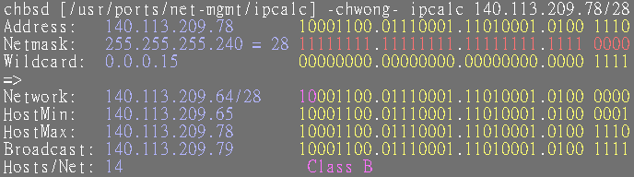
Network Layer
– Subnetting, CIDR, and Netmask (6)
The smallest subnetting
  Network portion : 30 bits
  Host portion : 2 bits
  ➔ 4 hosts, but only 2 IPs are available
ipcalc
  /usr/ports/net-mgmt/ipcalc

Slide 34
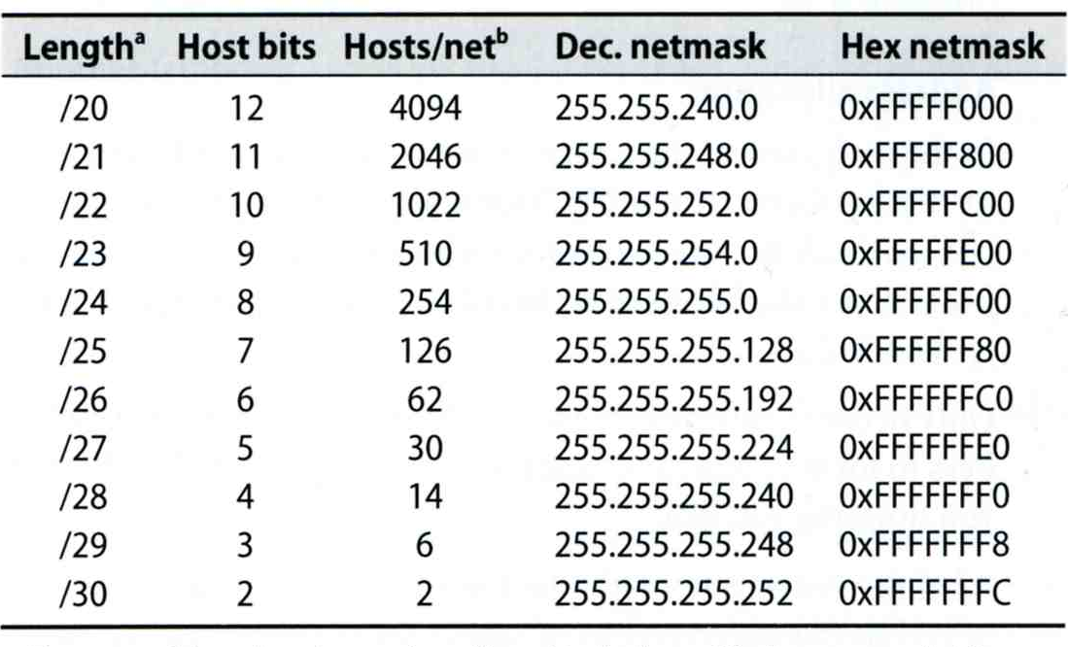
Network Layer
– Subnetting, CIDR, and Netmask (7)
Network configuration for various lengths of netmask

Slide 35
Network Layer
– Subnetting, CIDR, and Netmask (8)
CIDR (Classless Inter-Domain Routing)
  Use address mask instead of old address classes to determine the destination network
  CIDR requires modifications to routers and routing protocols
    Need to transmit both destination address and mask
  Ex:
    We can merge two ClassC network:
    203.19.68.0/24, 203.19.69.0/24 ➔ 203.19.68.0/23
  Benefit of CIDR
    We can allocate continuous ClassC network to organization
      Reflect physical network topology
      Reduce the size of routing table

Slide 36
Network Layer
– IP Routing (1)
Difference between Host and Router
  Router forwards datagram from one of its interface to another, while host does not
  Almost every Unix system can be configured to act as a router or both
    net.inet.ip.forwarding=1
Router
  IP layer has a routing table, which is used to store the information for forwarding datagram
  When router receiving a datagram
    If Dst. IP = my IP, demultiplex to other protocol
    Other, forward the IP based on routing table

Slide 37
Network Layer
– IP Routing (2)
Routing table information
  Destination IP
  IP address of next-hop router or IP address of a directly connected network
  Flags
  Next interface
IP routing
  Done on a hop-by-hop basis
  It assumes that the next-hop router is closer to the destination
  Steps:
    Search routing table for complete matched IP address
      Send to next-hop router or to the directly connected NIC
    Search routing table for matched network ID
      Send to next-hop router or to the directly connected NIC
    Search routing table for default route
      Send to this default next-hop router
    host or network unreachable

Slide 38
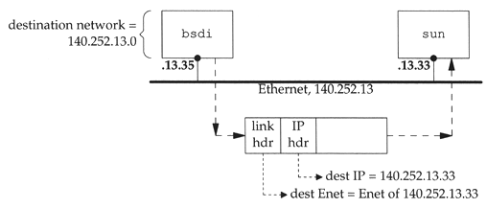
Network Layer
– IP Routing (3)
Ex1: routing in the same network
  bsdi: 140.252.13.35
  sun: 140.252.13.33
Ex Routing table:
140.252.13.33 00:d0:59:83:d9:16 UHLW fxp1

Slide 39
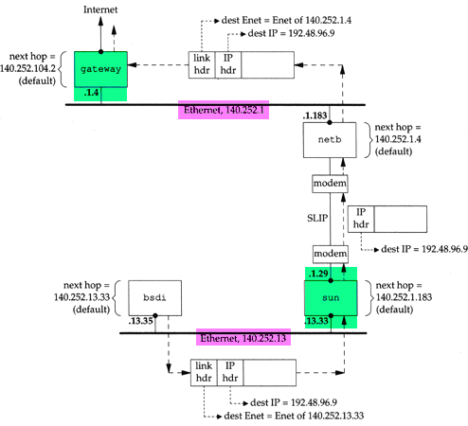
Network Layer
– IP Routing (4)
Ex2:
  routing across multi-network

Slide 40
ARP and RARP
Something between
MAC (link layer)
And
IP (network layer)

Slide 41
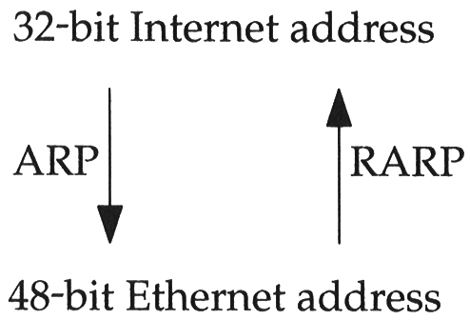
ARP and RARP
ARP – Address Resolution Protocol and
RARP – Reverse ARP
  Mapping between IP and Ethernet address
When an Ethernet frame is sent on LAN from one host to another,
  It is the 48bit Ethernet address that determines for which interface the frame is destined

Slide 42
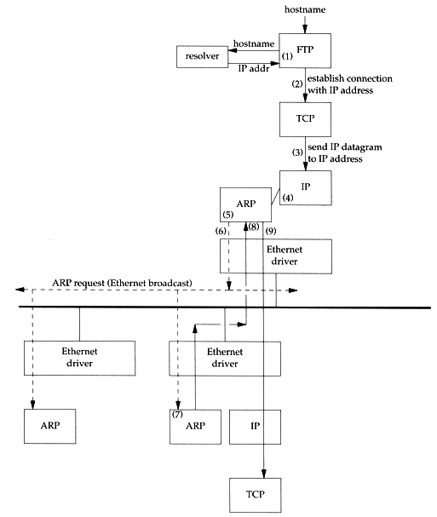
ARP and RARP
– ARP Example
Example
  % ftp bsd1
  (4) next-hop or direct host
  (5) Search ARP cache
  (6) Broadcast ARP request
  (7) bsd1 response ARP reply
  (9) Send original IP datagram

Slide 43
ARP and RARP
– ARP Cache
Maintain recent ARP results
  come from both ARP request and reply
  expiration time
    Complete entry = 20 minutes
    Incomplete entry = 3 minutes
  Use arp command to see the cache
  Ex:
    % arp –a
    % arp –da
    % arp –S 140.113.235.132 00:0e:a6:94:24:6e
csduty /home/chwong] -chwong- arp -a
cshome (140.113.235.101) at 00:0b:cd:9e:74:61 on em0 [ethernet]
bsd1 (140.113.235.131) at 00:11:09:a0:04:74 on em0 [ethernet]
? (140.113.235.160) at (incomplete) on em0 [ethernet]

Slide 44

ARP and RARP
– ARP/RARP Packet Format
Ethernet destination addr: all 1’s (broadcast)
Known value for IP <-> Ethernet
  Frame type: 0x0806 for ARP, 0x8035 for RARP
  Hardware type: type of hardware address (1 for Ethernet)
  Protocol type: type of upper layer address (0x0800 for IP)
  Hard size: size in bytes of hardware address (6 for Ethernet)
  Protocol size: size in bytes of upper layer address (4 for IP)
  Op: 1, 2, 3, 4 for ARP request, reply, RARP request, reply

Slide 45
ARP and RARP
– Use tcpdump to see ARP
Host 140.113.17.212 → 140.113.17.215
  Clear ARP cache of 140.113.17.212
    % sudo arp -d 140.113.17.215
  Run tcpdump on 140.113.17.215 (00:11:d8:06:1e:81)
    % sudo tcpdump –i sk0 –e arp
    % sudo tcpdump –i sk0 –n –e arp
    % sudo tcpdump –i sk0 –n –t –e arp
  On 140.113.17.212, ssh to 140.113.17.215
15:18:54.899779 00:90:96:23:8f:7d > Broadcast, ethertype ARP (0x0806), length 60:
arp who-has nabsd tell chbsd.csie.nctu.edu.tw
15:18:54.899792 00:11:d8:06:1e:81 > 00:90:96:23:8f:7d, ethertype ARP (0x0806), length 42:
arp reply nabsd is-at 00:11:d8:06:1e:81
15:26:13.847417 00:90:96:23:8f:7d > ff:ff:ff:ff:ff:ff, ethertype ARP (0x0806), length 60:
arp who-has 140.113.17.215 tell 140.113.17.212
15:26:13.847434 00:11:d8:06:1e:81 > 00:90:96:23:8f:7d, ethertype ARP (0x0806), length 42:
arp reply 140.113.17.215 is-at 00:11:d8:06:1e:81
00:90:96:23:8f:7d > ff:ff:ff:ff:ff:ff, ethertype ARP (0x0806), length 60:
arp who-has 140.113.17.215 tell 140.113.17.212
00:11:d8:06:1e:81 > 00:90:96:23:8f:7d, ethertype ARP (0x0806), length 42:
arp reply 140.113.17.215 is-at 00:11:d8:06:1e:81

Slide 46
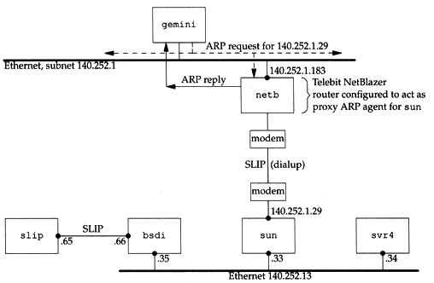
ARP and RARP
– Proxy ARP
Let router answer ARP request on one of its networks for a host on another of its network

Slide 47
ARP and RARP
– Gratuitous ARP
Gratuitous ARP
  The host sends an ARP request looking for its own IP
  Provide two features
    Used to determine whether there is another host configured with the same IP
    Used to cause any other host to update ARP cache when changing hardware address

Slide 48
ARP and RARP
– RARP
Principle
  Used for the diskless system to read its hardware address from the NIC and send an RARP request to gain its IP
RARP Server Design
  RARP server must maintain the map from hardware address to an IP address for many host
  Link-layer broadcast
    This prevent most routers from forwarding an RARP request

Slide 49
ICMP –
Internet Control Message Protocol

Slide 50
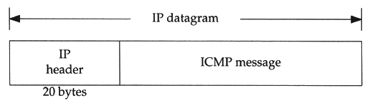
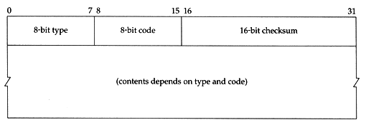
ICMP
– Introduction
Part of the IP layer
  ICMP messages are transmitted within IP datagram
  ICMP communicates error messages and other conditions that require attention for other protocols
ICMP message format

Slide 51
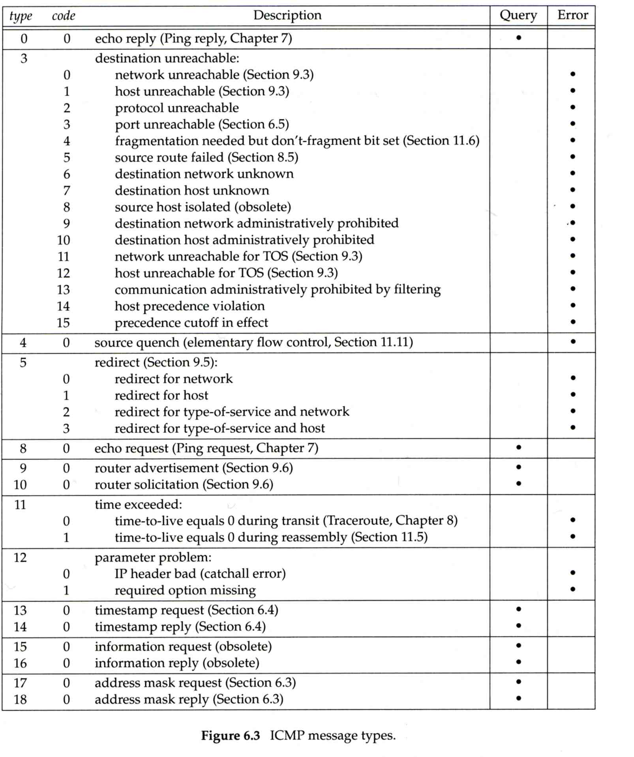
ICMP
– Message Type (1)

Slide 52
ICMP
– Message Type (2)

Slide 53
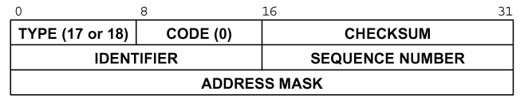
ICMP – Query Message
– Address Mask Request/Reply (1)
Address Mask Request and Reply
  Used for diskless system to obtain its subnet mask
  Identifier and sequence number
    Can be set to anything for sender to match reply with request
  The receiver will response an ICMP reply with the subnet mask of the receiving NIC

Slide 54
ICMP – Query Message
– Address Mask Request/Reply (2)
Ex:
chbsd [/home/chwong] -chwong- ping -M m sun1.cs.nctu.edu.tw
ICMP_MASKREQ
PING sun1.cs.nctu.edu.tw (140.113.235.171): 56 data bytes
68 bytes from 140.113.235.171: icmp_seq=0 ttl=251 time=0.663 ms mask=255.255.255.0
68 bytes from 140.113.235.171: icmp_seq=1 ttl=251 time=1.018 ms mask=255.255.255.0
68 bytes from 140.113.235.171: icmp_seq=2 ttl=251 time=1.028 ms mask=255.255.255.0
68 bytes from 140.113.235.171: icmp_seq=3 ttl=251 time=1.026 ms mask=255.255.255.0
^C
--- sun1.cs.nctu.edu.tw ping statistics ---
4 packets transmitted, 4 packets received, 0% packet loss
round-trip min/avg/max/stddev = 0.663/0.934/1.028/0.156 ms
chbsd [/home/chwong] -chwong- icmpquery -m sun1
sun1 : 0xFFFFFF00
※ icmpquery can be found in /usr/ports/net-mgmt/icmpquery

Slide 55
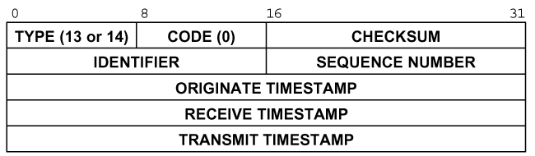
ICMP – Query Message
– Timestamp Request/Reply (1)
Timestamp request and reply
  Allow a system to query another for the current time
  Milliseconds resolution, since midnight UTC
  Requestor
    Fill in the originate timestamp and send
  Reply system
    Fill in the receive timestamp when it receives the request and the transmit time when it sends the reply

Slide 56
ICMP – Query Message
– Timestamp Request/Reply (2)
chbsd [/home/chwong] -chwong- ping -M time nabsd
ICMP_TSTAMP
PING nabsd.cs.nctu.edu.tw (140.113.17.215): 56 data bytes
76 bytes from 140.113.17.215: icmp_seq=0 ttl=64 time=0.663 ms
tso=06:47:46 tsr=06:48:24 tst=06:48:24
76 bytes from 140.113.17.215: icmp_seq=1 ttl=64 time=1.016 ms
tso=06:47:47 tsr=06:48:25 tst=06:48:25
chbsd [/home/chwong] -chwong- icmpquery -t nabsd
nabsd : 14:54:47
Ex:
nabsd [/home/chwong] -chwong- sudo tcpdump -i sk0 -e icmp
tcpdump: verbose output suppressed, use -v or -vv for full protocol decode
listening on sk0, link-type EN10MB (Ethernet), capture size 96 bytes
14:48:24.999106 00:90:96:23:8f:7d > 00:11:d8:06:1e:81, ethertype IPv4 (0x0800), length 110:
chbsd.csie.nctu.edu.tw > nabsd: ICMP time stamp query id 18514 seq 0, length 76
14:48:24.999148 00:11:d8:06:1e:81 > 00:90:96:23:8f:7d, ethertype IPv4 (0x0800), length 110:
nabsd > chbsd.csie.nctu.edu.tw: ICMP time stamp reply id 18514 seq 0: org 06:47:46.326,
recv 06:48:24.998, xmit 06:48:24.998, length 76
14:48:26.000598 00:90:96:23:8f:7d > 00:11:d8:06:1e:81, ethertype IPv4 (0x0800), length 110:
chbsd.csie.nctu.edu.tw > nabsd: ICMP time stamp query id 18514 seq 1, length 76
14:48:26.000618 00:11:d8:06:1e:81 > 00:90:96:23:8f:7d, ethertype IPv4 (0x0800), length 110:
nabsd > chbsd.csie.nctu.edu.tw: ICMP time stamp reply id 18514 seq 1: org 06:47:47.327,
recv 06:48:25.999, xmit 06:48:25.999, length 76

Slide 57
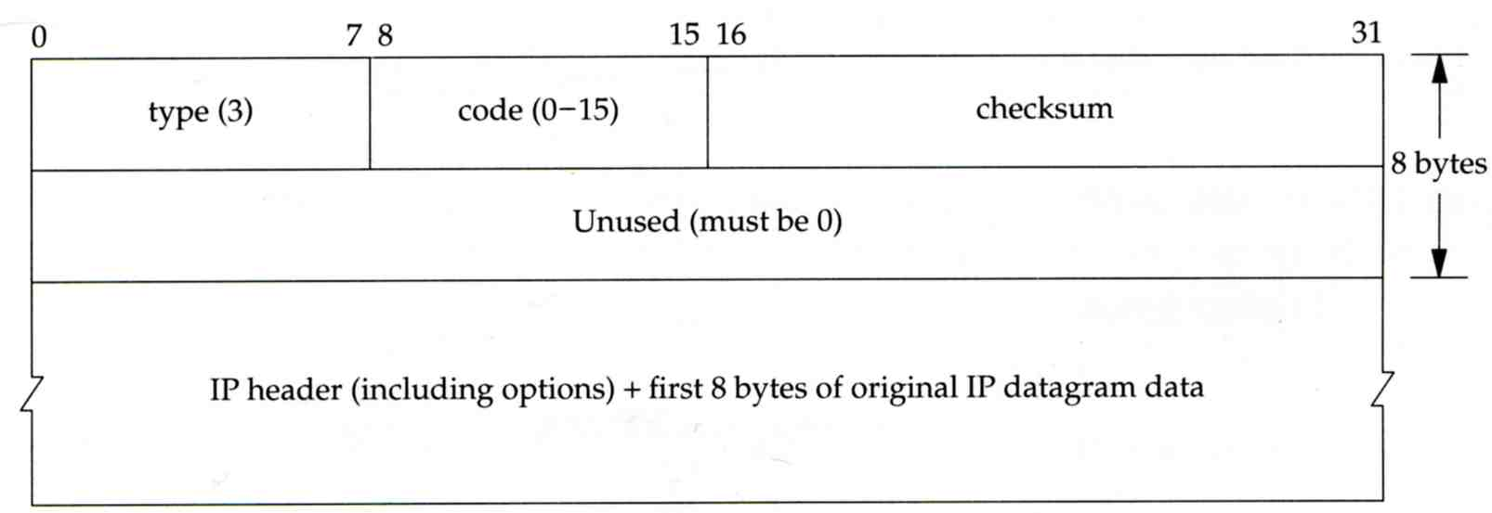
ICMP – Error Message
– Unreachable Error Message
Format
  8bytes ICMP Header
  Application-depend data portion
    IP header
      Let ICMP know how to interpret the 8 bytes that follow
    first 8bytes that followed this IP header
      Information about who generates the error

Slide 58
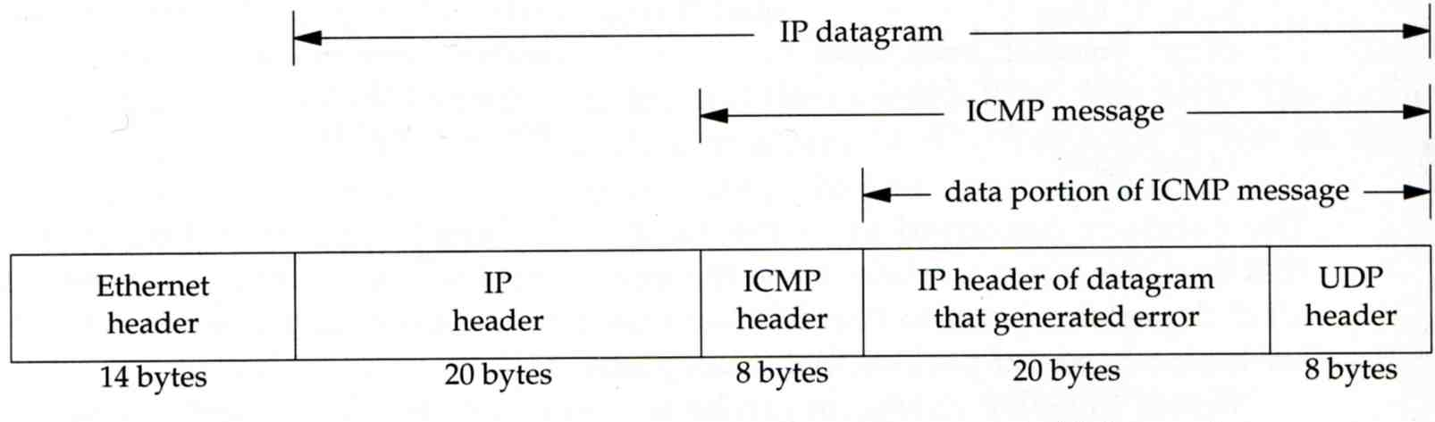
ICMP – Error Message
– Port Unreachable (1)
ICMP port unreachable
  Type = 3 , code = 3
  Host receives a UDP datagram but the destination port does not correspond to a port that some process has in use

Slide 59
ICMP – Error Message
– Port Unreachable (2)
Ex:
  Using TFTP (Trivial File Transfer Protocol)
    Original port: 69
chbsd [/home/chwong] -chwong- tftp
tftp> connect localhost 8888
tftp> get temp.foo
Transfer timed out.
tftp>
chbsd [/home/chwong] -chwong- sudo tcpdump -i lo0
tcpdump: verbose output suppressed, use -v or -vv for full protocol decode
listening on lo0, link-type NULL (BSD loopback), capture size 96 bytes
15:01:24.788511 IP localhost.62089 > localhost.8888: UDP, length 16
15:01:24.788554 IP localhost > localhost:
ICMP localhost udp port 8888 unreachable, length 36
15:01:29.788626 IP localhost.62089 > localhost.8888: UDP, length 16
15:01:29.788691 IP localhost > localhost:
ICMP localhost udp port 8888 unreachable, length 36

Slide 60
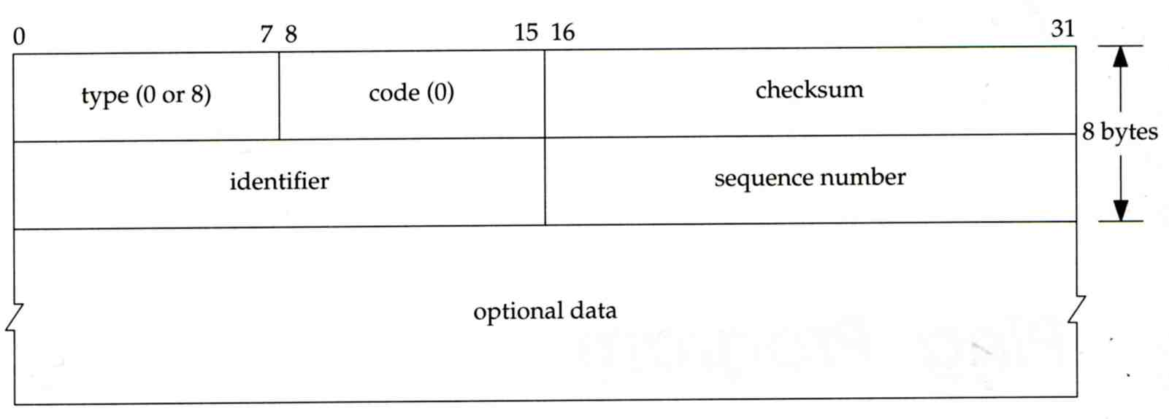
ICMP
– Ping Program (1)
Use ICMP to test whether another host is reachable
  Type 8, ICMP echo request
  Type 0, ICMP echo reply
ICMP echo request/reply format
  Identifier: process ID of the sending process
  Sequence number: start with 0
  Optional data: any optional data sent must be echoed

Slide 61
ICMP
– Ping Program (2)
Ex:
  chbsd ping nabsd
  execute “tcpdump -i sk0 -X -e icmp” on nabsd
chbsd [/home/chwong] -chwong- ping nabsd
PING nabsd.cs.nctu.edu.tw (140.113.17.215): 56 data bytes
64 bytes from 140.113.17.215: icmp_seq=0 ttl=64 time=0.520 ms
15:08:12.631925 00:90:96:23:8f:7d > 00:11:d8:06:1e:81, ethertype IPv4 (0x0800), length 98:
chbsd.csie.nctu.edu.tw > nabsd: ICMP echo request, id 56914, seq 0, length 64
0x0000: 4500 0054 f688 0000 4001 4793 8c71 11d4 E..T....@.G..q..
0x0010: 8c71 11d7 0800 a715 de52 0000 45f7 9f35 .q.......R..E..5
0x0020: 000d a25a 0809 0a0b 0c0d 0e0f 1011 1213 ...Z............
0x0030: 1415 1617 1819 1a1b 1c1d 1e1f 2021 2223 .............!"#
0x0040: 2425 2627 2829 2a2b 2c2d 2e2f 3031 3233 $%&'()*+,-./0123
0x0050: 3435 45
15:08:12.631968 00:11:d8:06:1e:81 > 00:90:96:23:8f:7d, ethertype IPv4 (0x0800), length 98:
nabsd > chbsd.csie.nctu.edu.tw: ICMP echo reply, id 56914, seq 0, length 64
0x0000: 4500 0054 d97d 0000 4001 649e 8c71 11d7 E..T.}..@.d..q..
0x0010: 8c71 11d4 0000 af15 de52 0000 45f7 9f35 .q.......R..E..5
0x0020: 000d a25a 0809 0a0b 0c0d 0e0f 1011 1213 ...Z............
0x0030: 1415 1617 1819 1a1b 1c1d 1e1f 2021 2223 .............!"#
0x0040: 2425 2627 2829 2a2b 2c2d 2e2f 3031 3233 $%&'()*+,-./0123
0x0050: 3435 45

Slide 62
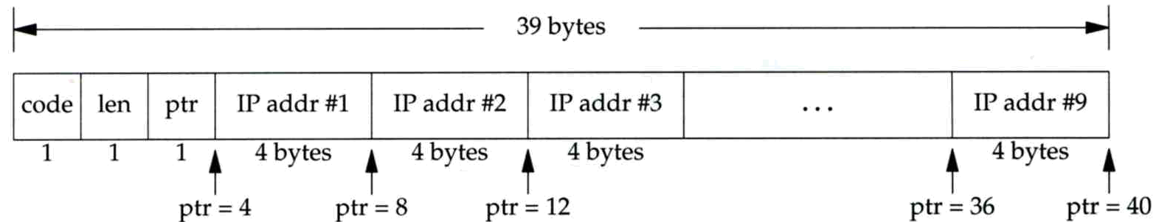
ICMP
– Ping Program (3)
To get the route that packets take to host
  Taking use of “IP Record Route Option”
  Command: ping -R
  Cause every router that handles the datagram to add its (outgoing) IP address to a list in the options field.
  Format of Option field for IP RR Option
    code: type of IP Option (7 for RR)
    len: total number of bytes of the RR option
    ptr:4 ~ 40 used to point to the next IP address
  Only 9 IP addresses can be stored
    Limitation of IP header

Slide 63
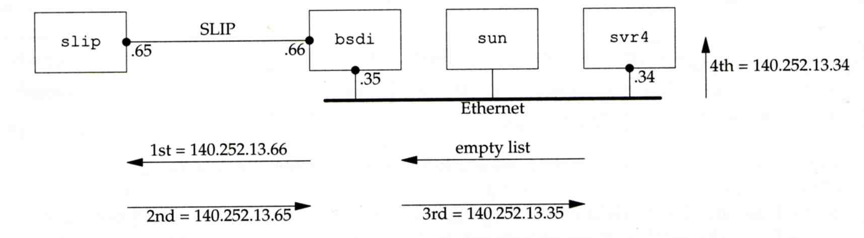
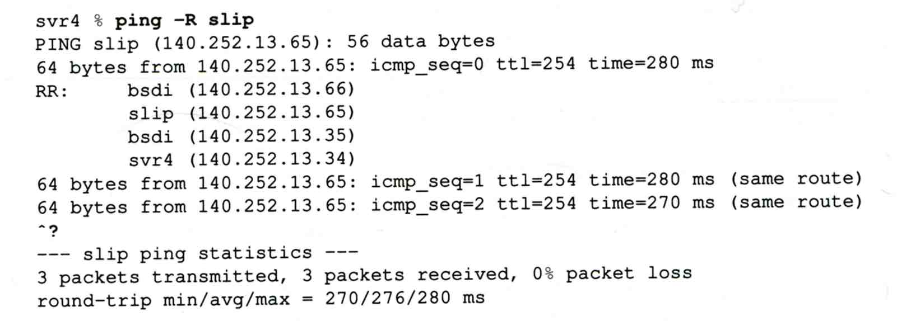
ICMP
– Ping Program (4)
Example:

Slide 64
ICMP
– Ping Program (5)
Example
chbsd [/home/chwong] -chwong- ping -R www.nctu.edu.tw
PING www.nctu.edu.tw (140.113.250.5): 56 data bytes
64 bytes from 140.113.250.5: icmp_seq=0 ttl=61 time=2.361 ms
RR: ProjE27-253.NCTU.edu.tw (140.113.27.253)
140.113.0.57
CC250-gw.NCTU.edu.tw (140.113.250.253)
www.NCTU.edu.tw (140.113.250.5)
www.NCTU.edu.tw (140.113.250.5)
140.113.0.58
ProjE27-254.NCTU.edu.tw (140.113.27.254)
e3rtn.csie.nctu.edu.tw (140.113.17.254)
chbsd.csie.nctu.edu.tw (140.113.17.212)
64 bytes from 140.113.250.5: icmp_seq=1 ttl=61 time=3.018 ms (same route)
chbsd [/home/chwong] -chwong- sudo tcpdump -v -n -i dc0 -e icmp
tcpdump: listening on dc0, link-type EN10MB (Ethernet), capture size 96 bytes
22:57:04.507271 00:90:96:23:8f:7d > 00:90:69:64:ec:00, ethertype IPv4 (0x0800), length 138:
(tos 0x0, ttl 64, id 17878, offset 0, flags [none], proto: ICMP (1), length: 124,
options ( RR (7) len 390.0.0.00.0.0.00.0.0.00.0.0.00.0.0.00.0.0.00.0.0.00.0.0.00.0.0.0EOL
(0) len 1 )) 140.113.17.212 > 140.113.250.5: ICMP echo request, id 45561, seq 0, length 64
22:57:04.509521 00:90:69:64:ec:00 > 00:90:96:23:8f:7d, ethertype IPv4 (0x0800), length 138:
(tos 0x0, ttl 61, id 33700, offset 0, flags [none], proto: ICMP (1), length: 124,
options ( RR (7) len 39140.113.27.253, 140.113.0.57, 140.113.250.253, 140.113.250.5,
140.113.250.5, 140.113.0.58, 140.113.27.254, 140.113.17.254, 0.0.0.0EOL (0) len 1 ))
140.113.250.5 > 140.113.17.212: ICMP echo reply, id 45561, seq 0, length 64
※

Slide 65
Traceroute Program (1)
To print the route packets take to network host
Drawbacks of IP RR options (ping -R)
  Not all routers have supported the IP RR option
  Limitation of IP header length
Background knowledge of traceroute
  When a router receive a datagram, , it will decrement the TTL by one
  When a router receive a datagram with TTL = 0 or 1,
    it will through away the datagram and
    sends back a “Time exceeded” ICMP message
  Unused UDP port will generate a “port unreachable” ICMP message

Slide 66
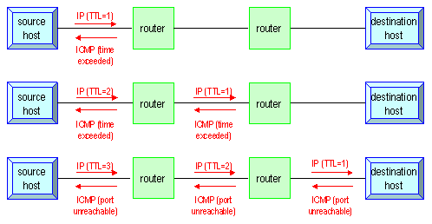
Traceroute Program (2)
Operation of traceroute
  Send UDP with port > 30000, encapsulated with IP header with TTL = 1, 2, 3, … continuously
  When router receives the datagram and TTL = 1, it returns a “Time exceed” ICMP message
  When destination host receives the datagram and TTL = 1, it returns a “Port unreachable” ICMP message

Slide 67
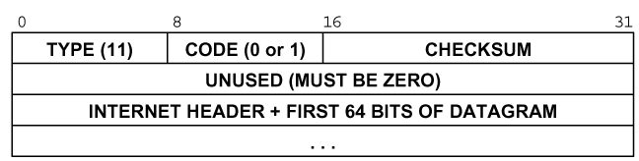
Traceroute Program (3)
Time exceed ICMP message
  Type = 11, code = 0 or 1
    Code = 0 means TTL=0 during transit
    Code = 1 means TTL=0 during reassembly
  First 8 bytes of datagram
    UDP header

Slide 68
Traceroute Program (4)
nabsd [/home/chwong] -chwong- traceroute bsd1.cs.nctu.edu.tw
traceroute to bsd1.cs.nctu.edu.tw (140.113.235.131), 64 hops max, 40 byte packets
1 e3rtn.csie.nctu.edu.tw (140.113.17.254) 0.377 ms 0.365 ms 0.293 ms
2 ProjE27-254.NCTU.edu.tw (140.113.27.254) 0.390 ms 0.284 ms 0.391 ms
3 140.113.0.58 (140.113.0.58) 0.292 ms 0.282 ms 0.293 ms
4 140.113.0.165 (140.113.0.165) 0.492 ms 0.385 ms 0.294 ms
5 bsd1.cs.nctu.edu.tw (140.113.235.131) 0.393 ms 0.281 ms 0.393 ms
Ex:
nabsd [/home/chwong] -chwong- sudo tcpdump -i sk0 -t icmp
tcpdump: verbose output suppressed, use -v or -vv for full protocol decode
listening on sk0, link-type EN10MB (Ethernet), capture size 96 bytes
IP e3rtn.csie.nctu.edu.tw > nabsd: ICMP time exceeded in-transit, length 36
IP e3rtn.csie.nctu.edu.tw > nabsd: ICMP time exceeded in-transit, length 36
IP e3rtn.csie.nctu.edu.tw > nabsd: ICMP time exceeded in-transit, length 36
IP ProjE27-254.NCTU.edu.tw > nabsd: ICMP time exceeded in-transit, length 36
IP ProjE27-254.NCTU.edu.tw > nabsd: ICMP time exceeded in-transit, length 36
IP ProjE27-254.NCTU.edu.tw > nabsd: ICMP time exceeded in-transit, length 36
IP 140.113.0.58 > nabsd: ICMP time exceeded in-transit, length 36
IP 140.113.0.58 > nabsd: ICMP time exceeded in-transit, length 36
IP 140.113.0.58 > nabsd: ICMP time exceeded in-transit, length 36
IP 140.113.0.165 > nabsd: ICMP time exceeded in-transit, length 36
IP 140.113.0.165 > nabsd: ICMP time exceeded in-transit, length 36
IP 140.113.0.165 > nabsd: ICMP time exceeded in-transit, length 36
IP bsd1.cs.nctu.edu.tw > nabsd: ICMP bsd1.cs.nctu.edu.tw udp port 33447 unreachable, length 36
IP bsd1.cs.nctu.edu.tw > nabsd: ICMP bsd1.cs.nctu.edu.tw udp port 33448 unreachable, length 36
IP bsd1.cs.nctu.edu.tw > nabsd: ICMP bsd1.cs.nctu.edu.tw udp port 33449 unreachable, length 36

Slide 69
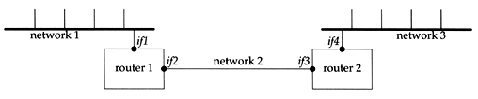
Traceroute Program (5)
The router IP in traceroute is the interface that receives the datagram. (incoming IP)
  Traceroute from left host to right host
    if1, if3
  Traceroute from right host to left host
    if4, if2

Slide 70
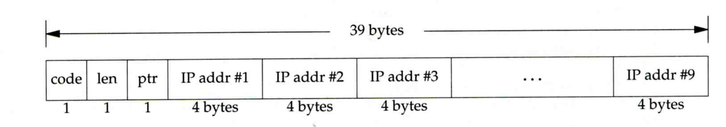
Traceroute Program –
IP Source Routing Option (1)
Source Routing
  Sender specifies the route
Two forms of source routing
  Strict source routing
    Sender specifies the exact path that the IP datagram must follow
  Loose source routing
    As strict source routing, but the datagram can pass through other routers between any two addresses in the list
Format of IP header option field
  Code = 0x89 for strict and code = 0x83 for loose SR option

Slide 71
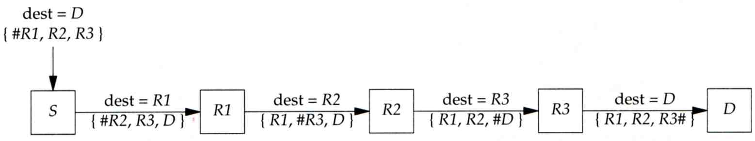
Traceroute Program –
IP Source Routing Option (2)
Scenario of source routing
  Sending host
    Remove first entry and append destination address in the final entry of the list
  Receiving router != destination
    Loose source route, forward it as normal
  Receiving router = destination
    Next address in the list becomes the destination
    Change source address
    Increment the pointer

Slide 72
Traceroute Program –
IP Source Routing Option (3)
Traceroute using IP loose SR option
Ex:
nabsd [/home/chwong] -chwong- traceroute u2.nctu.edu.tw
traceroute to u2.nctu.edu.tw (211.76.240.193), 64 hops max, 40 byte packets
1 e3rtn-235 (140.113.235.254) 0.549 ms 0.434 ms 0.337 ms
2 140.113.0.166 (140.113.0.166) 108.726 ms 4.469 ms 0.362 ms
3 v255-194.NTCU.net (211.76.255.194) 0.529 ms 3.446 ms 5.464 ms
4 v255-229.NTCU.net (211.76.255.229) 1.406 ms 2.017 ms 0.560 ms
5 h240-193.NTCU.net (211.76.240.193) 0.520 ms 0.456 ms 0.315 ms
nabsd [/home/chwong] -chwong- traceroute -g 140.113.0.149 u2.nctu.edu.tw
traceroute to u2.nctu.edu.tw (211.76.240.193), 64 hops max, 48 byte packets
1 e3rtn-235 (140.113.235.254) 0.543 ms 0.392 ms 0.365 ms
2 140.113.0.166 (140.113.0.166) 0.562 ms 9.506 ms 0.624 ms
3 140.113.0.149 (140.113.0.149) 7.002 ms 1.047 ms 1.107 ms
4 140.113.0.150 (140.113.0.150) 1.497 ms 6.653 ms 1.595 ms
5 v255-194.NTCU.net (211.76.255.194) 1.639 ms 7.214 ms 1.586 ms
6 v255-229.NTCU.net (211.76.255.229) 1.831 ms 9.244 ms 1.877 ms
7 h240-193.NTCU.net (211.76.240.193) 1.440 ms !S 2.249 ms !S 1.737 ms !S

Slide 73
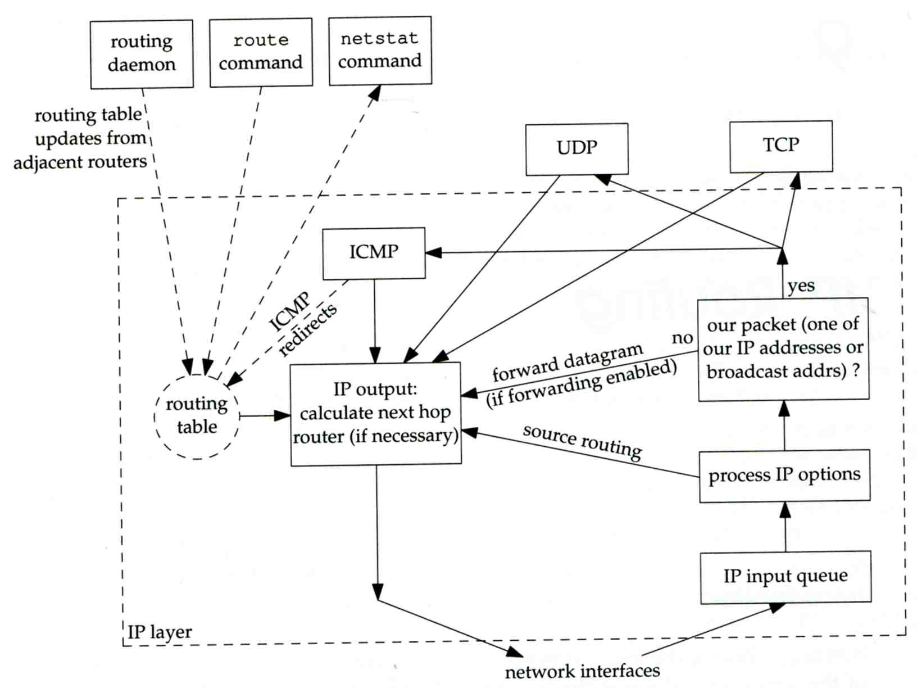
IP Routing
– Processing in IP Layer

Slide 74
IP Routing
– Routing Table (1)
Routing Table
  Command to list: netstat -rn
  Flag
    U: the route is up
    G: the route is to a router (indirect route)
      Indirect route: IP is the dest. IP, MAC is the router’s MAC
    H: the route is to a host (Not to a network)
      The dest. filed is either an IP address or network address
  Refs: number of active uses for each route
  Use: number of packets sent through this route
nabsd [/home/chwong] -chwong- netstat -rn
Routing tables
Internet:
Destination Gateway Flags Refs Use Netif Expire
default 140.113.17.254 UGS 0 178607 sk0
127.0.0.1 127.0.0.1 UH 0 240 lo0
140.113.17/24 link#1 UC 0 0 sk0
140.113.17.5 00:02:b3:4d:44:c0 UHLW 1 12182 sk0 1058
140.113.17.212 00:90:96:23:8f:7d UHLW 1 14 sk0 1196
140.113.17.254 00:90:69:64:ec:00 UHLW 2 4 sk0 1200

Slide 75
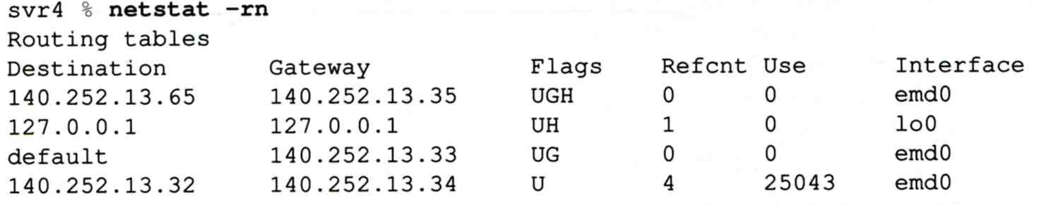
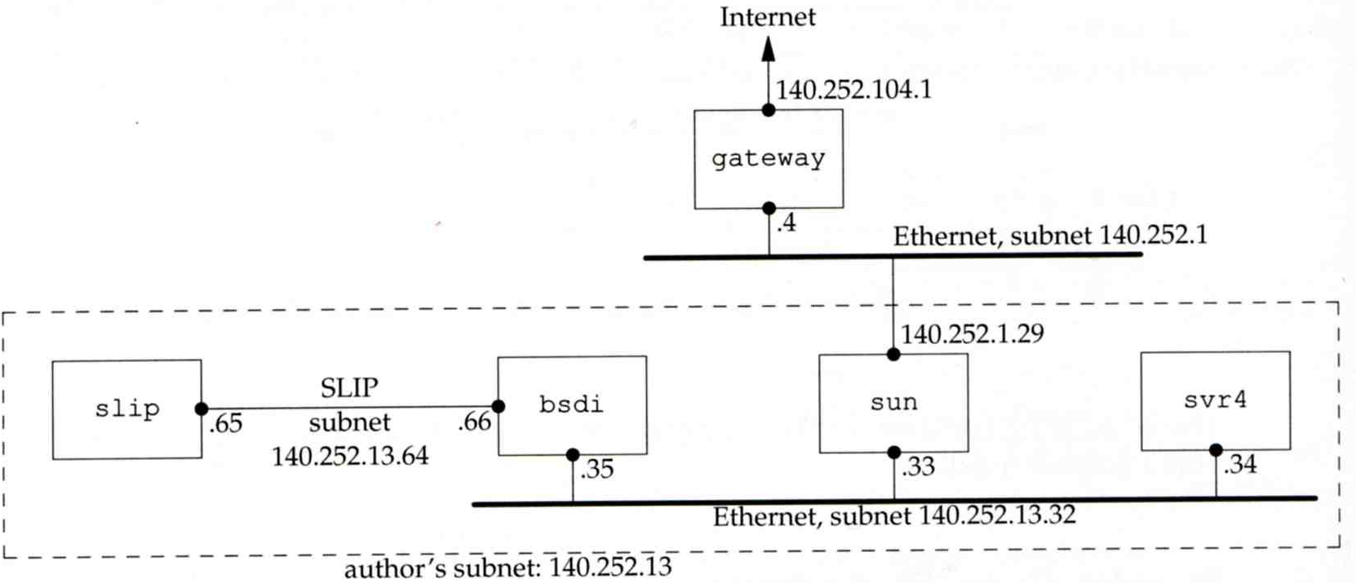
IP Routing
– Routing Table (2)
dst. = sun
dst. = slip
dst. = 192.207.117.2
dst. = svr4 or 140.252.13.34
dst. = 127.0.0.1
Ex:
loopback

Slide 76
ICMP
– No Route to Destination
If there is no match in routing table
  If the IP datagram is generated on the host
    “host unreachable” or “network unreachable”
  If the IP datagram is being forwarded
    ICMP “host unreachable” error message is generated and sends back to sending host
    ICMP message
      Type = 3, code = 0 for host unreachable
      Type = 3, code = 1 for network unreachable

Slide 77
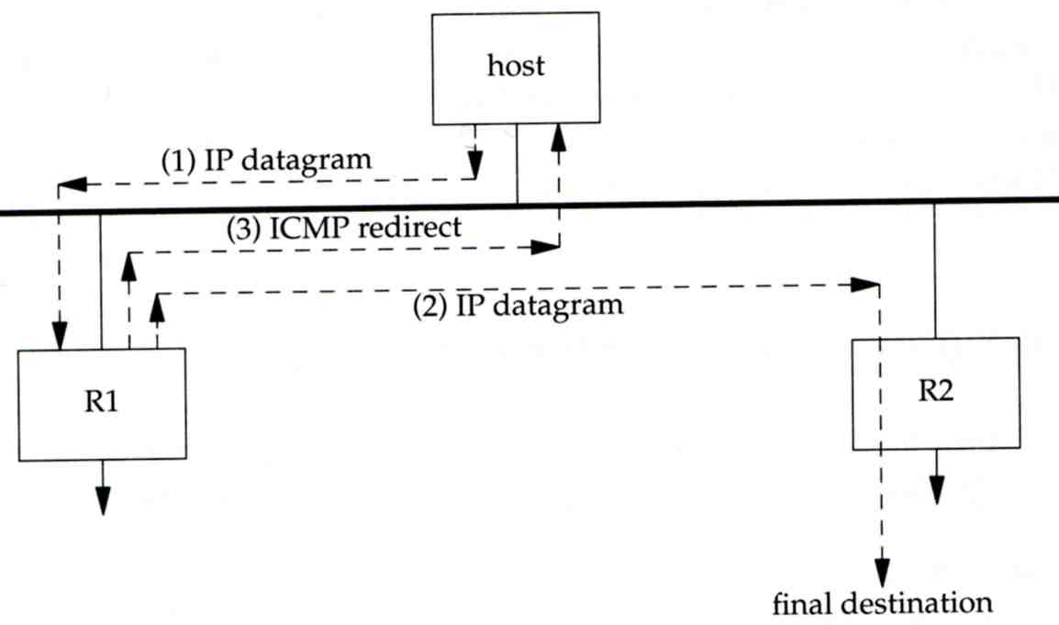
ICMP
– Redirect Error Message (1)
Concept
  Used by router to inform the sender that the datagram should be sent to a different router
  This will happen if the host has a choice of routers to send the packet to
    Ex:
      R1 found sending and receiving interface are the same

Slide 78
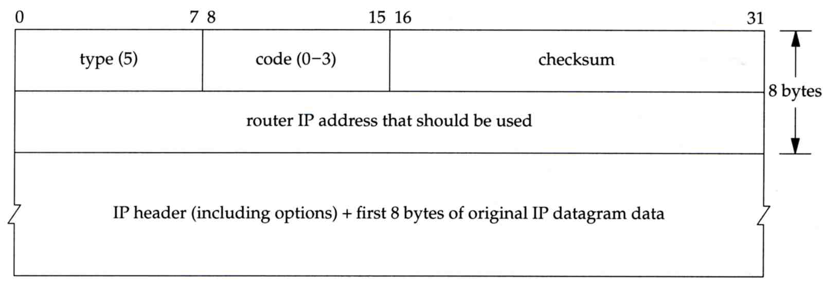
ICMP
– Redirect Error Message (2)
ICMP redirect message format
  Code 0: redirect for network
  Code 1: redirect for host
  Code 2: redirect for TOS and network (RFC 1349)
  Code 3: redirect for TOS and hosts (RFC 1349)

Slide 79
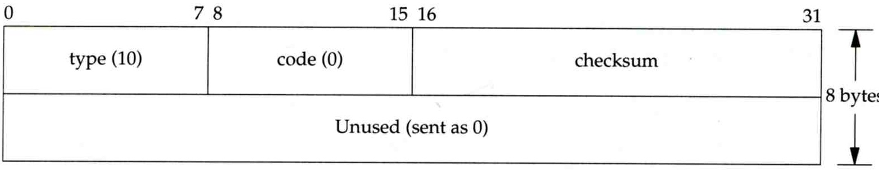
ICMP
– Router Discovery Messages (1)
Dynamic update host’s routing table
  ICMP router solicitation message (懇求)
    Host broadcast or multicast after bootstrapping
  ICMP router advertisement message
    Router response
    Router periodically broadcast or multicast
Format of ICMP router solicitation message

Slide 80
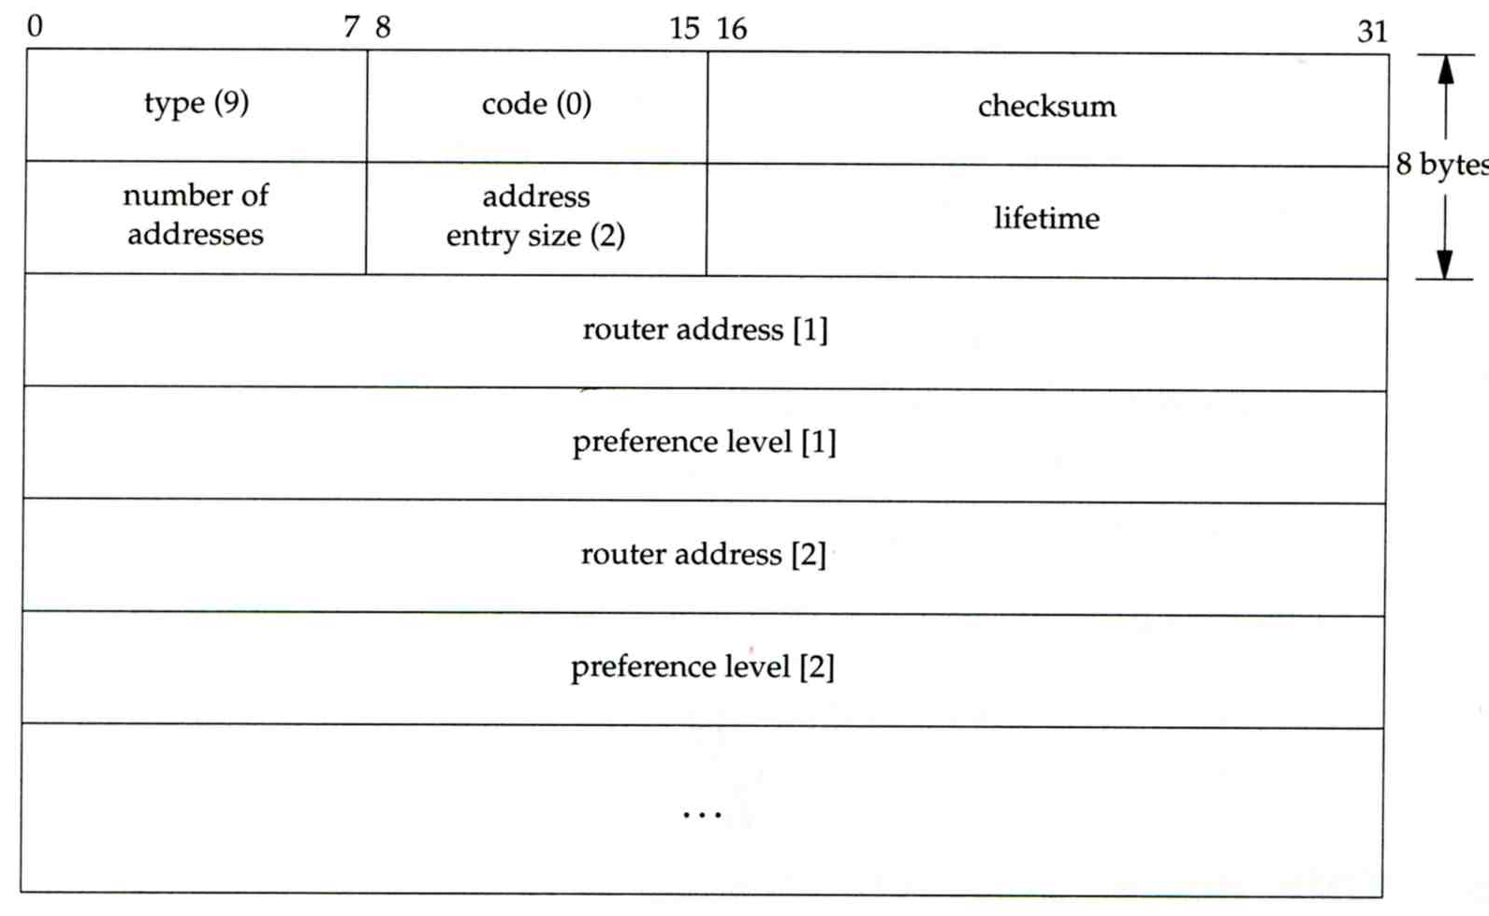
ICMP
– Router Discovery Messages (2)
Format of ICMP router advertisement message
  Router address
    Must be one of the router’s IP address
  Preference level
    Preference as a default router address

Slide 81
UDP –
User Datagram Protocol

Slide 82
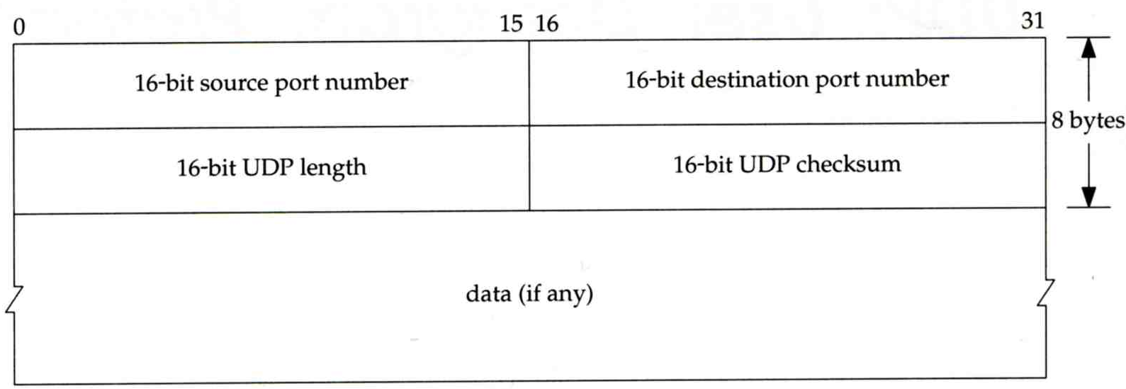
UDP
No reliability
  Datagram-oriented, not stream-oriented protocol
UDP header
  8 bytes
    Source port and destination port
      Identify sending and receiving process
    UDP length: ≧ 8

Slide 83
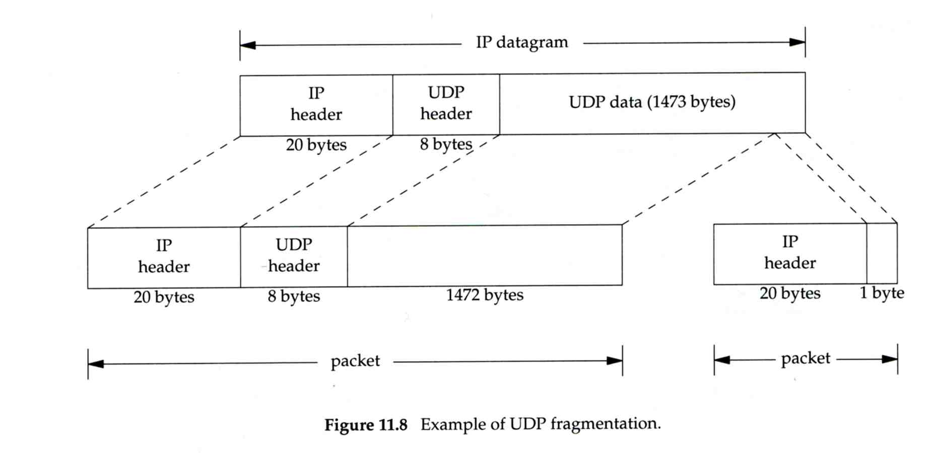
IP Fragmentation (1)
MTU limitation
  Before network-layer to link-layer
    IP will check the size and link-layer MTU
    Do fragmentation if necessary
  Fragmentation may be done at sending host or routers
  Reassembly is done only in receiving host
1501 bytes
1500 bytes

Slide 84
IP Fragmentation (2)
identification: which unique IP datagram
flags: more fragments?
fragment offset offset of this datagram from the beginning of original datagram
identification: the same
flags: more fragments
fragment offset 0
identification: the same
flags: end of fragments
fragment offset 1480

Slide 85
IP Fragmentation (3)
Issues of fragmentation
  One fragment lost, entire datagram must be retransmitted
  If the fragmentation is performed by intermediate router, there is no way for sending host how fragmentation did
  Fragmentation is often avoided
    There is a “don’t fragment” bit in flags of IP header

Slide 86
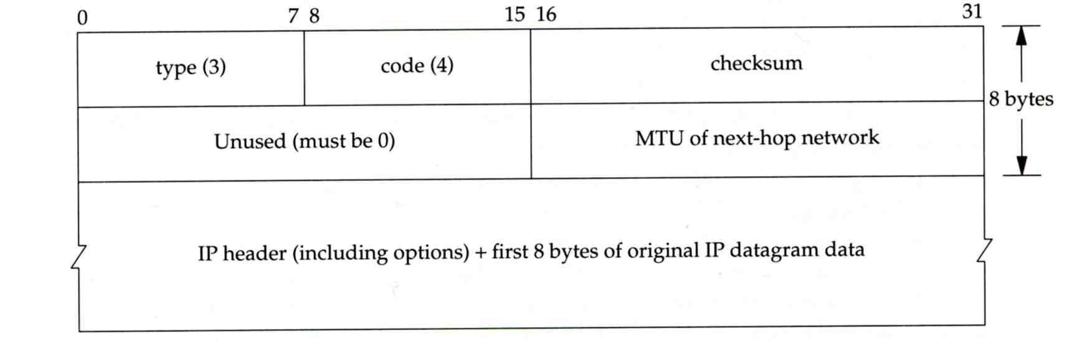
ICMP Unreachable Error –
Fragmentation Required
Type=3, code=4
  Router will generate this error message if the datagram needs to be fragmented, but the “don’t fragment” bit is turn on in IP header
Message format

Slide 87
ICMP
– Source Quench Error
Type=4, code=0
  May be generated by system when it receives datagram at a rate that is too fast to be processed
  Host receiving more than it can handle datagram
    Send ICMP source quench or
    Throw it away
  Host receiving UDP source quench message
    Ignore it or
    Notify application

Slide 88
TCP –
Transmission Control Protocol

Slide 89
TCP
Services
  Connection-oriented
    Establish TCP connection before exchanging data
  Reliability
    Acknowledgement when receiving data
    Retransmission when timeout
    Ordering
    Discard duplicated data
    Flow control

Slide 90

TCP
– Header (1)

Slide 91
TCP
– Header (2)
Flags
  SYN
    Establish new connection
  ACK
    Acknowledgement number is valid
    Used to ack previous data that host has received
  RST
    Reset connection
  FIN
    The sender is finished sending data

Slide 92

TCP connection establishment and termination
Three-way handshake
TCP’s half close

Slide 93

Appendix of IP Options: IP Timestamp Option
IP Timestamp Option
  Similar to RR option
  Record Timestamp in option filed
    code, len, ptr are the same as IP RR option
    OF
      Overflow field
      Router will increment OF if it can’t add a timestamp because of no room left
    FL
      Flags
      0: only timestamp
      1: both timestamp and IP address
      3: the sender initiates the options with up to 4
      pairs of IP address and timestamp
※

