Slide 1
FTP
File Transfer Protocol

Slide 2
FTP
FTP
  File Transfer Protocol
  Used to transfer data from one computer to another over the internet.
  Client-Server Architecture.
FTP connections
  Control connection
    Created when an FTP session is established
    Only for passing control information
  Data connection
    Each time that data is sent, a distinct TCP data connect is established
Data connection Modes:
    Active Mode
    Passive Mode

Slide 3
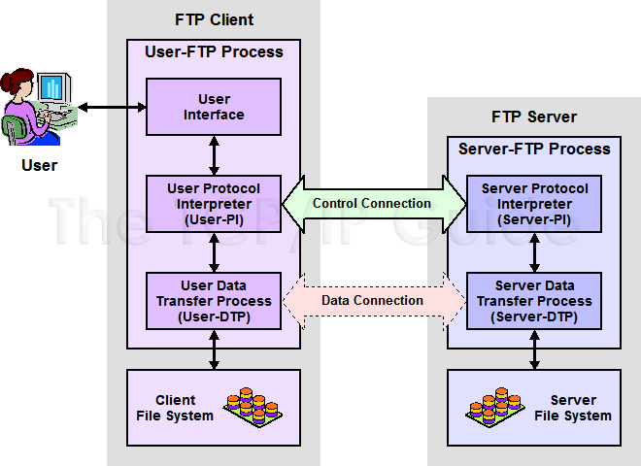
FTP
FTP RFCs:
    RFC 959 – File Transfer Protocol
    RFC 2228 – FTP Security Extensions
    RFC 2428 – FTP Extensions for IPv6 and NATs
    RFC 2640 – UTF-8 support for file name

Slide 4
FTP
– Flow (1)
Client
  Connect to server port 21 from port A.
  USER ####
  PASS ********
  EPRT |1|ip|portnum|
  Send some requests
  get return data from portnum
  Quit
Server
  Binding on port 21
  Accepts connection from client, output welcome messages.
  331 User name okay, need password.
  230 User logged in, proceed.
  200 PORT Command successful.
  Binding source port 20, connect to client port portnum, send data.
  …

Slide 5
FTP
– Flow (2)
% telnet freebsd.cs.nctu.edu.tw 21
Trying 140.113.17.209...
Connected to freebsd.cs.nctu.edu.tw.
Escape character is '^]'.
220---------- Welcome to Pure-FTPd [privsep] ----------
220-You are user number 7 of 1000 allowed.
220-Local time is now 16:25. Server port: 21.
220-Only anonymous FTP is allowed here
220-IPv6 connections are also welcome on this server.
220 You will be disconnected after 15 minutes of inactivity.
USER ftp
331 Any password will work
PASS ftp
230 Any password will work
EPRT |1|140.113.235.135|65000|
200 PORT command successful
list
150 Connecting to port 65000
226-Options: -l
226 2 matches total
quit
221-Goodbye. You uploaded 0 and downloaded 0 kbytes.
221 Logout.
Connection closed by foreign host.
Example
  Control
  Connection

Slide 6
FTP
– Flow (3)
Example (contd.)
  Retrieving Data
    Client must bind the random port
% nc -l 65000
drwxr-xr-x 852 888 2010 80328 Mar 28 11:39 distfiles
drwxr-xr-x 16 888 2010 34 May 11 2008 pub

Slide 7
FTP
– commands, responses
Commands
  USER username
  PASS password
  LIST
    Return list of file in current dir.
  CWD dirname
    Change working directory
  RETR filename
    Retrieves (gets) file.
  STOR filename
    Stores (puts) file onto server.
  EPRT |1|ip|port|
    Set to active mode
  PASV(EPSV)
    Set to passive mode
  DELE
    Remove file on the server.
  QUIT
Return Codes
  First code
  1: Positive Preliminary reply
  2: Positive Completion reply
  3: Positive Intermediate reply
  4: Transient Negative Completion reply
  5: Permanent Negative Completion reply
  Second code
  0: The failure was due to a syntax error
  1: A reply to a request for information.
  2: A reply relating to connection information
  3: A reply relating to accounting and authorization.
  5: The status of the Server file system

Slide 8
FTP
– Active Mode vs. Passive Mode (1)
Active Mode
  FTP client bind a random port (>1023) and sends the random port to FTP server using “EPRT” command.
  When the FTP server initiates the data connection to the FTP client, it binds the source port 20 and connect to the FTP client the random port sent by client.
  EPRT |1|ip|port|
  EPRT |2|ipv6|port|
Passive Mode
  FTP client sends “EPSV/PASV” command to the server, make the server bind a random port (>1023) and reply the random port back.
  When initializing the data connection, the FTP client connect to the FTP Server the random port, get data from that port.
  EPSV ➔ Server reply: 229 Entering Extended Passive Mode (|||1868|)
  PASV ➔ Server reply: 227 Entering Passive Mode (h1,h2,h3,h4,p1,p2)
※ IP:port (6bytes) → h1,h2,h3,h4,p1,p2
Ex. 140.113.17.215:45678 → 140,113,17,215,178,110

Slide 9
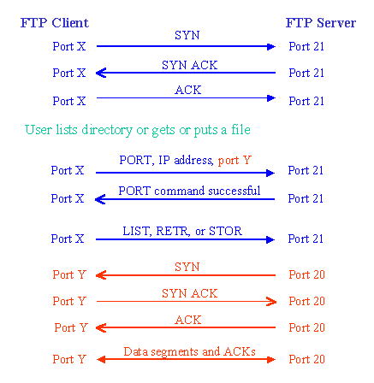
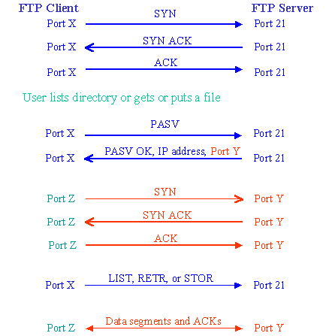
FTP
– Active Mode vs. Passive Mode (2)
Active mode
Passive mode

Slide 10
FTP
– When FTP meets NAT/Firewall (1)
Firewall behavior
  Generally, the NAT/Firewall permits all outgoing connection from internal network, and denies all incoming connection from external network.
Problem when FTP meets NAT/Firewall
  Due to the separated command/data connection, the data connections are easily blocked by the NAT/Firewall.
Problem Cases:
  Active mode, NAT/Firewall on client side.
    Passive mode can solve this problem.
  Passive mode, NAT/Firewall on server side.
    Active mode can solve this problem.
  Both client side and server side have NAT/Firewall
    The real problem.

Slide 11


FTP
– When FTP meets NAT/Firewall (2)
Active mode, NAT/Firewall on client side.
  Passive mode can solve this problem.
NAT/Firewall
NAT/Firewall
Client
Server
Client
Server
PORT IP, port Y
PASV
reply IP, port Z
Connect to port Y
BLOCKED
Connect to port Z
PASS
Active Mode
Passive Mode

Slide 12
FTP
– When FTP meets NAT/Firewall (3)
Passive mode, NAT/Firewall on Server side.
  Active mode can solve this problem.
NAT/Firewall
NAT/Firewall
Client
Server
Client
Server
PASV
PORT IP, port Y
reply IP, port Z
Connect to port Z
BLOCKED
Connect to port Y
PASS
Passive Mode
Active Mode

Slide 13
FTP
– When FTP meets NAT/Firewall (4)
Real Problem: Firewall on both sides.
  Solution: ftp-proxy running on NAT/Firewall
NAT/Firewall
NAT/Firewall
NAT/Firewall
NAT/Firewall
Client
Server
Client
Server
PORT IP, port Y
PASV
reply IP, port Z
Connect to port Y
BLOCKED
Connect to port Z
BLOCKED
Active Mode
Passive Mode

Slide 14
FTP
– Security
Security concern
  As we seen, FTP connections (both command and data) are transmitted in clear text.
  What if somebody sniffing the network?
    We need encryption.
Solutions
  FTP over SSH
    So called secure-FTP(sftp).
    Both commands and data are encrypted while transmitting.
    One connection, but poor performance.
  FTP over TLS
    Only commands are encrypted while transmitting.
    Better performance.

Slide 15
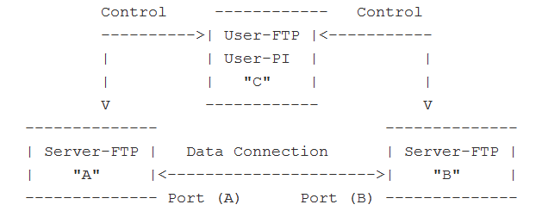
FXP
FXP
  File eXchange Protocol/Proxy FTP
  A user on one host performs a file transfer from one server to another
  Two control connections
    One each from User-PI to the two Server-PI
  One data connections
    Server-DTPs are invoked on each server to send data

Slide 16
FTP
– Pure-FTPd (1)
Introduction
  A small, easy to set up, fast and secure FTP server
  Support chroot
  Restrictions on clients, and system-wide.
  Verbose logging with syslog
  Anonymous FTP with more restrictions
  Virtual Users, and Unix authentication
  FXP (File eXchange Protocol)
  FTP over TLS
  UTF-8 support for filenames

Slide 17
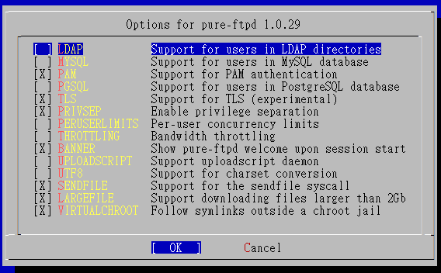
FTP
– Pure-FTPd (2)
Installation
  Ports: /usr/ports/ftp/pure-ftpd
  Options

Slide 18
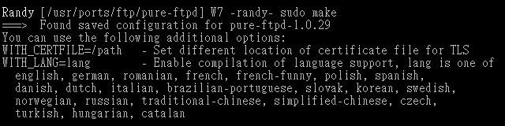
FTP
– Pure-FTPd (3)
  Other options
  WITH_CERTFILE for TLS
    Default: /etc/ssl/private/pure-ftpd.pem
  WITH_LANG
    Change the language of output messages
Startup:
  Add pureftpd_enable=“YES” in /etc/rc.conf

Slide 19
FTP
– Pure-FTPd Configurations(1)
Configurations:
  File: /usr/local/etc/pure-ftpd.conf
  Documents
    Configuration sample: /usr/local/etc/pure-ftpd.conf.sample
      All options are explained clearly in this file.
    Other documents
      See /usr/local/share/doc/pure-ftpd/*
Randy [/usr/local/share/doc/pure-ftpd] W7 -randy- ls
AUTHORS README README.MySQL pure-ftpd.png
CONTACT README.Authentication-Modules README.PGSQL pureftpd.schema
COPYING README.Configuration-File README.TLS
HISTORY README.Contrib README.Virtual-Users
NEWS README.LDAP THANKS

Slide 20
FTP
– Pure-FTPd Configurations(2)
# Cage in every user in his home directory
ChrootEveryone yes
# If the previous option is set to "no", members of the following group
# won't be caged. Others will be. If you don't want chroot()ing anyone,
# just comment out ChrootEveryone and TrustedGID.
TrustedGID 0
# PureDB user database (see README.Virtual-Users)
PureDB /usr/local/etc/pureftpd.pdb
# If you want simple Unix (/etc/passwd) authentication, uncomment this
UnixAuthentication yes
# Port range for passive connections replies. - for firewalling.
PassivePortRange 30000 50000
# This option can accept three values :
# 0 : disable SSL/TLS encryption layer (default).
# 1 : accept both traditional and encrypted sessions.
# 2 : refuse connections that don't use SSL/TLS security mechanisms,
# including anonymous sessions.
# Do _not_ uncomment this blindly. Be sure that :
# 1) Your server has been compiled with SSL/TLS support (--with-tls),
# 2) A valid certificate is in place,
# 3) Only compatible clients will log in.
TLS 2
# UTF-8 support for file names (RFC 2640)
# Define charset of the server filesystem and optionnally the default charset
# for remote clients if they don't use UTF-8.
# Works only if pure-ftpd has been compiled with --with-rfc2640
FileSystemCharset big5
# ClientCharset big5

Slide 21
FTP
– Pure-FTPd Problem Shooting
Logs Location
  In default, syslogd keeps ftp logs in /var/log/xferlog
  Most frequent problem
    pure-ftpd: (?@?) [ERROR] Unable to find the 'ftp' account
      It’s ok, but you may need it for Virtual FTP Account.
    pure-ftpd: (?@?) [ERROR] Sorry, but that file doesn't exist: [/etc/ssl/private/pure-ftpd.pem]
      If you set TLS = 2, then this file is needed.
    How to generate a pure-ftpd.pem?
      See README.TLS

Slide 22
FTP
– Pure-FTPd Tools
pure-*
pure-ftpwho
  List information of users who use the FTP server now.
pure-pw
  To create Virtual Users using PureDB
  pure-pw(8)
  See README.Virtual-Users

Slide 23
FTP
– More Tools
ftp/pureadmin
  Management utility for the PureFTPd
ftp/lftp
  A powerful functional client
  Support TLS
ftp/wget
  Retrieve files from the Net via HTTP(S) and FTP
ftp/mget
  Multithreaded commandline web-download manager
FileZilla
  An FTP Client for Windows
  Support TLS

Slide 24
FTP
– PF: Issues with FTP (1)
Reference: http://www.openbsd.org/faq/pf/ftp.html
FTP Client Behind the Firewall
  Problem
    Clients cannot use active mode
  Use ftp-proxy(8)
    ftpproxy_enable=“YES”
  In pf.conf
    nat-anchor “ftp-proxy/*”
    rdr-anchor “ftp-proxy/*”
    rdr on $int_if proto tcp from any to any port 21 -> 127.0.0.1 port 8021
    anchor “ftp-proxy/*”

Slide 25
FTP
– PF: Issues with FTP (2)
PF “Self-Protecting” an FTP Server
  Problem
    Clients cannot use passive mode
  Open holes so that clients can connect into the data channel
  In pf.conf
    pass in on $ext_if proto tcp from any to any port 21 keep state
    pass in on $ext_if proto tcp from any to any port > 49151 keep state

Slide 26
FTP
– PF: Issues with FTP (3)
FTP Server Protected by an External PF Firewall Running NAT
  Problem
    Clients cannot use passive mode
  Use ftp-proxy(8)
    Need some flags of ftp-proxy
    ftpproxy_flags="-R 10.10.10.1 -p 21 -b 192.168.0.1"
  In pf.conf
    nat-anchor “ftp-proxy/*”
    nat on $ext_if inet from $int_if -> ($ext_if)
    rdr-anchor “ftp-proxy/*”
    pass in on $ext_if inet proto tcp to $ext_ip port 21 flags S/SA keep state
    pass out on $int_if inet proto tcp to $ftp_ip port 21 user proxy flags S/SA keep state
    anchor “ftp-proxy/*”

