Slide 1
FreeBSD 9 Installation
bsdinstall

Slide 2
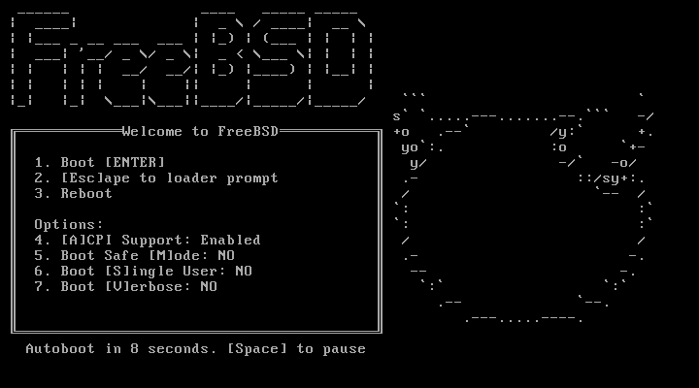
bsdinstall (FreeBSD 9) – (1)
http://www.freebsd.org/doc/handbook/bsdinstall.html

Slide 3
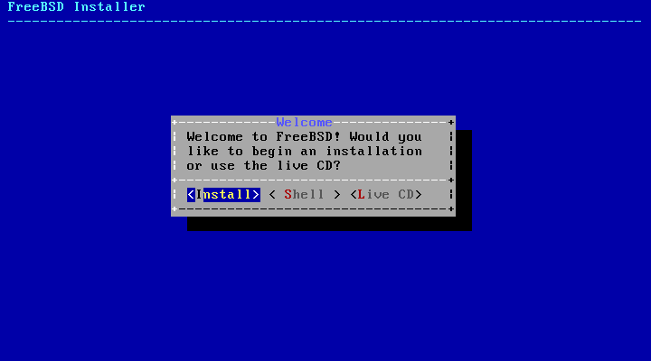
bsdinstall (FreeBSD 9) – (2)
Install、Shell、Live CD

Slide 4
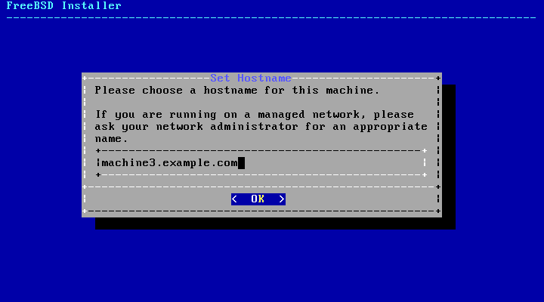
bsdinstall (FreeBSD 9) – (3)
Setting hostname

Slide 5
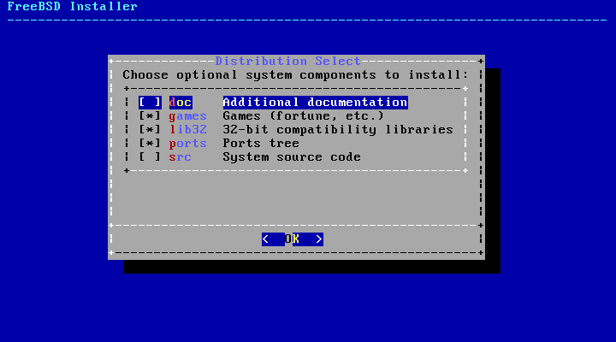
bsdinstall (FreeBSD 9) – (4)
Selecting components to install

Slide 6
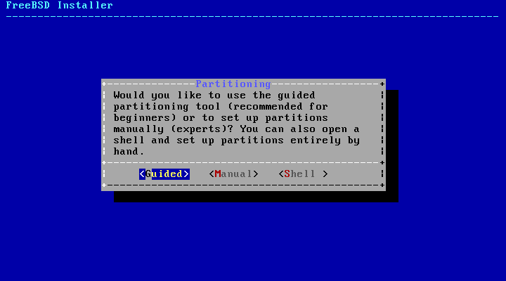
bsdinstall (FreeBSD 9) – (5)
Partitioning methods
  Shell – gpart(8)、fdisk(8)、bsdlabel(8)

Slide 7
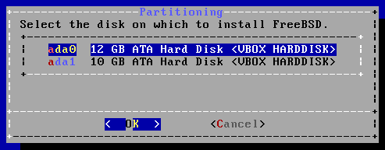
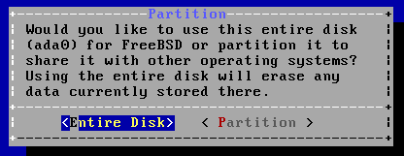
bsdinstall (FreeBSD 9) – (6)
Guided Partitioning
  Select disk
  Replace { ad | da }
  by ada
  { ad | da }’s are linked
  to ada’s
  How to partition the disk
    Entire Disk
    Partition – use free space

Slide 8
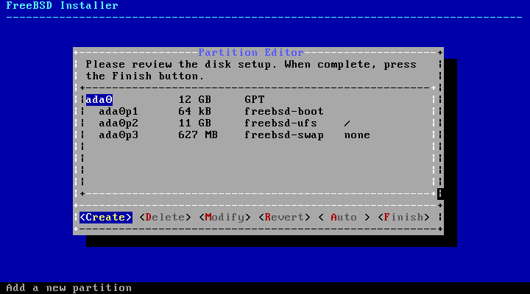
bsdinstall (FreeBSD 9) – (7)
Guided Partitioning result

Slide 9
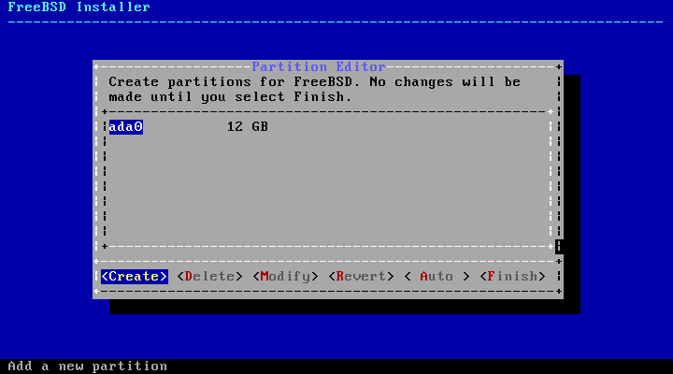
bsdinstall (FreeBSD 9) – (8)
Manual Partitioning

Slide 10
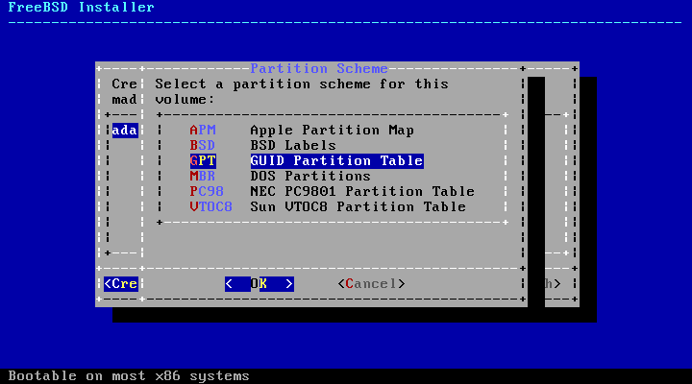
bsdinstall (FreeBSD 9) – (9)
Choose a partitioning scheme
  GPT、MBR
  DON’T use BSD!!!

Slide 11
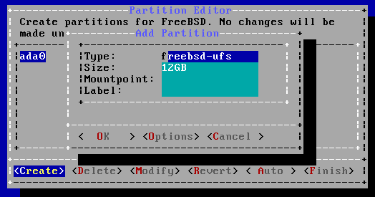
bsdinstall (FreeBSD 9) – (10)
Add partitions
  freebsd-boot
    FreeBSD boot code. This partition must be first on the disk.

Slide 12
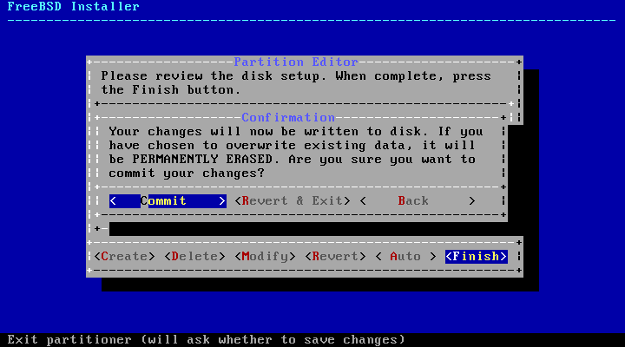
bsdinstall (FreeBSD 9) – (11)
Final confirmation

Slide 13
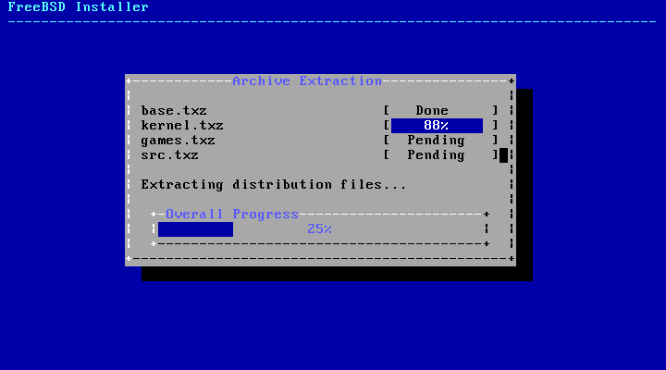
bsdinstall (FreeBSD 9) – (12)
Fetching → Checksum Verification → Extraction

Slide 14
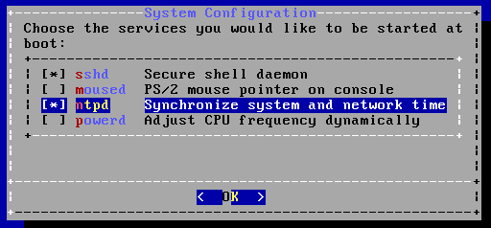
bsdinstall (FreeBSD 9) – (13)
Post-installation
  root password
  Network interfaces
    Wired – Static IPv4 / DHCP / Static IPv6 / SLAAC
    Wireless
    DNS
  Time Zone
  Services
  Add users

Slide 15
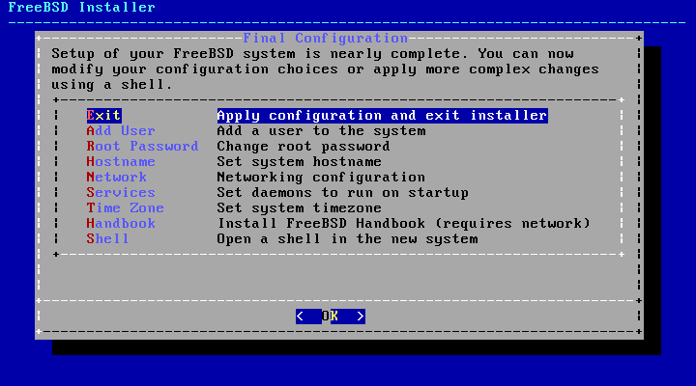
bsdinstall (FreeBSD 9) – (14)
Final configuration

