Slide 1
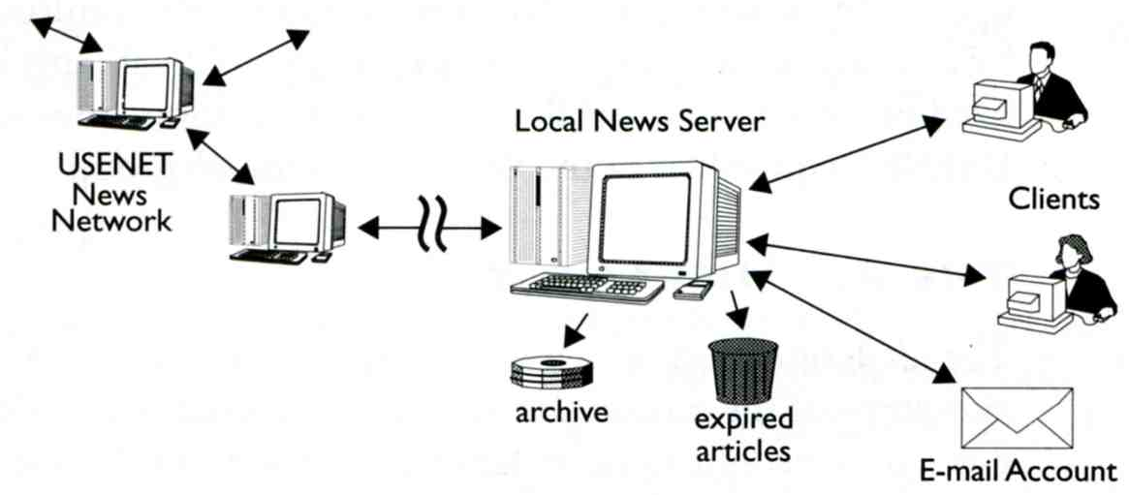
News
Usenet、NetNews

Slide 2
News outline
Introduction
  History of netnews
  History of newsgroups
  News operations
Transfer protocol
  NNTP – Network News Transfer Protocol
News softwares
  Reader: tin
  Server: INN – InterNet News

Slide 3
Introduction to News

Slide 4
Introduction to news (1)
Usenet is a worldwide distributed Internet discussion system.
  The initial Internet community
  Like bulletin board systems (BBS)
  Hybrid between e-mail and web forums
  Absence of a central server and dedicated administrator
    PTT – Error 37
The format and transmission of Usenet articles is similar to that of Internet e-mail messages.
Usenet has significant cultural importance in the networked world
  FAQ, spam.

Slide 5
Introduction to news (2)
Spamming: In 1994, advertisers began broadcasting messags to all newsgroups at once.
Usenet has diminished in importance with respect to Internet forums, blogs, and mailing lists.
Google made efforts to buy archive of Usenet newsgroups to attempt to create a complete one. Google has a web search interface and also allows newsgroup posting.
  http://groups.google.com
Usenet is a “must-have” resource?
  Altopia.com
Year | 1996 | 1997 | 1998 | 1999 | 2000 | 2001 | 2002 | 2003
Daily Vol. (GB) | 4.5 | 9 | 12 | 26 | 82 | 181 | 257 | 492
Year | 2004 | 2005 | 2006 | 2007 | 2008 | 2009 | 2010 | 2011 | 2012
Daily Vol. (TB) | 1 | 1.52 | 2.27 | 2.95 | 3.07 | 4.65 | 5.42 | 7.52 | 9.29

Slide 6
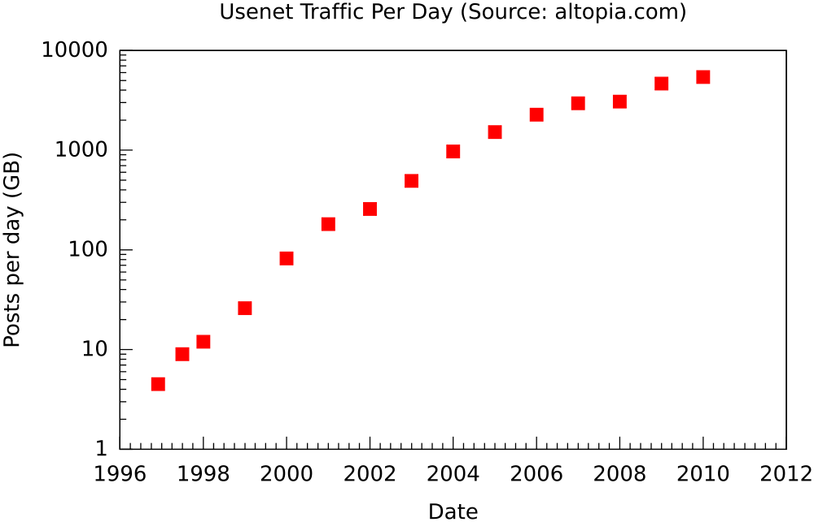
Introduction to news (3)

Slide 7
History (1)
Origins
  Tom Truscott and Jim Ellis conceived the idea in 1979
  Steve Bellovin assisted with writing Bourne shell scripts
  The first “netnews” program
  UUCP as its transport protocol
A News
  The public release of “netnews” in 1980
  Rewritten in C by Tom Truscott, Steve Daniel
B News
  Written by Mark Horton and Matt Glickman in 1981
  Development was passed on to Rick Adams in 1983 ~ 1989
  With a message format compatible with Internet mail
  Better performance for the grown news traffic

Slide 8
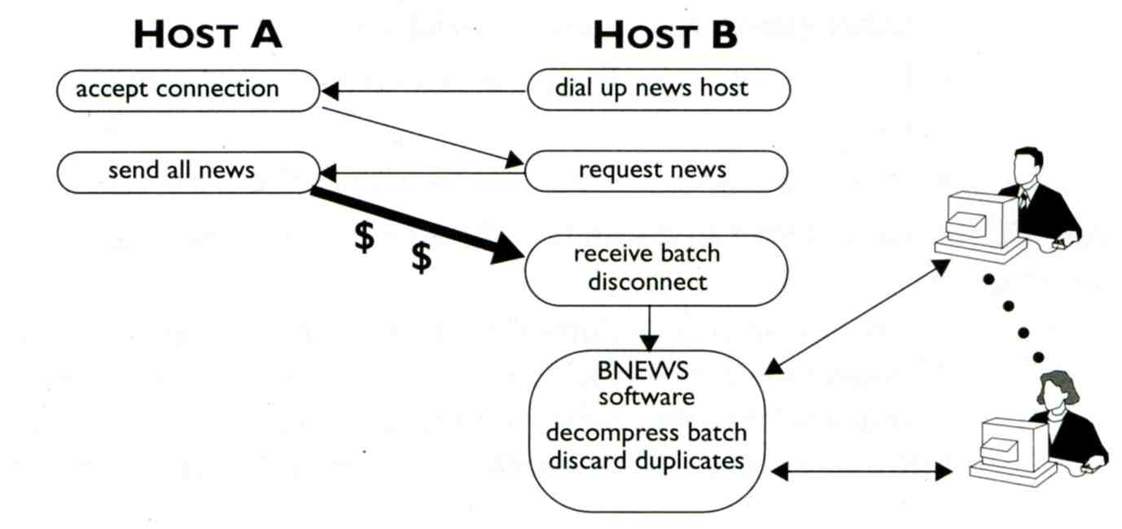
History (2)
UUCP
  Unix-to-Unix Copy Protocol
  Mostly commonly used over dial-up connections
  Replaced by the TCP/IP protocols SMTP for mail and NNTP for news
  Bang path are still use within the news network to record the nodes through which a message has passed
  Store-and-forward batch
  Duplicate articles

Slide 9
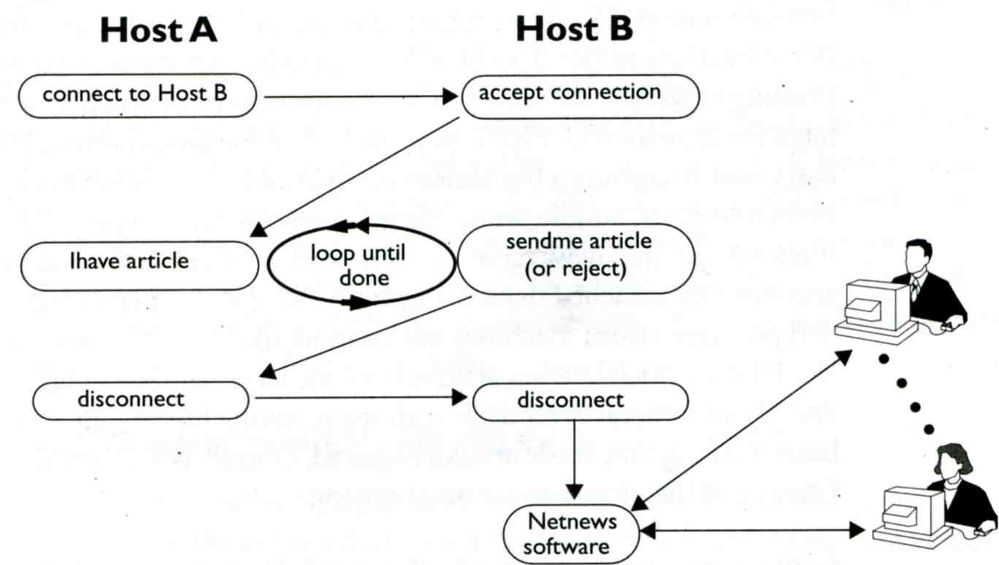
History (3)
NNTP
  Network News Transfer Protocol
  Introduced in 1985 to distribute netnews articles over TCP/IP network
  Specification is created by Phil Lapsley and Brian Kantor in 1986
  TCP port 119 for NNTP and TCP port 563 for NNTPS
  NNRP(Network News Reader Protocol)
  Sending required articles

Slide 10
History (4)
The CNEWS version
  Developed by Henry Spencer and Geoff Collyer in 1987
  Rewrite the code of B News to result in a cleaner, faster program
  The creation of a news index function in 1992
  NNTP XOVER command
  Allow news readers to rapidly retrieve header and threading information
INN (InterNet News)
  Released by Rich Salz in 1991
  The first news server package to fully integrate NNTP functionality
  NNTP and UUCP support
  The most commonly used news server package now
  Still actively developed by ISC(Internet Systems Consortium)

Slide 11

newsgroups (1)
The articles are organized into topical categories called newsgroups.
Newsgroups are organized into hierarchies, theoretically making it simpler to find related groups.
A usenet newsgroup is a repository, a discussion group.
Newsgroups
  Types: text or binary.
  Like the public message boards on BBS.
  Over 100000 Usenet newsgroups

Slide 12
newsgroups (2)
Great Renaming
  July 1986 ~ March 1987
  Before this
    fr.* for groups gatewayed from ARPANET
    mod.* for moderated discussions
    net.* for unmoderated groups
  Primary reason: the difficulty of maintaining a list of all the existing groups.
  Alternative explanation:
    European networks refuse to pay for some of the high volume and low content groups such as religion and racism.
    The suggested category was talk.*

Slide 13
newsgroups (3)
Great Renaming
  Initiated by Rick Adams
  Gene Spafford organized the “Backbone Cabal”
  Big 7 in 1987
    comp.* for computer related discussions
    news.* for discussions and announcements about netnews
    rec.* for discussions of recreational activities
    sci.* for science related discussions
    soc.* for socializing and discussions of social issues
    talk.* for discussions about various controversial topics
    misc.* for miscellaneous discussions
  Big 8 in 1995
    humanities.* for discussions of the humanities

Slide 14
newsgroups (4)
After the Great Renaming, the creation and organization of new newsgroups became an automated voting process.
  Post an RFD (Request for Discussion) into news.announce.newgroups
  Discuss in news.groups.proposals
  The proposal is formalized with a name, description, charter.
  Big-8 management board will vote on whether to create the group.
There was a great controversy over what newsgroups should be allowed.
  Drugs, and sex were not allowed.
Brain Reid suggested the alt.* hierarchy as an alternative to talk.*
  Dissatisfied with mod.gourmand → rec.food.recipies
  Created in May 1987.

Slide 15
newsgroups (5)
alt.* hierarchy
  It is ‘alternative’ to the mainstream Big-7.
  The first alt.* newsgroups were alt.config, alt.gourmand, and alt.drugs
  Most newsgroups follow an informal procedure involving a public discussion in alt.config before created.
  Not confined to newsgroups of any specific subject or type.
  Because of the anarchistic nature with which the groups sprung up, some jokingly referred to ALT standing for “Anarchists, Lunatics and Terrorists”
Two major sections of alt.*
  alt.sex.*: fearing the major news may be prevented from widely distributed.
  alt.binaries.*: often of extremely large size.

Slide 16
newsgroups (6)
The language of preference in the “original” Usenet hierarchies, including alt.*, is English.
  Other language hierarchies have later been created in parallel to the existing English ones.
    de.*, fr.*, …
  tw.*, tw.bbs.* (innbbsd)
Some access providers also create their own versions, prefixing the newsgroups names with their own name in a similar way.
  Messages posted in there “private” newsgroups are generally not passed to the other providers or the Internet in general.
Some users prefer to use “Usenet” to refer only to the Big-8 hierarchies, and to use “netnews” to incorporate the entire medium.

Slide 17
newsgroups (7)
Binary newsgroups
  Binaries are posted in alt.binaries.*
  Usenet was originally created to distribute text content encoded in ASCII.
  Encoded binaries by uuencode, Base64, Quoted-Printable MIME, or yEnc.
  The binaries might be split into pieces by means of RAR and PAR.
Moderated newsgroups
  A moderated newsgroup has one or more individuals as moderators.
  Messages submitted by readers are not distributed to Usenet, but are emailed to the moderators for approval, instead.
  Moderators receive submitted articles, review them, and inject approved articles. Such articles must bear the “Approved:” header line.

Slide 18
News operations (1)
Articles and posts
  Binary content: split among multiple articles, reassembled into a single unit by the news reader
  Plain text: majority of the articles are responses to some other article.
    Articles which can be traced to one single non-reply article is called a thread.
Headers and overviews
  The overview is a list of the most frequently used headers, and additional information such as article sizes.
newsfeeds
  When a user posts an article, it is initially only available on that user’s news server. Each news server talks to one or more other servers(peers) and exchanges articles with them.

Slide 19
News operations (2)
News Reader
  Read and post articles
  In early news implementations: news server and news reader were a single program suite.
  Mail clients or “communication suites” commonly have an integrated news reader.
    However, these integrated clients are of low quality: incorrectly implementing Usenet protocols, standards and conventions.
  A user subscribes to a newsgroup, the news reader software keeps track of which articles that user has read.
  With the rise of the World Wide Web, web front-ends have become more common.
  Common text-based news reader: tin (chinese/tin、news/tin)

Slide 20
News operations (3)
News Server
  Continually increasing storage
  Network capacity requirements
  Completion: the ability of a server to successfully receive all traffic
  Retention: the amount of time articles are made available to readers
  Overall system performance
  Split into
    Transit server: handle the basic articles exchange.
    Numbering server: insert the “Xref:” header line into each article
    Back end server: data storage
    Front end server: a user would actually connect to. Only store overviews, and carry the heaviest CPU load

Slide 21
News operations (4)
Spools
  A disk storage for the body of an article
  Types:
    One file per article
      Oldest storage scheme
      Performance relates to OS’s ability to create, remove and locate files within a dictionary
    Cyclical storage
      Since 1990s
      Articles are appended serially to large indexed container files
      When the end of the file is reached, new articles are written at the beginning of the file, overwriting the oldest entries.
      Traditional text manipulation tools are less well-suited to analyze the files
  Flexibility to retention and space used.

Slide 22
News operations (5)
Storage management
  Article sizes
    The maximum article size varies from site to site
  Retention
    How long the server keeps articles
    Text and binary
Speed
  How quickly a server can deliver an article to the user

Slide 23
News operations (6)
Control messages (RFC5537)
  newgroup messages
    Create a new newsgroup
  rmgroup messages
    Remove a newsgroup
  checkgroup messages
    Lists all groups of a hierarchy
  cancel messages
    Delete a article specified by Message-ID
    In cases where unsuitable content has been posted, Usenet has support for automated removal of a posting from the whole network by creating a cancel message.

Slide 24
News operations (7)
Spam filter
  Cancel message
    40% spams、40% cancel messages、20% useful information
    There is no authentication in cancel messages
  Cleanfeed
    Written by perl
    Count by md5(body)、Ph/l(Posting-host/lines)、F/s/l(From/subject/lines)
    Specific strings such as binary post、(mime) html post、MMF
  NoCeM
    No see ‘em
    Cancel-Key = hash(password, Message-ID)、Cancel-Challenge
    All notices must be public key signed to be accepted using PGP
    innbbsd patch by leeym

Slide 25
Take a break – nonsense
NCTU_Talk
tw.bbs.comp.linux ↔ ptt
tw.bbs.campus.nctu ↔ nctu.talk
Group.NCTU.edu.tw

Slide 26
NNTP
RFC 3977
Interact with INN news server

Slide 27
NNTP (1)
Command and response
  Response codes
    1xx - Informative message
    2xx - Command completed OK
    3xx - Command OK so far; send the rest of it
    4xx - Command was syntactically correct but failed for some reason
    5xx - Command unknown, unsupported, unavailable, or syntax error
    x0x - Connection, setup, and miscellaneous messages
    x1x - Newsgroup selection
    x2x - Article selection
    x3x - Distribution functions
    x4x - Posting
    x8x - Reserved for authentication and privacy extensions
    x9x - Reserved for private use (non-standard extensions)

Slide 28
NNTP (2)
NNTP vs. NNRP
  For your peers
  For your readers
liuyh@csnews$ telnet csnews2 433
Trying 140.113.235.121...
Connected to csnews2.cs.nctu.edu.tw.
Escape character is '^]'.
200 csnews2 InterNetNews server INN 2.4.6 ready
liuyh@bsd5$ telnet csnews2 433
Trying 140.113.235.121...
Connected to csnews2.
Escape character is '^]'.
502 Permission denied
liuyh@bsd5$ telnet csnews2 119
Trying 140.113.235.121...
Connected to csnews2.
Escape character is '^]'.
200 csnews2 InterNetNews NNRP server INN 2.4.6 ready (posting ok).

Slide 29
NNTP (3)
LIST (find the newsgroups)
  AVTIVE
  NEWSGROUPS
list active cs.*
215 Newsgroups in form "group high low flags".
cs.computer-center 0000000509 0000000071 m
cs.course.netadmin 0000000505 0000000131 y
cs.course.object-oriented-programming.a 0000000284 0000000108 y
list newsgroups cs.*
215 Descriptions in form "group description".
cs.computer-center [系計中公告] (Moderated)
cs.course.netadmin [課程] 計算機網路管理.
cs.course.object-oriented-programming.a [課程] 物件導向程式設計 A 班

Slide 30
NNTP (4)
LIST (overview format)
  OVERVIEW.FMT
list overview.fmt
215 Order of fields in overview database.
Subject:
From:
Date:
Message-ID:
References:
Bytes:
Lines:
Xref:full
.

Slide 31
NNTP (5)
GROUP (select a newsgroup)
LISTGROUP (select a newsgroup)
group cs.course.netadmin
211 359 131 505 cs.course.netadmin
listgroup cs.course.netadmin
211 359 131 505 cs.course.netadmin
131
132
134
138
141
…
504
505
.

Slide 32
NNTP (6)
STAT [ MessageID | Number ]
NEXT
LAST
stat
223 131 <f1sej8$2dev$1@csnews2.cs.nctu.edu.tw> status
stat 123
423 Bad article number
stat 131
223 131 <f1sej8$2dev$1@csnews2.cs.nctu.edu.tw> status
stat 500
223 500 <CS-NetAdmin$A15S3QN9@bbs.cs.nctu.edu.tw> status
next
223 501 <CS-NetAdmin$A15S8UDD@bbs.cs.nctu.edu.tw> Article retrieved; \
request text separately.
last
223 500 <CS-NetAdmin$A15S3QN9@bbs.cs.nctu.edu.tw> Article retrieved; \
request text separately.

Slide 33
NNTP (7)
Subject:
From:
Date:
Message-ID:
References:
Bytes:
Lines:
Xref:full
XOVER [ range ] (retrieve the overview)
XHDR header [ range | MessageID ] (retrieve the specific header)
xover 131-135
224 131-135 fields follow
131 [HW3] Sendmail sjwu <sjwu@cs.NCTU.edu.tw> Wed, 9 May 2007 \
12:25:12 +0000 (UTC) <f1sej8$2dev$1@csnews2.cs.nctu.edu.tw> \
70 Xref: csnews.cs.nctu.edu.tw cs.course.netadmin:131
132 …
134 …
.
xhdr subject 131-135
221 subject matches follow (NOV)
131 [HW3] Sendmail
132 Re: [HW3] Sendmail
134 …
.
xhdr newsgroups 131-135
221 newsgroups matches follow (art)
131 cs.course.netadmin
132 cs.course.netadmin
134 cs.course.netadmin
.

Slide 34
NNTP (8)
ARTICLE [ MessageID | Number ]
article 499
220 499 <hpkccf$283t$1@csnews2.cs.nctu.edu.tw> article
Path: csnews2!csnews.cs.nctu.edu.tw!news.cs.nctu.edu.tw!not-for-mail
From: Yung-Hsiang Liu <liuyh@cs.NCTU.edu.tw>
Newsgroups: cs.course.netadmin
Subject: Re: 上課講解手release
Date: Thu, 8 Apr 2010 10:49:51 +0000 (UTC)
Organization: College of Computer Science, National Chiao Tung University
Lines: 1
Sender: liuyh@NCTUCSCC
Message-ID: <hpkccf$283t$1@csnews2.cs.nctu.edu.tw>
References: <CS-NetAdmin$A15RO7EB@bbs.cs.nctu.edu.tw> \
<hphpk6$1sli$1@csnews2.cs.nctu.edu.tw>
NNTP-Posting-Host: bsd5.cs.nctu.edu.tw
X-Trace: csnews2.cs.nctu.edu.tw 1270723791 73853 140.113.235.135 …
X-Complaints-To: usenet@csnews2.cs.nctu.edu.tw
NNTP-Posting-Date: Thu, 8 Apr 2010 10:49:51 +0000 (UTC)
User-Agent: tin/1.8.3-20070201 ("Scotasay") …
Xref: csnews.cs.nctu.edu.tw cs.course.netadmin:499
上課講解手檔案已放到網頁上。
.

Slide 35
NNTP (9)
HEAD [ MessageID | Number ]
BODY [ MessageID | Number ]
head 499
221 499 <hpkccf$283t$1@csnews2.cs.nctu.edu.tw> head
Path: csnews2!csnews.cs.nctu.edu.tw!news.cs.nctu.edu.tw!not-for-mail
From: Yung-Hsiang Liu <liuyh@cs.NCTU.edu.tw>
Newsgroups: cs.course.netadmin
Subject: Re: 上課講解手release
Date: Thu, 8 Apr 2010 10:49:51 +0000 (UTC)
Organization: College of Computer Science, National Chiao Tung University
Lines: 1
Sender: liuyh@NCTUCSCC
Message-ID: <hpkccf$283t$1@csnews2.cs.nctu.edu.tw>
…
Xref: csnews.cs.nctu.edu.tw cs.course.netadmin:499
.
body 499
222 499 <hpkccf$283t$1@csnews2.cs.nctu.edu.tw> body
上課講解手檔案已放到網頁上。
.

Slide 36
NNTP (10)
POST (posting an article used by news clients)
    2xx - Command completed OK
    3xx - Command OK so far; send the rest of it
    x4x - Posting
post
340 Ok, recommended ID <hs8pdf$162r$1@csnews2.cs.nctu.edu.tw>
From: liuyh@cs.nctu.edu.tw
Newsgroups: cs.test
Subject: test telnet NNTP post
ha~ test
.
240 Article posted <hs8pdf$162r$1@csnews2.cs.nctu.edu.tw>

Slide 37
NNTP (11)
IHAVE (exchange articles with peers)
    x3x - Distribution functions
  RFC 5536
ihave <hs8pdf$162r$1@csnews2.cs.nctu.edu.tw>
435 Duplicate
ihave <fjaowiejfmavoewifjaefarwvoijesfr@bsd5.cs.nctu.edu.tw>
335
Path: bsd5.cs.nctu.edu.tw!liuyh
From: liuyh@cs.nctu.edu.tw
Newsgroups: cs.test
Subject: post from ihave
Date: 10 May 2010 19:28:01 GMT
Message-ID: <fjaowiejfmavoewifjaefarwvoijesfr@bsd5.cs.nctu.edu.tw>
test
.
235

Slide 38
NNTP (12)
NEWGROUPS [YY]YYMMDD hhmmss
NEWNEWS newsgroups [YY]YYMMDD hhmmss
newgroups 100401 000000
231 New newsgroups follow.
alt.binaries.movies.hdtv.russian 0 1 y
cs.u99 8 1 y
sci.physics.acoustics 47 1 y
alt.tv.channels.syfy 9 1 y
alt.comp.lang.lua 2 2 y
alt.fr.agence.notation.alteferienne 25 1 y
.
newnews cs.course.netadmin 100222 000000
230 New news follows
<CS-NetAdmin$A15ONVSO@bbs.cs.nctu.edu.tw>
<CS-NetAdmin$A15OVOGR@bbs.cs.nctu.edu.tw>
…
<CS-NetAdmin$A15UCP60@bbs.cs.nctu.edu.tw>
<CS-NetAdmin$A15UDBNR@bbs.cs.nctu.edu.tw>
.

Slide 39
tin
A Usenet news reader

Slide 40
Install (1)
Two versions in ports
  news/tin (default: US-ASCII)
  chinese/tin (default: Big5)
In RFC 3977
  This specification extends NNTP from US-ASCII [ANSI1986] to UTF-8 [RFC3629]
  Implementations MUST NOT use any other encoding.
  The character set of article bodies SHOULD be indicated in the article headers
  The newsgroup description SHOULD be in US-ASCII or UTF-8
  8-bit encodings other than UTF-8 SHOULD NOT be used
  But…
  IMHO, what is the hope?

Slide 41
Install (2)
Back to install tin
  ‘make install’ is ok
  TIN_EDITOR
Environment Variables
  VISUAL
  EDITOR
  TINRC=‘-r’
  NNTPSERVER=csnews2.cs.nctu.edu.tw

Slide 42
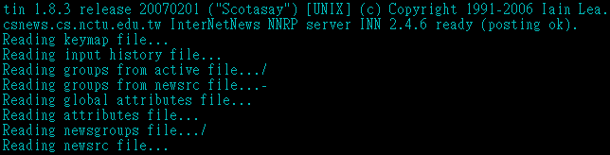
Start
First execution
  Generate ~/.tin/ and ~/.newsrc
Connect
Edit ~/.tin/tinrc
Second execution
  If you use UTF-8 environment
    Screen: encoding big5 utf8
    env LC_ALL=zh_TW.Big5 tin (This is for post)
# Charset used for MIME (Content-Type) header in postings.
mm_network_charset=Big5

Slide 43
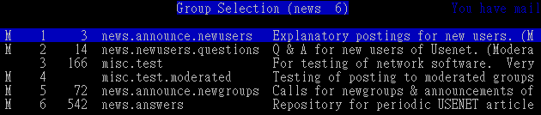

Search and subscribe newsgroups
Show some default subscribed newsgroups
y (yank): list all newsgroups
/?: search forwards/backwards for a group name
s: subscribe to chosen group
u: unsubscribe from chosen group

Slide 44
Read and post
Just like what you do in BBS
  h: help
Browse in a newsgroup
  /?: search for articles by Subject line forwards/backwards
  aA: search for articles by author forwards/backwards
  r: toggle display of all/unread articles
  <TAB>: display next unread article
  w: post an article to current group
Read an article
  /?: search forwards/backwards within this article
  f: post followup to current article
  D: cancel (delete) or supersede (overwrite) current article
  r: reply through mail to author
  ^H: show article in raw-mode (including all headers)

Slide 45
newsrc
After you quit tin or save configuration
  ~/.newsrc will keep
    newsgroups you subscribed/unsubscribed
    articles you have read
liuyh@NASA$ cat ~/.newsrc
news.announce.newusers! 1-4466
news.newusers.questions! 1-675699
misc.test! 1-546806,546808,546823,546885,546908
misc.test.moderated! 1-646
news.announce.newgroups! 1-4441
news.answers! 1-230198
cs.course.netadmin: 1-505
cs.course.sysadmin: 1-644,648,652,656-658,661-664,668-669,687-688,694,698,703,707,799,831,868,903,913-914,923,930-932,968,983,1023,1054,1115,1131,1142-1145,1164,1186-1187,1190,1192,1252,1323,1337,1433,1444,1451,1475,1489,1512,1520,1523,1536,1559,1572,1614,1619,1647,1687,1757-1758,1766-1768,1772,1781,1795,1818-1819,1906,1918,1988,1997,2012,2028,2057,2059,2142

Slide 46
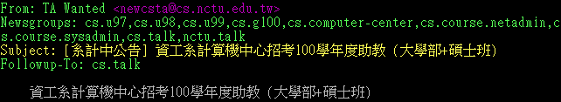
A crosspost example
Before posting
After posting
Path: csnews.cs.nctu.edu.tw!news.cs.nctu.edu.tw!not-for-mail
From: TA Wanted <newcsta@cs.nctu.edu.tw>
Newsgroups: cs.u97,cs.u98,cs.u99,cs.g100,cs.computer-center,cs.course.netadmin, cs.course.sysadmin,cs.talk,nctu.talk
Subject: [系計中公告] 資工系計算機中心招考100學年度助教 (大學部+碩士班)
Followup-To: cs.talk
Xref: csnews.cs.nctu.edu.tw cs.u97:4453 cs.u98:2529 cs.u99:1934 cs.g100:4 cs.computer-center:803 cs.course.netadmin:557 cs.course.sysadmin:2479 cs.talk:3528 nctu.talk:1541391

