Slide 1
Final Project
SNMP

Slide 2
Introduction
Use SNMP to collect system information and graph with RRDTool
Prerequisites
  SNMP software
    net-mgmt/net-snmp
  Graphing
    databases/rrdtool

Slide 3
Net-SNMP
An extendable SNMP implementation
Command
  snmpget
  snmpset
  snmpwalk
  …etc
Turotials
  http://www.net-snmp.org/wiki/index.php/Tutorials

Slide 4
RRDTool
Round-robin database
Data logging / graphing
  Known for its pretty graphing
Easy integration
  Bindings for Python, Perl, Ruby, Lua …
  Command line tools also enable integration with shell scripts
Documentation
  http://oss.oetiker.ch/rrdtool/doc/index.en.html

Slide 5
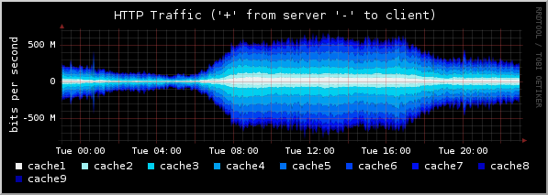
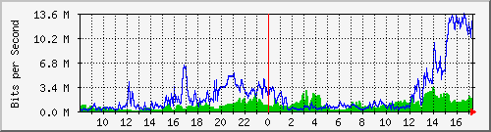
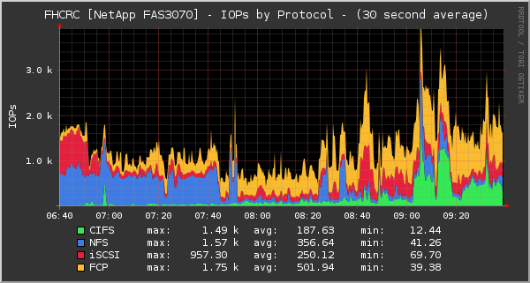
RRDTool – Compared with MRTG
MRTG
RRDTool

Slide 6
RRDTool – Flow
Create
  Create a new RRD
  $ rrdtool create
Fetch data
  Via SNMP, external programs… etc
Update
  Update the data
  $ rrdtool update
Graph
  Graph the result
  $ rrdtool graph
create RRD file
fetch data
update
graphing

Slide 7

RRDTool – Create
/usr/local/bin/rrdtool create \
/usr/local/share/cacti/rra/ggyy.rrd \
--step 300 \
DS:5min_cpu:GAUGE:600:0:100 \
RRA:AVERAGE:0.5:1:600 \
RRA:AVERAGE:0.5:6:700 \
RRA:AVERAGE:0.5:24:775 \
RRA:AVERAGE:0.5:288:797 \
RRA:MAX:0.5:1:600 \
RRA:MAX:0.5:6:700 \
RRA:MAX:0.5:24:775 \
RRA:MAX:0.5:288:797 \

Slide 8
RRDTool – Create (Cont.)
Data source (DS)
  DS:ds-name:DS Type:DST arguments
  e.g. DS:5min_cpu:GAUGE:600:0:100
Round-robin archive (RRA)
  RRA:Consolidation Function:CF arguments
  e.g. RRA:AVERAGE:0.5:288:797

Slide 9
RRDTool – Update
Use SNMP or other external program to get the value
  Inflow=`snmpget -c public 127.0.0.1 ifInOctets.1`
  data=`hexdump -n4 -e\"%u\" /dev/random`
Updating would be combined with graphing
  This poller should be invoked every ${step} sec.
#### update.sh ####
# update
Data=`get some value`
# graph
rrdtool graph ${PIC} …

Slide 10
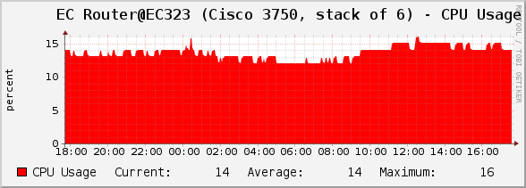
RRDTool – Graph
/usr/local/bin/rrdtool graph \
Aabbabc.png \
--title=‘Router' \
DEF:a="/usr/local/share/cacti/rra/ggyy.rrd":5min_cpu:AVERAGE \ AREA:a#FF0000FF:"CPU Usage" \ GPRINT:a:LAST:"Current\:%8.0lf" \ GPRINT:a:AVERAGE:"Average\:%8.0lf" \ GPRINT:a:MAX:"Maximum\:%8.0lf\n"

Slide 11
Requirement
Access control
  Use difference community name for RO / RW
Use RRDTool to monitor & graph host’s status
  CPU usage
  Memory usage
  Uptime
  Interface netflow (input/output)
Enable snmptrapd to receive traps
  Specify and implement a handler for a specific OID

Slide 12
Bonus – Cacti with Plugin Architecture
Install Cacti with PA support
Import and organize existing RRDs
  http://goo.gl/5ga6G

Slide 13
Hand-in
Due
  6/23
Demo
  TBA

Slide 14
Appendix
SNMP related use case in CSCC

Slide 15
Switch Management – Interface Shutdown
情境: 電資有小白在衝 ip
Solution 1
  拔他線
  電資超遠, 下雨天不想出門…
Solution 2
  從上層 ban 掉他 mac
  同一台 L2 switch 下的使用者表示遺憾…
Solution 3
  從 switch 上 ban 掉 !
  $ snmpset -v1 -c letmein 140.113.235.1 interfaces.ifTable.ifEntry.ifAdminStatus.123 i 2

Slide 16
Switch Management – 斷網
Similar to shutting down an interface
Move some ports to restricted VLANs
  Only do NAT for non-restricted VLANs
  802.1Q support in FreeBSD
Trunk
VLAN 56 (allowed)
NAT
324
315
316
pass
VLAN 78 (restricted)
block
330

Slide 17
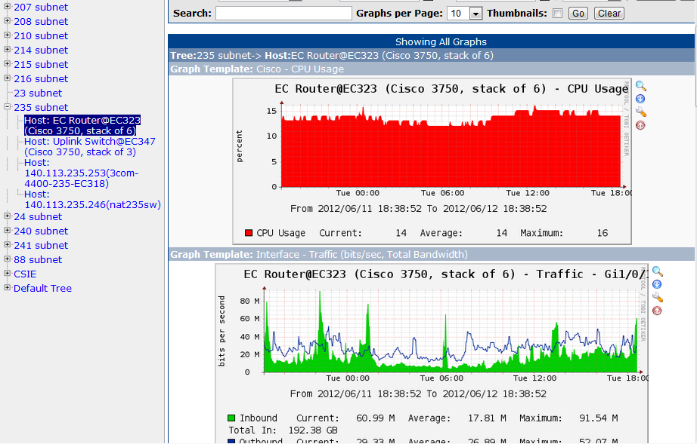
Monitoring – Cacti
50+ switches…

