Slide 1
Homework 02
NAT、DHCP、Firewall、Proxy

Slide 2
Basic Knowledge
DHCP
  Dynamically assigning IPs to clients
NAT
  Translating addresses for clients
Firewall
  Traffic filtering
Proxy
  Intermediary of client and server to translate requests

Slide 3
Basic Knowledge – Isolated Execution Environment
Provide a sandbox with limited access to resource
  Protect other programs from compromised one
OS-level virtualization (Used in this HW)
  Resource isolation
    File system, device…
  Lightweight
  Easy to manage
Implementation
  FreeBSD: jail
  Linux: lxc

Slide 4




Architecture Overview
Network card
Internet
IP0 - public
Server
IP1 – private
Private IP domain
HostA - GUI based host
HostB - FTP server
IP2 – private
IP3 – private

Slide 5
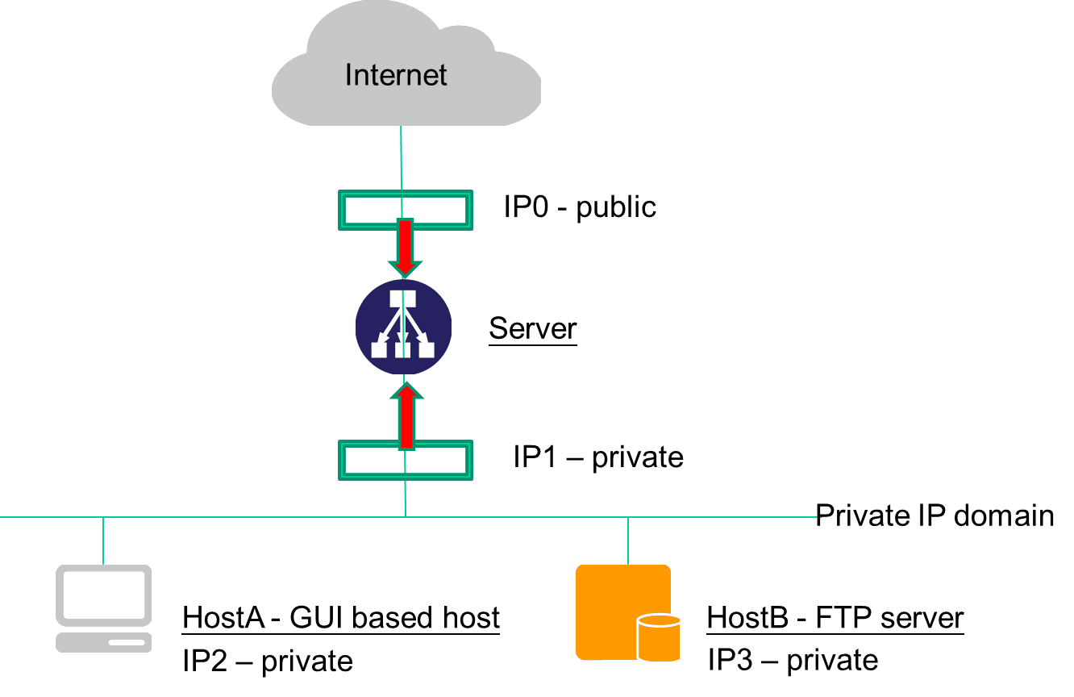
Architecture
Server
  UNIX-based OS
  Act as a gateway for all services
  DHCP & NAT server
  A dedicated Public IP and a static private IP
HostA
  Any OS
  A private IP via DHCP
HostB
  An isolated execution environment on Server
  Runs FTP service
  A static private IP

Slide 6
Requirement – NAT & DHCP
NAT
  HostA & HostB can access Internet via Server
DHCP
  Provided by Server
  Static range should be excluded
Authentication
  Only clients passed authentication can access the internet
    Exclude static range
  Redirect un-auth host to authentication page
    Web service on Server
    Serve a simple authentication page

Slide 7
Requirement – Firewall
Firewall
  Deny all connections come from <BadHost>
  Allow the connection from 140.113.17.0/24 to access HostB’s FTP server
  Drop packets from 140.113.235.0/24 to access HostB’s FTP server, and response TCP RST/ICMP unreachable
  Allow the connection from 140.113.17.0/24 to access HostB’s SSH server (Server will redirect the request for port 222 to HostB’s SSH server)
  Drop packets from 140.113.235.0/24 to access HostB’s FTP server, and response TCP RST/ICMP unreachable
  The connection from other public IP to access HostB’s FTP and SSH server should be denied and not response TCP RST/ICMP unreachable
  All public IP can’t send ICMP echo request packets to server (will not response ICMP ECHO-REPLY packets)

Slide 8
Requirement – Proxy
FTP proxy
  Setup an FTP proxy on Server
  All FTP requests should be proxied to HostB
HTTP proxy
  Setup a transparent proxy on Server
  All http traffic should pass through this TP
Hint
  ftp-proxy(8) (ftp)
  www/squid (http)
  www/privoxy (http)

Slide 9
Bonus – LB and HA for HTTP Service
Setup multiple worker nodes (>=2)
  Load balance
    Load should be distributed across all nodes
  High availability
    Health check on all nodes
    Remove fail node(s)

Slide 10
Hand-in
Due
  5/1
Demo
  TBA

